Slide 1
Maths

Slide 2
Date: Monday 8th February
L.O. To be able to interpret information from a tally chart in order to answer questions about the data.
Subject: Maths

Slide 3
Here are a couple of clips to support your learning. Click on the links below or copy and paste them into your web browser.
https://classroom.thenational.academy/lessons/representing-data-in-a-tally-chart-and-block-diagram-6ru34e?step=2&activity=video
https://www.youtube.com/watch?v=-pEA3w8SQws

Slide 4
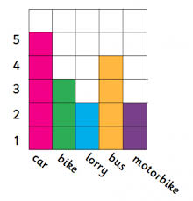
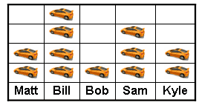
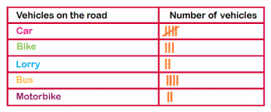
Today, we are going to begin to look at statistics. Statistics is data that is gathered from real life information. This is then inputted into different tables or graphs. The tables and graphs are there to help us to understand any questions we many have about the information given.
Here are a some tables and graphs we will be looking at over the next couple of weeks.
Tally chart
Pictogram
Bar chart

Slide 5
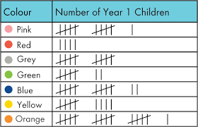
Let’s take a look at the different tables and graphs to see how we can extract the information in order to answer some questions.
Extract means to pull out or select the right information.
Year 3 children
The tally chart shows what the boys and girls favourite colours are in year 3

Slide 6
Let’s look more carefully at the chart and find out what each part means.
The black lines are tally marks they show us how many people like that colour.
The lines are always created in 5s
This is what the chart is about. It could be about anything like favourite sport, TV program or even your favourite food.
What is your favorited colour?
Year 3
5
1 2 3 4
The line going though the middle is always a total of 5.

Slide 7
Now we know all about the tally chart, lets see if we can extract some information.
Question:
How many children like yellow?
What is your favourite colour?
Year 3
16
Look and find where is says colour.
Then look down the list to find the word yellow.
Now count the tally marks.
5 10 15 16

Slide 8
Popular means favourite or which colour has the most tally marks.
Count the tallies
Question:
What is the most popular colour?
This time we will have to count each colour first. Then see which have the most tally marks.
What is your favourite colour?
Year 3
11
5
Write your answer below:
10
7
12
9
16

Slide 9
Now you know all about reading and extracting information, see if you can answer the following questions:
The tally chart shows what type of transport children have been on over the last year.
Questions:
1, How many children travel in a car?
2, How many children travel in a aeroplane?
3, Which is the most popular?
4, Which is the least popular?
5, Was there 24 or 34 children travelled on a bike?
Challenge question?
How may more children have travelled by car then lorry?
Type of transport used in the last year.

Slide 10
Date: Tuesday 10th February
L.O. To be able to input data onto a tally chart.
Subject: Maths

Slide 11
Now we know how to extract data from a tally chart, we are going to learn how to input the data.
Here is a blank tally chart.
The first thing we need to do is think of what data we want to collect.
I am going to collect data on people’s favourite sports, so I will label the first column as ‘sports.’
Next, I need to think of 6 sports to write into the column under the ‘sports’ heading.
Finally, I need to ask the correct question to gather the right data. The question I will ask is “ Which one of the following sports is your favourite?” I will then read out the list of sports to the person I am asking.
I am now ready to add tally marks to my table to collect the data.
As I ask each person what their favourite sport it, I need to put 1 tally mark into the column under ‘tally’ and next to the sport that the person likes. I then need to add up the tally marks in each row and write the total and the box that says ‘frequency’.
 | Tally | Frequency

Slide 12
Here is my completed tally chart below.
Favourite Sports
What data I am going to collect.
Sport | Tally | Frequency
football |  | 10
rugby |  | 9
running |  | 15
horse riding |  | 4
hockey |  | 2
cricket |  | 4
The sports I have chosen:
Football
Rugby
Running
Horse riding
Hockey
Cricket
The total the tally marks add up to.
The amount of people who have chosen this sport as their favourite.

Slide 13
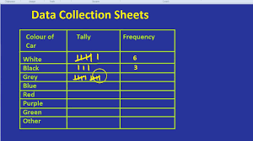
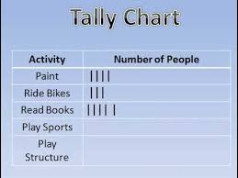
Here are a couple of videos to support your learning. Click on the links below or copy and paste them into your browser.
https://www.youtube.com/watch?v=KCOxGKuSCJ8
https://www.youtube.com/watch?v=zi7qQ2eHZlc
The clip takes 1 minute before a picture comes on the screen, but you need to listen carefully for that minute.

Slide 14
Let’s complete the tally chart together before reading and adding the results from the data collected.
Adults can you please support you child with reading the data collects.
Clare asked 50 people
“What is your favourite animal?”
Their choices were:
1) dog
2) cat
3) gold fish
4) horse
5) rabbit
6) mouse
Here is all the data collected
 | Tally | Frequency
The results were:
1) 18 people liked dogs
2) 8 people liked cats
3) 5 people liked goldfish
4) 6 people liked horses
5) 11 people liked rabbits
6) 2 people liked mice

Slide 15
Let’s check to make sure we have added the correct headings and tally marks.
Here is all the data collected
The choose of animal
Clare asked 50 people
“What is your favourite animal?”
Their choices were
1, dog
2, cat
3, gold fish
4, horse
5, rabbit
6, mouse
Favourite Animal
Animal | Tally | Frequency
dog
cat
gold fish
horse
rabbit
mouse
The results were.
1, 18 people liked dog
2, 8 people liked cat
3, 5 people liked gold fish
4, 6 people liked horse
5, 11 people liked rabbit
6, 2 people like mice
Well done we did it.

Slide 16
Can you now complete the tally chart and input the data into the tally chart.
Clare asked 100 people “ Who is you favourite Super Hero”
 | Tally | Frequency
The Super Hero’s:
Hulk
Iron Man
Spiderman
Black Panther
Captain America
Thor
The Data collected:
21 people like the Hulk
13 people like Iron Man
12 people like Spiderman
19 Black Panther
18 Captain America
6. 17 Thor
Adults: If you are unable to input the data on the Power Point, please will you support your child in drawing a chart.

Slide 17
Date: Wednesday 11th February
L.O. To be able to identify the value of each symbol in a pictogram and use it to find the total amount.
Subject: Maths

Slide 18
Today we are going to look at different symbols used in different types of graphs and charts and we will look at how we find their value.
As you can see, these charts and graphs all look very different. To find the value, we need to know what to count and how many each mark or picture represents.
Here on the block graph to find the value we count the coloured blocks and each block represents 1 vehicle.
Here on the pictogram, we count the cars above the boys names. There will be a ‘key’ next the pictogram telling us how much each car picture represents.
Here on the tally chart, we know that each black line is worth 1 and they are grouped together in 5s to make counting larger numbers of data quicker and easier.

Slide 19
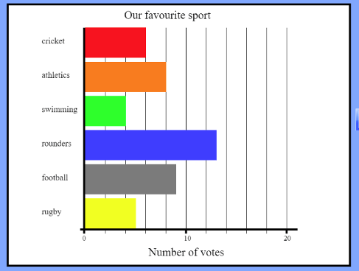
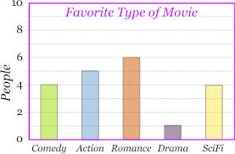
We have just looked at some simple graphs and charts, but not all are so simple. Let’s take a look at some more complicated ones:
y-axis
Here are two bar graphs but they are set out very differently.
y-axis
x-axis
x-axis
2 4 6 8 12 14 16 18
On this bar graph, the types of movies are on the x-axis. The amount of movies are on the y-axis. The amount of people is counted in 2s.
As you can see, on this bar graph the name of sports on the side, which is the y-axis. The amount of votes are on the bottom, which is the x-axis. The amounts of votes are also counted in 2s, not 1s.

Slide 20
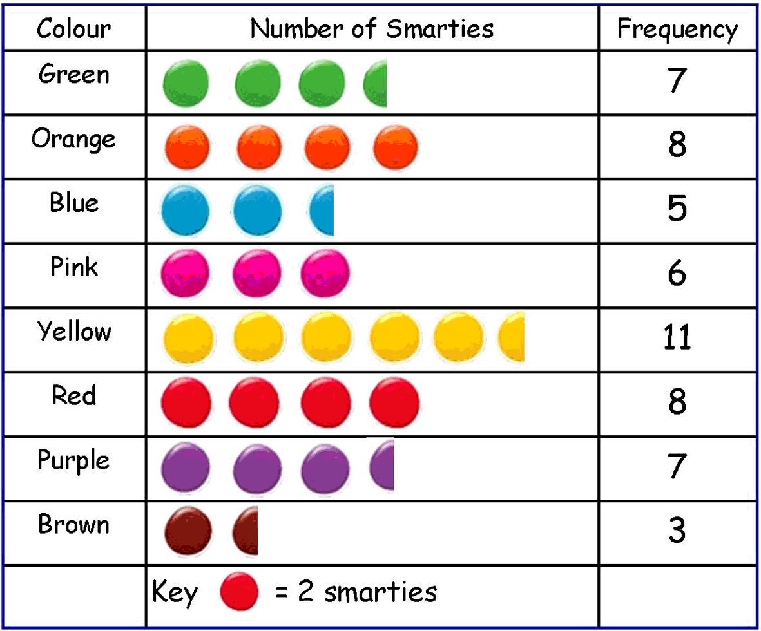
This pictogram shows us people’s favourites colours. As you can see, the pictogram tells us that each coloured circle is on a scale of 2. So when working out the frequency we would count in twos.
The key tells us that each circle is worth 2.
This means the circle that is cut in half is worth 1, because half of 2 is 1.

Slide 21
Let’s try to work out how much each picture represents on the pictogram below together – don’t forget to look at the key!
We can see the key shows us that each circle is worth 10 cars.
Now using the key and data shown, can we answer the following question?
How many cars travelled on Tuesday?
10+10+10+5= 35
10 10 10 5
 | 1 | 0
 | 1 | 0
 | 1 | 0
+ |  | 5
 | 3 | 5

Slide 22
Use the key to find our how many cars each circle represents before adding them together to answer the questions below:
+
How many cars travelled on Monday?
Show you working out.
+
Remember to check the key or scale
How many cars travelled on Friday?
5

Slide 23
The number of cars the circles represent has changed! Use the key to find our how many cars each circle represents before adding them together to answer the questions below:
+
How many cars travelled on Wednesday?
Show you working out.
+
How many cars travelled on Thursday?
Remember to check the key or scale
20 cars

Slide 24
Date: Thursday 11th February
L.O. To be able to read and interpret information from a pictogram and use it to answer questions about the data.
Subject: Maths

Slide 25
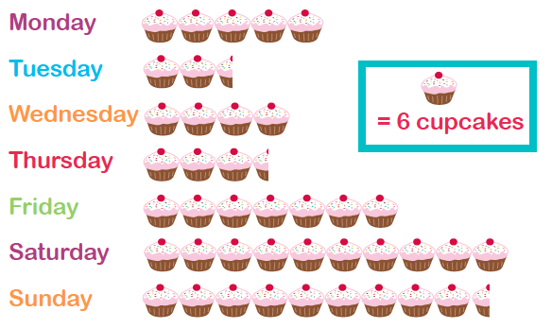
Today we are going to learn how to read and interpret information from a pictogram.
Pictograms are set out in a similar way to a bar chart. However, they use pictures instead of bars and do not have numbers on an axis.
Each picture could represent 1 or more items, and half or part-pictures represent fractions of a number. This information is usually represented in a key.
2
Pictogram

Slide 26
Key
I can see that the key represents 2s therefore I will need to count in 2s.
Question:
How many cakes are sold on Tuesday?
2
2 2 1
Pictogram
2+2+1= 5

Slide 27
Let’s try together to read information from the pictogram so that we can answer questions.
key
I can see that the key represents 6 and so I will need to count in 6s.
Question:
How many cakes are sold on Thursday?
Pictogram
6+6+6+1=

Slide 28
Can you read the information from the pictogram and answer the questions?
scale/key
Question: remember to show your working out
How many cakes were sold on Monday?
How many cakes were sold on Friday?
How many cakes were sold on Sunday?
2
Pictogram

Slide 29
Here are a couple of videos to help further support your learning. Click on the links under the videos or copy and paste the links into your web browser.
https://classroom.thenational.academy/lessons/reading-and-understanding-pictograms-6xj62c?activity=video&step=1
https://www.youtube.com/watch?v=7oyDsm-k9YQ

Slide 30
Date: Friday 12th January
L.O. To be able to gather information and construct a pictogram.
Subject: Maths

Slide 31
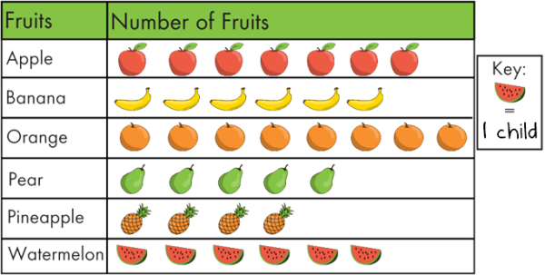
Today we are going to try and collect and construct our very own pictogram.
Pictograms are set out in a similar way to a bar chart. However, they use pictures instead of bars and do not have numbers on an axis.
Each picture could represent 1 or more items, and half or part-pictures represent fractions of a number. This information is usually represented in a key.
If you are at home you could collect your data by phoning your family, friends or you could even phone school and ask myself and Danielle, we would love to hear from you!
Here are some ideas:

Slide 32
First, I thought of what data I was going to collect.
I am going collect data about people’s favourite colours and the colours I am going to collect data about are:
Here are my results:
3 people like red.
2 people like yellow.
6 people like pink.
Next, I rang around school and asked my work friends what their favourite colour is:
“ What is your favourite colour? Here are your choices”.
3 people like blue.
1 people like green.
5 people like purple.

Slide 33
Colours | Number of colours | Frequency
Red |  | 3
Yellow |  | 2
Pink |  | 6
Blue |  | 3
Green |  | 1
Purple |  | 5
Now I have all of my data, I began making my pictogram.
I made sure my pictogram had:
Headings
A key
The information I am collecting in the first column.
Key: Each colour = 1

Slide 34
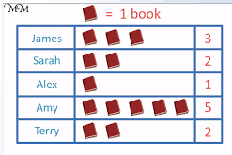
Collect data to input into your constructed a pictogram.
Now you know all about collecting and inputting data into a pictogram. It’s your turn to have a go.
Don’t forget if you are at home you could collect your data by phoning your family, friends or you could even phone school and ask myself and Danielle, we would love to hear from you.
Here are a some pictures to help you with some ideas.
We can't wait to see all your amazing pictograms and what you choose to collect your data on. Adults; please can you help you child draw their pictogram or use the blank template on the next page.
Challenge time:
Once you have created you pictogram can you write some questions for Danielle and I to answer?

Slide 35
Key:

