Slide 1
Subject: Topic

Slide 2
Date: Monday 8th February 2021
L.O. To be able to recall parts of the body in French
Subject: MFL - French

Slide 3
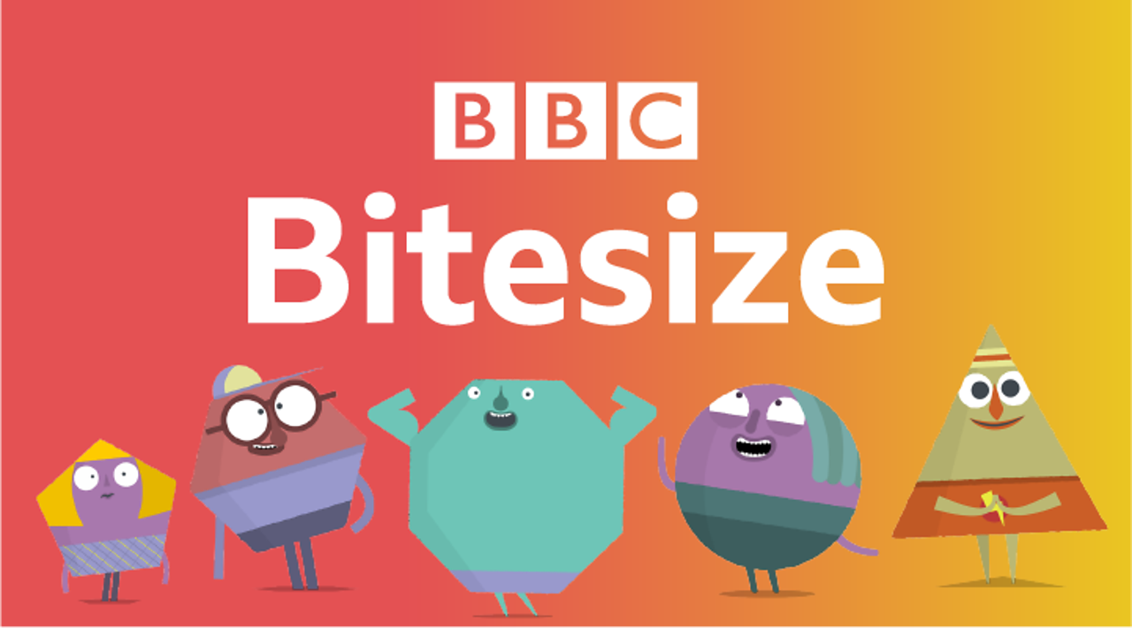
Pre-recorded Teaching
Access the online teaching below that will support you to complete the work in this lesson. This video will act as a support but all of the work can still be successfully understood & completed using paper-based versions of this pack. If you need further support to understand / complete work then please contact school via e-mail or telephone.
Click here

Slide 4
Let’s take a look at some body parts in French! Can you work out what it is by looking at the pictures?
Have a go at reading the word then saying it. Click to reveal the answer…

Slide 5
La main
hand

Slide 6
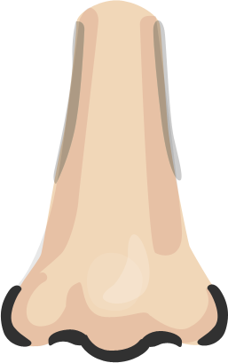
Le nez
nose

Slide 7
La bouche
mouth

Slide 8
Les yeux
Think back to last week, can you tell me what colour your eyes are, in French?
eyes

Slide 9
L’oreille
ear

Slide 10
La tête
head

Slide 11
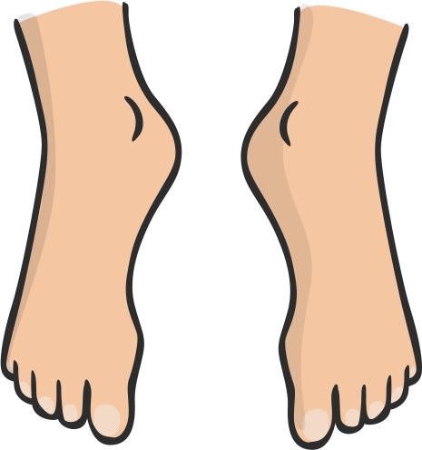
Les pieds
feet

Slide 12
Le cou
neck

Slide 13
Le corps
body

Slide 14
Le bras
arm

Slide 15
La jambe
leg

Slide 16
Les cheveux
Think back to last week, can you tell me what colour your hair is, in French?
hair

Slide 17
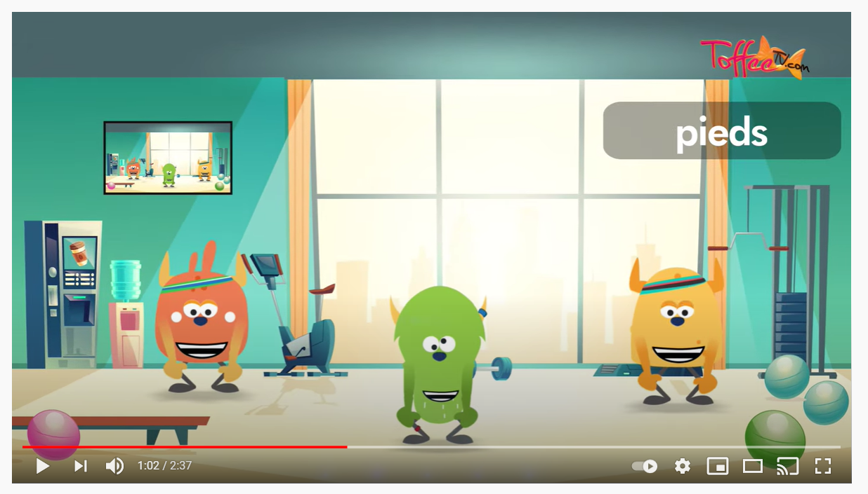
Song Time!
Click here & learn 'Heads, Shoulders, Knees and Toes' in French!

Slide 18
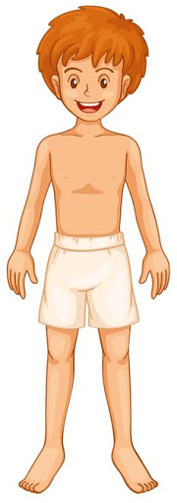
Task: Can you label the body parts in French?
les cheveux
La jambe
Le bras
Le cou
Les pieds
La tête
Les yeux
L’orielle
La bouche
Le nez
La main
Le ventre

Slide 19
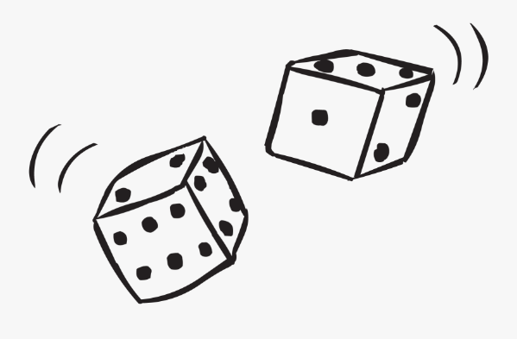
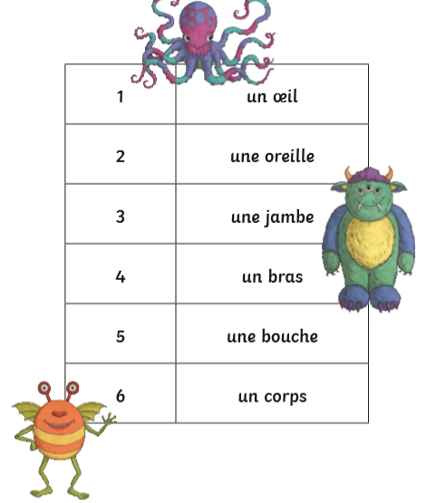
The Body Monster Game!
(2 or more players)
You Will Need:
Plain paper, a dice, pencils.
How to Play:
The aim of the game is to be the first to draw a monster that has:
At least 2 eyes
At least 2 ears
At least 2 legs
At least 2 arms
At least 1 mouth
You must roll a 6 to start drawing your monster – you can choose what shape you would like your monsters body to be! If you haven’t rolled a 6 in 3 turns, you can then draw the monster body.
Once you have drawn your monster, you can begin to add body parts by rolling the dice on your turn and adding the corresponding body part. You must read the word for the body part, then say it out loud in French and English. The first person to draw a monster is the winner! You will have lots of fun creating unusual monsters with lots of different body parts!
Miss a go – if a player rolls a 6 again after they have started to draw their monster, they miss a turn.

Slide 20
Date: Tuesday 9th February 2021
LO: To be able to recall animals in French
Subject: MFL - French

Slide 21
Pre-recorded Teaching
Access the online teaching below that will support you to complete the work in this lesson. This video will act as a support but all of the work can still be successfully understood & completed using paper-based versions of this pack. If you need further support to understand / complete work then please contact school via e-mail or telephone.
Click here

Slide 22
Let’s take a look at some animal names in French! Can you work out what it is by looking at the pictures?
Have a go at reading the word then saying it…

Slide 23
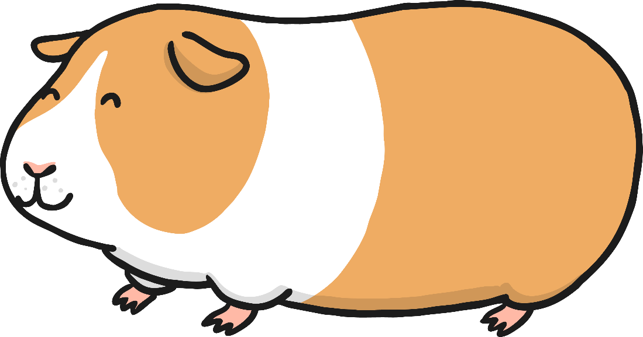
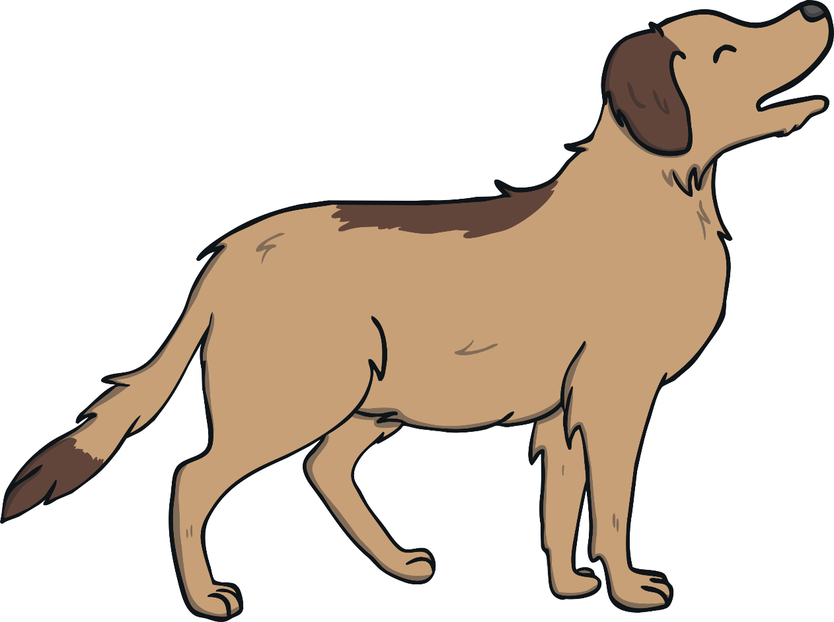
un cochon d’inde
un poisson
un chat
un chien
un serpent

Slide 24
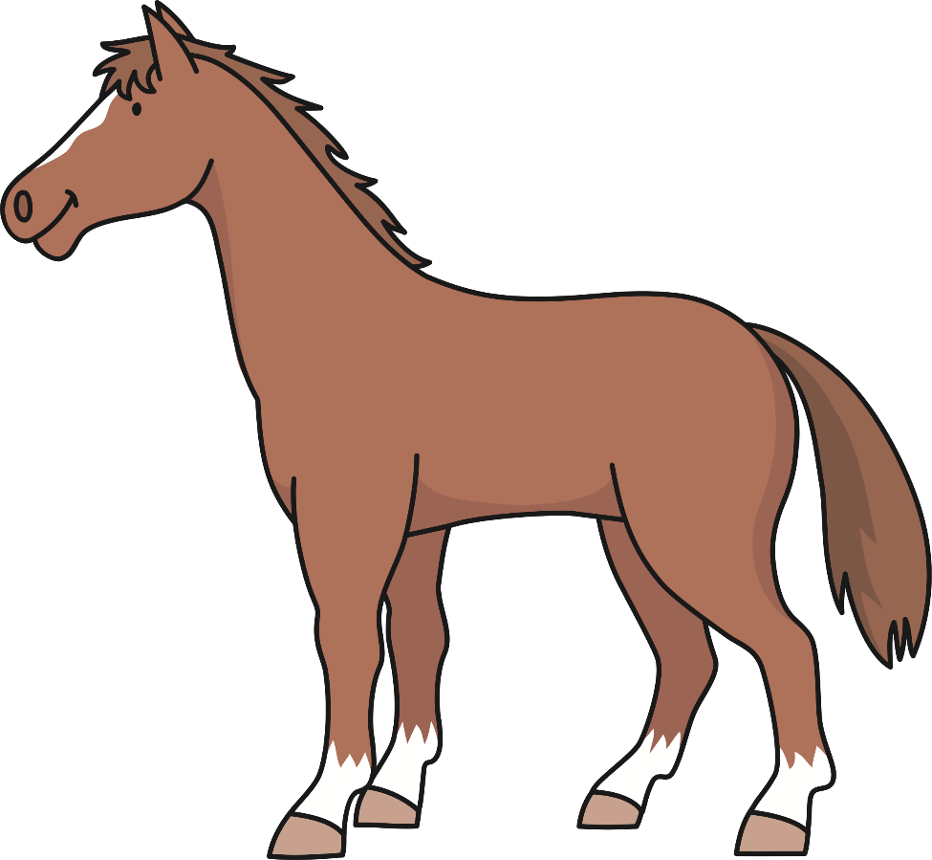
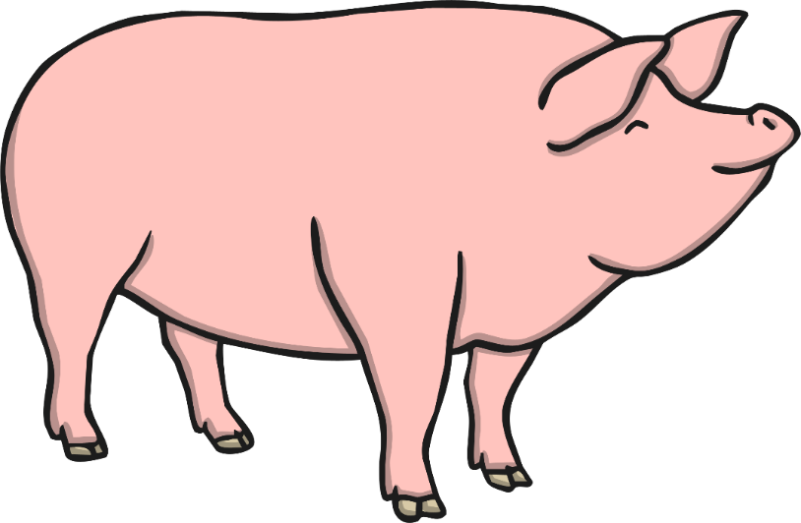
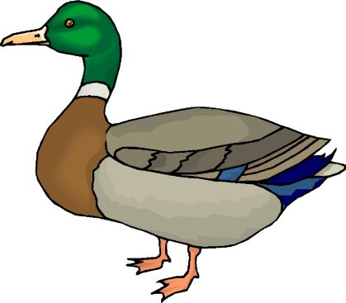
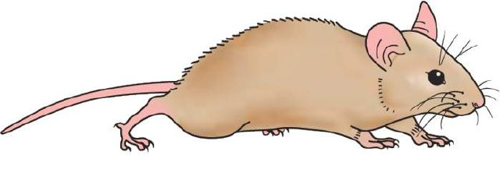
un cheval
un cochon
l’éléphant
un canard
un rat

Slide 25
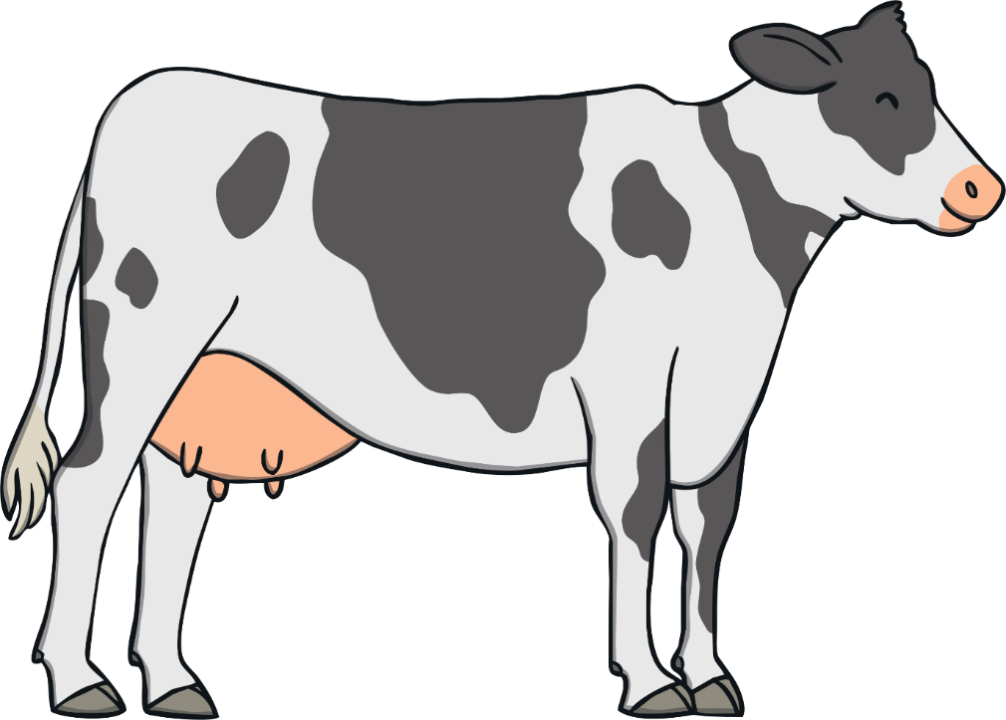
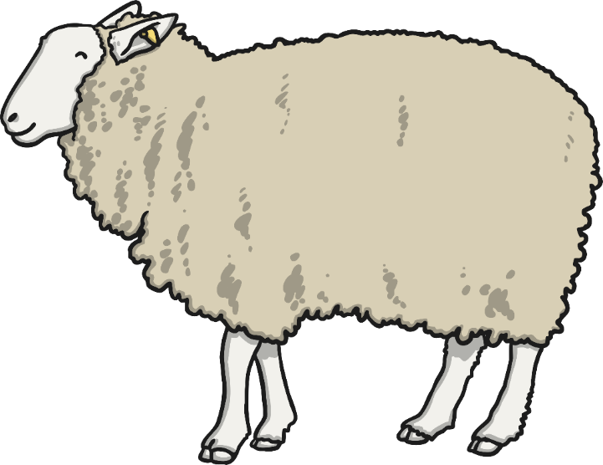
un papillon
une vache
un tigre
une girafe
un mouton

Slide 26
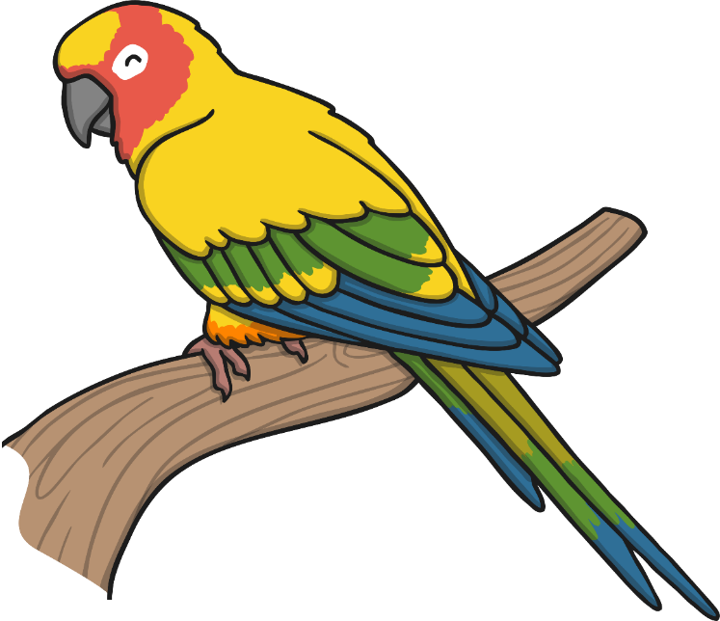
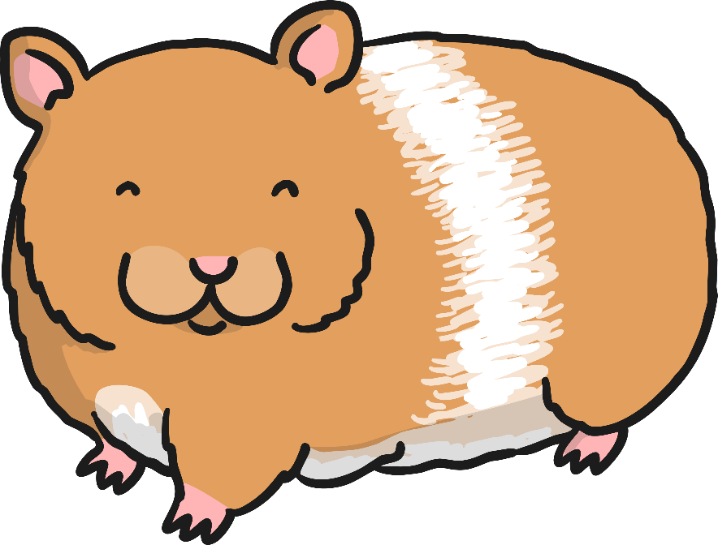
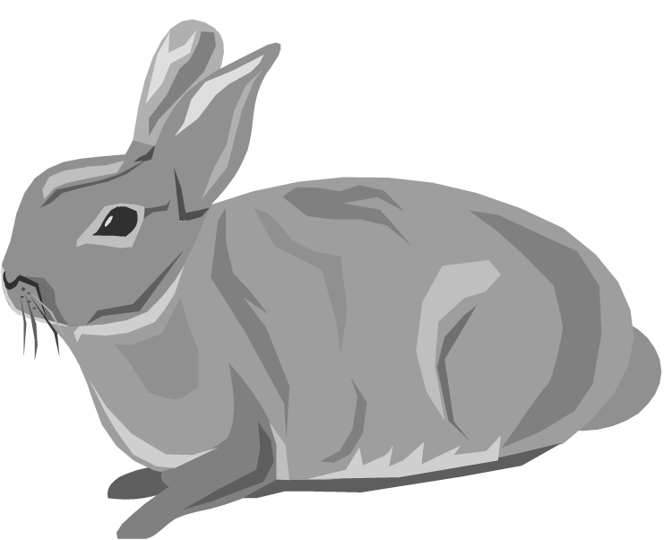
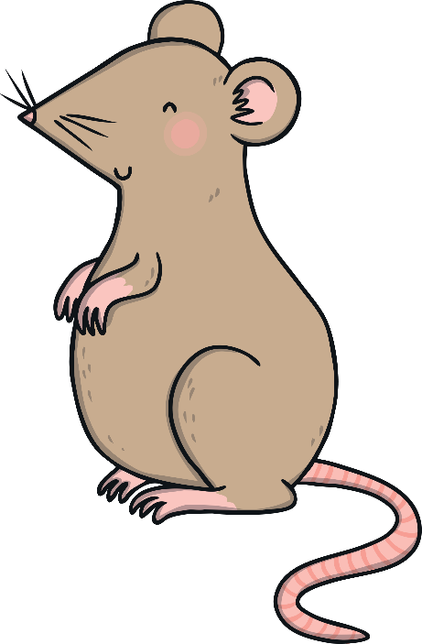
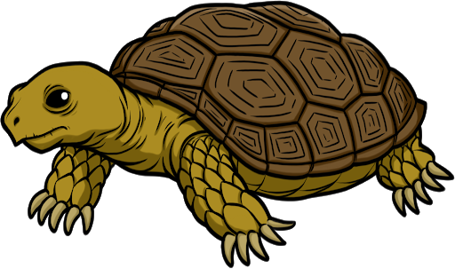
un oiseau
un hamster
un lapin
une souris
une tortue

Slide 27
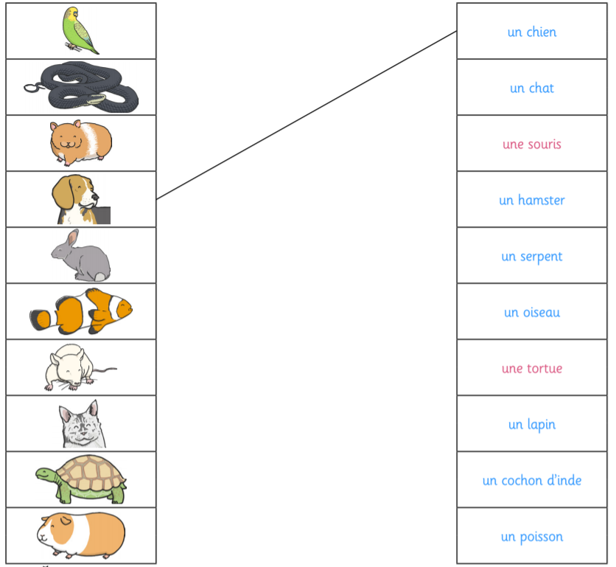
Task: Can you match the animal to the correct name in French? I have done one for you! ☺

Slide 28
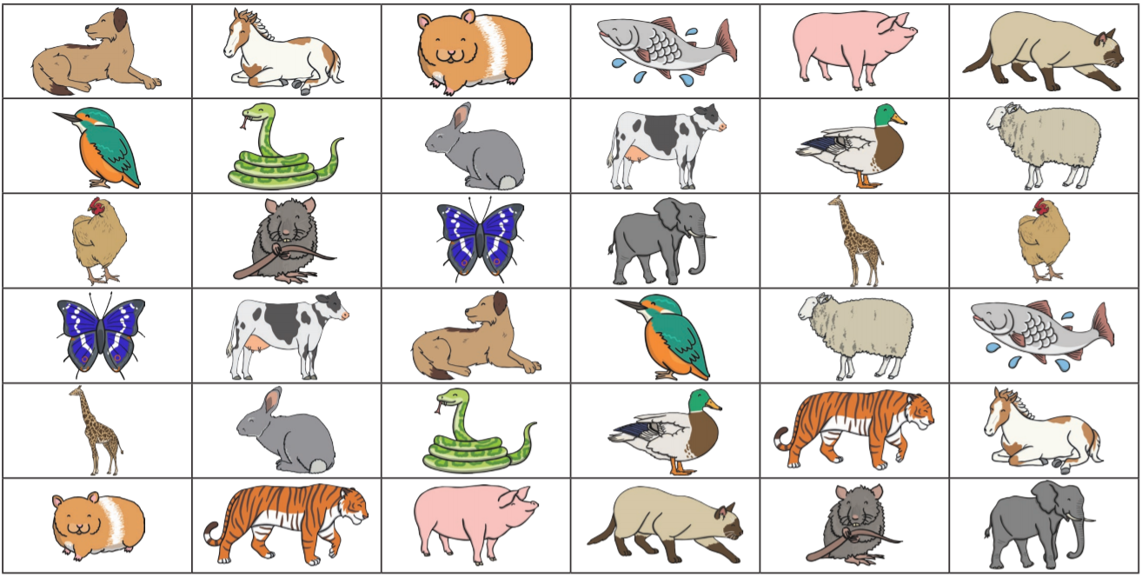
4 in a Row! (2 players)
Player 1 – choose an animal and say it in French. If you get it right, cover it with your colour counter. Player 2 does the same until one person covers 4 in a row!

Slide 29
Date: Wednesday 10th February 2021
LO: To be able to recall family members in French
Subject: MFL - French

Slide 30
Pre-recorded Teaching
Access the online teaching below that will support you to complete the work in this lesson. This video will act as a support but all of the work can still be successfully understood & completed using paper-based versions of this pack. If you need further support to understand / complete work then please contact school via e-mail or telephone.
Click here

Slide 31
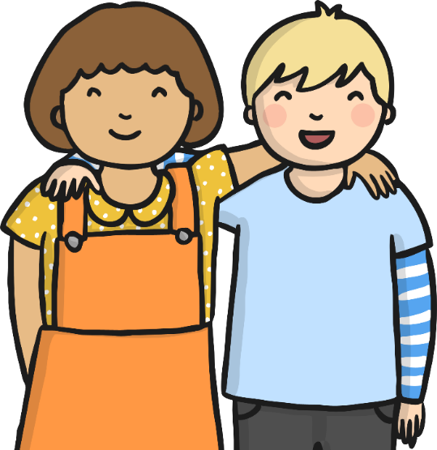
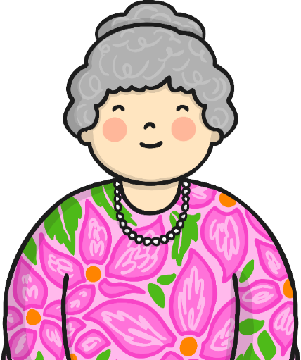
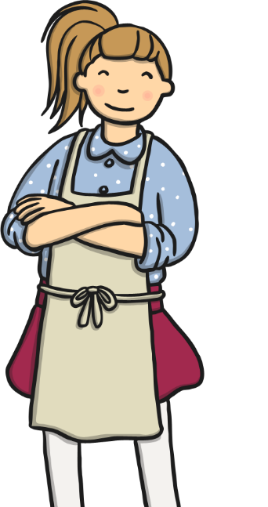
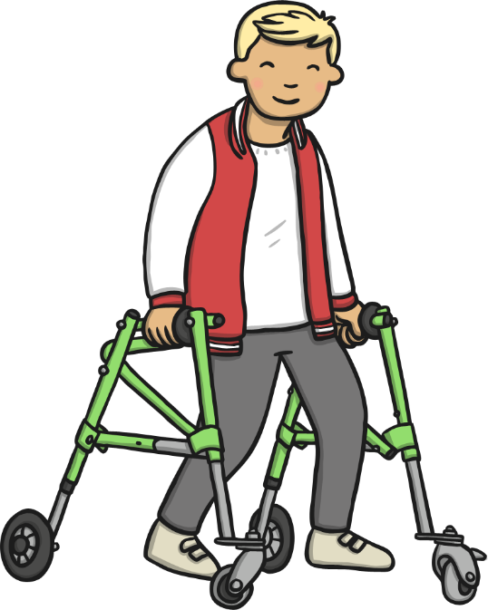
le frère brother
le père
father
la mère
mother
la soeur
sister
l’oncle
uncle
La tante
auntie
la grand-mère
grandmother
le grand-père
grandfather
le cousin cousin (male)
la cousine cousin (female)

Slide 32
Mollie’s Family Tree…
Le grand-pére
Eric
La grand-mére
Joan
Le pére
Lee
La mére
Claire
La tante
Carol
L’ oncle
Steven
Mollie
La soeur
Lily
La souer
Daisy
Le cousin
Harrison

Slide 33
Your task: can you create your own family tree using the French vocabulary for…
Grandma
Grandad
Mam
Dad
Brother
Sister
Auntie
Uncle
Cousin
You

Slide 34
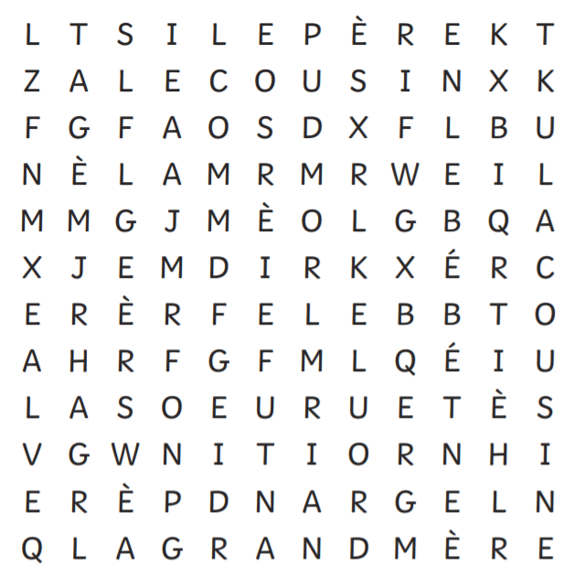
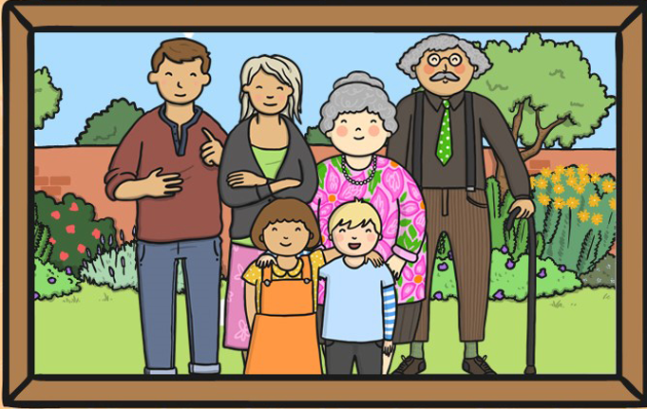
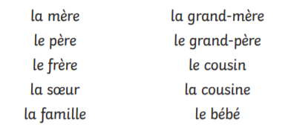
Can you find the French family member words in the word search? I have found one for you!

Slide 35
Date: Thursday 11th February 2021
LO: To be able to recall breakfast foods in French
Subject: MFL - French

Slide 36
Pre-recorded Teaching
Access the online teaching below that will support you to complete the work in this lesson. This video will act as a support but all of the work can still be successfully understood & completed using paper-based versions of this pack. If you need further support to understand / complete work then please contact school via e-mail or telephone.
Click here

Slide 37
le jus
d’orange
orange juice
Click me!

Slide 38
le café
coffee

Slide 39
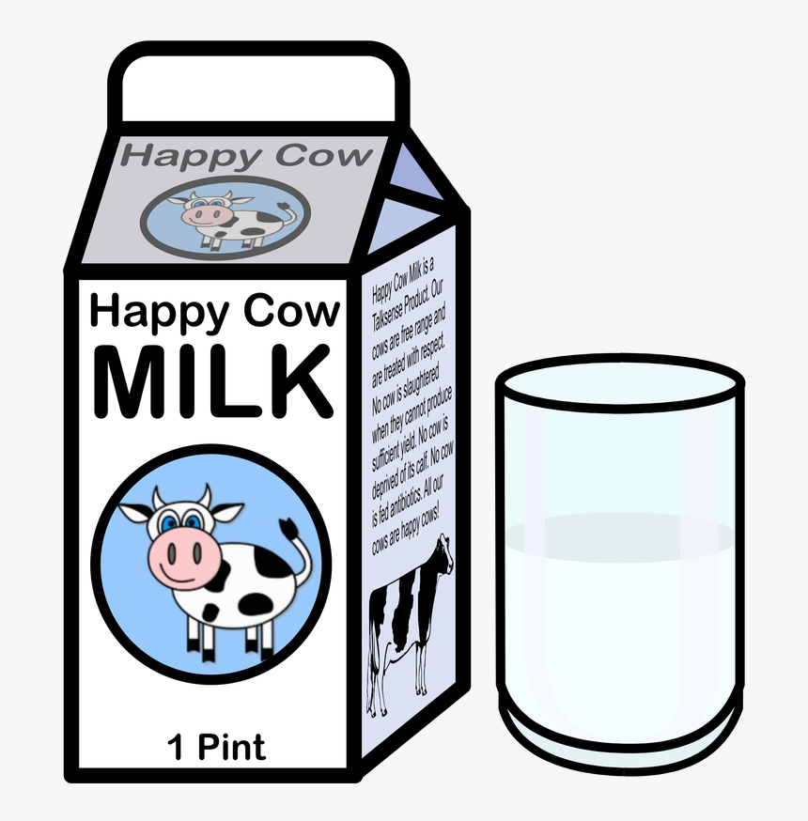
le lait
milk

Slide 40
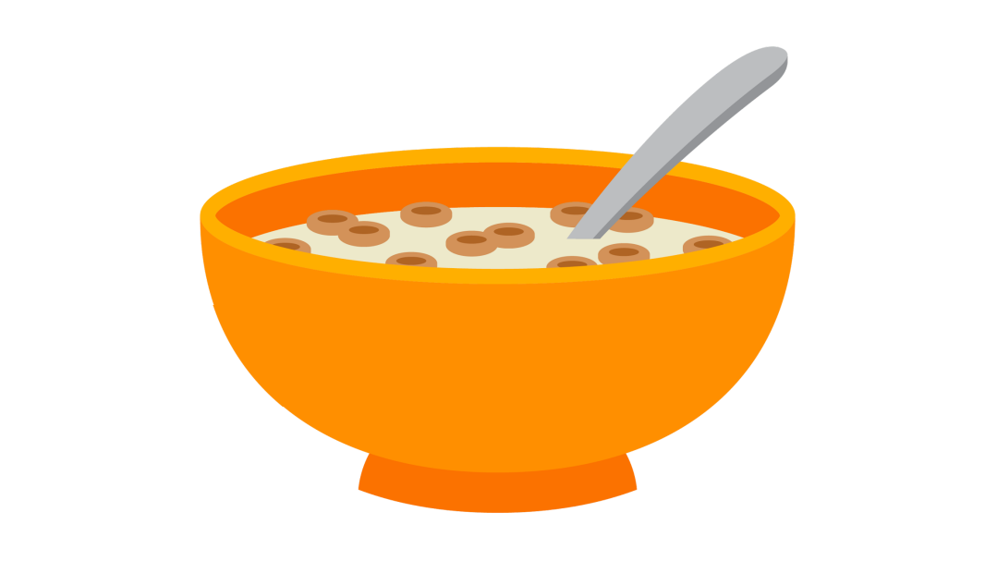
les céréals
cereal

Slide 41
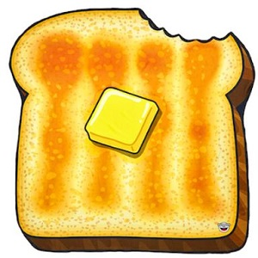
le pain grille
toast

Slide 42
le beurre
butter

Slide 43
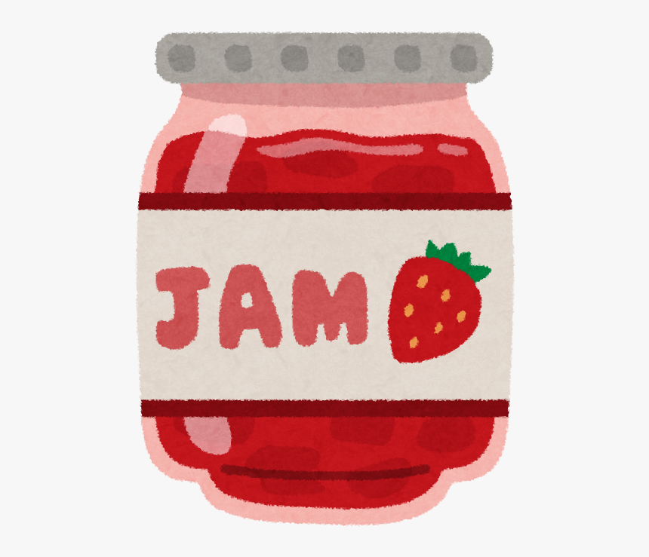
le confiture
jam

Slide 44
les chocolat chaud
hot chocolate

Slide 45
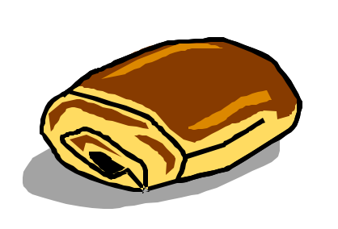
le pain au chocolat
chocolate bread

Slide 46
le croissant
croissant

Slide 47
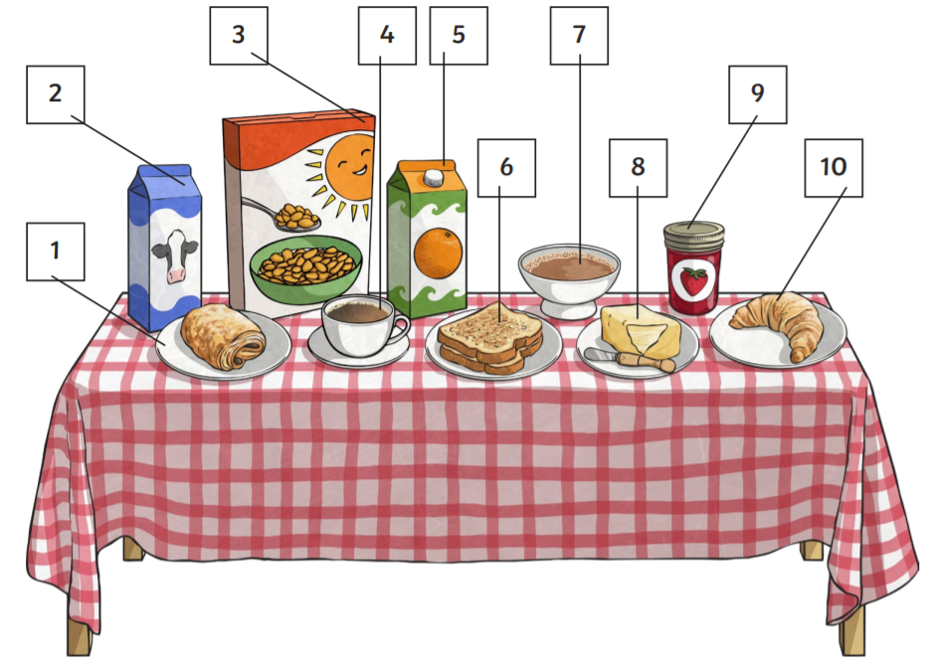
Task: Can you match the French words to the correct breakfast item? Use the table on the next slide to write down your answers.

Slide 48
I have done the first one for you! ☺
1 | Le pain au chocolat
2
3
4
5
6
7
8
9
10

Slide 49
In school, we will be asking for breakfast foods in French, before eating them!
Can you tell your parent / carer what you would like for breakfast in French?
Je voudrais un croissant, s’il vous plaît.
I would like a croissant, please.

Slide 50
Date: Friday 12th February
L.O. To be able to dribble using a football
Subject: P.E.

Slide 51
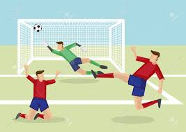
What is dribbling in football?
Dribbling is manoeuvring a ball whilst moving in a given direction, avoiding defenders' attempts to intercept the ball!
A successful dribble will bring the ball past defenders and create opportunities to score.
Click here

Slide 52
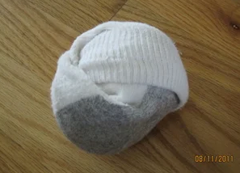
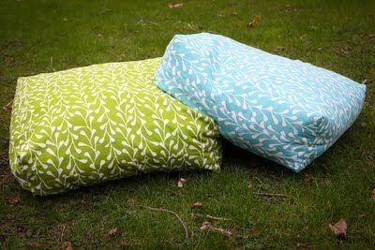
Note: you do not need goal posts / football to complete the drills!
Create your own goal using two cushions and use anything round as a ball!
Dribbling Drills
Click on the link and watch the video showing different dribbling drills.
Have a go at completing the drills at home.
Click here and complete the drills

