Slide 1
Date: Monday 1st February 2021
LO: To be able mix paints using primary and secondary colours.
s about the Pacific Ocean.
Subject: Art

Slide 2
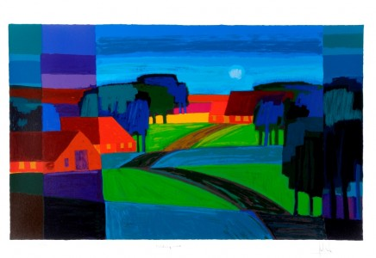
Primary colours are: Red, Blue and Yellow.
Tom Schulten is a Dutch artist (painter) that paint using bright blocks of colours. He uses very simple shades of colours.

Slide 3
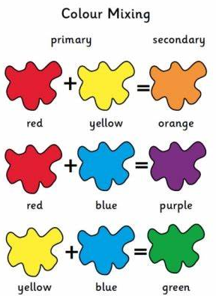
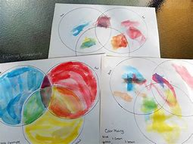
Today we are going to explore painting using primary colours mixing them together to see what colours we can make.
Using a paint palate put the colour blue, red and yellow on to it.
Encourage your child to mix two colours together to see what new colour then can make.
Don’t forget to wash the brush in between each mix.

Slide 4
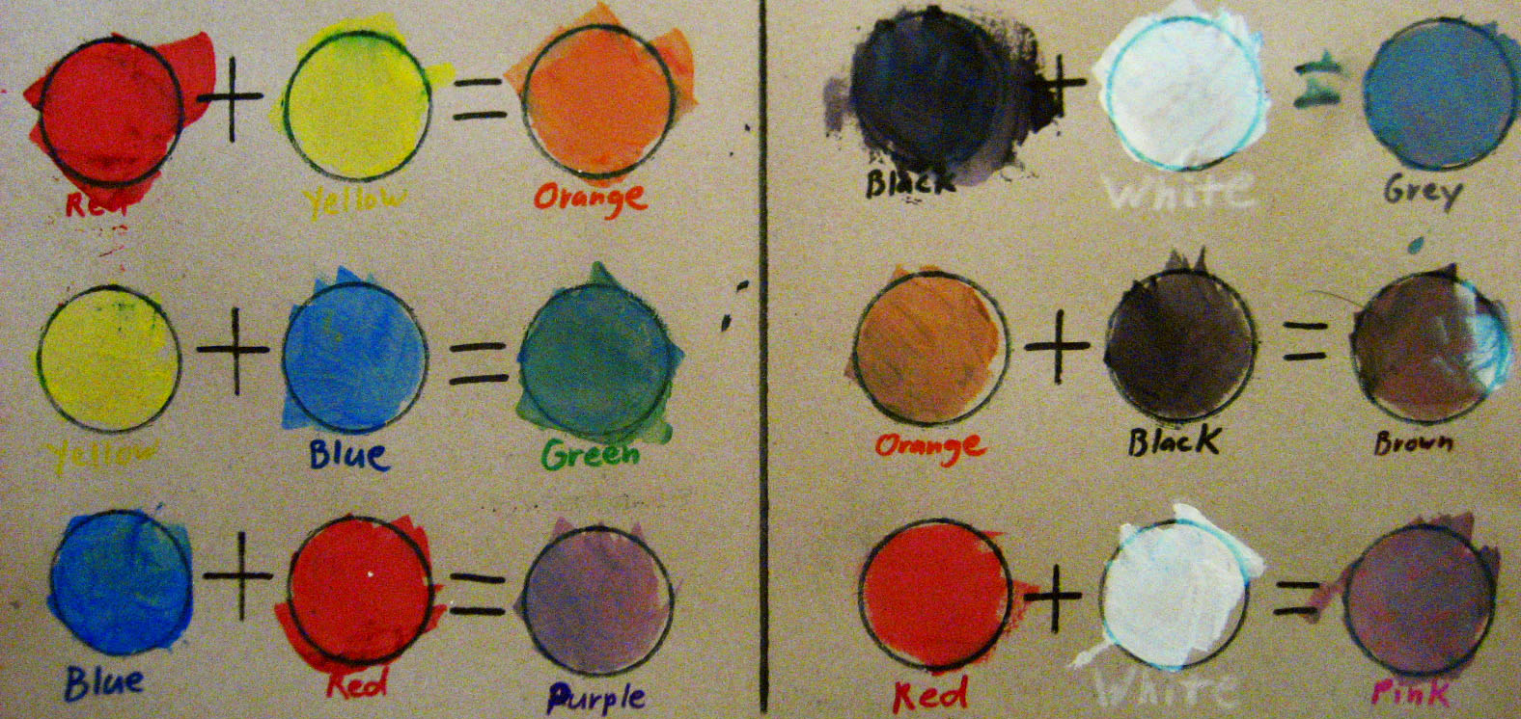
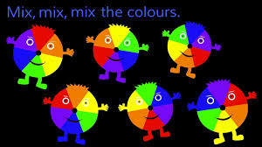
On the next slide is a grid to fill in to mix the paints on. Use this example to help your child mix the paints to the correct colour.
Now lets watch this fun clip on how to mix colours
https://www.youtube.com/watch?v=IwfZvRuE7s8

Slide 5
+
=
+
=
RED
YELLOW
ORANGE
BLACK
WHITE
GREY
=
+
=
+
YELLOW
BLUE
GREEN
ORANGE
BLACK
BROWN
+
=
+
=
BLUE
RED
PURPLE
RED
WHITE
PINK
The colours in the blue column are secondary colours.

Slide 6
+
=
+
=
RED
YELLOW
ORANGE
BLACK
WHITE
GREY
=
+
=
+
YELLOW
BLUE
GREEN
ORANGE
BLACK
BROWN
+
=
+
=
BLUE
RED
PURPLE
RED
WHITE
PINK
The colours in the blue column are secondary colours.
Ask your grown-up to help you mix your paints. Dont forget to
wash your brush in between each mix.

Slide 7
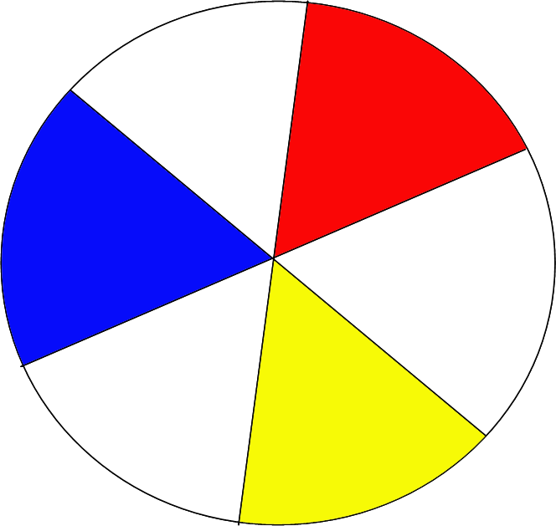
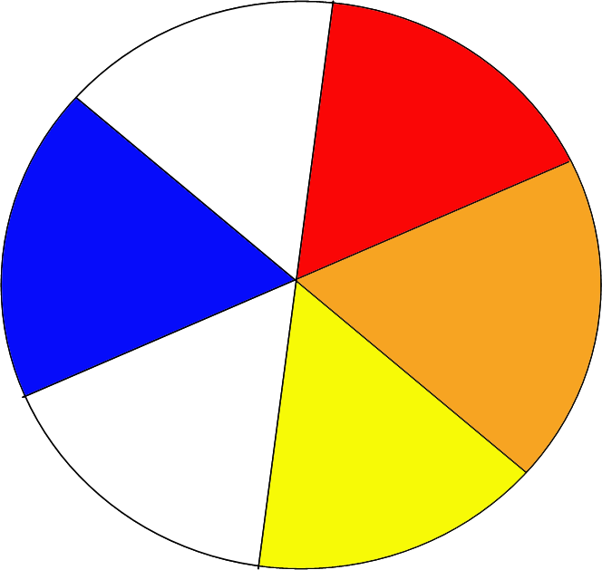
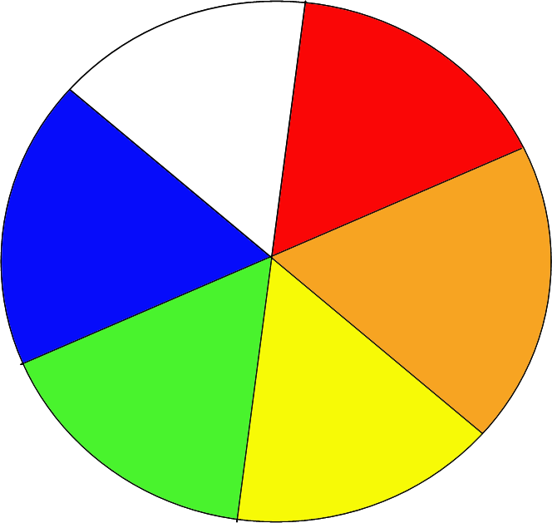
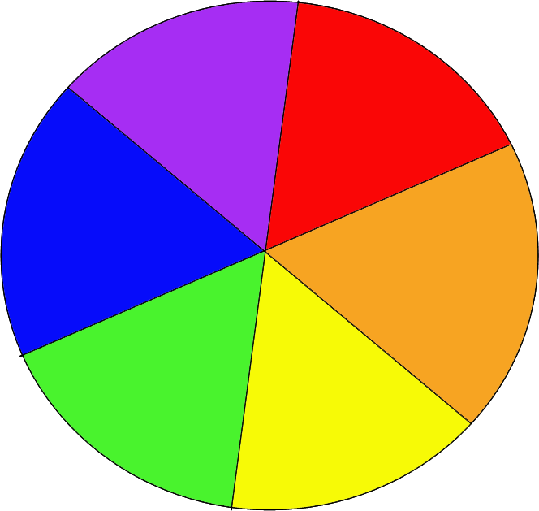
This is what happens if we mix colours …
red
red
blue
blue
yellow
yellow

Slide 8
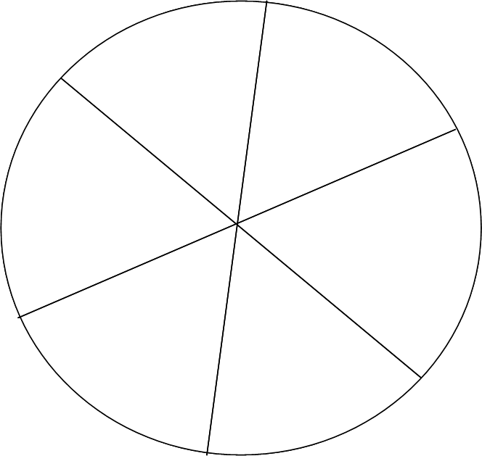
Now make your own colour wheel!

Slide 9
Date: Tuesday 02nd February
LO: To be able to experiment with monochromatic paint scales about the Pacific Ocean.
Subject: Art

Slide 10
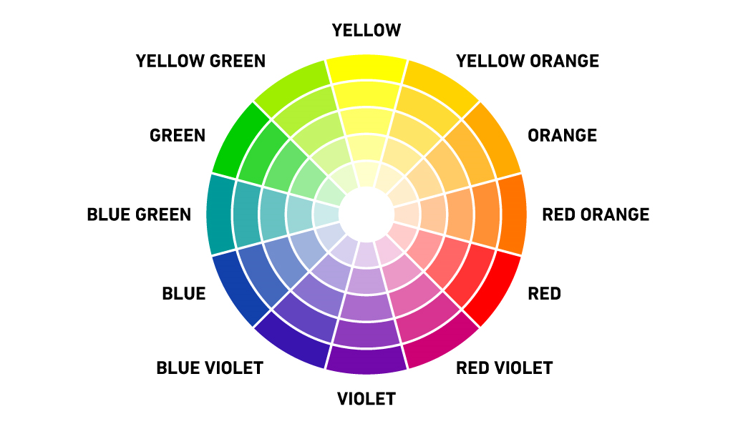
Monochromatic paint scales are variations of one colour.
Shades are made by adding white to a colour while tints and tones are made by adding black to a colour.
Using the slide below we are going to experiment with different shades and tones of colours. This can be done by adding black or white to a primary or secondary colour.

Slide 11
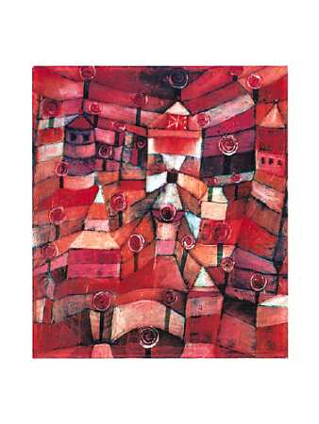
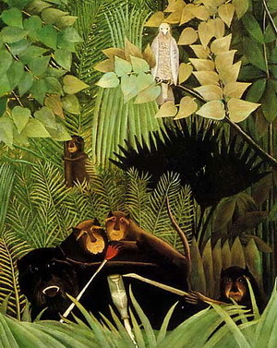
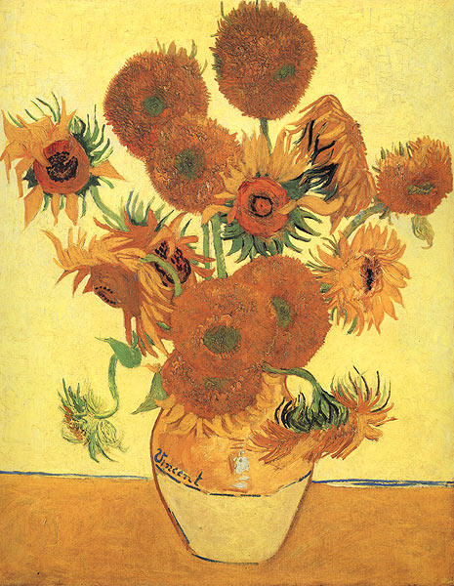
These paintings are examples of monochromatic paint scales.
‘The Rose Garden’
by Paul Klee
‘Sunflowers’
by Vincent van Gogh
‘The Merry Jesters’
Henri Rousseau

Slide 12
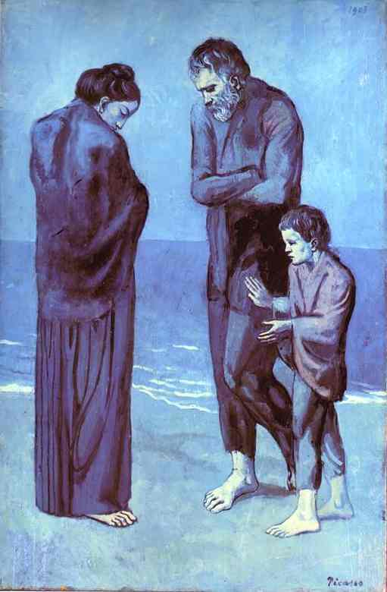
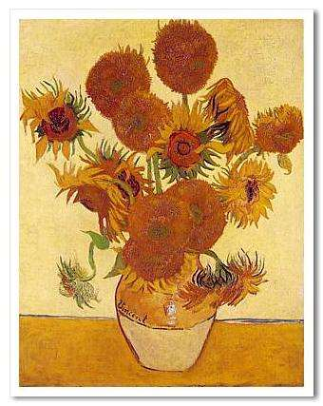
The Tragedy (1903)
by Pablo Picasso
Sunflowers (1888)
by Vincent Van Gogh
On the next slide we are going to look at mixing our own monochromatic paint shades.

Slide 13
+
=
+
=
RED
WHITE
PINK
BLACK
WHITE
GREY
=
+
=
+
YELLOW
WHITE
GREEN
WHITE
+
=
+
=
BLUE
WHITE
PURPLE
WHITE
Here I have provided some examples of what shade/ tones you can make by mixing white or black to the main colour.

Slide 14
+
=
+
=
RED
WHITE
BLACK
WHITE
=
+
=
+
YELLOW
WHITE
ORANGE
BLACK
+
=
+
=
BLUE
WHITE
PURPLE
BLACK
Using the chart above lets see what shades and tones you can make by adding black or white to a colour.

Slide 15
Date: Wednesday 04th February 2021
LO: To be able to explore complimentary colours.
Subject:Art

Slide 16
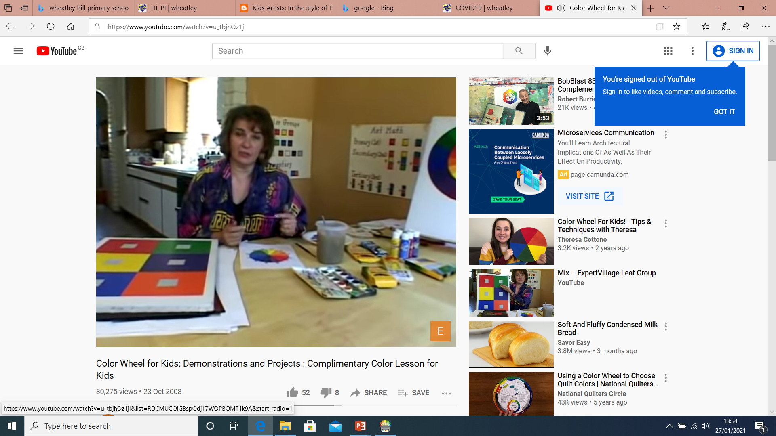
Complimentary colours are pairs of colours which when combined or mixed cancel each other our or contrast with each other.
Now let’s watch a fun clip on what complimentary colours are.
https://www.google.co.uk/url?sa=t&rct=j&q=&esrc=s&source=video&cd=&cad=rja&uact=8&ved=2ahUKEwjbnY_0oLzuAhUTThUIHYCxD2EQtwIwAHoECAIQAg&url=https%3A%2F%2Fwww.youtube.com%2Fwatch%3Fv%3Du_tbjhOz1jI&usg=AOvVaw0734tLOzR0XX66UHoT7Lze

Slide 17
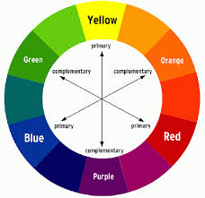
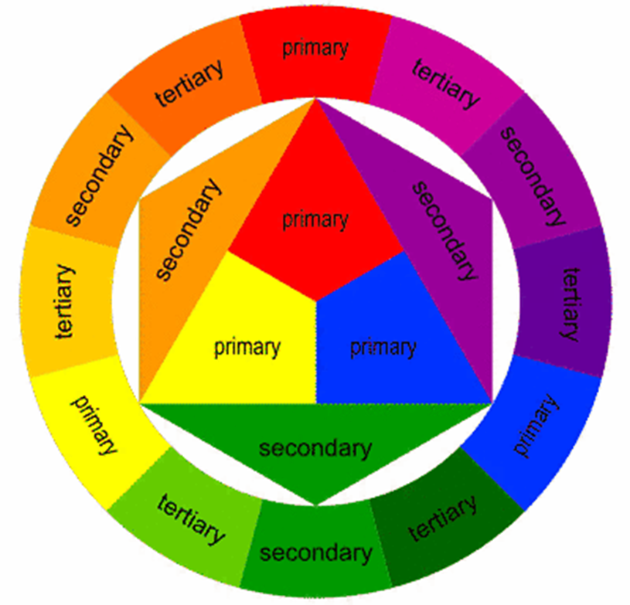
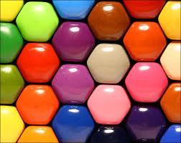
Complimentary colours are contrasting colours that are on the opposite side of the colour wheel. A complimentary colour to yellow is purple. Another 2 contrasting colours are red and green. See the colour wheel for more examples.

Slide 18
+
+
RED
WHITE
BLACK
WHITE
+
+
YELLOW
PURPLE
GREEN
PURPLE
+
+
BLUE
ORANGE
PINK
GREEN
Using the chart above lets see what contrasting colours you can make. Here is some examples for you to copy.

Slide 19
+
+
RED
WHITE
BLACK
WHITE
+
+
YELLOW
PURPLE
GREEN
PURPLE
+
+
BLUE
ORANGE
PINK
GREEN
Using the chart above let’s have a go at trying to make your own contrasting colours.

Slide 20
Date: 333333333
Date: Thursday 05th February 2021
January
LO: To be able to mix and match colours. about the Pacific Ocean.
Subject: Art

Slide 21
Tom Schulten was famous for painting in blocks of colours. Using what we know about making different shades and tones of colours let’s see what different colours we can paint with.

Slide 22
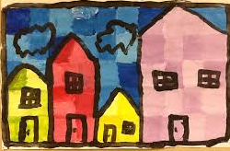
Why don’t you try painting your house and garden? Using the different things we have learnt about colour mixing this week?
Grown- ups please take photos of your childs work and upload to climbpupils@gmail.com

Slide 23
Date: Friday 05th Ferbuary 2021.
LO: To be able to identify emotions.
Subject: PSHE

Slide 24
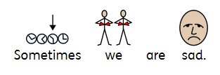
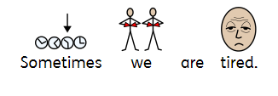
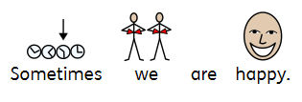
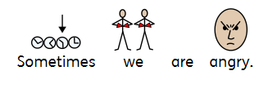
We have lots of different emotions.

Slide 25
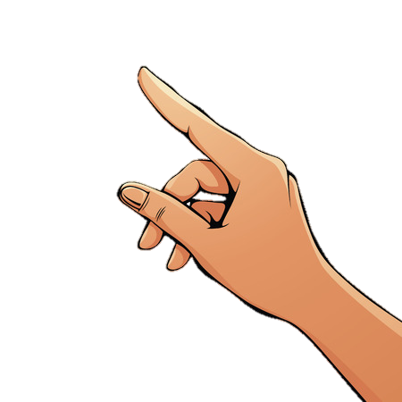
For grown-ups:
Please support your child to complete the emotions matching activity by dragging the colour pieces into the correct place with the mouse. If you have the paper resources, complete the activity as a matching exercise by hand.
Move this image to the grey image above

Slide 27
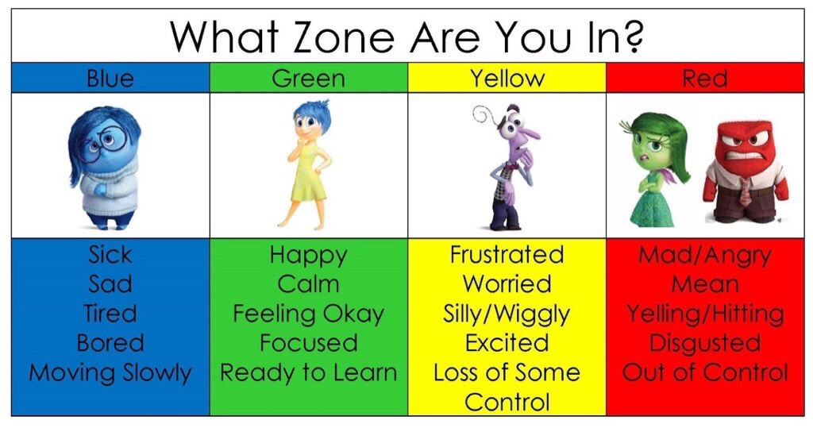
How do you feel?
I am in the green zone. I am happy because I’m having a good day.
Can you point to how you feel? Can you say why you feel like that?

Slide 28
How do you feel?
Can you point to how you feel? Can you say why you feel like that?

