Slide 1

Hello everyone,
Another great week of home learning last week. Thank you so much to everyone who sent in photos and videos of your learning. I’ve loved seeing it all, I can see you’re having lots of fun at home.
Please continue to send us anything you do at home and have lots of fun learning through play.
Miss Wilkinson, Mrs Cairns & Miss Anderson ☺
Phone: 01429 820594
Email: explorerspupils@gmail.com
Facebook: Explorers - WHPS

Slide 2

Monday 1st February 2021
Our book this week is ‘The Three Little Pigs’
You might have this story book at home. If so, ask your grown up to read it with you.
You can also use the link below to paste it into google and watch the story together.
Can you talk about what happens in the story?
Can you talk about the events in the story?
What did the pigs use to build their houses?
https://www.youtube.com/watch?v=QLR2pLUsl-Y

Slide 3



Time to practice our names, try and do this everyday. If you can write your first name you could try to do your surname too.
Can you write the different sounds we have learnt? m,s,a,d,t,I,n,p
You could try writing some simple words too.
More ideas…
See how many ovals you can find in your house.
Joe Wicks is on today at 9am doing his live PE. You could try to join in.
https://www.youtube.com/channel/UCAxW1XT0iEJo0TYlRfn6rYQ

Slide 4
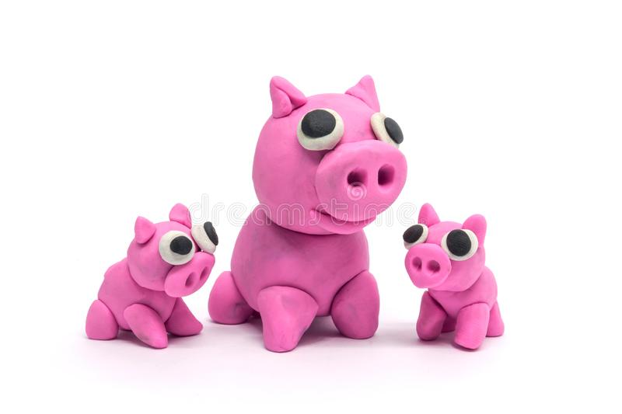
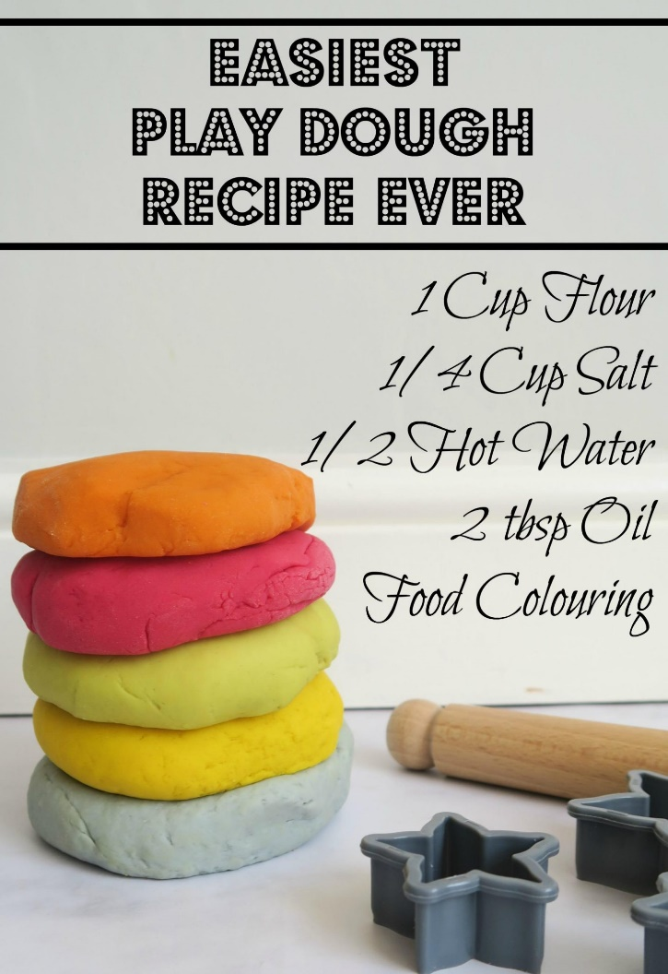
Tuesday 2nd February 2021
Can you make a playdough pig?
Here is a recipe to make your own playdough at home.
You can add pink food colouring to change the colour.
Mix it all together in a bowl
Once your dough is made you can manipulate it in different ways to create your own little pig.
Can you make all 3?

Slide 5



Choose your favourite story to read. Tell you grown up about what happens.
Draw a picture of your favourite character. Is it the Pigs or the Big Bad Wolf?
More ideas…
Can you count ten of your toys?
Lets check you beanstalk again, have you remembered to keep watering it? Draw a picture of what your beanstalk looks like now.
Once you have all ten toys could you write a number next to each and make your own number line?

Slide 6
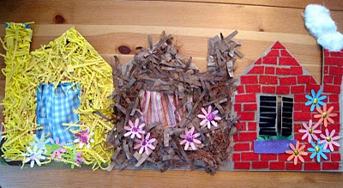
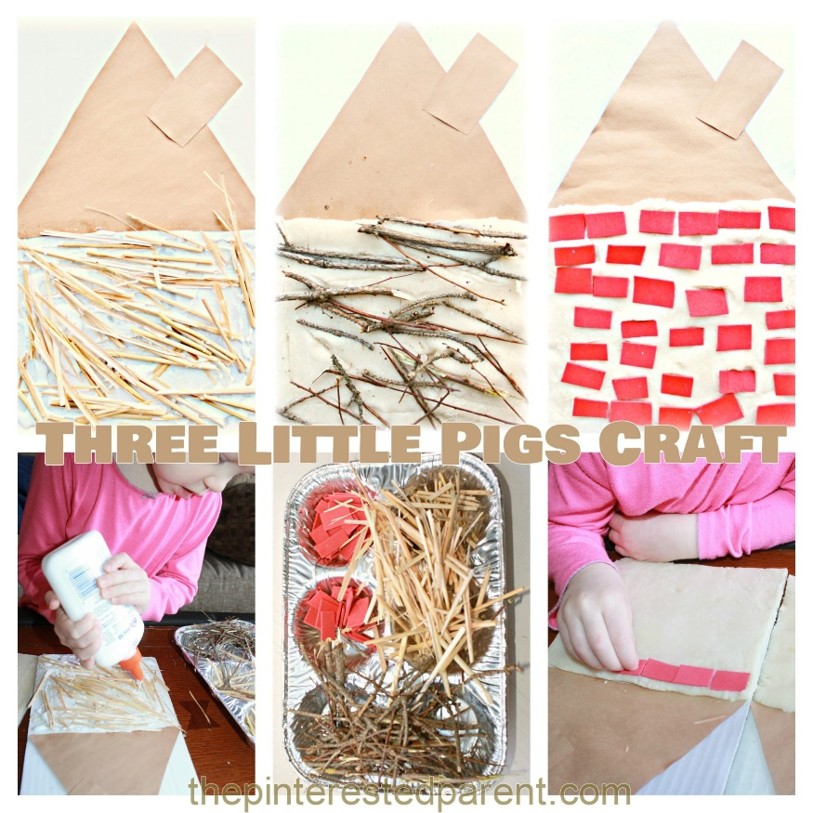
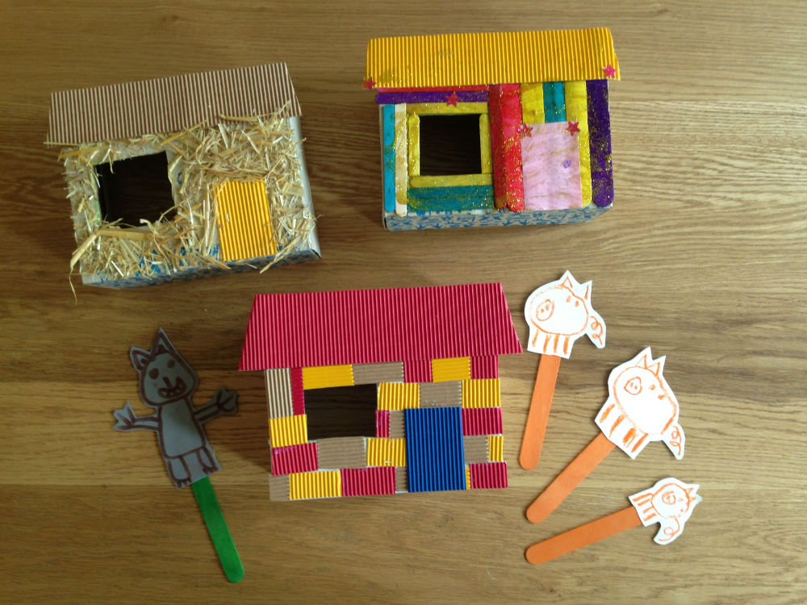
Wednesday 3rd February 2021
Build a pigs house…
Use the resources you have at home to create your own pigs house…
Will you build a house of bricks or straw or sticks?
Which do you think will be the strongest against the Big Bad Wolf?

Slide 7
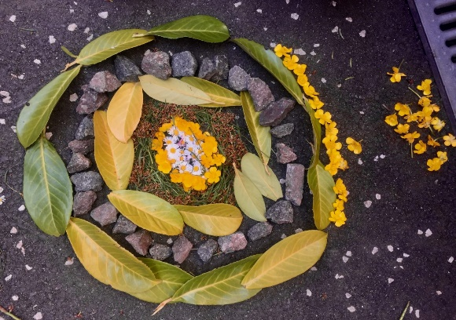

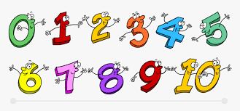
While out on your walk you could stop to do some transient art.
Can you write the numbers we have learnt…
0,1,2,3,4,5,6,7,8,9,10
More ideas…
Sing some number songs.
Go for a walk with your family. Can you talk about the weather today. When your return home you could draw a picture of what you saw.

Slide 8





Thursday 4th February 2021
Have a go at cutting out these story puppets and attach them to sticks. Then you can retell the story to your family. Can you remember what the characters say?
Story Time…

Slide 9
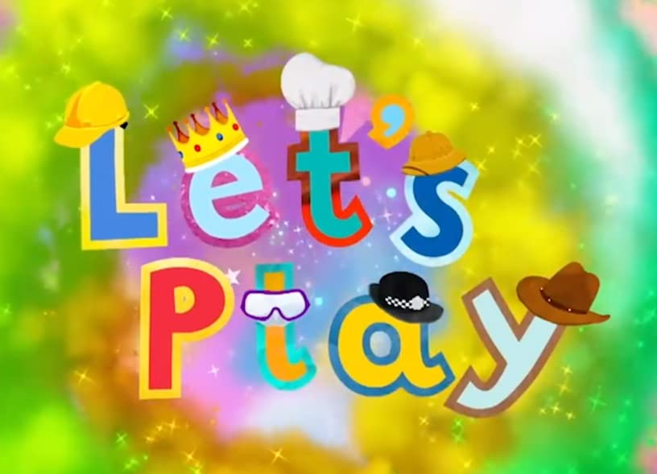
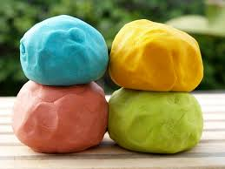


You could make a shop at home. What could you sell? Can you count the money?
Time to practice those fine motor skills. Can you use your playdough for some dough disco. Follow this link to join in with the moves.
https://www.youtube.com/watch?v=3K-CQrjI0uY
More ideas…
See how many pink objects you can find in your home.
Sing your favourite nursery rhyme.
Can you use material and move to the music?

Slide 10
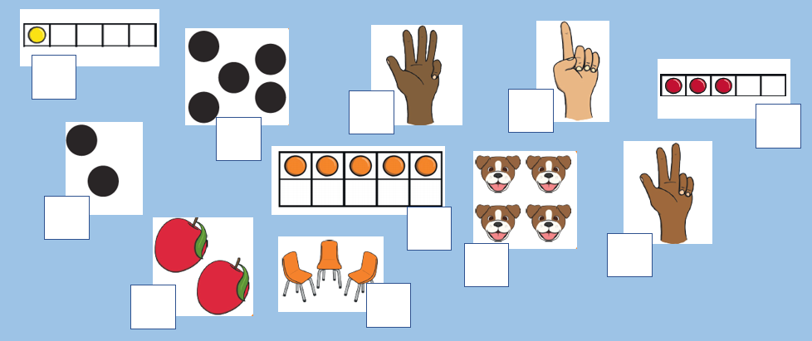
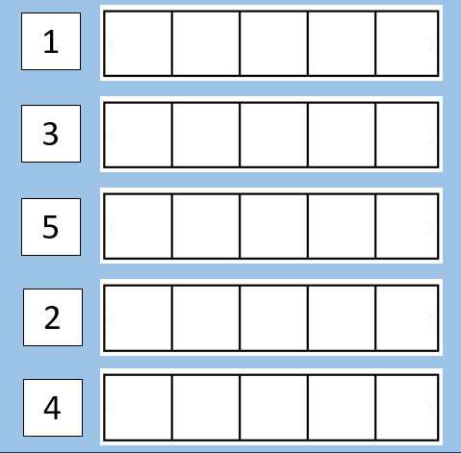
Friday 5th February 2021
Marvellous Maths…
Can you recognise these different representations of the numbers 1 to 5?
Write the answer in the box next to the picture.
Can you identify each digit and draw that number of circles into the five frame. Remember just one circle per box.

Slide 11

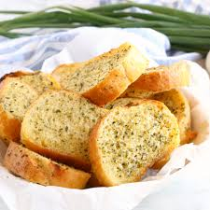
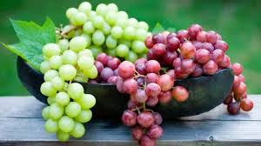
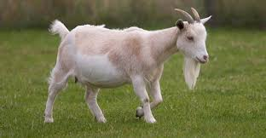
Our sound of the week is…
Can you find some objects in your home that start with our new sound?
Have a go at writing our new sound using the writing rhyme…
“Round her face, down her hair and give her a curl ”
This week our practical experience is to enjoy some food beginning with g.
Do you like grapes? Garlic bread? Grapefruit?

Slide 12


Our number of the week is…
Numbers 1 -10
Can you recognise the numbers we have been learning?
Can you make number line? See if you can put the numbers in order 1 to 10.
1 2 3 4 5 6 7 8 9 10

Slide 13


Colouring…

Slide 14
Have a great weekend everyone!
Please send us any photos of your home learning to our email or our Explorers Facebook page.
Email: explorerspupils@gmail.com

