Slide 1
Tuesday 5th January 2021
L.O To listen to the story of The Three Little Pigs
Subject: English

Slide 2
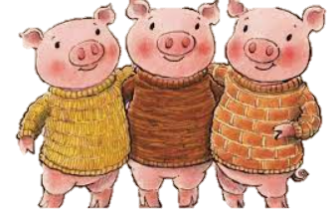
The Three Little Pigs
Watch the story of The Three Little Pigs. Try to join in with the actions and huff and puff.
Can you howl like the big bad wolf?
Can you blow some bubbles and pretend to be the big bad wolf?
The Three Little Pigs story

Slide 3
The Three Little Pigs
Who is?
Who is the pig?
Can you point to the picture?

Slide 4
The Three Little Pigs
Who is?
Who is the wolf?
Can you point to the picture?

Slide 5
The Three Little Pigs
Who is?
Who is the cat?
Can you point to the picture?

Slide 6
Wednesday 6th January 2021
L.O To practice mark making in shaving foam
Subject: English

Slide 7
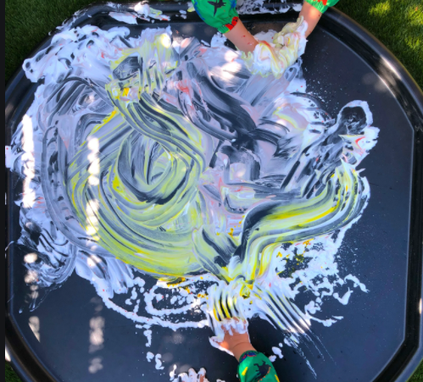
Mark making
Using shaving foam, salt, flour or anything you can find in your home, practice making marks/ writing letters.
Start by supporting your child’s
hand to make different movements
and then allow them to copy the
movements/ make movements freely.

Slide 8
Mark making
Can you draw a straight line?
Can you draw a wavy line?

Slide 9
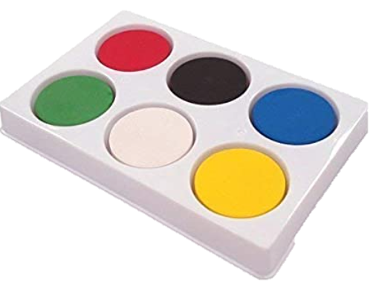
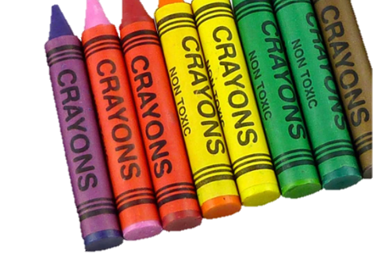
Mark making
What other items can you find around your home that you can make marks with? Can you create a picture using different objects?

Slide 10
Thursday 7th January 2021
L.O To build a house for The Three Little Pigs
Subject: English

Slide 11
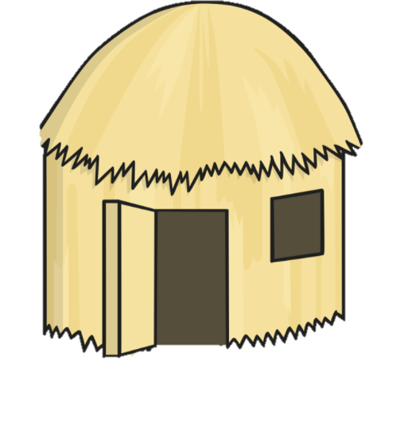
Building a house
Where is the straw house?
Can you point to it below.

Slide 12
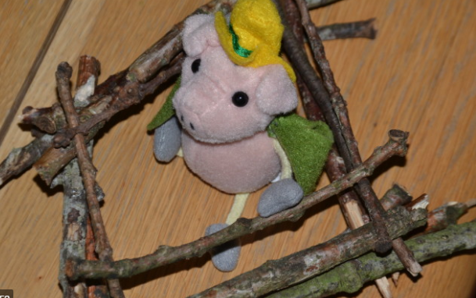
Building a house
Re-watch the story of The Three Little Pigs. Can you build a house using sticks from outside or materials you can find in your home.

Slide 13
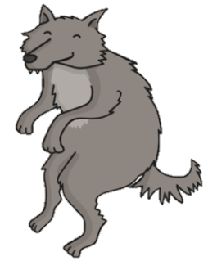
Building a house
Once you have built your house, try blowing on it. Does it fall over or does it stay up?
Would the big bad wolf be able
To blow your house down?

Slide 14
Friday 8th January 2021
L.O To copy a simple sound pattern
Subject: English

Slide 15
Copying sounds
Follow the link below, press a button on the screen to make a sound, can your child copy the sound? If they are able to copy one sound. Can they copy two or three sounds in a row?
Sound buttons

Slide 16
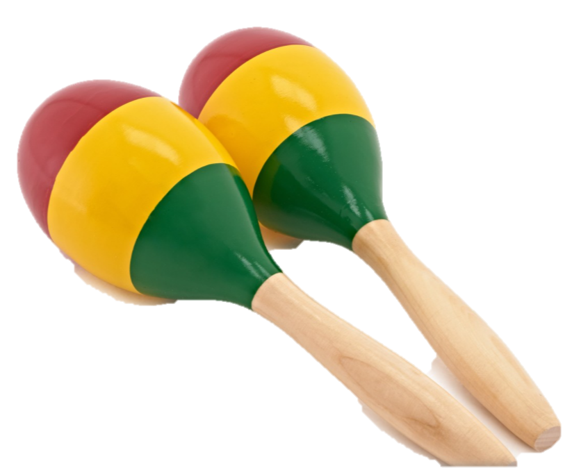
Copying sounds
Use the shakers above or use drums (pots and pans and wooden spoons are perfect) to play along with songs, rhymes and the radio. Try making the loudest sounds that you can then the quietest sounds that you can. Tap out simple rhythms. Can your child repeat the rhythm back to you?

