Slide 1




Date: 08.02.21
L.O. To be able to develop an understanding of how many the number 6 represents.
Subject: Maths

Slide 2
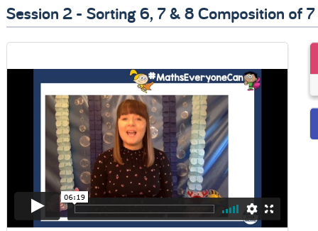
This week were are going to learn about the number 6 and different ways we can make it.
Lets start by watching this video, make sure you watch Session 2 – Sorting 6, 7 & 8 Composition of 7.
Video
https://whiterosemaths.com/homelearning/early-years/growing-6-7-8/
Copy and paste the link to watch the video of The Elves & The Shoemaker.

Slide 3
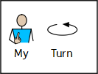


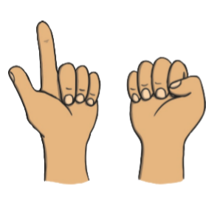



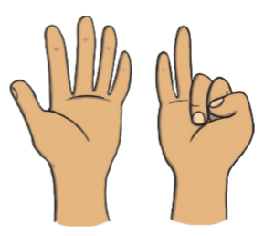
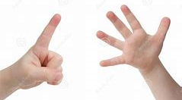


Here you can see different representations of some numbers. Can you circle the representation of the number 6?

Slide 4
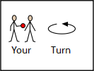
Here you can see different representations of some numbers. Can you circle the representation of the number 6?

Slide 5



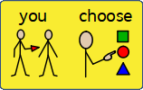
Now you know about the number 6 lets go on a scavenger hunt around the classroom or sensory room.
Can you find 6 balls? Can you find 6 animals?
Can you find 6 blocks?
Can you find 6 of something else in the classroom or sensory room? Surprise us with your choices.

Slide 6
Date: 09.02.2021
L.O. To be able to explore the different compositions of 6.
Subject: Maths

Slide 7
We are learning that all numbers are made up of smaller numbers. Today we will explore this further by looking at the different compositions of 6.
Here are some example of different ways we can make the number 6.
+
6
Can you count the total number of spots in the sum and write the answer in the box?
+
6

Slide 8
We are learning that all numbers are made up of smaller numbers. Today we will explore this further and notice the different compositions of 6.
Here are some example of different ways we can make the number 6.
+
Can you count the total number of spots? Write your answer in the box.
+

Slide 9
Now look at these different compositions of 6.
For example, 6 can be made from 4 and 2.
Can you fill in the white circles with the correct number of dots to make 6, you can either move the dots or draw them in.
Dot Bank
+
= 6
= 6
+
4 + 2 = 6
5 + 1 = 6

Slide 10
Now look at these different compositions of 6.
For example, 6 can be made from 4 and 2.
Can you fill in the white circles with the correct number of dots to make 6, you can either move the dots or draw them in.
Dot Bank
+
= 6
+
= 6
+ 2 = 6
3 + = 3

Slide 11
The number 6 is made up of groups of smaller numbers. Here the number is 6 split up into 3 parts, can you work out how many spots need to go into the empty circles to make 6.
Dot Bank
+
+
= 6
2 + 2 + 2 = 6
+
+
= 6
1 + 2 + 3 = 6

Slide 12
The number 6 is made up of groups of smaller numbers. Here the number is 6 split up into 3 parts, can you work out how many spots need to go into the empty circles to make 6.
Dot Bank
+
+
= 6
2 + 2 + = 6
+
+
= 6
1 + 2 + = 6

Slide 13
The number 6 is made up of groups of smaller numbers. Here the number is 6 split up into 3 parts, can you work out how many spots need to go into the empty circles to make 6.
Dot Bank
+
+
= 6
3 + 2 + 1 = 6
+
+
= 6
4 + 1 + 1 = 6

Slide 14
The number 6 is made up of groups of smaller numbers. Here the number is 6 split up into 3 parts, can you work out how many spots need to go into the empty circles to make 6.
Dot Bank
+
+
= 6
3 + + = 6
+
+
= 6
4 + + = 6

Slide 15
Date: 10.02.2021
L.O. To find the missing number in compositions of 6.
Subject: Maths

Slide 16



Instructions
Each slide shows a part-whole model with the ‘whole’ number and one ‘part’ number.
The ‘whole’ number will always be the number 6.
One of the parts will be given to you and your job is to work out what number needs to be added to get to 6.
Can you work out the missing ‘part’ number?
Can you say the equation? ‘Four add two equals six’.
Choose the correct number shape to complete the part-part-whole model.

Slide 17

Find the correct Numicon piece that shows the answer and drag it into the ‘whole’ circle. (Draw the correct number of circles if you are working on paper.

Slide 18
Find the correct Numicon piece that shows the answer and drag it into the ‘whole’ circle. (Draw the correct number of circles if you are working on paper.

Slide 19
Find the correct Numicon piece that shows the answer and drag it into the ‘whole’ circle. (Draw the correct number of circles if you are working on paper.

Slide 20
Find the correct Numicon piece that shows the answer and drag it into the ‘whole’ circle. (Draw the correct number of circles if you are working on paper.

Slide 21
Find the correct Numicon piece that shows the answer and drag it into the ‘whole’ circle. (Draw the correct number of circles if you are working on paper.

Slide 22

CHALLENGE
If I have 6 in one of my parts, what would I have in the other part?
Talk about this with your grown-up.

Slide 23



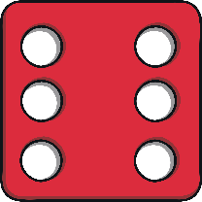


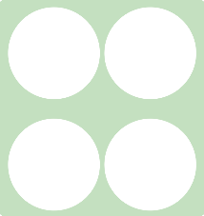

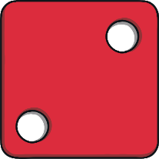
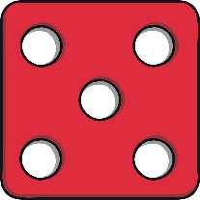
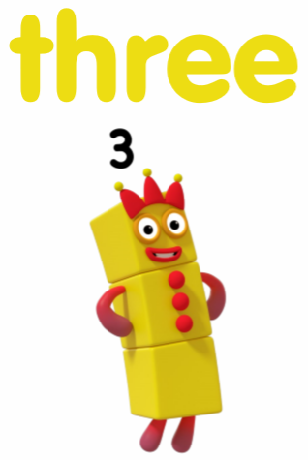



Here are some compositions of the number 6. Can you work out each one and put a circle around the compositions that equal 6.
+
+
+
+
+
+

Slide 24
Here are some compositions of the number 6. Can you work out each one and put a circle around the compositions that equal 6.
+
+
+
+
+
+

Slide 25
Date:11.02.2021
L.O. To be able to identify common 2D shapes.
Subject: Maths

Slide 26









Today we are going to have a look at 2D shapes. A 2D shape is a flat shape that has sides and corners. Let’s look at some of the names of these shapes:

Slide 27



Let’s have a look for some shapes around our classroom.

Slide 28


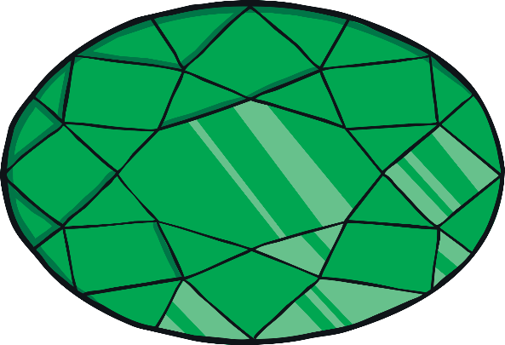


Slide 29
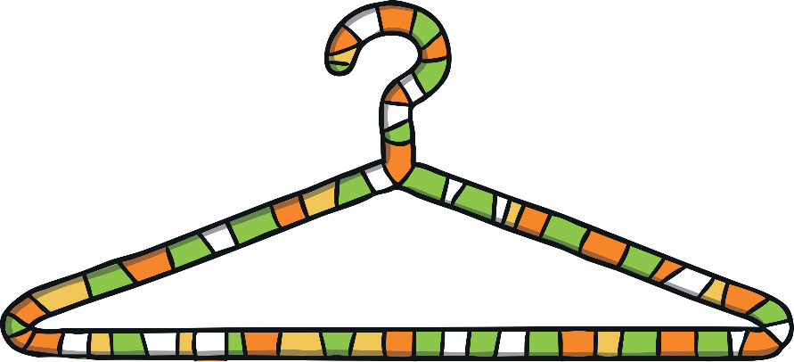
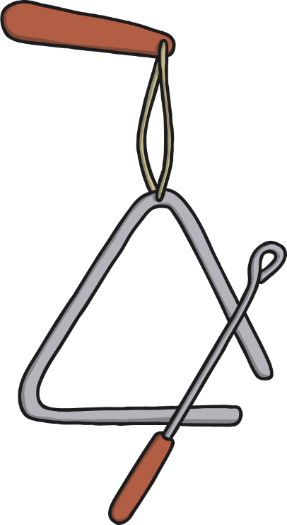

triangle
coat hanger
triangle

Slide 30
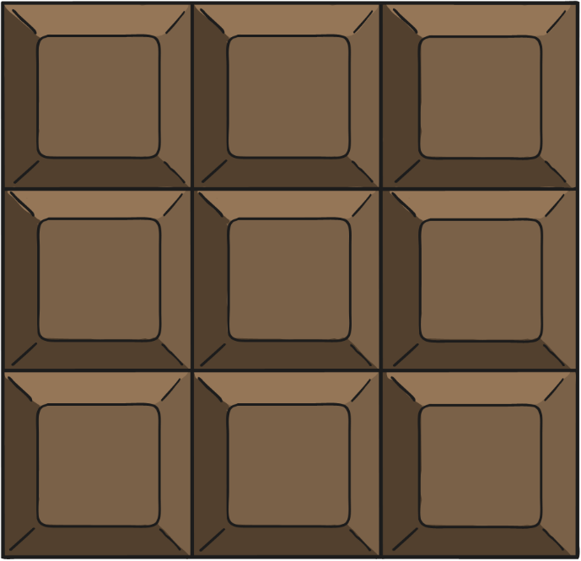



Slide 31
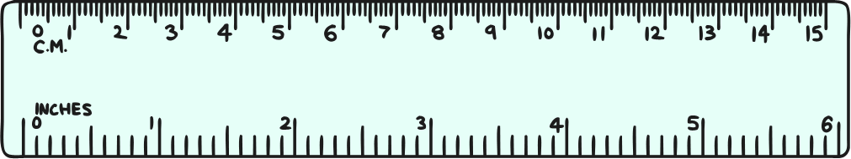



Slide 32





It would be great to see some photos of you with your 2D shapes.
It’s time to see how many of our 2D shapes we can find in our classroom. Here are some I have found and added to the chart below.

Slide 33
It would be great to see some photos of you with your 2D shapes.
Find as many circles, triangles, squares and rectangles as you can. Write what you find in the correct column below or stick photos in of the 2D shapes you find.

Slide 34
Date: 12.02.2021
L.O. To be able to identify the properties of 2D shapes.
Subject: Maths

Slide 35
Yesterday we had a look at these 2D shapes and what their names were. Today we are going to find out how many sides and corners each shape has. Before we get started, you can read the names of the shapes to refresh your memory.

Slide 36




This is a chart of how many sides and corners each shape has.
Can you name the shapes that have one side?
There is one shape that has three corners and three sides, which shape is it?
Look at all of the shapes, which one has the most sides?
Which one has 5 corners?
 |  | C
Circle | 1 | 0
Oval | 1 | 0
Triangle | 3 | 3
Square | 4 | 4
Rectangle | 4 | 4
Pentagon | 5 | 5
Hexagon | 6 | 6
Heptagon | 7 | 7

Slide 37

Zena has accidently deleted the numbers for the sides and corners. Can you help her by counting how many sides and corners each shape has got and write your answers into the table.
Circle
Triangle
Square
Pentagon
Heptagon

Slide 38
Zena has jumbled up the numbers you wrote. Can you draw a line to match the shape to the correct number of sides and corners?
4
5
5
4
3
0
1
7
7
3

Slide 39
Zena has jumbled up the numbers you wrote. Can you draw a line to match the shape to the correct number of sides and corners?
4
5
5
4
3
0
1
7
7
3

