Slide 1
Monday 12th July 2021
LO. To be able to understand Anglo-Saxon beliefs
Subject: History

Slide 2
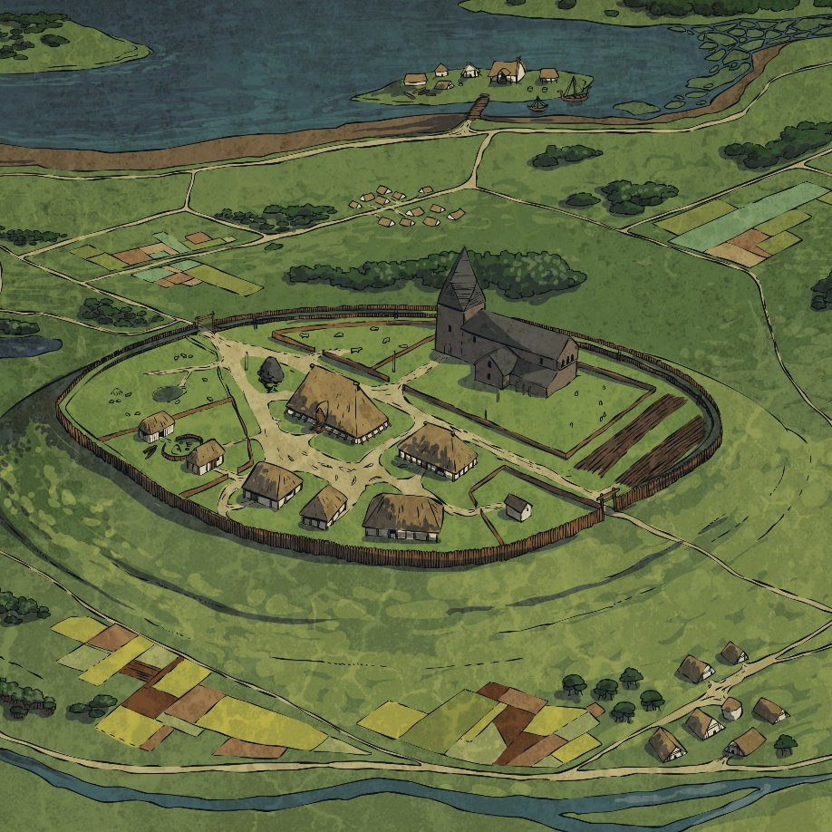
Where Did the Anglo-Saxon Gods Come From?
After the Romans left Britain, the Anglo-Saxons (Angles, Saxons and Jutes) arrived across the North Sea from Germany, Denmark and the Netherlands and with them came beliefs rooted in Norse mythology.
In the Norse legends, there were two groups of gods, whom the Anglo-Saxons called Ese and Wena. In time, Ese won over the Wena and the Ese became the rulers over the Wena.
The leader of the Ese, Woden, became King of all the gods.

Slide 3
Early Anglo-Saxons were Pagans!
In Roman Britain many people had been Christians. But the early Anglo-Saxons were not Christians, they were pagans.
Like the Vikings and the Greeks, the Anglo-Saxons believed in many gods and
had many superstitions.
Anglo-Saxons were superstitious and believed in lucky charms. They thought that rhymes, potions, stones and jewels would protect them from evil spirits or sickness.
Over time their beliefs changed, and many Anglo-Saxons were converted to Christianity.

Slide 4
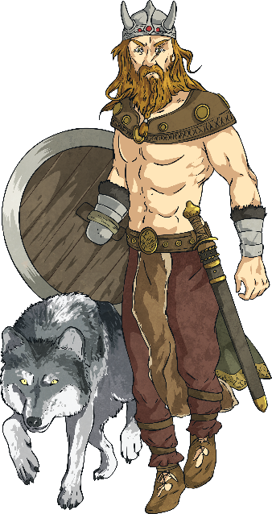
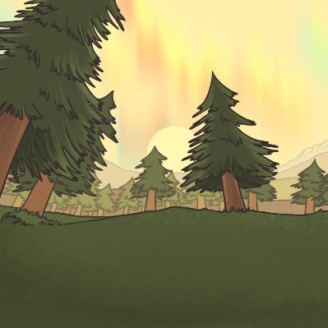
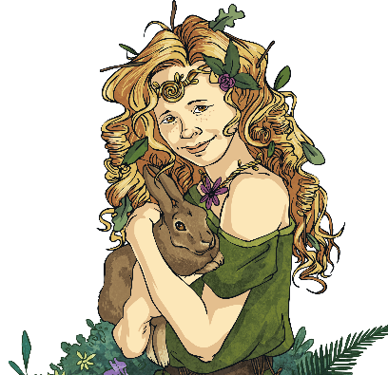
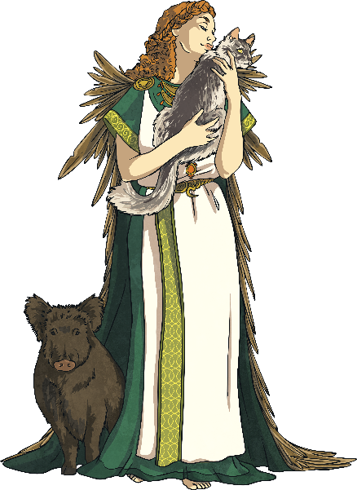
Meet the Gods
Click on a god or goddess to find out more about them.
More Gods
Notes:
The links between the Anglo-Saxon and Roman days of the week: Tuesday – Mars was the Roman god of war as was Tiw for the Anglo-Saxons; Wednesday – Mercury and Woden were both chief gods as well as being gods of the dead and were often portrayed wearing a hat and carrying a staff; Thursday – Jupiter and Thuner were both gods of thunder and lightning; Friday – Venus and Frige were both associated with love and family.

Slide 5
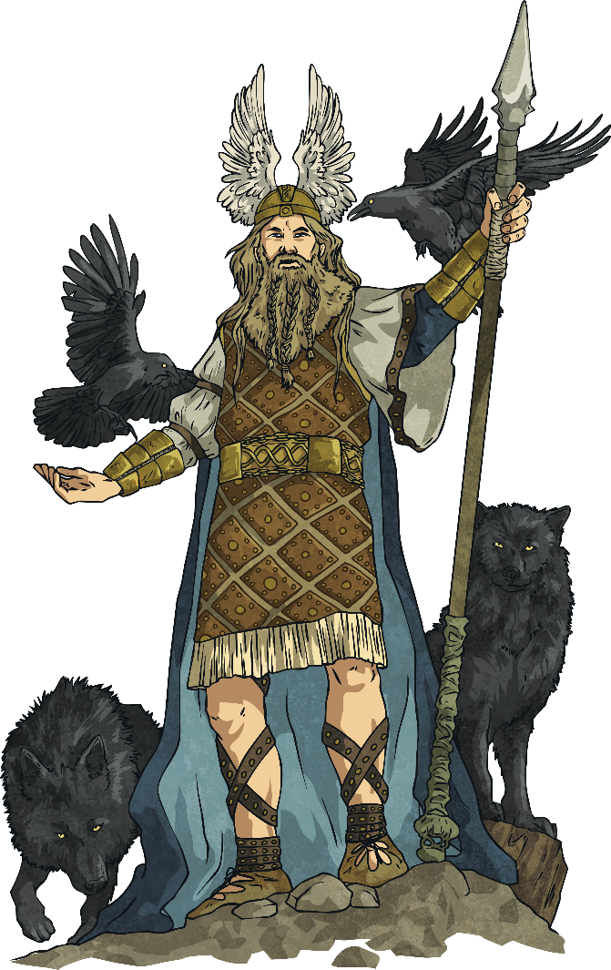
Woden – King of the Gods
Name: Woden
Nickname: Grim
Jobs: chief of the gods, god of war
Family: husband of Frige, father of Thunor and Bealdor
Sacred Animals: wolf, raven
Sacred Plant: ash tree
Equivalent Roman God: Mercury
Equivalent Norse God: Odin
Sacred Weapon: spear
Characteristics
Woden was sometimes shown with one eye, two
pet wolves and a horse with eight legs.
back
Notes:
The links between the Anglo-Saxon and Roman days of the week: Tuesday – Mars was the Roman god of war as was Tiw for the Anglo-Saxons; Wednesday – Mercury and Woden were both chief gods as well as being gods of the dead and were often portrayed wearing a hat and carrying a staff; Thursday – Jupiter and Thuner were both gods of thunder and lightning; Friday – Venus and Frige were both associated with love and family.

Slide 6
Frige – Goddess of the Home
Name: Frige
Jobs: goddess of the home, marriage, childbirth, Earth and harvest
Family: married to Woden, mother of Thunor and Bealdor
Sacred Animal: stork
Sacred Star Constellation: Orion’s Belt
Sacred Tool: spinning wheel
Equivalent Norse God: Frigg (married to Odin)
Equivalent Roman God: Venus
back
Notes:
The links between the Anglo-Saxon and Roman days of the week: Tuesday – Mars was the Roman god of war as was Tiw for the Anglo-Saxons; Wednesday – Mercury and Woden were both chief gods as well as being gods of the dead and were often portrayed wearing a hat and carrying a staff; Thursday – Jupiter and Thuner were both gods of thunder and lightning; Friday – Venus and Frige were both associated with love and family.

Slide 7
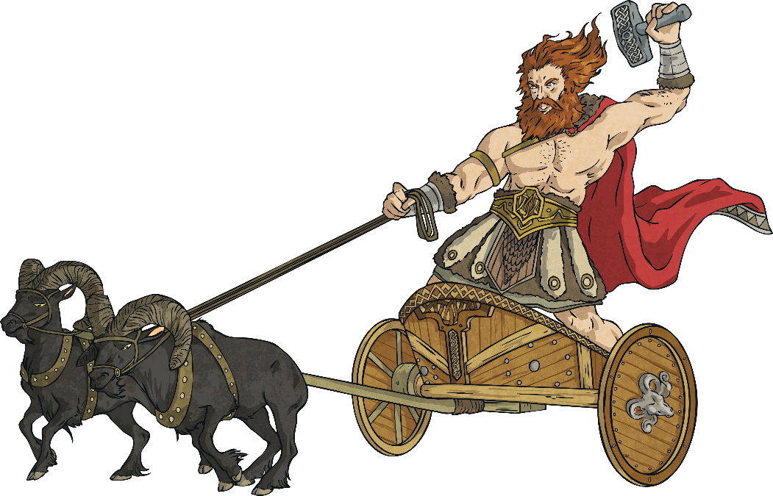
Thunor – God of Thunder
Name: Thunor
Job: god of storms, thunder and lightning
Family: son of Woden
Sacred Animal: goat
Sacred Plant: oak tree
Sacred Weapon: hammer
Equivalent Norse God: Thor
Equivalent Roman God: Jupiter
Characteristics
Thunor was often depicted on a chariot pulled by goats.
back
Notes:
The links between the Anglo-Saxon and Roman days of the week: Tuesday – Mars was the Roman god of war as was Tiw for the Anglo-Saxons; Wednesday – Mercury and Woden were both chief gods as well as being gods of the dead and were often portrayed wearing a hat and carrying a staff; Thursday – Jupiter and Thuner were both gods of thunder and lightning; Friday – Venus and Frige were both associated with love and family.

Slide 8
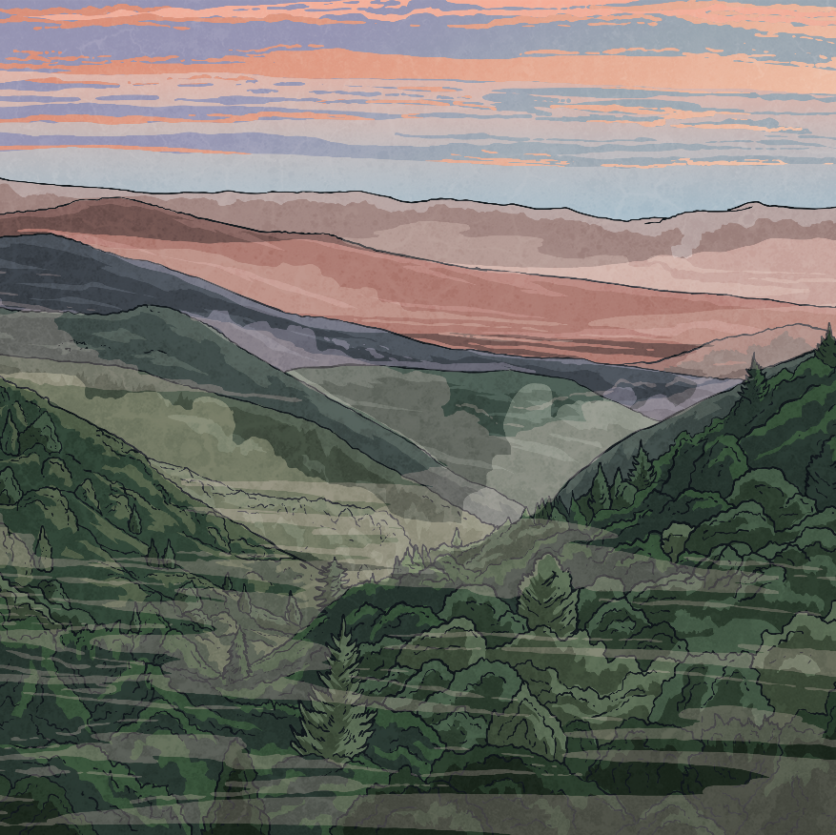
Freo – Goddess of Love
Name: Freo
Job: goddess of love
Family: sister of Ingui
Sacred Animals: cat, boar
Equivalent Norse God: Freya
Equivalent Roman God: Venus
Characteristics
Freo wore a magic cloak of falcon feathers and a necklace called ‘Brisingamen’.
back
Notes:
The links between the Anglo-Saxon and Roman days of the week: Tuesday – Mars was the Roman god of war as was Tiw for the Anglo-Saxons; Wednesday – Mercury and Woden were both chief gods as well as being gods of the dead and were often portrayed wearing a hat and carrying a staff; Thursday – Jupiter and Thuner were both gods of thunder and lightning; Friday – Venus and Frige were both associated with love and family.

Slide 9
Eostre – Goddess of Spring
Name: Eostre
Job: goddess of spring, goddess of rebirth
Sacred Animal: hare
Sacred Symbol: egg Equivalent Norse God: Austra
Equivalent Roman God: Aurora Special Month: April
(around where Easter is now)
back
Notes:
The links between the Anglo-Saxon and Roman days of the week: Tuesday – Mars was the Roman god of war as was Tiw for the Anglo-Saxons; Wednesday – Mercury and Woden were both chief gods as well as being gods of the dead and were often portrayed wearing a hat and carrying a staff; Thursday – Jupiter and Thuner were both gods of thunder and lightning; Friday – Venus and Frige were both associated with love and family.

Slide 10
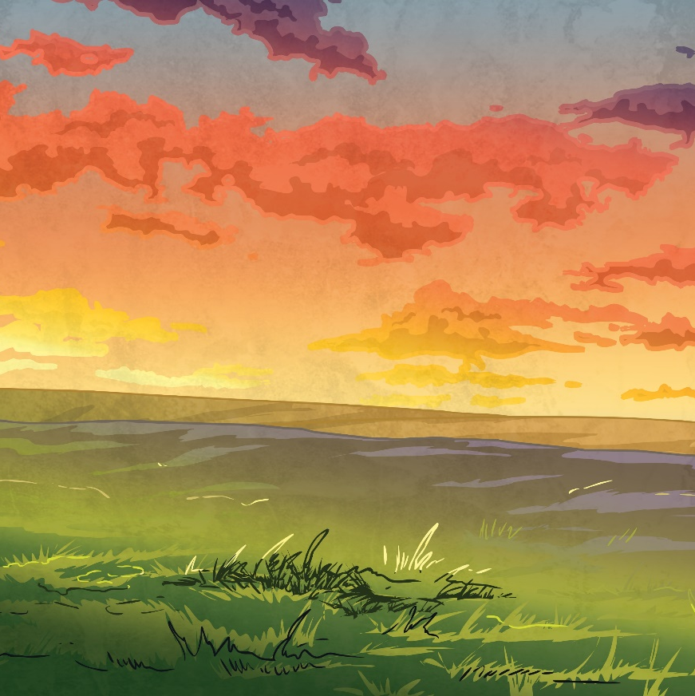
Tiw – God of War
Name: Tiw
Job: god of war, justice and a sky god
Sacred Animal: wolf
Equivalent Norse God: Tyr
Equivalent Roman God: Mars
Characteristics
Tiw was often shown as having only one hand.
back
Notes:
The links between the Anglo-Saxon and Roman days of the week: Tuesday – Mars was the Roman god of war as was Tiw for the Anglo-Saxons; Wednesday – Mercury and Woden were both chief gods as well as being gods of the dead and were often portrayed wearing a hat and carrying a staff; Thursday – Jupiter and Thuner were both gods of thunder and lightning; Friday – Venus and Frige were both associated with love and family.

Slide 11
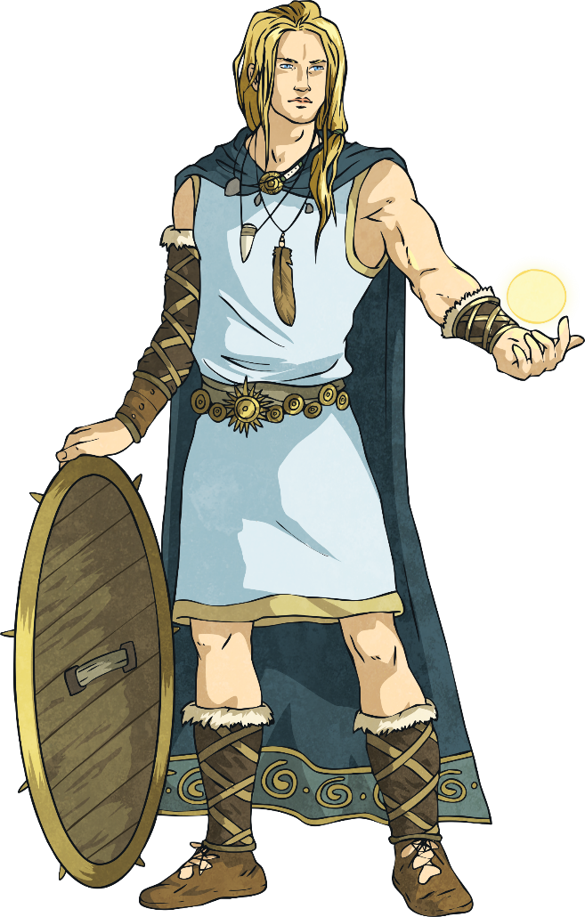
Bealdor – God of Light
Name: Bealdor
Job: god of light
Family: son of Woden and Frige
Equivalent Norse God: Baldr
Equivalent Roman God: Apollo
Characteristics
He gave off light from his good looks, generosity and goodness.
back
Notes:
The links between the Anglo-Saxon and Roman days of the week: Tuesday – Mars was the Roman god of war as was Tiw for the Anglo-Saxons; Wednesday – Mercury and Woden were both chief gods as well as being gods of the dead and were often portrayed wearing a hat and carrying a staff; Thursday – Jupiter and Thuner were both gods of thunder and lightning; Friday – Venus and Frige were both associated with love and family.

Slide 12
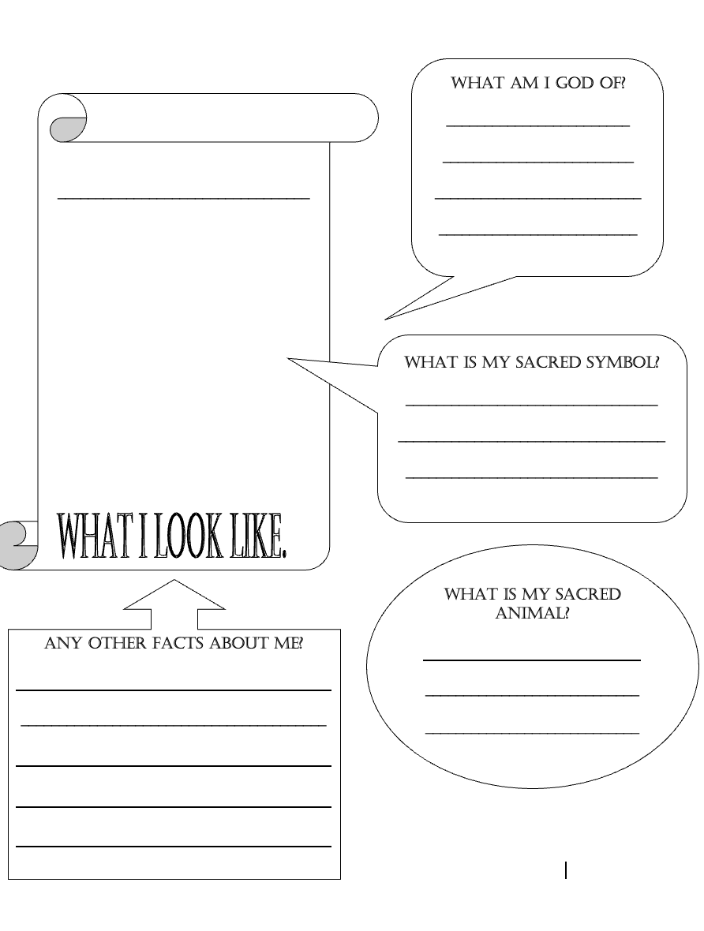
Create a fact file about an Anglo-Saxon God
GOD | GOD OF WHAT?
Frigg | Goddess of love
Loki | God of cunning
Saxnot | God of the family
Thunor | God of thunder
Tiw | God of war
Wade | God the sea
Wayland | God of metalworking
Woden | Chief God

Slide 13
The Arrival of Christianity
The Romans did introduce Christianity to Britain but the Anglo-Saxons mainly kept their pagan beliefs.
Later, in AD 597 the pope in Rome sent a missionary (someone who promotes a religion in another country) to travel to Britain to spread the word of Christianity and help convert people to the religion.
This missionary was a monk named Augustine. He was successful in converting Ethelbert, the King of Kent, to Christianity and King Ethelbert even built Augustine a Church at Canterbury.
Augustine became the first Archbishop of Canterbury and the one named as the founder of the Church of England.
Next Page

Slide 14
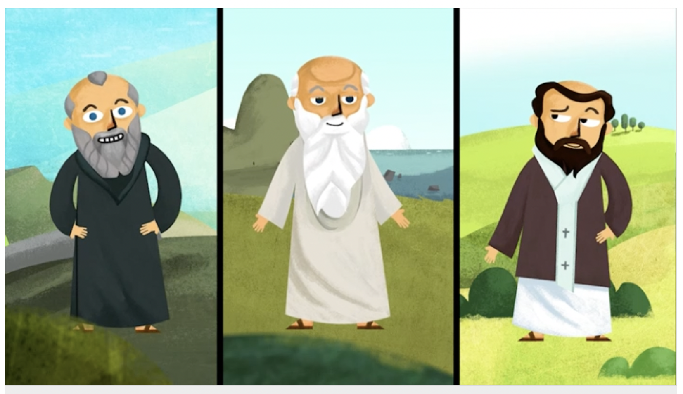
Lets learn more!
https://www.bbc.co.uk/bitesize/topics/zxsbcdm/articles/zs3gcdm

Slide 15
Tuesday 13th July 2021
LO To be able to compare the lives of an Anglo-Saxon child and a modern child.
Subject: History

Slide 16
What jobs do you do around the house?

Slide 17
What was life like for an Anglo-Saxon child?
https://www.bbc.co.uk/bitesize/topics/zxsbcdm/articles/zq2m6sg#:~:text=Anglo-Saxon%20children%20had%20to%20grow%20up%20very%20quickly.,cooking%20meals%2C%20making%20cheese%20and%20brewing%20ale.%20

Slide 20
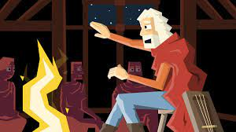

Slide 21
Modern Child
Anglo-Saxon Child
Similarities
Listening to music
Listening to stories
Playing with toys

Slide 22
Wednesday 14th July 2021
LO To be able to identify the committees we belong to and how if make us feel.
Subject: PHSE

Slide 23
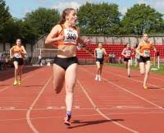
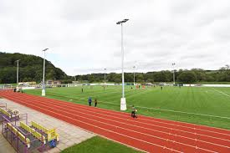
What groups do you belong to?
A group is a collection of people that gather together to discuss issues, organise events or to do a sport.
Examples of groups: running, rugby, football, gymnastics, swimming, friendship, school class, family.
Here is 1 of the clubs that I belong to.
1, Who is in these groups with you?
My family, friends, other athletes.
2, How does it make you feel to be part of these groups?
It makes me fell relaxed and safe.
3, What do you do at your club?
I run with my family and I teach the other athletes how to run fast.
Durham City Harries

Slide 24
Your turn: can you think of a clubs you belong to and answers the questions.
What club do you belong to?
What club do you belong to?
1, Who is in these groups with you?
2, How does it make you feel to be part of these groups?
3, What do you do at your club?
1, Who is in these groups with you?
2, How does it make you feel to be part
of these groups?
3, What do you do at your club?

Slide 25
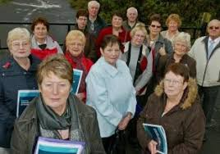
Do you know anyone in theses clubs?
Are you part of any of theses clubs?
Belonging to our community
A community is when a group of people come together because they share the same things for example: social interest football, dance, job, where they live and school.
Here are some of our clubs in our community.
Football Club History Club Our School The Mothers Club

Slide 26
Lets listen to the story of Beegu.
Listen careful and see if you think she belongs to a group or not. How She is feeling at the beginning and the end of the story.

Slide 27
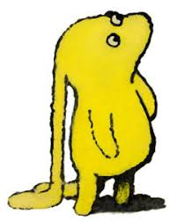
Your turn: Can you now answer the question now on the story Beegu?
Wanting to belong to a group
How did Beegu feel each time she was excluded from a group?
_______________________________________________________________________________________________________________________________________
What might Beegu have thought when this happened?
_______________________________________________________________________________________________________________________________________

Slide 28
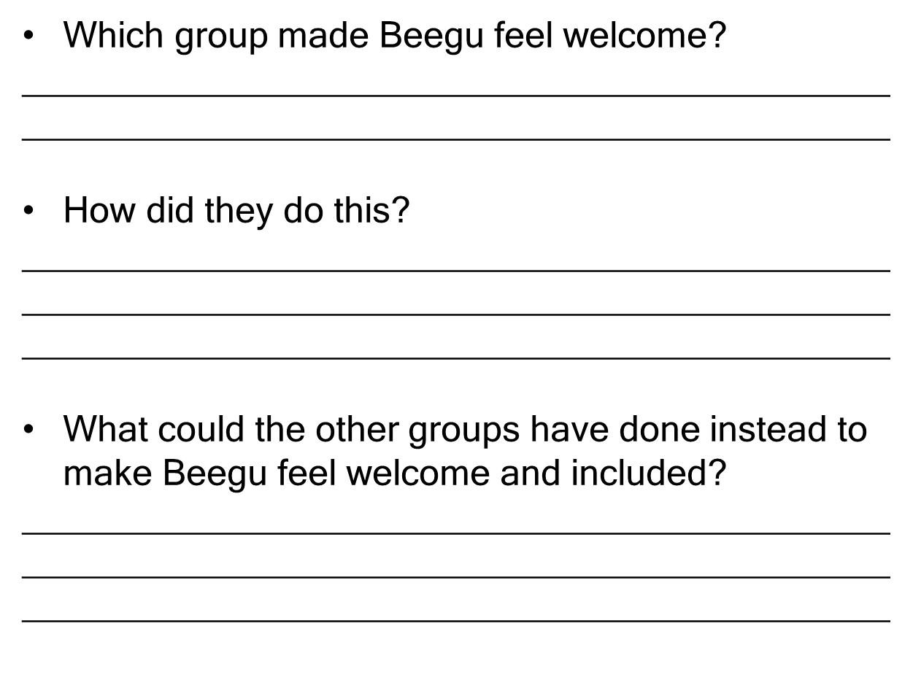

Slide 29
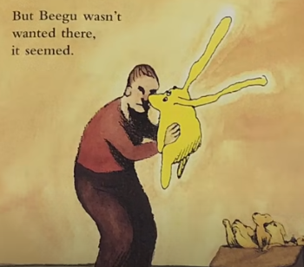
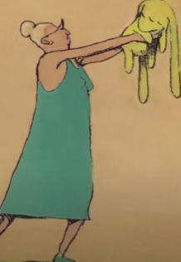
Being Beegu
We are now going to look more carefully at how she was feeling.
Beegu didn’t like being alone. She needed to find some friends.
But Beegu wasn’t wanted there, it seemed.
But not everyone thought so...
Some wouldn’t even stay still to listen.

Slide 30
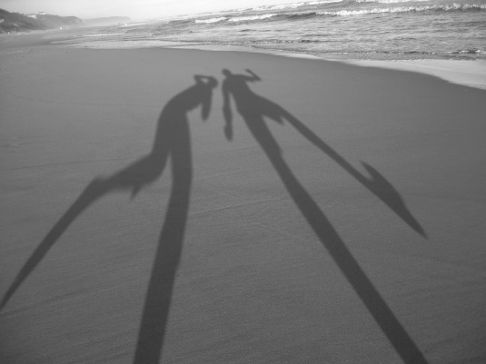
Together can we pick out some to the emotions we thing Beegu is feeling.
Remember all Beegu wanted was a friend.

Slide 31
My Turn: To use emotions and put into a sentence.
.
Remember full shop, Capital letters and finger spaces.
Now we have identified how Beegu is feeling I am going to put into some sentences.
Beegu was upset to think no one wanted to be his friend.
Beegu was getting angry because he did not know what he was doing wrong.

Slide 32
Your Turn: To understand others feelings.
.
Now we have identified Beegus feeling can you write 5 sentences.

Slide 33
Thursday 15th July 2021
LO To be able to write a letter, discussing emotions.
Subject: PHSE

Slide 34
Being Beegu
Today I what you to imagine you are Beegu and write a letter to the children (small ones) she meet on earth explaining the following.
What I want you to explain?
How they made her feel being included for once.
What she felt when she was excluded
Why they give her hope.

Slide 35
My Turn: To write about Beegus emotions
.
Before I start I need to know how to write a letter.
Your Name _______________
Your address:
Their Addreess:____________________________________________________
Date ___________________
The person how need to read the letter
_________________________________
What the letter is about. ____________________________________________________________________________________________________________________________________________
How the letter is from___________________________

Slide 36
My Turn: To write about Beegus emotions
.
Now here is my letter to the children
(the small ones) for the school
Beegu
Your Name _______________
Your address:
Over the moon road
Moon way
Space
Wheatley Hill
School
Wheatley Hill
Their Addreess:____________________________________________________
What I want you to explain?
How they made her feel being included for once.
What she felt when she was excluded
Why they give her hope.
Date ___________________
The person how need to read the letter
________________________________
The Small Ones
What the letter is about. Dear Small Ones
Thank you so much for making me feel so special when you let me join in your games. My heart batted with excitement and I was overwhelmed with gratitude. My heart broke in two when your adult tossed me aside, I know I was going to be alone again and I was distraught and worried about my future. I sat lonely and cold on the hill side until I yellow glue appeared over me, it was my family. I was alone no me, but you small one give me hope, that one day when you become an adult and someone like me arrives you will make them welcome and I hope their have the small felling I did. Thanks you small ones I will never forget you.
How the letter is from___________________________
Love Beegu

Slide 37
Your Turn: To write about Beegus emotions
.
Now here is my letter to the children
(the small ones) for the school
________________________
____________________________________________________________________________________________________
What I want you to explain?
How they made her feel being included for once.
What she felt when she was excluded
Why they give her hope.
________________________
________________________________
________________________________
__________________________________________________________________

