Slide 1
Hello base camp 3, we hope that you enjoyed your home learning last week and had some great fun with the activities. Here you can find your home learning pack for this week.
We have put together some new exciting activities to learn about while you are at home this week. We have added a phonics section in your pack this week with some ideas on how you can learn your sounds at home. As well as this, this week you can pick up your set of phonics cards from school to use at home. We have added set 1 to begin with as these are the sounds we have been learning in school. You can also check out the new video clips on the phonics page.
Again, we are always here to help and support you with your learning.
We hope you have lots of fun and enjoy your home learning. From the base camp 3 staff.
*TOP TIP- DON'T USE SLIDE SHOW TO VIEW THIS POWERPOINT*

Slide 2
Parent Guidance
We hope we find you safe and well during these difficult times. We recognise that home learning provides its own challenges and is not always easy. We have put together some daily learning for your children. They have several activities for each day which will hopefully keep their learning moving forward. As the children are still so little the activities will need to be supported by an adult. All children learn differently and at different paces, as well as needing different levels of support. Some children may just need you to be with them while others may need you to write things out for them and support them step by step. All of this is fine. We want the activities to be fun for everybody, including yourselves. ☺
When completing this weeks work please make sure it is completed either on the PowerPoint, or if this isn’t possible written onto paper. This will be used as evidence that the home learning is being completed.
The base camp 3 staff at school are always here for you and are ready to help with any queries that you may have. If you have any problems please get in touch via the methods below and we will get back to you as soon as we can.
Email: Telephone: Climbpupils@gmail.com
01429 820594
Hopefully we will see you all in person really soon, stay safe. The base camp 3 team.
Monday | Tuesday | Wednesday | Thursday | Friday
1 phonics activity English Maths Topic | 1 phonics activity English Maths Topic | 1 phonics activity English Maths Topic | 1 phonics activity English Maths Topic | 1 phonics activity English Maths Topic

Slide 3
Date: Monday 25th January 2021
LO. To know a variety of things can be counted.
Subject: Maths

Slide 4
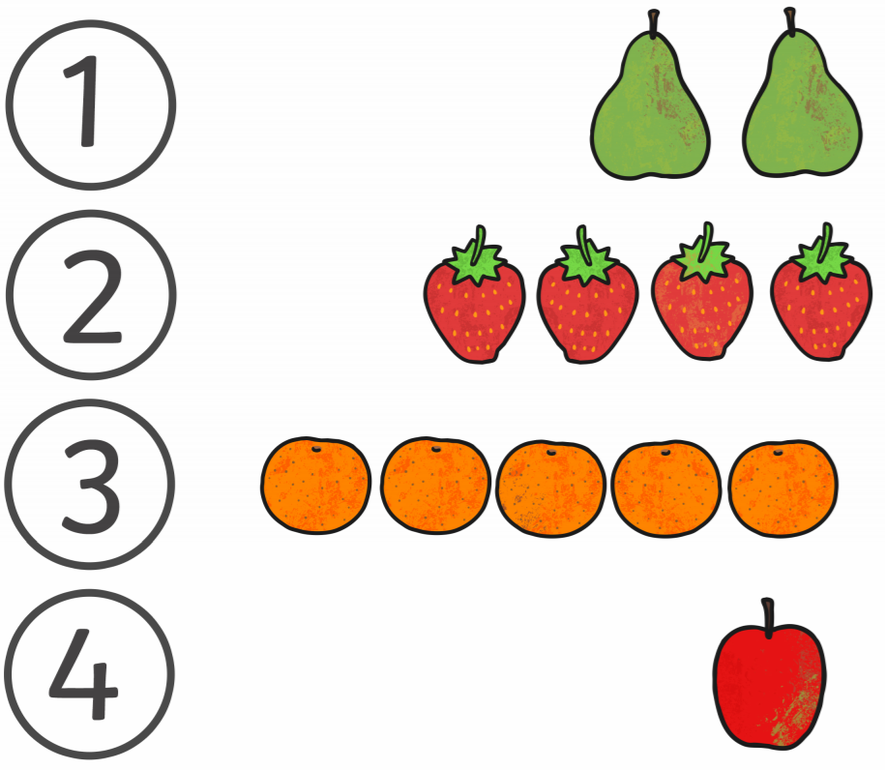
The very Hungry Caterpillar
Can you add the correct number of caterpillars body? You could do some finger painting to circles to make your very hungry create the dots or use pens, pencils, dabbers or counters.

Slide 5
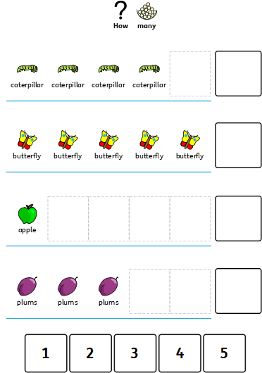
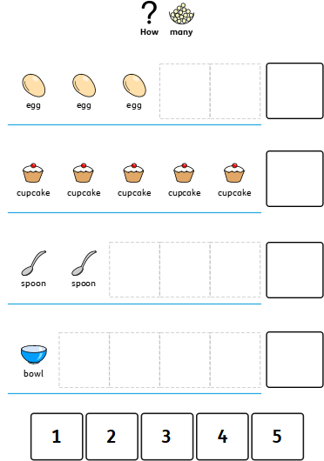

Slide 6
Date: Tuesday 26th January 2021
LO. To sequence numerals to 5.
Subject: Maths

Slide 7
Don’t worry if you do not have a printer at home you can use the numbers and place them on top.

Slide 8
Oh no. Miss Anderson has mixed up all the digit cards! We need you to rearrange them back into the correct order. Drag each digit box to the right place on the line or, if you are writing on paper, write each digit in the right order. I'll start it for you.
5
0
1
4
2
3
0
Now practice writing your numbers 0 – 5 on some paper if you haven’t already.

Slide 9
Date: Wednesday 27th January 2021
LO. To match numbers to 5.
Subject: Maths

Slide 12
Date: Thursday 28th January 2021
LO. To order objects according to their length.
Subject: Maths

Slide 14
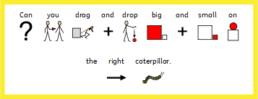

Slide 15
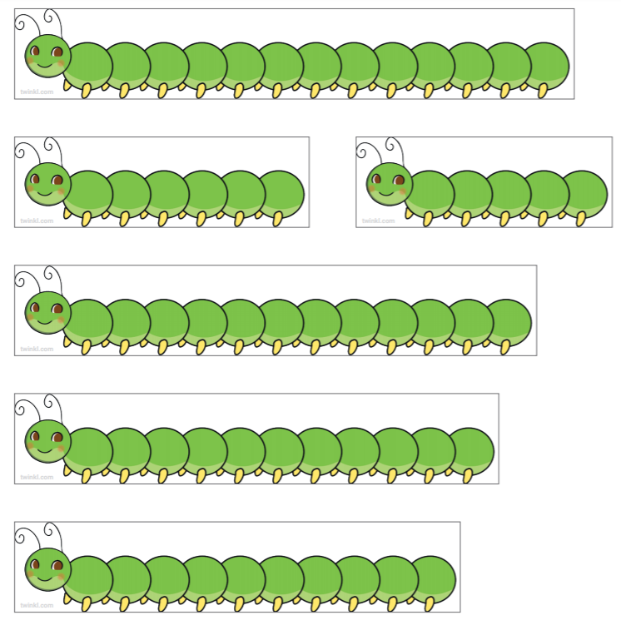
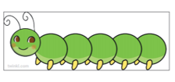
Maybe you can print the caterpillars out and order them in size.

Slide 16
Date: Friday 29th January 2021
LO. To understand the terms long and short.
Subject: Maths

Slide 17
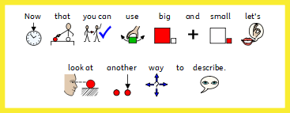

Slide 18
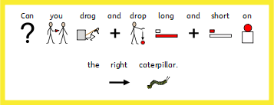

Slide 19
Now you know that big and small are ways to describe size, let's look at another way. We can use the words long and short to describe the size of some things.
Tick the box next to the longest

Slide 20
Tick the box next to the shortest.

