Slide 1
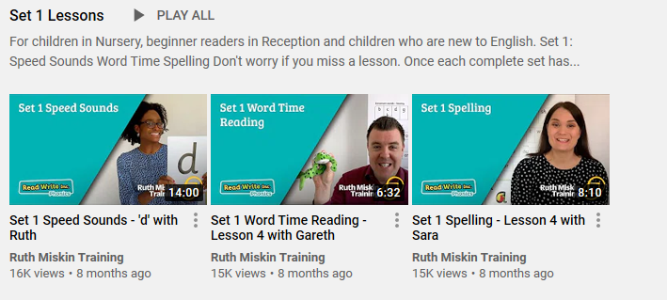
https://www.youtube.com/channel/UCo7fbLgY2oA_cFCIg9GdxtQ?mc_cid=71ef745098&mc_eid=c9705b8c67
Phonics information for remote learning.
At school, the children have daily phonics sessions to teach the letter sounds. In Term 1, base 3 children were taught all set 1 sounds. All children will be at different stages with which sounds they can remember but it will still be beneficial to recap sounds already taught.
The image above is an example of the videos which are available through Read Write Inc on their YouTube channel for you to access daily from home (See link below).
S sSubject: Phonics

Slide 2
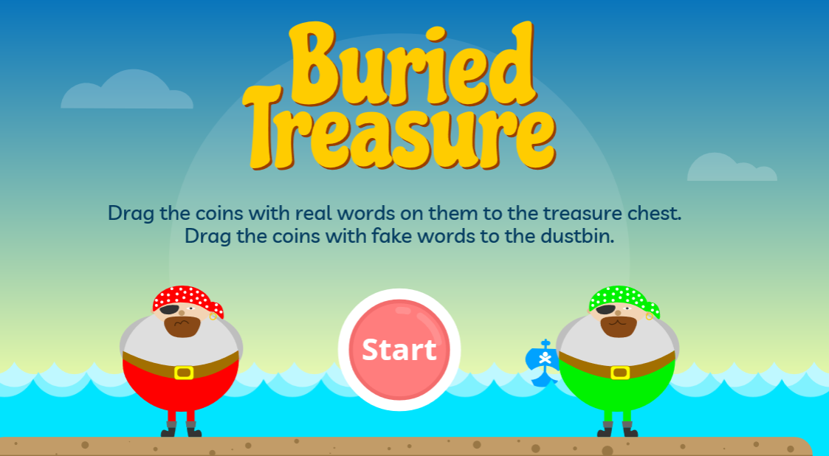
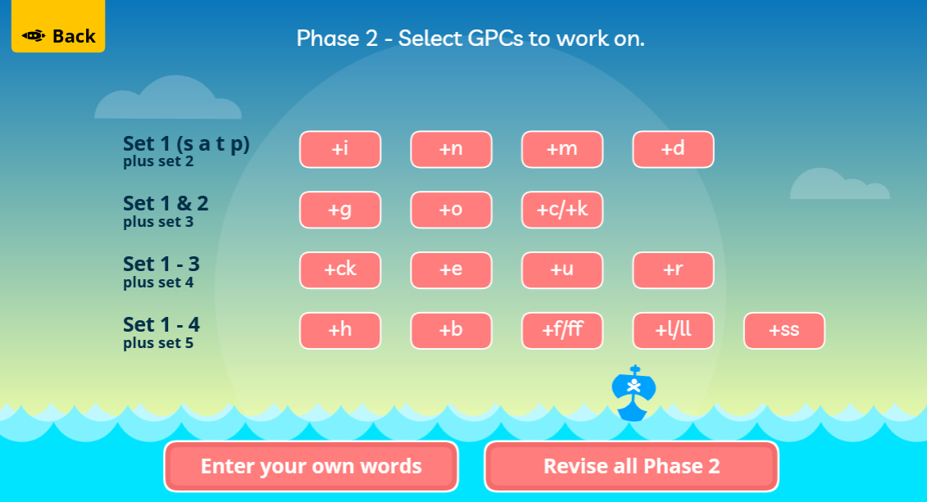
Phonics information for remote learning.
Here are some links to online phonics games you can play with your child at home.
Buried treasure
https://www.phonicsplay.co.uk/resources/phase/2/buried-treasure
After clicking start, choose phase 2 and revise all phase 2 sounds.

Slide 3
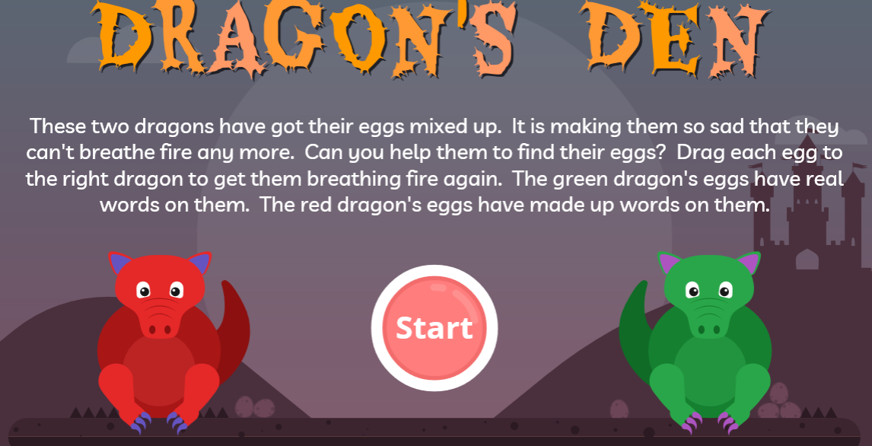
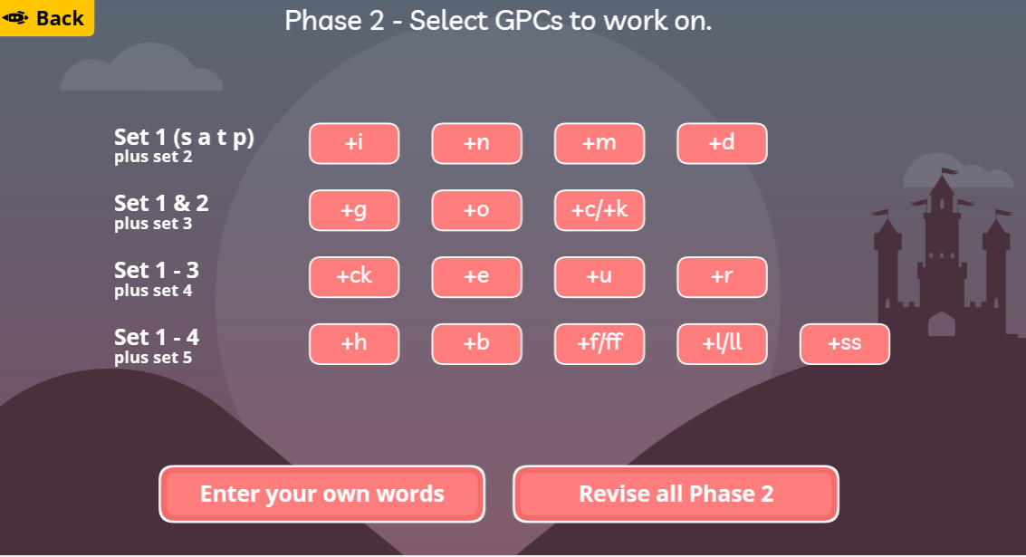
Phonics information for remote learning.
Here are some links to online phonics games you can play with your child at home.
Dragon's Den
https://www.phonicsplay.co.uk/resources/phase/2/dragons-den
After clicking start, choose phase 2 and revise all phase 2 sounds.

Slide 4
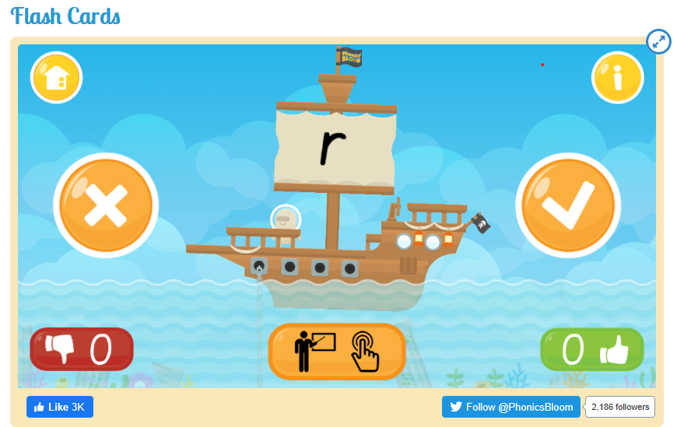
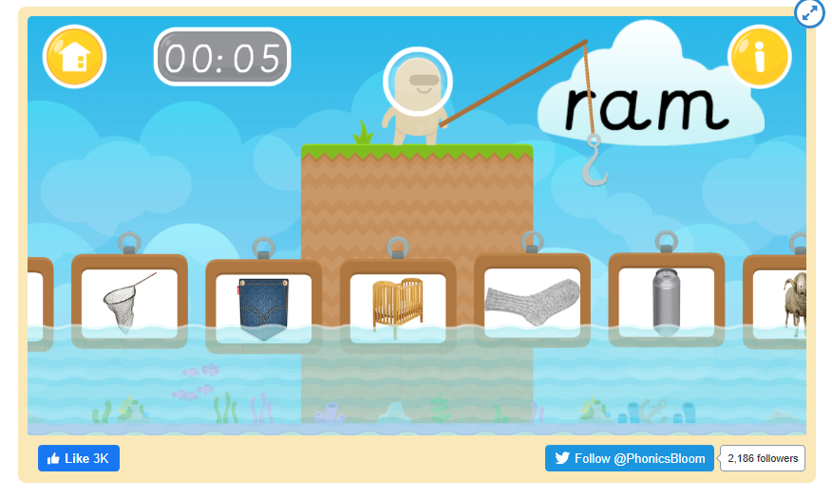
Phonics information for remote learning.
Here are some links to online phonics games you can play with your child at home.
Flash cards
https://www.phonicsbloom.com/uk/game/flash-cards?phase=2
Fishy Phonics
https://www.phonicsbloom.com/uk/game/fishy-phonics?phase=2

Slide 5
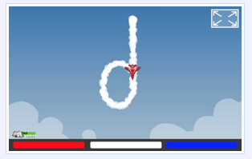
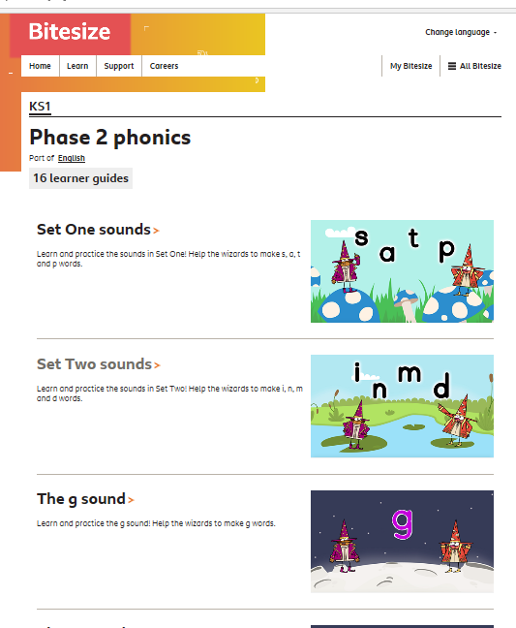
Phonics information for remote learning.
Here are some links to online phonics games you can play with your child at home.
Sky Writer
This is not a game but it demonstrates letter formation in a fun way.
http://www.ictgames.com/mobilePage/skyWriter/index.html
BBC Bitesize Phonics videos
This is a collection of fun videos to learn all about the set 1 and 2 sounds.
https://www.bbc.co.uk/bitesize/topics/zf2yf4j

Slide 7
Can you read ‘The Very Hungry Caterpillar’ at home with your grown up.
Or use the link below and watch the story together.
https://www.youtube.com/watch?list=PLhEIi09Phg4uhWOkCGZ9RyVL4yxni-gmE&v=75NQK-Sm1YY

Slide 9
LO. To give meaning to the marks made.
Subject: English

Slide 10
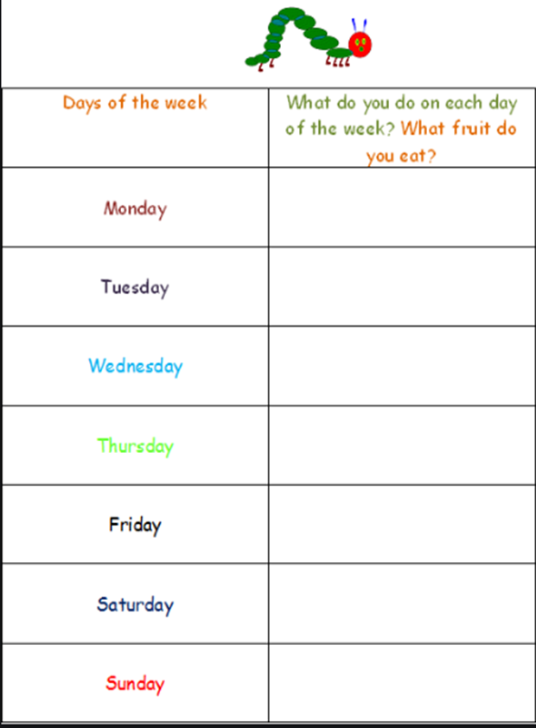
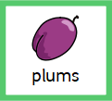
Can you draw or attempt to write what the caterpillar eats' each day.
Maybe you could draw your favourite fruit.

Slide 11
Date: Wednesday 27th January 2021
LO. To hold a pencil and retrace lines.
Subject: English

Slide 12
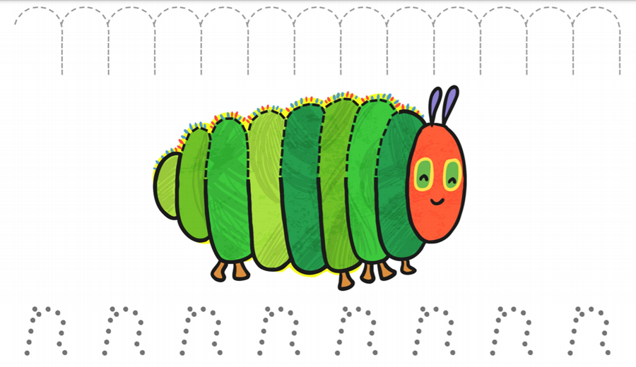
Can you help the caterpillar find the tasty treats to fill himself up ready to turn into a butterfly.
Maybe you could use your finger to follow the line or use coloured pencils to colour your picture.

Slide 14
Date: Thursday 28th January 2021
to
L.O. To attempt to make some identifiable letters.
Subject: English

Slide 15
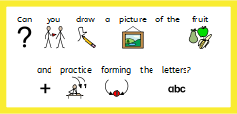

Slide 16
Date: Friday 29th January 2021
LO. To attempt to make a list of the ingredients used to make cakes.
Subject: English

Slide 17
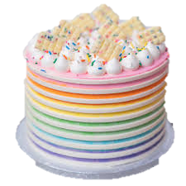
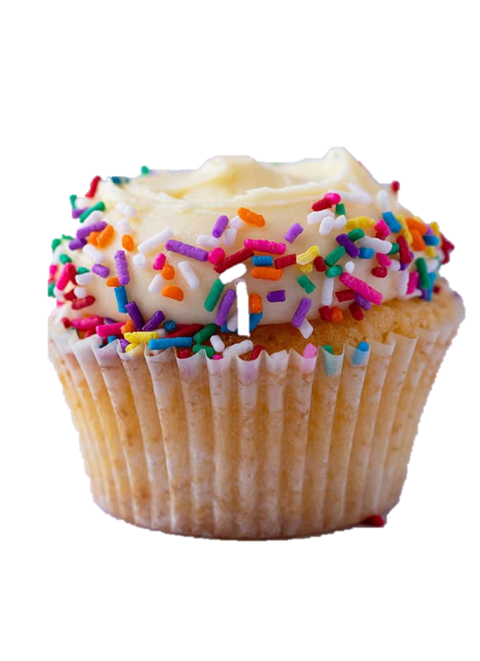
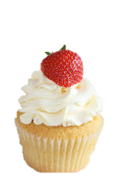
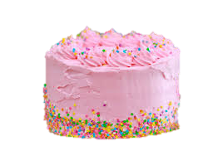
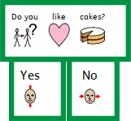

Slide 19
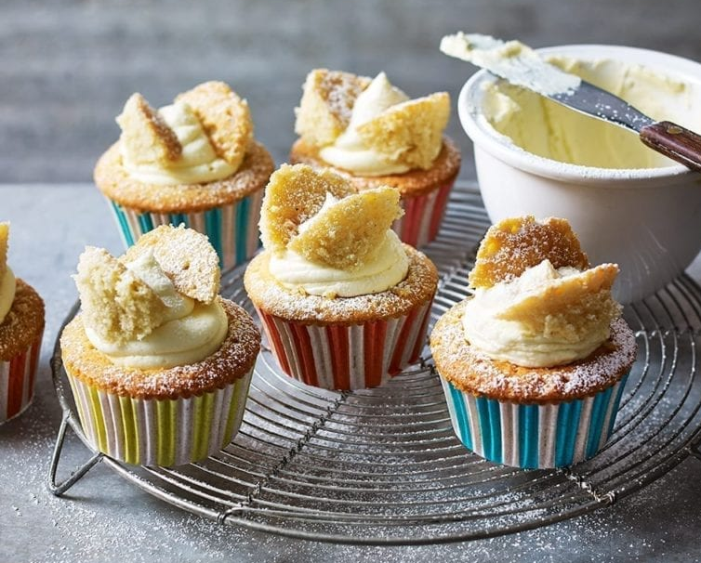
Method.
Heat the oven to 170°C.
Put all the cupcake ingredients in a large mixing bowl, mix together to form a thick smooth batter.
Line the muffin tin with the paper cases and evenly spoon in the batter.
Bake for 20-25 minutes until risen
Meanwhile, make the buttercream. Put the softened butter in a large mixing bowl and mix with a wooden spoon.
Add half the icing sugar and beat until combined, then add the remaining sugar with the vanilla. Whisk or beat until smooth and paler in colour.
Use a small sharp knife to cut a circle of cake out of the top of each cupcake leaving a small border no more than 1cm deep.
Cut the cake circle in half to make butterfly wings.
Fill a disposable piping bag with the icing and cut off the (no need for a nozzle).
Pipe the icing on top of the small holes in the cakes then place the cake wings on top.
Ingredients
For the cakes.
160g butter
160g caster sugar
3 medium eggs
160g self-raising flour
2 tsp vanilla bean extract
For the buttercream
160g butter
270g icing sugar
1 tsp vanilla extract
You will also need
12-hole muffin tin, 12 cupcake paper muffin cases disposable piping bag
Makes 12 Cakes

