Slide 1



Date: Monday 25th January
L.O. To be able to identify what carnivores, herbivores and omnivores eat.
s about the Pacific Ocean.
Subject: Science

Slide 2


Pre-recorded Teaching
Access the online teaching video below that will support you to complete the work in this lesson. This video will act as a support but all of the work can still be successfully understood & completed using paper-based versions of this pack. If you need further support to understand / complete work then please contact school via e-mail or telephone. To access the video, click on the link below or copy and paste it into your browser.
What types of food do living things eat? (thenational.academy)
Works best on Google Chrome

Slide 3

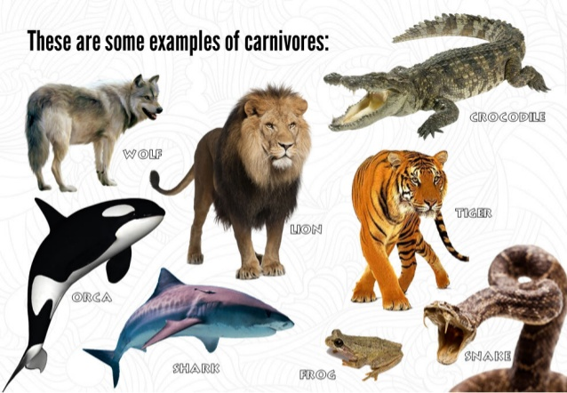
What are Carnivores?
Click on the links to watch and learn more about carnivores.
https://youtu.be/LFAopjonuAo
https://youtu.be/dOFbeQ95gSk

Slide 4





Task:

Slide 5

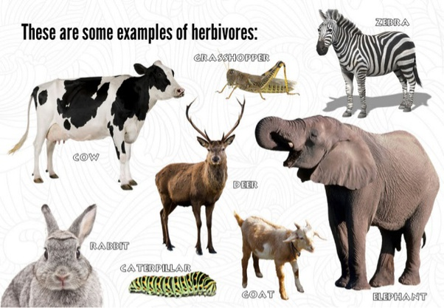
What are Herbivores?
Click on the link to watch and learn more about herbivores.
https://youtu.be/yhxFvMcm5Jg

Slide 6

Task:

Slide 7

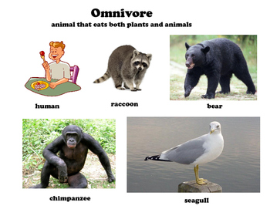
What are Omnivores?
Click on the link to watch and learn more about omnivores.
https://youtu.be/uM3CVFOlBuQ

Slide 8

Task:

Slide 9
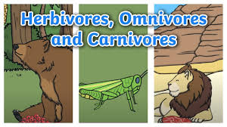
Carnivores, herbivores and omnivores.
Here are some more videos to watch about all three animal types; carnivores, herbivores and omnivores. Click on the links and watch the videos, you can even sing along.
https://youtu.be/bjnquo_BZ_Y
https://youtu.be/3yrikH2QEFA

Slide 10



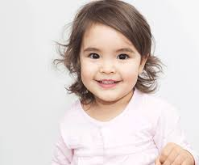
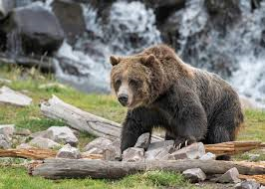
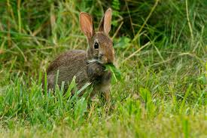
What animals eat…
Human
Bear
Rabbit

Slide 11
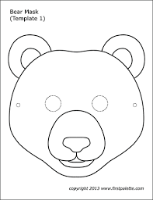
Task: Make an animal mask that is a carnivore, herbivore and omnivore.
Get your grown-up to help you cut out your bear mask. Use coloured pencils, crayons or paint to colour him in.

Slide 12

Get your grown-up to help you cut out your rabbit mask. Use coloured pencils, crayons or paint to colour him in.

Slide 13
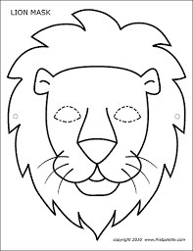
Get your grown-up to help you cut out your lion mask. Use coloured pencils, crayons or paint to colour him in.

Slide 14
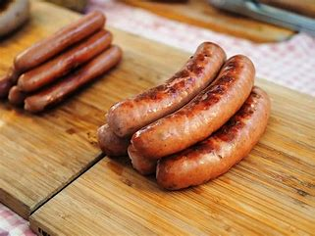
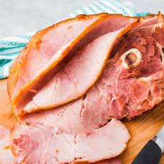
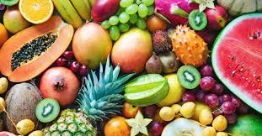
Let's use our bear mask to pretend to be a bear! Bears are omnivores, they eat meat and fruit – let's try some!

Slide 15
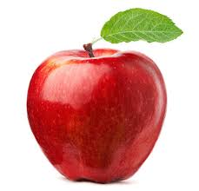
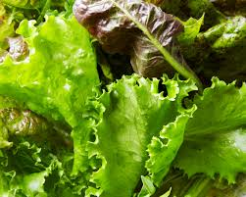
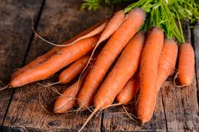
Let's use our rabbit mask to pretend to be a rabbit! Rabbits are herbivores and so they eat plants, fruit and vegetables – let's try some!

Slide 16
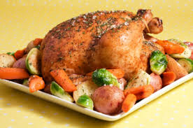
Let's use our lion mask to pretend to be a lion! Lions are carnivores, they only eat meat – let's try some!

Slide 17

Well done for all of your hard work this lesson!
Please send a photograph of you and your completed work to school or deliver it to the dropbox outside of school on a Friday.

Slide 18
Date: Tuesday 25th January
L.O. To be able to identify animals that have an endoskeleton and an exoskeleton.
s about the Pacific Ocean.
Subject: Science

Slide 19
Pre-recorded Teaching
Access the online teaching video below that will support you to complete the work in this lesson. This video will act as a support but all of the work can still be successfully understood & completed using paper-based versions of this pack. If you need further support to understand / complete work then please contact school via e-mail or telephone. To access the video, click on the link below or copy and paste it into your browser.
Works best on Google Chrome
https://classroom.thenational.academy/lessons/what-is-the-difference-between-an-invertebrate-and-a-vertebrate-71gker

Slide 20

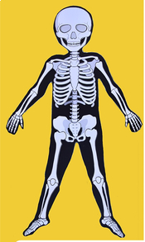
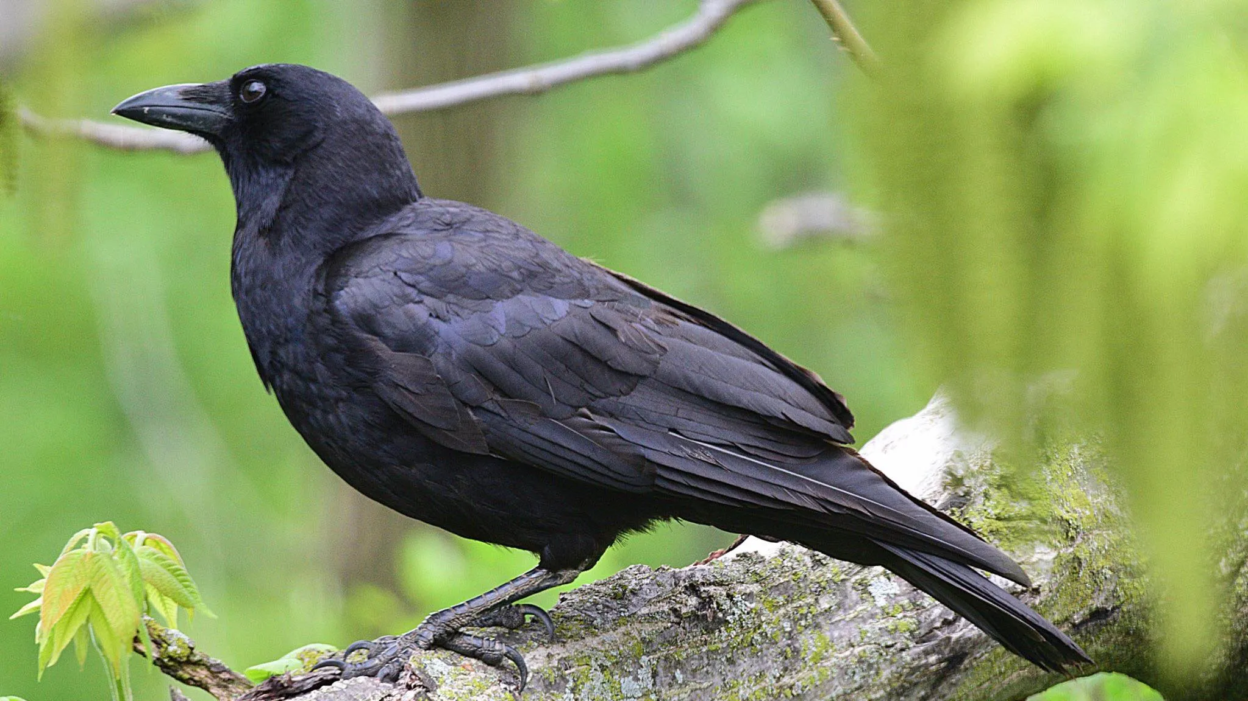
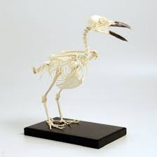
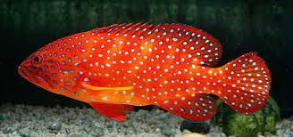
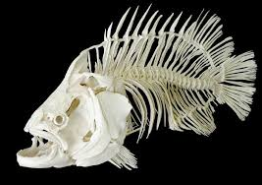
What is an endoskeleton?
A vertebrate is an animal with a backbone. Fish, amphibians, reptiles, birds, mammals and humans are all vertebrates, and their skeletons are on the inside of their bodies. Skeletons which are on the inside of a body are called endoskeletons. Humans are also vertebrates and have endoskeletons.

Slide 21
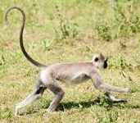
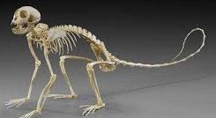
Task: To match the animals to their endodoskeletons.
Can you match the animals to their endoskeletons? Draw lines to match the animal to its endoskeleton on the next page. Here is an example below:

Slide 22
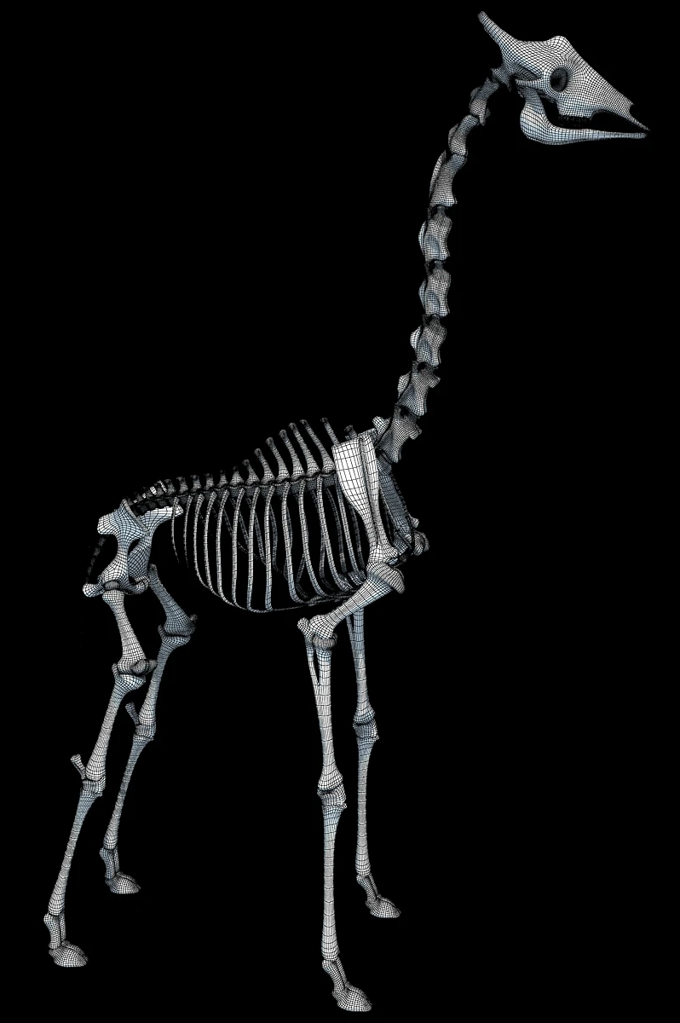
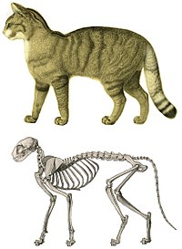
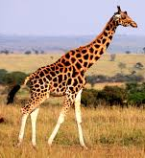
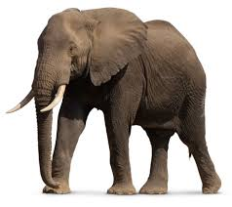
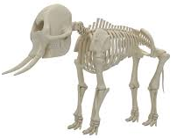
Draw lines to match the animal to its endoskeleton.

Slide 23
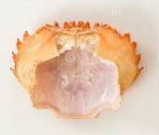
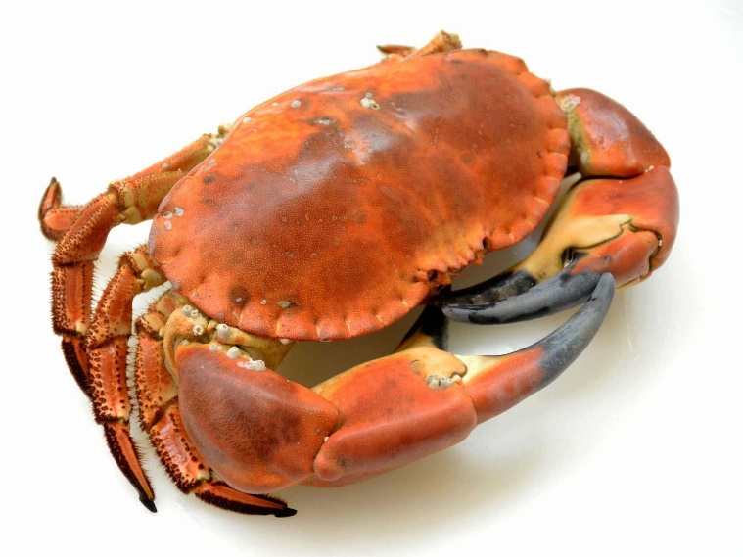
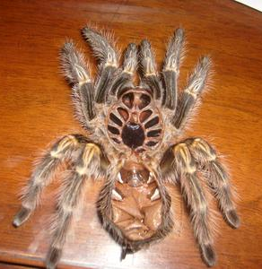
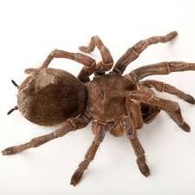
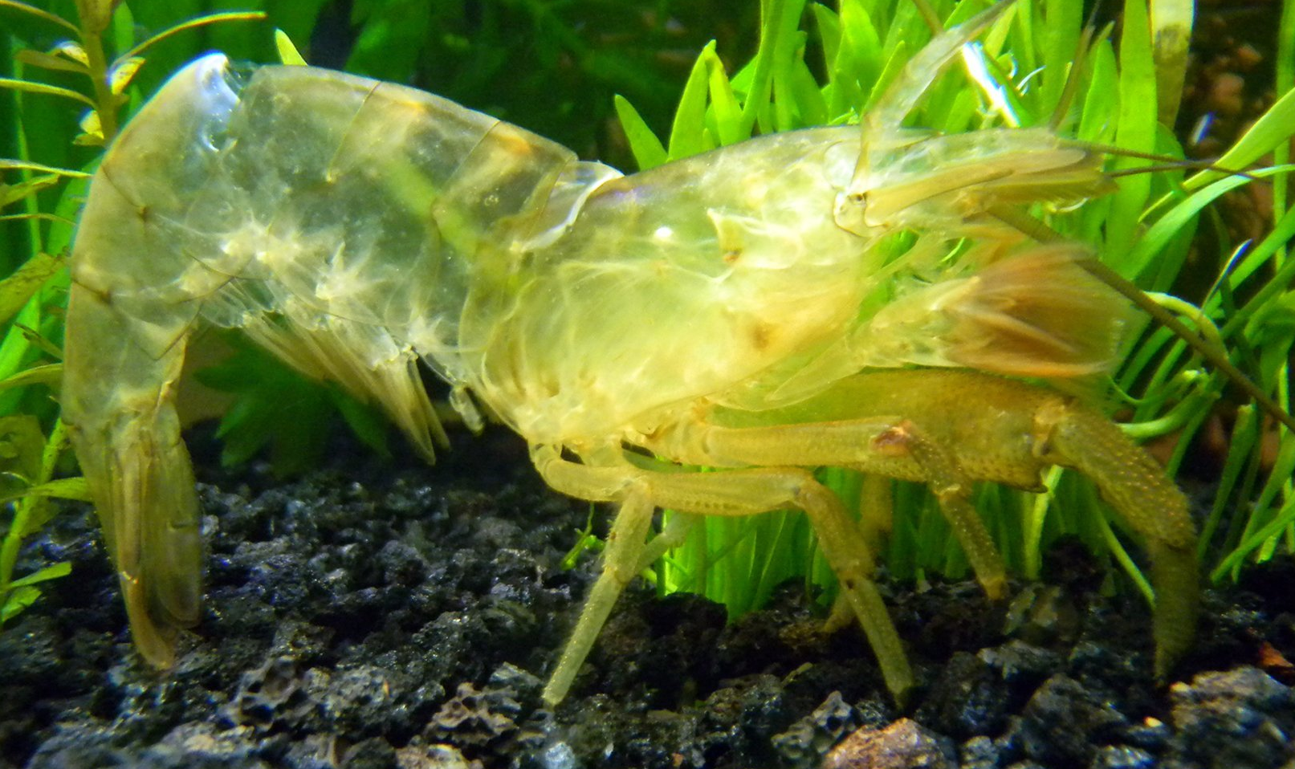
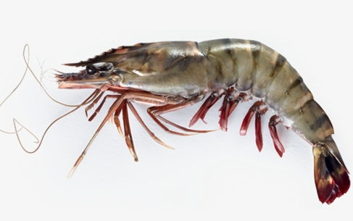
What is an exoskeleton?
An exoskeleton is a skeleton that is outside of an animal’s body. Here are some animals below that have exoskeletons.

Slide 24
Task: To match the animals to their exodoskeletons.
Can you match the animals to their exskeletons? Draw lines to match the animal to its skeleton on the next page. Here is an example below:

Slide 25
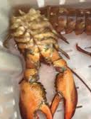

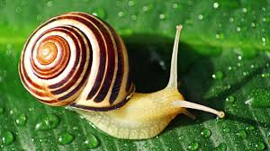
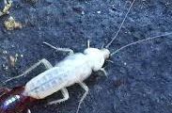
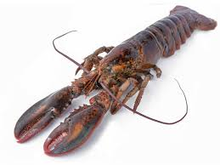
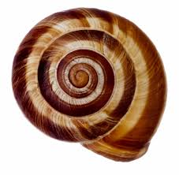
Draw lines to match the animal to its exoskeleton.

Slide 26

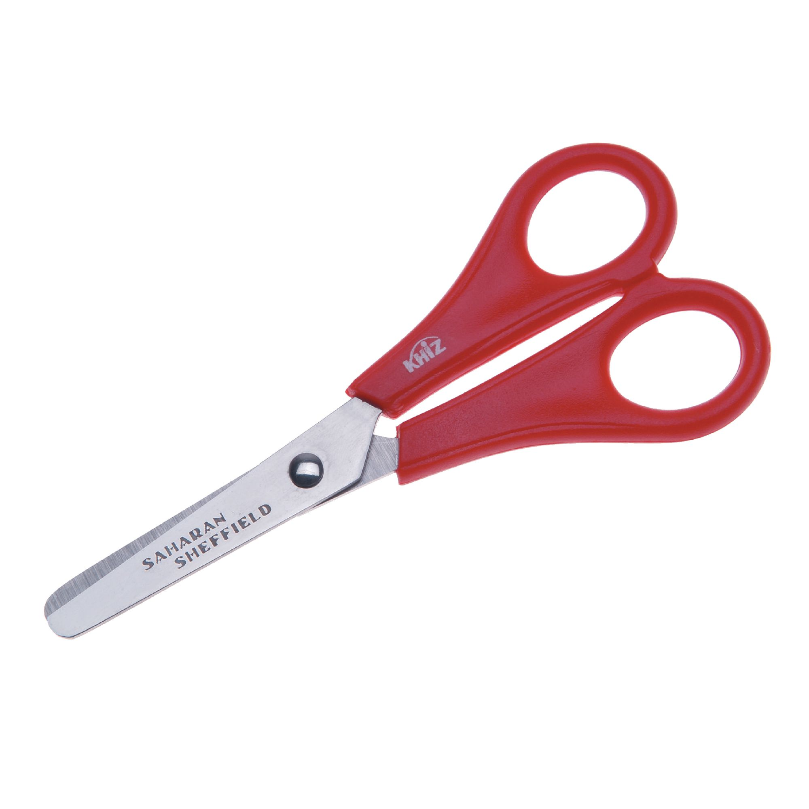
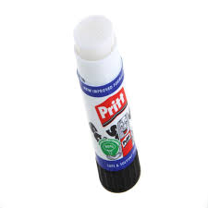
Task: To sort the animals into two skeletal groups.
Can you sort the animals into 2 categories endoskeletons and exoskeletons? Cut and stick the labels and pictures from the next page into the correct category. Or, you could draw your own pictures into the correct category and write the animals' name underneath its picture. The first two have been done for you.
You will need:
Paper
Scissors
glue stick.

Slide 27
Cut, sort and stick the animals onto the next page.

Slide 28
Exoskeleton
Endoskeleton

Slide 29
Well done for all of your hard work this lesson!
Please send a photograph of you and your completed work to school or deliver it to the dropbox outside of school on a Friday.

Slide 30
Date: Wednesday 27th January 2021
LO: To be able to name and locate parts of the skeleton.
Subject: Science

Slide 31
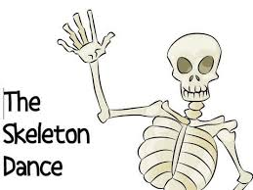
Skeletons are an important part of the body. Skeletons help to protect our organs (such as our hearts, brain and lungs). They also help the body to move around and keep our body together!
Task: Click the video to watch a skeleton song. Can you join in with the skeleton dance and move the correct parts of your body?
https://www.youtube.com/watch?v=Jpvuqj5nv6U

Slide 32
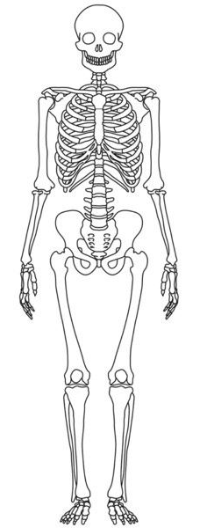
We have lots of different bones that make our skeleton:
cranium
clavical
ribs
spine
pelvis
femur

Slide 33
Task: Cut out the names of the bones and stick them into the correct place on the skeleton.
femur
clavical
spine
pelvis
cranium
ribs

Slide 34
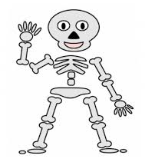
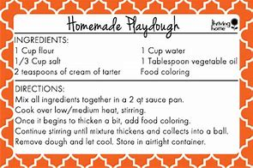
Task: Make some playdough using the recipe below. Can you make a skeleton using the playdough to make its bones?

Slide 35
Well done for all of your hard work this lesson!
Please send a photograph of you and your completed work to school or deliver it to the dropbox outside of school on a Friday.

Slide 36
Date: 333333333
Date: Thursday 28th January
January
L.O. To be able to identify joints and muscles. about the Pacific Ocean.
Subject: Science

Slide 37
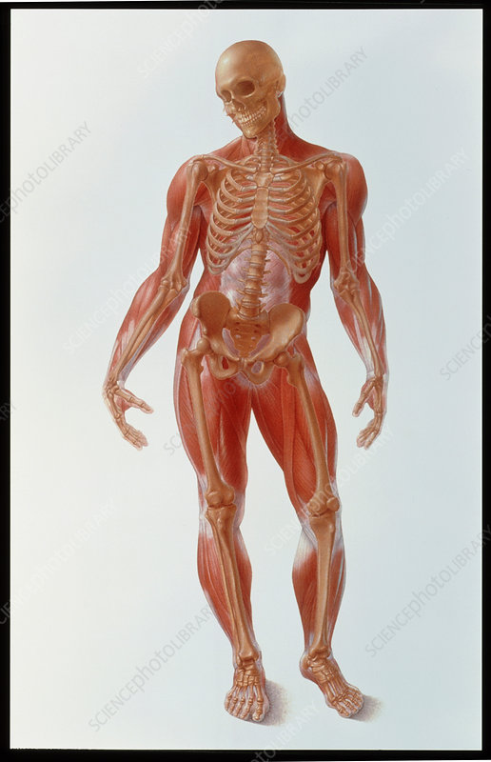
Our bones can move with the support of muscles and joints. Below is a skeleton with its muscles covering the bones and its joints.
hip
elbow
knee
ankle

Slide 38
Task: Can you label the muscle-covered skeleton’s joints? Cut and stick the labels into the correct place.
hip
hip
elbow
elbow
ankle
knee
knee
ankle

Slide 39
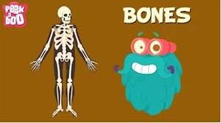
Task: Watch the video link below. After watching the video, can you point to and move all of the different joints in your body?
https://www.youtube.com/watch?v=ywDOiNEdJVc&list=PLZNAbh0qDoB4-cm2jN_50lbk06bjDE6LW

Slide 40
Well done for all of your hard work this lesson!
Please send a photograph of you and your completed work to school or deliver it to the dropbox outside of school on a Friday.

Slide 41
Date: Friday 29th January 2021.
L.O. To be able to piece together bones to make a human skeleton.
Subject: Science

Slide 42
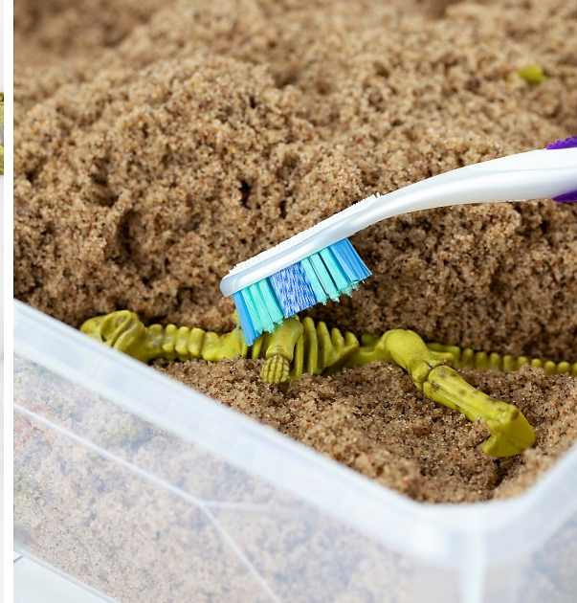
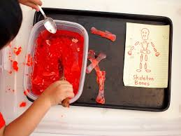
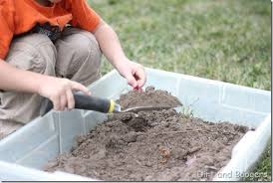
Task: Can you dig up the bones and put them together to make a human skeleton?
Adult: Cut out the bones and hide them in some sand. You could use wet soil or red jelly if your child prefers wet sensory play. You'll find the pieces needed on the next few pages.

Slide 43





Slide 44





Slide 45
Well done for all of your hard work this lesson!
Please send a photograph of you and your completed work to school or deliver it to the dropbox outside of school on a Friday.

