Slide 1


Subject: English
Base 1

Slide 2


Date: Monday 8th February
LO To be able to follow instructions to make a ham and cheese sandwich.
Subject: English

Slide 3

Pre-recorded Teaching
Access the online teaching video below that will support you to complete the work in this lesson. This video will act as a support but all of the work can still be successfully understood & completed using paper-based versions of this pack. If you need further support to understand / complete work then please contact school via e-mail or telephone.
Play Video
You can also copy and paste this link if you would prefer:
https://teachers.thenational.academy/lessons/to-identify-the-features-of-instructions-cru38r?from_query=instruction

Slide 4

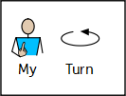





Slide 5

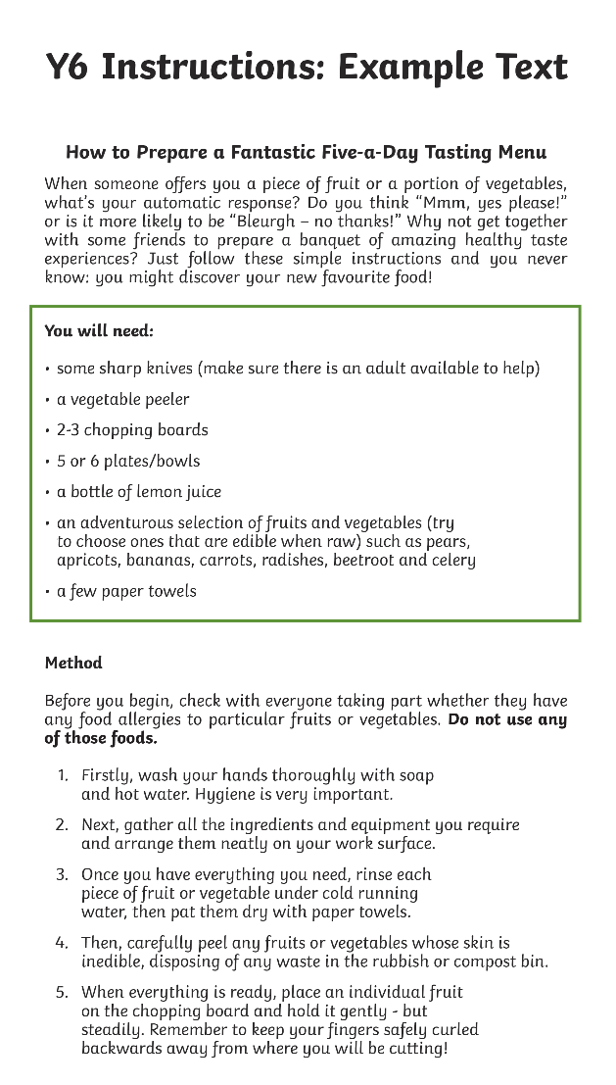

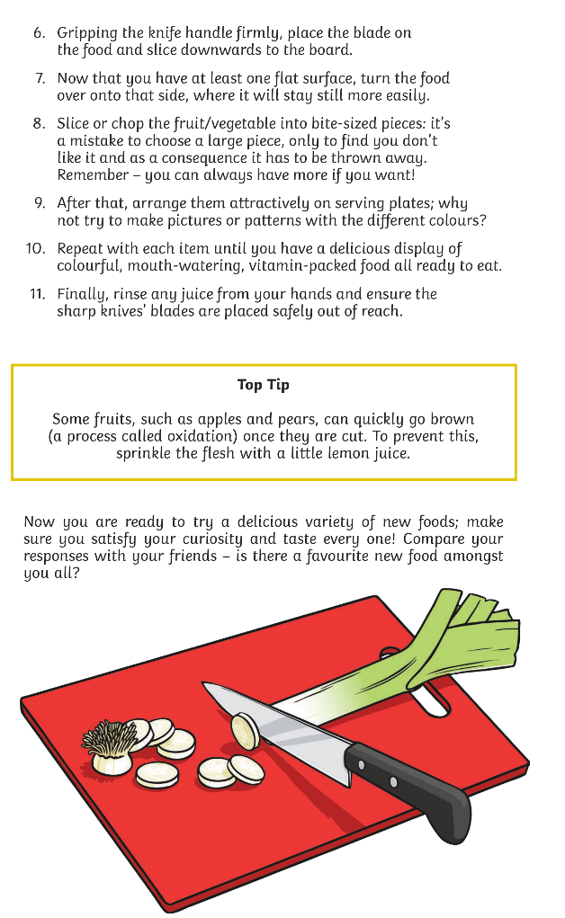









Slide 6
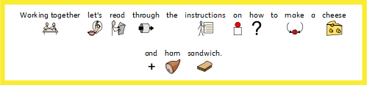
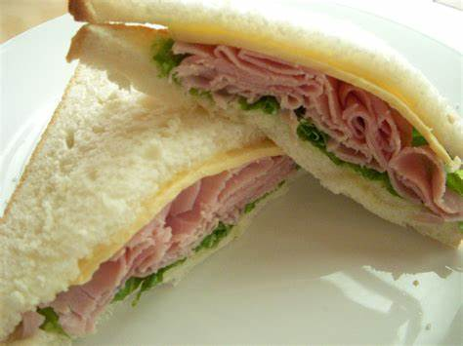



Slide 7

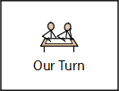

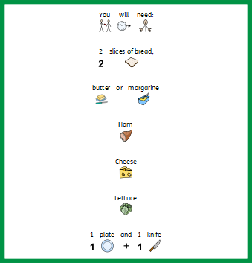
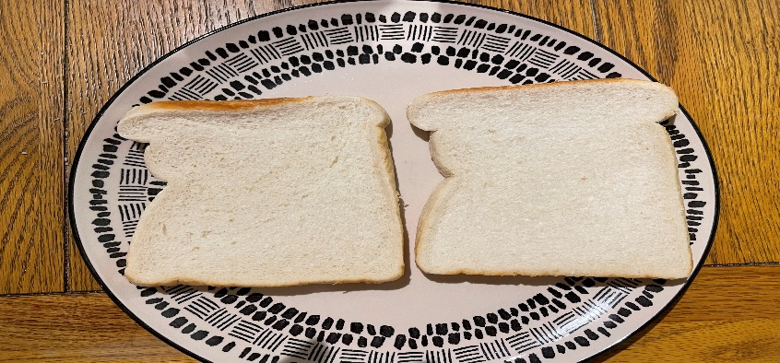

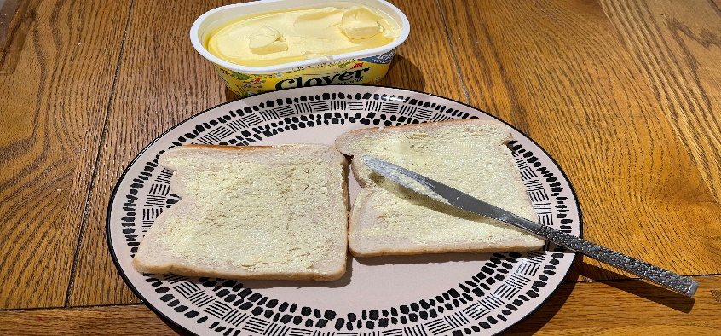

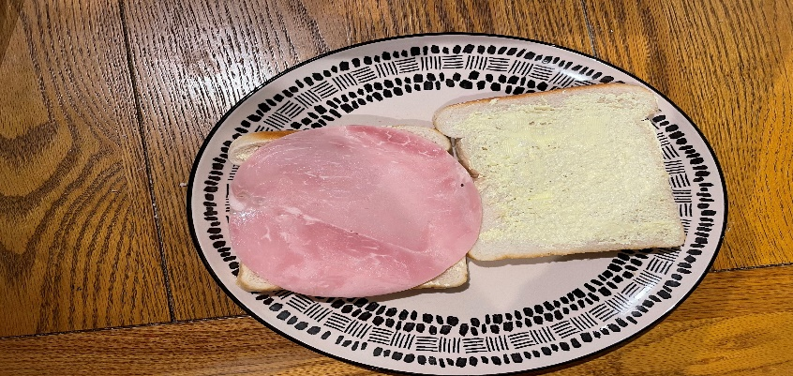
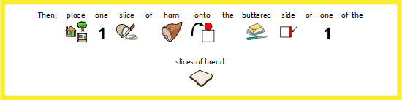
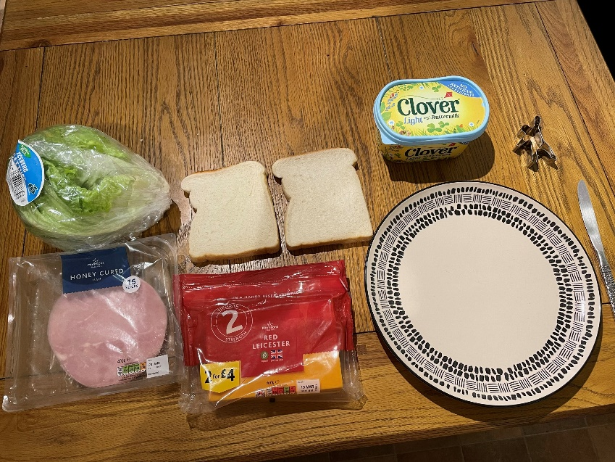
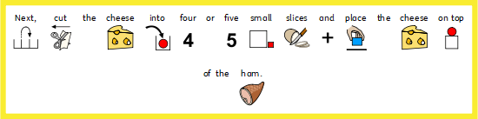
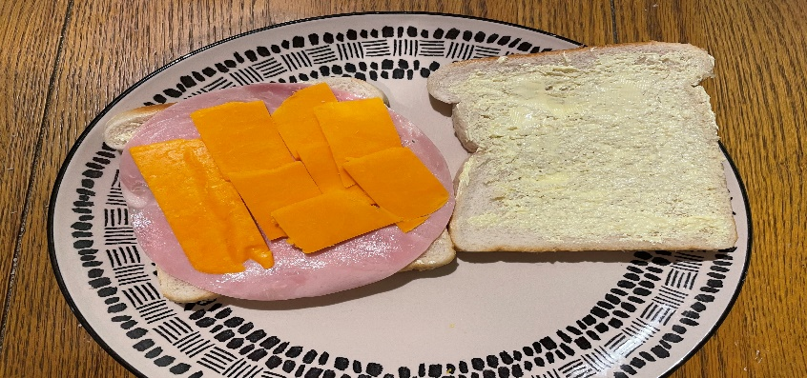

Slide 8
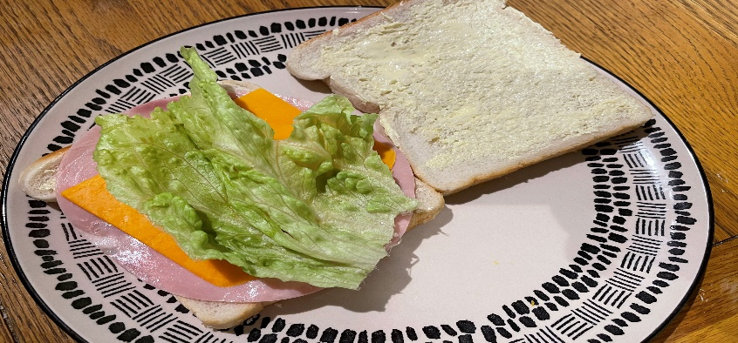
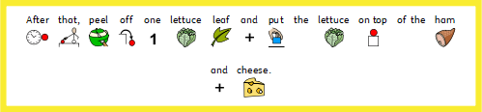
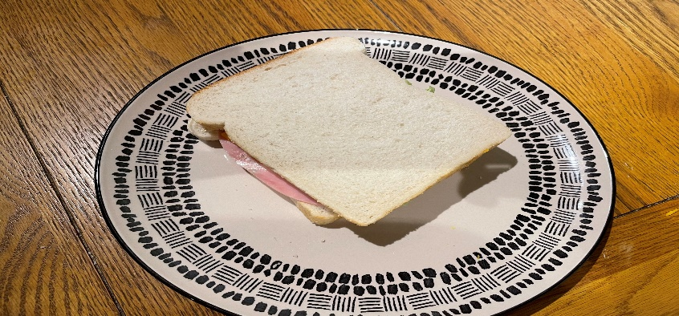
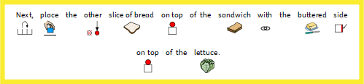

Slide 9




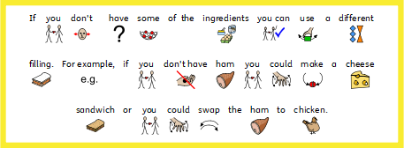

Slide 10


Slide 11
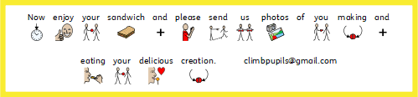

Slide 12
Date: Tuesday 9th February
LO To be able to use imperative verbs.
Subject: English

Slide 13
Pre-recorded Teaching
Access the online teaching video below that will support you to complete the work in this lesson. This video will act as a support but all of the work can still be successfully understood & completed using paper-based versions of this pack. If you need further support to understand / complete work then please contact school via e-mail or telephone.
Play Video
You can also copy and paste this link if you would prefer:
https://teachers.thenational.academy/lessons/to-use-imperative-verbs-6tj32d?from_query=imperative+verbs

Slide 14
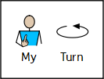


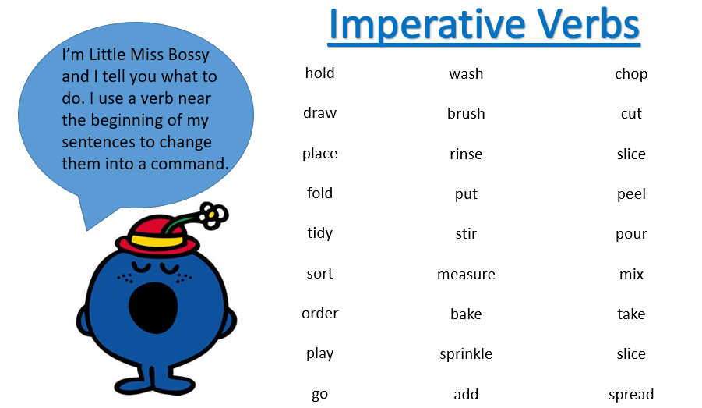

Slide 15














Slide 16












Slide 17







Choose from these verbs:

Slide 18

Spread
Choose from these verbs:
Put
Cut

Slide 19
Date: Wedensday 10th February
LO To be able to use time openers.
Subject: English

Slide 20
Pre-recorded Teaching
Access the online teaching video below that will support you to complete the work in this lesson. This video will act as a support but all of the work can still be successfully understood & completed using paper-based versions of this pack. If you need further support to understand / complete work then please contact school via e-mail or telephone.
Play Video
You can also copy and paste this link if you would prefer:
https://teachers.thenational.academy/lessons/to-use-imperative-verbs-6tj32d?from_query=imperative+verbs

Slide 21

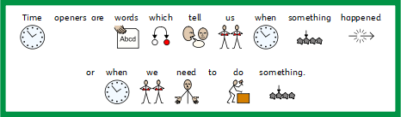
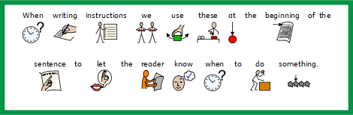

Slide 22











Slide 23








Slide 24
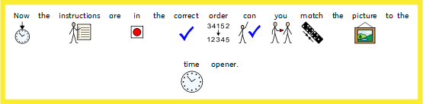
Finally
First
Then
Next
Secondly

Slide 25

Finally
First
Then
Next
Secondly

Slide 26
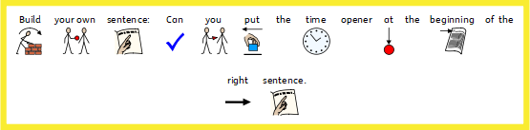





Slide 27





Slide 28

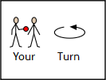






Time openers:
First
Next
Then
After that
Finally
Before
Imperative verbs:
Brush
Turn
Wash
Rinse
Scrub

Slide 29
Date: Thursday 11th February
LO To be able to write instruction on how to make a ham, cheese and lettuce sandwich.
Subject: English

Slide 30


Slide 32
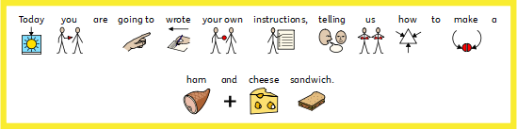
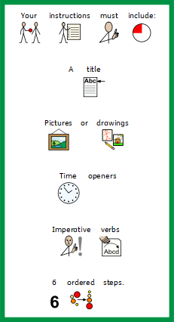


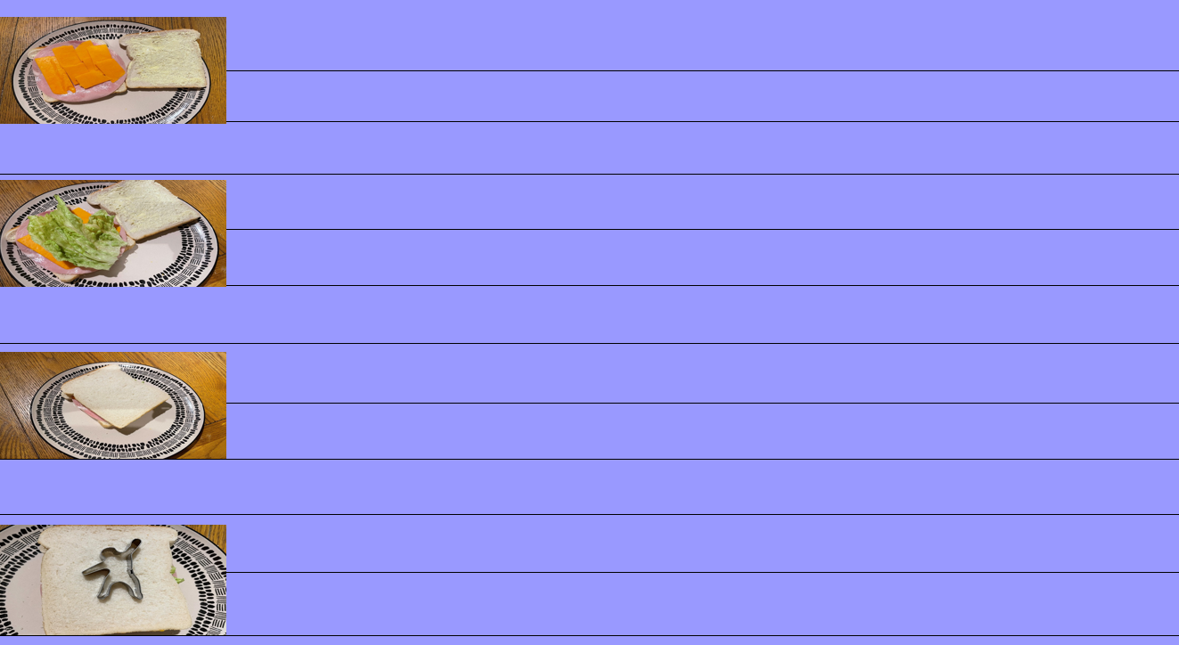
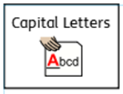


Don’t forget:

Slide 34
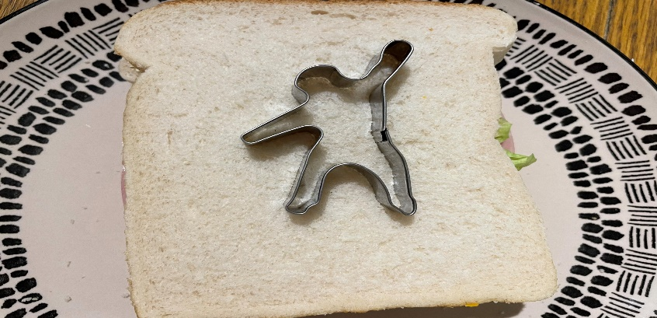

Slide 35
Date: Friday 5th February
LO To be able to read and spell ‘ee’ words.
Subject: English

Slide 36

Spellings
Remember:
Tree
Bee
See
Meet
Deep
Week
Feet
keep

Slide 37
Spellings
Do not forget:
Can you put each one in a sentence?
Tree:
Bee :
See:
Meet:

Slide 38
Spellings
Do not forget:
Can you put each one in a sentence?
Deep:
Week:
Feet:
Beep:

