Slide 1
Subject: English
Base camp 3

Slide 2
English Lessons
WC 01/02/21

Slide 3
Date: Monday 1st February 2021
LO. To notice details in the pictures of a story.
Subject: English

Slide 4
Can your child predict what might happen in the story by looking at the picture?
Can you read Goldilocks and the Three Bears story at home with your grown up if you have it, If not please use the link below and watch the story together.
Click on the picture above to share the story, alternatively you can copy and paste the link in to your browser.
https://www.youtube.com/watch?v=Rm3JsewQIWw

Slide 5
Point to a character from the story.

Slide 9
Date: Tuesday 2nd February 2021
LO. To give meaning to the marks made.
Subject: English

Slide 10
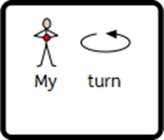
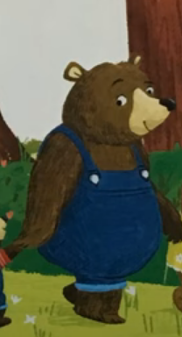
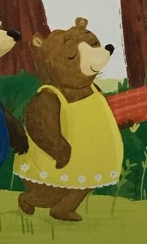
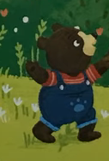
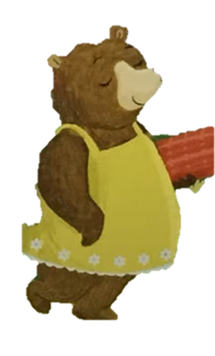

Slide 11
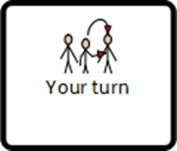
Can you finish the sentence?

Slide 12
Date: Wednesday 3rd February 2021
to
L.O. To be able to write a set of instructions for making porridge.
Subject: English

Slide 13
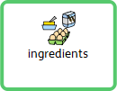
Any toppings you might like!
Makes 3 bowls of porridge.

Slide 14
Oh dear! Mrs Hann wants you to help write some instructions for making porridge, but she has mixed up the instructions! We need you to sort them back into the right order. What did you do first? Look at the sentences below. Can you spot the first one?
Get your adult to drag the sentences to the right order. If you are using a paper copy, get your adult to cut them out then you can sort them.
1.
4.
2.
5.
3.
6.

Slide 15
Great work everyone! That sorting was fantastic. Look, our instructions are now in the right order. Now it is your turn to have a go at writing some. We have chosen some of the simpler sentences for you to try for yourself.
Use the previous slide to copy the words and your adult will help you sound them out.
1.
4.
2.
5.
3.
6.

Slide 16
Date: Thursday 4th February 2021
to
L.O. To be able to complete a sentence.
Subject: English

Slide 17
Goldilocks made a lot of mess. Let's think about what she did. Your adult could help you to read these sentences.
Complete the next sentences by filling in the missing words or writing
them out on your paper.
Use the words to help

Slide 18
Date: Friday 4th February 2021
LO. To be able to describe goldilocks using labels.
Subject: English

Slide 19
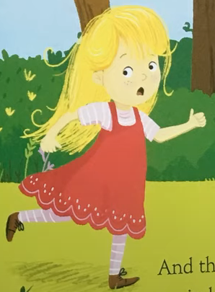
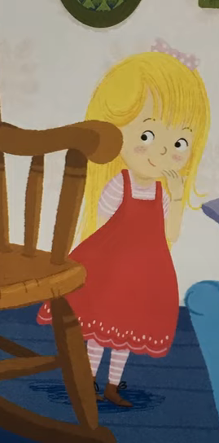
Today we are going to write a character description of Goldilocks. Have a look at her pictures and highlight what she looks like.
Think about what she is wearing, her hair ect. Don’t forget to use describing words (adjectives). Here are some examples below.
Adjectives Noun
Can you finish the sentence below using one of your ideas? Ask your adult to help you.

Slide 20
Date: Friday 4th February 2021
LO. To identify objects in a picture.
Subject: English

Slide 21
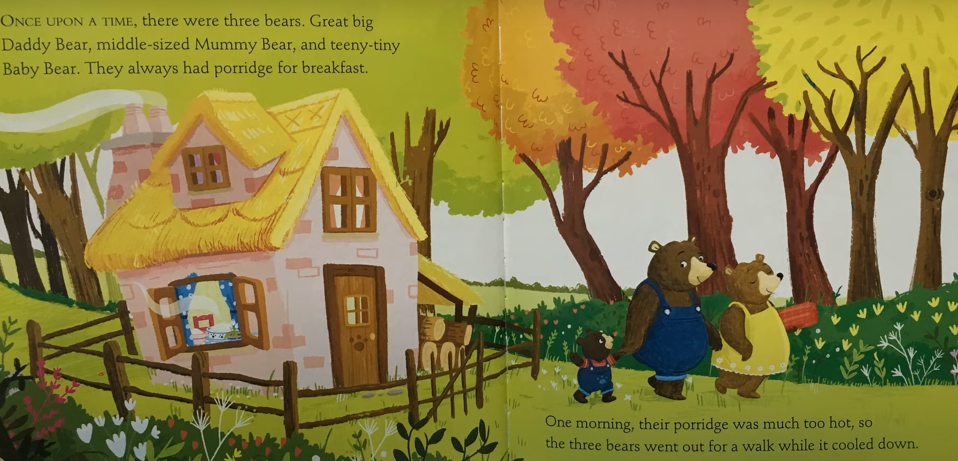
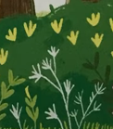
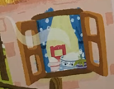
Can you find the objects in the picture? You could circle them or drag the picture and place it in the correct position.

