Slide 1
Remote Learning – Base 1
Week Beginning Monday 25th January 2021
Topic

Slide 2
Date: 25/01/2021
L.O. To be able to build a drawbridge with a moving mechanism.
Last week we explored different types of bridges and their functions. We also designed our own drawbridge and made a list of materials needed to build the bridge.
This week we are going to build our own drawbridge using the materials we collected and our bridge design.
Subject: Design Technology

Slide 3
Before you begin building your drawbridge use the check list below to make sure you are prepared.
Tick the box if you have got your...
design sheet from last week
your list of materials
materials to build with
tools to cut with
tools to stick with

Slide 4
At the beginning of the instructional video, they first measure and cut out the pieces needed for the drawbridge. Here are the measurements you need below. Use a ruler for the sides of the shapes to make sure they are nice and straight so that they fit together.

Slide 5
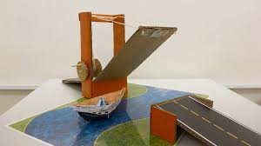
The video link below shows you how to build your drawbridge using the materials you have collected on your check list from last week. You may find it helpful to pause the video at each step of your build.
https://www.youtube.com/watch?v=Ah-l88JAAaE

Slide 6
Now that you have built your drawbridge, we are going to evaluate it. Complete the chart below by writing a short sentence about your answer.
If you can, take some photographs or a video of your drawbridge- we would love to see it!
Did you enjoy building the drawbridge?
Did you learn something new?
Which part of your drawbridge are you most pleased with?
If you made it again, would you change anything?

Slide 7
Date: 26/01/2021
L.O. To be able to explore the causes of floods in the UK.
Over the last few weeks we have been learning about natural disasters, such as earthquakes. We also explored the impact they have on people and the local environment when natural disasters cause things to be ruined and destroyed. This week we are going to be exploring floods and what causes flooding here in the UK.
Subject: Geography

Slide 8
What is a flood? Discuss some of the questions below with your adult.
What is a flood?
Have you ever seen or experienced a flood?
Why do you think a flood may happen here, in the UK?

Slide 9
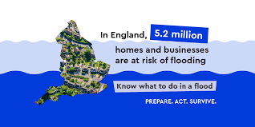
What is a flood?
A flood is water which covers land that is normally dry.
What causes Floods in the UK?
Floods are caused by extreme weather conditions.
When does flooding occur?
Flooding occurs when there is too much water for the ground to absorb.

Slide 10
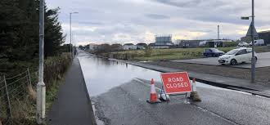
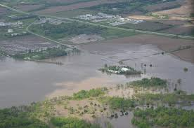
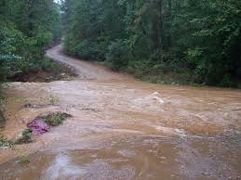
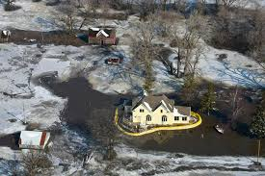
Floods may be caused by:
Too much rock or other hard surfaces which are unable to absorb water.
Flat land.
Steep slopes meaning that water runs down hills filling rivers too quickly.
Heavy snow fall that melts too quickly.

Slide 11
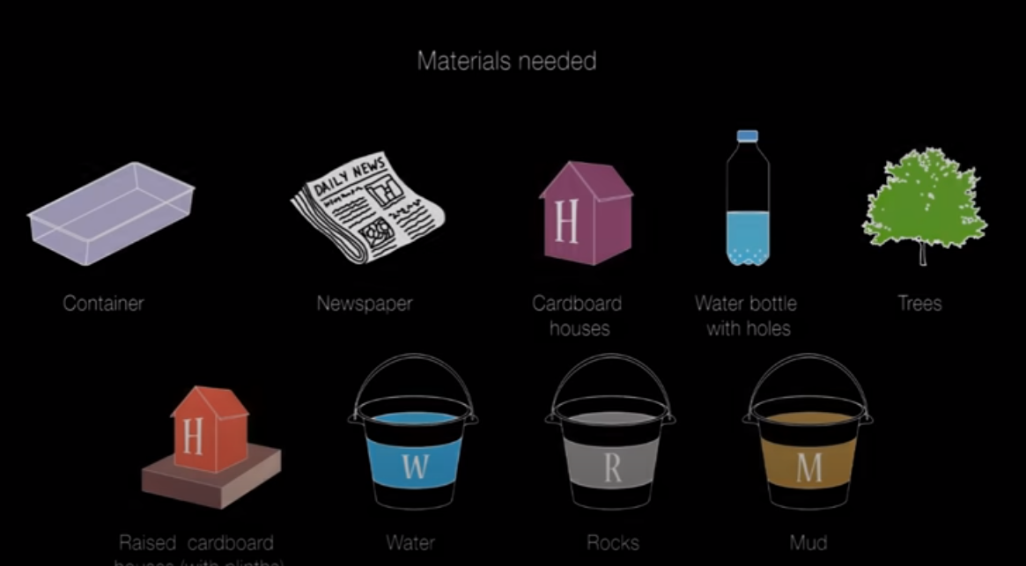
Flood Experiment
Watch the video below and see if you can replicate a flood. Discuss with your adult what you think may happen to the houses at the top, the bottom and the middle of the hill.
Do-it-yourself experiments-Flood - YouTube

Slide 12
Can you answer the questions below about your experiment with your adult?
What happened to the houses at the bottom of the hill?
What happened to the houses on the middle of the hill?
What happened to the houses at the top of the hill?
What could you do to prevent the flood?

Slide 13
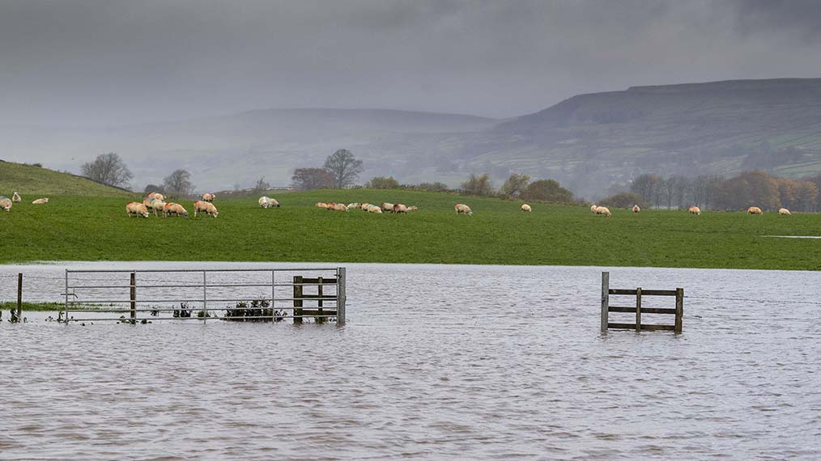
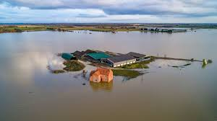
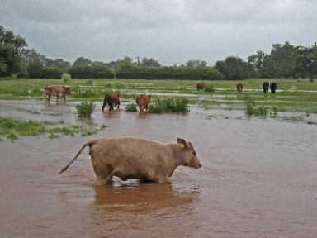
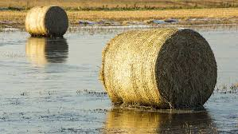
Last week, some parts of the UK declared a state of emergency after Storm Christoph brought lots of rain, strong winds, sleet and snow causing flooding.
Research Storm Christoph online to find out what damage was caused by the storm.
Use what you have found out to complete the spider chart on the next page- here is an example below.
Farmland
Things which may be ruined or destroyed by floods.

Slide 14
Now that you have researched and found some things which may be ruined and destroyed by floods in the UK, can you use your mind map to write down what impact the loss and damage of these things may have on people? Have a look at the example below to give you some ideas- you can discuss your answers with an adult.
Farmland
People may lose their animals, food, money, homes, machinery
Things which may be ruined or destroyed by floods.

Slide 15
What impact do floods have on people?

Slide 16
Below are some videos showing how to keep safe in the event of a flood. Watch the videos by clicking the links below. See if you can answer or discuss some of the questions on this page with your adult.
Is the grab bag you need for a flood the same as the one you packed for an earthquake?
What can you do to help stop a flood?
Why should you keep out of flood water?
• Keep out of floodwater - http://www.youtube.com/watch?v=_CIqf8elpeo
• Have a grab bag ready - http://www.youtube.com/watch?v=2wM0a3e17nE
• Flood proofing - https://www.youtube.com/watch?v=blTOzfGxvy8&feature=youtu.be

Slide 17
Extra task: Can you complete the wordsearch? It contains nine words from our flood topic.

Slide 18
Date: 27/01/21
L.O. To be able to recognise that light travels in straight lines and reflects off reflective surfaces.
Last lesson we are going to explore how light travels to our eyes in straight lines to enable us to see. This lesson we are going to explore how light reflects off reflective surfaces and back to our eyes.
Subject: Science

Slide 19
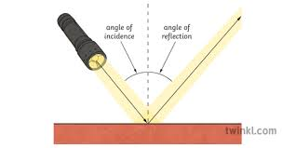
When light is reflected on a reflective surface, it bounces back from the reflective surface at an angle. Look at the diagram below, can you point to the angle of incidence and the angle of reflection?

Slide 20
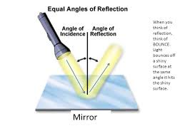
Find a mirror and a torch. Shine the torch onto the mirror and explore what happens to the light from the angle of reflection when you change the angle of incidence by tilting the mirror.
What happens, to the reflected light, when you tilt the mirror towards the torch?
What happens, to the reflected light, when you tilt the mirror away from the torch?

Slide 21
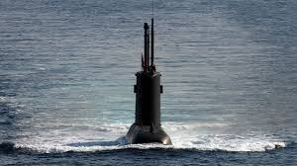
We have explored how light can be reflected by changing the angle of a reflective surface. Next, we are going to explore how we can use more than one mirror to reflect light and images back to ours eyes. Below is a picture of a periscope. Periscopes are used to see above a surface. Submarines use periscopes to look above the sea when they are underneath the surface.

Slide 22
Use a ruler and a pencil to show the direction the light reflects from the top of the periscope to the bottom. The answer is on the next page; check to see if you are correct.

Slide 23
Check your answer, did you get the lines of reflection correct?

Slide 24
Now that we have explored how a periscope works, we are going to have a go at building our own. Follow the steps on the website (click on the link below or copy and paste it into your web browser) after collecting the resources you need. www.sciencetoymaker.org/the-periscope/how-to-make-a-periscope-with-cd-or-dvd/
Resources you will need:
Pencil.
Ruler.
Cardboard.
Paper periscope template (a copy if this is on the next page).
Glue.
Cellotape.
2 small mirrors or a disk to make 2 mirrors with.
If you do not have two small mirrors, you can use 1 old disk and cut it like the photo below to make 2 small mirrors.

Slide 26
Can you answer the questions below about your Periscope with your adult?
Does your periscope work?
What can you see using your periscope?
What would you do to make your periscope better?
Did you enjoy making your periscope?
What could you use the periscope for?

Slide 27
Last week we explored the impact that litter has on the wildlife living in our seas and rivers; a lot of the litter is made from plastics. This week are going to debate the advantages and disadvantages of using plastics.
Date: 28/01/21
L.O. To be able to express your own opinions about your responsibility towards the environment.
Subject: PSHE

Slide 30
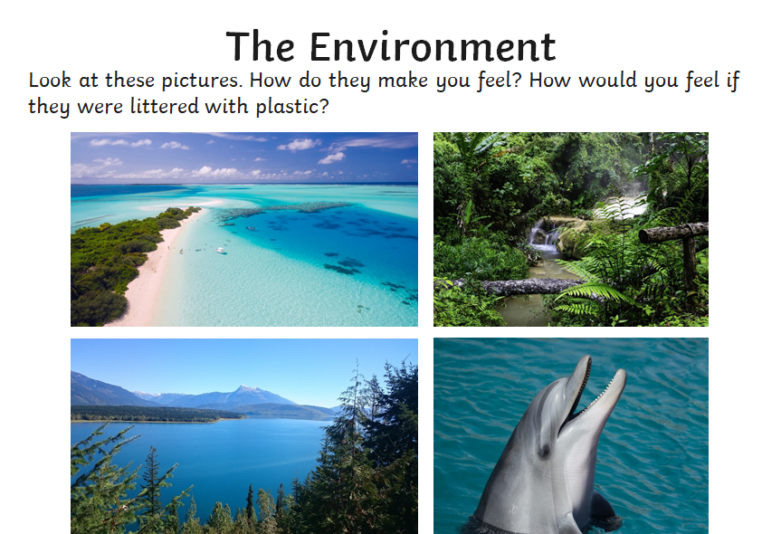

Slide 31
Read the statements from three people on the next three pages. Discuss with your adult the advantages and disadvantages of their arguments.

Slide 32
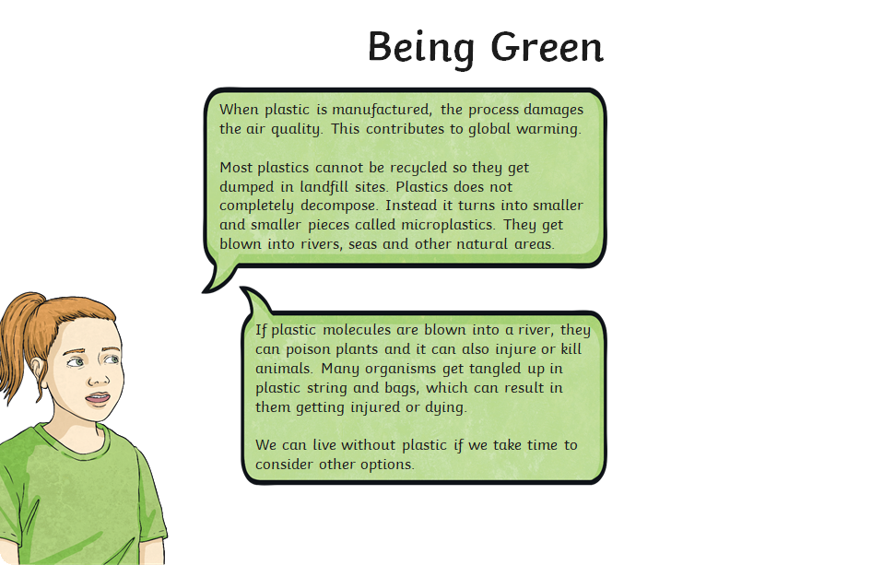

Slide 36
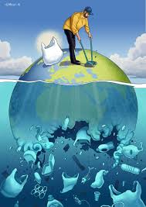

Slide 37
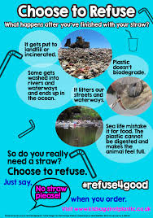
Have a look at the examples of posters on the next to slides. They are all examples of posters that try to persuade people to use less plastic to protect our environment. Notice how they all include pictures or photos and a big bold title to capture the reader's attention.

Slide 38
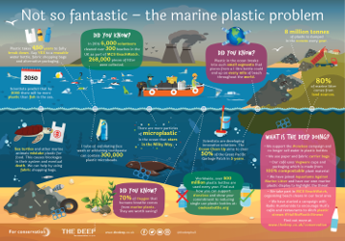

Slide 39
On your poster make sure you include:
A big, bold message.
Eye-catching photos or pictures to get your message across to your reader quickly.
An eye-catching background
Perhaps you could include an alternative to using plastics, or encourage people to recycle.

Slide 40
Date: 29/01/2021
L.O. To be able to choose and write a recipe for a main course meal.
Subject: Cookery

Slide 41
In cookery this term you have been challenged to create a delicious three course meal!
Click on the video links below. They may give you some ideas for a main course if you are not sure what you would like to cook. The main course of your meal should be a full plate of food, you eat this after your starter. After you have watched the videos, decide on a main course you would like to make with your adult. Research the ingredients you will need and write them on the next page- we look forward to seeing your ideas!
Chicken dishes: https://www.youtube.com/watch?v=jPOxWOE-3Xk
Pasta dishes:
https://www.youtube.com/watch?v=504JUAmAw5k
Burgers:
https://www.youtube.com/watch?v=oqeW9YMHweo
Pizza:
https://www.youtube.com/watch?v=9TIBIuhgE-Y

Slide 42
Discuss these questions with your adult before writing you list.
Are the ingredients going to be easy to get at the shop?
What is your main course going to be?
Do you need any non-food items on your shopping list too?

Slide 43
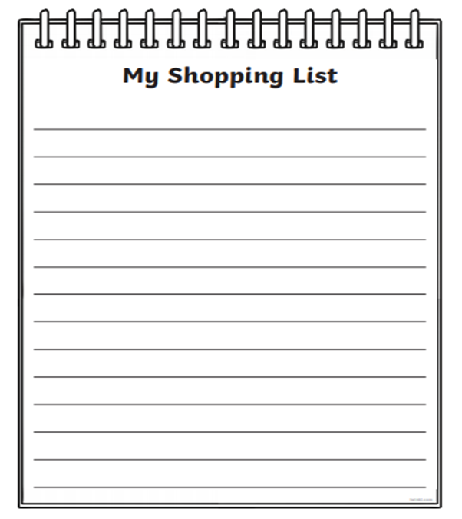

Slide 44
Ingredient | Cost
 | £
 | £
 | £
 | £
 | £
 | £
 | £
 | £
 | £
 | £
 | £

