Slide 1
Date: 28.06.21
LO: To be able to sequence events in chronological order.
Subject: Maths

Slide 2
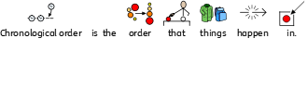
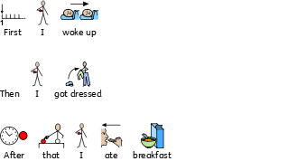
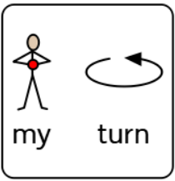

Slide 3
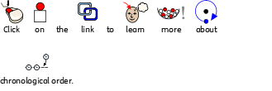
https://www.youtube.com/watch?v=kHWYClfj2pw

Slide 4
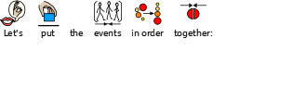

Slide 8
Date: 29.06.21
LO: To be able to recognise the numbers on a clock.
Subject: Maths

Slide 9
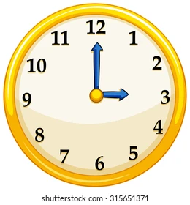

Slide 10
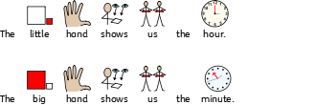

Slide 11
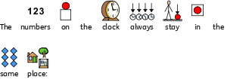

Slide 12
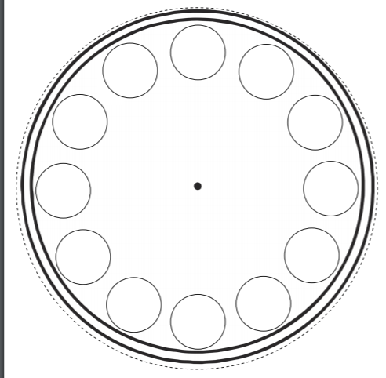
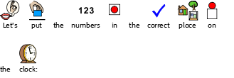

Slide 13
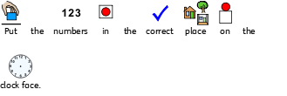

Slide 14
Date: 30.06.21
LO: To be able to tell the time to the hour.
Subject: Maths

Slide 18
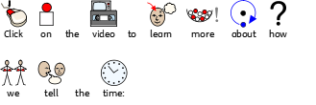
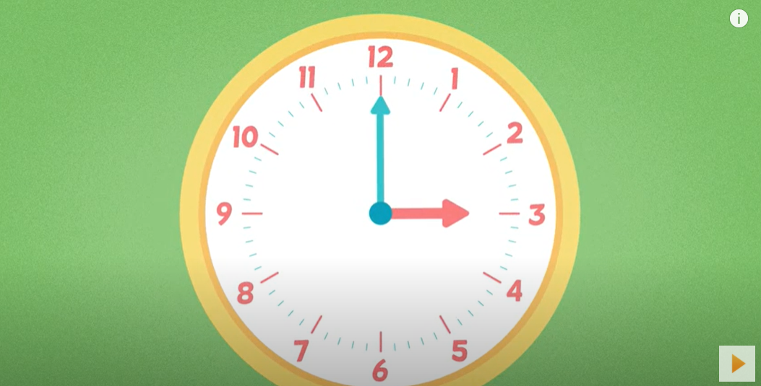
https://www.youtube.com/watch?v=ja_j2yGHIl8

Slide 19
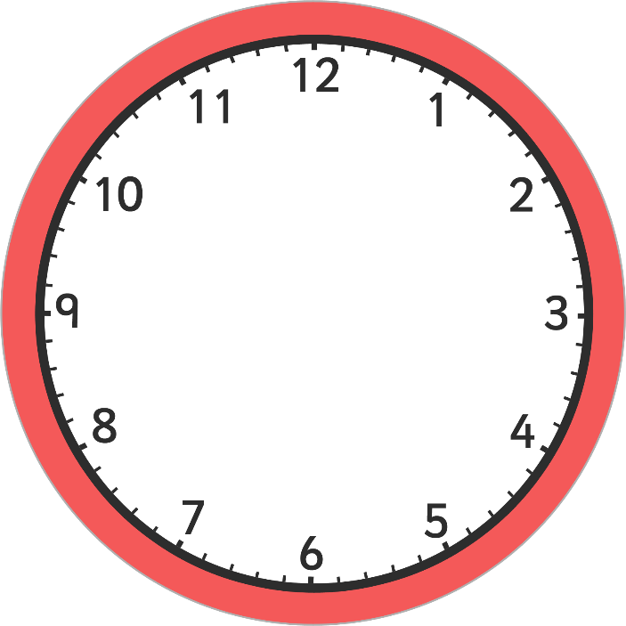

Slide 26
Date: 04.07.21
LO: To be able to tell the time to the hour.
Subject: Maths

Slide 30
https://www.youtube.com/watch?v=ja_j2yGHIl8

Slide 31
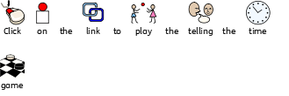
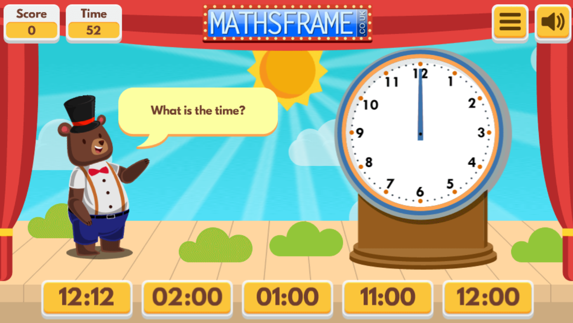
https://mathsframe.co.uk/en/resources/resource/116/telling_the_time#

Slide 32
Date: 05.07.21
LO: To be able to tell the time to half past the hour.
Subject: Maths

Slide 36
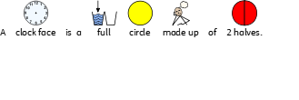
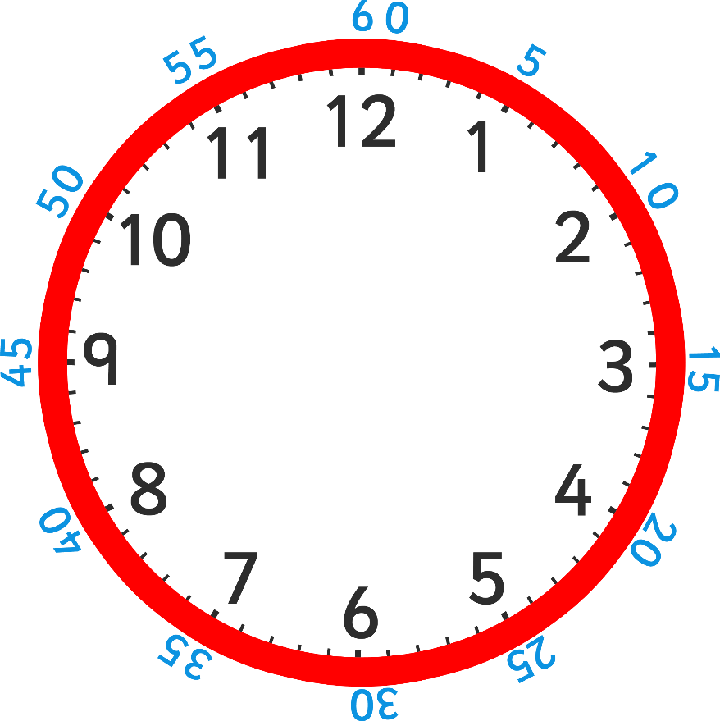
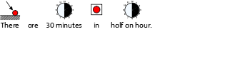

Slide 37
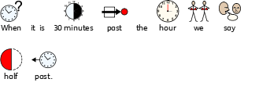
o’clock
half past

Slide 38
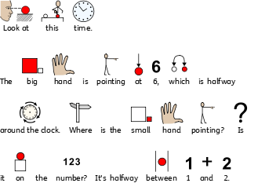
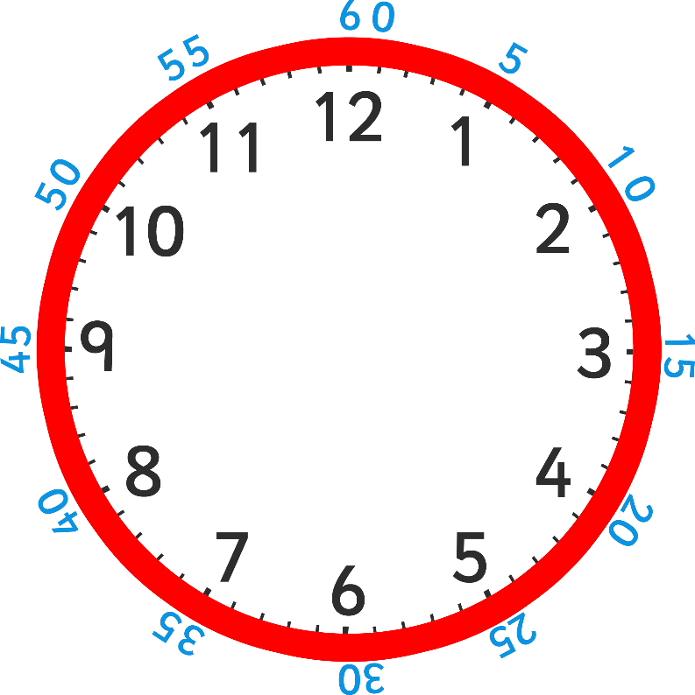
half past

Slide 39
