Slide 1
Date: Monday 28th June
LO: To be able to identify the ‘h’ sound
Subject: English

Slide 2
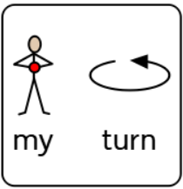
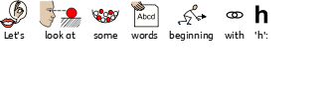
The ‘h’ sound
Hh
This is the letter ‘h’.

Slide 3
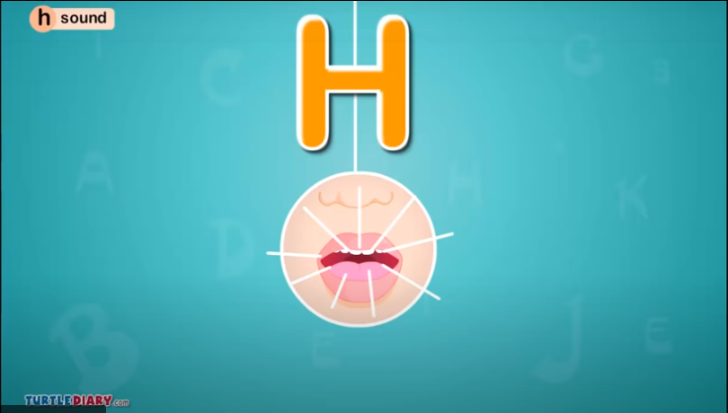
https://youtu.be/_wem6l2yhDU

Slide 4
Click on the pencil to see how we draw a ‘h’.
h
Can you follow along with your finger?
Can you draw a h on some paper?

Slide 5
h
n

Slide 6
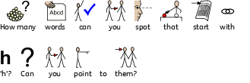

Slide 7
Date: Tuesday 29th June
LO: To be able to build sentences about the beach.
Subject: English

Slide 8
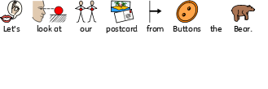
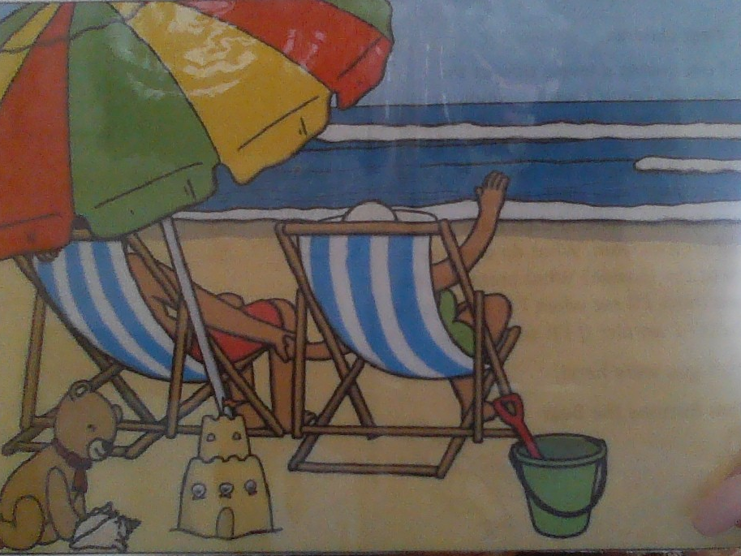

Slide 9
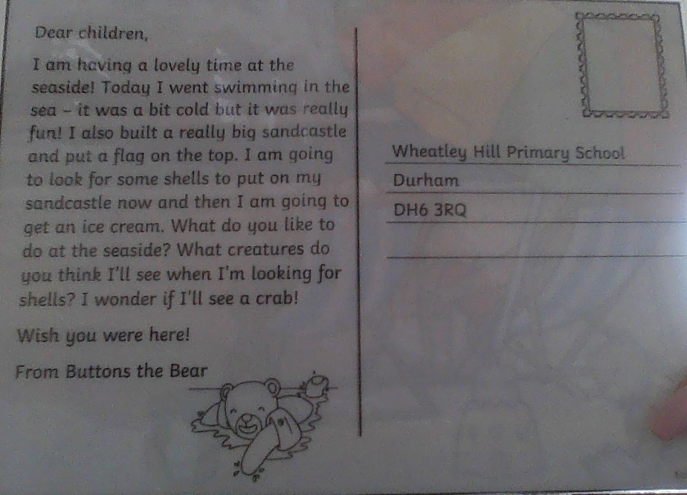

Slide 10
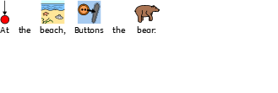
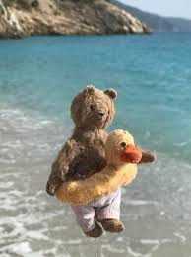

Slide 11
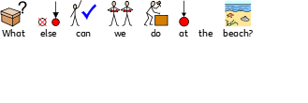
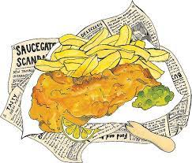

Slide 13
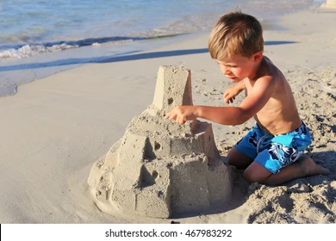

Slide 14
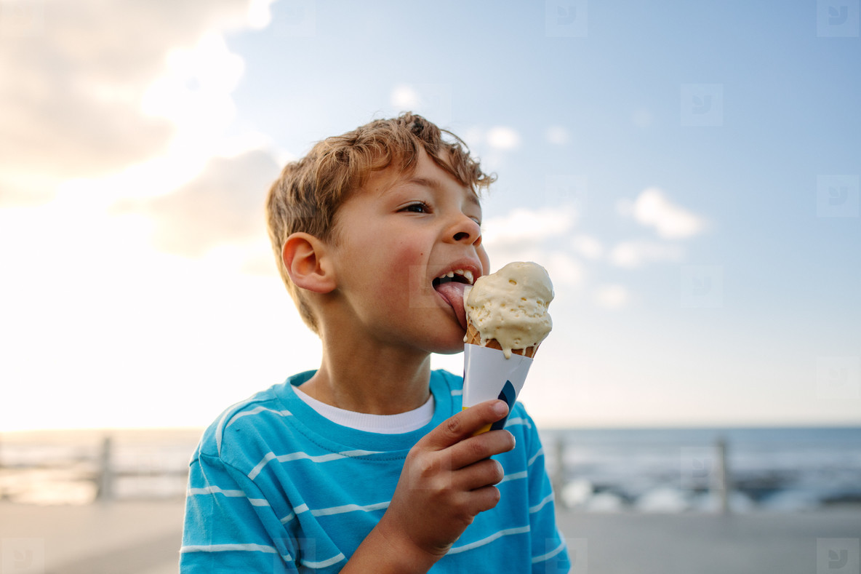

Slide 16
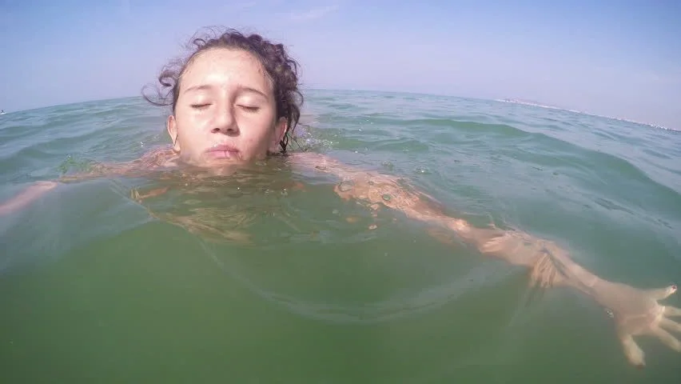

Slide 17
Date: Wednesday 30th June
LO: To be able to write a recount.
Subject: English

Slide 20
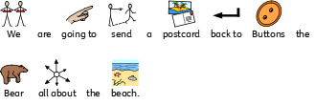
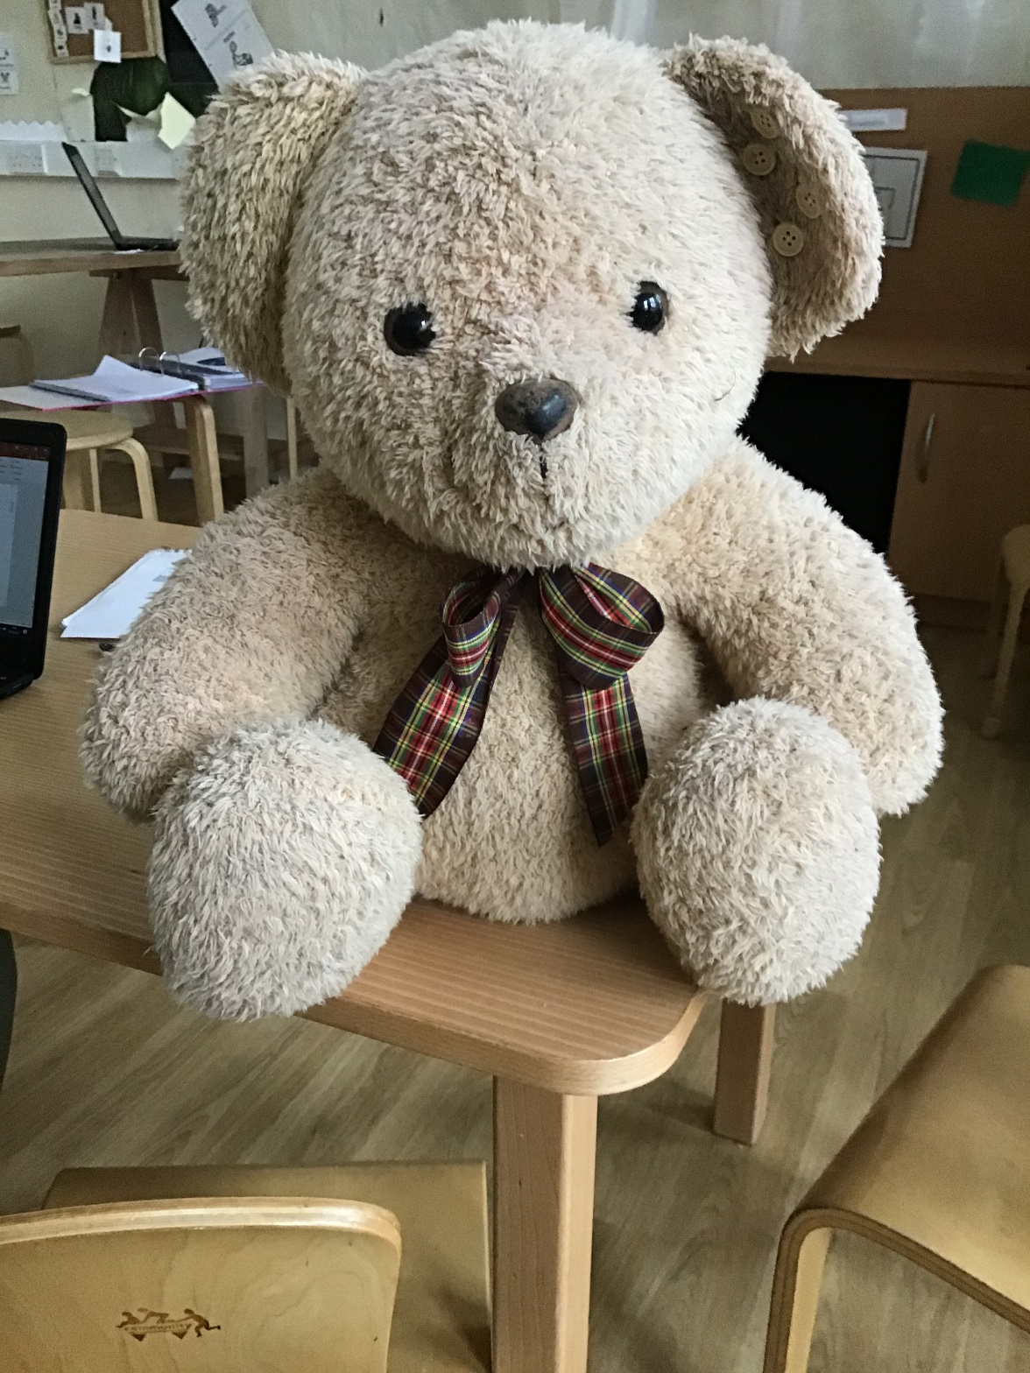
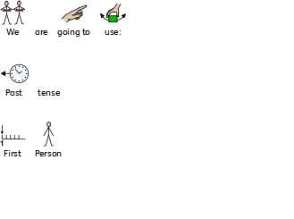

Slide 21
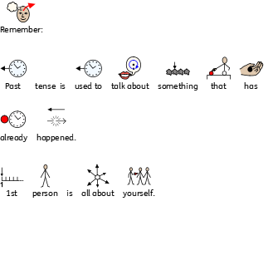

Slide 22
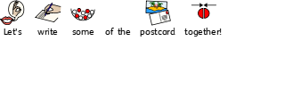

Slide 24
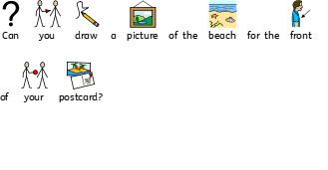
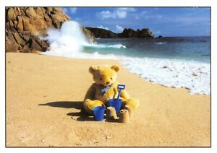

Slide 25
Date: Thursday 1st July
LO: To be able to evaluate a recount.
Subject: English

Slide 27
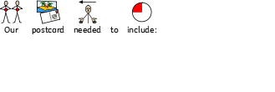

Slide 29
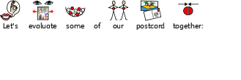
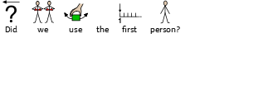

Slide 30
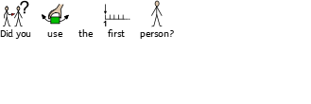

Slide 31
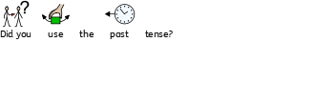

Slide 32
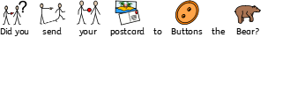

Slide 34
Date: Friday 2nd June
LO: To be able to revise known phonics sounds.
Subject: English

Slide 35
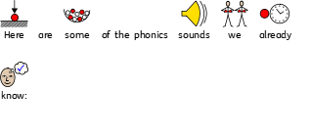
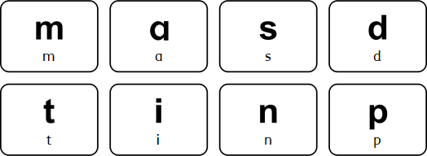

Slide 36
You will need:

Slide 37
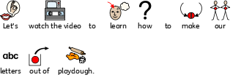
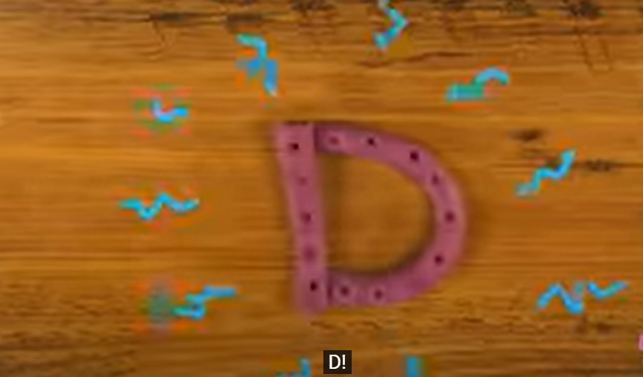
https://www.youtube.com/watch?v=oDilSKCrKQo

Slide 38
