Slide 1

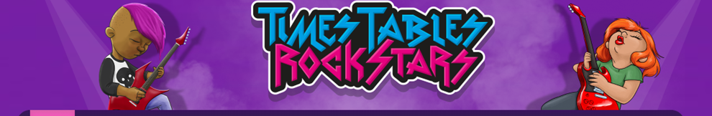


Date: 11.1.2021
L.O To be able to find 10 more and less than a number.
Go to Times Tables Rock Stars to warm up your number brain before you start your maths activity.
Subject: Maths

Slide 2
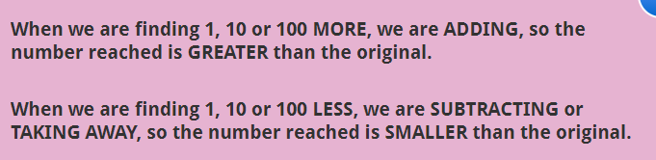
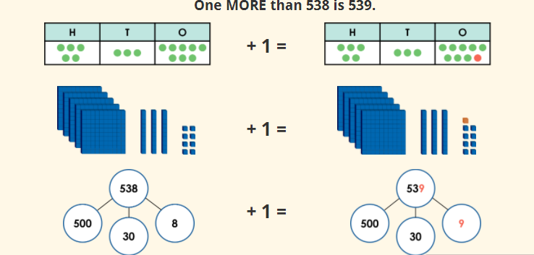
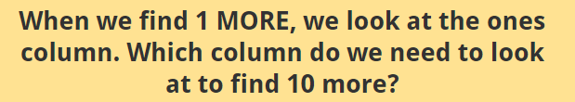
538 can be represented in different ways.
Subject: Maths

Slide 3
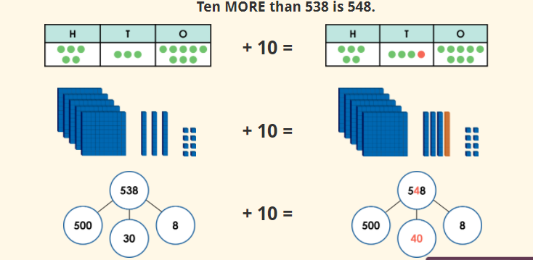

Subject: Maths

Slide 4
Complete the calculations below.
1. 356 + 1 =
2. 723 + 1 =
3. 585 + 1 =
4. 822 + 1 =
5. 479 + 1 =
6. 274 - 1 =
7. 836 - 1 =
8. 719 - 1 =
9. 507 - 1 =
10. 370 – 1 =
Subject: Maths

Slide 5
Complete the calculations below.
1. 763 + 10 =
2. 132 + 10 =
3. 615 + 10 =
4. 324 + 10 =
5. 529 + 10 =
6. 674 - 10 =
7. 426 - 10 =
8. 810 - 10 =
9. 357 - 10 =
10. 990 – 10 =
Subject: Maths

Slide 6
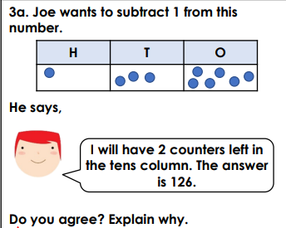
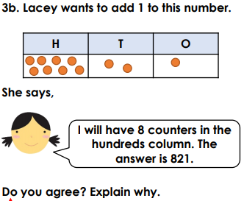
Try these challenges.
Subject: Maths

Slide 7
Date: 12.1.2021
L.O To be able to find 100 more or less.
Go to Times Tables Rock Stars to warm up your number brain before you start your maths activity.
Subject: Maths

Slide 8
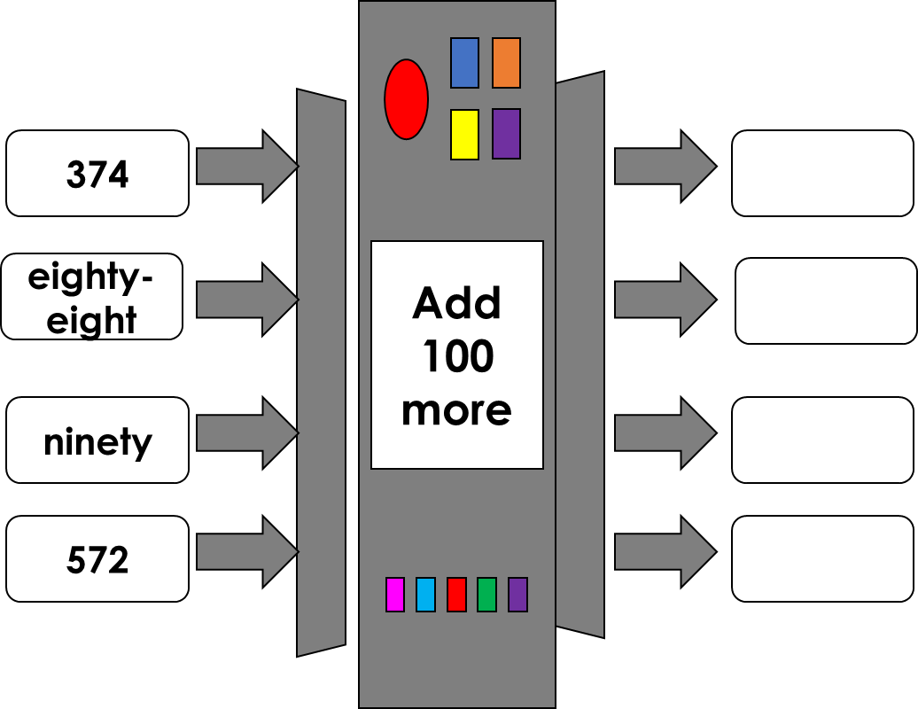
Yesterday you found 1 and 10 more or less than a number. Today you will be finding 100 more or less.
Subject: Maths

Slide 9
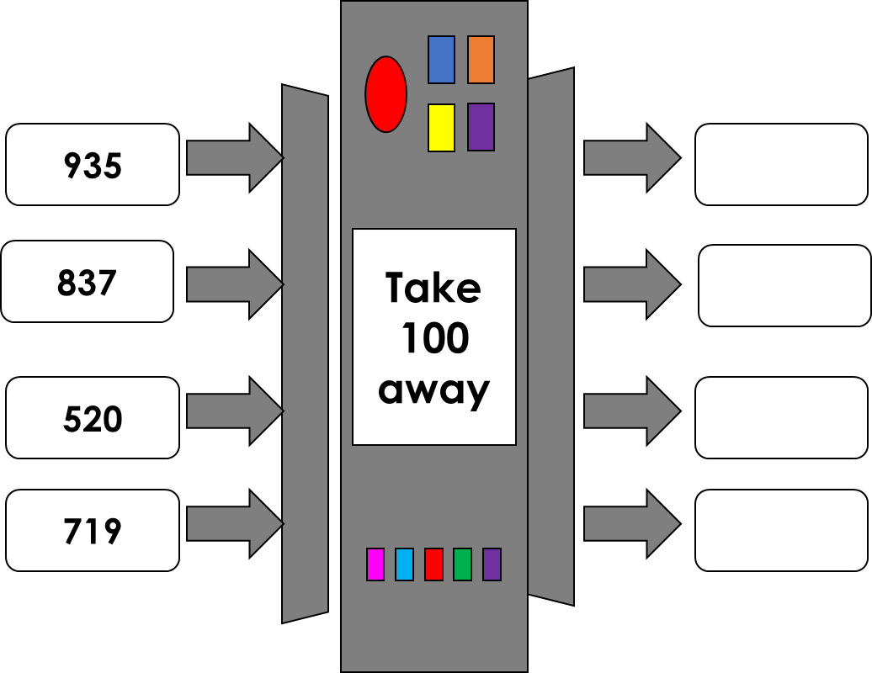
Subject: Maths

Slide 10
Now try these calculations.
1. 367 + 100 =
2. 245 + 100 =
3. 190 + 100 =
4. 732 + 100 =
5. 401 + 100 =
6. 563 – 100 =
7. 821 – 100 =
8. 703 – 100 =
9. 489 – 100 =
10. 674 – 100 =
Tip – The only number that should change is in hundreds column.
Subject: Maths

Slide 11

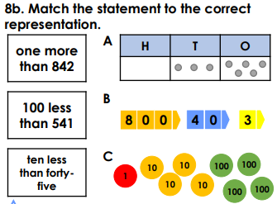
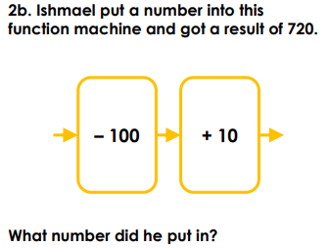
Subject: Maths

Slide 12
Date: 13.1.2021
L.O To be able to count in multiples.
Go to Times Tables Rock Stars to warm up your number brain before you start your maths activity
Subject: Maths

Slide 13
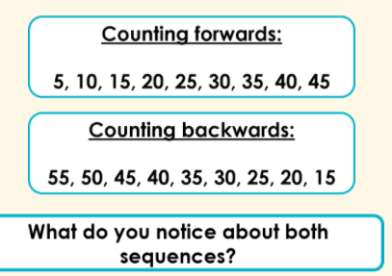
When we are counting forwards, the numbers increase in value.
When we are counting backwards, the numbers decrease in value.
Subject: Maths

Slide 14
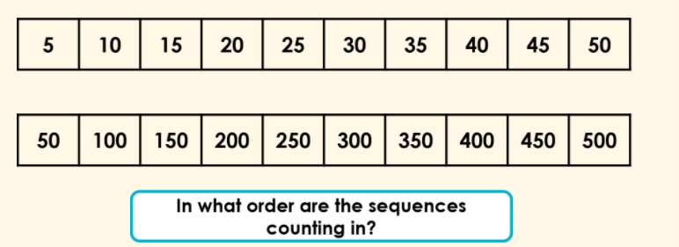
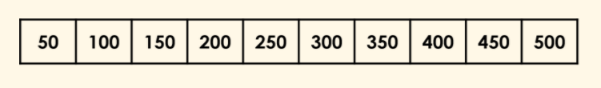

Fill in the missing numbers.

Slide 15
Complete these number sequences.
50 _____ 150 _____ _______
150 200 ____ _____ 350 ____
300 _____ 400 450 _____ _____
600 _____ 700 _____ _____ 850
5. 500 450 400 _____ _____
6. 350 300 ____ 200 _____
7. ______ 200 150 100 _____
Tip. Counting in 50s is like counting in 5s with a zero on the end of the number.

Slide 16
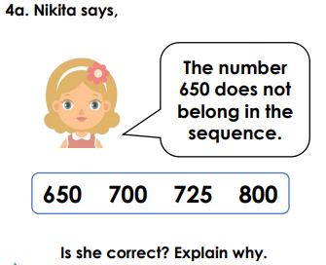
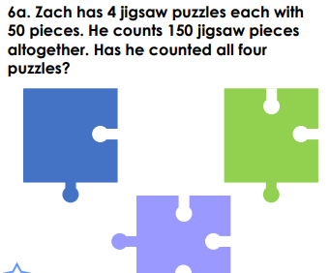

Slide 17
Date: 14.1.2021
L.O To be able to compare numbers
Go to Times Tables Rock Stars to warm up your number brain before you start your maths activity
Subject: Maths

Slide 18
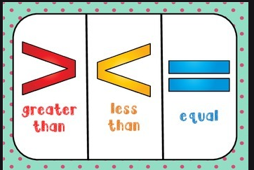
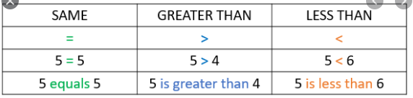
We can compare numbers using these symbols.

Slide 19
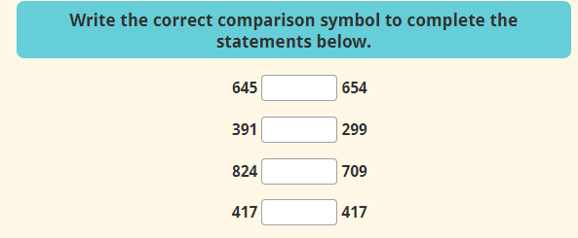
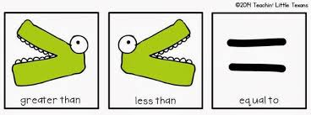

Slide 20

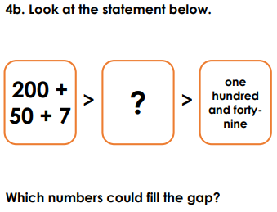
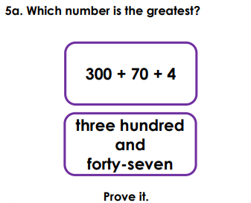
.

Slide 21
Date: 15.1.2021
L.O To be able to order numbers
Go to Times Tables Rock Stars to warm up your number brain before you start your maths activity
Subject: Maths

Slide 22
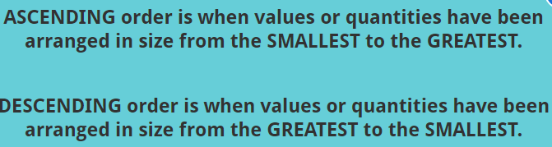
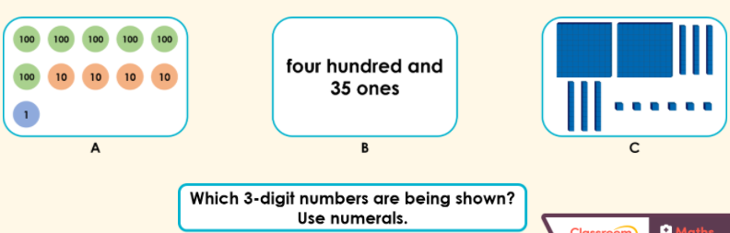
Write down the value of each set then order them into ascending order.

Slide 23
Write these numbers in ascending order (smallest to largest).
23 65 12 29
45 89 32 26
325 234 187 400
677 332 456 310
422 409 478 400
762 326 713 306

Slide 24
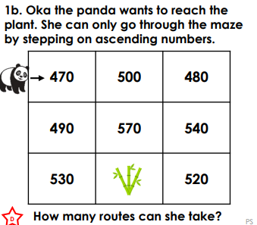
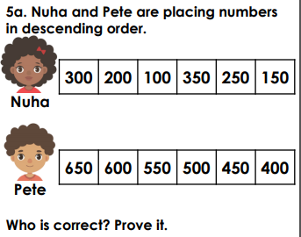
.

Slide 25
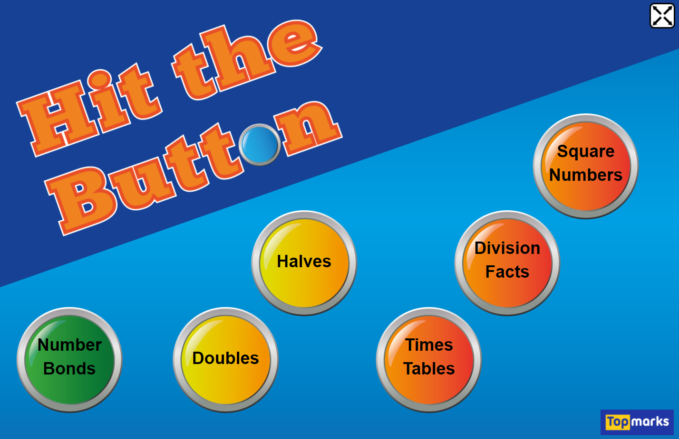
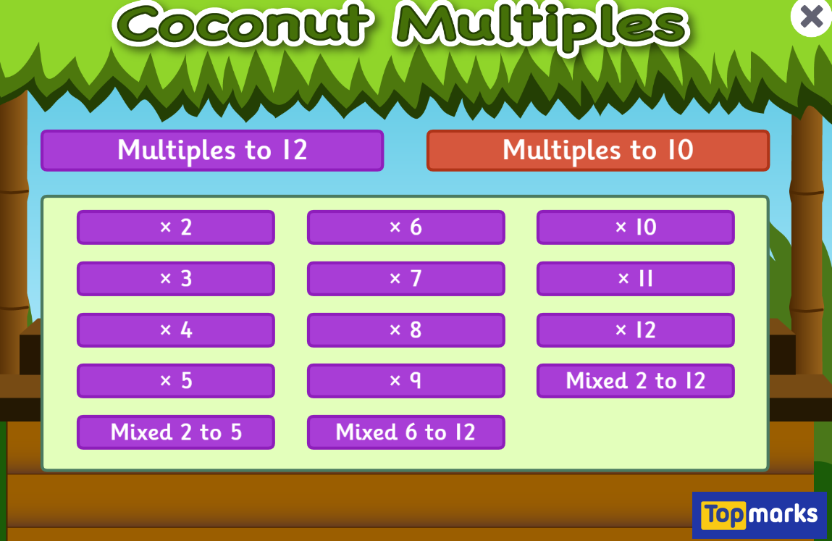

Fun Maths Games!
Copy and paste the link to play these fun maths games.
https://www.topmarks.co.uk/maths-games/hit-the-button
Times tables x4 x8 x3
https://www.topmarks.co.uk/times-tables/coconut-multiples
https://ttrockstars.com/
Multiples of numbers

