Slide 1
Subject: English
Pack: A

Slide 2
Date: Tuesday 1st – Friday 6th February
L.O To be able to recognise special friends.
Please practise phonics every day for 20 minutes.
Subject: Phonics

Slide 3
Special Friends – Sound 1
‘Special friends’ are two letters that make one sound.
When we put ‘o’ and ‘u’ together they form the sound ‘ou’.
Try my turn, your turn with a partner “ou” > “ou”
Say: ou
“shout it out”

Slide 4
Blending Independently – Special Friends
Fred Talk - Fred Frog can only say words in sounds but not the entire word all at once for example m-ou-th.
Read the Phonics green word card: Special Friends, Fred talk, read the word.
out
kout
shout
lout
Review the words
Special Friends, Fred Talk, read the word
Fred in your head
Speedy reading
Can you separate the real words from the alien words?

Slide 5
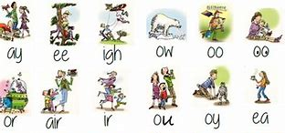
Review and Write
Can you spot todays Special Friends?
Try thinking of some other words that have the sound ‘ou’.
_______________________________________________________________________________________
Challenge! Can you put a word from your list into a sentence?
_______________________________________________________________________________________
Example- On our treasure hunt we found gold.

Slide 6
Special Friends – Sound 2
‘Special friends’ are two letters that make one sound.
When we put ‘o’ and ‘y’ together they form the sound ‘oy’.
Try my turn, your turn with a partner “oy” > “oy”
Say: “oy”
“Toy for a boy”

Slide 7
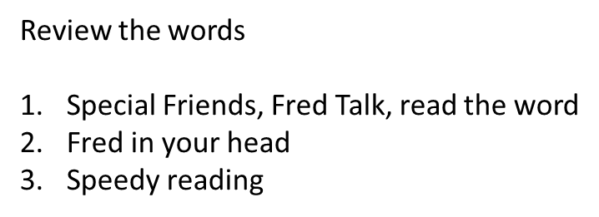
Blending Independently – Special Friends 2
Fred Talk - Fred Frog can only say words in sounds but not the entire word all at once for example .
Read the Phonics green word card: Special Friends, Fred talk, read the word.
toy
poy
enjoy
noy

Slide 8
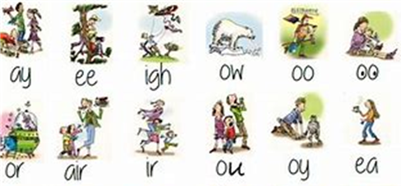
Review and Write 2
Try and think of other words that have the sound ‘oy’.
___________________________________________________________________________________
Examples – toy, boy, joy
Challenge! Can you put a word from your list into a sentence?
___________________________________________________________________________________
Example – The boy played with his new toys.

Slide 9
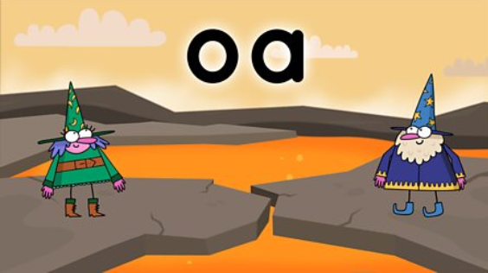
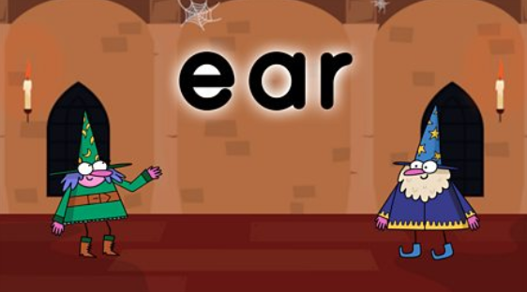
Phonics
BBC Bitesize has lots of 30 second videos focusing on each of the phonics sounds.
https://www.bbc.co.uk/bitesize/topics/zvq9bdm
Copy and paste the link.

Slide 10
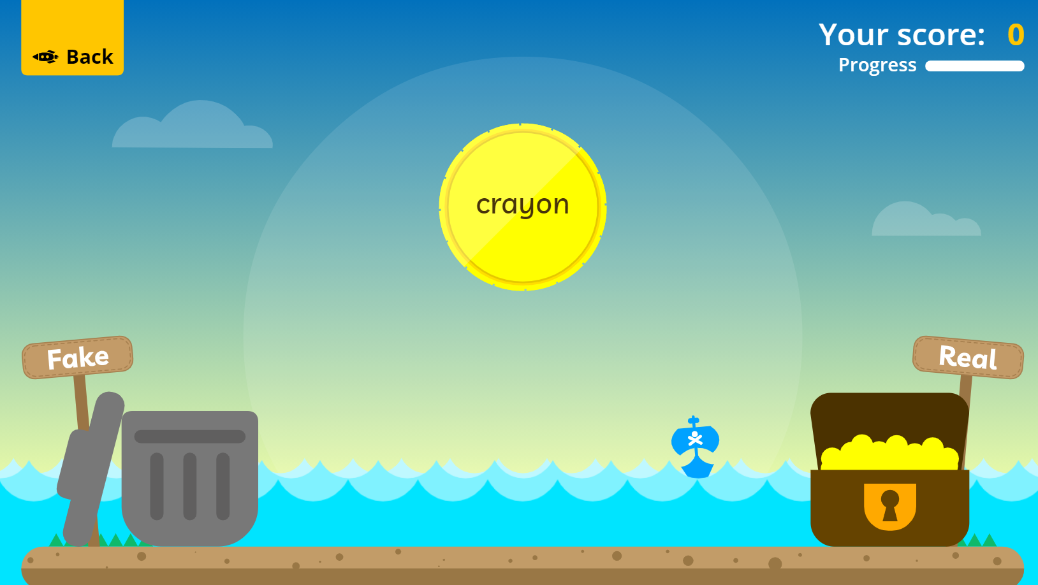
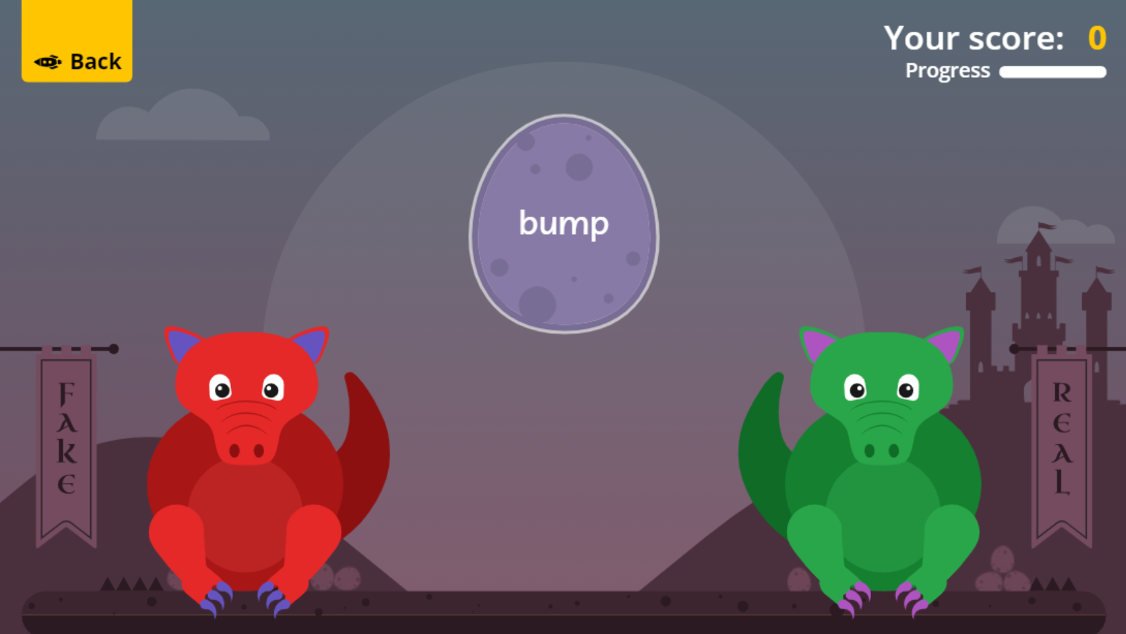
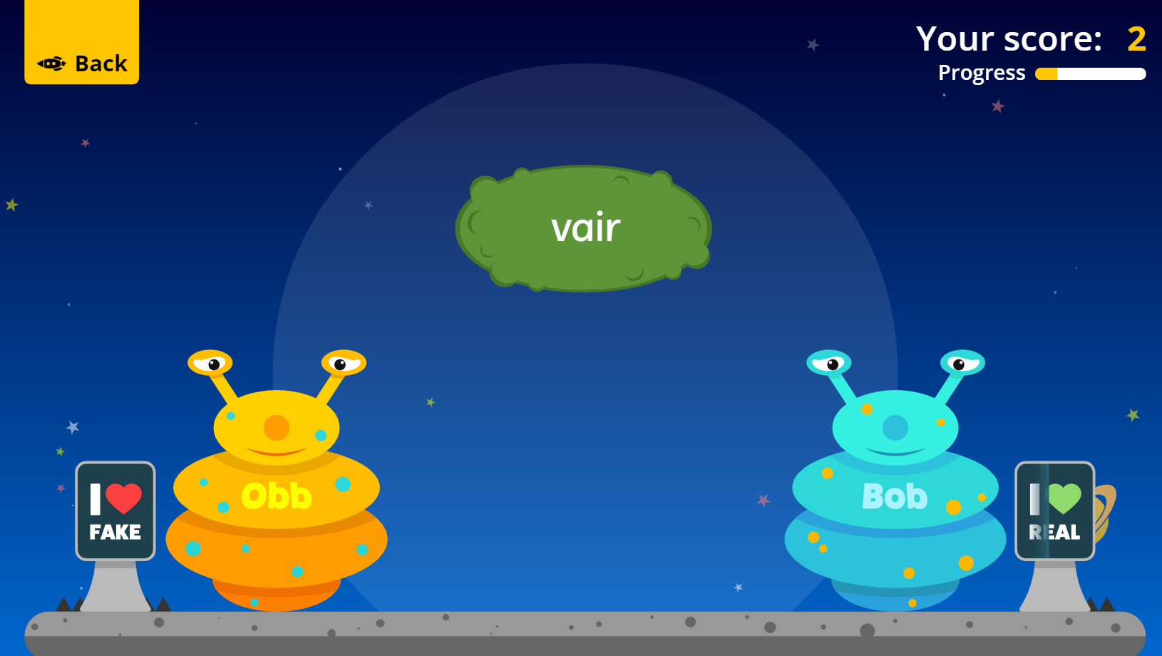
Fun Phonics Games!
Copy and paste the link to play these fun phonics games!
https://www.phonicsplay.co.uk/resources/phase/2/buried-treasure
All phases
https://www.phonicsplay.co.uk/resources/phase/2/dragons-den
All phases
https://www.phonicsplay.co.uk/resources/phase/2/picnic-on-pluto
All phases

