Slide 1
Subject: Topic
Pack: A + B

Slide 2
This lesson was also included in the first powerpoint so you may have completed it if you were ahead
Monday 28th June
L.O To be able to use classroom instructions.
Subject: French

Slide 3
Use the link below to help you pronounce a range of classroom instructions in French.
Locate the Instructions in the classroom heading and click the orange sound symbols to listen.
https://www.bbc.co.uk/bitesize/topics/zjcbrj6/articles/z4q8g7h

Slide 4
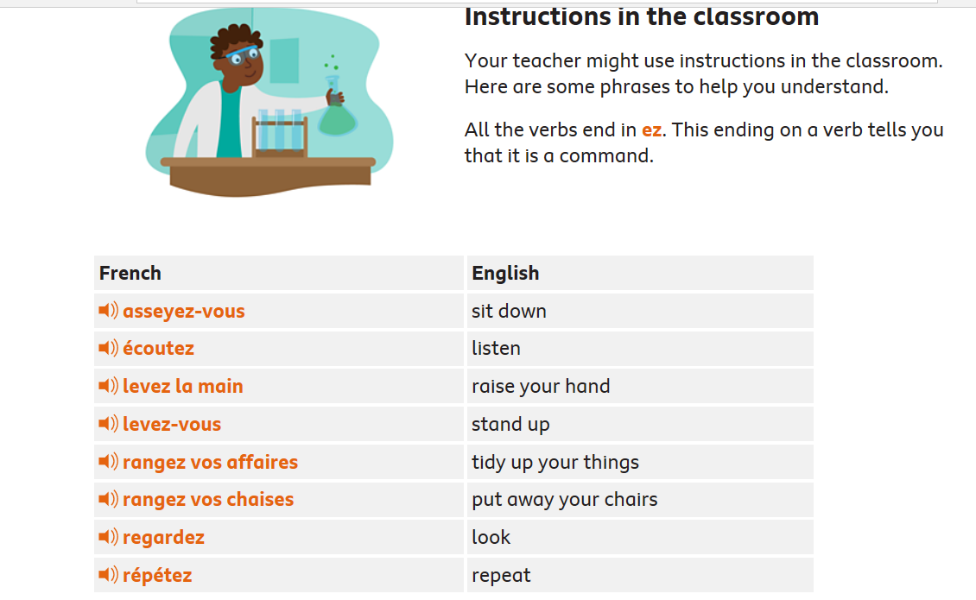
With a partner take turns pronouncing some of the instructions.

Slide 5
Task 1 - Number the images correctly in each box so the demonstration and instruction match.
1. ecoutez
2. levez-vous
3. regardez
4. levez la main
5. asseyez-vous

Slide 6
Task 2- Complete the sentences by adding in the correct classroom instruction.
When I want to share my ideas I must ______________.
I must _________________ carefully so I understand the task given.
Sometimes when we _________ at the board, it is easier if we ___________ in our carpet spots.
At the end of the day we __________ and push our chairs under the table.
Word list
asseyez-vous
ecoutez
levez- la main
levez-vous
regardez

Slide 7
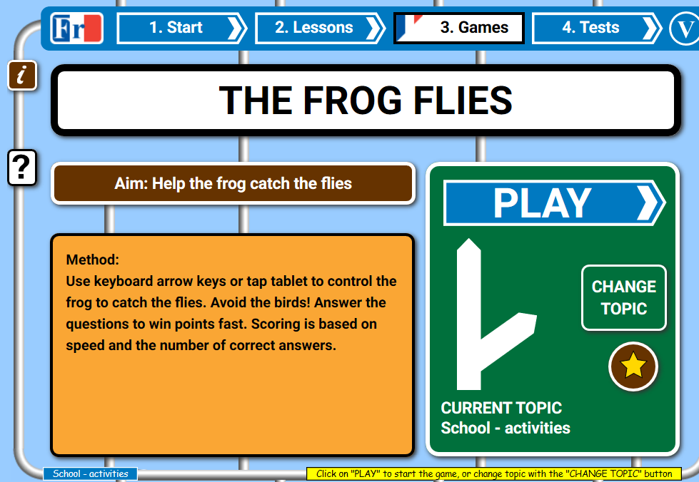
Test yourself using a school activities game!
https://www.french-games.net/frenchgames/the-frog-flies?topic=School%20-%20activities&level=primary

Slide 8
Tuesday 29th June 2021
L.O To be able to understand the importance of personal care
Subject: PSHE

Slide 9
Remember if you need help to read any of the information ask someone to help.

Slide 10
What Is Personal Hygiene?
Personal Hygiene is how we look after our bodies. Keeping ourselves clean and tidy makes us feel better about ourselves and also keeps us, and those around us, healthier!

Slide 12
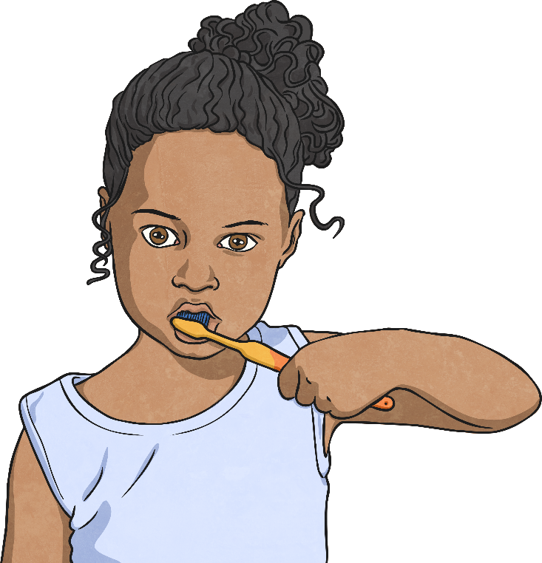
Brushing Our Teeth
It is recommended that we brush our teeth twice a day, for around
2 minutes.
We should visit the dentist every 6 months for a check up.
Brushing properly removes plaque which can cause cavities, tooth ache, gum disease and even our teeth falling out!
It also gives us lovely fresh breath!

Slide 13
Washing Our Hands
Washing our hands is one of the simplest ways we can keep ourselves and those around us healthy.
Think about everything your hands touch in a day…
door handles;
stair banisters;
toilet flushers.
Think about how many other people have touched these things too!

Slide 14
Dirtier Than a Toilet Seat?
A study from a University in Arizona claimed there were things that we touch that are actually dirtier than a toilet seat!
Have a quick chat with someone at home or a think to yourself and see if you can think of anything that may be dirtier than a toilet seat.
Remember: think of things that people touch regularly, not things we try to avoid!

Slide 16
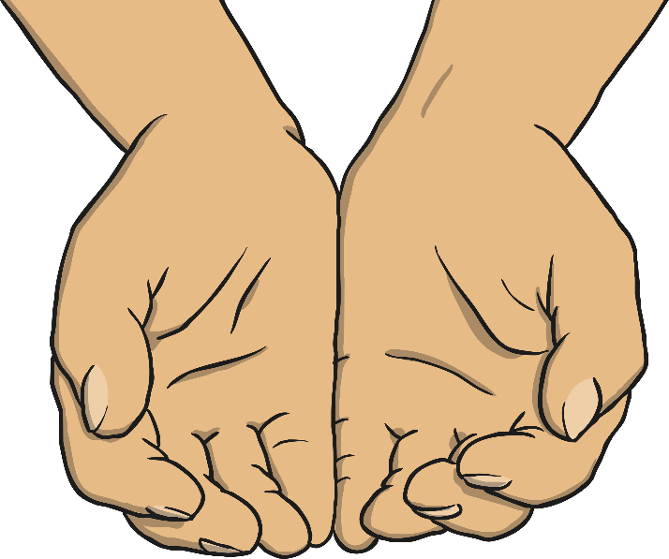
Handwashing
When we touch things we pick up germs, which we can then spread by rubbing our eyes, putting things into our mouths, etc.
We can even spread them to our friends and family without realising. Some germs can make us unwell, spreading everything from a cold to stomach bugs
(and much more).
Washing our hands with clean, warm water and soap will kill off the germs and keep our hands clean.

Slide 18
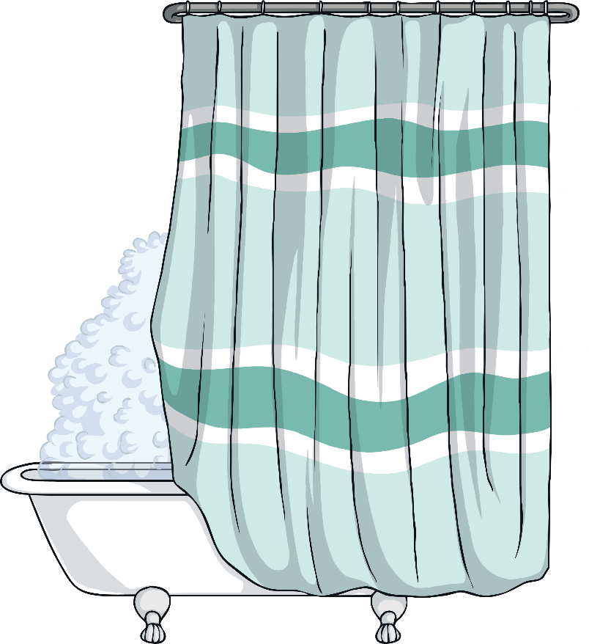
Showering or Bathing Regularly
As we get older and start to experience body changes therefore it becomes important to shower and bathe more regularly.
Both boys and girls bodies change as they grow older, but one of the main changes that we all experience is that our sweat glands grow and start to produce more sweat.

Slide 19
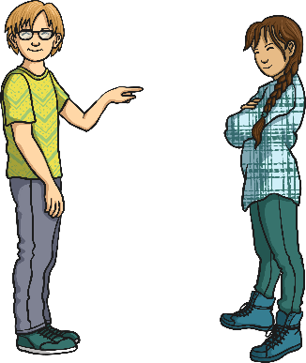
Hormones and body odour
As you get older, hormones kick in - different hormones for boys and girls - but they can both cause oily skin and more sweat. If we don’t wash regularly we are more likely to get spots and have BO (body odour).
Remember, sweat doesn’t smell…it is stale sweat that produces the body odour. You can keep yourself fresh by remembering to use deodorants but this is not a substitute for showers or baths!

Slide 20
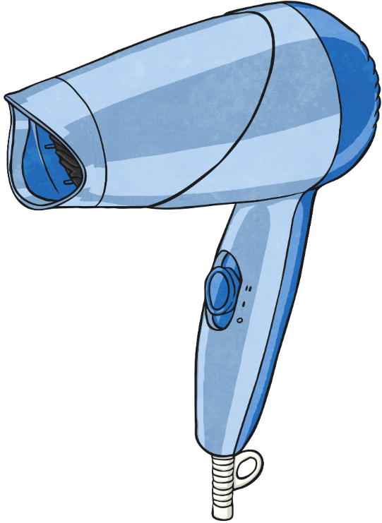
Hair
Different types of hair needs caring for in different ways. Some hair types need washing regularly whereas others don't need washing as much. Your parents will know what is the best hair care routine for your hair type.
When we wash our hair, shampoo can be used to clean our scalp. To help prevent tangles, some people also choose to use conditioner.
There are millions of products that we can use in our hair such as gels, mousse, hairspray or oils.

Slide 21
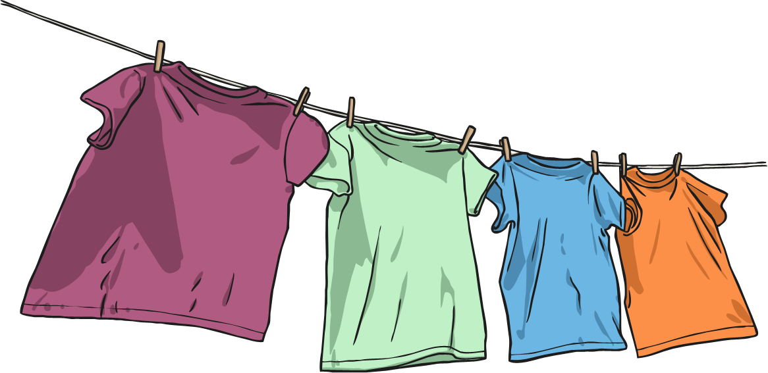
Clean Clothes
It is really important to wear clean clothes. If we wore the same thing all the time they would get dirty and start to smell. Even if it is the most fashionable thing you own…it will still need to be washed!
You don’t need to wear fresh, clean clothes every day, but if, for example, you wear the same trousers to school for a few days - make sure that you take them off as soon as you get home and let them air out for a while!

Slide 22
Keep Our Noses Clean
Have you ever had a really runny nose? Or has it been really blocked and you feel like you can’t breathe through it?
It’s a horrible feeling, but we have all been there!
The only acceptable way of dealing with this is a tissue.
Sniffing, picking, wiping with sleeves… Yuck!

Slide 23
Using a Tissue
Bring a small packet of tissues with you to school. If you have a really bad cold, they can even stay at your desk!
However:
dirty tissues must be binned or flushed
down a toilet straight away;
don’t share used tissues with others;
wash your hands after using a tissue.

Slide 24
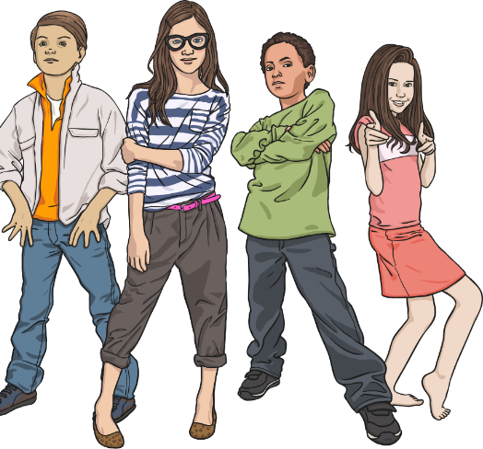
Spreading Germs
Germs and bacteria spread. It’s a fact and we can’t stop it, but we can try to minimise their spread. Following the tissue rules and washing our hands are really easy ways to minimise the germs we spread.
Can you think of any other ways? Discuss
Covering our mouths when we sneeze or cough.
Not sharing water bottles, etc.
Not coming to school if you have a stomach bug and have been sick or have diarrhoea.
Try not to touch our eyes, nose and mouth too much.

Slide 25
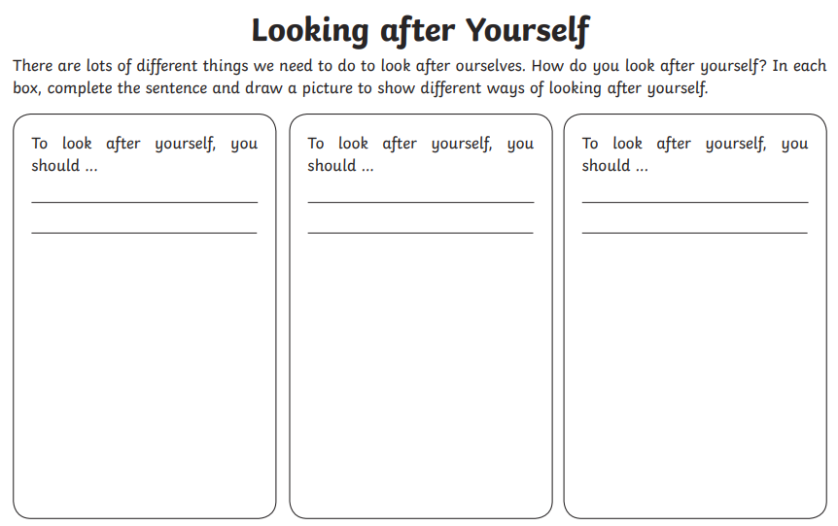
Task:

Slide 26
Wednesday 30th July
L.O To be able to explore the importance of Durham Cathedral
Subject: R.E

Slide 27
Remember if you need help to read any of the information ask someone to help.

Slide 28
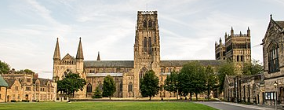
Has anyone heard of or seen this famous landmark before?
What is it called?
Where is it?

Slide 29
Has anyone heard of or seen this famous landmark before?
What is it called? Durham Cathedral
Where is it? Durham

Slide 30
Durham Cathedral
Built in 1093 to house the Shrine of St Cuthbert, Durham Cathedral is renowned for its magnificent Romanesque architecture and spectacular location at the heart of the Durham World Heritage Site. It has been a place of pilgrimage for over a thousand years and is the resting place of the Venerable Bede.
You can use the website to explore Durham Cathedral for extra information (not a must to complete work)
https://www.durhamcathedral.co.uk/visit-us/inside-durham-cathedral

Slide 31
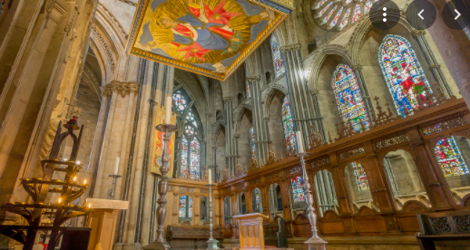
Durham Cathedral
Why do you think people might visit Durham Cathedral?
Children to think about why people might visit the Cathedral and write down ideas around the picture or on a separate piece of paper.

Slide 32
Examples of why people visit
Worship – daily acts of worship take place and open to all.
To visit the shrines of St. Cuthbert and The Venerable Bede
A quiet place to think or pray (visitors can light candles)
To explore the sculptures, stained glass windows, art and architecture
To attend services during festivities such as Christmas
To attend events such as memorials, graduations and the festival of light
Exhibitions that go on display (lego)
School trips

Slide 33
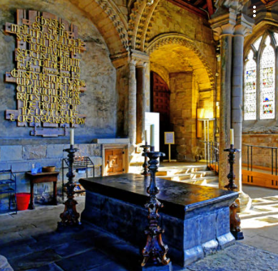
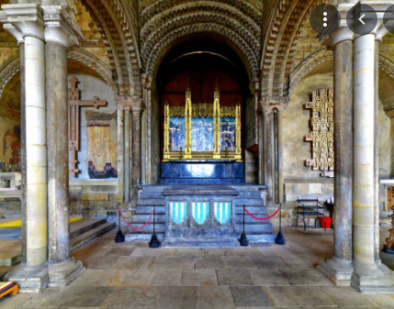
Durham Cathedral
Durham Cathedral is well-known for its architecture, statues, stained glass windows and also for being a resting place for famous monks like the Venerable Bede. We will explore more about these monks next lesson.

Slide 34
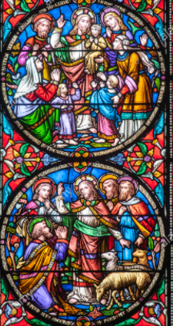
Stained glass windows inside Durham Cathedral

Slide 35
Task: Answer the following questions in full sentences.
When was Durham Cathedral built?
__________________________________________________________________________________________________________________________________________________________
Who was it a shrine to?
__________________________________________________________________________________________________________________________________________________________
Which religion is practised here?
__________________________________________________________________________________________________________________________________________________________
List 5 things people do when they visit
_______________________________________________________________________________________________________________________________________________________________________________________________________________________________________

Slide 36
Extension task:
To create your own stained glass window
Stained glass windows in Durham Cathedral display many stories from the bible. Displaying the journey that has been made by many.
Task:
Can you think of an important time in your life journey and create your own stained glass window using one of the following templates on the next slide. You can colour it using coloured pencils, felt tips or paints.

Slide 38
Thursday 1st July
L.O To be able to recognise colours
Subject: French

Slide 39
Watch the video below to help you pronounce a range of colours in French.
https://www.bing.com/videos/search?q=colours+in+french+video&&view=detail&mid=CD9BCEABC303E356DF96CD9BCEABC303E356DF96&&FORM=VDRVRV

Slide 40
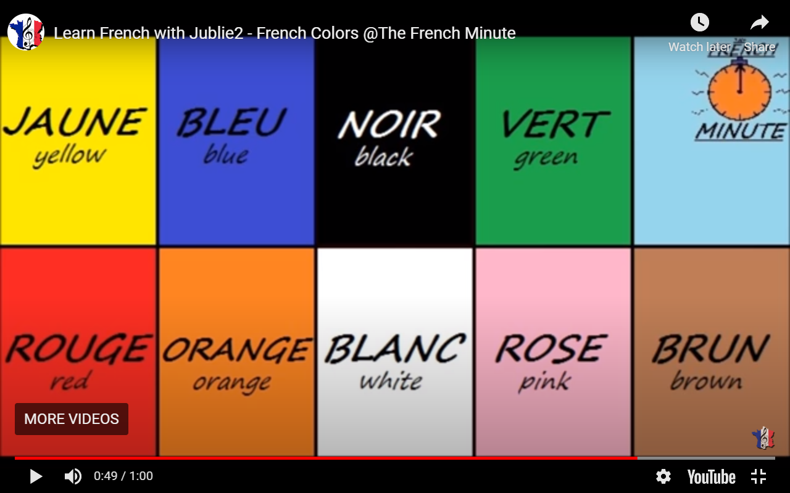
Here are the colours we have looked at in the video. Try your best pronouncing them again.

Slide 41
Task – Can you match the colours? Draw a line connecting the English and French.
English
Yellow
Blue
Green
Pink
White
Red
Orange
French
Orange
Vert
Blue
Jaune
Rouge
Rose
Blanc
French
Orange
Vert
Blue
Jaune
Rouge
Rose
Blanc

Slide 42
Task – Look at the image and fill in the gaps in French using the correct colour. Use the previous slide for support.
The sparkling, __________ sea is filled with beautiful sea creatures.
I can see two different colours on the striped fish, they are ________ and _________.
Resting on the coral I can see a _________ star fish.
The ________ turtle glides through the peaceful waters.
My favourite colour is _________ and that is why I like the _______ best.

Slide 43
Great work so far! Can you complete the word search?

Slide 44
Friday 2nd July :
LO To be able to use different drawing techniques
Subject: : Art

Slide 45
Have a look through and remind yourself of the different drawing techniques.
Stippling

Slide 46
Here at the different techniques to add shades and tones to these circles
similar to hatching with another layer on top in a different direction
parralel lines
running in the
same direction
random scribbles
running in
different directions
small dots together
Tonal shading refers to the lightness or darkness of an object. It is done by setting down various strengths of shading to demonstrate where an object is affected by the light and shadows.

Slide 47
This is a value scale, it shows different tones using the drawing techniques
Pick 2 different techniques and make your own value scale
A pencil would be best for this but a pen/coloured pencil/crayon will be fine
if not.

Slide 48
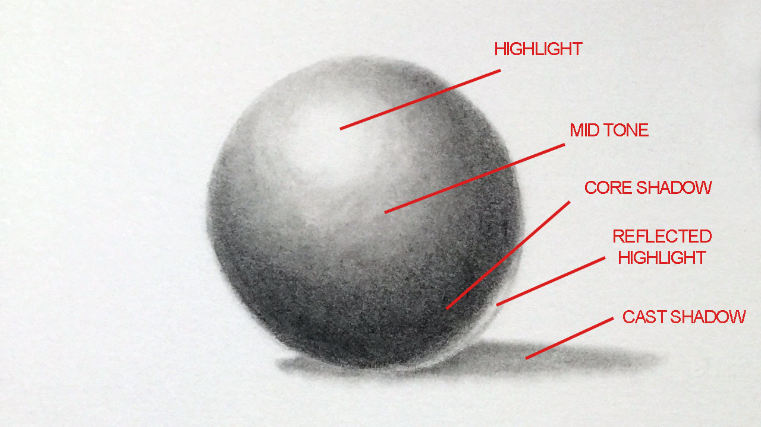
Now have a go applying these techniques to add tones to a circle.
Think about where shadows are formed and where the light will hit.
This makes the same look more realistic.

Slide 49
Evalutation
What drawing technique looks the best?
What part of your drawing do you think
you think is most successful? (light tones,
shadows, etc)

