Slide 1


Subject: Maths
Pack: B

Slide 2



Date: 28.06.21
LO To be able to identify the place value of numbers to 50.
Subject: Maths

Slide 3
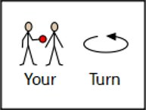
Warm Up
Timed Twenty!
Get someone to time you! We will repeat these each day – can you beat your time???
Have a go at working out the answer to these 20 arithmetic sums as quickly as you can!
2 + 1 =
10 + 1 =
3 + 1 =
4 + 1 =
7 + 1 =
2 + 2 =
9 + 4 =
10 + 3 =
8 + 2 =
6 + 4 =
11. 10 – 2 =
10 – 1 =
10 – 4 =
10 – 0 =
10 – 5 =
8 – 3 =
9 – 7 =
6 – 4 =
6 – 6 =
5 – 4 =

Slide 4
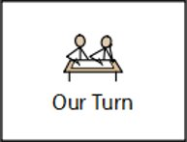
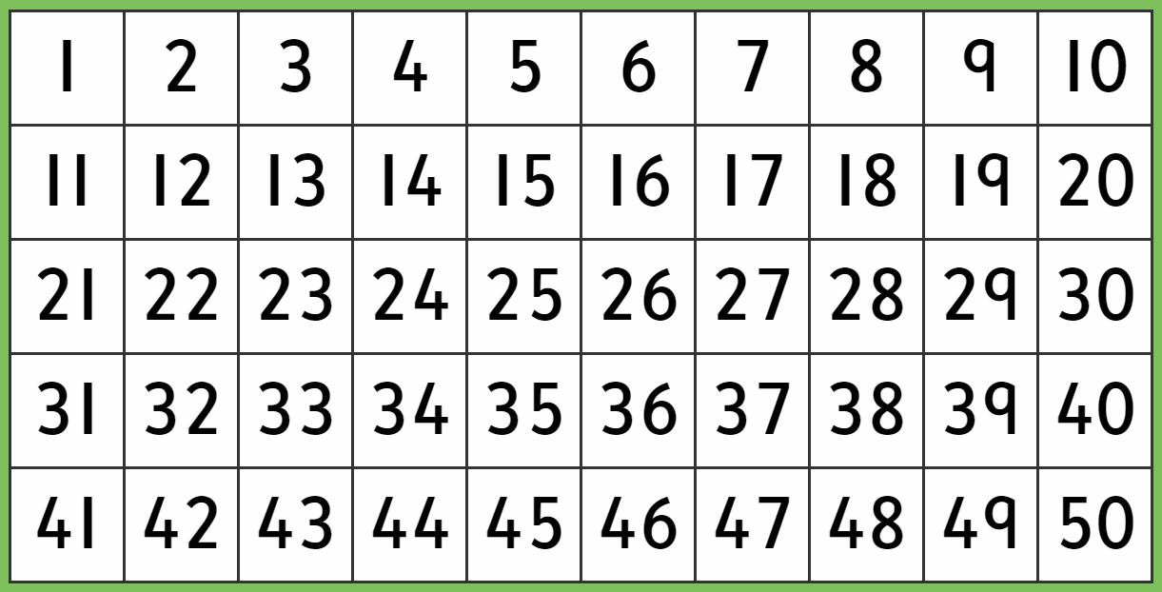
Counting to 50
Count to 50 in different voices!

Slide 5
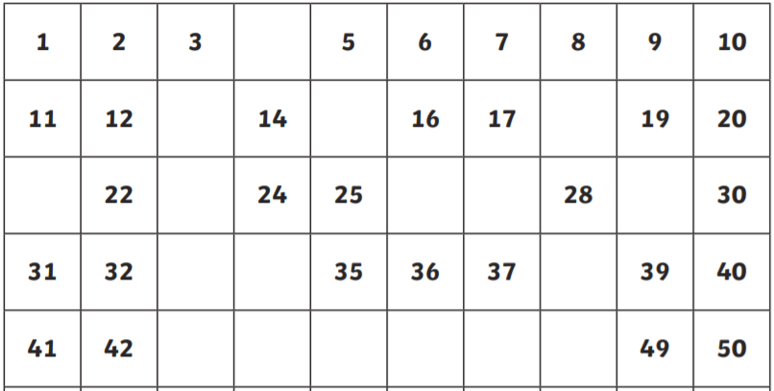
Counting to 50
Use your knowledge of numbers to 50, to fill in the missing numbers!

Slide 6
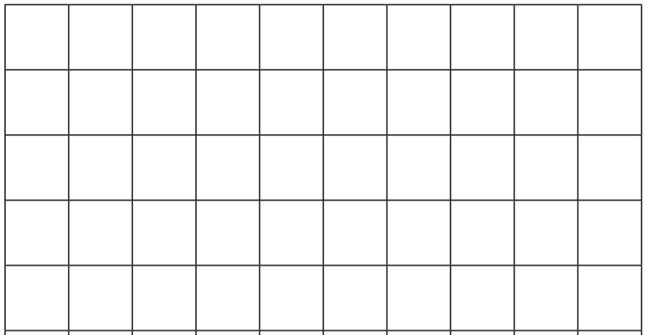
Counting to 50
This time – have a go yourself! Remember to start at 1.

Slide 7
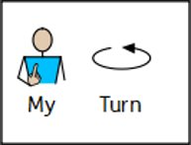
Value of Numbers
Numbers are made of tens and ones.
There is 1 in the tens column so we have to draw 1 tens counter.
TO
There is 3 in the ones column so we have to draw 3 ones counters.
13
‘T’ stands for tens.
‘O’ stands for ones.
TO
10
1
13
1
1

Slide 8
Value of Numbers
Numbers are made of tens and ones.
This time, we need 2 tens counters as there’s a 2 in the tens column (for a twenty number).
There is 1 in the tens column so we have to draw 1 tens counter.
There is 6 in the ones column so we have to draw 6 ones counters.
TO
TO
16
24
Draw the ones counters here!
Draw the ones counters here!
10
10
10

Slide 9
Draw the tens and ones counters to make each number.
Value of Numbers
Numbers are made of tens and ones.
Remember to draw the counters under the numbers (in column).
TO
27
TO
31
TO
22
TO
46
TO
39

Slide 10


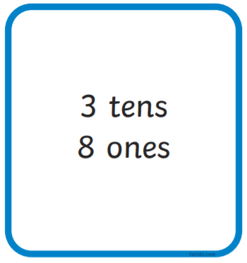


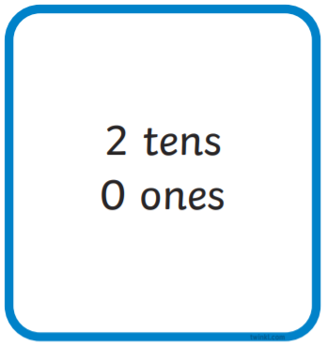
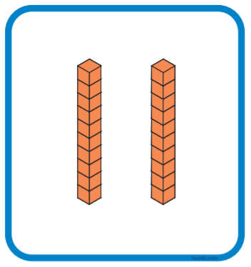

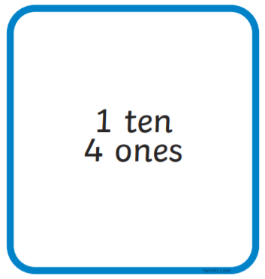
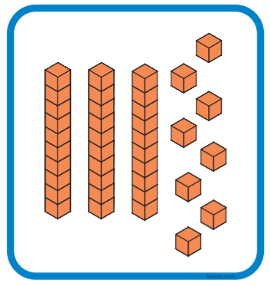
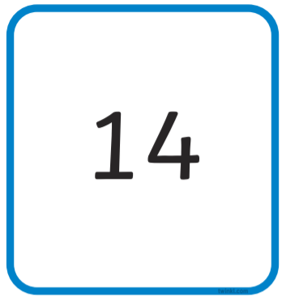
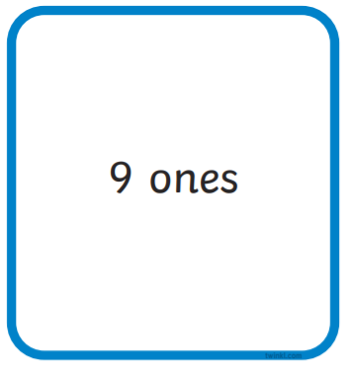
Tens don’t have to be drawn as counters, they can be shown as sticks of ten instead.
Value of Numbers – Part 1
Numbers are made of tens and ones.
Match the numbers to their picture and their tens and ones!
For example:

Slide 11


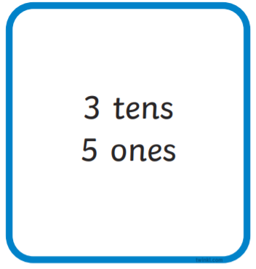
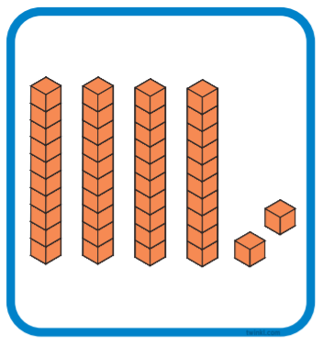
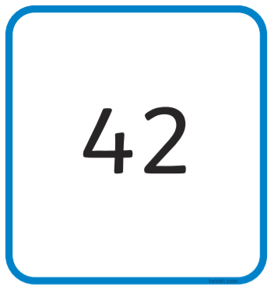
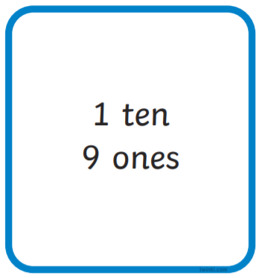


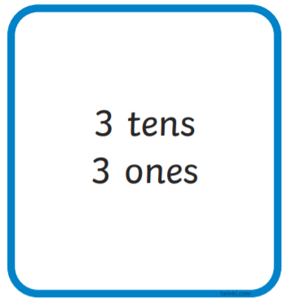


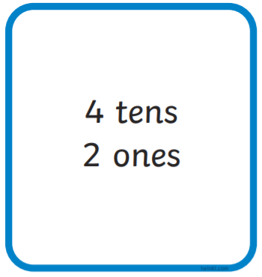
Tens don’t have to be drawn as counters, they can be shown as sticks of ten instead.
Value of Numbers – Part 2
Numbers are made of tens and ones.
Match the numbers to their picture and their tens and ones!

Slide 12
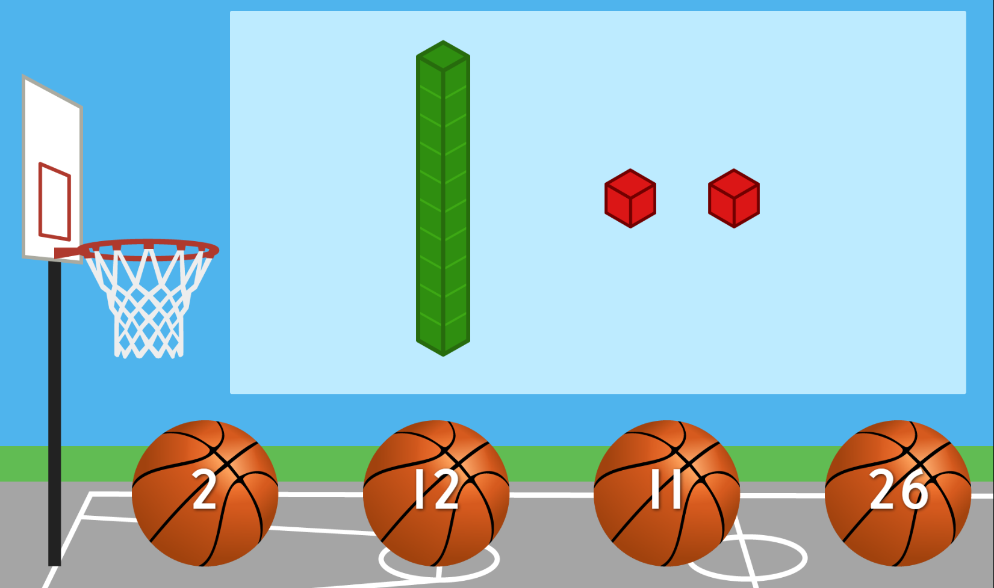
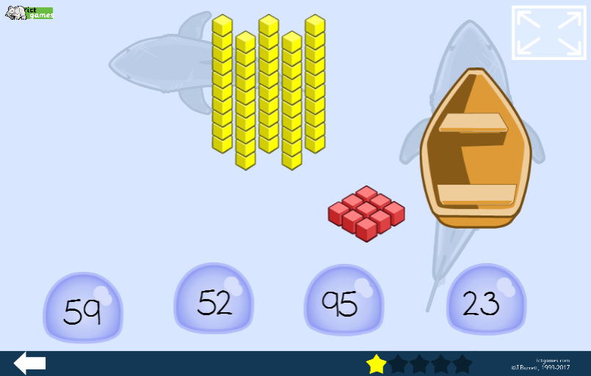
Place Value Games
Copy and paste the links into ‘Google’.
Place Value Basketball Game
https://www.topmarks.co.uk/learning-to-count/place-value-basketball
Lifeguards Place Value Game
https://www.ictgames.com/mobilePage/lifeguards/index.html
Shark Numbers Game
https://ictgames.com/sharkNumbers/mobile/index.html

Slide 13

Challenge!
Have a go at these problems…

Slide 14
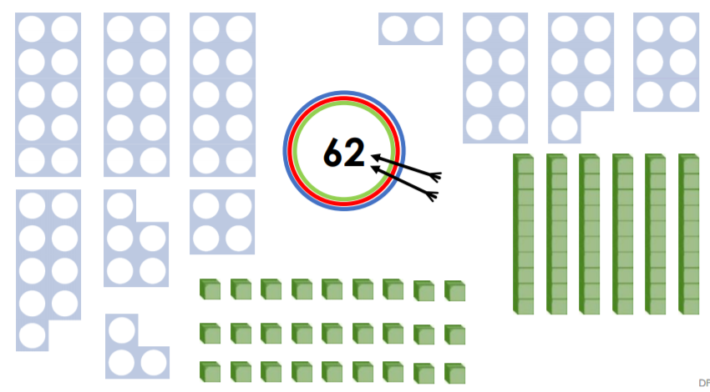
Challenge
Not all the equipment has to be used each time!
Use the Base Ten and the Numicon equipment below to make the number in as many different ways as you can!
Draw at least 4 different ways in the boxes below:

Slide 15








Here are some of the ways you might have come up with but there are others!
Challenge - Answers
Use the Base Ten and the Numicon equipment below to make the number in as many different ways as you can!
Draw at least 4 different ways in the boxes below:

Slide 16
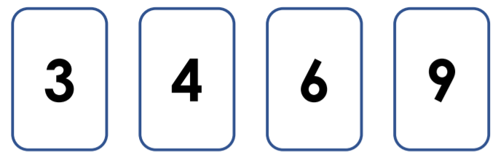
Tricky Challenge!
Use the digit cards below to make as many 2-digit numbers as you can!
Then, draw the numbers too!
Can you make all 12 numbers???
Write and draw your numbers in the boxes below:

Slide 17
Tricky Challenge! - Answers
Use the digit cards below to make as many 2-digit numbers as you can!
Then, draw the numbers too!
Can you make all 12 numbers???
Write and draw your numbers in the boxes below:
34
43
36
63
39
93
46
64
49
94
69
96

Slide 18

Well done for all of your hard work this lesson!
Please send your completed work for this session to: pioneerspupils@gmail.com

Slide 19
Date: 29.06.21
LO To be able to add 2 numbers.
Subject: Maths

Slide 20
Warm Up
Timed Twenty!
Have a go at working out the answer to these 20 arithmetic sums as quickly as you can!
Get someone to time you!
2 + 1 =
10 + 1 =
3 + 1 =
4 + 1 =
7 + 1 =
2 + 2 =
9 + 4 =
10 + 3 =
8 + 2 =
6 + 4 =
11. 10 – 2 =
10 – 1 =
10 – 4 =
10 – 0 =
10 – 5 =
8 – 3 =
9 – 7 =
6 – 4 =
6 – 6 =
5 – 4 =
DID YOU BEAT YESTERDAY’S TIME?

Slide 21
Strategy 1: Tens and Ones …
T O T O T O
Count up the counters, start with your tens
and then move to your ones…
12 + 7 =
1 9
10
1
1
1
1
1
1
1
1
1
Count… 10, 11, 12, 13, 14, 15, 16, 17, 18, 19

Slide 22
Strategy 1: Tens and Ones …
T O T O T O
15 + 3 =
____
2. Write your answer into your number sentence.
10
1
1
1
1
1
1
1
1. Count up the counters, start with your tens
and then move to your ones…
Count… 10, 11, 12, 13, 14, 15, 16, 17, 18
1

Slide 23
Strategy 1: Tens and Ones …
T O T O T O
14 + 13 =
2. Write your answer into your number sentence.
10
1
10
1
1
1
1
1
1
1. Count up the counters, start with your tens
and then move to your ones…
Finish counting….
10, 20, 21, 22, 23, 24, ___, ___, ___

Slide 24
Strategy 1: Tens and Ones …
T O T O T O
21 + 16 =
2. Write your answer into your number sentence.
10
1
10
1
1. Count up the counters, start with your tens
and then move to your ones…
10
1
1
1
1
1

Slide 25
Strategy 1: Tens and Ones …
T O T O T O
12 + 33 =
3. Write your answer into your number sentence.
1. Draw your tens and ones for both numbers.
2. Count up the counters, start with your tens
and then move to your ones…

Slide 26
Now have a go at these questions yourself …
(Remember to draw your tens and ones to help you).
15 + 4 =
23 + 5 =
32 + 7 =
11 + 28 =
25 + 14 =
12 + 26 =
33 + 25 =
15 + 11 =
If you found these really easy, have a go at the next 8 on the following slide!

Slide 27
Strategy 2 - Mentally …
T O T O T O
15 + 14 = 29
3. Put your tens and ones together in the correct columns to get your answer…
1. Add your tens together first…
2 tens
2. Then add your one together…
9 ones

Slide 28
Strategy 2 - Try these mentally …
1. 13 + 11 =
2. 24 + 12 =
3. 32 + 17 =

Slide 29
Challenge!
Have a go at these problems…

Slide 30
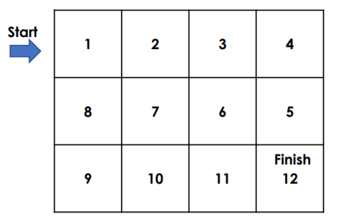
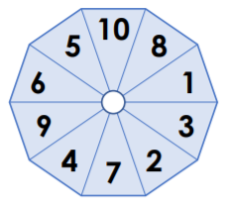
Challenge 1…
Danny is playing the game below. He spins the spinner and then moves the number of squares the spinner shows.
It only takes Danny two spins of the spinner to finish the game and reach the finish point.
Investigate the numbers that Danny could have spun.

Slide 31
Challenge 1… - Answers
Danny is playing the game below. He spins the spinner and then moves the number of squares the spinner shows.
The two numbers off the spinner need to add together to make 12.
It only takes Danny two spins of the spinner to finish the game and reach the finish point.
Investigate the numbers that Danny could have spun.
10 and 2
9 and 3
8 and 4
7 and 5

Slide 32
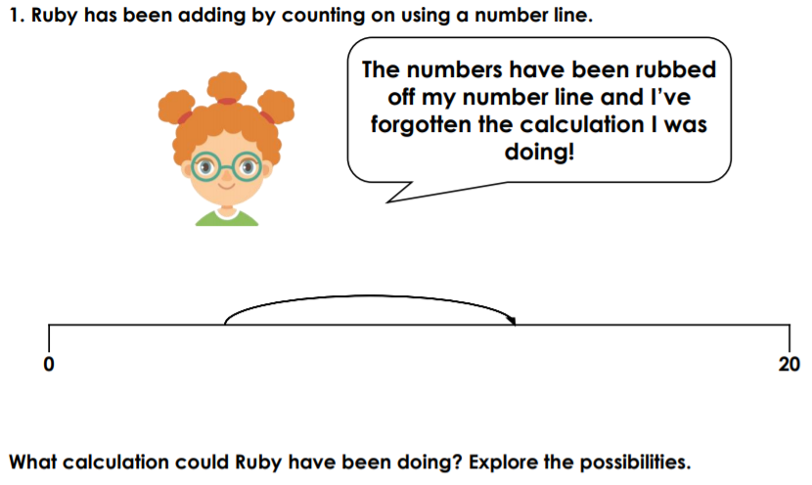
Challenge 2…
Ruby has been adding by counting on, using a number line.
Here is Ruby’s number line.
Think about what number would be roughly here…
What calculation could Ruby have been doing? Explore the possibilities.

Slide 33
Challenge 2… - Answers
Ruby has been adding by counting on, using a number line.
This number is below half way so about 12 or 13.
Here is Ruby’s number line.
This point is about half way so 4, 5 or 6.
This point in the middle of the number line would be 10.
Here are some of the calculations you may have come up with.
What calculation could Ruby have been doing? Explore the possibilities.
5 + 8 = 13
5 + 7 = 12
4 + 8 = 12
5 + 8 = 13

Slide 34
Well done for all of your hard work this lesson!
Please send your completed work for this session to: pioneerspupils@gmail.com

Slide 35
Date: 30.06.21
LO To be able to subtract from a number up to 50.
Subject: Maths

Slide 36
Warm Up
Timed Twenty!
Have a go at working out the answer to these 20 arithmetic sums as quickly as you can!
Get someone to time you!
2 + 1 =
10 + 1 =
3 + 1 =
4 + 1 =
7 + 1 =
2 + 2 =
9 + 4 =
10 + 3 =
8 + 2 =
6 + 4 =
11. 10 – 2 =
10 – 1 =
10 – 4 =
10 – 0 =
10 – 5 =
8 – 3 =
9 – 7 =
6 – 4 =
6 – 6 =
5 – 4 =
DID YOU BEAT YESTERDAY’S TIME?

Slide 37
Strategy 1: Tens and Ones…
T O T O T O
1. Make your biggest number (16 – 1 ten and 6 ones).
16 - 3 =
1 3
10
1
1
1
2. Then cross out the number of ones you are taking away (3 ones).
1
3. Count up how many you have got left…
10, 11, 12, 13
1
1

Slide 38
Strategy 1: Tens and Ones…
T O T O T O
1. Make your biggest number (24 – 2 tens and 4 ones).
24 - 11 =
10
1
Write your answer here!
10
1
2. Then cross out the number of tens you are taking away (11 - 1 tens and 1 ones).
1
1
Count up how many you have got left…
__________________________________

Slide 39
Strategy 1: Tens and Ones…
T O T O T O
1. Make the number using tens and ones counters.
48 - 25 =
10
1
1
Write your answer here!
10
1
1
10
1
1
Cross out your tens and ones.
Count up how many you have got left…
__________________________________
10
1
1

Slide 40
Strategy 1: Tens and Ones…
Draw your biggest number using your tens and ones.
T O T O T O
35 - 23 =
Write your answer here!
Cross out your tens and ones.
Count up how many you have got left…
__________________________________

Slide 41
Subtracting 2-digit numbers
(Draw your tens and ones to help you!)
46 – 4 =
39 – 5 =
45 – 21 =
27 – 17 =
5. 48 – 32 =
6. 25 – 22 =
7. 36 – 21 =
8. 49 – 38 =

Slide 42
Strategy 2: Mentally …
T O T O T O
26 - 11 = 15
3. Put your tens and ones together in the correct columns to get your answer…
1. Take the ones of your second number away from the ones of your first number.
1 ten
5 ones
2. Then take the tens of your second number away from the tens of your first number.

Slide 43
Strategy 2: Try these mentally …
1. 33 - 21 =
2. 44 - 12 =
3. 29 - 17 =

Slide 44
Challenge!
Have a go at these problems…

Slide 45
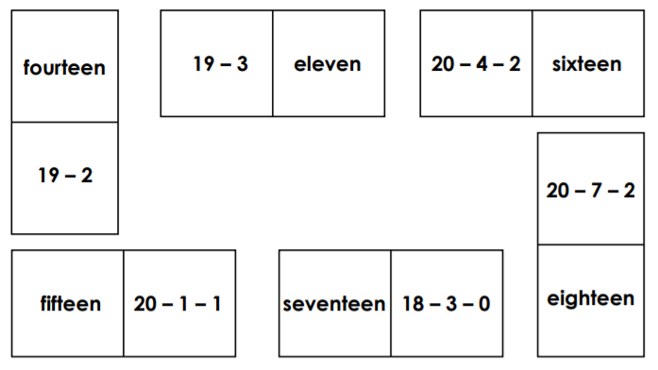
Challenge 1…
Anna has arranged the loop cards below so they go around in a loop.
Use ‘because’ to help you prove it.
Has she arranged the cards correctly? Prove it.

Slide 46
Challenge 1… - Answers
Anna has arranged the loop cards below so they go around in a loop.
Card 1
Card 2
Check each subtraction links to the answer on the next card…
Has she arranged the cards correctly? Prove it.
Anna hasn’t arranged the cards correctly because 20-7=13 and then 13-2=11 but Anna has matched this to 16.
Card 1 and 2 are the incorrect way around.

Slide 47






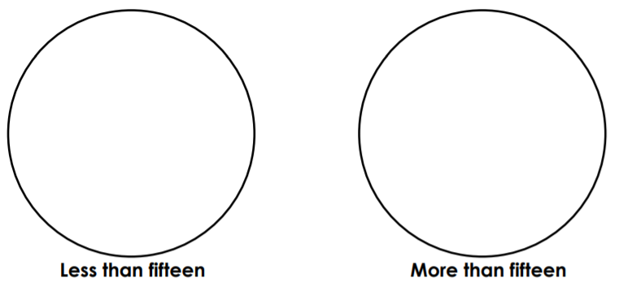
Challenge 2…
Solve the calculations and put each calculation in the correct hoop.

Slide 48
Challenge 2… - Answers
Solve the calculations and put each calculation in the correct hoop.

Slide 49
Well done for all of your hard work this lesson!
Please send your completed work for this session to: pioneerspupils@gmail.com

Slide 50
Date: 01.07.21
LO To be able to count in multiples of 2, 5 and 10.
Subject: Maths

Slide 51
Warm Up
Timed Twenty!
Have a go at working out the answer to these 20 arithmetic sums as quickly as you can!
Get someone to time you!
2 + 1 =
10 + 1 =
3 + 1 =
4 + 1 =
7 + 1 =
2 + 2 =
9 + 4 =
10 + 3 =
8 + 2 =
6 + 4 =
11. 10 – 2 =
10 – 1 =
10 – 4 =
10 – 0 =
10 – 5 =
8 – 3 =
9 – 7 =
6 – 4 =
6 – 6 =
5 – 4 =
DID YOU BEAT YESTERDAY’S TIME?

Slide 52
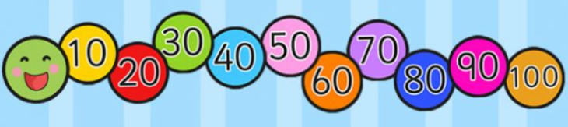
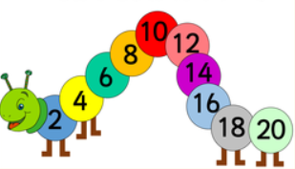
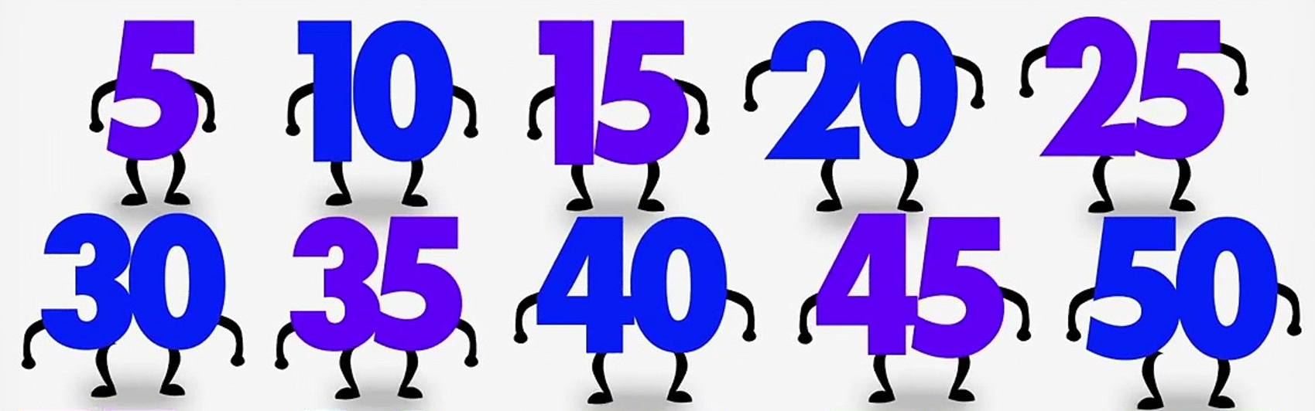
Count in 2’s, 5’s and 10’s
Warm Up
Chant in 10’s, 5’s and 2’s!
Counting in 10’s
Count forwards and backwards!
Counting in 2’s
Counting in 5’s

Slide 53
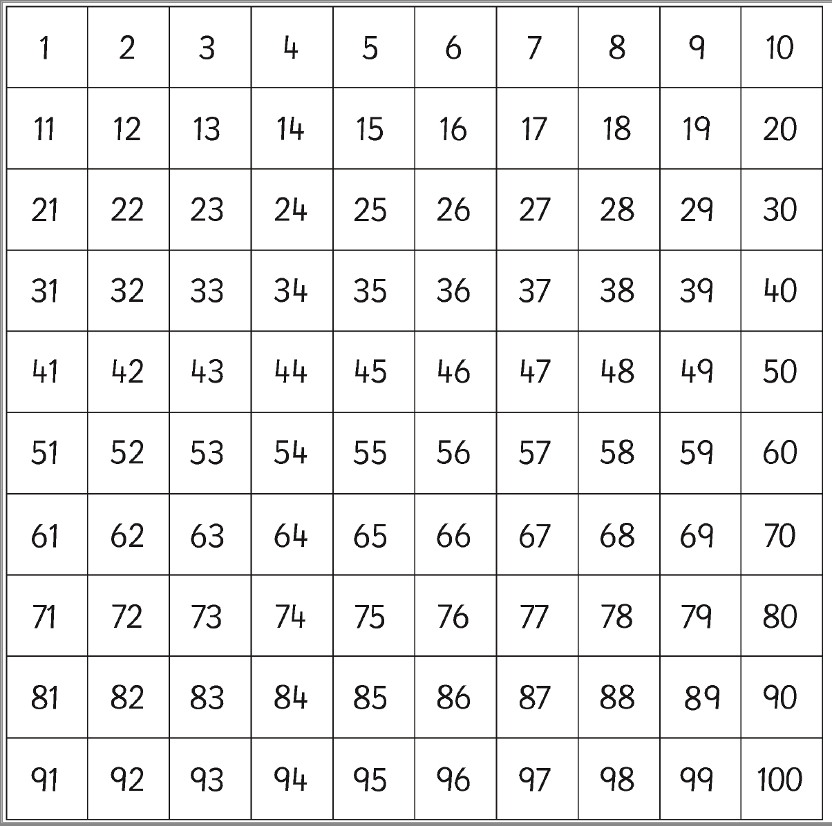
Count in 2’s, 5’s and 10’s
Colour the multiples of 2 up to 20 (e.g. red)
Colour the multiples of 5 up to 50 (e.g. green)
Colour the multiples of 10 up to 100 (e.g. yellow)
Use the previous slide to help you if you need!

Slide 54
You can use your number square to help you if you need it!
Fill in the Missing Numbers…
Counting in 10’s
60
10, ____, 30, ____, 50, ____, 70, ____, 90, ____
50, ____, ____, 80, 90, _____, _____, 120, _____
60, ____, 40, ____, ____, 10, ____
120, _____, _____, 90, ____, 70, ____ 50 ____ 30
100, 90, ____, ____, ____, ____, 40, ____, 20
20
50
30
20
0
Be careful – you are now working backwards!

Slide 55
You can use your number square to help you if you need it!
Fill in the Missing Numbers…
Counting in 2’s
2, ____, 6, ____, 10, ____, 14, ____, 18, ____
0, ____, ____, 6, 8, ____, ____, 14, 16, 18
10, ____, 14, ____, ____, 20, ____, ____, 26, ____, 30
24, ____, ____, 18, ____, 14, ____, 10, ____, 6, 4
30, ____, ____, 24, ____, ____, 18, ____, 14, ____, 10
Backwards!

Slide 56
You can use your number square to help you if you need it!
Fill in the Missing Numbers…
Counting in 5’s
5, ____, 15, ____, 25, ____, 35, ____, 45, ____
10, ____, 20, ____, ____, 35, ____, ____, 50 ____
40, ____, ____, 55, ____, ____, 70, ____, 80, ____
40, 35, 30, ____, 20, _____, _____, 5, 0
55, ____, _____, 40, 35, 30, _____, 20, _____
Backwards!

Slide 57
Challenge!
Have a go at these problems…

Slide 58
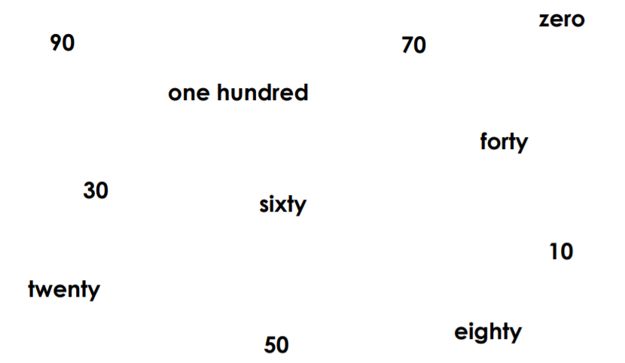
Challenge…
Can you include your knowledge of odd and even numbers?
How many ways can you think of ordering these numbers?
See if you can think of at least 3 ways below:

Slide 59
Challenge… - Answers
How many ways can you think of ordering these numbers?
Forwards
Odd Tens Digits
Backwards
Even Tens Digits
See if you can think of at least 3 ways below:
Zero, 10, twenty, 30, forty, 50, sixty, 70, eighty, 90, one hundred – Forwards counting in 10s
One hundred, 90, eighty, 70, sixty, 50, forty, 30, twenty, 10, zero – Backwards counting in 10s
10, 30, 50, 70, 90 – Odd tens digit

Slide 60
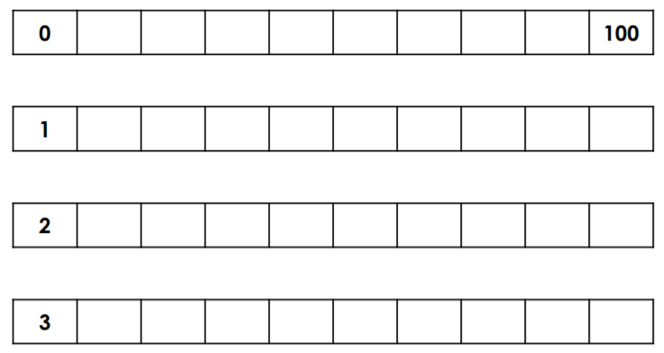
Challenge 2…
Count in 10’s from…
Do you notice a pattern?
11
21
What is the same about each set of numbers?
What is the different about each set of numbers?

Slide 61
Challenge 2… - Answers
Count in 10’s from…
10 20 30 40 50 60 70 80 90
Do you notice a pattern?
11
21
31 41 51 61 71 81 91
12 22 32 42 52 62 72 82 92
13 23 33 43 53 63 73 83 93
What is the same about each set of numbers?
The tens go up by 1 with each number in all the sequences.
What is the different about each set of numbers?
Each set of numbers have a different number of ones.

Slide 62
Well done for all of your hard work this lesson!
Please send your completed work for this session to: pioneerspupils@gmail.com

Slide 63
Date: 02.07.21
LO To be able to solve maths problems.
Subject: Maths

Slide 64
Warm Up
Timed Twenty!
Have a go at working out the answer to these 20 arithmetic sums as quickly as you can!
Get someone to time you!
2 + 1 =
10 + 1 =
3 + 1 =
4 + 1 =
7 + 1 =
2 + 2 =
9 + 4 =
10 + 3 =
8 + 2 =
6 + 4 =
11. 10 – 2 =
10 – 1 =
10 – 4 =
10 – 0 =
10 – 5 =
8 – 3 =
9 – 7 =
6 – 4 =
6 – 6 =
5 – 4 =
DID YOU BEAT YESTERDAY’S TIME?

Slide 65




Word Problems
Jenny and Thomas put their pocket money together to buy some sweets. If Jenny has 10p and Thomas has 15p, how much money do they have to spend altogether?
You can use whichever strategy is easiest for you to find out the answer!
TO TO
10p + 15p = 20 + 5 = 25p
Altogether tells us that we need to add the two amounts.
2 tens (20)
5 ones (5)
+
=
=
25
2 tens and 5 ones
+
=
=
25
2 tens and 5 ones

Slide 66

Word Problems
Carly and Emma put their pocket money together to buy some sweets. If Jenny has 15p and Thomas has 13p, how much money do they have to spend altogether?
Write your answer
here!
You can use whichever strategy is easiest for you to find out the answer!
TO TO
15p + 13p = ____
Altogether tells us that we need to add the two amounts.
Show your working out in this box:
15p + 13p =

Slide 67

Word Problems
Jake had 17 marbles and Billy had 21 marbles. How many marbles do they have altogether to put in the marble jar?
Write your number sentence here!
You can use whichever strategy is easiest for you to find out the answer!
TO TO
___ + ___ = ____
Altogether tells us that we need to add the two amounts.
Show your working out in this box:

Slide 68
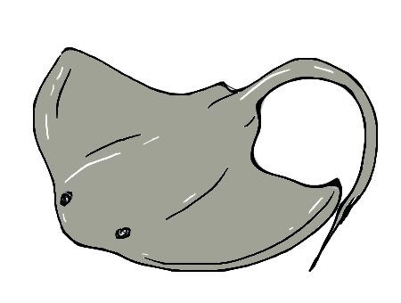
Word Problems
At the aquarium, there are 25 stingrays and 20 clownfish that share a tank. How many sea creatures are in the tank altogether?
Write your number sentence here!
You can use whichever strategy is easiest for you to find out the answer!
TO TO
___ + ___ = ____
Altogether tells us that we need to add the two amounts.
Show your working out in this box:

Slide 69

Word Problems
Chloe holds a bake sale to raise money for charity. Chloe bakes 24 cupcakes for the event and her best friend Tim brings 14 crispy cakes. How many cakes do they have altogether to sell at the bake sale?
Write your number sentence here!
You can use whichever strategy is easiest for you to find out the answer!
TO TO
___ + ___ = ____
Altogether tells us that we need to add the two amounts.
Show your working out in this box:

Slide 70
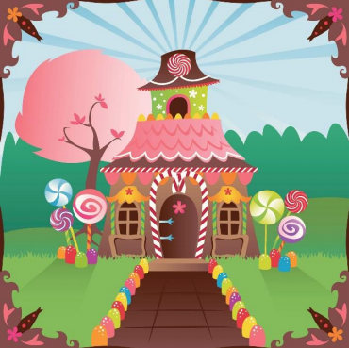

Wilma’s Wonderful Party
Wilma the witch is hosting a big party of all of her neighbours in the forest. She needs your help with some of the preparations to make sure that she hosts the BEST party ever!
Each problem you solve will help Wilma organized for the celebrations! Don’t worry though, if you’re not sure how to work out the answer to a problem, there is help and guidance on the following page.
I want my house to look like this for the party!

Slide 71



Wilma’s Wonderful Party
First, Wilma needs to get some decorations! She would like some giant gum drops to go around the front of her cottage.
She knows that she needs more than 20 but less than 27 giant gumdrops in total to go along the front path.
How many does she need to buy at the shop? Find the different amounts of gumdrops Wilma could buy.
Show your answers in this box:
More than 20 but less than 27 means:
Have a go at writing all the different combinations to give you the right amount of gumdrops!

Slide 72
Wilma’s Wonderful Party - Answers
First, Wilma needs to get some decorations! She would like some giant gum drops to go around the front of her cottage.
She knows that she needs more than 20 but less than 27 giant gumdrops in total to go along the front path.
How many does she need to buy at the shop? Find the different amounts of gumdrops Wilma could buy.
Show your answers in this box:
More than 20 but less than 27 means:
21
22
23
24
25
26
Have a go at writing all the different combinations to give you the right amount of gumdrops!

Slide 73

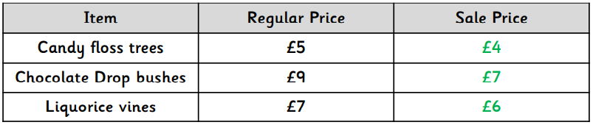

Wilma’s Wonderful Party
Next, Wilma wants to decorate the rest of the garden so she goes to Gemma’s Garden Utopia. She looks at the cost of some different garden decorations:
Wilma wants 2 candy floss trees, 2 chocolate drop bushes and 2 liquorice vines to make her garden look amazing for the party! Luckily, the three things are on sale.
How much does she spend on each different thing?
2 candy floss trees:
Show your working out in this box:
Write your number sentence for each different thing.
2 chocolate drop bushes:
2 liquorice vines:

Slide 74
Wilma’s Wonderful Party - Answers
Next, Wilma wants to decorate the rest of the garden so she goes to Gemma’s Garden Utopia. She looks at the cost of some different garden decorations:
Wilma wants 2 candy floss trees, 2 chocolate drop bushes and 2 liquorice vines to make her garden look amazing for the party! Luckily, the three things are on sale.
How much does she spend on each different thing?
2 candy floss trees:
Show your working out in this box:
£4 + £4 = £8
You have to add 2 of each thing together.
2 chocolate drop bushes:
£7 + £7 = £14
2 liquorice vines:
£6 + £6 = £12

Slide 75



Wilma’s Wonderful Party
If the chocolate drop bushes used to be £9 but now they are £7, how much cheaper are they now?
Show your working out in this box:
What is the difference – subtract!

Slide 76
Wilma’s Wonderful Party - Answers
If the chocolate drop bushes used to be £9 but now they are £7, how much cheaper are they now?
Show your working out in this box:
£9 - £7 = the difference
Start with the original price.
Original price
New sale price
£9 - £7 = £2

Slide 77
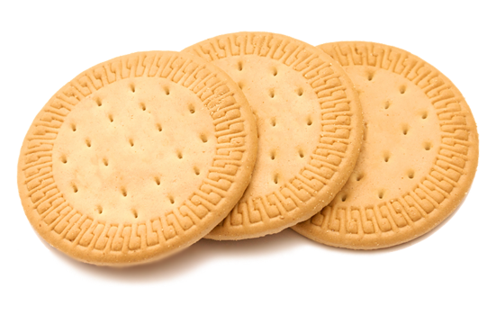


Wilma’s Wonderful Party
Finally, Wilma wants to make sure there are plenty of biscuits for her guests to eat! She wants to buy 26 biscuits altogether to make sure she has enough.
Wilma buys her biscuits in packs of 2.
How many packs of biscuits does Wilma need to buy to have 26 biscuits?
Show your working out in this box:
Think about what you are going to count in…

Slide 78
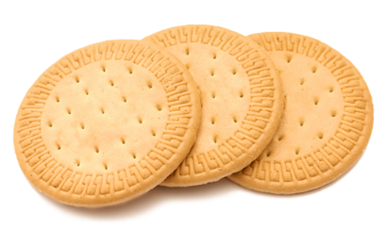
Wilma’s Wonderful Party - Answers
Finally, Wilma wants to make sure there are plenty of biscuits for her guests to eat! She wants to buy 26 biscuits altogether to make sure she has enough.
Wilma buys her biscuits in packs of 2.
How many packs of biscuits does Wilma need to buy to have 26 biscuits?
Show your working out in this box:
2 biscuits in a pack means we count in 2’s.
Need a total of 26
Think about what you are going to count in…
2, 4, 6, 8, 10, 12, 14, 16, 18, 20, 22, 24, 26 – How many 2’s did we count in?
13 lots of two
This means we need 13 packs of biscuits!

Slide 79




Wilma’s Wonderful Party
Thank you for all of your help!

Slide 80
Well done for all of your hard work this lesson!
Please send your completed work for this session to: pioneerspupils@gmail.com

