Slide 1


Subject: Maths
Pack: A

Slide 2



Date: 22.2.2021
LO. To be able to identify representations of 9 and 10.
Subject: Maths

Slide 3

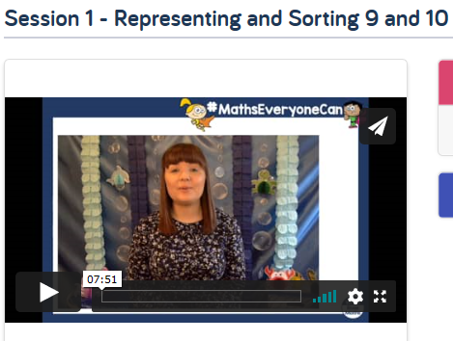
Pre-recorded Teaching
Access the online teaching video below that will support you to complete the work in this lesson. This video will act as a support but all of the work can still be successfully understood & completed using paper-based versions of this pack. If you need further support to understand / complete work then please contact school via e-mail or telephone.
Play Video
The link will take your to a page full of videos. Please make sure you watch Session 1 – Representing and Sorting 9 and 10.
You can also copy and paste this link if you would prefer:
https://whiterosemaths.com/homelearning/early-years/building-9-10-week-1/

Slide 4



Today we are going to have a look at the different representations of the number 9 and 10!
Here you can see the Numicon that shows us the number 9 and the number 10.
I know that the purple Numicon is the number 9 as it has 9 holes.
I know that the blue Numicon is the number 10 as it has 10 holes.

Slide 5

The numbers 9 and 10 can also be represented by their digit. You can see the representations of each number below.
10
You can practice forming the numbers using different coloured pencils

Slide 6

We can also write the numbers in words. Mrs Levington has done this for you below.
Mrs Levington has told us that one of the words represents 9 and the other represents 10. Do you know which word shows which number?
nine
ten
You could try and Fred Talk the green word to your adult.

Slide 7
Let’s find out together which dice shows the number 9 and which one shows the number 10. Count the spots on each dice with me.
1
2
1
7
3
2
5
8
4
5
6
6
3
9
7
8
9
4
10
That’s right this dice shows us the number 9. Super counting!
How many dots did we have on this dice?
Tell your adult how you know.

Slide 8


Lets work out which pair of hands are showing us 10 and which pair are showing us 9.
I have helped you by starting the counting on each pair of hands, count with me and then keep going.
Write your answer in the boxes below the hands.
2
3
2
3
4
4
5
1
1

Slide 9
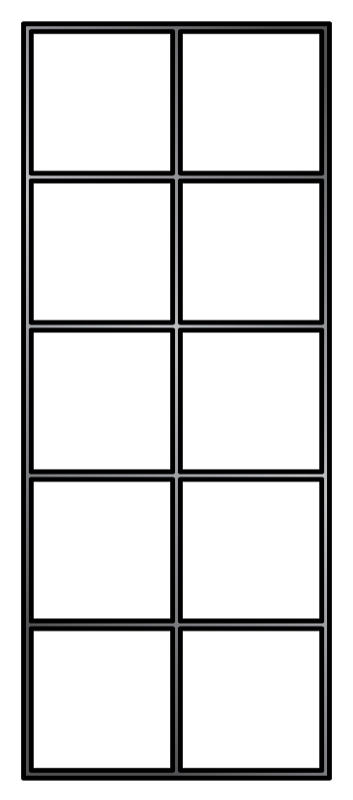

Here you can see 2 10s frames.
Can you work out which one shows us the number 9 and which one shows us the number 10.
Write your answer in the box below the 10s frame.

Slide 10
Here you can see different representations of the numbers 9 and 10.
Can you sort them into the correct column?
10
ten
nine
9 | 10

Slide 11
Date: 23.2.2021
LO. To be able to identify representations of 9 and 10.
Subject: Maths

Slide 12
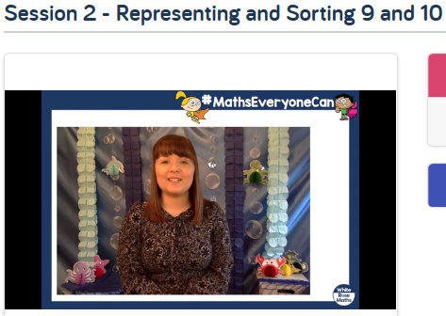
Pre-recorded Teaching
Access the online teaching video below that will support you to complete the work in this lesson. This video will act as a support but all of the work can still be successfully understood & completed using paper-based versions of this pack. If you need further support to understand / complete work then please contact school via e-mail or telephone.
Play Video
The link will take your to a page full of videos. Please make sure you watch Session 2 – Representing and Sorting 9 and 10.
You can also copy and paste this link if you would prefer:
https://whiterosemaths.com/homelearning/early-years/building-9-10-week-1/

Slide 13
Today we are going to look at different ways that we can represent the number 9 and 10.
Let’s start by refreshing our memory about how a 10 frame works.
Mrs Levington can count the spots to give her the answer.
1
2
3
4
Mrs Levington knows that a 10s frame has 10 spaces, she can see that there are 5 spots in the 10s frame. This means Mrs Levington has 5.
5
Let’s take a look at the next one…

Slide 14
Here we can see a full 10s frame. Are there any empty spaces in our 10s frame?
We have 5 spots on the top row…
We can now do 5 + 5 to get our answer, or you can count each spot.
Let’s do that now.
Mrs Levington has wrote her answer in the box below. Is she correct?
1
2
3
4
5
1
2
3
4
5
… and 5 spots on the bottom row.
10

Slide 15
We know that there are 10 spaces in a 10s frame. Let’s count the spots together to find out what number we have got.
Count the spots out loud to your adult.
1
2
3
4
5
Super job. We now know that we have the number 9 in our 10s frame.
6
7
8
9
If you are super confident you might be able to see that there are 5 spots in the top row and 2 on the bottom row.
Then you can do 5 + 4 = 9

Slide 16
Here’s a 10s frame. I have put 8 in for you, can you make a total of 10 circles in the frame.
Can your write the total number of spots in your 10s frame in the box below?
1
2
3
4
5
6
7

Slide 17
Here we can see a 10s frame. Can you tell me how much we have in this 10s frame? Write your answer in the box. Could you tell me how you worked the answer out?
Write your answer here
How did you work out the answer?

Slide 18



You are going to see 9 and 10 shown to you in different ways. Your job will be to decide if you have a representation of the number 9 or the number 10.
Mrs Simpson is going to help you with the first couple of problems.
Mrs Simpson has been give 2 pieces of Numicon. She has been given the number 7 and 2. Mrs Simpson knows this because she has counted the spots on each piece of Numicon.
1
Mrs Simpson did 7 + 2 to give her the answer of 9.
She could have also counted each individual spot to give her the answer of 9.
2
3
4
5
6
7
1
2

Slide 19


Let’s have a look at this one together. We need to work out if Mrs Simpson has 9 or 10 buns. Remember there are 2 ways that we can work the answer out.
We could count each bun to see how many there are altogether.
We could also do it like this, we know that we have 4 buns on top and 6 buns on the bottom. This means we would need to do 4 + 6 to give us the answer.
Choose which way you are going to help Mrs Simpson work out her answer then drag the buns to the correct bucket.
The answer is on the next slide.

Slide 20
That’s right, we have 10 buns. Mrs Simpson did 4 + 6 to give her 10. To check she was right she then counted each bun to check that she had 10.
Super job!

Slide 21






Have a look at the 10s frame, you can see you have some yellow spots and a red spot. Can you work out how many spot you have altogether and put the picture into the correct bucket.

Slide 22
You can now see you have 2 pieces of Numicon that in total make 9 or 10. But which one is it? Can you work it out from me.
Again drag the picture to the correct bucket or draw a line.

Slide 23
Count the spots on the ladybirds back. How many does she have?

Slide 24
Here you can see two dice. Do I have 9 dots or 10 dots?

Slide 25
We have already seen some Numicon today, but here is a different composition to make either 9 or 10. Can you work it out for me?
Well done, you have done an amazing job sorting out our representations of the numbers 9 and 10.

Slide 26
Date: 24.2.2021
LO. To be able to order numerals to 10.
Subject: Maths

Slide 27
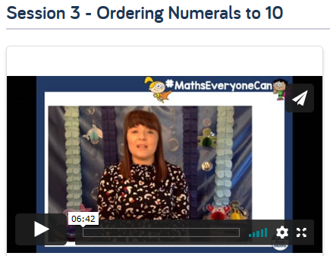
Pre-recorded Teaching
Access the online teaching video below that will support you to complete the work in this lesson. This video will act as a support but all of the work can still be successfully understood & completed using paper-based versions of this pack. If you need further support to understand / complete work then please contact school via e-mail or telephone.
Play Video
The link will take your to a page full of videos. Please make sure you watch Session 3 – Ordering Numerals to 10
You can also copy and paste this link if you would prefer:
https://whiterosemaths.com/homelearning/early-years/building-9-10-week-1/

Slide 28






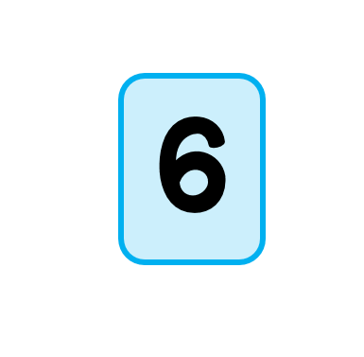


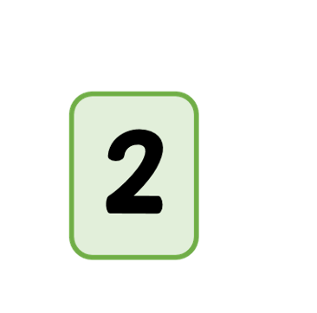

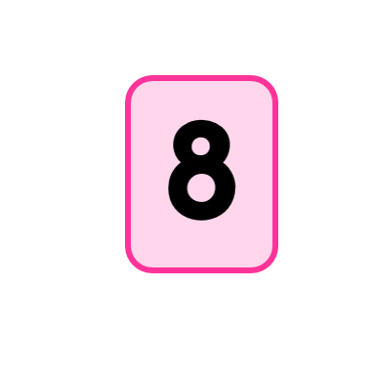
Today we are going to be ordering numbers 1-10.
Miss Bentley has got some jumbled up numbers. How is she going to reorder them?
Miss Bentley knows that number 1 goes at the start…
… and that number 10 goes at the end.
… number 5 goes in the middle….

Slide 29
Miss Bentley now has her beginning, middle and end. She now needs to fill in the other missing numbers.
Miss Bentley thinks that number 2 comes after number 1.
… and that number 10 goes at the end.
I need to count on from 5. Adding 1 more equals 6
2 add 1 = 3
I know that 3 add 1 more equals 4
6 + 1 = 7

Slide 30
I have finished ordering my numbers.
I am going to count them. 1, 2, 3, 4, 5, 7, 6……. That’s not right?
Did you spot where I went wrong?
I got 6 and 7 the wrong way around. Let’s fix it.
1, 2, 3, 4, 5, 6, 7, 8, 9, 10.
My numbers are now in the correct order.

Slide 31
Let’s try this together. The numbers have been mixed up again by Mr Pennal.
Can you help him put the numbers into the correct order?
He has helped you by putting some of the numbers in the correct place for you.

Slide 32
Now it’s your turn, order the numbers correctly then read it to your adult making sure you have put them into the correct order.

Slide 33
You did a great job at ordering your numbers. Take a look at the
order of these numbers. Can you spot something that doesn’t look right?
Did you spot it?
You can either move the numbers back into the correct order or put a circle around the 2 numbers that are in the wrong place.

Slide 34
Take a look at the ordering of these numbers. Can you spot which numbers are in the wrong place?
Did you spot it?
You can either move the numbers back into the correct order or put a circle around the 2 numbers that are in the wrong place.

Slide 35
Take a look at the ordering of these numbers. Can you spot which numbers are in the wrong place? There might be more than 2 numbers in the wrong place this time so look carefully.
Did you spot it?
You can either move the numbers back into the correct order or put a circle around the numbers that are in the wrong place.

Slide 36
Date: 25.2.2021
LO. To be able to partition 9 and 10.
Subject: Maths

Slide 37
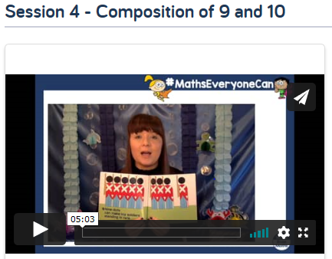
Pre-recorded Teaching
Access the online teaching video below that will support you to complete the work in this lesson. This video will act as a support but all of the work can still be successfully understood & completed using paper-based versions of this pack. If you need further support to understand / complete work then please contact school via e-mail or telephone.
Play Video
The link will take your to a page full of videos. Please make sure you watch Session 4 – Composition of 9 and 10.
You can also copy and paste this link if you would prefer:
https://whiterosemaths.com/homelearning/early-years/building-9-10-week-1/

Slide 38

Today we are going to look at the different ways which we can make the numbers 9 and 10.
I am going to help teddy work out how many wheels he has on his train.
I can see that this train has 3 wheels on each section.
1
2
3
1
2
3
1
2
3
3
+
3
+
3
=
9

Slide 39


After teddy got off the train he got some strawberries. Teddy picks up 9 strawberries and would like me to help him separate them into 2 groups. How could I do this?
I can see a 10s frame that has 9 strawberries in it.
I am going to separate the strawberries into a group of 6 and a group of 3
I now know that I can separate 9 into 6 and 3.
6 + 3 = 9

Slide 40
Can you help me and Teddy? I have worded out that Teddy has got 9 strawberries. He wants to split his 9 strawberries up into 7 and 2.
I have put 2 strawberries on the plate. Can you move 7 more onto the empty plate to make 9.
Can you complete the numbered sum below.
2 + 7 =

Slide 41
Now it’s your turn to help Teddy.
Can you help Teddy separate his 9 strawberries into the correct number.
Move the strawberries onto the plates below.
Once you have moved the strawberries completed the sum.
+
=

Slide 42
Can you help Teddy separate his 9 strawberries into the correct number.
Move the strawberries onto the plates below.
Once you have moved the strawberries completed the sum.
+
=

Slide 43
This time Teddy wants to partition his 9 strawberries into 3 parts. Can you help him?
Teddy wants to split his strawberries into 3 groups of 3. Move the right number onto each plate.

Slide 44
Can you spot what has changed?
Yeah that’s right! We now have 10 strawberries.
This time we need to help Teddy partition his 10 strawberries.
We do this in the same way that we partitioned 9 strawberries, let’s do this one together.
I have moved 5 strawberries for you. Check that I have moved the correct amount then put the correct amount onto the empty plate.
Teddy wants to partition his 10 strawberries into 5 and 5.
+
=

Slide 45
Now it’s your turn to help Teddy partition his 10 strawberries.
Have a look at how many strawberries Teddy wants on each plate then help him move them.
+
=

Slide 46
Have a look at this one, Teddy has partitioned his 10 strawberries in a different way.
Have a look at how many strawberries Teddy wants on each plate then help him move them.
What does 7 + 3 = ?
+
=

Slide 47
Teddy can also partition his 10 strawberries into 3 parts. Can you help him?
Teddy is going to let you choose how many strawberries you want to put on each plate?
Write the number you put on each plate in the box below.
=

Slide 48
Date: 26.2.2021
LO. To be able to match numerals and quantities.
Subject: Maths

Slide 49
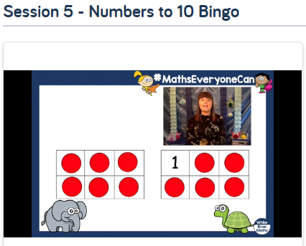
Pre-recorded Teaching
Access the online teaching video below that will support you to complete the work in this lesson. This video will act as a support but all of the work can still be successfully understood & completed using paper-based versions of this pack. If you need further support to understand / complete work then please contact school via e-mail or telephone.
Play Video
The link will take your to a page full of videos. Please make sure you watch Session 5 – Numbers to 10 Bingo.
You can also copy and paste this link if you would prefer:
https://whiterosemaths.com/homelearning/early-years/building-9-10-week-1/

Slide 50

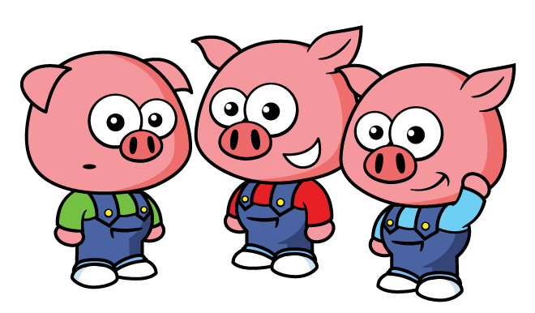

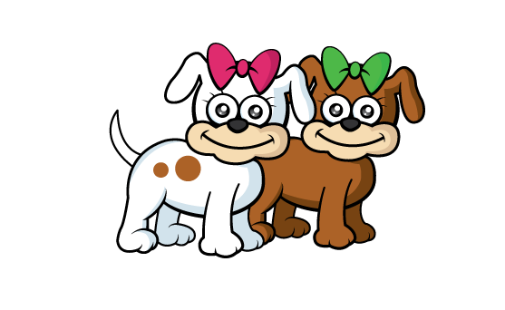

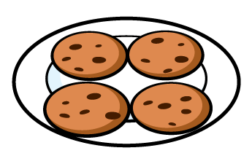


Today we are going to have a game of number 1-10 bingo. Here’s how we play.
1
2
3
4
5
I can see that the first card is a Numicon piece of the number 7
6
7
8
9
10 | 8 | 4
5 | 2 | 7
1 | 6 | 8
9 | 3 | 5
I need to find who has got the number 7. It’s the elephant. I need to put a red counter over the number 7.

Slide 51
Let’s try this one together. We need to have a look at the next card.
Can you tell me what number it shows?
1
2
3
4
5
6
7
8
9
The winner of the game is the first animal to cover all of their numbers.
10 | 8 | 4
5 | 2 | 7
1 | 6 | 8
9 | 3 | 5
That’s right it’s the number 10. Can you either move a red dot to cover the number 10 or cross it out.

Slide 52

Now it’s your turn to play against the Elephant. Good luck. Be careful, some numbers might be on both players cards so look carefully.
1
2
3
4
5
6
7
8
9
The winner of the game is the first one to cover all of their numbers.
10 | 8 | 4
5 | 2 | 7
1 | 6 | 8
9 | 3 | 5

Slide 53





Let’s play another game against the turtle.
1
2
3
4
5
6
7
8
9
The winner of the game is the first one to cover all of their numbers.
7 | 5 | 8
4 | 10 | 2
5 | 3 | 8
6 | 9 | 1

