Slide 1



Date: Monday 25th January
LO To be able to identify features of a letter.
Subject: English

Slide 2
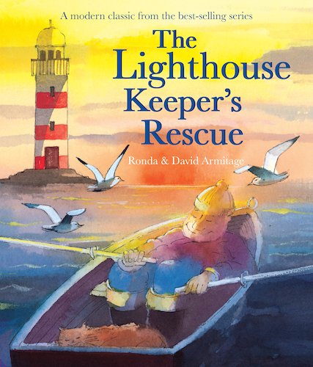
This is the story we are going to be focusing on this week.
We hope you enjoy it!
The Lighthouse Keeper's Rescue - Give Us A Story! – YouTube
Click on the link or copy and paste it into your internet browser to listen to the story being read.

Slide 3
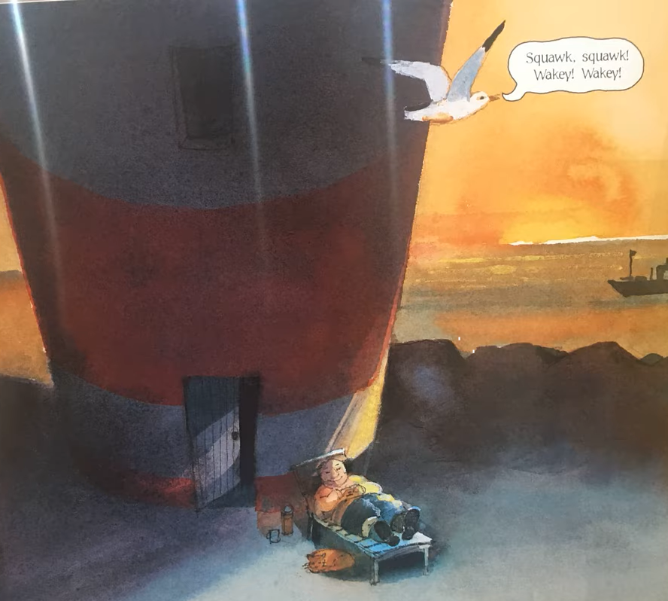
Thank you letter
This week we are going to be writing a thank you letter to the lighthouse inspectors.
What do you think we might need to include when writing a letter?
What are the key features of a letter?
Write your ideas on a piece of paper or type your ideas on the lines.

Slide 4
Thank you letter
Read my letter!
23 Harbour View,
Ocean Bay
OB2 4EN
25th January 2021
Dear the Inspectors of Lighthouses,
I am writing to say thank you for allowing me to keep my job. You won’t regret it!
I am extremely sorry for the mistakes I made and for falling asleep whilst at work! My bones ache because I’m getting old so I need to sleep more often. Did you know I have been a lighthouse keeper for over 40 years?
What is my new assistant like? Does he know when to turn the light on and off? Don’t worry he is in safe hands with me! I will make sure he knows everything there is to know about being a lighthouse keeper! I’m sure with my training he will become the second best lighthouse keeper in the world!
Thanks again for your support. I will make sure I go to bed early and get lots of rest on my days off so that I can do the job to the best of my ability. I will not let you down again because I love being a lighthouse keeper and keeping the brave sailors safe.
Yours sincerely,
Mr Grinling
P.S Mrs Grinling has baked you a delicious, chocolate cake to say thank you because we are ever so grateful.

Slide 5
Now find the features …
Thank you letter
23 Harbour View,
Ocean Bay
OB2 4EN
25th January 2021
Dear the Inspectors of Lighthouses,
I am writing to say thank you for allowing me to keep my job. You won’t regret it!
I am extremely sorry for the mistakes I made and for falling asleep whilst at work! My bones ache because I’m getting old so I need to sleep more often. Did you know I have been a lighthouse keeper for over 40 years?
What is my new assistant like? Does he know when to turn the light on and off? Don’t worry he is in safe hands with me! I will make sure he knows everything there is to know about being a lighthouse keeper! I’m sure with my training he will become the second best lighthouse keeper in the world!
Thanks again for your support. I will make sure I go to bed early and get lots of rest on my days off so that I can do the job to the best of my ability. I will not let you down again because I love being a lighthouse keeper and keeping the brave sailors safe.
Yours sincerely,
Mr Grinling
P.S Mrs Grinling has baked you a delicious, chocolate cake to say thank you because we are ever so grateful.
Use the key to highlight/ underline the key features in the correct colour
Address
Date
Dear
Yours Sincerely
Question
Exclamation mark
Because

Slide 6

Well done for all of your hard work! We can’t wait to see your completed work.
Could any completed work / photographic evidence of completed work please be sent to pioneerspupils@gmail.com
Thank you!

Slide 7
Date: Tuesday 26th January
LO To be able to punctuate questions with a question mark.
Subject: English

Slide 8
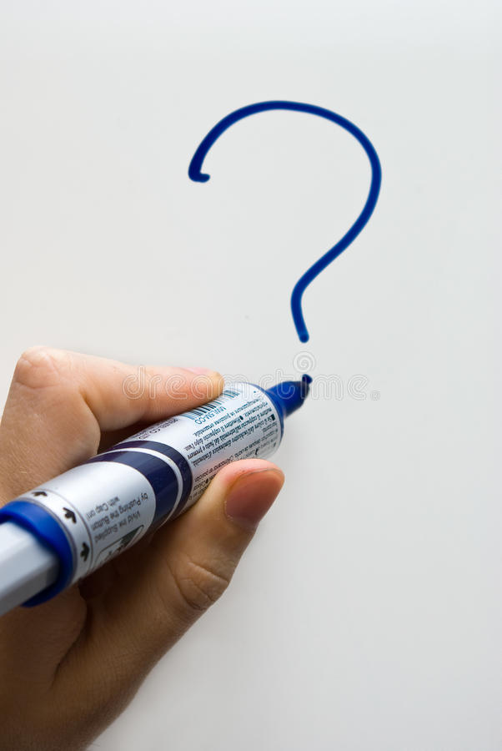
Recap - Question Marks
A question mark looks like this ?
It goes at the end of a question
Can you draw a question mark with your finger?
Now can you write a question mark on your paper?

Slide 9
What?
Question words
When?
Who?
Now can you write questions to ask the Inspector of Lighthouses.
Where?
Why?
How?
Example
Who will be my assistant?
Write 3 questions on the lines below or on a piece of paper.

Slide 10

Did
The word ‘did’ is often used to start questions.
Look at these examples:
Did you enjoy your tea party?
Did you go for a walk today?
Did Mrs Grinling bake a cake?
Did you know the sun sets at different time each day?
Did you know the tide comes in at different times each day?
All of the examples end with a question mark because when we use the word ‘did’ at the start of a sentence we are asking a question.

Slide 11
Add the question mark
Can you punctuate the sentences correctly using a question mark – remember a question mark looks like this ?
Where is the lighthouse
What do seagulls eat
How do you turn the light on in the lighthouse
When does the tide come in
Did you know that lighthouses are used to stop boats crashing into the rocks
Remember the ? goes at the end of the sentence

Slide 12

Add the question mark - answers
Check your answers. Did you put the question mark in the right place?
Where is the lighthouse?
What do seagulls eat?
How do you turn the light on in the lighthouse?
When does the tide come in?
Did you know that lighthouses are used to stop boats crashing into the rocks?

Slide 13
Question or statement?
A statement is a simple sentence.
A statement is always punctuated with a full stop at the end.
A question is something you can ask or answer.
A question is always punctuated with a question mark at the end .

Slide 14
Question or statement?
Read the sentences and decide if they need a full stop or question mark at the end. Use the word at the start of the sentence to help you decide.
1. Lighthouses are usually at the end of a pier
2. How does the lighthouse keeper get to the lighthouse
3. Did you know lighthouses are used to stop boats crashing into the rocks
4. Lighthouses are red and white
5. When does the light turn on
6. Where does the lighthouse keeper live
7. Seagull eat small fish
8. Why does the light turn on at different times every day

Slide 15
Question or statement? Answers
Check your answers. Did you get them all right?
1. Lighthouses are usually at the end of a pier.
2. How does the lighthouse keeper get to the lighthouse?
3. Did you know lighthouses are used to stop boats crashing into the rocks?
4. Lighthouses are red and white.
5. When does the light turn on?
6. Where does the lighthouse keeper live?
7. Seagull eat small fish.
8. Why does the light turn on at different times every day?

Slide 16
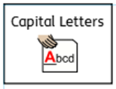


Now can you write your own questions to ask the Inspectors of Lighthouses?
You can use some of the questions we have already looked at to help.
What?
Who?
Question words
Don’t forget:
When?
Why?
Where?
Write your questions neatly onto a piece of paper or type them on the lines below. You will be able to use them in your writing tomorrow!
How?
Did?

Slide 17
Well done for all of your hard work! We can’t wait to see your completed work.
Could any completed work / photographic evidence of completed work please be sent to pioneerspupils@gmail.com
Thank you!

Slide 18
Date: Wednesday 27th January
LO To be able to extend sentences using ‘because’.
Subject: English

Slide 19
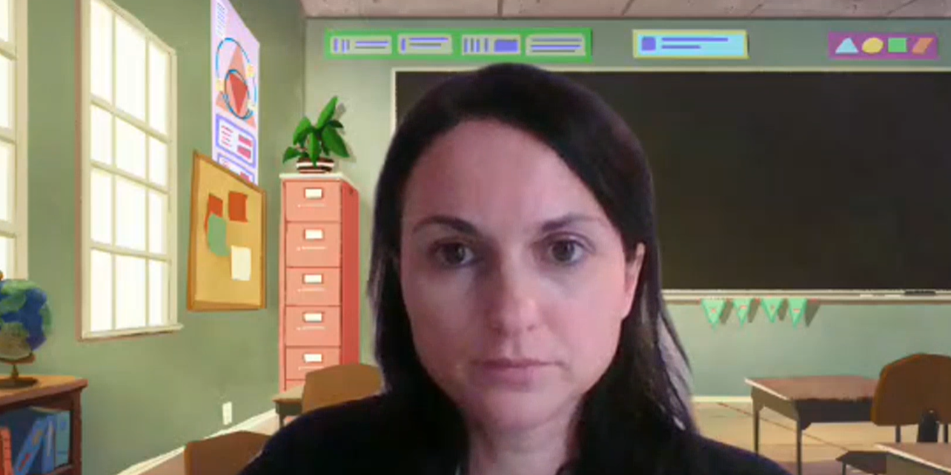
Pre Recorded Teaching
On the school website you will find a pre recorded video that will support the teaching of todays lesson. The video is called English video – using because.

Slide 20
because
We are going to use the word because to extend our sentences.
Can you say the word because?
Can you spell it out loud b e c a u s e?
Now can you practise writing the word because on a piece of paper?
Some people also use this funny sentence to help remember how to spell because –
big elephants can always understand small elephants

Slide 21
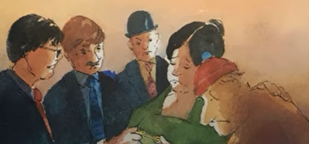
The word ‘because’ is a conjunction.
Conjunctions join two sentences together …
Example
The light house inspectors were cross because Mr Grinling fell asleep whilst at work.

Slide 22
Match the correct ending to the sentences
Sentence starters:
Ending:
Mrs Grinling was worried because
Mr Grinling fell asleep and forgot to turn the light on.
The lighthouse inspectors were cross because
it was dark and the light in the lighthouse wasn’t on.
Mr Grinling was sad because
Mr Grinling saved the whale.
All of the villagers cheered because
he lost his job.

Slide 23
Match the correct ending to the sentences – answers
Sentence starters:
Ending:
Mrs Grinling was worried because
Mr Grinling fell asleep and forgot to turn the light on.
The lighthouse inspectors were cross because
it was dark and the light in the lighthouse wasn’t on.
Mr Grinling was sad because
Mr Grinling saved the whale.
All of the villagers cheered because
he lost his job.

Slide 24
and or because?
A few weeks ago we looked at using ‘and’ to extend sentences. Lets see what you can remember! Read the sentences below and decide if the missing conjunction is ‘and’ or ‘because’.
Mr Grinling sat down ____________ watched the noisy, white seagull fly past.
2. The lighthouse inspectors were cross ____________ Mr Grinling fell asleep whilst at work.
3. Mr Grinling was sad ____________ hid in his bedroom.
4. All of the villagers were happy ____________ they rescued the huge, black whale.
5. Mr Grinling fell asleep ____________ forgot to turn the light on.

Slide 25
and or because? Answers
A few weeks ago we looked at using ‘and’ to extend sentences. Lets see what you can remember read the sentences below and decide if the missing conjunction is ‘and’ or ‘because’.
Mr Grinling sat down and watched the noisy, white seagull fly past.
2. The lighthouse inspectors were cross because Mr Grinling fell asleep whilst at work.
3. Mr Grinling was sad and hid in his bedroom.
4. All of the villagers were happy because they rescued the huge, black whale.
5. Mr Grinling fell asleep and forgot to turn the light on.

Slide 26
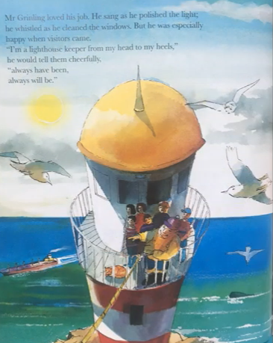
Complete my sentences:
Mr Grinling was sad because ___________________________________________.
The light house inspectors were angry because ___________________________________________.
Mrs Grinling was worried because ___________________________________________.
The word ‘because’ is a …
Conjunction

Slide 27
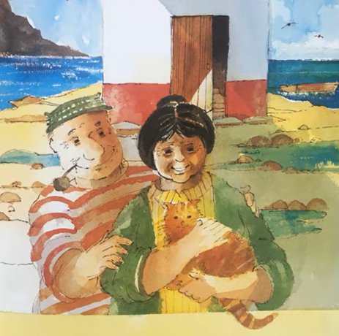

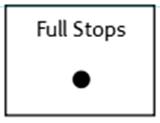
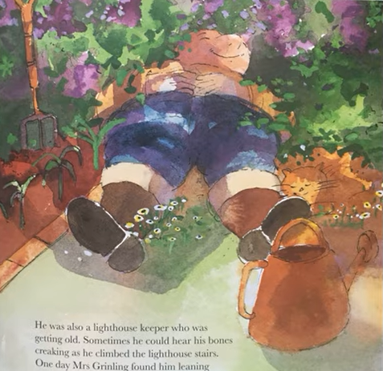
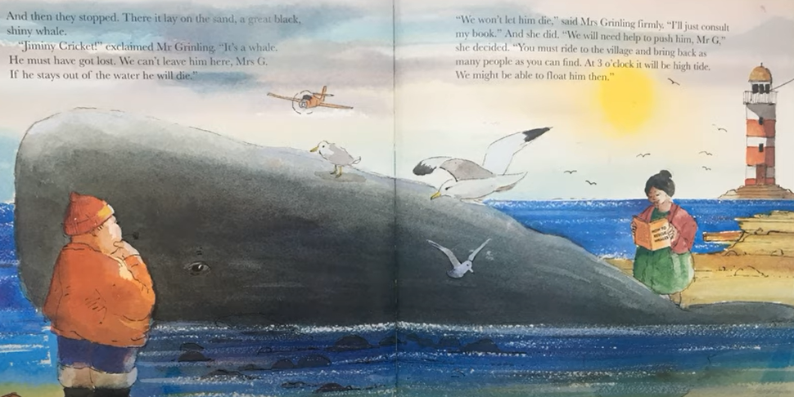
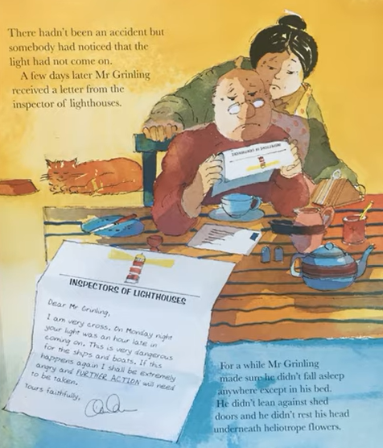
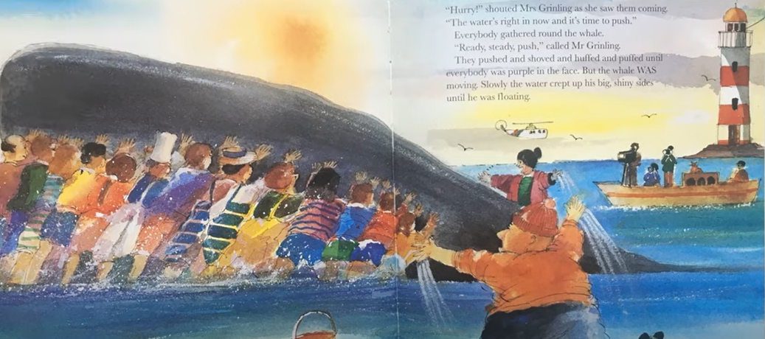
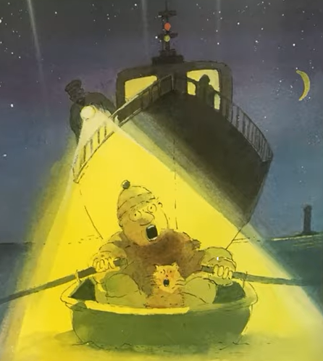
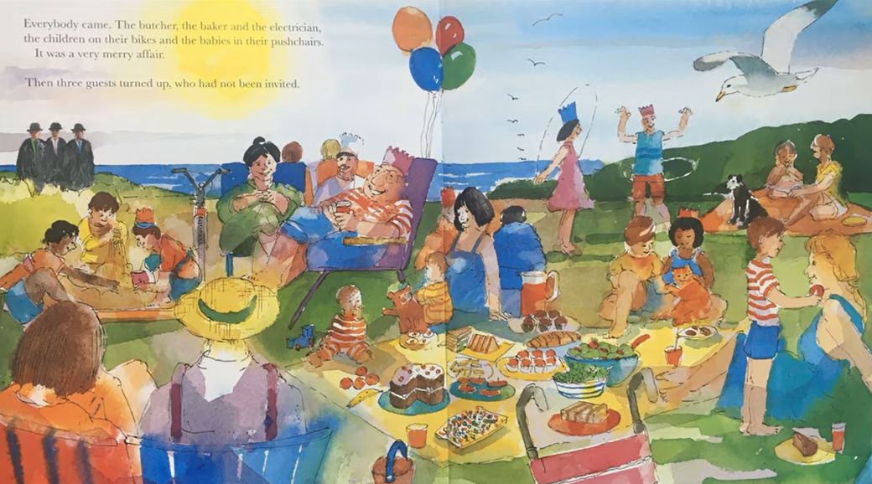
My turn …
Don’t forget
You will find a video to support this slide on the school website. The video is called: Writing sentences using because.

Slide 28
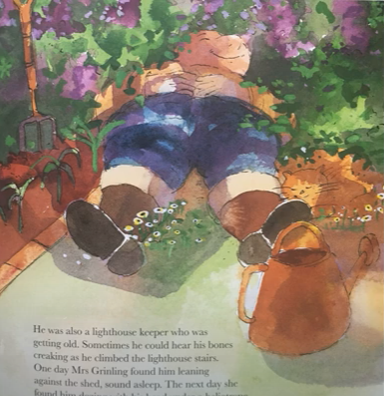
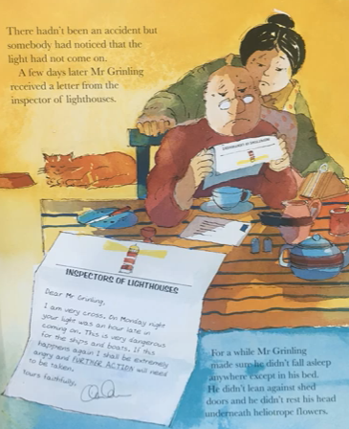
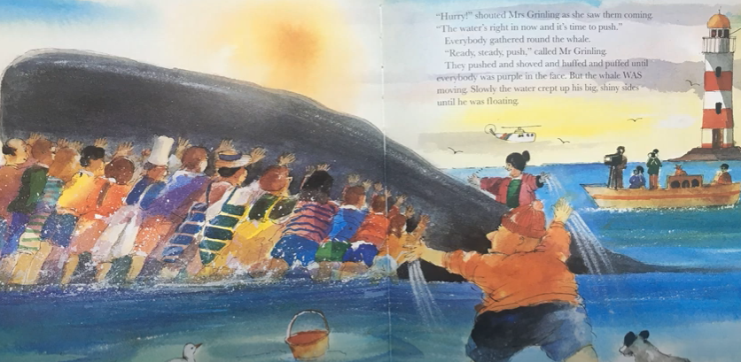
Your Sentences…
Write your own sentences about the story using the conjunction ‘because’ to extend your sentences
Don’t forget:
Use the pictures to help

Slide 29
Well done for all of your hard work! We can’t wait to see your completed work.
Could any completed work / photographic evidence of completed work please be sent to pioneerspupils@gmail.com
Thank you!

Slide 30
Date: Thursday 28th January
LO To be able to write a letter.
Subject: English

Slide 31
Thank you letter
Re read my letter to get it back in your head.
23 Harbour View,
Ocean Bay
OB2 4EN
25th January 2021
Dear the Inspectors of Lighthouses,
I am writing to say thank you for allowing me to keep my job. You won’t regret it!
I am extremely sorry for the mistakes I made and for falling asleep whilst at work! My bones ache because I’m getting old so I need to sleep more often. Did you know I have been a lighthouse keeper for over 40 years?
What is my new assistant like? Does he know when to turn the light on and off? Don’t worry he is in safe hands with me! I will make sure he knows everything there is to know about being a lighthouse keeper! I’m sure with my training he will become the second best lighthouse keeper in the world!
Thanks again for your support. I will make sure I go to bed early and get lots of rest on my days off so that I can do the job to the best of my ability. I will not let you down again because I love being a lighthouse keeper and keeping the brave sailors safe.
Yours sincerely,
Mr Grinling
P.S Mrs Grinling has baked you a delicious, chocolate cake to say thank you because we are ever so grateful.

Slide 32

Write a thank you letter
Today you are going to pretend to be Mr Grinling and write a thank you letter to the Inspectors of Lighthouses for allowing you to keep your job!
Your letter must include:
An address for the lighthouse inspectors
The date underneath the address
Dear Inspectors of Lighthouses
An introduction explaining why you are writing (1 sentence)
Paragraphs about what you will do differently to do the job better (at least 6 sentences)
Questions (at least 3)
Yours sincerely Mr Grinling
You can use the blank lines on the next slide to type your letter or you can write your letter on paper.
Address
Dear
Date
Information
This piece of writing should take approximately 45 minutes
Yours sincerely

Slide 34
Well done for all of your hard work! We can’t wait to see your completed work.
Could any completed work / photographic evidence of completed work please be sent to pioneerspupils@gmail.com
Thank you!

Slide 35
Date: Friday 29th January
LO To be able to read and spell words with the ‘wr’ sound.
Subject: English

Slide 36
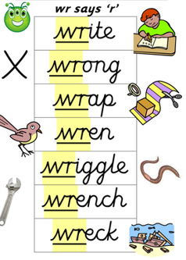
‘r’ – sound spelt as ‘wr’
The spelling rule we are focusing on today is ‘r’ but it is spelt ‘wr’.
It sounds like ‘r’ but we spell it with ‘wr’
Click on the links or copy and paste the links into your internet browser to watch the spelling videos.
https://www.youtube.com/watch?v=kiqtXCWtDkM
https://www.youtube.com/watch?v=ILyAP0yoP3k
https://www.youtube.com/watch?v=BQs-lP_eiwI

Slide 37
Read the ‘wr’ words
wrap
wrong
wrote
write
wren
wrapped
wrapping
wrestle
wriggle
wrecked
wrist
wreath
wrinkle
Now write the words on a piece of paper and underline the ‘wr’ sound.

Slide 38
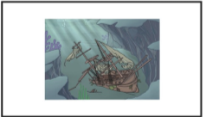

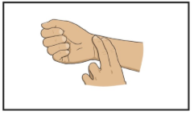
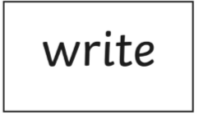

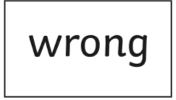
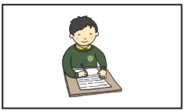


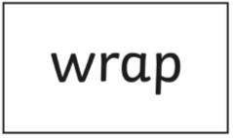
Match the picture to the correct word

Slide 39
Match the picture to the correct word - answers

Slide 40
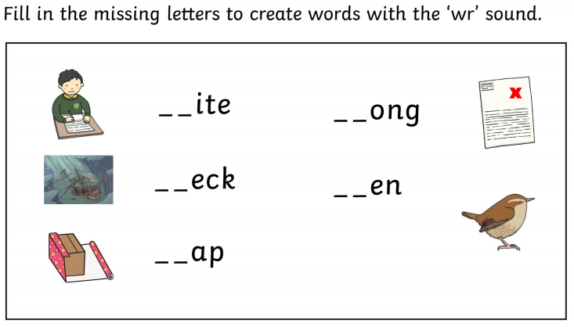

Slide 41
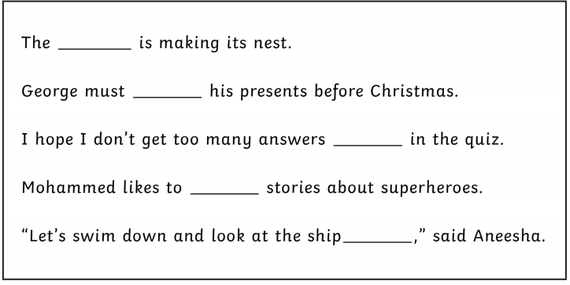
Read the sentences and fill in the missing words
wren
wreck
Choose from these words
wrap
write
wrong

Slide 42
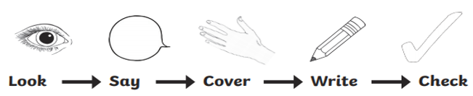
Word | 1st try | 2nd try | 3rd try
wrap
write
wrist
wrinkle
wrong
wreck
wriggle
Practice writing the words on a piece of paper or type into the table on your computer.

Slide 43
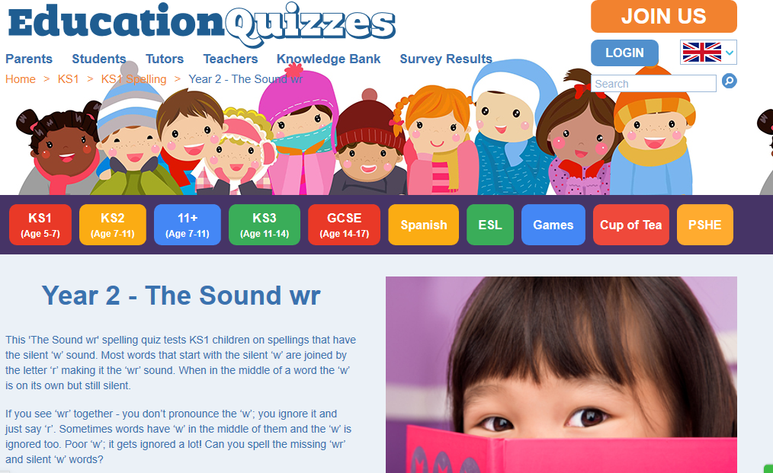
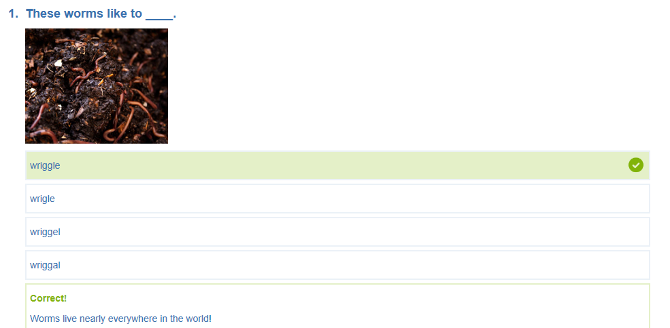
Spelling game
Use the link to play the game and practice spelling the ‘wr’ words
https://www.educationquizzes.com/ks1/english-spelling/year-2-the-sound-wr/

Slide 44
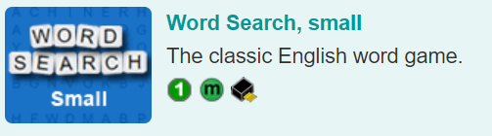
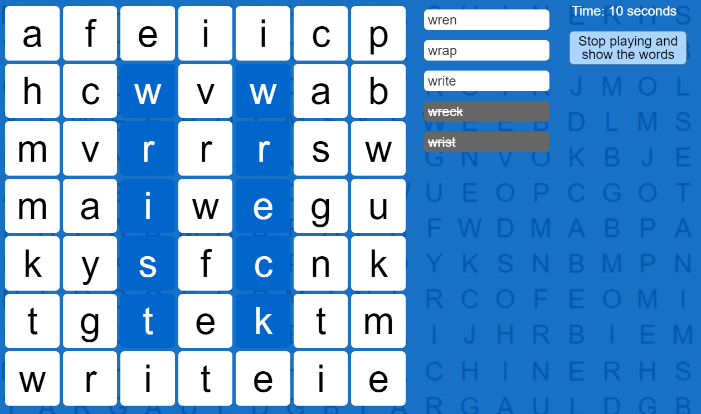
Spelling game
Use the link to play the game and practice spelling the ‘wr’ words
Spelling games: wr (spellzone.com)

Slide 45
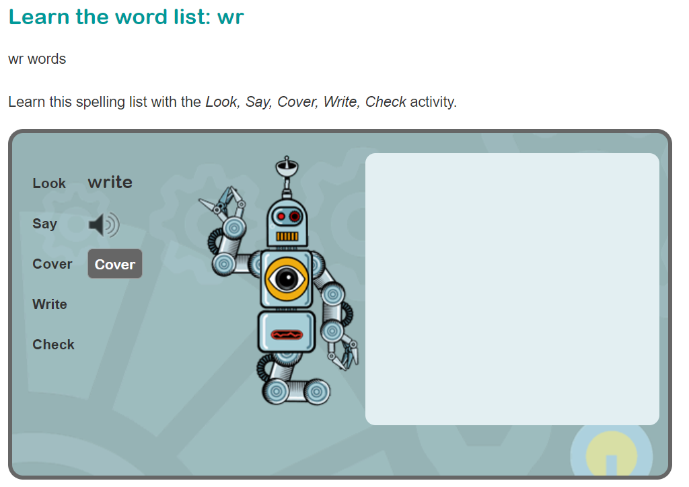
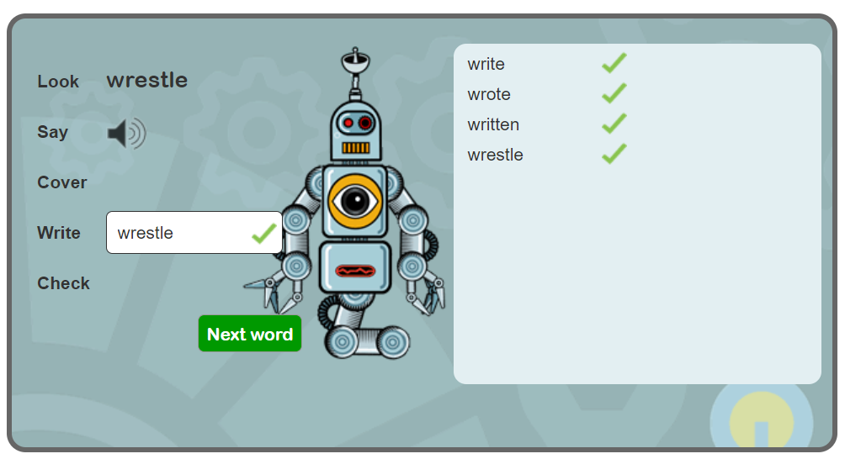
Spelling game
Use the link to play the game and practice spelling the ‘wr’ words
Learn spelling activity: wr (spellzone.com)

Slide 46
Well done for all of your hard work! We can’t wait to see your completed work.
Could any completed work / photographic evidence of completed work please be sent to pioneerspupils@gmail.com
Thank you!

