Slide 1
Date: Monday 28th June 2021
LO
LO.
Subject: P.E

Slide 2
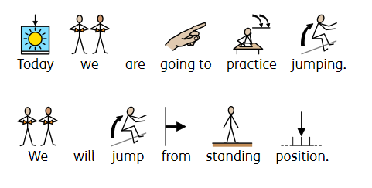
Jumping

Slide 3
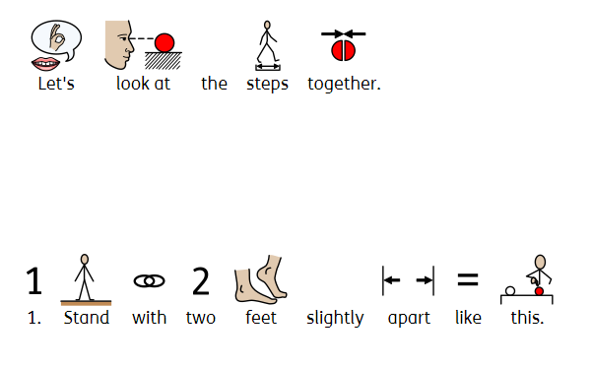
Jumping

Slide 4
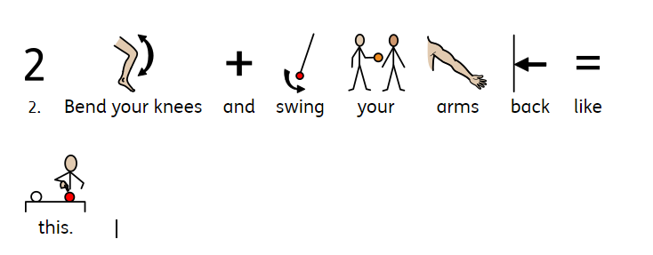
Jumping

Slide 5
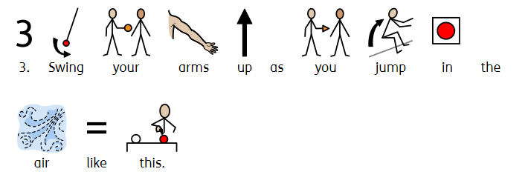
Jumping

Slide 6
Jumping
Click on the link to watch the music video.
jumping song

Slide 7
Date: Tuesday 29th June 2021
LO
LO.
Subject: Science

Slide 8
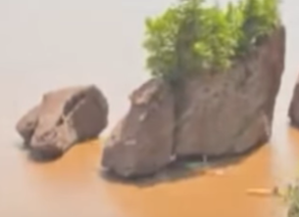
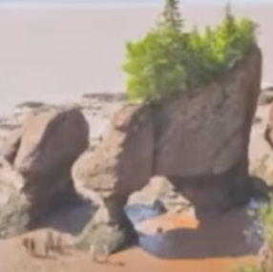
Rock erosion

Slide 9
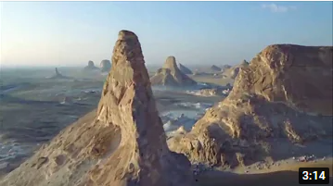
Rock erosion
.
rock erosion

Slide 10
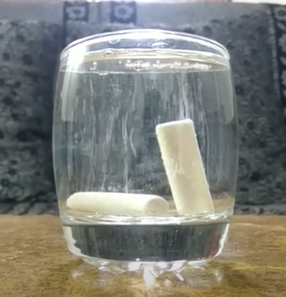
Rock erosion.
chalk in water

Slide 11
Rock erosion

Slide 12
Date: Wednesday 30th June 2021
LO
LO.
Subject: Science

Slide 13
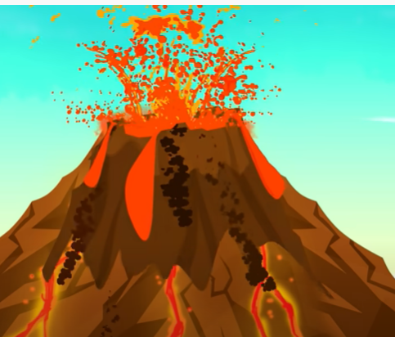
Volcanoes.

Slide 14
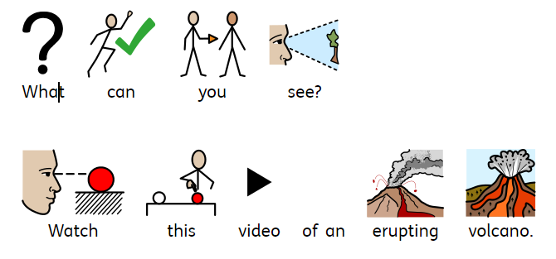
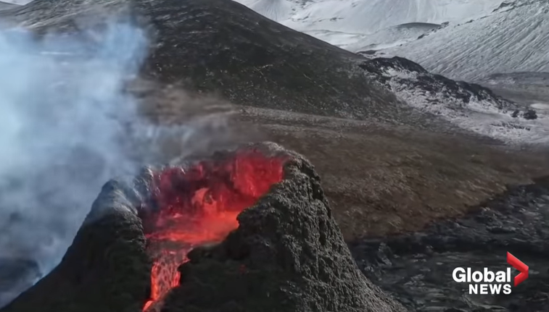
Volcanoes
Iceland volcano: Drone footage captures stunning up-close view of eruption - YouTube

Slide 15
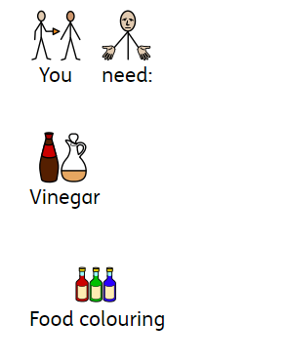
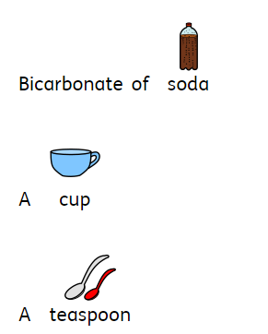
Volcanoes

Slide 16
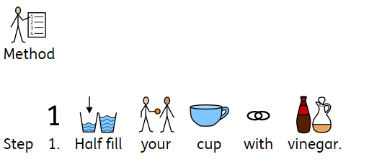
Volcano

Slide 17
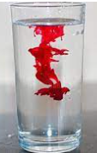
Volcano

Slide 18
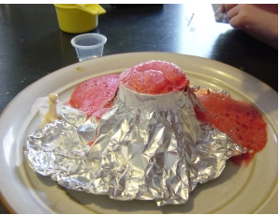
Volcano

Slide 19
Volcano

Slide 20
Date: Thursday 1st July 2021
LO
LO.
Subject: Science

Slide 21
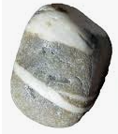
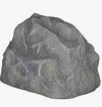
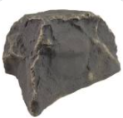
Rocks.

Slide 22
Rocks.

Slide 23
Rocks.

Slide 24
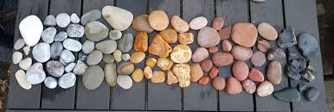
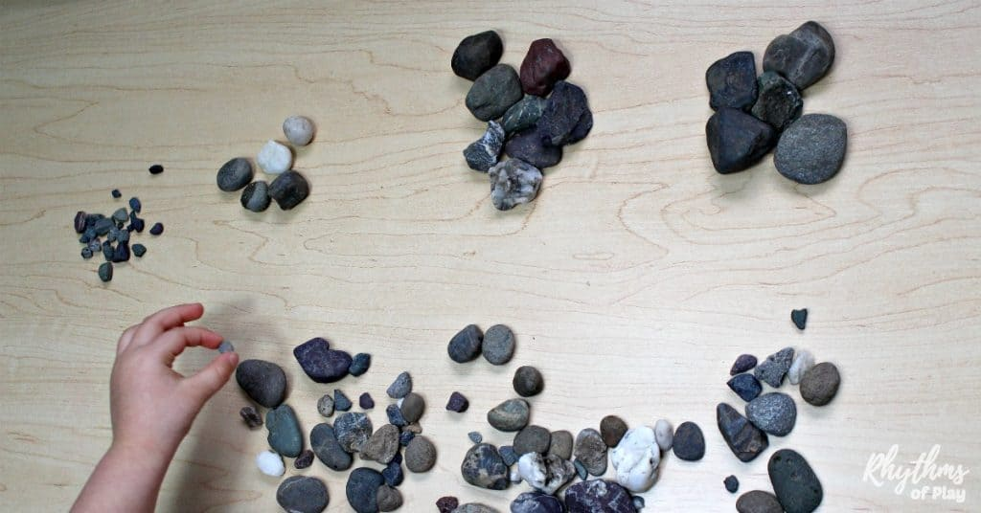
Rocks.

Slide 25
Date: Friday 2nd July 2021
LO
LO.
Subject: Science

Slide 26
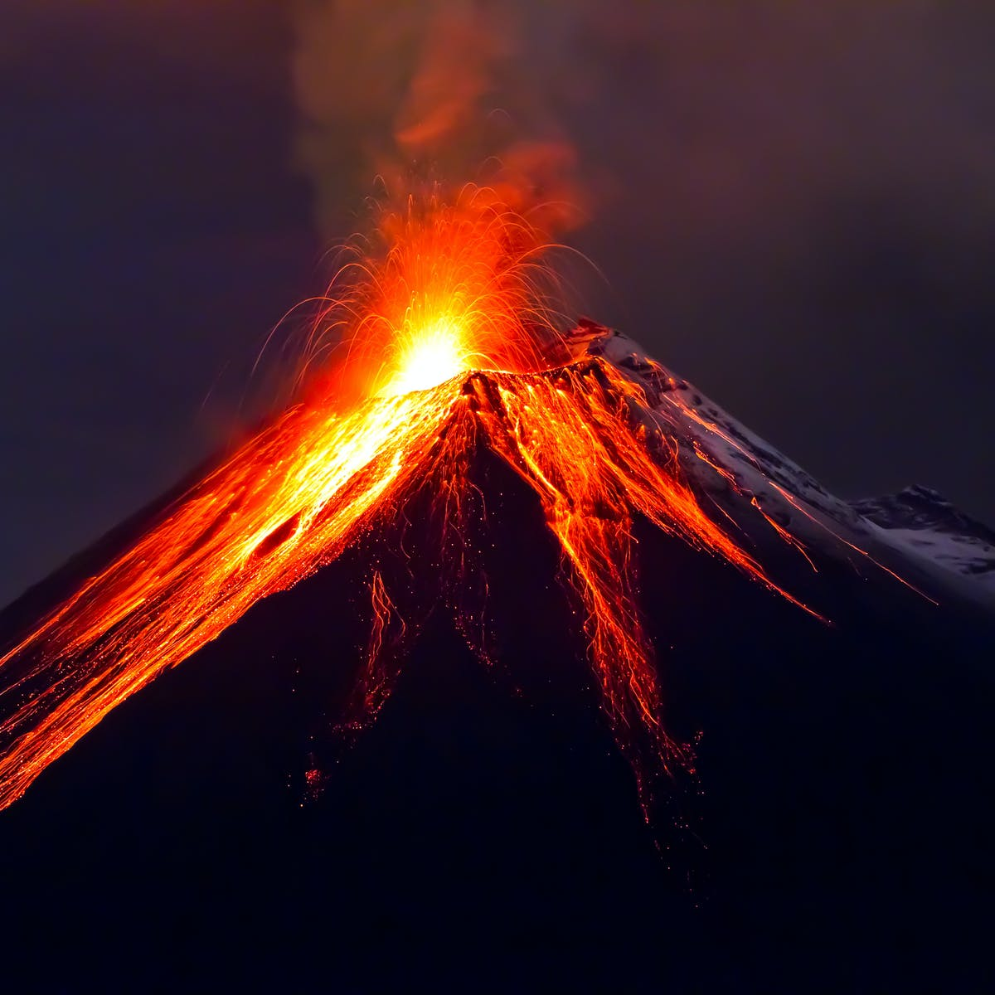
Volcanoes.

Slide 27
Volcanoes.
Big
smoky
hot
black
orange

Slide 28
Volcanoes.

Slide 29
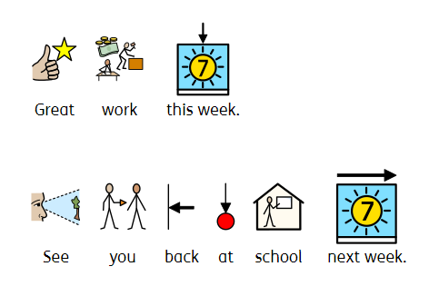
Finished.

