Slide 1


Subject: English
Base 1

Slide 2


Date: Monday 8th February
LO To be able to follow instructions to make a ham and cheese sandwich.
Subject: English

Slide 3

Pre-recorded Teaching
Access the online teaching video below that will support you to complete the work in this lesson. This video will act as a support but all of the work can still be successfully understood & completed using paper-based versions of this pack. If you need further support to understand / complete work then please contact school via e-mail or telephone.
Play Video
You can also copy and paste this link if you would prefer:
https://teachers.thenational.academy/lessons/to-identify-the-features-of-instructions-cru38r?from_query=instruction

Slide 4

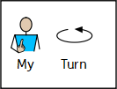





Slide 5

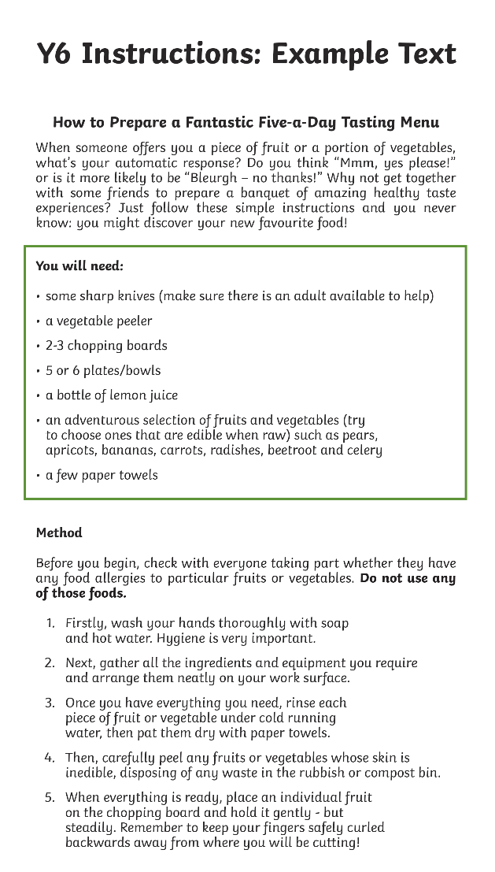

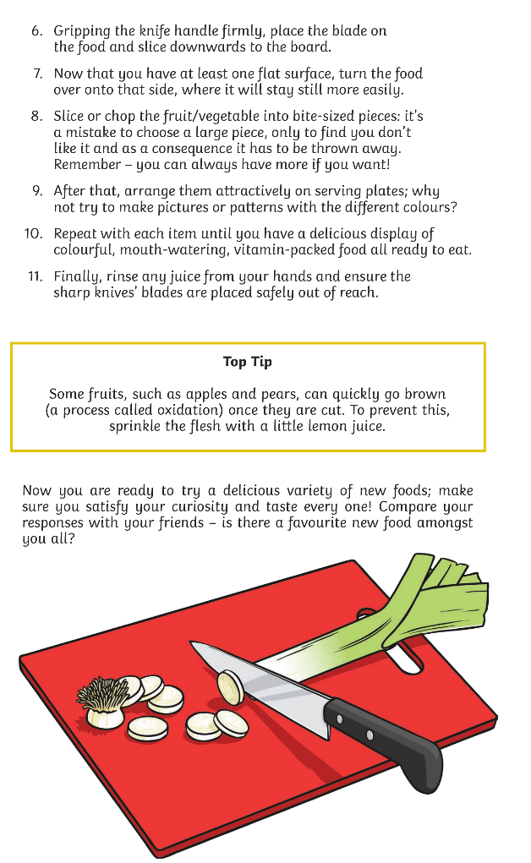









Slide 6
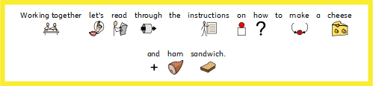
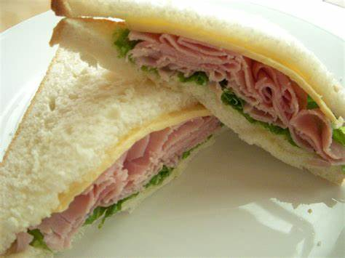



Slide 7

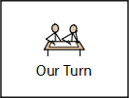

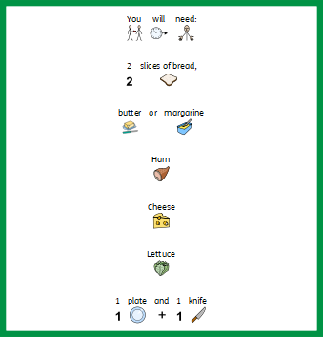
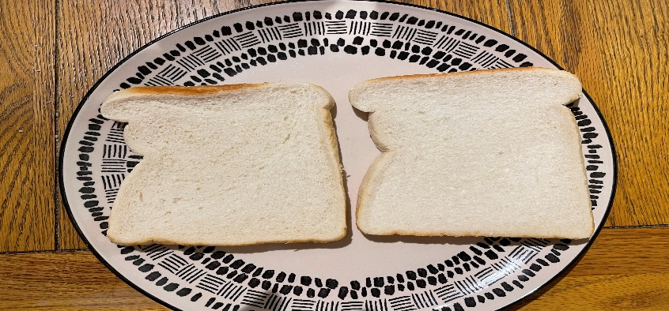

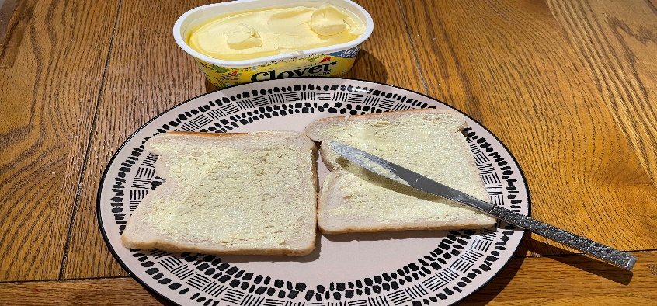

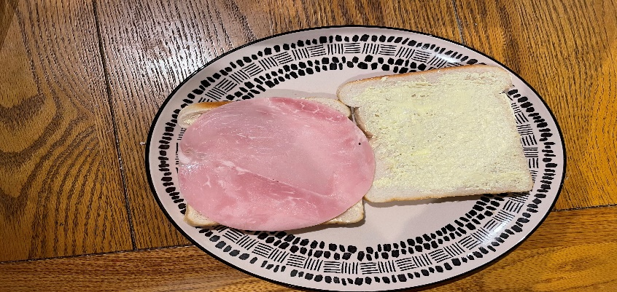
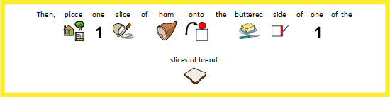
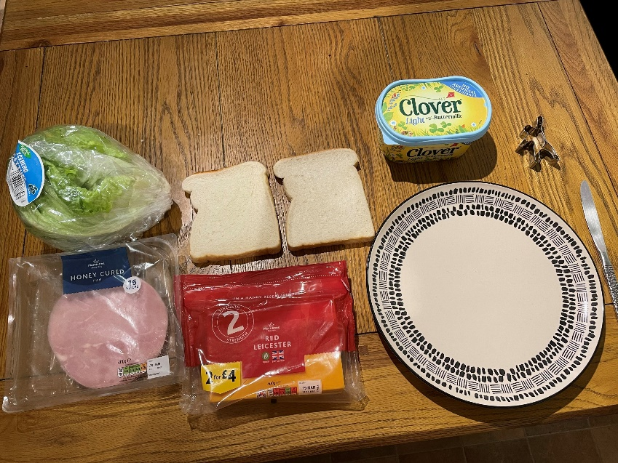
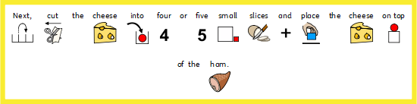
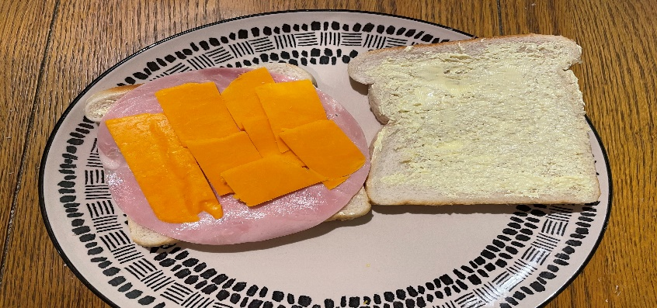

Slide 8
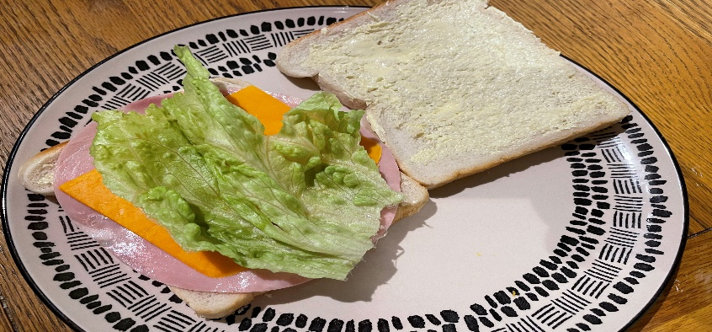
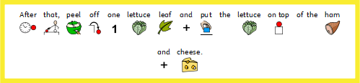
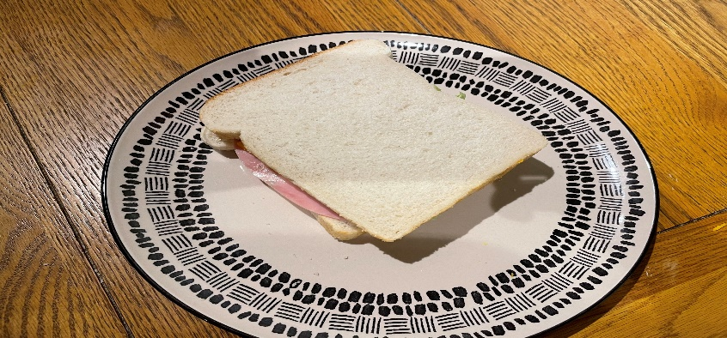
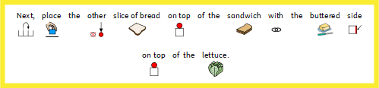

Slide 9

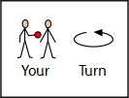


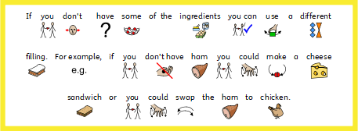

Slide 10


Slide 11
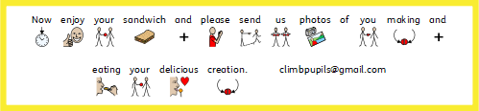

Slide 12
Date: Tuesday 9th February
LO To be able to use imperative verbs.
Subject: English

Slide 13
Pre-recorded Teaching
Access the online teaching video below that will support you to complete the work in this lesson. This video will act as a support but all of the work can still be successfully understood & completed using paper-based versions of this pack. If you need further support to understand / complete work then please contact school via e-mail or telephone.
Play Video
You can also copy and paste this link if you would prefer:
https://teachers.thenational.academy/lessons/to-use-imperative-verbs-6tj32d?from_query=imperative+verbs

Slide 14
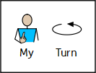


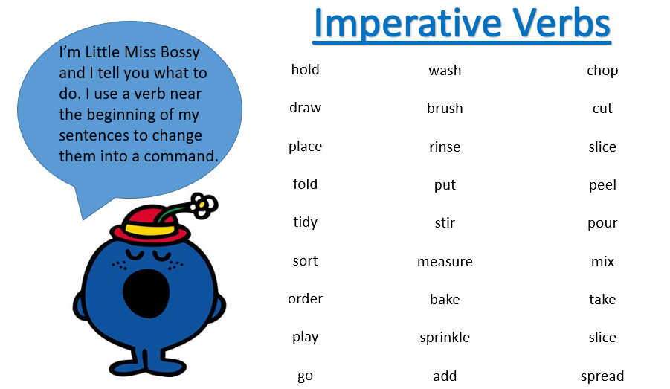

Slide 15














Slide 16












Slide 17







Choose from these verbs:

Slide 18

Spread
Choose from these verbs:
Put
Cut

Slide 19
Date: Wedensday 10th February
LO To be able to use time openers.
Subject: English

Slide 20

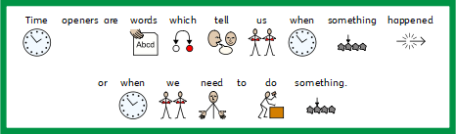
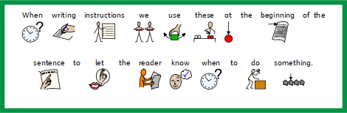

Slide 21











Slide 22

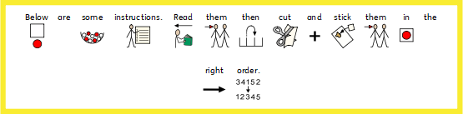


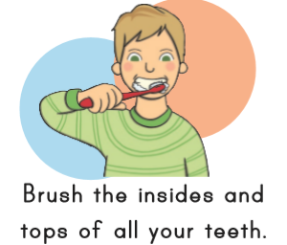

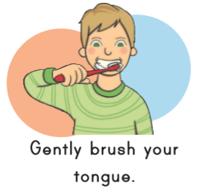

Slide 23
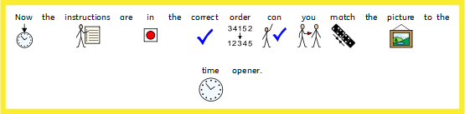
Finally
First
Then
Next
Secondly

Slide 24

Finally
First
Then
Next
Secondly

Slide 25
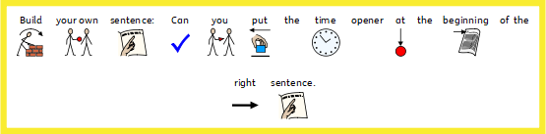





Slide 26





Slide 27

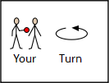






Time openers:
First
Next
Then
After that
Finally
Before
Imperative verbs:
Brush
Turn
Wash
Rinse
Scrub

Slide 28
Date: Thursday 11th February
LO To be able to write instruction on how to make a ham, cheese and lettuce sandwich.
Subject: English

Slide 29


Slide 31
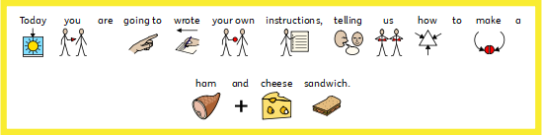
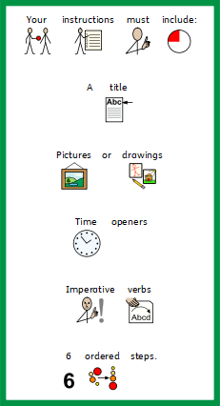

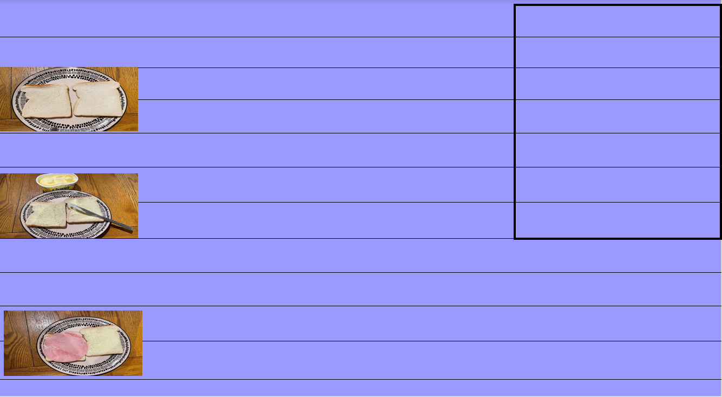
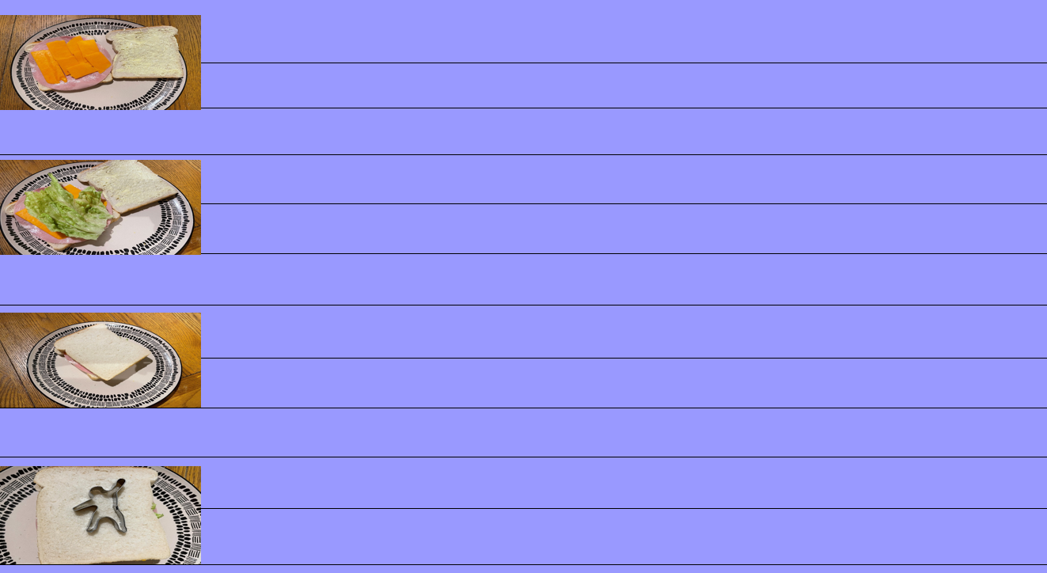
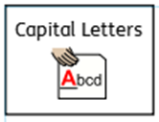

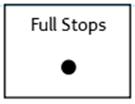
Don’t forget:

Slide 33
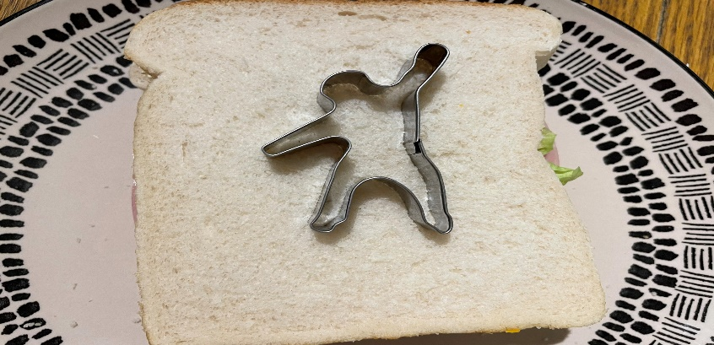

Slide 34
Date: Friday 5th February
LO To be able to read and spell common exception words.
Subject: English

Slide 35

Spellings
Remember:
Certain
Decide
Different
Famous
February
History
Important
Often

Slide 36
Spellings
Do not forget:
Can you put each one in a sentence?
Certain:
decide :
different:
Famous:

Slide 37
Spellings
Do not forget:
Can you put each one in a sentence?
February:
History:
Important:
Often:

