Slide 1


Subject: Phonics
Pack: A

Slide 2



Date: Monday 8th February 2021
LO To be able to practise phonics sounds.
LO To be able to answer questions about a text.
Please practise phonics every day for 20 minutes.
Subject: Phonics/Guided Reading

Slide 3

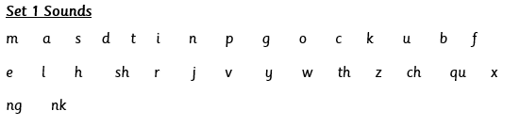

Each day we are going to focus on a different sound.
Please choose from set 1 or set 2. Each day, for phonics, there will be a video to watch and some words to read linked to the taught sound.
Here are the sounds which are in each set1 and set 2.
Please contact the school if you are not sure which set your child should be focusing on, or whether you’re unsure if your child does guided reading rather than phonics.
Then, play some phonics games!

Slide 4
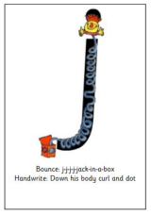
Set 1 Sounds
This week we are going to focus on some sounds that we know you find difficult. Remember you can never have too much practice.
Skip this slide if your child is not focusing on this set.
Today’s sound:
Please click the link or copy the below link into the internet:
https://schools.ruthmiskin.com/training/view/FYSgNDei/2dndPNTi
Or copy the below into YouTube:
‘Phonic Lesson - Set 1 Speed sounds j with Ruth.’
j
Scavenger Hunt!
What can you find in your house that begins with j?

Slide 5

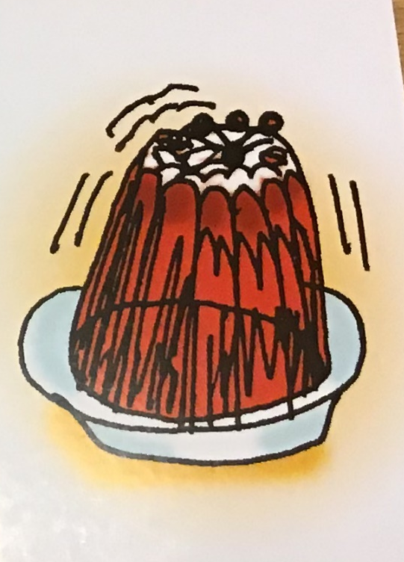



Today’s sound is j. Can you say j, j, j to your adult?
I have some pictures of things that begin with the sound j.
Try saying them out loud to your adult.
j
j j jelly
j j jug
j j jigsaw
j j jam
j
Hiding behind Jack-in-the-box is the grapheme j. Can you point to it and say j?
When you see this side of the card say j.
Look at the picture on the left.
That is my friend
Jack-in-the-box.
When you see this picture, as quick as you can say j, Jack-in-the-box.

Slide 6

Below, I have given you some cards. Point to each one and say j, Jack-in-the-box or j.
j
j
Now let’s have a go at writing the sound j. Use your finger and move it over the picture card saying, “Down the body, curl and dot or j j j j j j until you have traced the whole grapheme.
j
Now have a turn on your own. Keep practising until you get it right.

Slide 7






Set 1 Sounds
Now its time to Fred talk, read the word. Let me show you.
Here is my green word.
I am going to point to the button below each sound and say it out loud. This is Fred Talk.
j a m, after sounding out the word remember to read the word, jam. I have now read the word.
Now time to read some words beginning with ‘j’. You could even practise writing these words!
j a m
j e t
j u g
j u m p

Slide 8
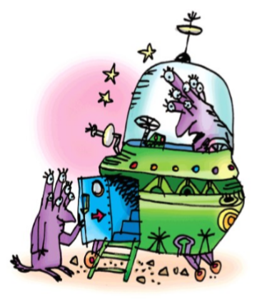
Set 2 Sounds
Skip this slide if your child is not focusing on this set.
Today’s sound:
Please click the link or copy the below link into the internet:
https://schools.ruthmiskin.com/training/view/FgLJeTiI/X3WHXB6q
Or copy the below into YouTube:
‘Phonics Lesson - Set 2 ‘or with Rosie.’
Or shut the door
Can you think of any words with the ‘or’ sound in it?

Slide 9

Today’s sound is or. Can you say or, or, or to your adult?
Look at the picture on your left. What can you see?
Can you see the aliens in their spaceship? Yes that’s right they are saying,
“or, shut the door.”
Let’s Fred Talk some ‘or’ words.
c or n f or k sh or t.
or shut the door
On the other side of the card is the digraph, or.
These letters are
special friends.
They are two letters that make one sound. When we see them we say,
or.
When we see the picture side we say,
“or, shut the door.”
or shut the door

Slide 10
Below, I have given you some cards. Point to each one and say or or or, shut the door.
or shut the door
Now let’s have a go at writing the sound or. You already know how to form each letter. Now we simply put them together to write the sound or.
Now have a turn on your own. Keep practising, saying the sound, until you get it right.

Slide 11
Set 2 Sounds
Now its time to Fred talk, read the word. Let me show you.
Here is my green word.
I am going to point to the button below each sound and say it out loud. This is Fred Talk.
f or k, after sounding out the word remember to read the word, fork.
I have now read the word.
fork
Now it’s your turn. Fred talk, read the words below.
f or k | h or s e | sh or t
s n or t | s or t | s p or t
. __ .
. ___ ___
___ ___ .
. . __ .
. __ .
. . __ .

Slide 12
Date: Tuesday 9th February
LO To be able to practise phonics sounds.
Please practise phonics every day for 20 minutes.
Subject: Phonics

Slide 13

Set 1 Sounds
Skip this slide if your child is not focusing on this set.
Today’s sound:
Please click the link or copy the below link into the internet:
https://schools.ruthmiskin.com/training/view/kmMy7Ovn/akqNkWzE
Or copy the below into YouTube:
‘Phonic Lesson - Set 1 Sound v’
v
vvvvvv vulture.
Scavenger Hunt!
What can you find in your house that begins with v?

Slide 14
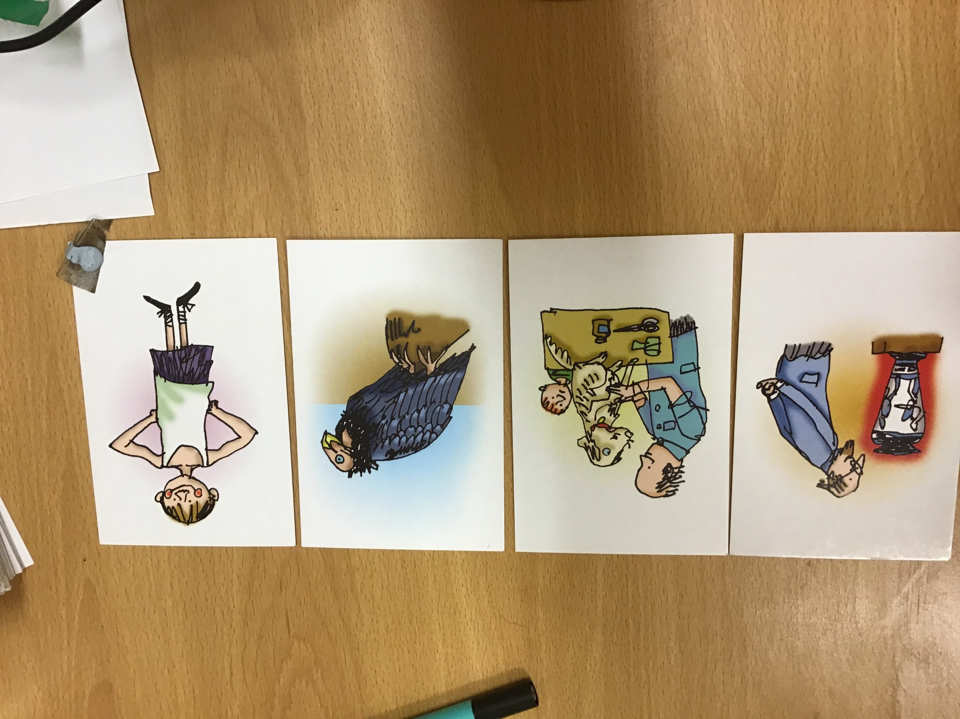
Today’s sound is v. Can you say v, v, v to your adult?
I have some pictures of things that begin with the sound v.
Try saying them out loud to your adult.
v
vvvvvv vulture.
v v vase
v v vet
v v vulture
v v vest
v
Look at the picture on the left.
Can you see the vulture in the middle of it? When you see this picture, as quick as you can say vulture
Hiding behind the vulture is the
grapheme v.
Can you point to it and say v?
When you see this side of the card say v.
vvvvvv vulture.

Slide 15
Below, I have given you some cards. Point to each one and say vulture or v.
v
v
vvvvvv vulture.
vvvvvv vulture.
vvvvvv vulture.
Now let’s have a go at writing the sound v. Use your finger and move it over the picture card saying, “Down a wing, up a wing or v, v, v, v, until you have traced the whole grapheme.
v
Now have a turn on your own. Keep practising, saying the sound, until you get it right.
vvvvvv vulture.

Slide 16

Set 1 Sounds
Now its time to Fred talk, read the word. Let me show you.
Here is my green word.
I am going to point to the button below each sound and say it out loud. This is Fred Talk.
v e t, after sounding out the word remember to read the word, vet.
I have now read the word.
Now time to read some words including ‘v’. You could even practise writing these words!
v e s t | v e t
v i c | v a n
. . . .
. . .
. . .
. . .

Slide 17
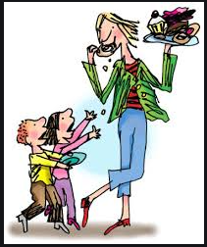
Set 2 Sounds
Skip this slide if your child is not focusing on this set.
Today’s sound:
Please click the link or copy the below link into the internet:
https://schools.ruthmiskin.com/training/view/On9dvzq4/8pGFmVoP
or copy the below into YouTube:
‘Phonics Lesson - Set 2 ‘air’ sound.
air
Can you think of any words with the ‘air’ sound in it?
air, that’s not fair!

Slide 18
Today’s sound is air. Can you say air, air, air to your adult?
Look at the picture on your left. What can you see?
The lady is eating all the cakes and the children are saying,
“air, that’s not fair!”
Let’s Fred Talk some ‘air’ words.
fair chair hair.
air
air, that’s not fair!
air
On the other side of the card is the digraph, air.
These letters are
special friends.
They are two letters that make one sound. When we see them we say,
air.
When we see the picture we say,
“air, that’s not fair”
air
air, that’s not fair!

Slide 19
Below, I have given you some cards. Point to each one and say air or air, that’s not fair!
air
air
air
air
air, that’s not fair!
air, that’s not fair!
air
Now let’s have a go at writing the sound air. You already know how to form each letter. Now we simply put them together to write the sound air.
Now have a turn on your own. Keep practising, saying the sound, until you get it right.

Slide 20

Set 2 Sounds
Now its time to Fred talk, read the word. Let me show you.
Here is my green word.
I am going to point to the button below each sound and say it out loud. This is Fred Talk.
ch air , after sounding out the word remember to read the word, chair.
I have now read the word.
Now time to read some words including ‘air’. You could even practise writing these words!
chair | stair | hair
fair | pair | lair
. . __
. __
. __
. __
. __

Slide 21
Date: Wednesday 10th February 2021
LO To be able to practise phonics sounds.
Please practise phonics every day for 20 minutes.
Subject: Phonics

Slide 22

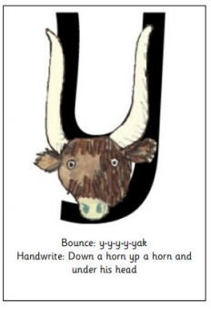
Set 1 Sounds
Skip this slide if your child is not focusing on this set.
Today’s sound:
Please click the link or copy the below link into the internet:
https://schools.ruthmiskin.com/training/view/66F4ZEbG/gDSBxq4a
Or copy below into YouTube:
‘Phonics Lesson - Set 1 Sound y’
Scavenger Hunt!
What can you find in your house that begins with y?

Slide 23

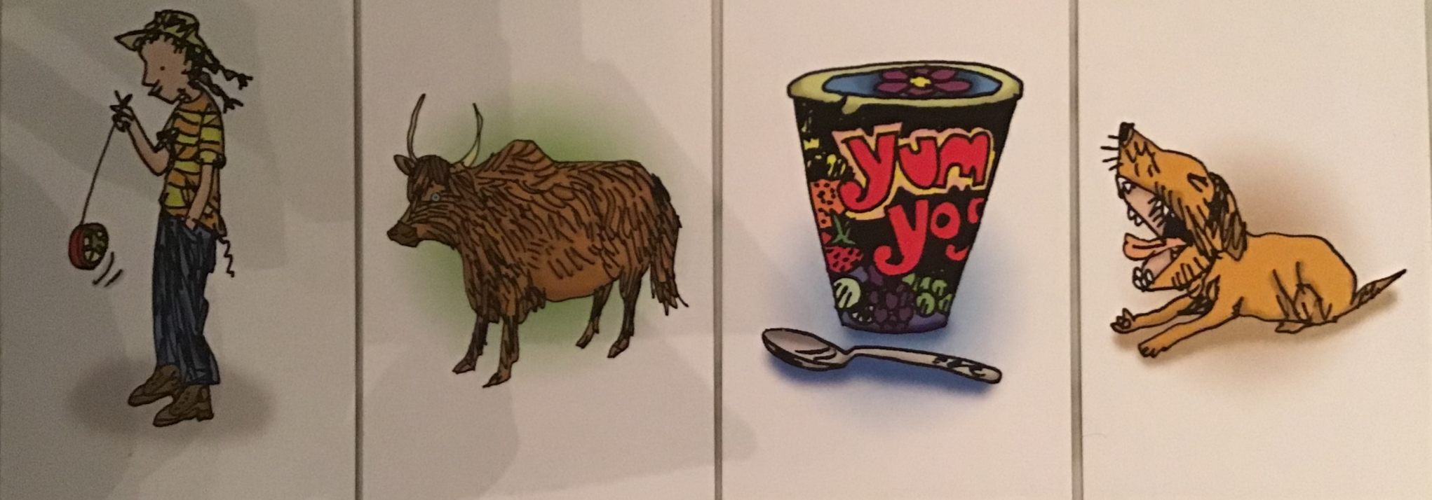
Today’s sound is y. Can you say y, y, y to your adult?
I have some pictures of things that begin with the sound y.
Try saying them out loud to your adult.
y y yak
y y yogurt
y y yawn
y y yoyo
Hiding behind yak is the grapheme y. Can you point to it and say y?
When you see this side of the card say y.
Look at the picture on the left.
Can you see the yak’s big horns?
When you see this picture, as quick as you can say,
y,y,y yak.

Slide 24
Below, I have given you some cards. Point to each one and say yak or y.
Now let’s have a go at writing the sound y. Use your finger and move it over the picture card saying, “Down a horn, up a horn and under the head or yyyyy until you have traced the whole grapheme.
Now have a turn on your own. Keep practising, saying the sound y, until you get it right.

Slide 25

Set 1 Sounds
Now its time to Fred talk, read the word. Let me show you.
Here is my green word.
I am going to point to the button below each sound and say it out loud. This is Fred Talk.
y, a, k, after sounding out the word remember to read the word, yak.
I have now read the word.
Now time to read some words including ‘y’. You could even practise writing these words!
y a k | y e s
y e t | y a p

Slide 26
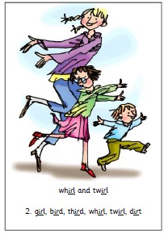
Set 2 Sounds
Skip this slide if your child is not focusing on this set.
Today’s sound:
Please click the link or copy the below link into the internet:
https://schools.ruthmiskin.com/training/view/1NaWG4z1/k4jyIdXA
Or copy the below into YouTube:
‘Phonic Lesson - Set 2 sounds ‘ir’
ir
Can you think of any words with the ‘ir’ sound in it?

Slide 27
Today’s sound is ir.
Can you say ir, ir, ir to your adult?
Look at the picture on your left. What can you see?
Can you see that they are twirling around? Yes that’s right they are saying,
“ir, whirl and twirl”
Let’s Fred Talk some ‘ir’ words.
girl dirt bird.
On the other side of the card is the digraph, ir.
These letters are
special friends.
They are two letters that make one sound. When we see them we say,
ir.
When we see the picture we say,
“ir, whirl and twirl”
ir

Slide 28
Below, I have given you some cards. Point to each one and say ir or ir, whirl and twirl.
ir
ir
ir
Now let’s have a go at writing the sound ir. You already know how to form each letter. Now we simply put them together to write the sound ir.
Now have a turn on your own. Keep practising, saying the sound, until you get it right.

Slide 29




Set 2 Sounds
Now its time to Fred talk, read the word. Let me show you.
Here is my green word.
I am going to point to the button below each sound and say it out loud. This is Fred Talk.
d ir t, after sounding out the word remember to read the word, dirt.
I have now read the word.
Now time to read some words including ‘ir’. You could even practise writing these words!
dirt | shirt | girl
first | twirl | bird

Slide 30
Date: Thursday 11th February 2021
LO To be able to practise phonics sounds.
Please practise phonics every day for 20 minutes.
Subject: Phonics

Slide 31
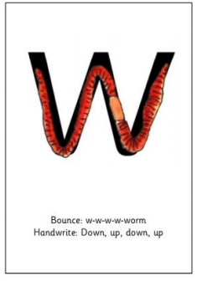
Set 1 Sounds
Skip this slide if your child is not focusing on this set.
Today’s sound:
Please click the link or copy the below link into the internet:
https://schools.ruthmiskin.com/training/view/DYjgzRuS/V4S8qv0j
Or copy the below into YouTube:
‘Phonic Lesson - Set 1 Sound – w’
w
Scavenger Hunt!
What can you find in your house that begins with w?

Slide 32
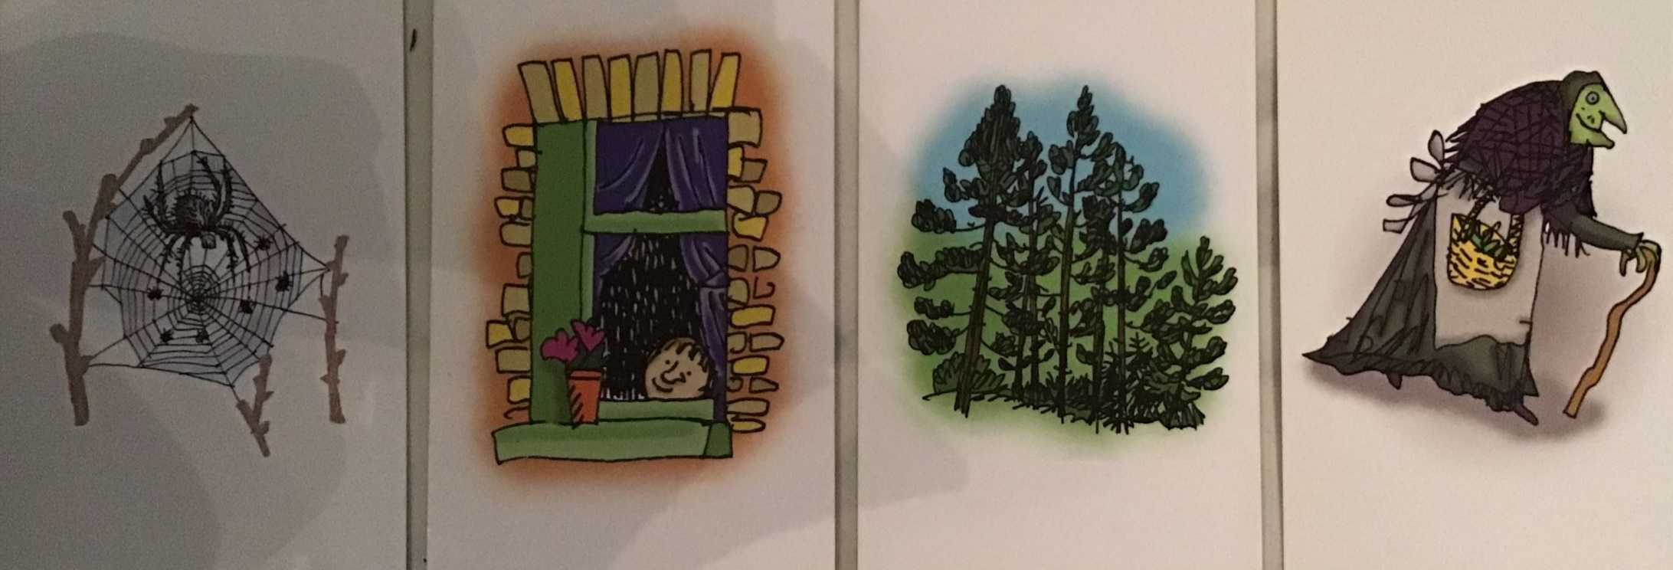
Today’s sound is w. Can you say w, w, w to your adult?
I have some pictures of things that begin with the sound w.
Try saying them out loud to your adult.
w
w w web
w w window
w w wood
w w witch
d d dinosaur
w
Look at the picture on the left.
Can you see the worm? When you see this picture, as quick as you can say w,w,worm
Hiding behind the worm is the
grapheme w.
Can you point to it and say w?
When you see this side of the card say w.

Slide 33
Below, I have given you some cards. Point to each one and say worm or w.
w
w
w
Now let’s have a go at writing the sound w. Use your finger and move it over the picture card saying, “Down, up, down, up”. or w,w,w,w, until you have traced the whole grapheme.
w
Now have a turn on your own. Keep practising, saying the sound, until you get it right.

Slide 34



Set 1 Sounds
Now its time to Fred talk, read the word. Let me show you.
Here is my green word.
I am going to point to the button below each sound and say it out loud. This is Fred Talk.
w, e, b, after sounding out the word remember to read the word, web.
I have now read the word.
Now time to read some words including ‘w’. You could even practise writing these words!
wet | win
web | wish

Slide 35
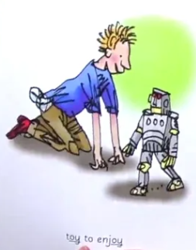
Set 2 Sounds
Skip this slide if your child is not focusing on this set.
Today’s sound:
Please click the link or copy the below link into the internet:
https://schools.ruthmiskin.com/training/view/8qUVwgwf/Dohsosoo
Or copy the below into YouTube:
‘Phonics Lesson - Set 2 sound ‘oy’
oy
Can you think of any words with the ‘oy’ sound in it?

Slide 36
Today’s sound is oy.
Can you say oy, oy, oy to your adult?
Look at the picture on your left. What can you see?
Can you see the boy playing with a toy? Yes that’s right they are saying,
“oy, toy to enjoy”
Let’s Fred Talk some ‘oy’ words.
toy joy boy.
On the other side of the card is the digraph, oy.
These letters are
special friends.
They are two letters that make one sound. When we see them we say,
oy.
When we see the picture
we say,
“oy, toy to enjoy”
oy

Slide 37
Below, I have given you some cards. Point to each one and say oy or oy, toy to enjoy.
oy
oy
oy
Now let’s have a go at writing the sound oy. You already know how to form each letter. Now we simply put them together to write the sound oy.
Now have a turn on your own. Keep practising, saying the sound, until you get it right.

Slide 38

Set 2 Sounds
Now its time to Fred talk, read the word. Let me show you.
Here is my green word.
I am going to point to the button below each sound and say it out loud. This is Fred Talk.
b oy, after sounding out the word remember to read the word, boy.
I have now read the word.
Now time to read some words including ‘oy’. You could even practise writing these words!
toy | joy
boy | annoy

Slide 39
Date: Friday 12th February
LO To be able to practise reading and writing tricky words.
Please practise phonics every day for 20 minutes.
Subject: Phonics

Slide 40

Set 1 sound spelling
Today we are going to revisit what we have learnt this week.
We have learnt the sounds
j,v,y,w
Below I have placed some of the flashcards we have used this week. Can you point to each one and say the picture word or the letter sound.
w
worm
vvvvvv vulture.
j
v
j
j

Slide 41





Today we are going to revisit what we have learnt this week.
I have jumbled up some of the words we read this week. Here is a recap of how to read them.
Here is my green word.
I am going to point to the button below each sound and say it out loud. This is Fred Talk.
w, e, t, after sounding out the word remember to read the word, wet.
Now it’s your turn. Can you Fred talk, read the words?

Slide 42
Now let’s practice writing the sounds we have learnt this week.
We learnt how to form the letters y, j, v, w. Let’s practice writing them again.
Don’t forget to sit straight, hold your pencil the right way and say the sound as you write it.
y___________________________
j____________________________
w____________________________
v____________________________

Slide 43
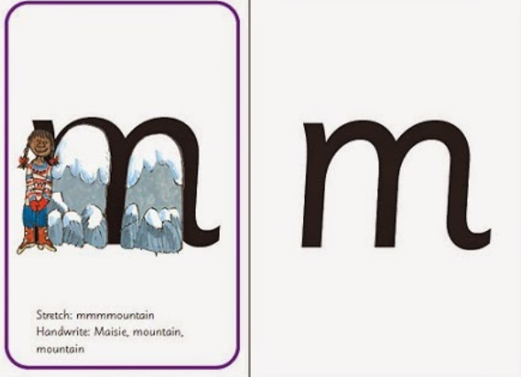
Today we are going to revisit what we have learnt this week.
We have learnt the sounds
or, air, ir, oy
Below I have placed some of the flashcards we have used this week. Can you point to each one and say the picture word or the letter sound.
Set 2 Sounds
or
air
oy, toy to enjoy.
air, that’s not fair!
ir
oy
air
ir
ir
or shut the door

Slide 44






Today we are going to revisit what we have learnt this week.
I have jumbled up some of the words we read this week. Here is a recap of how to read them.
Here is my green word.
I am going to point to the button below each sound and say it out loud. This is Fred Talk.
f, air, after sounding out the word remember to read the word, fair.
Now it’s your turn. Can you Fred talk, read the words?

Slide 45
Now we are going to practice writing the sounds we have learnt this week.
We learnt how to write the special friends sounds or, air, ir, oy.
Let’s practice writing them again.
Don’t forget to sit straight, hold your pencil the right way and say the sound as you write it.
or____________________________
air____________________________
ir____________________________
oy____________________________

