Slide 1
Date: 01.02.21
LO To be able to count accurately.
Subject: Maths

Slide 2
Pre-recorded Teaching
Access the online teaching video below that will support you to complete the work in this lesson. This video will act as a support but all of the work can still be successfully understood & completed using paper-based versions of this pack. If you need further support to understand / complete work then please contact school via e-mail or telephone.
Play Video

Slide 3
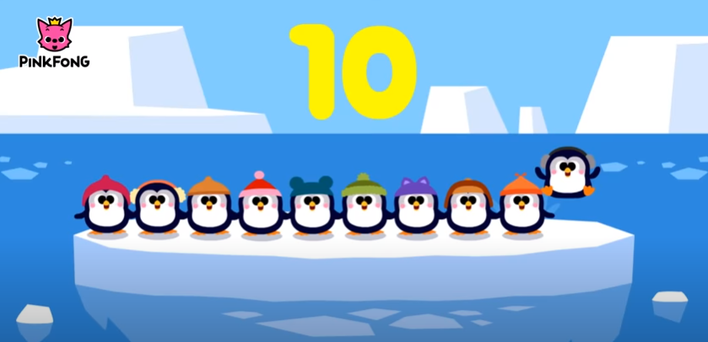
Watch this video. Can you join in with counting the penguins?
https://www.youtube.com/watch?v=Yt8GFgxlITs
Click the above link or copy and paste into the internet.
‘Counting 1 to 10 | Number Songs | PINKFONG Songs for Children’ - YouTube

Slide 4
Count the objects
Write the answer in the box next to the shapes.
Remember, use your finger and count every time you touch a new object.
My Turn.
=
1.
5
=
2.
3
=
3.
7

Slide 5
Write the answer in the box next to the shapes.
Remember, use your finger and count every time you touch a new object.
Count the objects
Your Turn.
=
1.
=
2.
=
3.

Slide 6
Write the answer in the box next to the shapes.
Remember, use your finger and count every time you touch a new object.
Count the objects
My Turn.
4.
2
5.
6
6.
4

Slide 7
Count the objects
Write the answer in the box next to the shapes.
Remember, use your finger and count every time you touch a new object.
4.
5.
6.

Slide 8
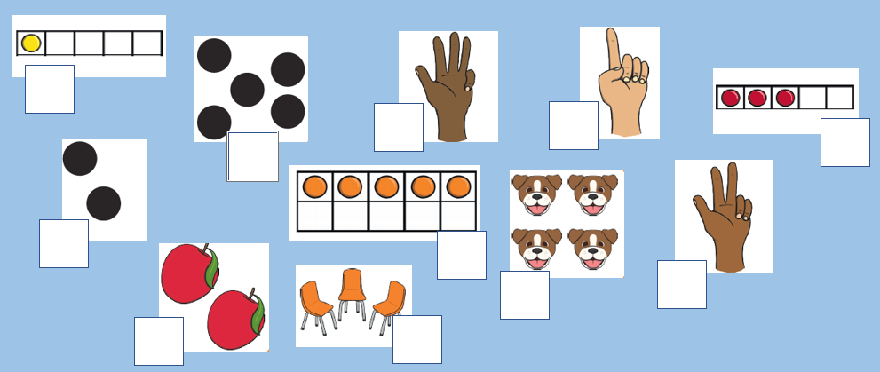
Count the objects and write the number in the box
1.
5.
8.
10.
3.
2.
6.
9.
11.
4.
7.
If you are working on a computer, insert a text box to type your answer.

Slide 9
Challenge!
Choose something you would like to draw.
I want you to draw 6 objects!
Make sure you keep counting so you draw the correct amount.

Slide 10
Date:
02/02/21
L.O.
To be able to add one more using digits.
Subject: Maths

Slide 11
Today we are going to be learning about adding 1 more.
There are a few different ways that we can add one more, we can collect objects and add one more or we can look at numbers and think about what comes next.
Lets start by adding one more dot to these five frames.
I had 3 circles in my five frame, I added one more to make 4.
Can you try adding one more circle to the five frames below.
One more can be added to anything. Try the next slide to add one more to different objects.

Slide 12
Write your answers either on some paper or in the box on the PowerPoint. You can draw your one extra object in the space next to the picture but make sure you still count the total.
My Turn.
I have 6 sweets. Show me 1 more. 1 more than 6 is
7
I have 2 flowers. Show me 1 more. 1 more than 2 is
3

Slide 13
Your Turn.
I have 5 coins. Show me 1 more. 1 more than 5 is
I have 7 socks. Show me 1 more. 1 more than 7 is

Slide 14
I have 9 apples. Show me 1 more. 1 more than 9 is
I have 4 stars. Show me 1 more. 1 more than 4 is

Slide 15
Adding one more digit
Put your finger on the number given and jump to the next number. This tells you what one more is.
Can you complete the questions below.
1 more than 5 =
1 more than 9 =
6
1 more than 2 =
1 more than 1 =
1 more than 6 =
1 more than 8 =
1 more than 4 =
1 more than 3 =
1 more than 7 =
1 more than 0 =

Slide 16
Date: 03.01.21
LO To be able to add within 10.
Subject: Maths

Slide 17
Pre-recorded Teaching
Access the online teaching video below that will support you to complete the work in this lesson. This video will act as a support but all of the work can still be successfully understood & completed using paper-based versions of this pack. If you need further support to understand / complete work then please contact school via e-mail or telephone.
Play Video

Slide 18
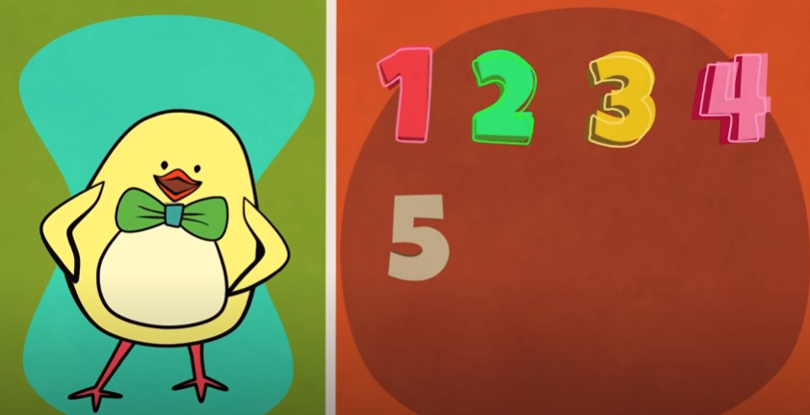
Warm your maths brain up by watching this video and singing along!
https://www.youtube.com/watch?v=HkkYaj0m6cg
Click the above link or copy and paste into the internet.
‘Funky Counting Song | Numbers 1-10 | The Singing Walrus’ - YouTube

Slide 19
Adding 1
My turn!
+
3 + 1 = 4
I counted the counters altogether to find the answer!

Slide 20
Adding 1
Your turn!
+
4 + 1 = ___
Use the counters to help you work out the answer.

Slide 21
Adding 1
Your turn!
+
5 + 1 = ___
Use the pictures to help you work out the answer.

Slide 22
Adding 1
Your turn!
+
2 + 1 = ___
Use the pictures to help you work out the answer.

Slide 23
Adding 1
Your turn!
3 + 1 = ___
6 + 1 = ___
7 + 1 = ___
4. 5 + 1 = ___
5. 8 + 1 = ___
6. 9 + 1 = ___
Use your fingers or draw counters to help you.

Slide 24
Date: 04.01.21
L.O. To be able to add within 10.
Subject: Maths

Slide 25
Pre-recorded Teaching
Access the online teaching video below that will support you to complete the work in this lesson. This video will act as a support but all of the work can still be successfully understood & completed using paper-based versions of this pack. If you need further support to understand / complete work then please contact school via e-mail or telephone.
Play Video

Slide 26
Warm your maths brain up by counting to 20 and working out!
https://www.youtube.com/watch?v=_MVzXKfr6e8&t=9s
Click the above link or copy and paste into the internet.
‘Count to 20 and Workout | Fun Counting Song for Kids | Count by 1's to 20 | Jack Hartmann’ - YouTube

Slide 27
Adding
My turn!
+
4 + 2 = 6
I counted the counters altogether to find the answer!

Slide 28
Adding
Your turn!
+
3 + 2 = __
I counted the counters altogether to find the answer!

Slide 29
Adding
Your turn!
+
6 + 3 = ___
Use the counters to help you work out the answer.

Slide 30
Adding
Your turn!
+
3 + 3 = ___
Use the pictures to help you work out the answer.

Slide 31
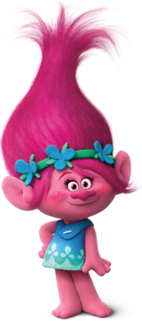
Adding
Your turn!
+
5 + 5 = ___
Use the pictures to help you work out the answer.

Slide 32
Adding 1
Your turn!
3 + 2 = ___
6 + 3 = ___
7 + 2 = ___
4. 5 + 3 = ___
5. 8 + 2 = ___
6. 9 + 1 = ___
Use your fingers or draw counters to help you.

Slide 33
Date: 05.01.21
L.O. To be able count to 20.
Subject: Maths

Slide 34
Pre-recorded Teaching
Access the online teaching video below that will support you to complete the work in this lesson. This video will act as a support but all of the work can still be successfully understood & completed using paper-based versions of this pack. If you need further support to understand / complete work then please contact school via e-mail or telephone.
Play Video

Slide 35
Let’s start by watching this fun video of how to count to 20.
https://www.youtube.com/watch?v=azIG0kLIlgs

Slide 36
To help us learn our numbers to 20 lets play a game. Ask your grown- up to help click the link to play the helicopter game.
It is a super fun game where you rescue people using the helicopter.
https://www.topmarks.co.uk/learning-to-count/helicopter-rescue

Slide 37
Watch this video. Can you join in and count to 20?
https://www.youtube.com/watch?v=_MVzXKfr6e8
Click the above link or copy and paste into the internet.
‘Count to 20 and work out with Jack Hartmann’ - YouTube

Slide 38
Counting to 20
Last week we looked at numbers up to 10 using numicon. This week we are going to look at how to make numbers up to 20 using numicon.
11
12
13
14
15
16
17
18
19
20

Slide 39
Counting to 20
11
12
13
14
15

Slide 40
16
17
18
19
These are a representation using numicon to make numbers up to 20.
20

Slide 41
Now we are going to try make number sentences to 20 using numicon.
My Turn.
?
=
+
3
10
=
+
3
13
10

Slide 42
Now we are going to try make number sentences to 20 using numicon.
Your Turn.
?
=
+
3
10
=
+
3
__
10

Slide 43
My Turn.
+
=
?
+
5
=
15
10

Slide 44
Your Turn.
+
=
?
+
5
=
__
10

Slide 45
Your Turn.
+
=
?
__
+
9
=
10

Slide 46
Your Turn.
+
=
__

Slide 47
Your Turn.
+
=
__

Slide 48
+
+
=
__

Slide 49
+
+
=
__

Slide 50
Fill in the missing numbers from 10 to 20 …
11 12 ___ 14 ___ 16 ___ 18 ___ 20
11 ___ 13 ___ 15 ___ 17 ___ 19 ___
11 12 13 ___ ___ 16 ___ 18 ___ ____
If you are working on a computer, insert a text box to type your answer.

