Slide 1
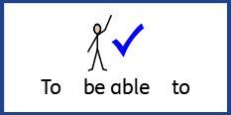
Date: Monday 28th June 2021
L.O. To be able to identify and name the parts of the eye.
Subject: Science

Slide 2
Our Eyes
Our eyes are amazing! From the moment we open our eyes in the morning, they are constantly at work. They take in information about the world around us, and constantly send images to the brain to be processed.

Slide 3
Look Closely
If you look closely at your family’s eyes, you will be able to see some of the parts of the eye.
Take a minute to describe with your partner what you can see.
We are going to find out about the parts of the eye that we can and can’t see, and the job that each part does.

Slide 4
Eyelids
Our eyes are about the size of a ping pong ball.
Our eyelids cover the front part of our eyes. Their job is to keep the eye clean and moist by blinking several times a minute. (Try blinking to clean your eyes)
The eyelashes on our eyelids also help to keep dust and dirt from getting in our eyes.

Slide 5
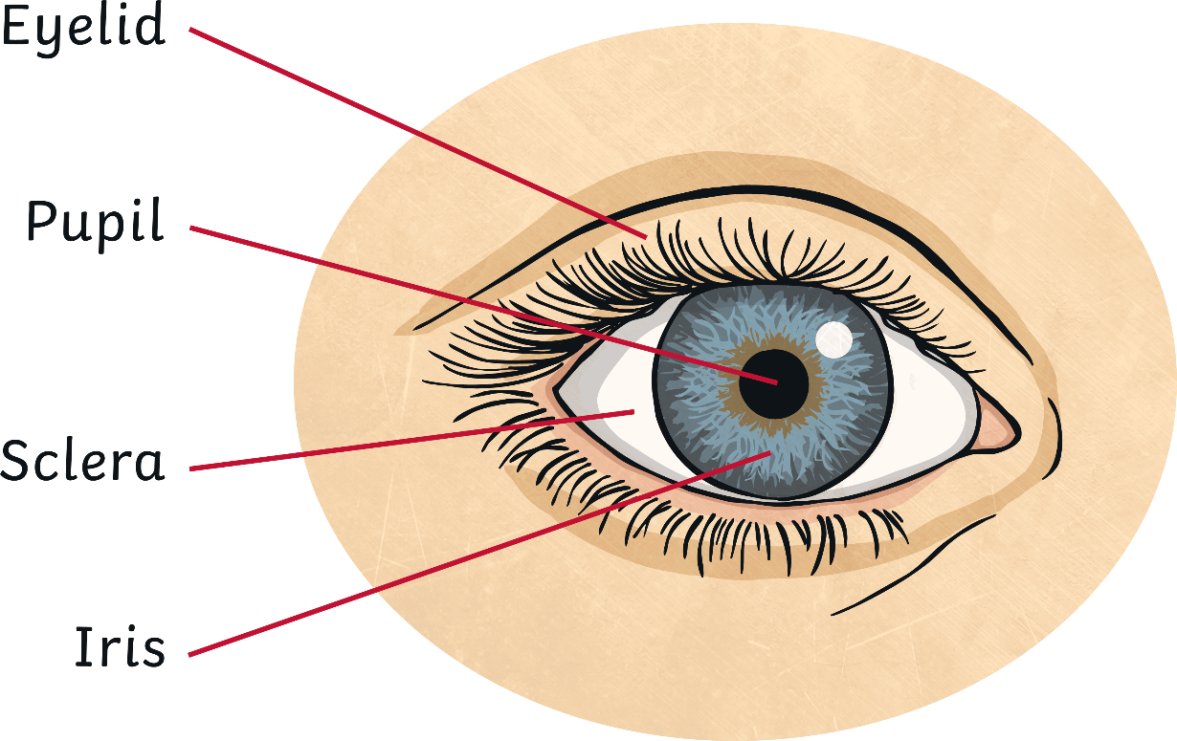
The Sclera
The sclera is the white part of the eye. Can you see yours in a mirror?

Slide 6
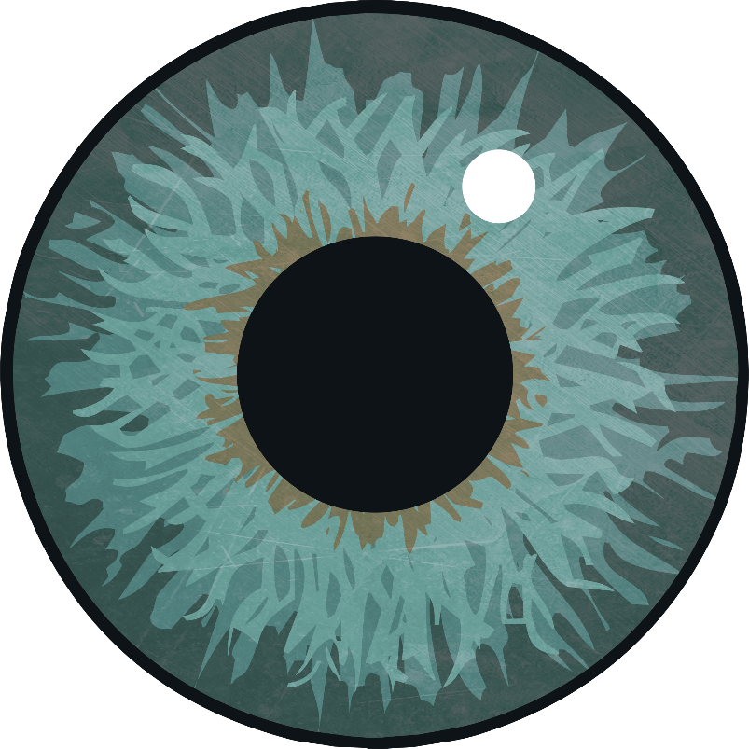
Iris
The iris is the colourful part of the eye. It can change in size to control how much light goes through the pupil. We will look more at this next week.

Slide 7
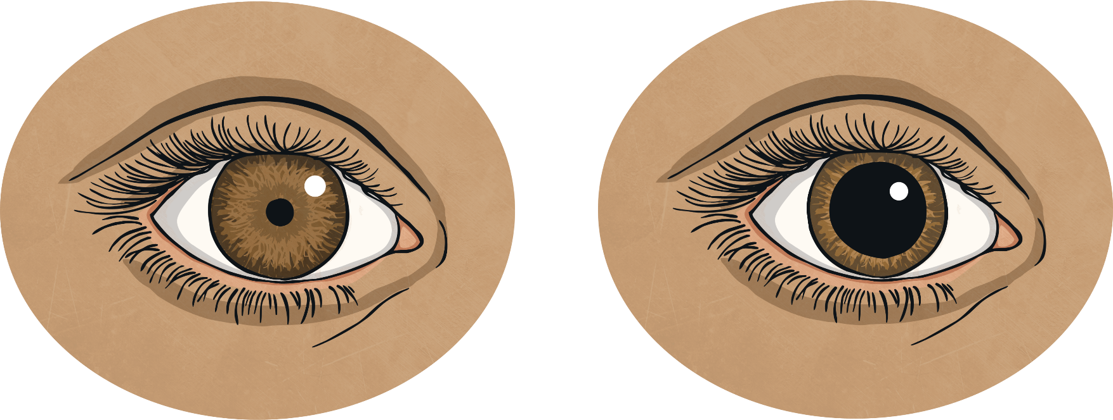
Pupil
The pupil looks like a black circle in the centre of the eye, but it is really an opening in the iris which lets light enter the eye.
The pupil can change size;
it gets smaller in very bright conditions and larger in dark conditions.
Turn the light on and off and use a mirror to see if your Pupil changes size.

Slide 8
Can you label the parts of eye.
Try to remember what each part does.

Slide 9
Date: Tuesday 29th June 2021
L.O. To be able to identify different light sources and how light travels.
Subject: Science

Slide 10
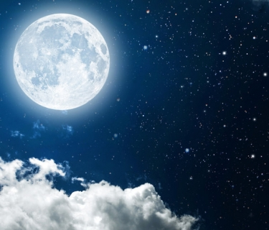
Close your eyes, what can you see? In order for us to see the things around us we need two things; light and for nothing to be blocking the light our vision such as an object or our own eyelids. Have a look around your home and outside (with an adult's permission!) How many sources of light can you find which help us to see?
Here are some examples in the photographs on this page.
Challenge: Can you add 5 of your own by writing the name of and drawing a picture of the light sources you find on the next page?

Slide 11
What light sources did you find? Draw them in the boxes below and write their names.
Lamp

Slide 12
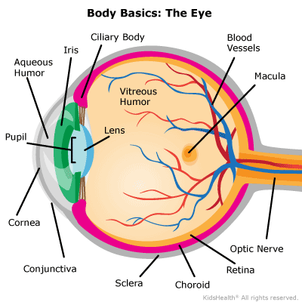
Once light hits an object, it bounces back to the eye and allows us to see what we are looking at. The pupil lets in the light to the back of the eye, where it is turned into colour and fine-tuned by the macula. The retina then turns the light into a brain friendly message to the brain through the optic nerve to process the image of what we are looking at.

Slide 13
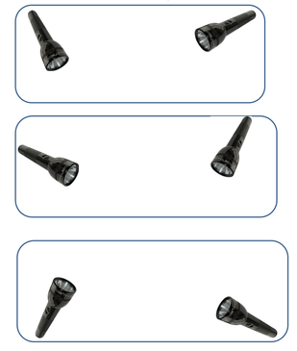
Use a ruler and yellow pencil or pen to draw the light in straight lines until they hit the edge of each box. Remember, the light cannot bend if there is nothing to reflect it off. The first one has been done for you.

Slide 14
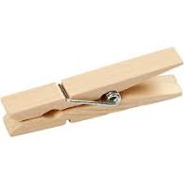
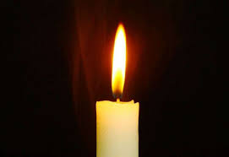
Watch the video link below and carry out the investigation. Complete the chart on the next slide to show your results from your investigation.
Light travels in a Straight Line : School Science Project - YouTube
For the investigation you will need:
3 CDs or DVDs
6 pegs
A candle

Slide 15
Tick the correct box to show your results on the table below.
Which disk was moved | I can see the light | I cannot see the light
First Disk
Second Disk
Third Disk
No Disks

Slide 16
Date: Wednesday 30th June 2021
L.O. To be able to identify that light travels in straight lines and reflects off surfaces.
Subject: Science

Slide 17
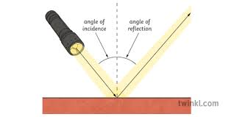
When light is reflected on a reflective surface, it bounces back from the reflective surface at an angle. Look at the diagram below, can you point to the angle of incidence and the angle of reflection?

Slide 18
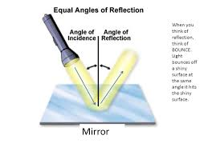
Find a mirror and a torch. Shine the torch onto the mirror and explore what happens to the light from the angle of reflection when you change the angle of incidence by tilting the mirror.
What happens, to the reflected light, when you tilt the mirror towards the torch?
What happens, to the reflected light, when you tilt the mirror away from the torch?

Slide 19
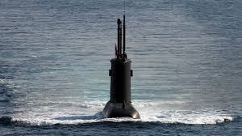
We have explored how light can be reflected by changing the angle of a reflective surface. Next, we are going to explore how we can use more than one mirror to reflect light and images back to ours eyes. Below is a picture of a periscope. Periscopes are used to see above a surface. Submarines use periscopes to look above the sea when they are underneath the surface.

Slide 20
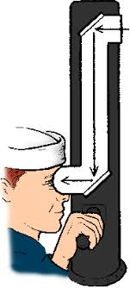
Use a ruler and a pencil to show the direction the light reflects from the top of the periscope to the bottom. The answer is on the next page; check to see if you are correct.

Slide 21
Check your answer, did you get the lines of reflection correct?

Slide 22
Now that we have explored how a periscope works, we are going to have a go at building our own. Follow the steps on the website (click on the link below or copy and paste it into your web browser) after collecting the resources you need. www.sciencetoymaker.org/the-periscope/how-to-make-a-periscope-with-cd-or-dvd/
Resources you will need:
Pencil.
Ruler.
Cardboard.
Paper periscope template (a copy if this is on the next page).
Glue.
Cellotape.
2 small mirrors or a disk to make 2 mirrors with.
If you do not have two small mirrors, you can use 1 old disk and cut it like the photo below to make 2 small mirrors.

Slide 24
Can you answer the questions below about your Periscope with your adult?
Does your periscope work?
What can you see using your periscope?
What would you do to make your periscope better?
Did you enjoy making your periscope?
What could you use the periscope for?

Slide 25
Date: Thursday 1st July 2021
L.O. To be able recognise how shadows are formed.
Subject: Science

Slide 26
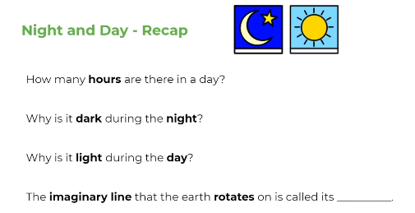
Think about answers to these questions.

Slide 27
How do we see?

Slide 28
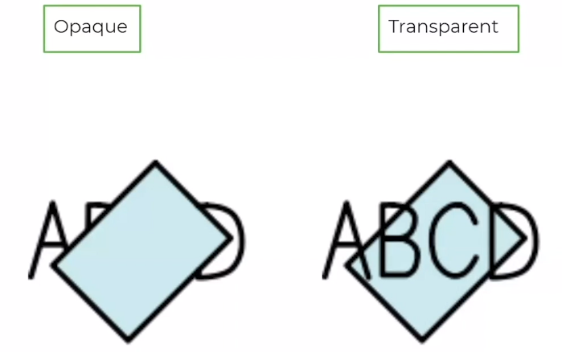
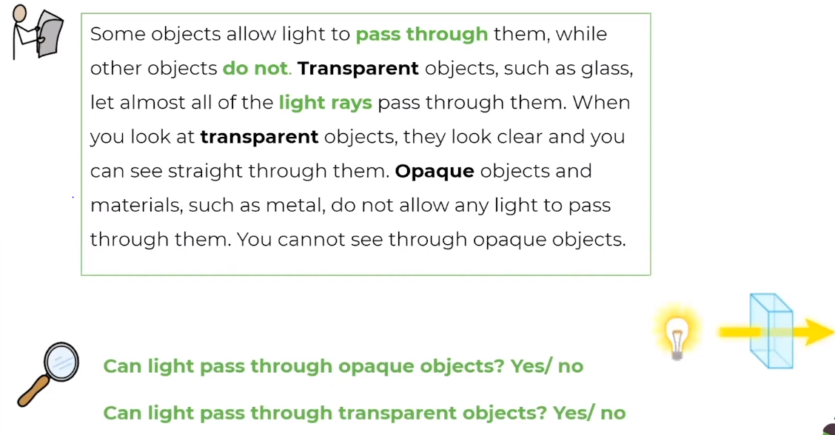

Slide 29
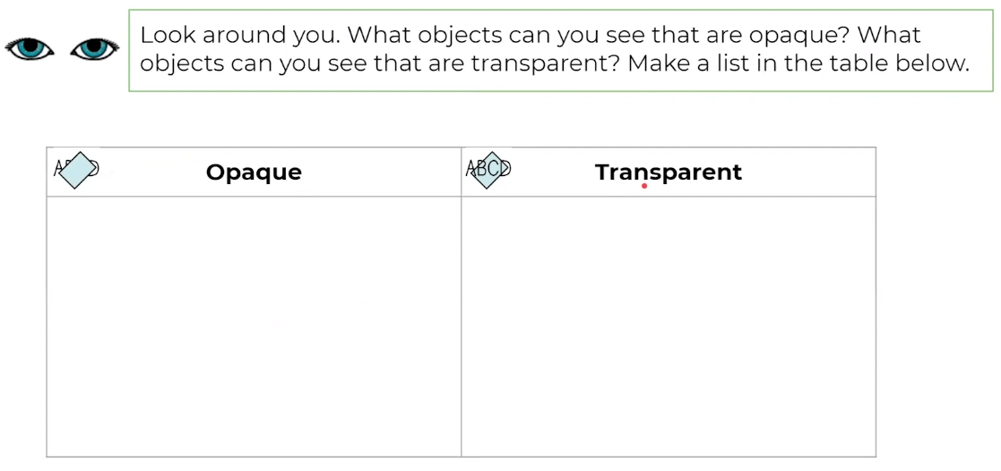

Slide 30
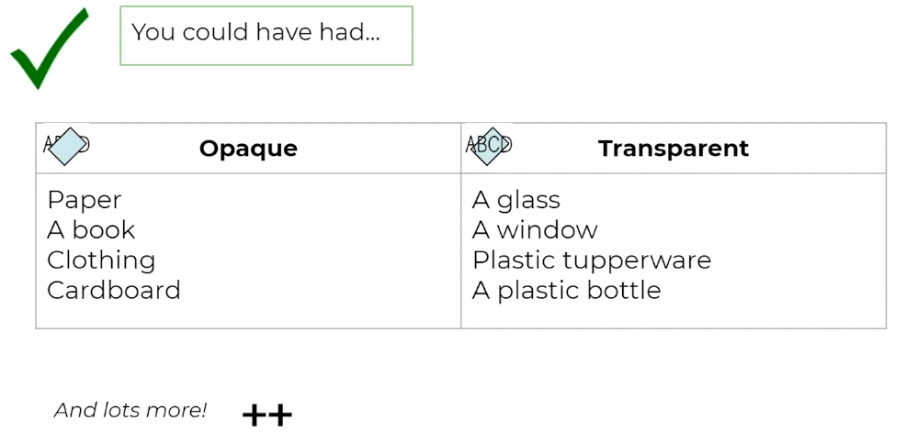

Slide 32
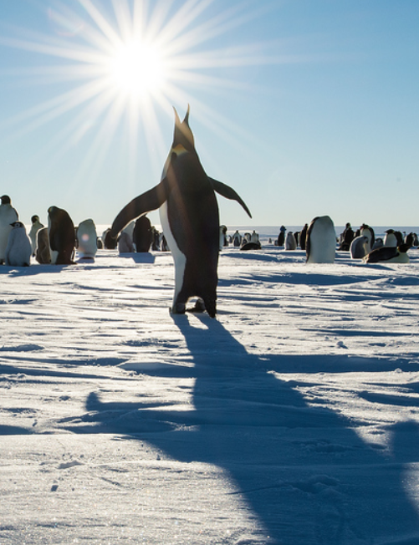
Shadows are formed when light from a source is blocked by an opaque object.
Sunlight that travels towards the Earth takes just over 8 minutes to reach us. When the rays reach Earth, they hit whatever is in their path. If the object they hit is opaque, the light cannot pass through, and a shadow forms.
Task: Go outside and make different shadows using your body or objects. Can you change the size or position of the shadows?

Slide 33
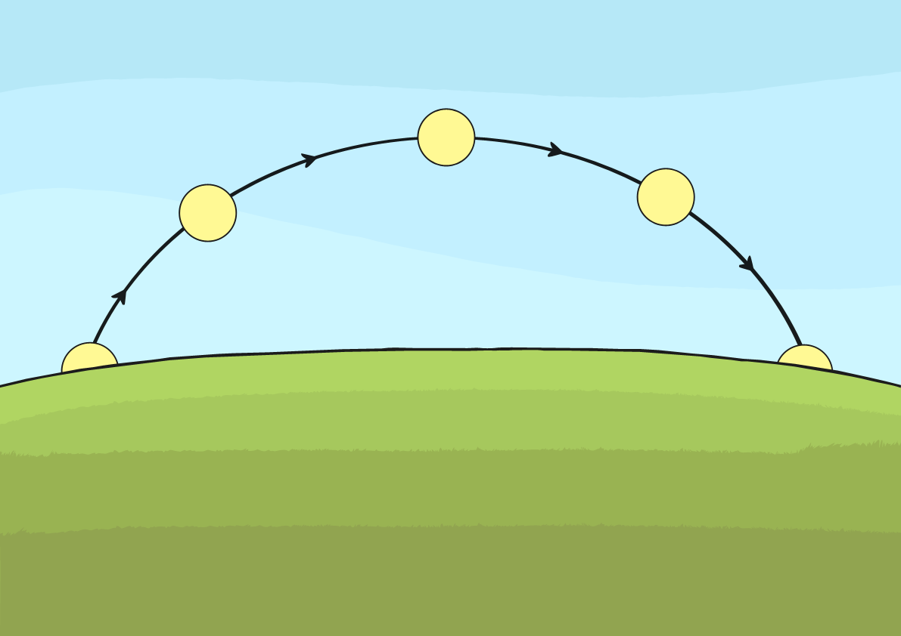
Does the Sun Move?
Have you noticed how shadows change throughout the day?
Why do you think this is?
The Sun stays in the same place in relation to the Earth. It appears to move because of the movements of Earth as it orbits the Sun.
In the morning and late afternoon, shadows are longer. They are shortest at midday as this is when the sun appears to be highest in the sky. This idea of the sun appearing to move during the day is where the traditional stories explaining day and night came from.

Slide 34
When we are outside on a sunny day, we can see how our shadows change throughout the day.
The Sun’s position in the sky affects the length of the shadow.
When the Sun is low on the horizon, the shadows are long.
When the Sun is high in the sky, the shadows are much shorter.
Task: Create a shadow ‘diary’ using an object.
Place an object outside, leave it in the same spot and position, at different points of the day (make sure it is sunny) go outside to check the shadow and use chalk to draw around the shadow. If you don’t have chalk you can observe. What changes happen?

Slide 35
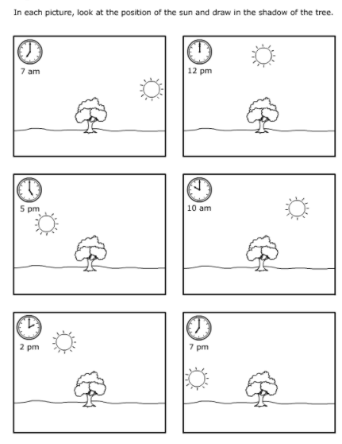
L.O To be able to explain how shadows are formed
Draw each picture onto a piece of paper if you do not have this sheet.
Look at the position of the sun.
Draw where you think the shadow of the tree would be in relation to the new position of the sun.
Ext: Write a sentence to explain how shadows are formed.

Slide 36
Date: Friday 2nd June 2021
L.O. To be able to identify how day and night occur.
Subject: Science

Slide 37
Watch the video that explains about day and night
https://www.youtube.com/watch?v=Wr-CRKsTYGs

Slide 38
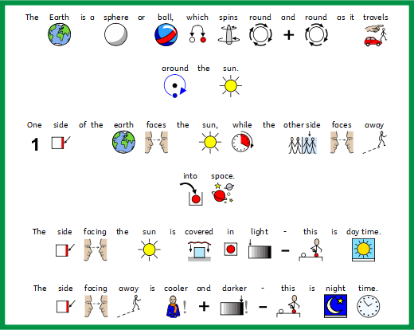

Slide 39
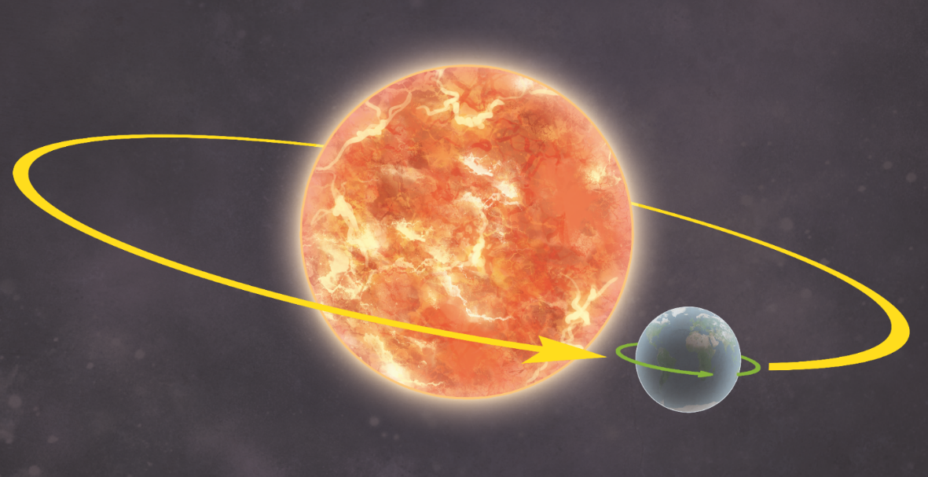
How Does Earth Move?
Earth moves in two ways.
It revolves (orbits) the Sun. One revolution takes just over 365 days.
It rotates (spins) round once every 24 hours.
Earth rotates on its axis. This is an imaginary line that runs from the North Pole to the South Pole.

Slide 40
How Does Earth Move?
The revolution of Earth (once every 365 days) causes the seasons.
The rotation of Earth (once every 24 hours) causes night and day.

Slide 41
Explaining our seasons
The Earth's axis is tilted as it travels around the Sun, so some parts of the Earth receive more sunlight each day than others.
This changes during the year because the Earth moves about the Sun, which gives rise to the seasons.
The UK is in the top half (northern hemisphere) of the Earth. When the northern hemisphere is tilted towards the Sun it is summer in the UK.
Six months later the northern hemisphere is tilted away from the Sun and it is winter.
In Spring, the temperature and day length become longer. In Autumn, they are shorter.

Slide 42
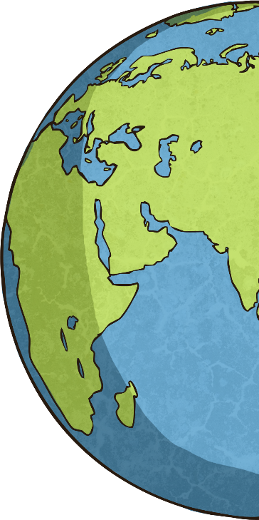
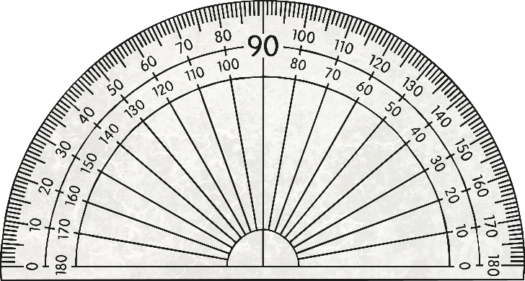
Day and Night
Have you ever noticed that a globe is slightly tilted?
This is because Earth itself is slightly tilted on its axis. Currently, this tilt is 23.5°. However, this can change over thousands of years.
https://www.youtube.com/watch?v=CqkQv617bcw

Slide 43
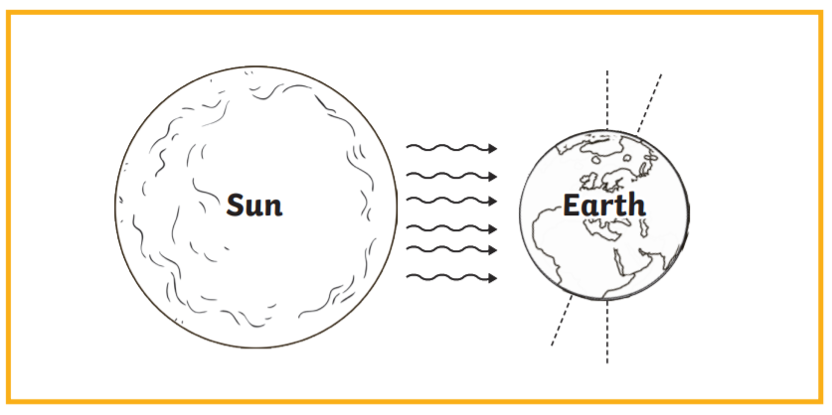
Draw the diagram and shade where we will be in night-time, then copy the sentences and fill in the blanks.
One side of the Earth faces the ________, while the other side faces away into ____________________.
The Earth _______________ on its axis one each day.
The rotation of Earth causes ______________________________.
When the Sun shines on our part of Earth, we are in ____________________________.
When Earth spins away from the Sun, we are in ________________________________.
Earth rotates on its axis. This is an ____________ line that runs from the _________to the __________________.
The Earth's ____________ is tilted as it travels around the Sun.
When the _______________________________is tilted towards the Sun it is summer in the UK.
When the northern hemisphere is tilted away from the Sun, it is __________________________.
night and day imaginary Sun light North pole daytime night-time spins axis reflects South pole northern hemisphere winter Earth's tilted

