Slide 1



Date: Monday 11th January
LO. To be able to describe the process of reproduction in some plants.
Subject: Science

Slide 2
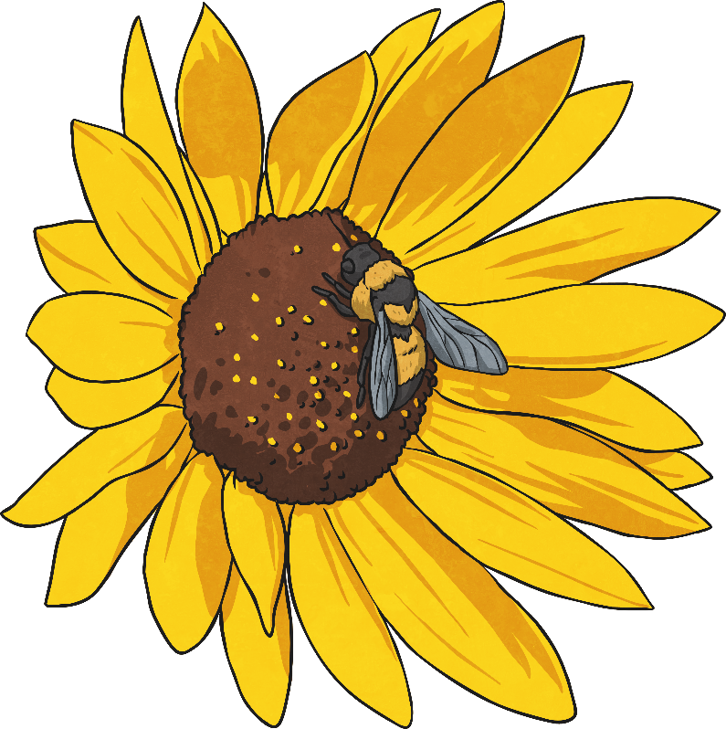
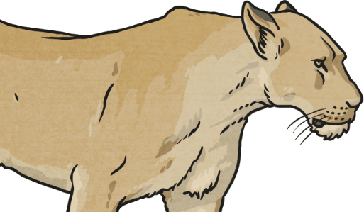
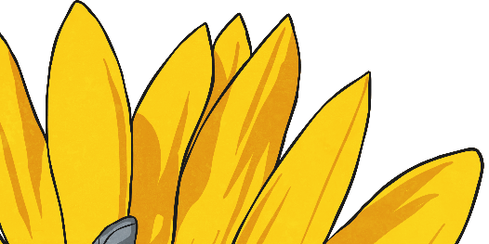
Asexual Reproduction
Some plants use sexual reproduction to make seeds, which grow to make new plants. These plants need pollen (containing the male gamete or sex cell) from one flower to fuse with the ovule (the female gamete) of another flower, which makes a seed.
However, some plants use asexual reproduction to make new plants.
Unlike sexual reproduction, asexual reproduction only needs one parent plant to make new plants.
Because there is only one parent plant, there is no fusion of gametes, and no mixing of genetic information. The new plants are identical to the parent plant. They are clones.

Slide 3
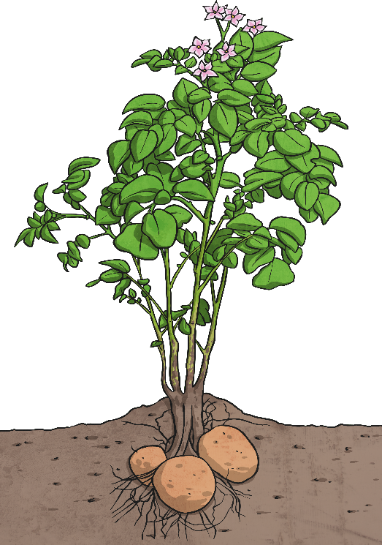
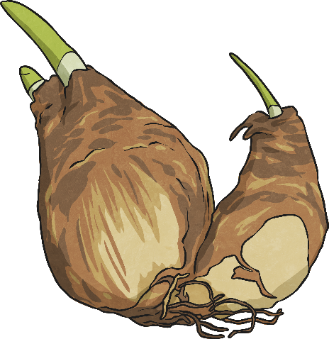
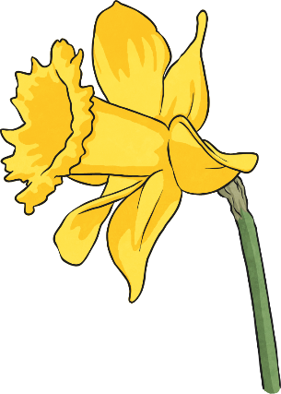
Plants That Use Asexual Reproduction
Other plants produce side branches or runners with new plantlets on. The roots of each plantlet grow down into the soil, and the plantlets will grow to form new plants identical to the parent.
Spider plants and strawberries are examples of plants that reproduce this way.
Daffodil bulbs store energy underground. Once the daffodil plant has died back, the bulb develops side shoots that will grow into new daffodils for next year.
Potato plants grow tubers underground during the spring and summer. These tubers will grow into new plants the following spring if they are left undisturbed.

Slide 4
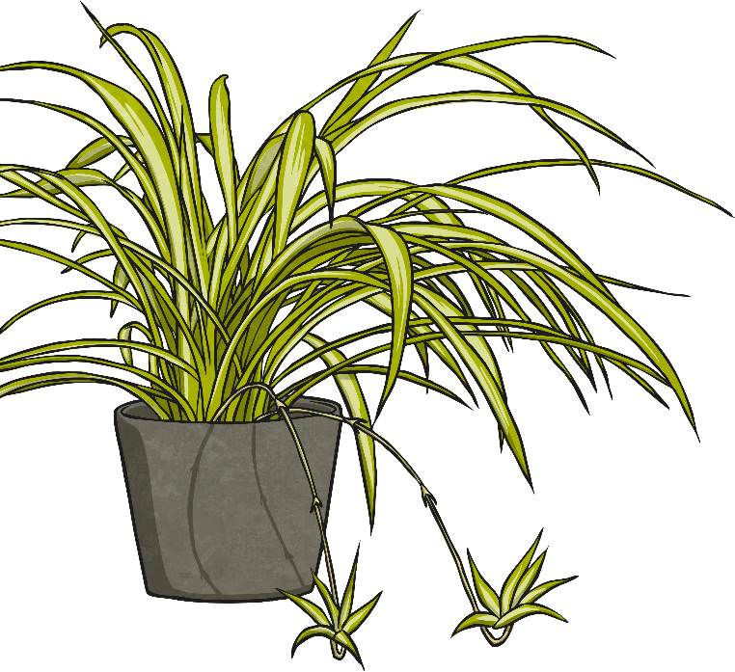
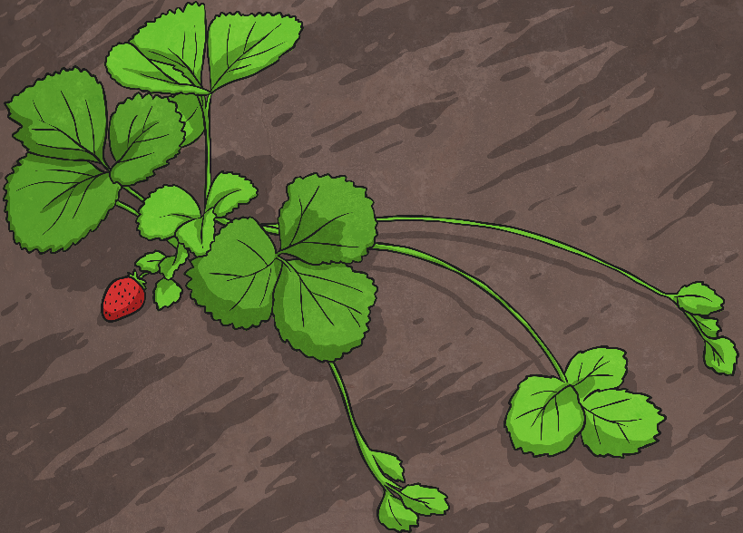
Plants That Use Asexual Reproduction
Some plants develop bulbs or tubers underground. These bulbs or tubers will develop into new plants for the following year. The new plants will be genetically identical to the parent plant.
Daffodils and potatoes are examples of plants that reproduce this way.
Strawberry plants send out runners with small plantlets on. These will each grow into a new strawberry plant.
Spider plants send out branches with baby plantlets on. Each plantlet will grow into a new plant.

Slide 5
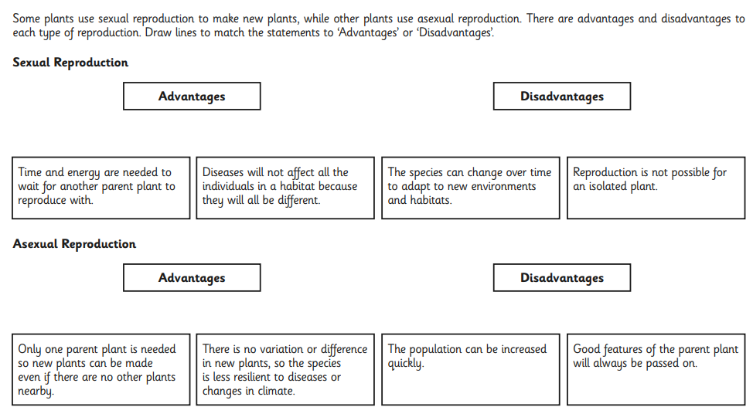
Task:
Alternatively: Discuss and decide which statement would go where.

Slide 6
Date: Tuesday 12th January
LO. To be able to label parts of a plant and describe their functions.
Subject: Science

Slide 7
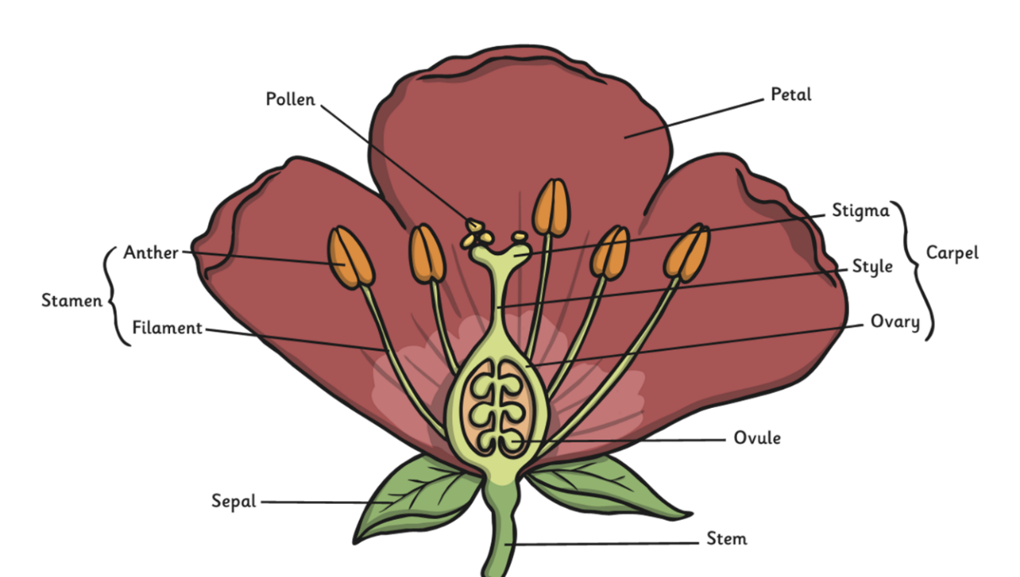
Parts of a flower
Copy and paste the link below into a browser, then watch the video.
https://www.bbc.co.uk/teach/class-clips-video/science-ks1-ks2-ivys-plant-workshop-the-anatomy-of-the-flower/zjmhkmn
Copy and paste the link below into a browser to find out more about the different parts of a flower
https://www.dkfindout.com/uk/animals-and-nature/plants/parts-flower/

Slide 8
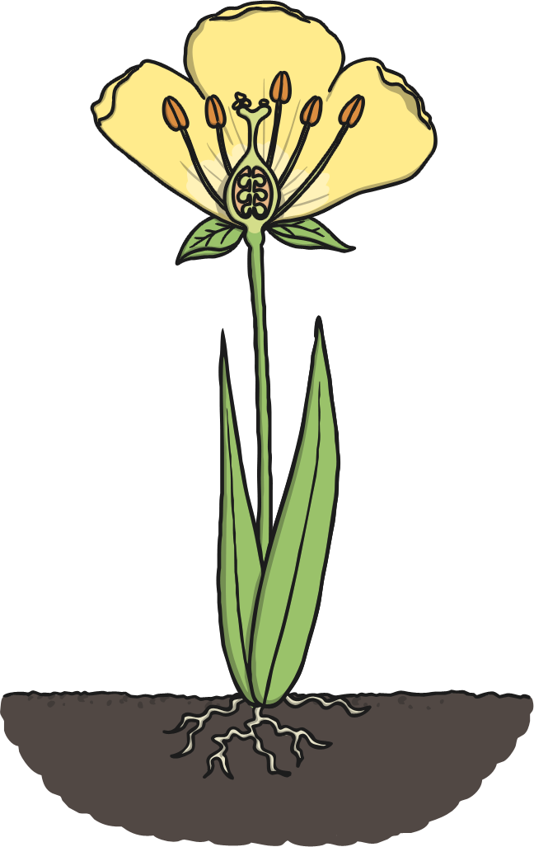

Leaf
Leaves make food for the plant from carbon dioxide in the air and sunlight.

Slide 9
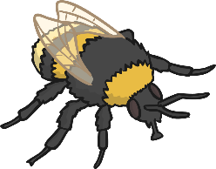

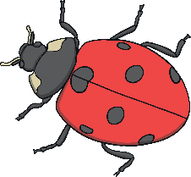
Petal
Petals attract insects to
the plant.
Plants need insects to bring pollen they have collected from other flowers so they can make seeds.
Petals are bright colours to attract the insects.

Slide 10
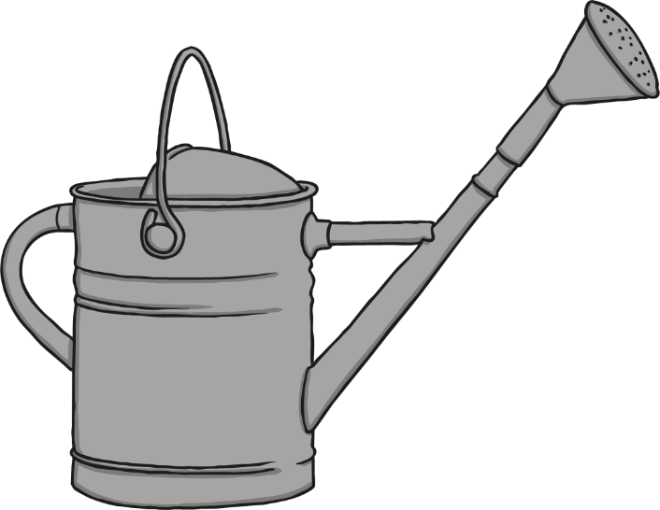
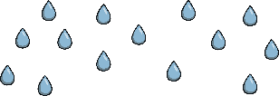

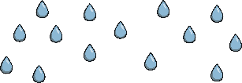
Roots
Roots absorb minerals and water from the soil.
The roots also help the plant anchor in the soil and stay upright.

Slide 11
Stem
The stem transports water around the plant.
It also holds the plant upright so it can get more sunlight.

Slide 12

Anther
The anther contains pollen which brushes onto insects when they land on the flower.
The pollen is moved by insects to other flowers.

Slide 13

Task: Create your own diagram of the flower and label each part.
Can you remember the function of any of the parts?
Which parts are male and which are female?
If you have any flowers, ask your grown up if you could dissect them to try and find the different parts.
Lilies are great for this!

Slide 14
Date: Wednesday 13th January
LO. To be able to explain the process of pollination.
Subject: Science

Slide 15
What is pollination?
https://www.bbc.co.uk/programmes/p0128z6q
https://www.bbc.co.uk/teach/class-clips-video/science-ks1-ks2-ivys-plant-workshop-what-is-pollination-and-how-does-it-work/zv4df4j
During plant reproduction, pollen grains need to move from the anther of one flower to the stigma of another flower. This is called pollination. Insects can pollinate flowers, and so can the wind. Insect-pollinated flowers are different in structure from wind-pollinated flowers.

Slide 16
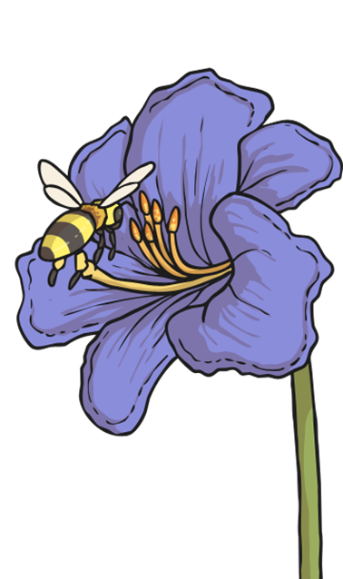
The Pollination Process
The Pollination Process
The flower petal’s bright colours and fragrant scents attract insects.
The insect arrives on the flower to collect nectar. This nectar is a sweet liquid which makes perfect insect food.
As the insect is gathering the nectar, it rubs against the anthers, which rub pollen onto the insect.
After the insect is done feeding on the flower’s nectar, it gets hungry and gets attracted by another flower`s bright colours.

Slide 17
The Pollination Process
As the insect feeds on the nectar in this new flower, the pollen stuck to the insect from the first flower rubs off onto the female parts of the second flower (the stigma).
Part of this pollen travels down the style and then into the ovary.
The tiny piece of pollen joins onto an ovule in the ovary. The plant has now been fertilised.
The ovary of the flower turns into seeds which will then be dispersed so that new plants will be able to grow somewhere else.

Slide 18
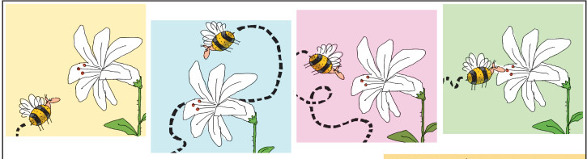
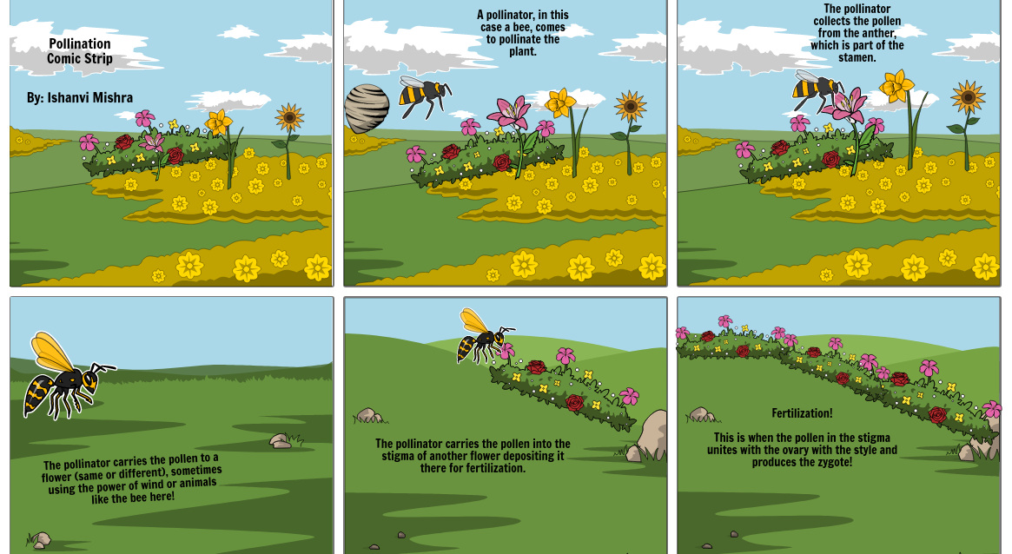
Examples of the task:
Here are some ideas for the pictures to draw for the stages of pollination.
You can use the information read to help with writing a sentence for each picture to explain the different stages.

Slide 19
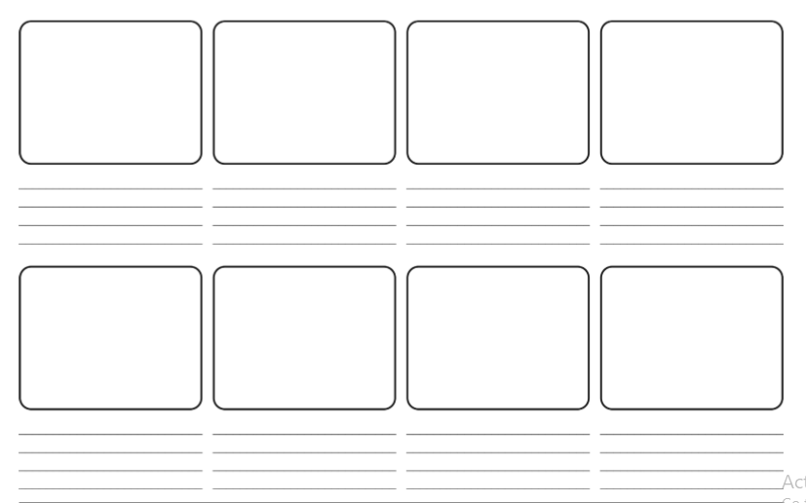
Task: Draw a picture and write a sentence about each part of the pollination process.
You could create your own story board, similar to this, on paper.

Slide 20
Date: Thursday 14th January
LO. To be able to explain seed dispersal and fertilisation.
Subject: Science

Slide 21
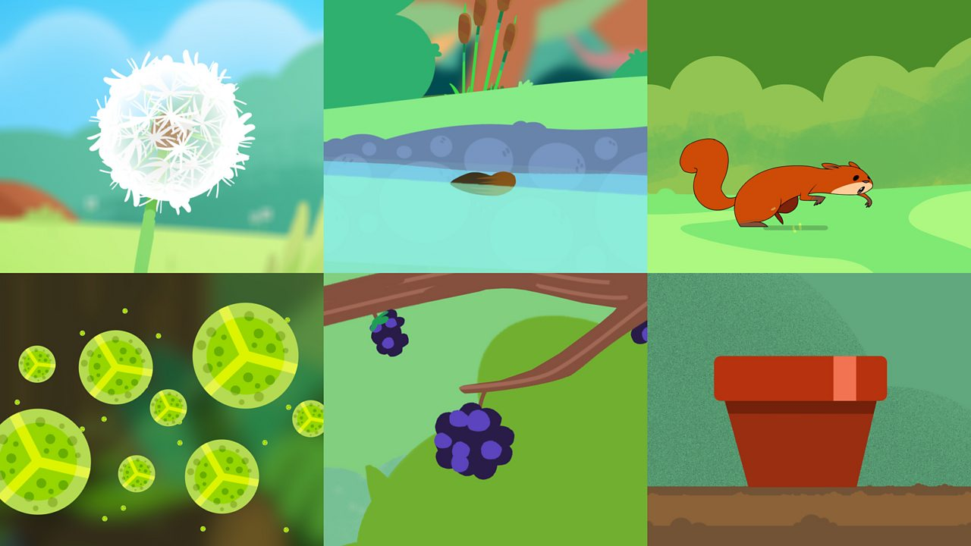
Seed dispersal
A plant produces many seeds. If all the seeds fell to the ground not many would germinate. The area would become over crowed and there would not be enough water or minerals for all the seeds. Plants have developed so that seeds can be transported in a number of ways: by the wind, by animals eating them, by water or by sticking to animals.
What types of fruits can you think of that are eaten by animals and people with seeds inside?
Copy and paste the link below into a web browser
https://www.bbc.co.uk/bitesize/clips/znvfb9q

Slide 22
Wind
Sticking to animals
Sycamore ‘helicopters’ and dandelion ‘clocks’ both have fruits which have adapted to use the wind to carry the seeds away when the seeds are ready.
Some plants such as cockleburs have developed to grow tiny hooks on their fruits which hook on to animals (or people) that pass by the plant. Eventually they will drop off on to the ground.
Water
Animals eating them
Some plants rely on water to disperse their fruits. These will either grow on the water or by the side of water.
Water lilies live on the water so they use the water to disperse their seeds. They make very light seeds which will float away on the water for a while, then sink to the bottom of a pond to grow a new lily.
Some plants make tasty fruits. This is to encourage animals (and people!) to eat the fruits. The seeds then pass through the animal unharmed and out the other end with a ready supply of fertiliser (not tasty in the slightest…quite the opposite). This method ensures the seed is given nutrients to help it grow

Slide 23
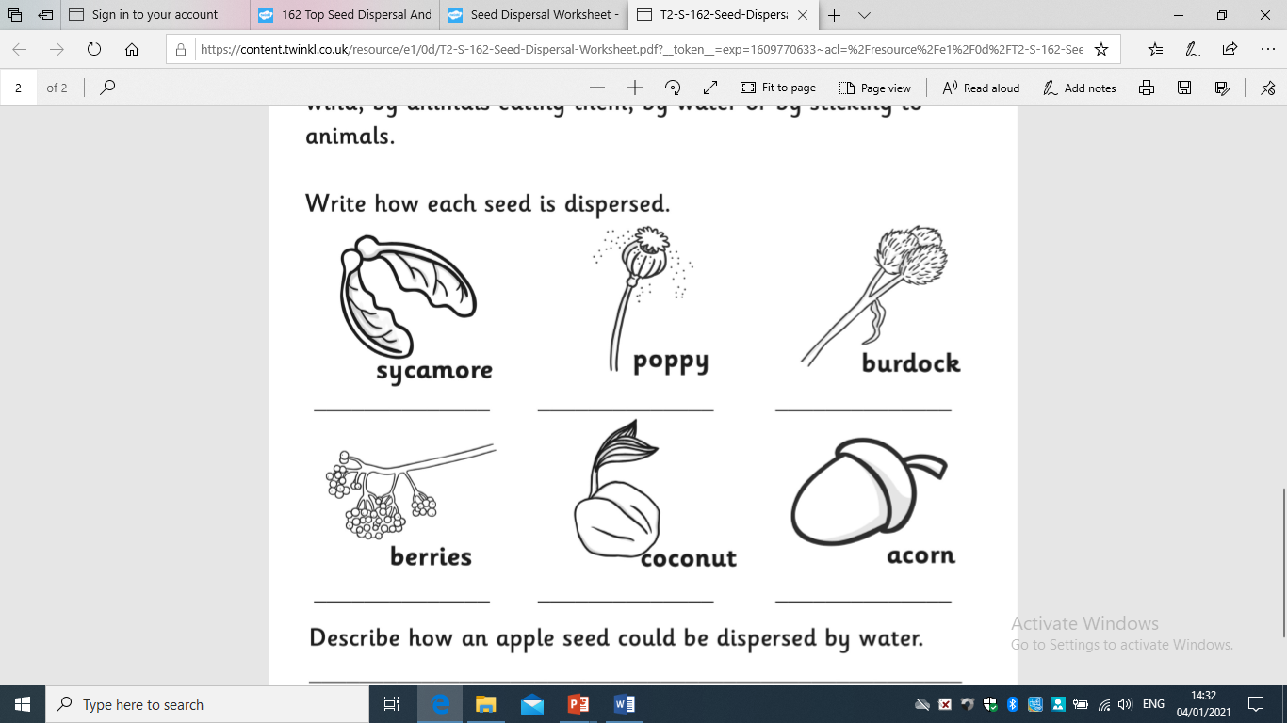
Task: Have a look at these seeds and write how you think they would be dispersed.
You can write the name of the seed and how you think it will dispersed if you don’t have this sheet.
Can you think of other examples and how the seeds are dispersed?

Slide 24
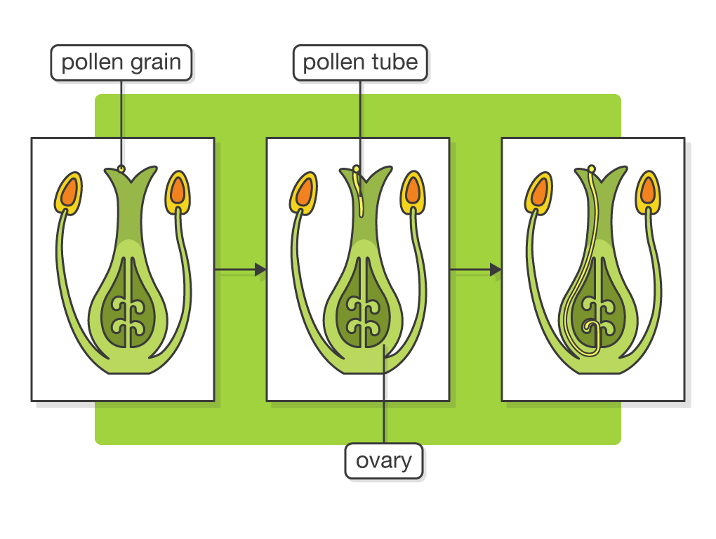
Fertilisation and germination
Copy and paste the link into a browser. Watch this video to find out more information.
https://www.bbc.co.uk/bitesize/guides/z2xg87h/video
When a pollen grain lands on the stigma of a flower of the correct species, a pollen tube begins to grow. It grows through the style until it reaches an ovule inside the ovary. The nucleus of the pollen then passes along the pollen tube and fuses (joins) with the nucleus of the ovule. This process is called fertilisation.
Germination is a process in which the seed begins to develop into a new young plant. Three main factors are needed for successful germination.
Water -Lets the seed swell and the embryo start to grow
Oxygen - Needed for aerobic respiration
Warmth -Increases growth rate and enzyme activity (but very high temperatures denature enzymes)

Slide 25
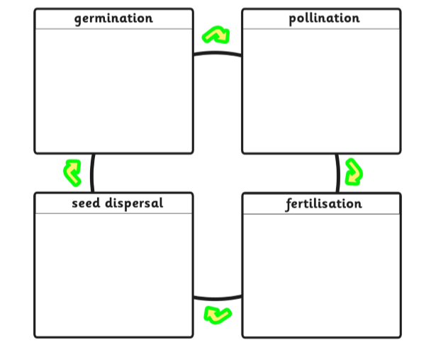
Task:
Draw a picture and write a sentence for each of the headings.

Slide 26
Date: Friday 15th January
LO. To be able to observe cycle changes over time and plants in the local area.
Subject: Science

Slide 27
Different places in the world have different plants and flowers. Research the different environments and compare the plants.
https://study.com/academy/lesson/desert-plants-lesson-for-kids.html - Plants in the desert
https://study.com/academy/lesson/ocean-plants-lesson-for-kids.html - Plants in the ocean
https://www.sciencekids.co.nz/videos/nature/amazonrainforest.html - Plants in the rainforest
Have a look at these videos to help you get started on your research.
You could present your ideas on as a written piece, a table or a poster.

Slide 28
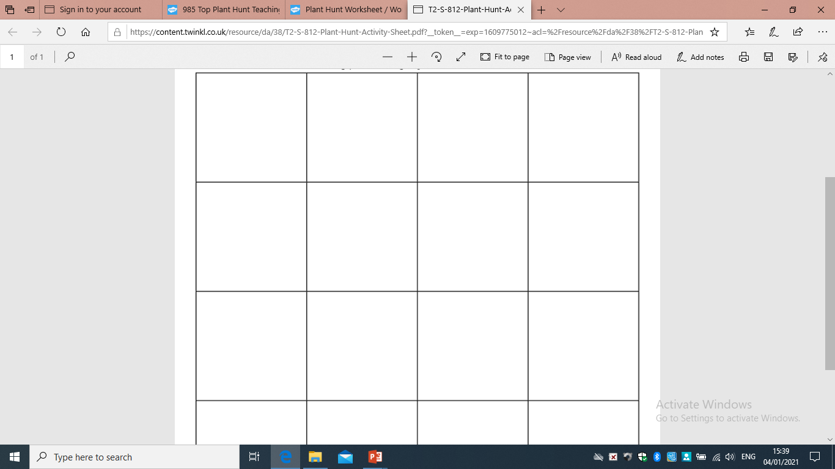
Task:
Have a look in your garden or an outside space near you and see what plants you can find.
Draw the plant
Key features
Description of plant
You could present your findings in a table.

