Slide 1



Subject: Topic

Slide 2


Date: Monday 7th February 2021
LO
LO. To join materials using different techniques and resources.
Subject: Science

Slide 3



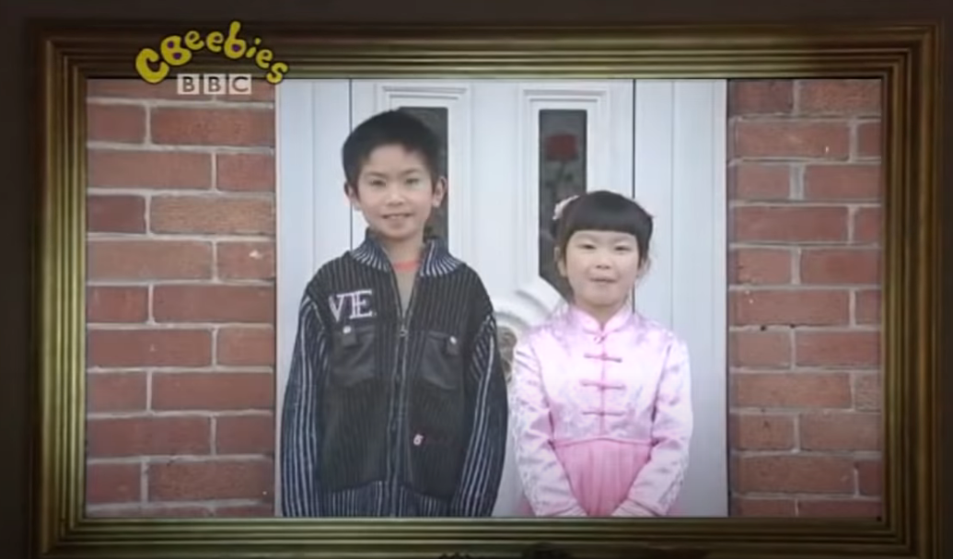
https://www.youtube.com/watch?v=c8ssHXZ9_qU
Click on the picture to watch the video about how Chinese New year is celebrated.

Slide 4
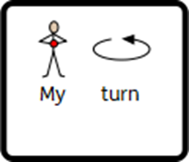
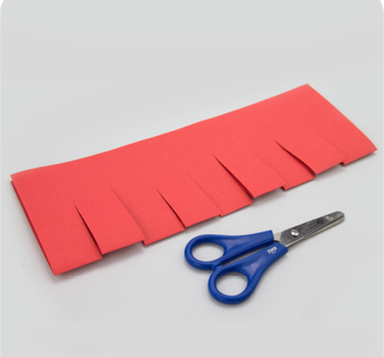
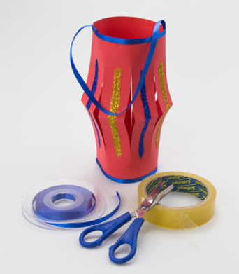


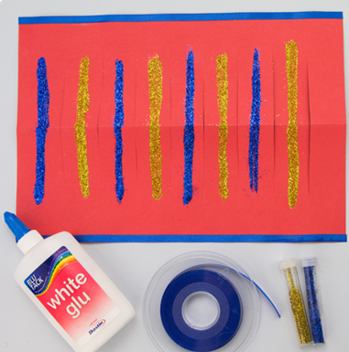
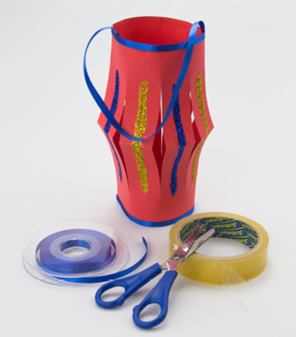



Slide 5
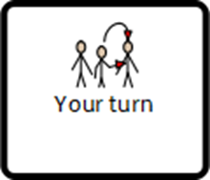






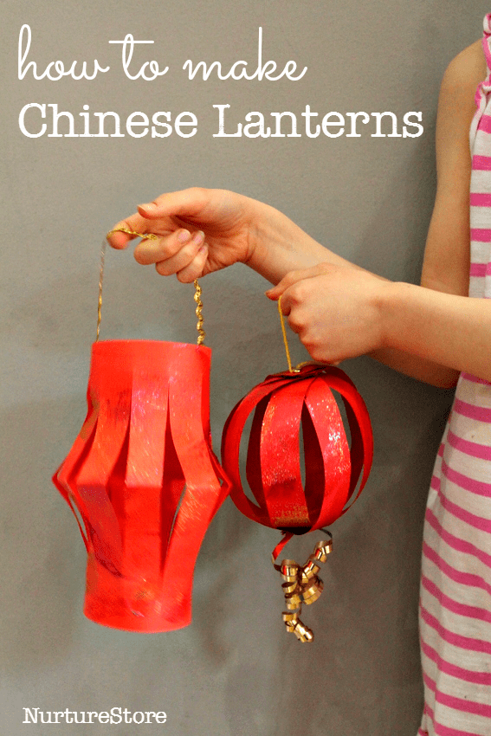

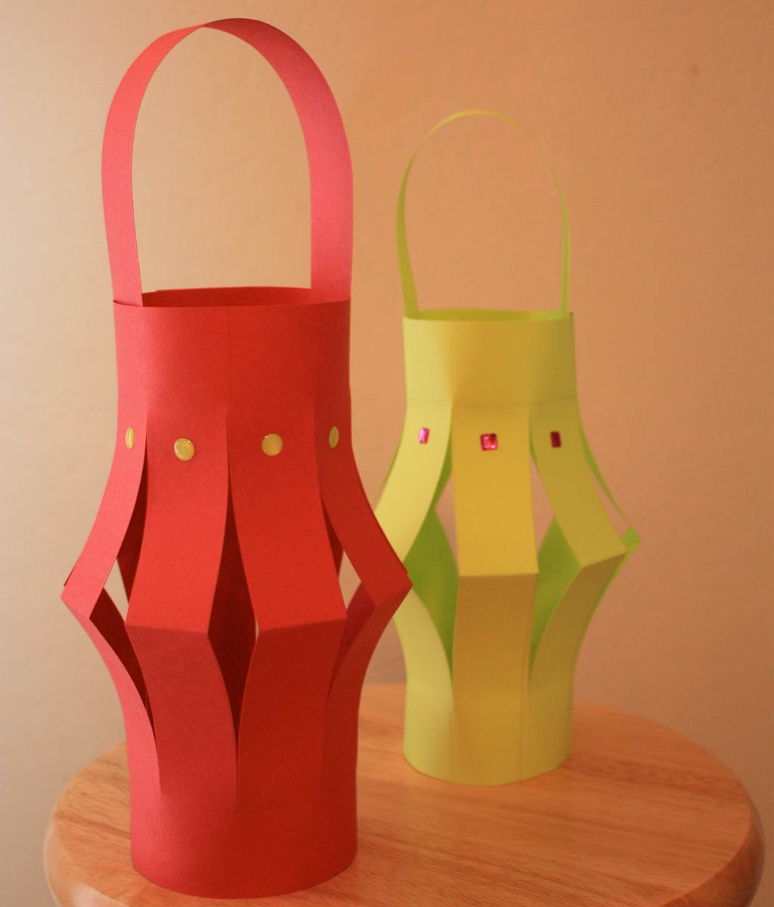



At this point your adult could draw some lines for you to follow. Don’t forget when cutting to stop before the edge.
Step 1 –
Step 2 –
Step 3 –
Step 4 –
Step 5-
Click on the picture above to watch the process on you tube or type the link into google https://www.youtube.com/watch?v=CeZKYGmuZn0.

Slide 6
Date: Tuesday 8th February 2021
LO
LO. To create a picture that contains patterns and shapes.
Subject: Art

Slide 7
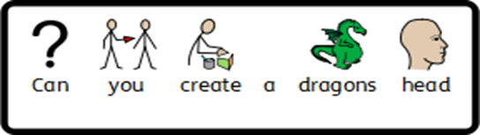














Slide 8



You can use the shapes on here or cut them out. Please remember if you do not have a printer at home you can collect a paper copy from school.

Slide 9
Date: Wednesday 9th February 2021
LO
LO. To be able to fold paper.
Subject: Art

Slide 10
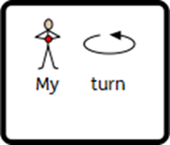
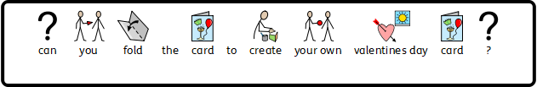

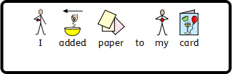


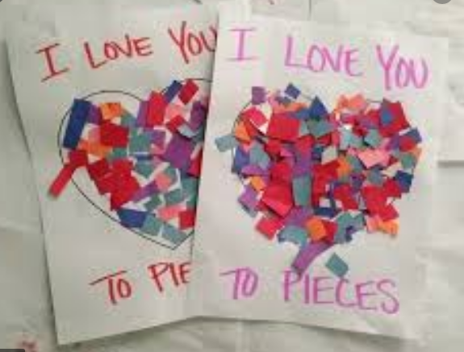




You could colour your heart or add pieces of paper to create a collage

Slide 11
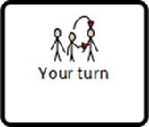

Slide 12
Date: Thursday 10th February 2021
LO
LO. To develop a range of practical cooking skills.
Subject: DT

Slide 13





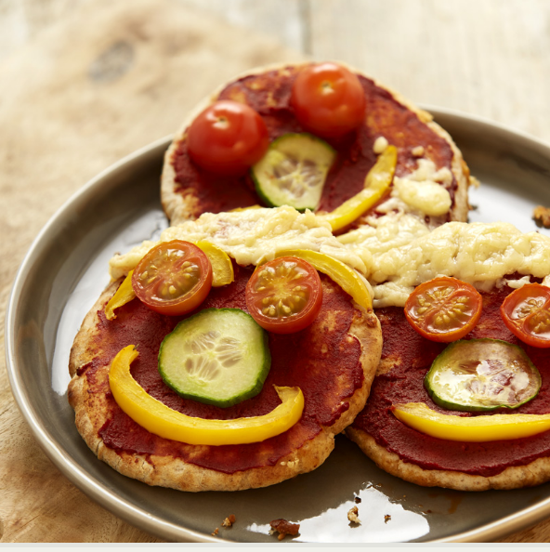








Wrap or pitta bread
4 tsp tomato purée
1 tsp dried mixed herbs
40g reduced-fat cheese, grated
.

Slide 14
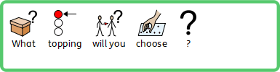
Wrap or pitta bread
4 tsp tomato purée
1 tsp dried mixed herbs
40g reduced-fat cheese, grated
.

Slide 15
Date: Friday 11th February 2021
LO
LO. To combine different parts of the body when singing and dancing .
Subject: PE

Slide 16

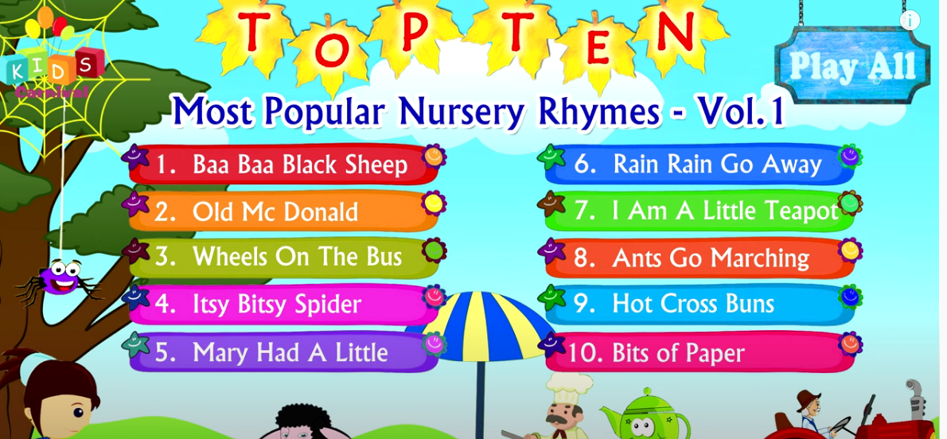


Click on the pictures to listen to some of our favourite nursery rhymes
https://www.youtube.com/watch?v=6PA3ewtp3ng
https://sites.google.com/alice-smith.edu.my/jbklassfit/pe-activities/eyfs-year-2/dance/zumba-for-kids
Click the picture to dance along to the valentines song.

Slide 17

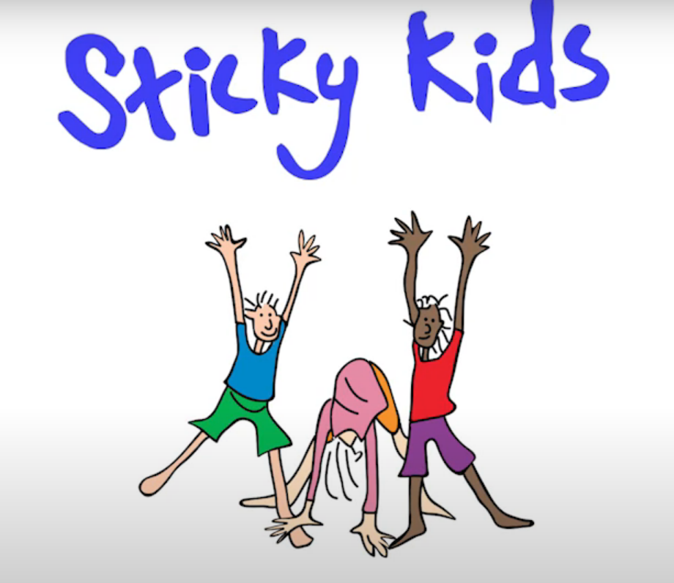
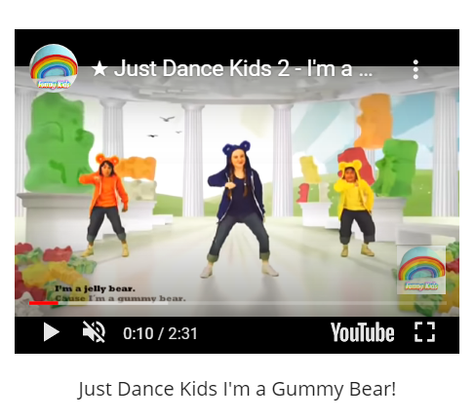
Click on the picture below to follow the link
Click the picture above to dance along to sticky kids.
Join in with our favourite action songs by following the link below
https://www.bbc.co.uk/programmes/p038bb48
https://sites.google.com/alice-smith.edu.my/jbklassfit/pe-activities/eyfs-year-2/dance/just-dance-for-kids

