Slide 1
Date: Monday 25th January
L.O. To be able identify what homophones are.
Subject: English

Slide 3
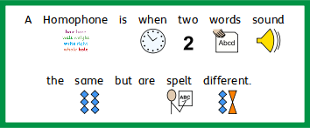

Slide 5
.
My Turn
Harold ate eight bowls of soggy cereal for his breakfast.

Slide 6
Build A Sentence – Build 3 sentences using the homophones.

Slide 7
Scaffold A Sentence - – Finish the 3 sentences by adding the homophones then underline all the homophones.

Slide 8
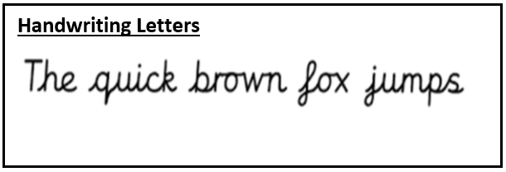
Write A Sentence – Find 3 pairs of homophones then use them to write 6 sentences.
Pair / Pear : Peter Piper picked a pair of pears.
Sew / so : My socks had a hole in so I had to sew them.
Hare / hair: The grey, beautiful hare had very soft hair.

Slide 9
Date: Tuesday 26th January
L.O. To be able to identify and use adverbs in sentences.
Subject: English

Slide 10
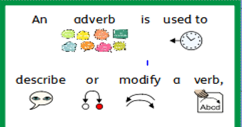
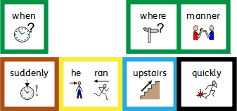

Slide 13
.
My Turn
Frequently, he wandered through the field slowly.
Suddenly, they jumped in the puddle excitedly.

Slide 14
Build A Sentence – Build 3 sentences.

Slide 15
Scaffold A Sentence - – Finish the 3 sentences by adding the adverbs.

Slide 16
Write A Sentence – Choose 3 verbs then write 3 sentences using your adverbs.
Cheerfully, she danced in the street
Quietly, he read his book in the museum.
Happily, they laughed in the class .

Slide 17
Date: Wednesday 27th January
L.O. To be able to write sentences with subordinating conjunctions.
Subject: English

Slide 18
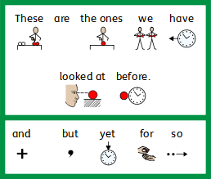
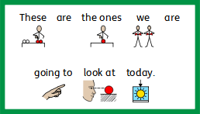

Slide 19
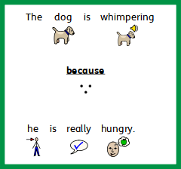

Slide 21
.
My Turn
When I wake up I do yoga before getting dressed. I then feel ready for school because I have exercised.

Slide 22
Build A Sentence – Build 3 sentences using the subordinate conjunctions to join the sentences.

Slide 23
Scaffold A Sentence - – Finish the 3 sentences by adding the subordinate conjunctions then finishing the sentences.

Slide 24
Write A Sentence – Write 3 sentences using the subordinate conjunctions.
I was daydreaming while waiting for the movie to start.
Sadly, the boy cried after hurting his leg.
My enormous, smelly sock was wet because it had just been in the washing machine.

Slide 25
Date: Wednesday 27th January
L.O. To be able to write sentences using two clauses.
Subject: English

Slide 27
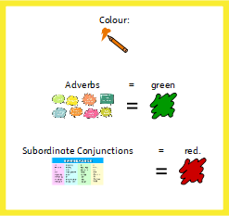

Slide 31
.
My Turn
Daily, I brush my teeth in the bathroom, so that they are nice and clean.

Slide 32
Build A Sentence – Build 3 sentences with subordinate clauses.

Slide 33
Scaffold A Sentence - – Finish the 3 sentences by adding the subordinate conjunctions then finishing the sentences.

Slide 34
Write A Sentence – Write 3 sentences using the subordinate conjunctions.
Frequently, I laugh in school loudly, then my friends laugh too.
Suddenly, the boy jumped, because he had hurt his leg.
Annually, I visit Australia, so that I can see the kangaroos.

Slide 35
Date: Friday 29th January
L.O. To be able to spell homophones.
Subject: English

Slide 36
Spellings
Remember:
Their
There
They’re
Stares
Stairs
Waist
Waste

Slide 37
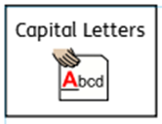
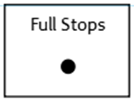
Spellings
Do not forget:
Can you put each one in a sentence?
Their:
There:
They’re:

Slide 38
Spellings
Do not forget:
Can you put each one in a sentence?
Stares:
Stairs:
Waist:
Waste:

