Slide 1
Subject: English
Pack: B

Slide 2
Text type: Mystery Narrative
Trailblazers
Monday | Tuesday | Wednesday | Thursday | Friday
L.O. To be able to use exciting synonyms. | L.O. To be able to use show not tell. | L.O. To be able to write clues that tantalise the reader. | L.O. To be able to use relative clauses. | L.O. To be able to write a mystery narrative.

Slide 3
Read, copy, cover, spell this week’s spellings.
Date: Monday 1st March 2021
chef
chalet
chandelier
chute
machine
brochure
moustache
parachute

Slide 4
Date: Monday 1st March 2021
LO: To be able to use exciting synonyms.
Subject: English

Slide 5
What language did Arthur Conan Doyle use?
Starter
Language

Slide 6
What language did Arthur Conan Doyle use?
Starter
Dialogue
Simile
Formal language
Onomatopoeia
Language
Narrative voice
Mystery vocabulary
Personification

Slide 7
What is a synonym?
A synonym is a word that means exactly or nearly the same as another word.

Slide 8
Examples
Synonyms for strange
Perplexing
Bizarre
Curious
Astonishing
Peculiar
Unusual
Mystifying

Slide 9
Examples
Synonyms for scary
Frightening
Hair-raising
Terrifying
Petrifying
Alarming
Daunting
Eerie

Slide 10
Examples
Synonyms for dark
Dim
Gloomy
Dusky
Overcast
Pitch black
Indistinct

Slide 11
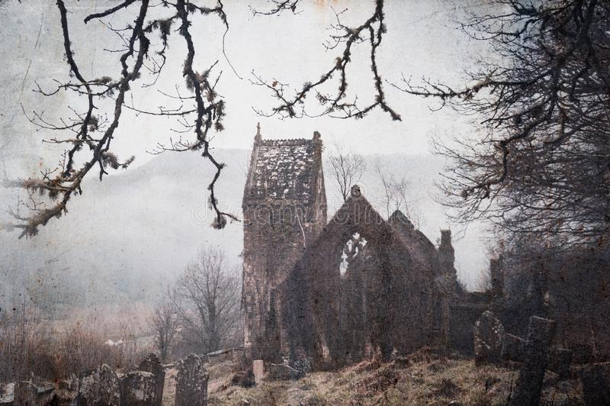
Think of a synonym for the following word.
Synonyms for old
Use a thesaurus to help you.
https://www.thesaurus.com/

Slide 12
Think of a synonym for the following word.
Synonyms for old
Decrepit
Worn
Antique
Archaic
Ancient
Here are some of my ideas.

Slide 13
Think of a synonym for the following word.
Synonyms for tall
Use a thesaurus to help you.
https://www.thesaurus.com/

Slide 14
Think of a synonym for the following word.
Synonyms for tall
Towering
Giant
Extensive
Soaring
Elevated

Slide 15
Think of a synonym for the following word.
Synonyms for investigate

Slide 16
Think of a synonym for the following word.
Synonyms for investigate
Examine
Explore
Peer
Inspect
Observed
Scrutinise

Slide 17
Create a word bank of synonyms we have been through this lesson.

Slide 18
Fill in the missing words with an appropriate synonym.
Holmes peered out the window, it was a ________ night. For what was about to happen, no one expected. A _______ noise pierced the air.
“What was that?” questioned Holmes, walking towards the door.
_______ the hallway, Holmes spotted a hunched silhouette outside the victim's door.
Examining | Investigating | Frightening | Terrifying
Gloomy | Dark | Scary | Petrifying

Slide 19
Fill in the missing words with an appropriate synonym.
Holmes peered out the window, it was a gloomy night. For what was about to happen, no one expected. A terrifying noise pierced the air.
“What was that?” questioned Holmes, walking towards the door.
Examining the hallway, Holmes spotted a hunched silhouette outside the victim's door.
Examining | Investigating | Frightening | Terrifying
Gloomy | Dark | Scary | Petrifying

Slide 20
Using the image, let’s write 3 sentences using exciting synonyms.

Slide 21
Using the image on the right, let’s write 3 sentences using exciting synonyms.
There was something eerie about this mansion, Holmes could not put his finger on it. Was it the gloomy hallway with the crackling fire? Was it the ancient framework towering over us?

Slide 22
Using the images below, write 6 sentences that include exciting synonyms. Underline the synonyms that you have included.
Remember to look at your work bank from earlier.
Ambitious Vocabulary
isolated | agitated | turbulent | triumph | simultaneously | devastation
endeavor | submerged | vandalise | torrent | temperament | Haphazard

Slide 23
Reading time
Now that you have finished your main task, please enjoy some reading time.
You can read to yourself, an adult or sibling.
This can be done by logging on to your myON account, picking a book or magazine and enjoying at least 15 minutes reading time.
https://www.myon.co.uk/login/index.html
Remember that your login is your first name and first letter of your surname then password:
harryp
password1
Please email trailblazerspupils@gmail.com if you have any login issues.

Slide 24
End of lesson.

Slide 25
Read, copy, cover, spell this week’s spellings.
Date: Tuesday 2nd March 2021
chef
chalet
chandelier
chute
machine
brochure
moustache
parachute

Slide 26
Date: Tuesday 2nd March 2021
L.O. To be able to use show not tell.
Subject: English

Slide 27
What is show not tell?
Show not tell is a technique used to describe something without explicitly saying what it is.

Slide 28
What is show not tell?
We can use facial expressions, body language and voice.
She was angry.
Face | Tears streamed down her red cheeks.
Body | She was shaking life a leaf. Her whole body quivered.
Voice | She yelled at the top of her lungs.

Slide 29
Which sentence includes show not tell?
Sherlock homes was confused.
As he examined the outside of the windows with deep intensity, he raised one eyebrow and stood quiet for a moment.

Slide 30
Which sentence includes show not tell?
Telling our feelings.
Sherlock Holmes was confused.
As Holmes examined with deep intensity the outside of the windows, he raised one eyebrow and stood quiet for a moment.
Showing our feelings.

Slide 31
Which sentence includes show not tell?
After retelling the horrific event, her eyes filled with water.
She was sad.

Slide 32
Which sentence includes show not tell?
After retelling the horrific event, her eyes filled with water.
Showing our feelings.
Telling our feelings.
She was sad.

Slide 33
We can use show not tell for our emotions.
Afraid | Shocked | Angry | Happy
Hands shaking Knees like jelly Heart pounding Feeling sick to your stomach Butterflies in my stomach | Jaw drops Mouth wide open Gasp Drop what you are holding Step back | Red in the face Hands on hips Jaw clenched Slamming door Gritting teeth | Smiling from eye to eye. Jumping up and down. Eye wide and bright.

Slide 34
Let’s write some show sentences.
Write the next sentence to show that the girl was afraid.
As she ran towards the house, she heard crunching footsteps behind her. _______ ___________________________________________________________________.
Afraid
Hands shaking. Knees like jelly. Heart pounding. Feeling sick to your stomach. Butterflies in my stomach. | Eyes wide with fright. Covered face with hands. Voice quivered.

Slide 35
Let’s write some show sentences.
As she ran towards the house, she heard crunching footsteps behind her. Unease slithered down her spine.

Slide 36
Let’s write some show sentences.
Finish the sentence showing Holmes was angry.
As Holmes stepped into his office, _________________________________ .
Angry
Red in the face. Hands on hips. Jaw clenched. Slamming door. Gritting teeth

Slide 37
Let’s write some show sentences.
As Holmes stepped into his office, he slammed the door behind him.

Slide 38
Write two show sentences for each of the following feelings. Use the phrase bank and examples from this lesson to help you.
Afraid | Shocked | Angry | Happy
Phrase bank:
Afraid | Shocked | Angry | Happy
Hands shaking Knees like jelly Heart pounding Feeling sick to your stomach Butterflies in my stomach | Jaw drops Mouth wide open Gasp Drop what you are holding Step back | Red in the face Hands on hips Jaw clenched Slamming door Gritting teeth | Smiling from eye to eye. Jumping up and down. Eye wide and bright.

Slide 39
Reading time
Now that you have finished your main task, please enjoy some reading time.
You can read to yourself, an adult or sibling.
This can be done by logging on to your myON account, picking a book or magazine and enjoying at least 15 minutes reading time.
https://www.myon.co.uk/login/index.html
Remember that your login is your first name and first letter of your surname then password:
harryp
password1
Please email trailblazerspupils@gmail.com if you have any login issues.

Slide 40
End of lesson.

Slide 41
Read, copy, cover, spell this week’s spellings.
Date: Wednesday 3rd March 2021
chef
chalet
chandelier
chute
machine
brochure
moustache
parachute

Slide 42
Date: Wednesday 3rd March 2021
L.O. To be able to use clues to tantalise the reader.
Subject: English

Slide 43
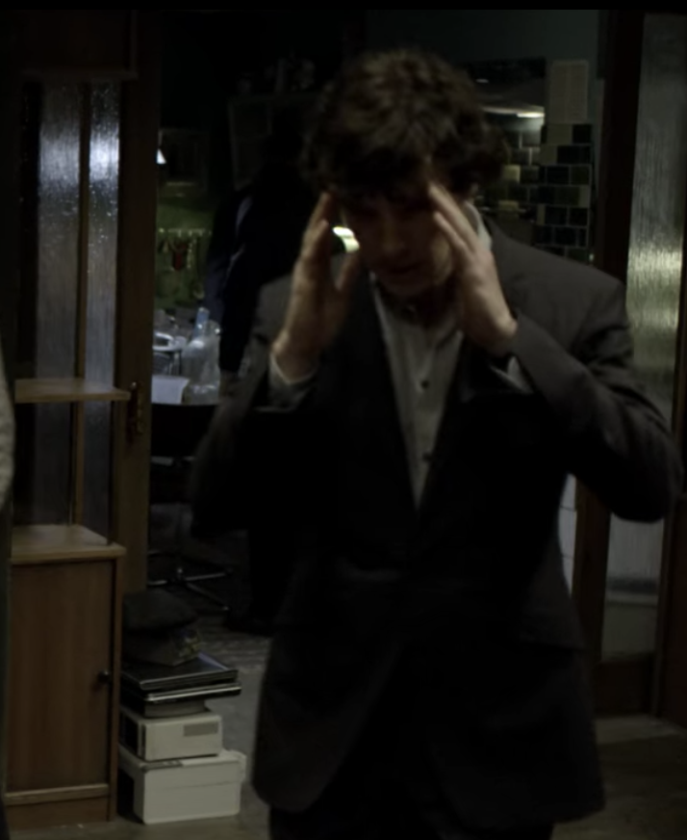
In this image Holmes is confused. Write a sentence to show this feeling through actions.
Starter

Slide 44
Today we are going to think of clues to include in our mystery narrative to tantalise the reader.
To tantalise:
This is means to fascinate the reader and make them what to read on to find out what happened.

Slide 45
Clues are hints that can help the reader and the detective solve the mystery. They can be things people say or do, or objects found that provide important information.

Slide 46
Examples of clues:
Peering into the hallway, Holmes saw a hunched silhouette disappear into the darkness.
What do we learn about the suspect here? Would this clue help us narrow down our search?

Slide 47
Examples of clues:
Examining the room, Holmes’ attention was drawn to a set of fingerprints on the dusty cabinet.
How could this help us solve the mystery?

Slide 48
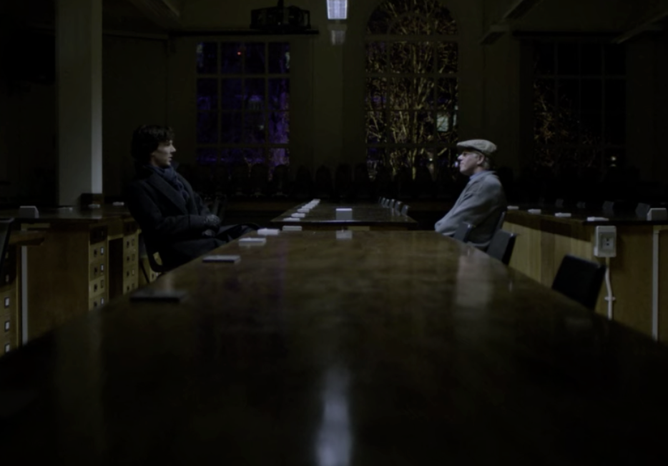
Examples of clues:
As the suspect told his story, Holmes realised he had no alibi.
Why would this make us suspicious? What is an alibi?

Slide 49
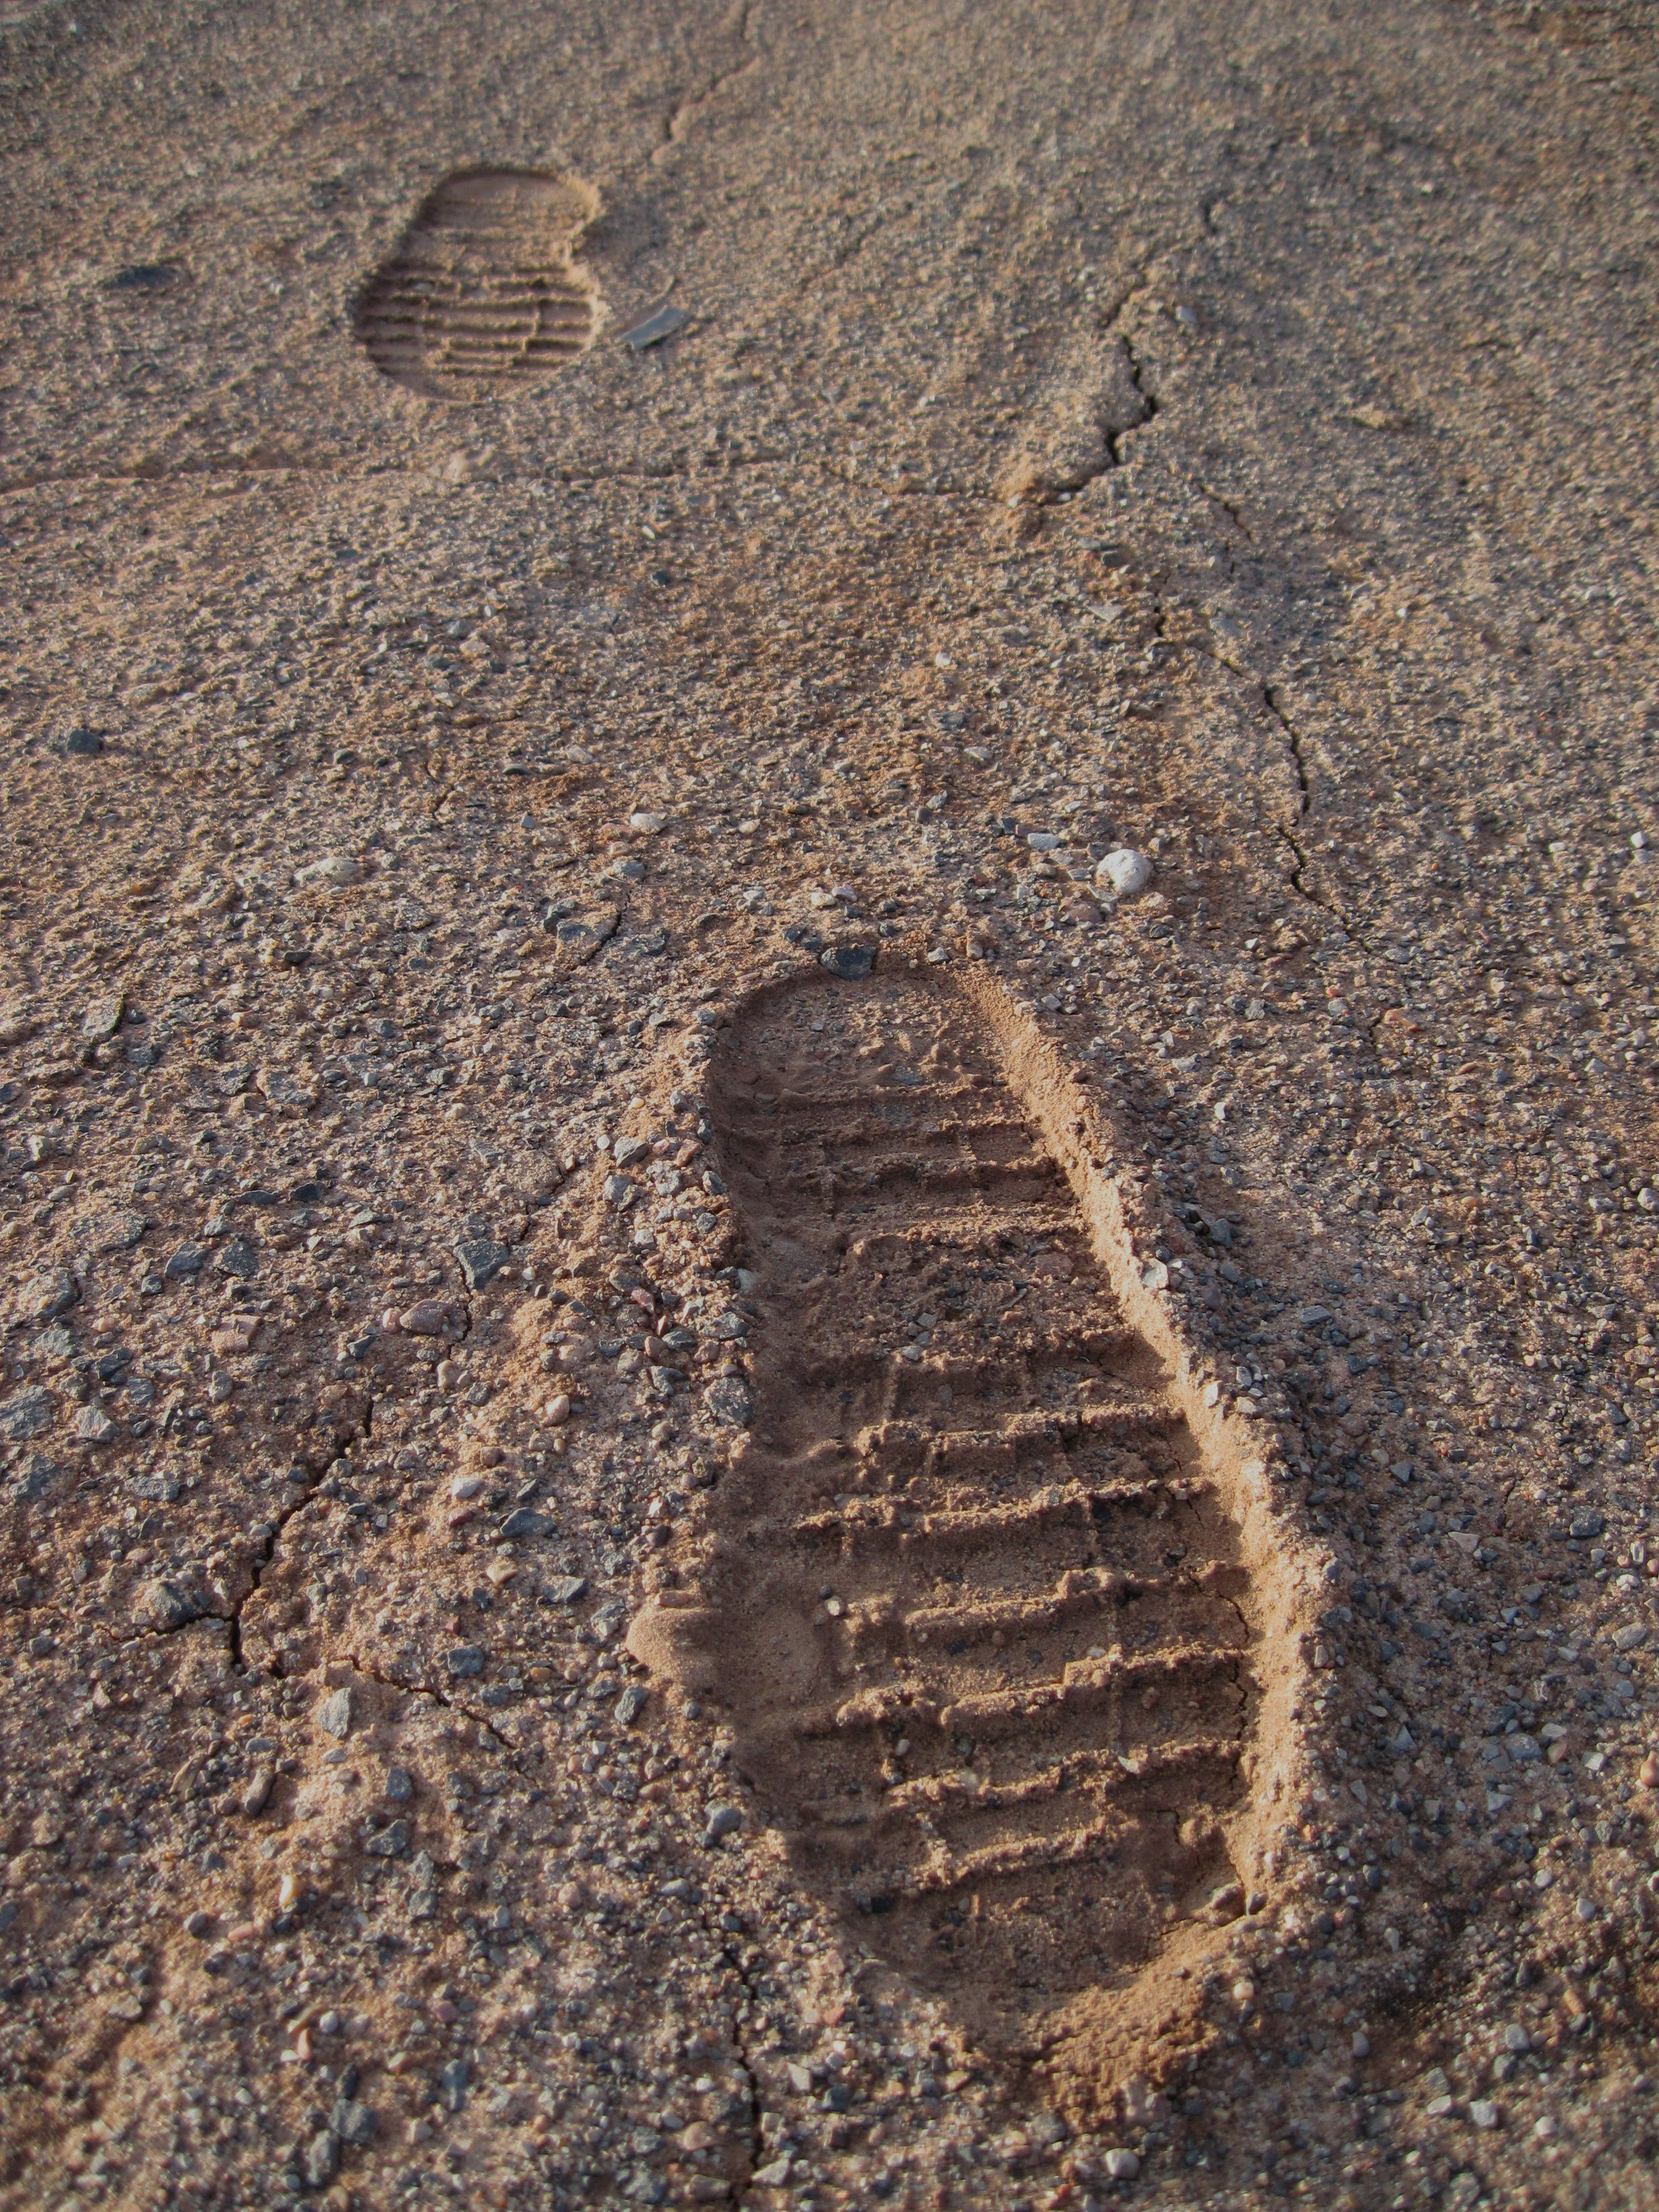
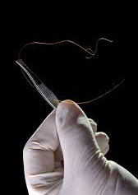
Write 3 different clues you can think of. They can be things people say or do, or objects found that provide important information.

Slide 50
Clues
They can be things people say or do, or objects found that provide important information.
Examples:
Foot marks
Distinctive features e.g. the foot print was worn on the heel so the suspect must drag their left foot.
Clothing left behind e.g. a glove that was likely to belong to a woman.
There could be something suspicious about the setting:
The lock is on the outside of the door
The windows don’t open
Suspicious noises
There was no sign of forced entry
What could this tell us?

Slide 51
There is one clue in this text. Write it down.
“Where does that bell communicate with?” he asked at last pointing to a thick bell-rope which hung down beside the bed, the tassel actually lying upon the pillow.
“It goes to the housekeeper’s room.” “It looks newer than the other things?”
“Yes, it was only put there a couple of years ago.”
“Your sister asked for it, I suppose?”
“No, I never heard of her using it. We used always to get what we wanted for ourselves.”
“Indeed, it seemed unnecessary to put so nice a bell-pull there.”

Slide 52
There is one clue in this text. Write it down.
“Where does that bell communicate with?” he asked at last pointing to a thick bell-rope which hung down beside the bed, the tassel actually lying upon the pillow.
“It goes to the housekeeper’s room.” “It looks newer than the other things?”
“Yes, it was only put there a couple of years ago.”
“Your sister asked for it, I suppose?”
“No, I never heard of her using it. We used always to get what we wanted for ourselves.”
“Indeed, it seemed unnecessary to put so nice a bell-pull there.”
Why might someone want to communicate secretly?

Slide 53
There is one clue in this text. Write it down.
“Did you observe anything very peculiar about that bed?”
“No.”
“It was clamped to the floor. Did you ever see a bed fastened like that before?”
“I cannot say that I have.”

Slide 54
There is one clue in this text. Write it down.
“Did you observe anything very peculiar about that bed?”
“No.”
“It was clamped to the floor. Did you ever see a bed fastened like that before?”
“I cannot say that I have.”

Slide 55
There is one clue in this text. Write it down.
“There are one or two very singular points about this room. For example, what a fool a builder must be to open a ventilator into another room, when, with the same trouble, he might have communicated with the outside air!”

Slide 56
There is one clue in this text. Write it down.
“There are one or two very singular points about this room. For example, what a fool a builder must be to open a ventilator into another room, when, with the same trouble, he might have communicated with the outside air!”

Slide 57
There is one clue in this text. Write it down.
“Tell me, Helen,” said she, ”have you ever heard anyone whistle in the dead of the night?”
“Never,” said I. “I suppose that you could not possibly whistle, yourself, in your sleep?”
“Certainly not. But why?”
“Because during the last few nights I have always, about three in the morning, heard a low, clear whistle. I am a light sleeper, and it has awakened me. I cannot tell where it came from— perhaps from the next room, perhaps from the lawn. I thought that I would just ask you whether you had heard it.”

Slide 58
There is one clue in this text. Write it down.
“Tell me, Helen,” said she, ”have you ever heard anyone whistle in the dead of the night?”
“Never,” said I. “I suppose that you could not possibly whistle, yourself, in your sleep?”
“Certainly not. But why?”
“Because during the last few nights I have always, about three in the morning, heard a low, clear whistle. I am a light sleeper, and it has awakened me. I cannot tell where it came from— perhaps from the next room, perhaps from the lawn. I thought that I would just ask you whether you had heard it.”

Slide 59
Holmes notices the ventilator between Helen's room and her stepfather Dr. Roylott's room directly next door. He also discovers that the bell-rope beside Helen's bed is a dummy and that the bed itself is fastened to the floor with clamps. By talking to Miss Roylott, he learns about the whistling noise.

Slide 60
“My attention was speedily drawn to this ventilator, and to the bell-rope which hung down to the bed. The discovery that this was a dummy, and that the bed was clamped to the floor, instantly gave rise to the suspicion that the rope was there as a bridge for something passing through the hole and coming to the bed. The idea of a snake instantly occurred to me. Then I thought of the whistle. Of course, he must recall the snake before the morning light revealed it to the victim.”

Slide 61
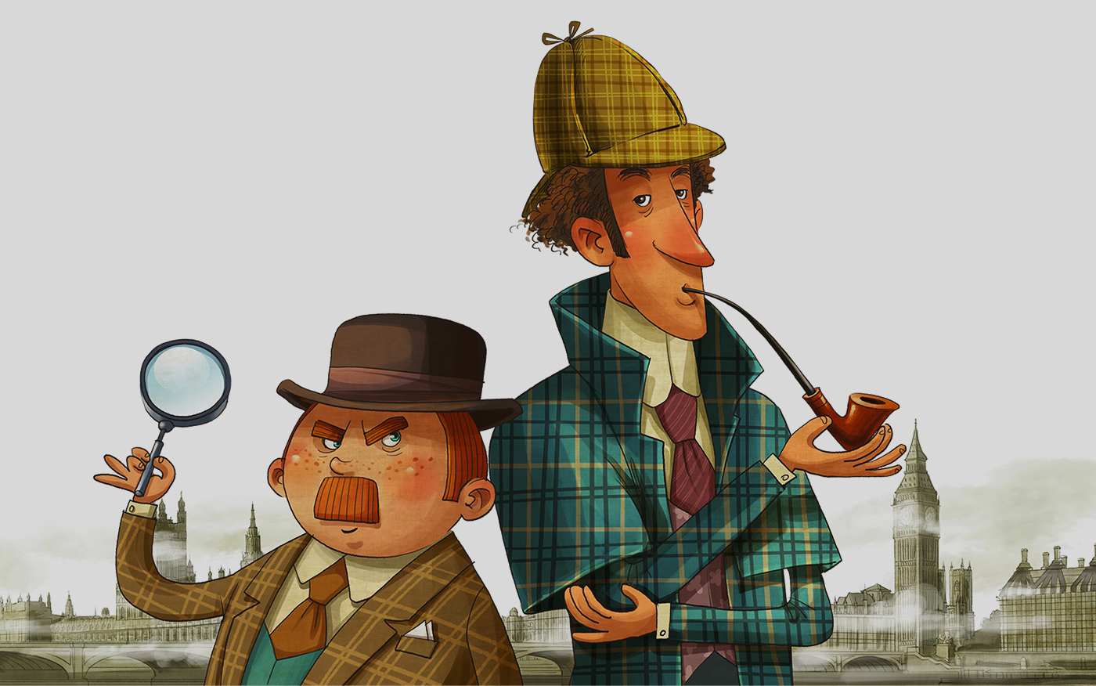
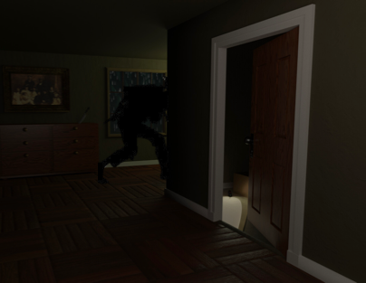
Look at the setting description you wrote last week.
Write 6 sentences to show your detective examining the crime scene and finding clues that will help him/her solve the mystery.
Fronted adverbial (manner) Cautiously, Holmes investigated the foot print left beneath the window.
Bravely, Cautiously, Proudly, Anxiously, Bleakly, Desperately,

Slide 62
Reading time
Now that you have finished your main task, please enjoy some reading time.
You can read to yourself, an adult or sibling.
This can be done by logging on to your myON account, picking a book or magazine and enjoying at least 15 minutes reading time.
https://www.myon.co.uk/login/index.html
Remember that your login is your first name and first letter of your surname then password:
harryp
password1
Please email trailblazerspupils@gmail.com if you have any login issues.

Slide 63
End of lesson.

Slide 64
Read, copy, cover, spell this week’s spellings.
Date: Thursday 4th March 2021
chef
chalet
chandelier
chute
machine
brochure
moustache
parachute

Slide 65
Date: Thursday 4th March 2021
L.O. To be able to use relative clauses.
Subject: English

Slide 66
Pre-recorded Teaching
Access the online teaching video below that will support you to complete the work in this lesson. This video will act as a support but all of the work can still be successfully understood & completed using paper-based versions of this pack. If you need further support to understand / complete work then please contact school via e-mail or telephone.
Play Video
You can also copy and paste this link if you would prefer:
https://teachers.thenational.academy/lessons/to-explore-relative-clauses-6xjp4c?from_query=relative+clauses

Slide 67
What is a relative clause?
A relative clause adds more information about a noun using a relative pronoun.
Example:
This is the man, who saw the crime.
noun
More information about the noun.
What punctuation do you notice?
Relative pronoun examples:
That Which Who
Whose Where When

Slide 68
Examples
Holmes walked towards the woman, who was shaking like a leaf.
Which part of the sentence is the main clause?
Which part of the sentence is the relative clause?
What punctuation has been used?
Which relative pronoun has been used?

Slide 69
Examples
The events were retold by the grounds man, who heard the noises and called the police.
Which part of the sentence is the main clause?
Which part of the sentence is the relative clause?
What punctuation has been used?
Which relative pronoun has been used?

Slide 70
Add a relative clause to the sentence.
Sherlock Holmes arrived at the crime scene, which___________________.
Holmes of suspicious of the maid, who___________________.
The crime must have taken place in the cellar, ___________________.
Pronoun examples:
That Which Who
Whose Where When

Slide 71
Write 6 sentences and extend them using a relative clause. Use the images to help you.
Pronoun examples:
That Which Who
Whose Where When

Slide 72
Reading time
Now that you have finished your main task, please enjoy some reading time.
You can read to yourself, an adult or sibling.
This can be done by logging on to your myON account, picking a book or magazine and enjoying at least 15 minutes reading time.
https://www.myon.co.uk/login/index.html
Remember that your login is your first name and first letter of your surname then password:
harryp
password1
Please email trailblazerspupils@gmail.com if you have any login issues.

Slide 73
End of lesson.

Slide 74
Read, copy, cover, spell this week’s spellings.
Date: Friday 5th March 2021
chef
chalet
chandelier
chute
machine
brochure
moustache
parachute

Slide 75
Date: Friday 5th March 2021
L.O. To be able to write a mystery narrative.
Subject: English

Slide 76
What language did Arthur Conan Doyle use?
Starter
Language

Slide 77
What language did Arthur Conan Doyle use?
Starter
Dialogue
Simile
Formal language
Onomatopoeia
Language
Narrative voice
Mystery vocabulary
Personification

Slide 78
Today we are writing a mystery narrative that builds on from your setting description last week.

Slide 79
The Adventure of the Speckled Band.
A young woman named Helen Stoner contacts Sherlock Holmes and Dr. Watson after the mysterious death of her sister Julia. Helen seeks aid in stopping the villainous plans of her stepfather, Grimesby Roylott.

Slide 80
Paragraph 1: Setting description.
The building was of grey, lichen-blotched stone, with a high central portion and two curving wings, like the claws of a crab, thrown out on each side. In one of these wings the windows were broken and blocked with wooden boards, while the roof was partly caved in, a picture of ruin. The central portion was in little better repair, but the right-hand block was comparatively modern, and the blinds in the windows, with the blue smoke curling up from the chimneys, showed that this was where the family resided. Some scaffolding had been erected against the end wall, and the stone-work had been broken into, but there were no signs of any workmen at the moment of our visit. Holmes walked slowly up and down the ill-trimmed lawn and examined with deep attention the outsides of the windows.
An extract from The Adventure of the Speckled Band.

Slide 81
Paragraph 2: Holmes finds clues
A small side door led into the whitewashed corridor from which the three bedrooms opened. Holmes refused to examine the third chamber, so we passed at once to the second in which Julia met with her fate.
“There are one or two very singular points about this room. For example, what a fool a builder must be to open a ventilator into another room, when, with the same trouble, he might have communicated with the outside air!” exclaimed Holmes.
“Did you observe anything very peculiar about that bed?” asked Holmes.
“No,” I replied.
“It was clamped to the floor. Did you ever see a bed fastened like that before?” questioned Holmes.
“I cannot say that I have.”
An extract from The Adventure of the Speckled Band.

Slide 82
Paragraph 3: Holmes talks to Dr Grimesby Roylott, the suspect.
As Holmes contemplated the evidence, our door suddenly dashed open, and a huge man had framed himself in.
“I am Dr. Grimesby Roylott, of Stoke Moran.”
“Indeed, Doctor,” said Holmes blandly. “Pray take a seat.”
“I will do nothing of the kind. What has my step-daughter been saying to you? Don’t you dare to meddle with my affairs. I am a dangerous man to fall foul of! See here. See that you keep yourself out of my grip,” he snarled, and hurling the twisted poker into the fireplace he strode out of the room.
An extract from The Adventure of the Speckled Band.

Slide 83
Paragraph 3: Holmes uses his theory gained from the clues and stays the night in Helens room.
Suddenly there was the momentary gleam of a light up in the direction of the ventilator, which vanished immediately. Someone in the next room had lit a dark-lantern. I heard a gentle sound of movement, and then all was silent once more. Then suddenly another sound became audible—a very gentle, soothing sound, like that of a small jet of steam escaping continually from a kettle. The instant that we heard it, Holmes sprang from the bed, struck a match, and lashed furiously with his cane at the bell-pull.
“You see it, Watson?” he yelled. “You see it?”
But I saw nothing. At the moment when Holmes struck the light I heard a low, clear whistle, but the sudden glare flashing into my weary eyes made it impossible for me to tell what it was at which my friend lashed so savagely. He had ceased to strike and was gazing up at the ventilator when suddenly there broke from the silence of the night the most horrible cry to which I have ever listened.
“What can it mean?” I gasped.
“It means that it is all over,” Holmes answered.
An extract from The Adventure of the Speckled Band.

Slide 84
Let’s plan
Paragraph 1: Setting description.
Paragraph 2: Your detective will find clues.
Paragraph 3: The topic of this paragraph is your choice.

Slide 85
Let’s plan
Paragraph 1: Setting description.
Paragraph 2: Your detective will find clues.
Paragraph 3: Your detective could interview spectators at the crime scene. A victim could retell the story of what happened. Your detective could interview a suspect. You could stay the night at the crime, and something could happen. The villain could be revealed.

Slide 86
Use this template to plan your ideas for each paragraph. Think about the ideas we have been through this week and the extracts from The Adventure of the Speckled Band.
__________________________________________________________________________________________________________________________________________________________________________________________________________________________________________________________________________________________________________________________________________
__________________________________________________________________________________________________________________________________________________________________________________________________________________________________________________________________________________________________________________________________________
__________________________________________________________________________________________________________________________________________________________________________________________________________________________________________________________________________________________________________________________________________
Paragraph 1: Setting description.
Paragraph 2: Your detective will find clues.
Paragraph 3: Your choice

Slide 87
Over to you! Its now time to write your mystery narrative. Use your plan, the checklist and examples to help you.
My work is finished when:
Mystery vocabulary
Narrative voice
Dialogue
Descriptive language (similes, metaphor, onomatopoeia, personification)
Show not tell
Relative clauses
Exciting synonyms
Clues

Slide 88
Reading time
Now that you have finished your main task, please enjoy some reading time.
You can read to yourself, an adult or sibling.
This can be done by logging on to your myON account, picking a book or magazine and enjoying at least 15 minutes reading time.
https://www.myon.co.uk/login/index.html
Remember that your login is your first name and first letter of your surname then password:
harryp
password1
Please email trailblazerspupils@gmail.com if you have any login issues.

Slide 89
End of lesson.

