Slide 1
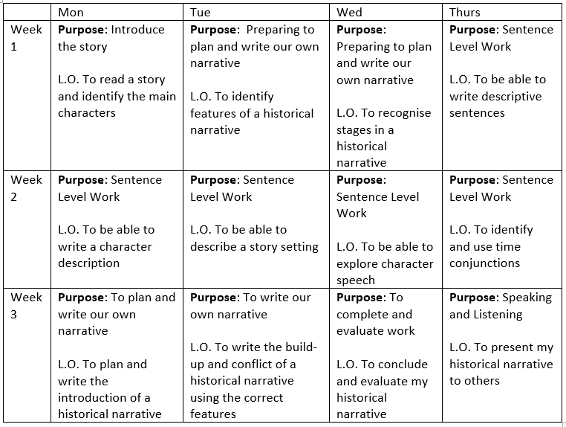
Date: W.B. Monday 25th January 2021
Hello Base 5! In English over the next few weeks, we will be looking at Historical Narratives. I have chosen the book ‘Escape from Pompeii’ to look at, as this links to our new topic – The Romans. On this PowerPoint, you will find this weeks’ English lessons, and some tasks to complete. Once complete, please email your work to climbpupils@gmail.com or ask an adult to drop it off at school. I am looking forward to seeing your amazing work!
Word of the week…
Serene: calm, peaceful, and untroubled
Subject: English

Slide 2
Date: Monday 25th January 2021
L.O. To be able to write a character description
Subject: English

Slide 3
Date: Monday 25th January 2021
What Work? | L.O. To be able to write a character description
How Much Work?
My work is Finished when...
Next?
or

Slide 4
How do we describe something?
We use adjectives! Adjectives are describing words – they describe a noun. Can you think of an adjective to describe yourself?
My turn…
curly, red hair.
Tranio has shiny, green eyes.

Slide 5
Your turn…
Complete the 3 sentences…
Drag and drop the correct word into the sentences and then write them underneath.

Slide 6
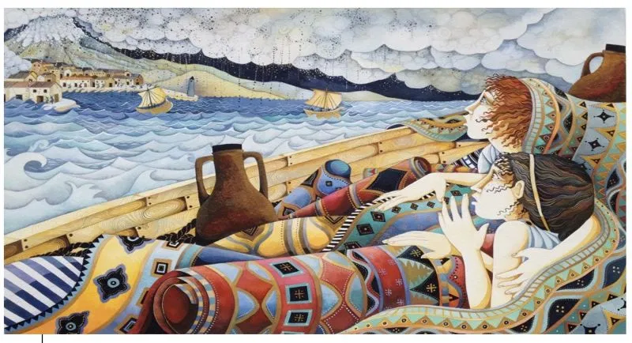
Your turn…
Complete the sentences…

Slide 7
Your turn…
Write 5 sentences, don’t forget to include the correct punctuation…
1.
2.
3.
4.
5.

Slide 8
Date: Tuesday 26th January 2021
LO: To be able to describe a story setting
Subject: English

Slide 9
Date: Tuesday 26th January 2021
What Work? | L.O. To be able to describe a story setting
How Much Work?
My work is Finished when...
Next?
or

Slide 10
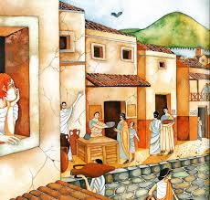
Think about the story setting before Mount Vesuvius erupted.
What might you…
 | Ground shaking
 | Boats on the harbour Children playing Actors performing
 | Fresh bread Fish
 | People laughing Dogs barking
 | Bread Fish

Slide 11
Your turn…
Complete the 3 sentences…
Drag and drop the correct word into the sentences.

Slide 12
Your turn…
Complete the sentences

Slide 13
Write 5 sentences about the setting before Mount Vesuvius erupted
The serene city of Pompeii glimmered in the sun.
Your turn…
Write 5 sentences about the setting before Mount Vesuvius erupted
The serene city of Pompeii glimmered in the sun.
Think about what you might…
1.
2.
3.
4.
5.

Slide 14
Date: Wednesday 27th January 2021
LO: To be able to explore character speech.
Subject: English

Slide 15
Date: Wednesday 27th January 2021
What Work? | L.O. To be able to explore character speech
How Much Work?
My work is Finished when...
Next?

Slide 16
How do we know if a character is speaking?
Click here and watch the video
When you are writing speech marks go before and after any words that a character says.
For example: “Come on, Livia!” called Tranio.
‘Come on, Livia’ are the words that Tranio says out loud, so the speech marks go at the start and end of those words.
Can you circle the punctuation that shows a character is speaking?

Slide 17
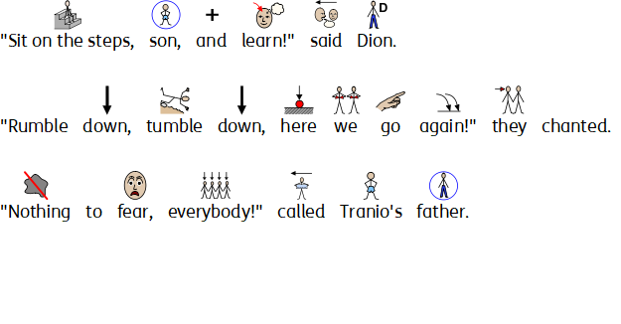
Your turn…
Can you underline the words the characters are saying? How do you know those words are spoken?

Slide 18
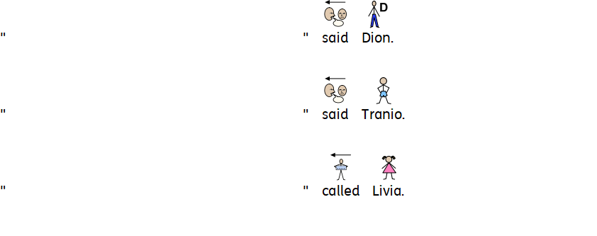
Your turn…
Think about what the characters might say and complete the sentences.

Slide 19
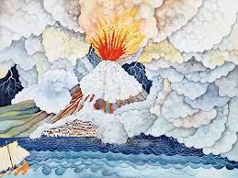
Your turn…
Can you write 3 sentences using speech? Think about what Tranio and Livia might say.
“We escaped just in time!” Tranio said to Livia.
1.
2.
3.

Slide 20
Date: Thursday 28th January 2021
LO: To identify and use time conjunctions
Subject: English

Slide 21
Date: Thursday 28th January 2021
What Work? | L.O. To identify and use time conjunctions
How Much Work?
My work is Finished when...
Next?
or

Slide 22
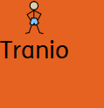
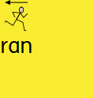
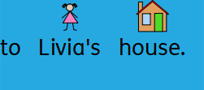
What are time conjunctions?
Time conjunctions are words or phrases which are used to tell us WHEN something is happening. For example:
Underline the time conjunction in the sentence above.
Other time conjunctions include:
first, last, next, then, finally, eventually, this evening, last week, after a while, soon afterwards, meanwhile

Slide 23
Your turn…
Identify the time conjunctions and underline them.

Slide 24
Your turn…
Complete the sentences about the story.
Challenge – can you write your own sentence, using a time conjunction?

Slide 25
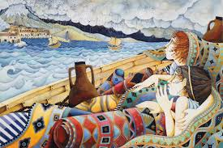
Your turn…
Write 5 sentences about the story, using a different time conjunction in each sentence.
1.
2.
3.
4.
5.

Slide 26
Date: Friday 29th January 2021
LO: To spell words with the prefix ‘in’
Subject: Spellings

Slide 27
Task 1: Here are your spellings this week.
Look, say, cover, write, check.
incorrect
incredible
independent
inconsiderate
income

Slide 28
Task 2: Choose 3 of your spellings and include them in a sentence, ensuring you use the correct punctuation.
My turn: Mount Vesuvius was an incredible sight.
Your turn:
1.
2.
3.

