Slide 1



Date: Monday 28th June 2021
LO: To be able to explain the UK’s trade links with other countries.
Subject: Geography

Slide 2
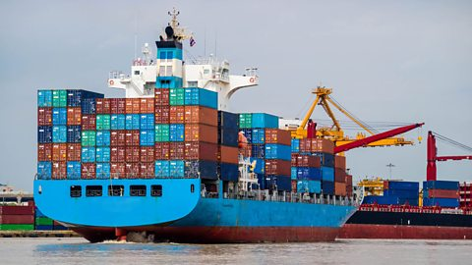
What is trade?
Buying and selling things is called trade.
Trade is an important way for countries to make money and has been happening across the world for hundreds of years.
Today, goods are carried around
the world in container ships
from port to port and by
aeroplane.

Slide 3

Export and import
People in the UK can sell things they make when people in other countries want them.
Why do we import produce from other countries?

Slide 4
This might be because they can’t make them themselves or because they are cheaper or better quality.
Sending goods like this to other countries is called export.
There are also things, such as bananas, that are hard to grow in the UK and we have to buy these things from abroad.
This is called import.
For example, certain fruits and vegetables need specific climates in which to grow, so countries sell surplus produce to other countries and buy in items they cannot grow or produce themselves.

Slide 5
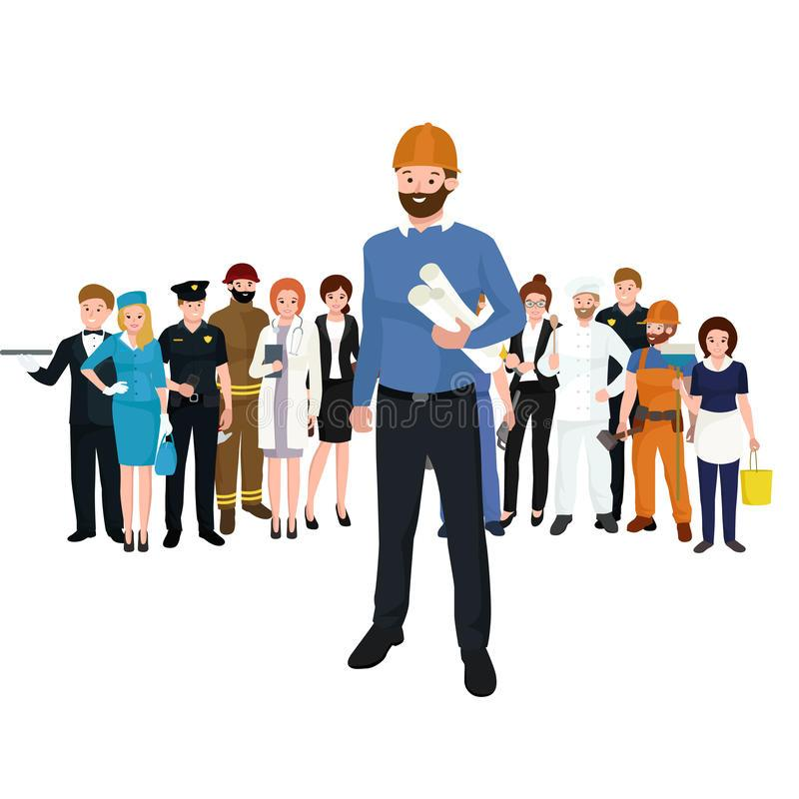
Sometimes countries need experts from abroad such as engineers, scientists or teachers. These experts can sell their services to people around the world and this is called a service industry.
The service industry is the UK's main
industry today and we import more goods
than we export.

Slide 6
Imported | Exported | Both
Aircraft parts
Which items do you think
are exported from the UK?
Coffee beans
Scrap iron
Cars
Which items do you think are
imported from the UK?
Bananas
Whisky
Which items do you think are
exported and imported from
the UK?
Computers
Tartan
Medicines
For what reason?
Oil and gas
Coffee beans | Aircraft parts | Bananas | Cars | Computers
Medicines | Scrap iron | Whisky | Oil and gas | Tartan

Slide 7
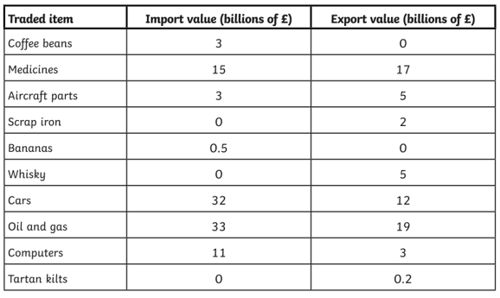
Data to show the value of import and export items

Slide 8

Task: Use the data for the UK trade links to produce a bar chart to show British imports and a bar cart to
show British exports.
Add text
Add text here
5
0
Coffee
Add here
Add here
Add here
Add here
Add here
Add here
Add here
Add here
Add here
Resize and change the colour of
the shapes to add on to your bar graph.

Slide 9
Resize and change the colour of
the shapes to add on to your bar graph.
Add text
Add text here
5
0
Add here
Add here
Add here
Add here
Add here
Add here
Add here
Add here
Add here
Add here

Slide 10
End of Lesson

Slide 11
Date: Tuesday 29th June 2021
LO: To be able to explain what the UK lead in industry.
Subject: Geography

Slide 12

What industry does the UK lead in?
For the Middle East it’s oil.
For Japan it’s electronics.
For Germany it’s luxury cars.
For France it’s cheese or wine.
For Belgium it’s chocolate.
What Britain exports is a bit more mysterious...

Slide 13

There are plenty of British brands with worldwide name recognition, from Burberry to Land Rover, but no one would describe Britain as a country particularly known for the production of clothing or cars; that particular combination clearly belongs to Italy.
Yet Britain has one of the largest economies in the world, so we must be making something good.

Slide 14

Let’s see what that something is..
Music
Britain consistently punches above its weight on the international music scene.
Only seven bands and artists have ever sold more than a quarter of a billion records. They are the Beatles, Elvis Presley, Michael Jackson, Madonna, Elton John, Led Zeppelin and Pink Floyd – and of that list of seven, a full four are British, while the other three are American. Given that the US population is five times that of Britain, it’s clear that the UK punches significantly above its weight when it comes to producing musicians.

Slide 15

TV
British children’s shows such as Peppa Pig have wide international appeal.
The story of Britain’s TV is pretty similar to the story of its music. TV ratings have shifted dramatically over the past few decades, and the most-watched shows of different countries are dominated by sports and programmes shown on public holidays. But British TV exports were worth £1.28 billion last year, which gives some indication of how popular British TV is around the world. An mix of programmes – Peppa Pig, Doctor Who, Downtown Abbey, Who Wants to Be a Millionaire?, Top Gear and the Great British Bake Off – are sold or have their format licensed in a remarkable number of countries.

Slide 16
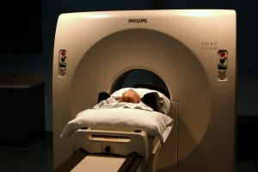
Medical research
The UK consistently leads the world in medical developments.
Scientific research, particularly medical research, is another area where the UK punches significantly above its weight. In terms of citations for research papers.
The success stories of British medical research range from DNA fingerprinting to the first draft of the complete human genome sequence.
Britain’s leading role in medical research is aided by outstanding universities that attract top students and researchers from all over the world.

Slide 17
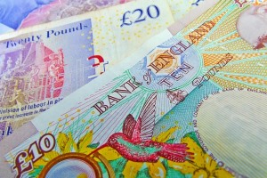
Financial services
Financial services in the UK play a massive role in the economy. Britain is the world’s largest exporter of financial services.
The UK’s multiculturalism enables its financial services to diversify.
High levels of immigration within a thriving multicultural society also means that Britain is able to offer financial products that are not available in many other countries, such as Islamic finance.

Slide 18

Aerospace technology
The British aerospace industry is the second or third largest in the world, covering companies such as Rolls-Royce.
Aerospace technology covers aircraft and spacecraft, and Britain’s contributions range from aircraft, to satellites, to missiles, to exciting new ideas such as the Skylon spaceplane, which could theoretically travel from London to Sydney in four hours, and which should have its first test flights within a decade.

Slide 19

Education
UK universities remain desirable places to study.
The UK usually comes in the top handful of international league tables for education. When it comes to primary and secondary education, countries such as Finland, Singapore and South Korea usually do better, just ahead of British universities when higher education is compared. That said, the UK is unusual in coming out well in education across the board; UK state schools, private schools, summer schools and universities all rank highly.

Slide 20

Artificial intelligence
One of the world’s leading artificial intelligence companies is in London.
This one might come as a surprise. Surely all artificial intelligence research is happening in Silicon Valley, or perhaps in Beijing, where Baidu is based? Certainly a great deal is happening in those places. But one of the world’s leading artificial intelligence companies, Google DeepMind, is based in the UK, in London.

Slide 21
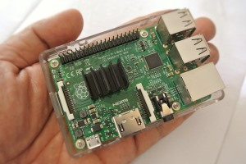
Electronic systems
Electronics is another area in which the UK does remarkably well, particularly in niche areas. British labour is both skilled and expensive, so mass production of parts is done more effectively by other countries, but small-scale production of electronic components is better suited to the British skillset.

Slide 22

Literature
We don’t normally think of literature as an export that gets manufactured like chairs, pencil cases or Westlife, but it’s another area where Britain makes a supersized contribution to the world.
This is particularly the case among children’s books – it’s not just Rowling, but also CS Lewis, Enid Blyton and Beatrix Potter who have sold vast numbers of books.
Harry Potter defined a generation of childhoods worldwide.

Slide 23

Task: Choose six areas the UK lead in and write a short summary for each one.
Add text
Add text
Add text
Add text
Add text
Add text
Add text
Add text
Add text
Delete on the ones, you don’t use. OR for a challenge, try and complete them all!
There’s some help on the next slide.

Slide 24
Music
TV
Seven bands have ever sold more than a quarter of a billion records. They are the Beatles, Elvis Presley, Michael Jackson, Madonna, Elton John, Led Zeppelin and Pink Floyd, four are British.
Medical research
British TV exports were worth £1.28 billion last year. Peppa Pig and Doctor Who are sold in a number of countries.
England has outstanding universities that attract top students from all over the world.
Financial services
Aerospace technology
Education
Britain is the world’s largest exporter of financial services.
The British industry is the second largest in the world.
The UK usually comes in the top handful of international league tables for education.
Artificial intelligence
Electronic systems
Literature
One of the world’s leading artificial intelligence companies, Google DeepMind, is based in the UK, in London.
British labour is both skilled but expensive, so electronic components is better suited to the British skillset.
This is among children’s books – it’s not just Rowling, but also CS Lewis, Enid Blyton and Beatrix Potter.

Slide 25
End of Lesson

Slide 26
Date: 30.06.2021
LO: To be able to complete a circuit of exercises and beat my personal best.
Subject: P.E

Slide 27
Today, we are going to complete an at-home P.E lesson.
The aim of this lesson is to improve our fitness, our flexibility, coordination and most importantly… to have some fun.
The following slides show the whole workout and instructions on how to complete each exercise.
The exercises have advice on how to make them easier or harder and you can complete the circuit as many times as you wish. If possible, however, try and complete this circuit at least 3 times, between now and next Wednesday.
One circuit takes 15 minutes with 30 second breaks between each exercise (however you can lengthen or shorten your rest, depending on how you feel or shorten the exercise down to 30 seconds – remember you are competing against yourself and no one else).
You should be able to complete this workout with very little equipment. Something small for the last exercise, so you can touch your toe on it and a soft enough floor will be all you need.
Included at the end of this presentation is a table for you to record how many of each exercise you managed to do within the minute.
Have fun!

Slide 28


The workout
30secs rest between exercises

Slide 29
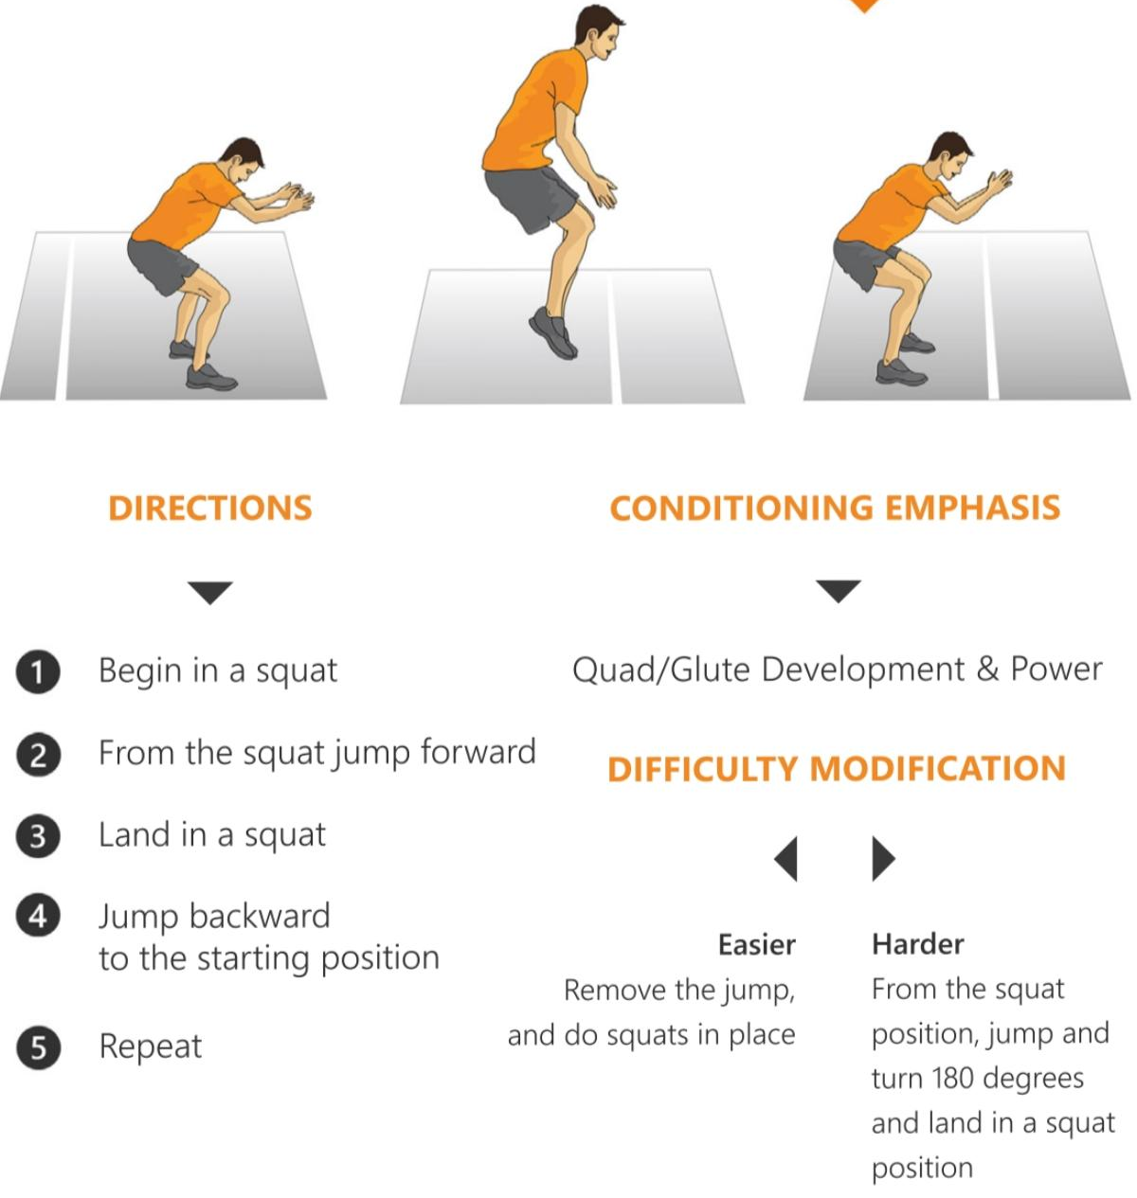
Front and Back Jump Squats

Slide 30
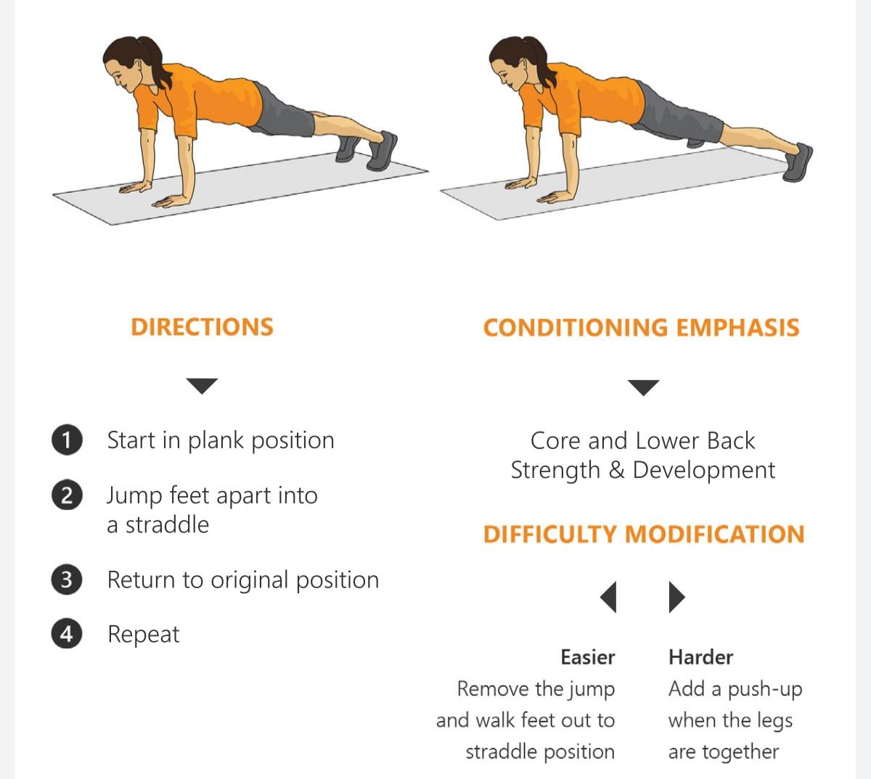
Plank Jacks

Slide 31
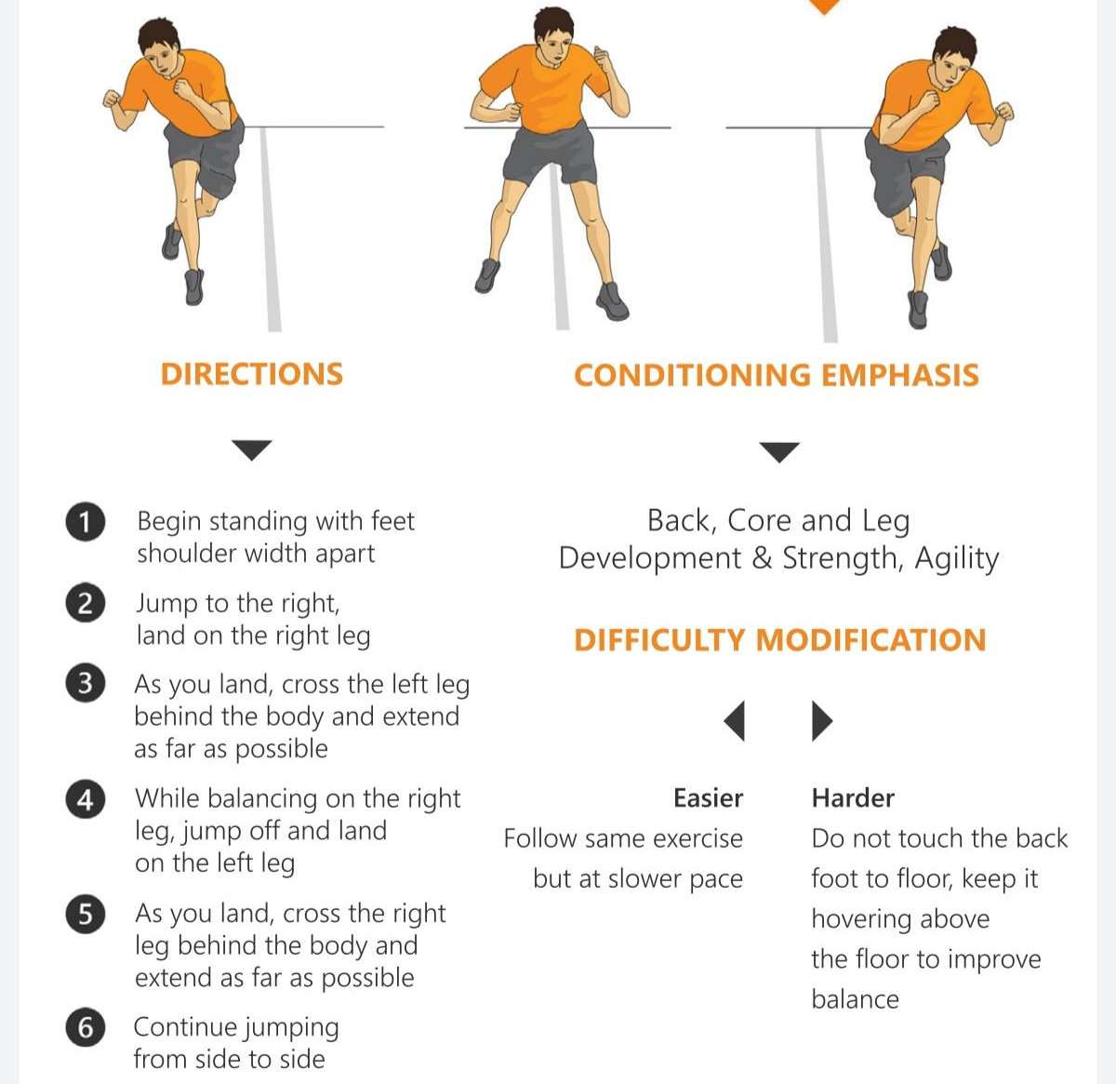
Speed Skaters

Slide 32

Burpees

Slide 33
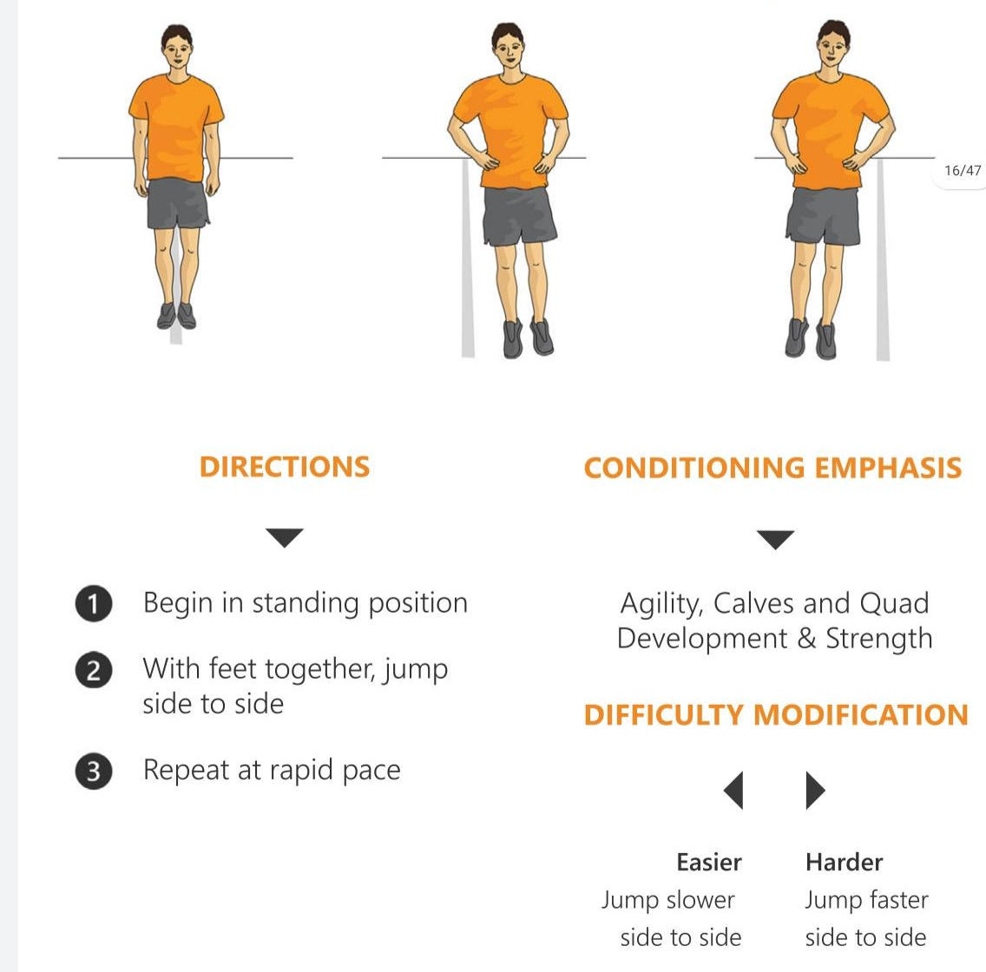
Skier Hops

Slide 34
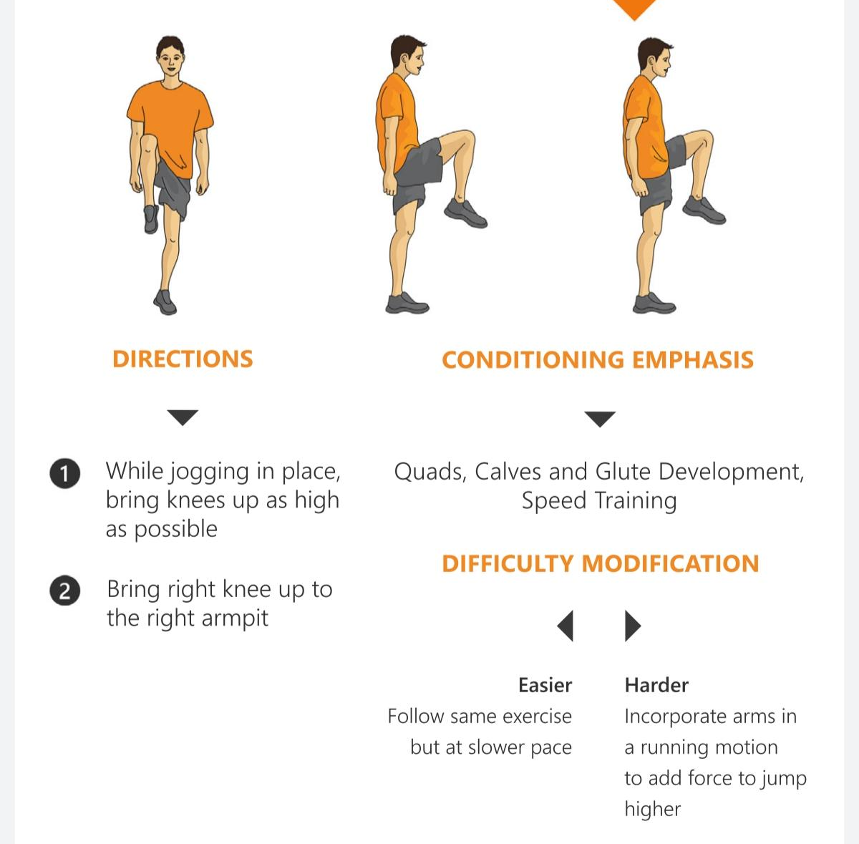
High Knees

Slide 35
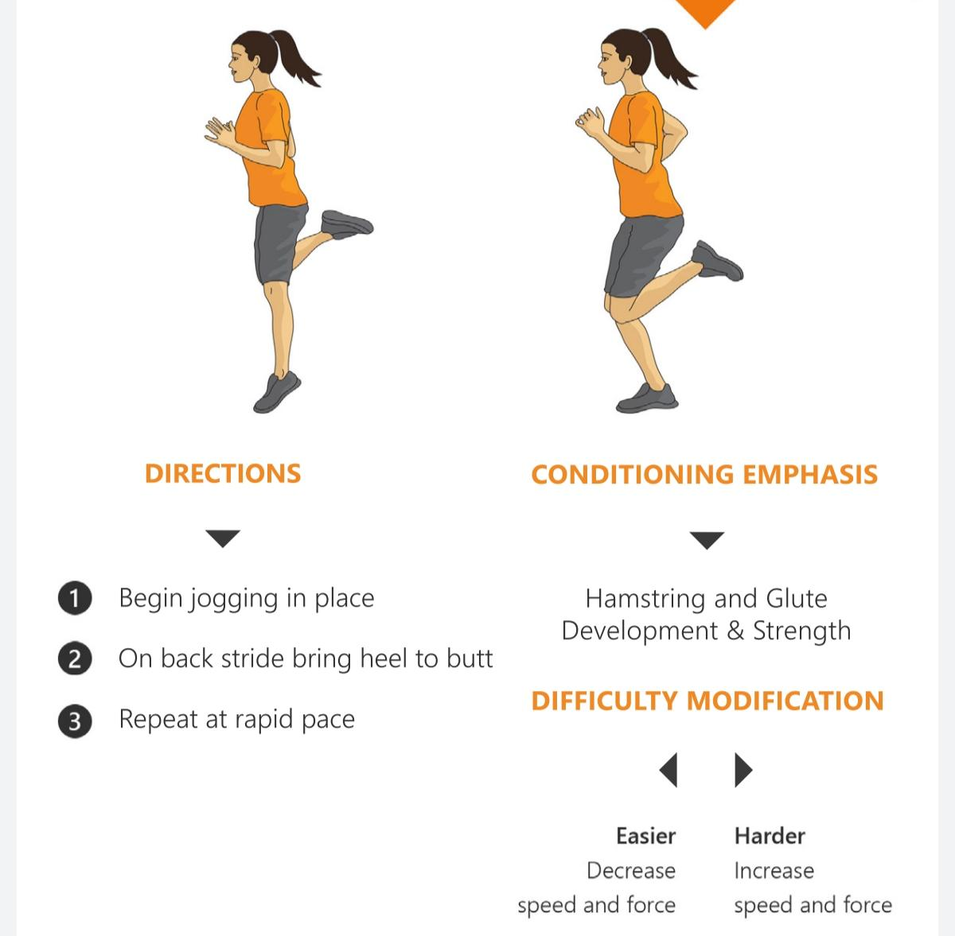
Butt Kicker Run

Slide 36
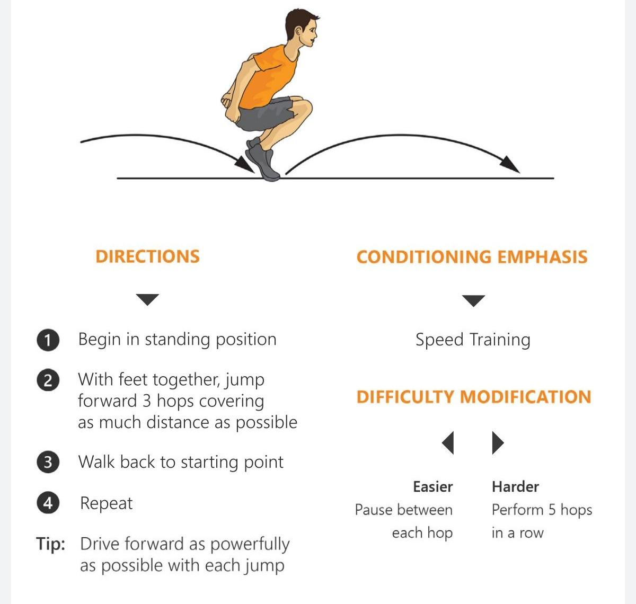
Rabbit Hops

Slide 37
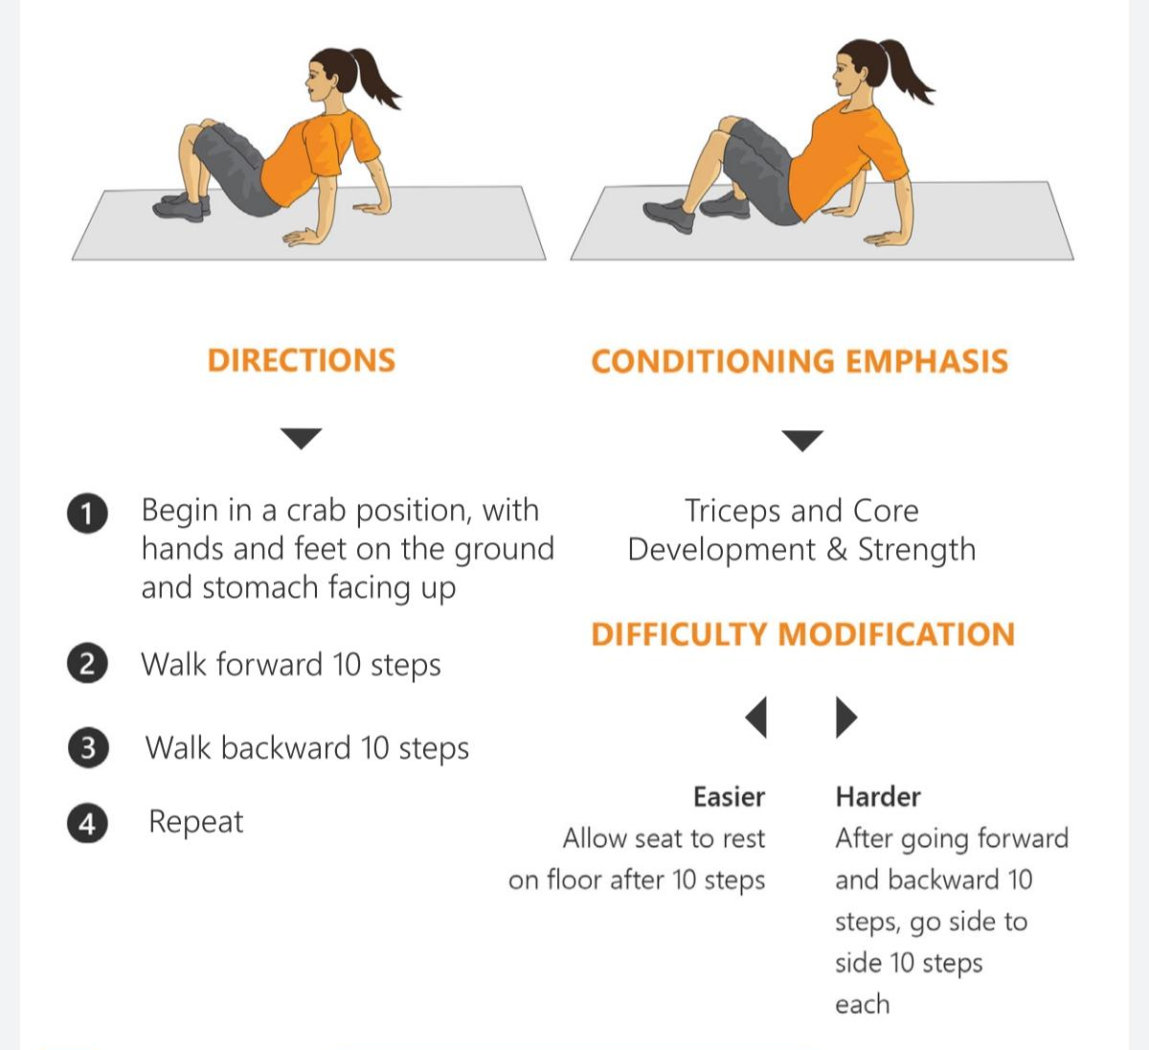
Crab Walks

Slide 38
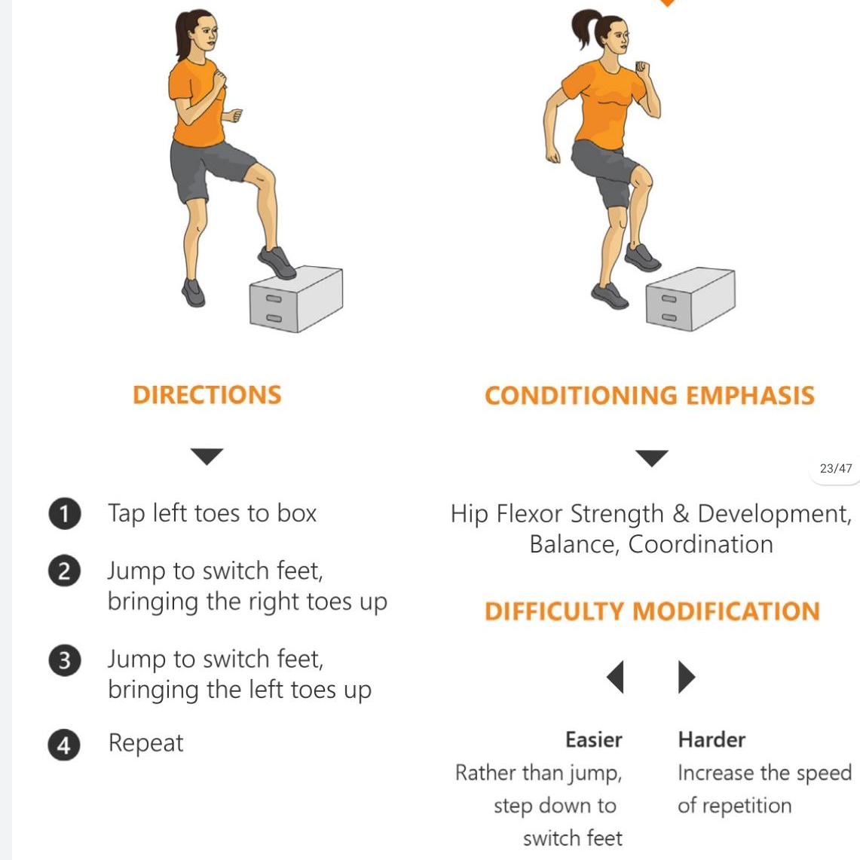
Box Toe Touches

Slide 39
Personal Best Chart
Name: ________________________________
Exercise | Example | Attempt 1 | Attempt 2 | Attempt 3
Front & Back Squats | 22
Plank Jacks | 35
Speed Skaters | 62
Burpees | 10
Skier Hops | 90
High Knees | 115
Butt Kicker Run | 92
Rabbit Hops | 6
Crab Walks
Box Toe Touches

Slide 40
End of Lesson

Slide 41
Date: Thursday 1st July 2021
LO: To be able to use maps to show identify countries the UK’s trade with.
Subject: Geography

Slide 42
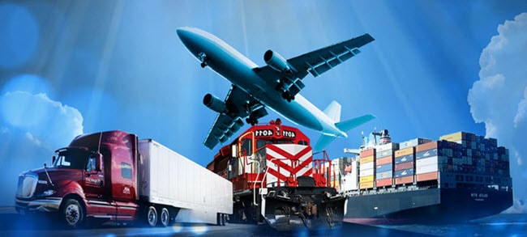
Can you remember which items and imported and exported?
Which are both imported and exported?

Slide 43
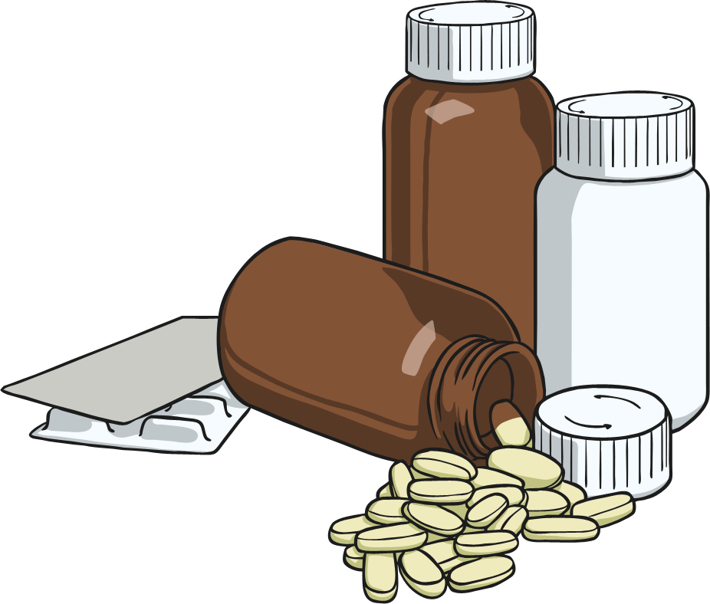

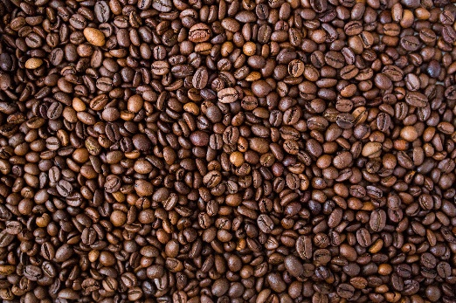
Imported
Exported
Imported and exported
Imported
Exported
Imported and exported

Slide 44
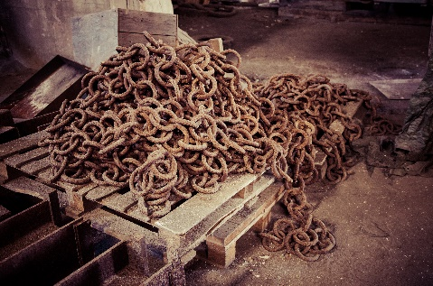
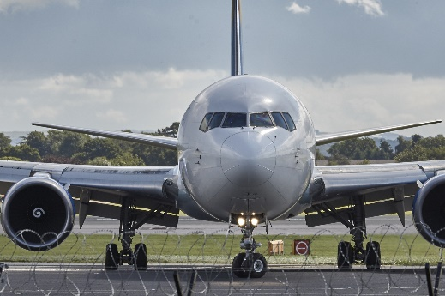
Imported
Exported
Imported and exported
Imported
Exported
Imported and exported

Slide 45

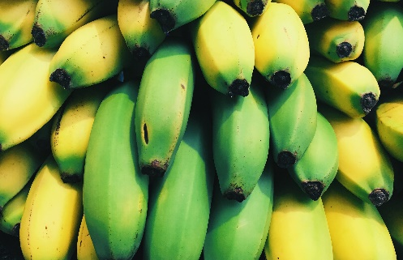
Imported
Exported
Imported and exported
Imported
Exported
Imported and exported

Slide 46
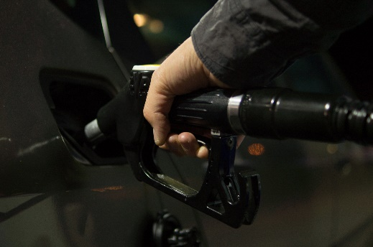

Imported
Exported
Imported and exported
Imported
Exported
Imported and exported

Slide 47
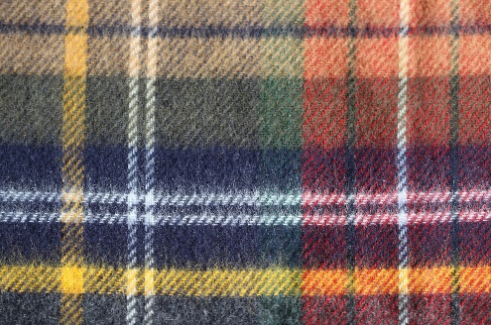

Imported
Exported
Imported and exported
Imported
Exported
Imported and exported

Slide 48
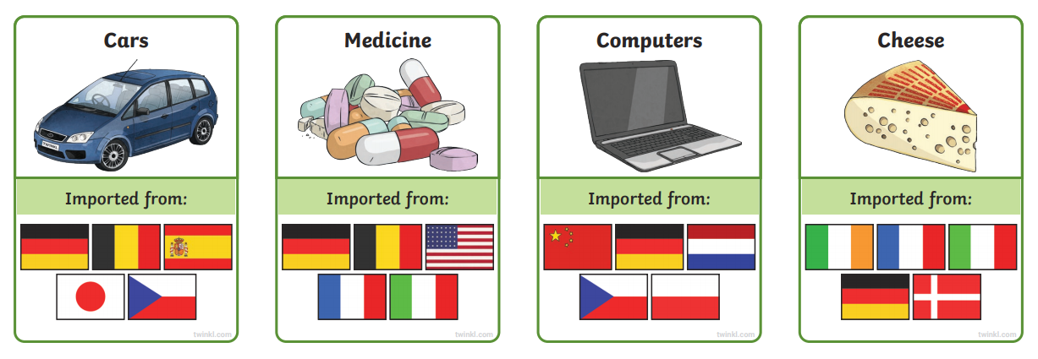
Which country do you think each item is imported from?
Germany
France
Italy
Germany
Ireland
Italy
Germany
China
Germany
Germany
USA
France
China
Ireland
Italy

Slide 49
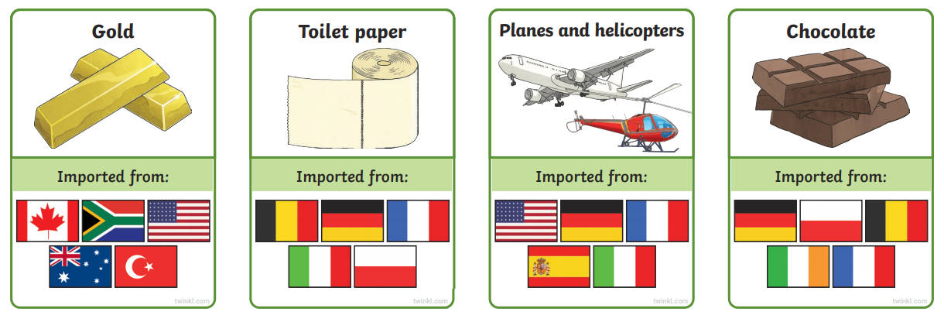
USA
France
USA
China
Italy
France
Germany
Germany
Ireland
Germany
France
Italy
USA
Germany
France
Italy
Germany
France
Ireland
USA

Slide 50
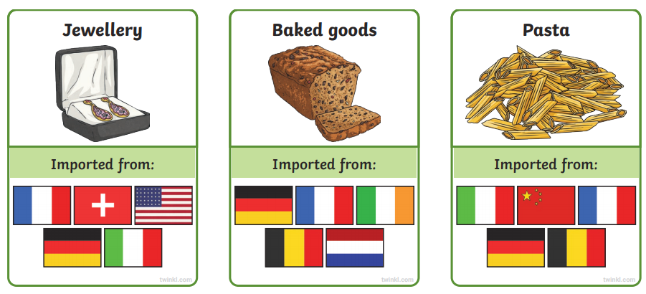
France
USA
China
Germany
Ireland
Italy
Germany
France
Ireland
Germany
France
Italy
Germany
USA

Slide 51
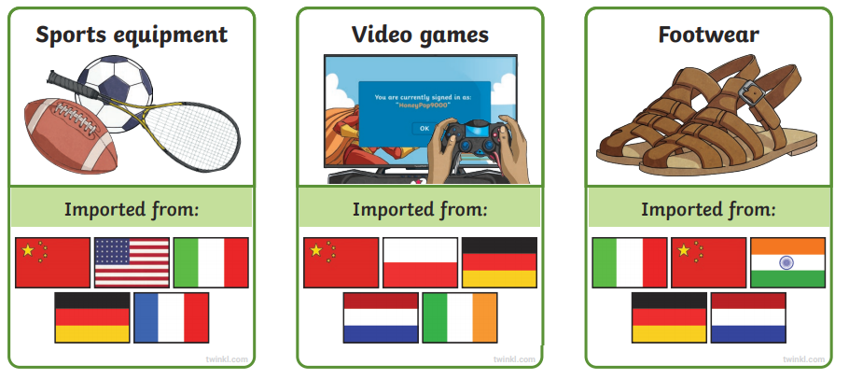
France
USA
China
Germany
Ireland
Italy
Germany
France
USA
China
Italy
Germany
China
Ireland
Germany
China
Italy

Slide 52
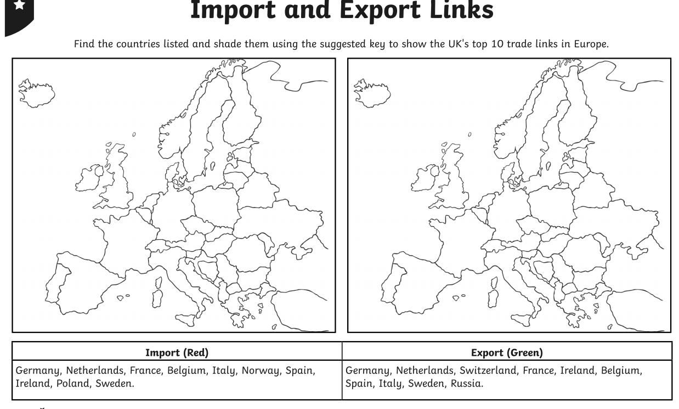
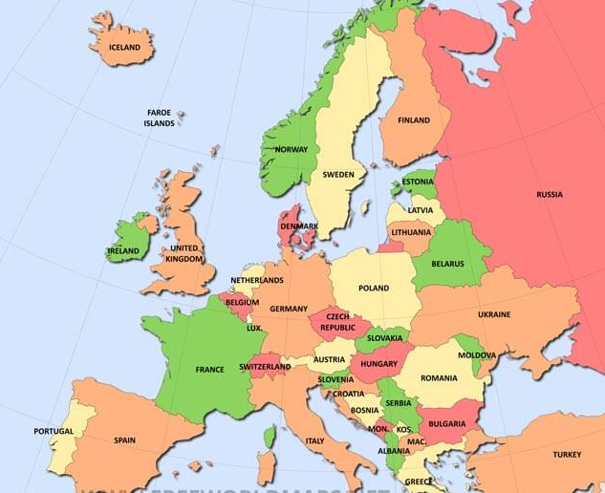
Task: Place the labels on the map to show UK export countries
Ireland
Germany
Sweden
Italy
Russia
Netherlands
France
Belgium
Spain
Switzerland

Slide 53
Task: Place the labels on the map to show UK export countries
LO To be able to find the main countries the UK import and export from.
Ireland
Germany
Sweden
Italy
Poland
Netherlands
France
Belgium
Spain
Norway

Slide 54






Using the information from the slides, fill in the boxes to show what products are imported from different countries.
USA
China
Add text
Add text
Ireland
France
Add text
Add text
Germany
Italy
Add text
Add text

Slide 55
End of Lesson

Slide 56
Date: Friday 2nd July 2021
LO: To be able to recognise the benefits of Fairtrade.
Subject: Geography

Slide 57

Is all trading fair?
Unfortunately not, because not everyone benefits equally from trading. There are international rules which govern trade however, many people believe that these rules are fairer for the richer countries but make poor people even poorer.

Slide 58

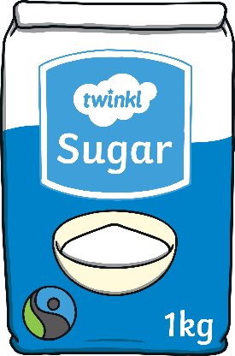


Fairtrade
Fairtrade is there to help the producer receive a guaranteed fair price for whatever he or she is selling meaning their quality of life should improve. You may have seen the Fairtrade logo on products at the supermarket. These products cost a little more but many people think this is a small price to pay to help people all over the world live a better life. Fairtrade also sets minimum standards for pay and work conditions. Products include tea, coffee, chocolate and sugar.

Slide 59
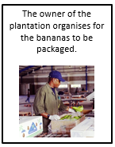
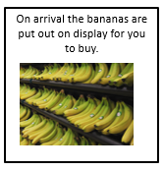
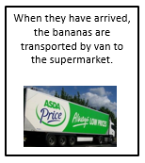
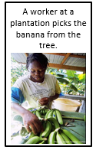
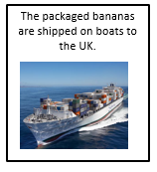
How does a banana get from the tree in Ghana, to your house?
Can you organise the cards into the correct order, showing how the bananas get from the tree to the shelf in the supermarket?
1
2
4
5
3

Slide 60
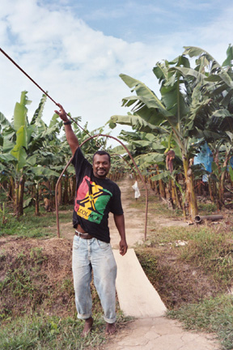
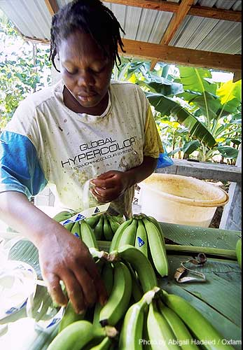
Banana plantation worker (Ghana) – what might they do in the process of trading?
Plantation Worker
You work for 14 hours a day in very hot conditions.
You look after the bananas and cut them down when they are ripe.
You carry heavy loads of the bananas to the washing area.
You have poor working conditions.

Slide 61
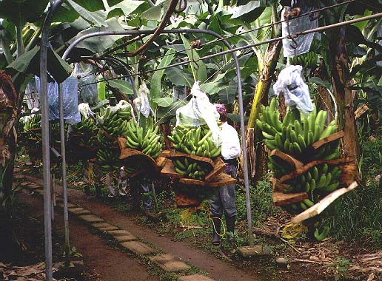
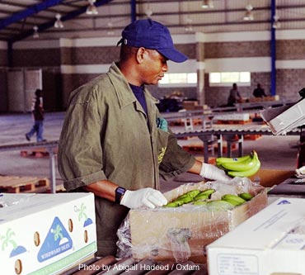
Plantation owner (Ghana) – what might they do?
Plantation Owner
You provide all the tools and equipment for your workers.
You have to pay the wages of all your workers.
Each year you have to buy more fertiliser to keep the soil fertile and healthy, which can be expensive.

Slide 62
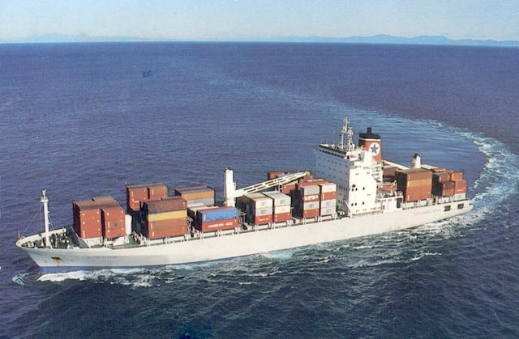
Shipper (UK) - What might they do?
Shipper
You have to buy very expensive cargo ships and maintain them.
You have to pay shipyards to dock your ship there.
You mist buy massive refrigerators to keep the bananas from ripening early.
You must buy fuel for your ships.

Slide 63
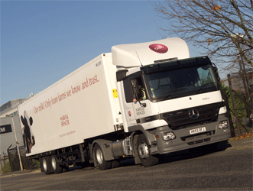
Importer (UK) - What might they do?
Importer
You have to buy massive warehouse to store the bananas when they arrive in the UK.
You have to pay companies to transport the bananas to and from where you want them.
You have to pay tax to the government for bringing the bananas into the country.

Slide 64
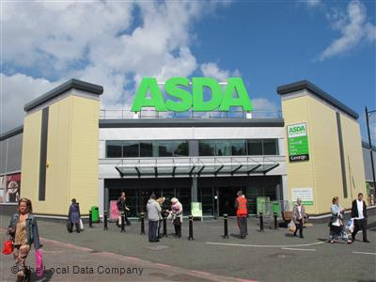
Supermarket - What job might they do?
The Supermarket
You have to pay people to stack the shelves and serve on the tills.
You have to buy lorries to move the products.
You pay electricity for your shop as well as pay for carrier bags and tools.
You have to make a profit on what you sell.

Slide 65
How much from £1 do they actually get?
Plantation Worker
Plantation owner
Shipper
Importer
Supermarket
Is this fair?
1p
5p
15p
Write here, why you think this is fair or unfair.
35p
44p
LEDC (Poor)
MEDC (Rich)
6p
Less economically developed country
94p
More economically developed country

Slide 66



Fair trade
Fair trade aims to help producers in poorer countries make
better trading conditions, in order to receiver a better
percentage of the money you pay for products.
It promotes equality.
Fair trade is about better prices, decent working conditions, local sustainability, and fair terms of trade for farmers and workers in the developing world.

Slide 67
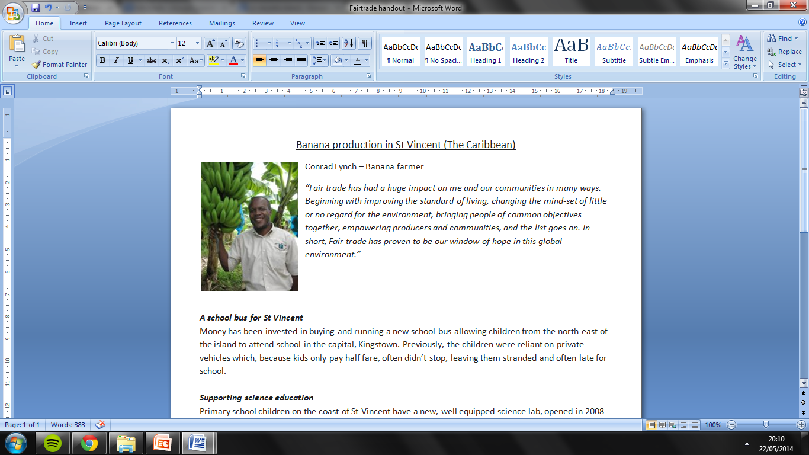

Slide 68
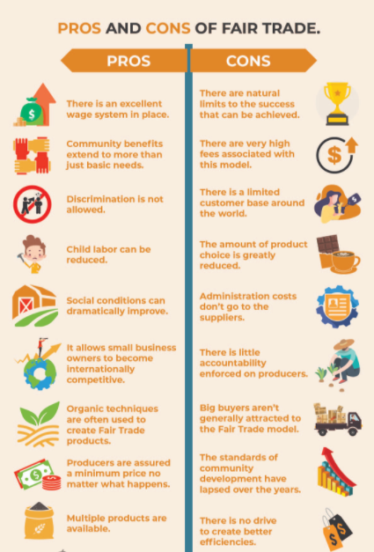
Benefits of Fair Trade
Organic techniques are used to create their products.
Discrimination is not allowed.
There is an excellent
Wage system in place.
Social conditions improve.
Child labour is reduced.
Producers are assured a minimum price.
It allows small business owners to become internationally competitive.
More products are available.

Slide 69
Task: Using the information you have read, write a summary of what you think are the 5 most important benefits of Fairtrade.
Benefit 1:
Benefit 2:
Benefit 3:
Benefit 4:
Benefit 5:

