Slide 1
Maths Lessons
WC 25/01/21

Slide 2
Date: 25.1.2021
LO. To develop an understanding of the different compositions of 7.
Subject: Maths

Slide 3
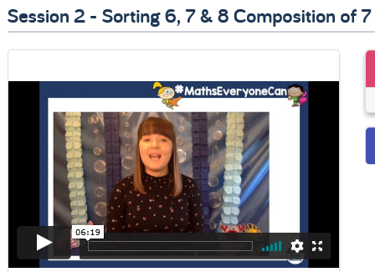
This week were are going to learn about the number 7 and different ways we can make it.
Lets start by watching this video, make sure you watch Session 2 – Sorting 6, 7 & 8 Composition of 7.
Video
https://whiterosemaths.com/homelearning/early-years/growing-6-7-8/
Copy and paste the link to watch the video of The Elves & The Shoemaker.

Slide 4
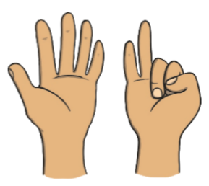
Here you can see different representations of some numbers. Can you circle the representation of the number 7?

Slide 5
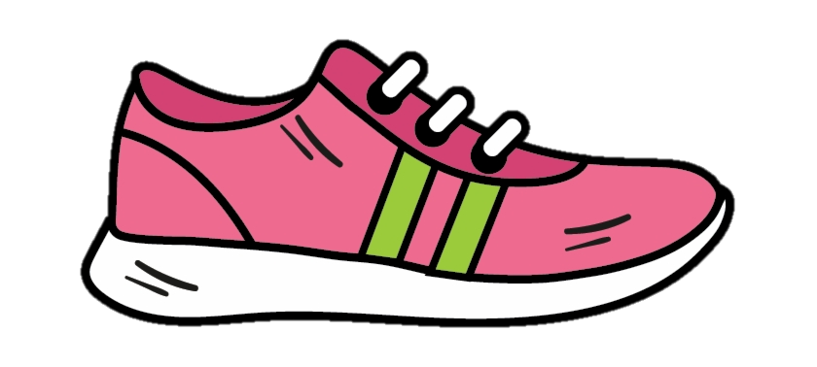
LET’S GO ON A SCAVENGER HUNT!!! Now you know about the number 7 lets go on a scavenger hunt around your house. LETS GO!!!
Adults, it would be great if you could take a photo of your child with the items and send them into us.
Can you find 7 socks?
Can you find 7 cups?
Can you find 7 shoes?
Can you find 7 toilet rolls?
Can you find 7 toys?
Can you find 7 of something else in your house? Surprise us with your choices.

Slide 6
Date: 26.1.2021
LO. To develop an understanding of the different compositions of 7.
Subject: Maths

Slide 7
We are learning that all numbers are made up of smaller numbers. Today we will explore this further and notice the different compositions of 7.
Here are some example of different ways we can make the number 7.
+
Can you count the total number of spots in the sum and write the answer in the box?
+

Slide 8
Now look at these different compositions of 7.
For example, 7 can be made from 4 and 3.
Can you fill in the white circles with the correct number of dots to make 7, you can either move the dots or draw them in.
Dot Bank
+
= 7
+
= 7
4 + 3 = 7
+ 1 = 7
+
= 7
+
= 7
5 + = 7
3 + = 7

Slide 9
The number 7 is made up of groups of smaller numbers. Here the number is 7 split up into 3 parts, can you work out how many spots need to go into the empty circles to make 7.
+
+
= 7
+
+
= 7
3 + + = 7
2 + 2 + = 7
+
+
= 7
+
+
= 7
4 + + = 7
1 + 2 + = 7
+
+
= 7
Dot Bank
+ + = 7

Slide 10
Date: 27.1.2021
LO. To find the missing number in compositions of 7.
Subject: Maths

Slide 11
Instructions
Each slide shows a part-whole model with the ‘whole’ number and one ‘part’ number.
The ‘whole’ number will always be the number 7.
One of the parts will be given to you and your job is to work out what number needs to be added to get to 7.
Can you work out the missing ‘part’ number?
Can you say the equation? ‘Four add three equals seven.’
Choose the correct number shape to complete the part-part-whole model.

Slide 12
Find the correct Numicon piece that shows the answer and drag it into the ‘whole’ circle. (Draw the correct number of circles if you are working on paper.

Slide 13
Find the correct Numicon piece that shows the answer and drag it into the ‘whole’ circle. (Draw the correct number of circles if you are working on paper.

Slide 14
Find the correct Numicon piece that shows the answer and drag it into the ‘whole’ circle. (Draw the correct number of circles if you are working on paper.

Slide 15
CHALLENGE
If I have 7 in one of my parts, what would I have in the other part?
Talk about this with your adult.

Slide 16
Here we are going to write down all of the different ways in which we can make the number 7.
Using 7 objects and the part-part-whole how many more ways can you make the number 7?
Write a list below.
I used the part-part-whole model and my numicon and found that:
2 + 5 = 7
6 + 1 = 7

Slide 17
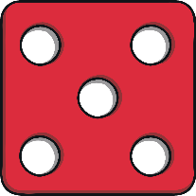
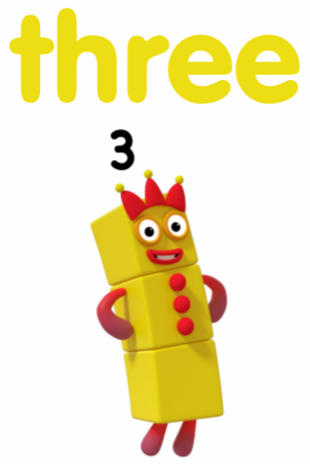
Here are some compositions of the number 7. Can you work out each one and put a circle around the compositions that equal 7.
+
+
+
+
+
+

Slide 18
Date: 28.1.2021
LO. To be able to name a 2D shape.
Subject: Maths

Slide 19
Today we are going to have a look at 2D shapes. A 2D shape is a flat shape that has sides and corners. Lets take a look at some of the names for these shapes:
oval
triangle
circle
square
rectangle
pentagon
hexagon
heptagon

Slide 20
Soon we are going to have a look for some shapes around our house. But first lets have a look at some examples of our shapes.
circle
disks
clock

Slide 21
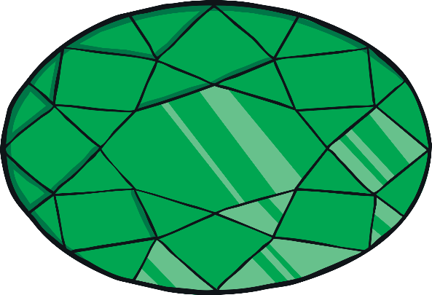
oval
jewel
mirror

Slide 22
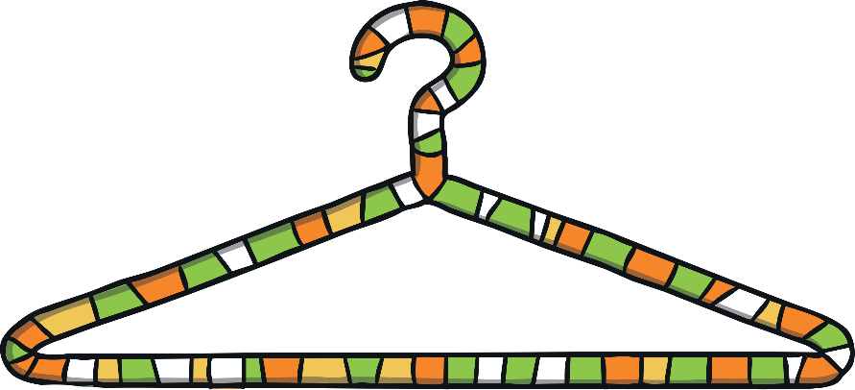
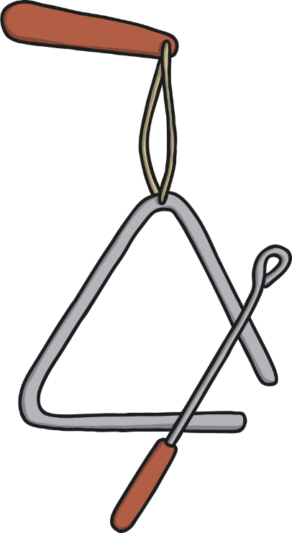
triangle
coat hanger
triangle

Slide 23
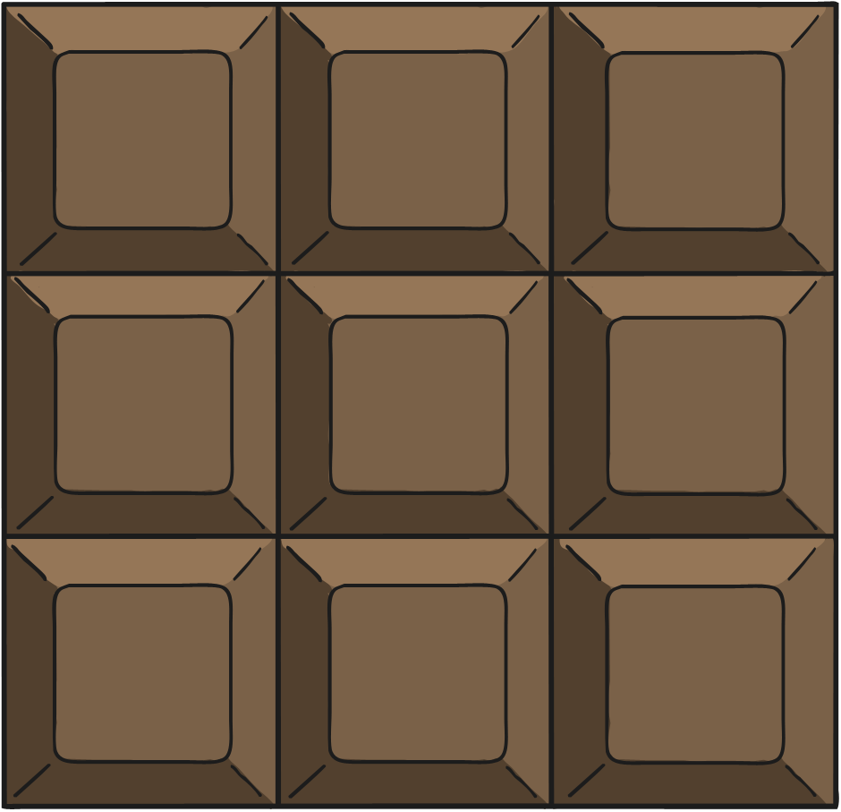
square
chocolate
windows

Slide 24
rectangle
rulers
envelopes

Slide 25
It would be great to see some photos of you with your shapes.
Shape Hunt
It’s time to see how many of our shapes we can find in our house.
You have 10 minutes to find as many circles, triangles, squares and rectangles as you can. Write what you find in the correct column below.

Slide 26
Date: 29.1.2021
LO. To be able to describe the properties of 2D shapes.
Subject: Maths

Slide 27
Yesterday we had a look at these 2D shapes and what their names were. Today we are going to find out how many sides and corners each shape has. Before we get started, you can read the names of the shapes with your adult to refresh your memory.
oval
triangle
circle
square
rectangle
pentagon
hexagon
heptagon

Slide 28
Mrs Simpson has made this chart of how many sides and corners each shape has.
Can you name the shapes that have one side?
There is one shape that has three corners and three sides, which shape is it?
Look at all of the shapes, which one has the most sides?
Which one has 5 corners?
Name | Sides | Corners
Circle | 1 | 0
Oval | 1 | 0
Triangle | 3 | 3
Square | 4 | 4
Rectangle | 4 | 4
Pentagon | 5 | 5
Hexagon | 6 | 6
Heptagon | 7 | 7

Slide 29
Mr Pennal has accidently deleted the numbers for the sides and corners. Can you help him by counting how many sides and corners each shape has got and write your answers into the table.
Name | Sides | Corners
Circle
Triangle
Square
Pentagon
Heptagon

Slide 30
You did a super job at writing the number of sides and corners each shape has.
But Mrs Simpson has jumbled up the numbers you wrote. Can you draw a line to match the shape to the correct number of sides and corners?
shape
sides
corners
4
5
5
4
3
0
1
7
7
3

