Slide 1
Subject: Maths
Pack: B

Slide 2
Date: 22.02.2021
L.O. To be able to compare capacity.
Subject: Maths

Slide 3
Pre-recorded Teaching
Access the online teaching video below that will support you to complete the work in this lesson. This video will act as a support but all of the work can still be successfully understood & completed using paper-based versions of this pack. If you need further support to understand / complete work then please contact school via e-mail or telephone.
Play Video
Or copy and paste the below link
https://classroom.thenational.academy/lessons/comparing-capacity-70v68t?step=1&activity=video

Slide 4
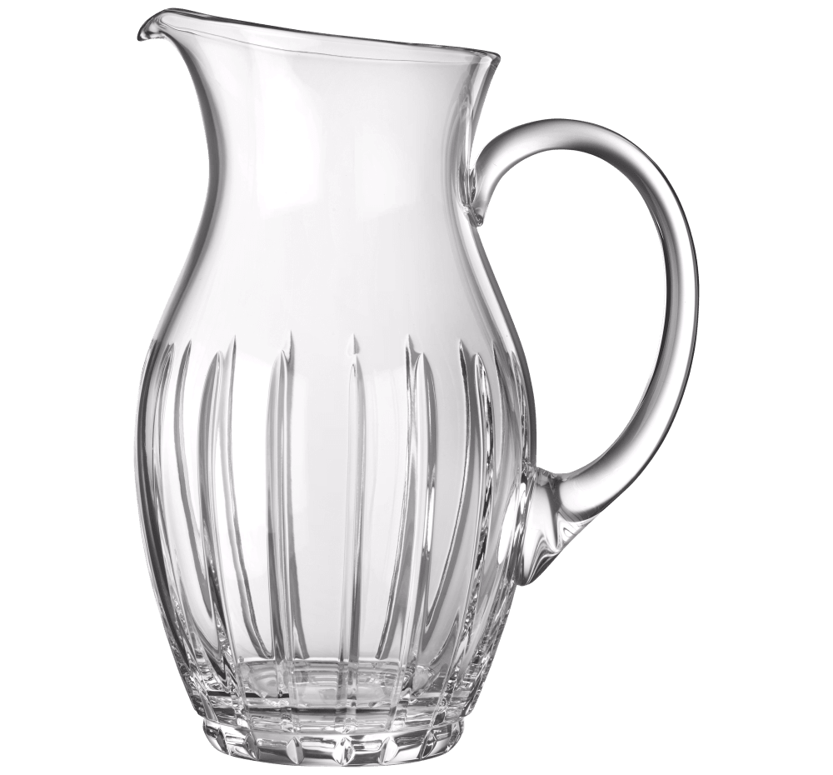
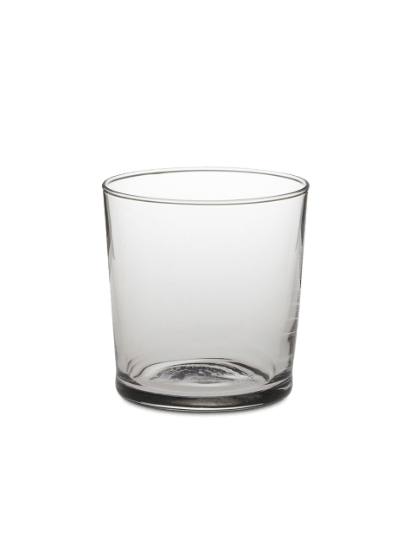
Capacity
Capacity is how much a container can hold.
Today we are going to compare the capacity of different containers. We will find out which container can hold more water and which can hold less.
Let’s compare the jug and the cup.
Greater is another word for bigger – this means the container would hold the most.
The jug is taller and wider. This means it can contain more water.
If I poured water into the jug and into the cup, I know that the jug could contain more water. This means the jug has a greater capacity than the cup. The cup has a smaller capacity than the jug.

Slide 5
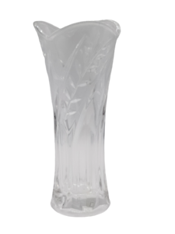
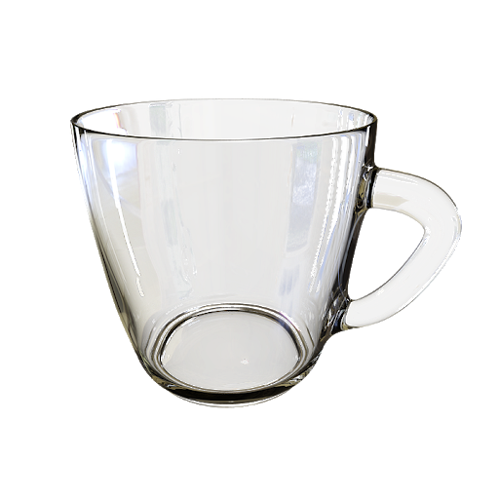
Capacity
Capacity is how much a container can hold.
Together, we will compare containers to find out which one can hold the most or least water.
Task 1: Fill in the blanks to complete the sentences.
Choose from greater, smaller or the same
The vase is taller and wider. This means it can contain more water.
Greater is another word for bigger – this means the container would hold the most.
Vase
Cup
The vase has a ____________ capacity than the cup.
The cup has a _____________ capacity than the vase.

Slide 6
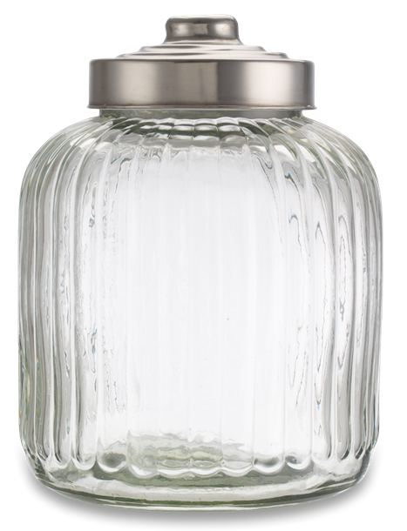
Capacity
Capacity is how much a container can hold.
Task 2: Fill in the blanks to complete the sentences.
Choose from greater, smaller or the same
Greater is another word for bigger – this means the container would hold the most.
Mug
Jar
The mug has a ____________ capacity than the jar.
The jar has a _____________ capacity than the mug.

Slide 7
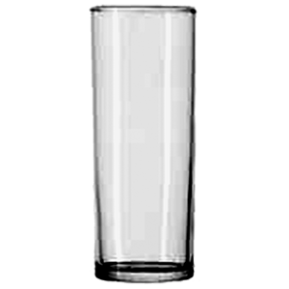
Capacity
Capacity is how much a container can hold.
Task 3: Fill in the blanks to complete the sentences.
Choose from greater, smaller or the same
Greater is another word for bigger – this means the container would hold the most.
Tall cup
Short cup
The tall cup has a ____________ capacity than the short cup.
The short cup has a _____________ capacity than the tall cup.

Slide 8
Capacity
Capacity is how much a container can hold.
Both containers are tall.
If I am not sure which container has the greater capacity (which container would hold the most water), I could carry out the following test…

Slide 9
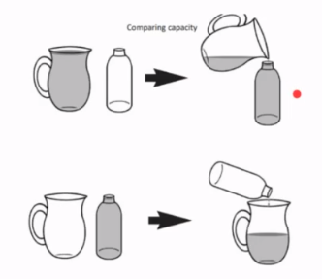
Capacity
Container 1
Fill up container 1.
Pour container 1 into container 2.
If it overspills, then container 1 has a greater capacity.
If it does not fill up, then container 2 has a greater capacity.
Container 1
Container 2
Container 2
Container 2
Container 1
Container 2
Container 1

Slide 10
Capacity
Capacity is how much a container can hold.
Task 4: Find two containers in your house. Compare which container has the greater capacity.
If you are not sure which container has the greater capacity, try the test explained on the previous slide!
Complete the below sentences.
Choose from greater, smaller or the same
Greater is another word for bigger – this means the container would hold the most.
The ________ has a ____________ capacity than the __________.
The ________ has a ____________ capacity than the __________.
Send a picture of you comparing the capacity of two containers to our email Pioneerspupils@gmail.com

Slide 11
Capacity
We are still comparing containers to find out which one has a greater capacity, but this time we are using the symbols < > =
Remember:
The crocodile eats the bigger object. So this time it will be eating the container which holds the most water!
If they are the same it will be =.
The jug is taller and wider. This means it can contain more water.
Jug
Cup
The jug is > the cup.

Slide 12
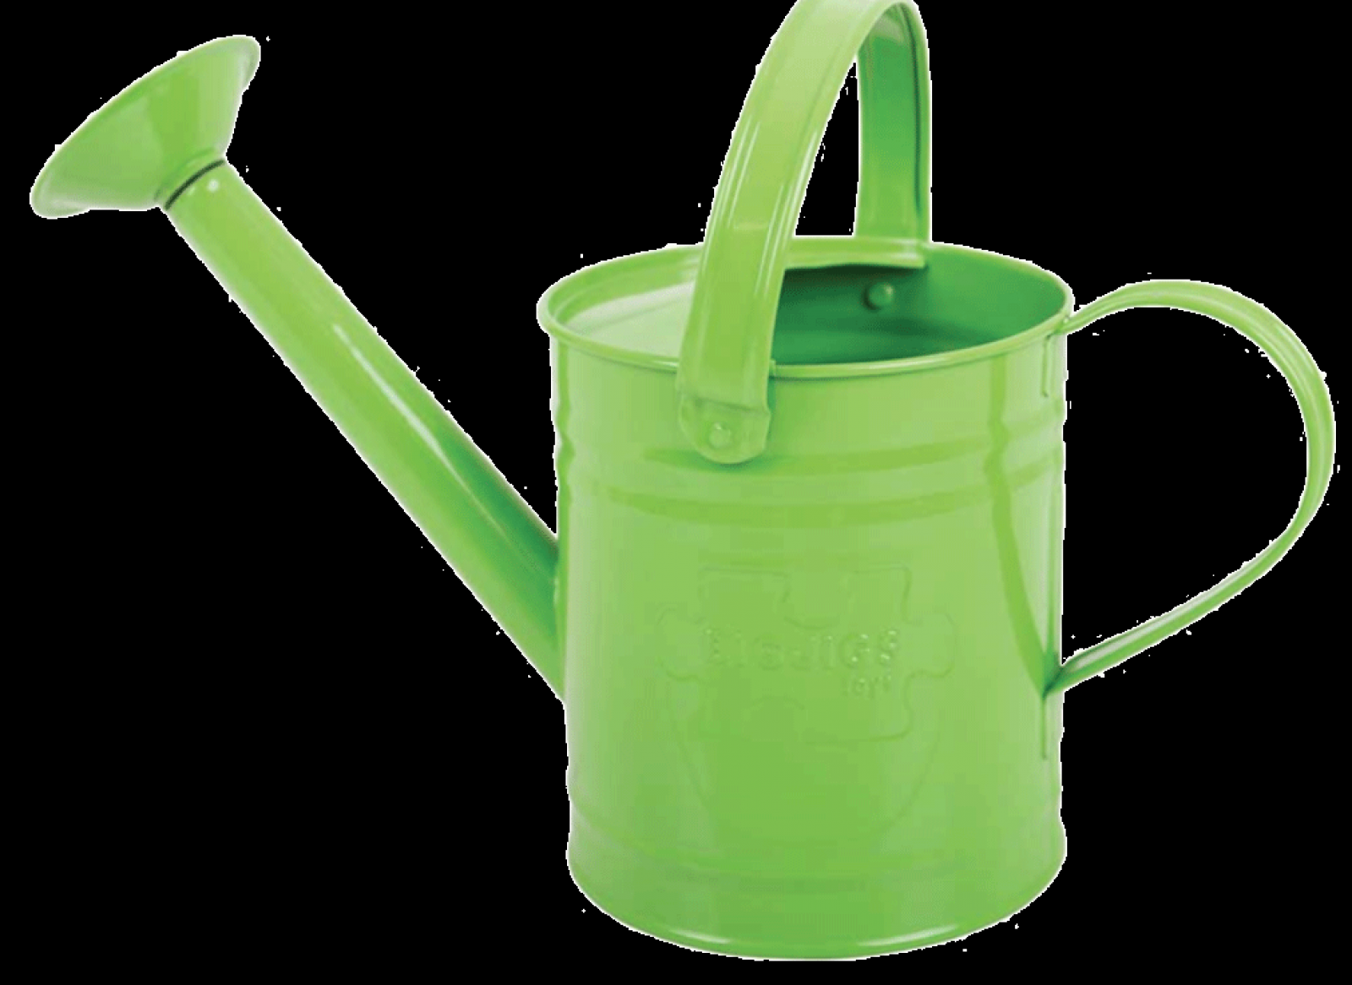
Capacity
Together, we will compare containers to find out which one can hold the most or least water.
Task 5: Complete the sentence by using the correct symbol.
Choose from < > =
Remember:
The crocodile eats the bigger object. So this time it will be eating the container which holds the most water!
If they are the same it will be =.
The watering can is taller and wider. This means it can contain more water.
Watering can
Mug
The watering can is ________ the mug.

Slide 13
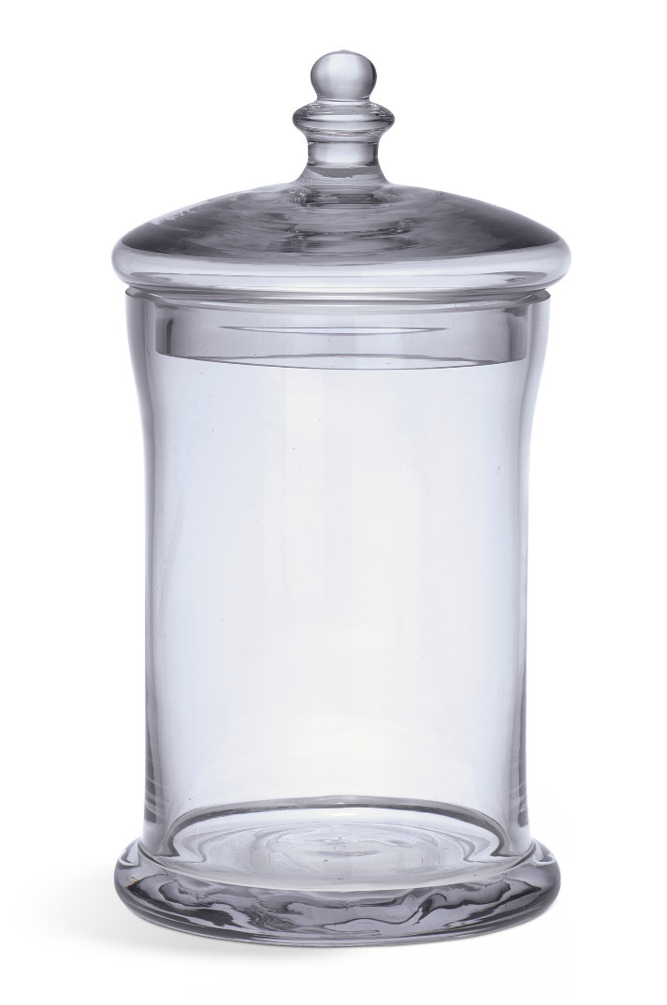
Capacity
Capacity is how much a container can hold.
Task 6: Complete the sentence by using the correct symbol.
Choose from < > =
Remember:
The crocodile eats the bigger object. So this time it will be eating the container which holds the most water!
If they are the same it will be =.
Cup
Jar
The cup is ________ the jar.

Slide 14
Capacity
Capacity is how much a container can hold.
Task 7: Complete the sentence by using the correct symbol.
Choose from < > =
Remember:
The crocodile eats the bigger object. So this time it will be eating the container which holds the most water!
If they are the same it will be =.
Cup
Cup
The cup is ________ the cup.

Slide 15
Capacity
Task 8: Find another two containers in your house. Compare which container has the greater capacity.
If you are not sure which container has the greater capacity, try the test!
Complete the sentence using the correct symbol < > =.
Remember:
The crocodile eats the bigger object. So this time it will be eating the container which holds the most water!
If they are the same it will be =.
The ___________ is ________ the ___________.
object
symbol
object
Send a picture of you comparing the capacity of two containers to our email Pioneerspupils@gmail.com

Slide 16
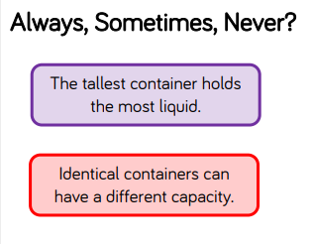
Challenge!
If you are working on a computer, insert a text box to type your answer.
Answer always, sometimes or never for each statement.
Test it out at home with containers!

Slide 17
Well done for your hard work today!
Could any completed work / photographic evidence of completed work please be sent to Pioneerspupils@gmail.com or submitted into the drop box at school.
Thank you

Slide 18
Date: 23.02.2021
L.O. To be able to measure capacity using non-standard units of measure.
Subject: Maths

Slide 19
Pre-recorded Teaching
Access the online teaching video below that will support you to complete the work in this lesson. This video will act as a support but all of the work can still be successfully understood & completed using paper-based versions of this pack. If you need further support to understand / complete work then please contact school via e-mail or telephone.
Play Video
Or copy and paste the below link
https://classroom.thenational.academy/lessons/comparing-capacity-measures-60tp4d?step=2&activity=video

Slide 20
Recap: Capacity
Capacity is how much a container can hold.
Task 1: Fill in the blanks to complete the sentences to compare the capacity of the two containers.
Choose from greater, smaller or the same
Greater is another word for bigger – this means the container would hold the most.
Jug
Cup
The jug has a ____________ capacity than the cup.
The cup has a _____________ capacity than the jug.

Slide 21
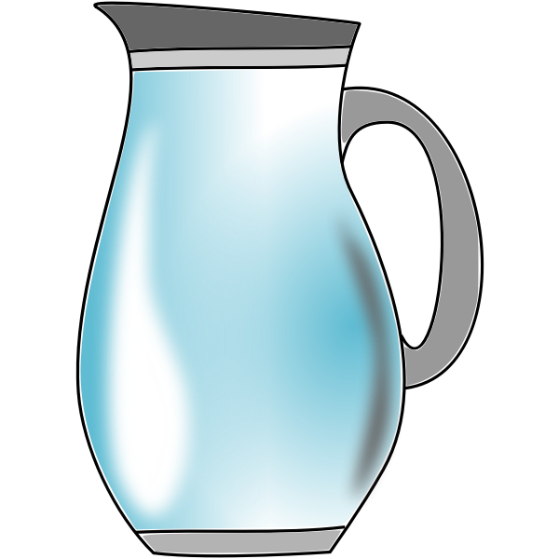
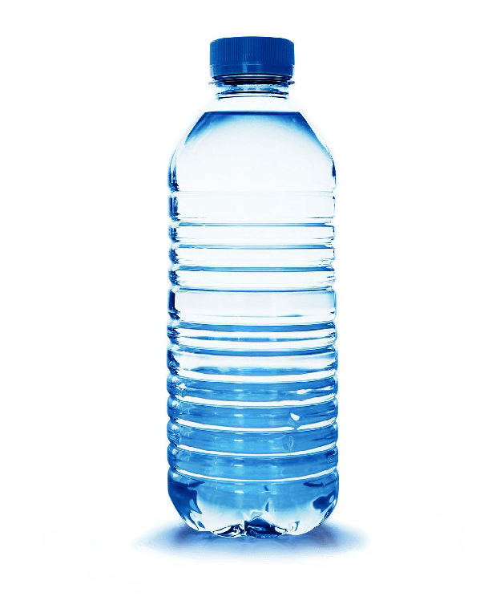
Capacity
Today we are going to measure capacity. This means we are going to find out how much the container can hold.
We are going to use other containers to measure this.
For example:
I have poured the jug of water into bottles until there was no water left.
I could fill up 2 water bottles.
This means the capacity of the jug is 2 water bottles.

Slide 22
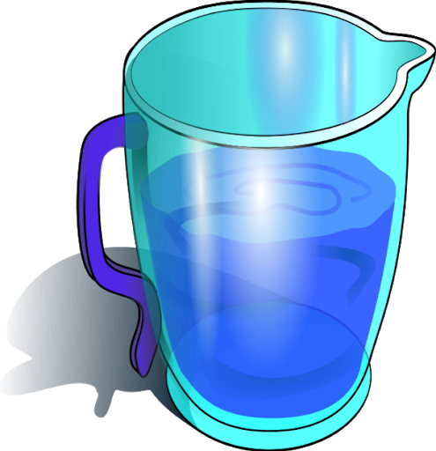
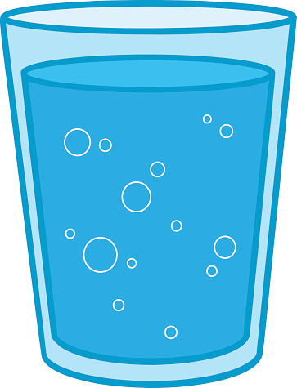
Capacity
Task 2: This time lets use cups. Together lets find out the capacity of the jug. Complete the sentence.
I have poured the jug of water into cups until there was no water left.
I filled 5 cups with water.
The capacity of the jug is _______ cups.

Slide 23
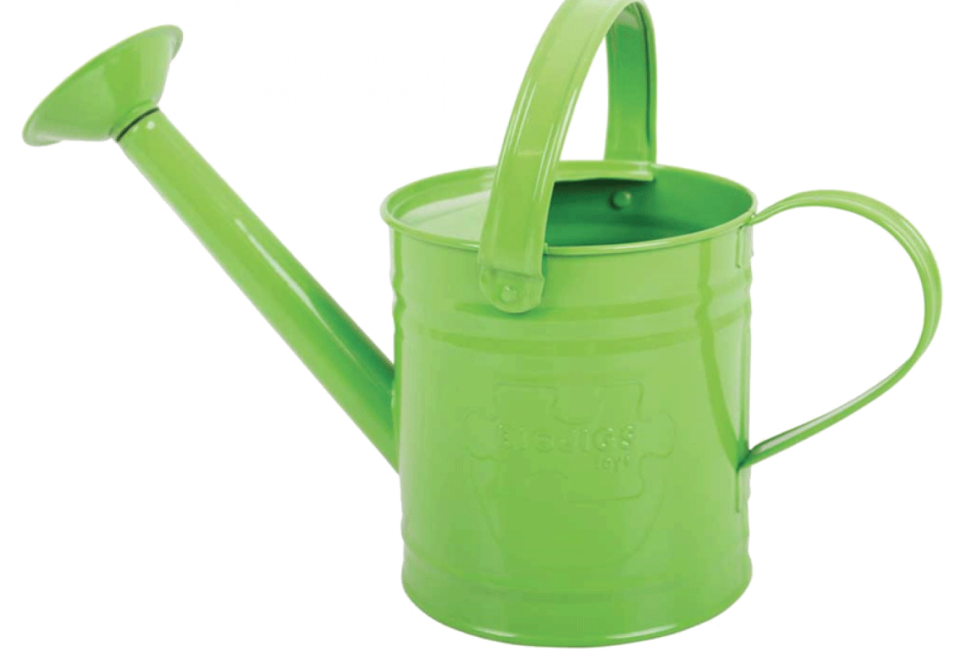
Capacity
Task 3: Complete the sentence to explain the capacity of the watering can.
The capacity of the watering can is _______ cups.

Slide 24
Capacity
Task 4: Find out the capacity of a container in your house.
Use a big container and fill it with water. Then, find a smaller container which you have more than one of (same sized cups, same sized water bottles, etc)
Find out how many times you can fill the small containers until there is no water left in the big container. This will tell you the capacity.
Complete the sentence below.
The capacity of the ________ is ____ ________.
Send a picture of you comparing the capacity of two containers to our email Pioneerspupils@gmail.com

Slide 25
Capacity
Now we are going to compare which container has the greatest capacity by measuring the capacity of each container.
The capacity of the jug is 4 bottles.
6 is greater than 4.
The capacity of the jar is 6 bottles.
The jar has a greater capacity than the jug.
The jug has a smaller capacity than the jar.

Slide 26
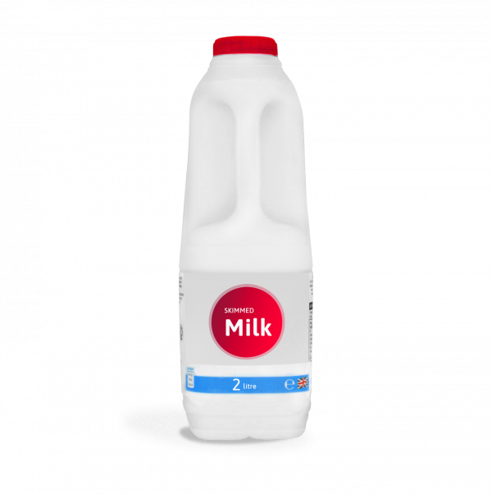
Capacity
Task 5: Together, lets find out the capacity for each container and find out which one is the greatest. Complete the sentences.
Choose from greater, smaller or the same
The capacity of the water bottle is 2 cups.
5 is greater than 2.
The capacity of the milk bottle is 5 cups.
The water bottle has a _____________ capacity than the milk bottle.
The milk bottle has a ____________ capacity than the water bottle.

Slide 27
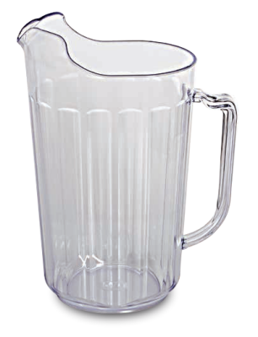
Capacity
Task 6: Find out the capacity for each container and find out which one is the greatest. Complete the sentence.
Choose from greater, smaller or the same
The watering can has a _____________ capacity than the jug.
The jug has a ___________ capacity than the watering can.

Slide 28
Capacity
Task 7: Find out the capacity for each container and find out which one is the greatest. Complete the sentence.
Choose from greater, smaller or the same
The mug has a _____________ capacity than the cup.
The cup has a ___________ capacity than the mug.

Slide 29
Capacity
Task 8: Can you find out the capacity of 2 containers in your house?
Just like I have in the previous slides, measure the capacity of each container.
Then, compare which container has the greatest or smallest capacity, or if they are the same!
Complete the below sentence.
The _______ has a ________ capacity than the ________.
Send a picture of you comparing the capacity of two containers to our email Pioneerspupils@gmail.com

Slide 30
Challenge!

Slide 31
Well done for your hard work today!
Could any completed work / photographic evidence of completed work please be sent to Pioneerspupils@gmail.com or submitted into the drop box at school.
Thank you

Slide 32
Date: 24.02.2021
L.O. To be able to compare volume.
Subject: Maths

Slide 33
Pre-recorded Teaching
Access the online teaching video below that will support you to complete the work in this lesson. This video will act as a support but all of the work can still be successfully understood & completed using paper-based versions of this pack. If you need further support to understand / complete work then please contact school via e-mail or telephone.
Play Video
Or copy and paste the below link
https://classroom.thenational.academy/lessons/comparing-volume-6rw38t

Slide 34
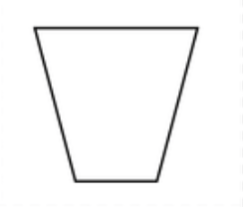
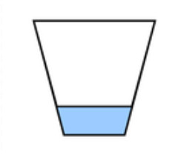
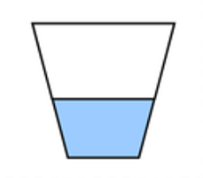
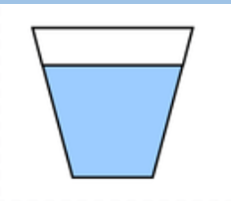
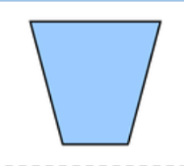
Comparing Volume
Volume is how much liquid is in a container.
Today, I am going to show you how I would describe the volume in each container.
Empty
Nearly empty
Half full
Nearly full
Full

Slide 35
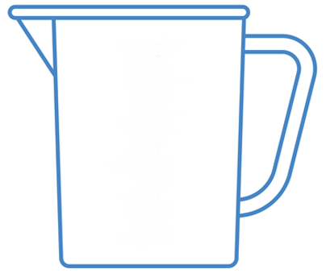
Comparing Volume
Task 1: Can you put the jugs in order starting with the least amount of volume to the greatest amount of volume?
A
B
C
D
E
Remember least is less and greatest is more

Slide 36
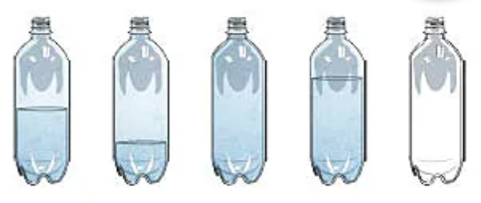
Comparing Volume
Task 2: Look at the bottles below and match the correct words to the correct bottles. Draw a line. I have done the first one for you.
A
B
C
D
E
Empty
Half full
Full
Nearly full
Nearly empty

Slide 37
Comparing Volume
Task 3: Using the glasses above can you draw a line or colour them to show the correct volume.
Empty
Nearly empty
Half full
Nearly full
Full

Slide 38
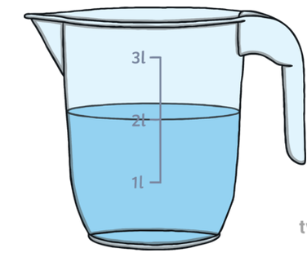
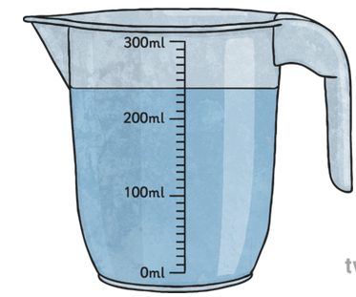
Comparing Volume
I am going to look at the volume of each of these jugs.
A
B
Jug A is half full
Jug B is nearly full

Slide 39
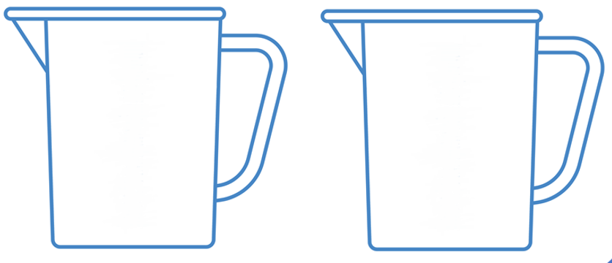
Comparing Volume
Task 4: Complete the sentence below. Remember to use the words empty, nearly empty, half full, nearly full or full.
A
B
Jug A is __________________
Jug B is _________________

Slide 40
Comparing Volume
Task 5: Let’s take another look and complete the sentence below.
Remember to use the words empty, nearly empty, half full, nearly full or full
A
B
Jug A is __________________
Jug B is _________________

Slide 41
Comparing Volume
Now, I am going to compare volume using less than and greater than. This is to find out which jug has the most liquid inside.
A
B
The volume of jug A is less than the volume of jug B.
The volume of jug B is greater than the volume of jug A

Slide 42
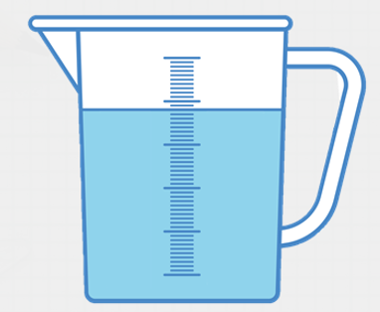
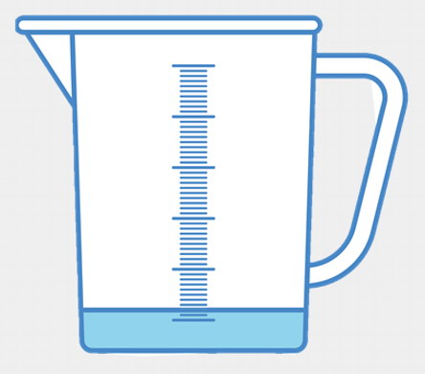
Comparing Volume
Task 6: Complete the sentence below to compare volume.
A
B
The volume of jug A is _______________ than jug B.
The volume in jug B is _______________ than jug A.
Remember to use the words less than, greater than or equal to.

Slide 43
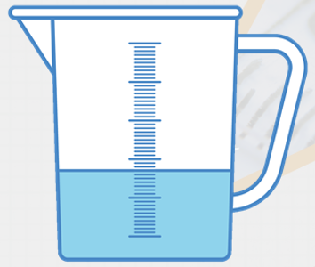
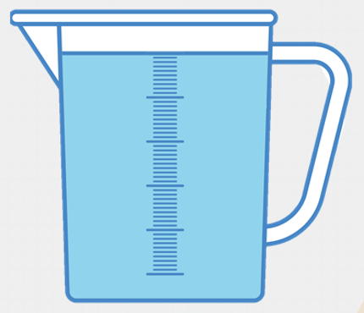
Comparing Volume
Task 7: Complete the sentence below to compare volume.
A
B
The volume of jug A is _______________ than jug B.
The volume in jug B is _______________ than jug A.
Remember to use the words less than, greater than or equal to.

Slide 44
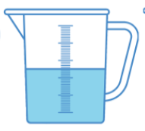
Comparing Volume
Task 8: Let’s have another go and complete the sentence below to compare volume.
A
B
The volume of jug A is _______________ than jug B.
The volume in jug B is _______________ than jug A.
Remember to use the words less than, equal to or greater than.

Slide 45
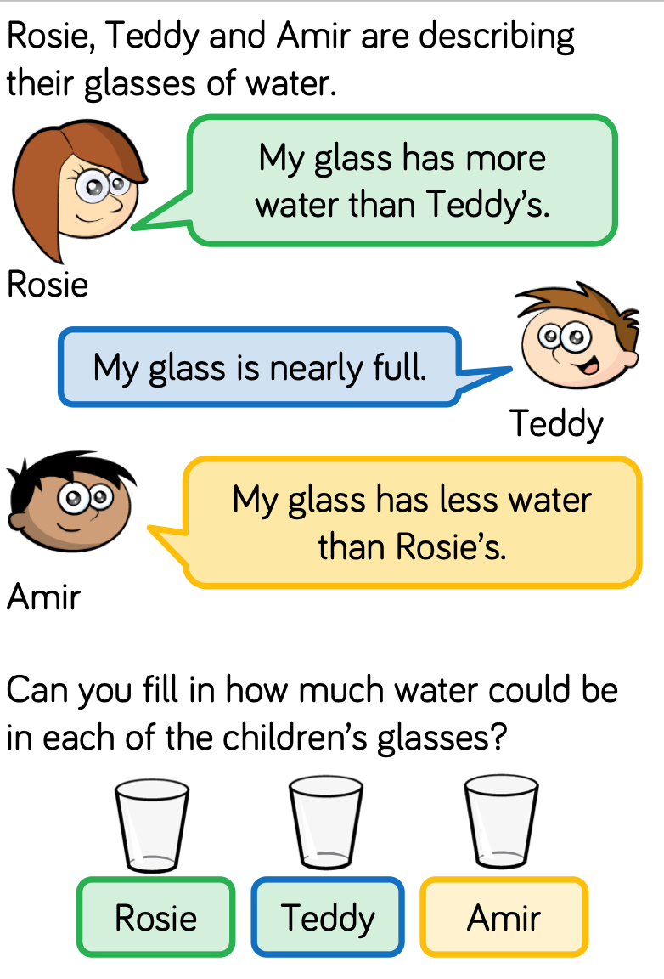
Challenge!

Slide 46
Well done for your hard work today!
Could any completed work / photographic evidence of completed work please be sent to Pioneerspupils@gmail.com or submitted into the drop box at school.
Thank you

Slide 47
Date: 25.02.2021
L.O. To be able to experience measuring 1 litre.
Subject: Maths

Slide 48
Pre-recorded Teaching
Access the online teaching video below that will support you to complete the work in this lesson. This video will act as a support but all of the work can still be successfully understood & completed using paper-based versions of this pack. If you need further support to understand / complete work then please contact school via e-mail or telephone.
Play Video
Or copy and paste the below link
https://classroom.thenational.academy/lessons/standard-units-of-measure-cct6cd?step=2&activity=video

Slide 49
Recap: Volume
Task 1: Match the bottles to the correct volume.
A
B
C
D
E
Empty
Half full
Full
Nearly full
Nearly empty

Slide 50
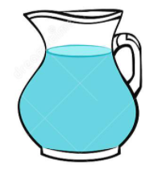
Measuring in litres
Today we are going to measure capacity in a different way.
So far we have measured length in cm’s, measured mass in kg’s and now we are going to measure capacity (liquid) in litres.
If you have a jug or kettle in your house, go and get it and have a look.
You might be able to see ‘1L’ or ‘1 Litre’ on it, just like this…
1 Litre
I know there is 1 litre of water in this jug because the water stops where it says 1 litre.

Slide 51
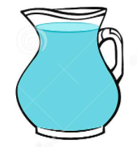
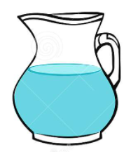
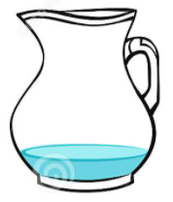
Measuring in litres
I am going to describe the volume of the jugs, comparing it with 1 litre.
1 Litre
1 Litre
1 Litre
1 Litre
The water is greater than 1 litre
The water is equal to 1 litre
The water is less than 1 litre
The water is less than 1 litre

Slide 52
Measuring in litres
Task 2: Together, can we match the volume of jugs with the pictures? Draw lines.
1 Litre
1 Litre
1 Litre
1 Litre
The water is less than 1 litre
The water is less than 1 litre
The water is equal to 1 litre
The water is greater than 1 litre

Slide 53
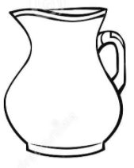
Measuring in litres
Task 3: Can you draw / colour in where the water could be up to in the jug after reading my description?
1 Litre
1 Litre
1 Litre
1 Litre
The water is equal to 1 litre
The water is greater than 1 litre
The water is less than 1 litre
The water is less than 1 litre

Slide 54
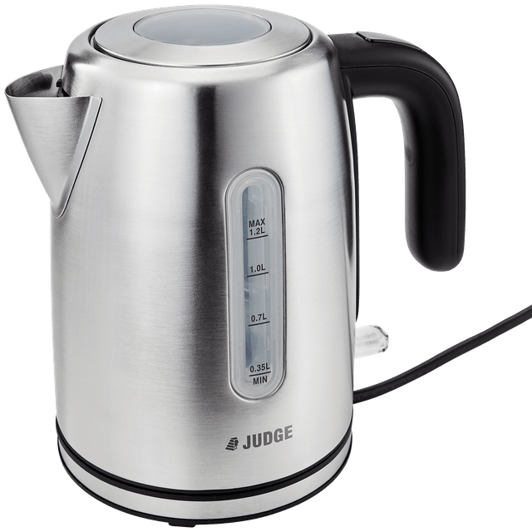
Measuring in litres
Task 4: Use a container in your house which has ‘1 litre’ marked on it. Can you measure 1 litre of water? Pour in water and stop when you get to 1 litre!
For example:
A jug or kettle which has 1 litre written on it
If you do not have a container which you can use to measure 1 litre, can you use an empty bottle of milk or bottle of coke which is 1 litre? Fill it to the top to understand how much water 1 litre is.
Send a picture of you measuring 1 litre of water to our email Pioneerspupils@gmail.com

Slide 55
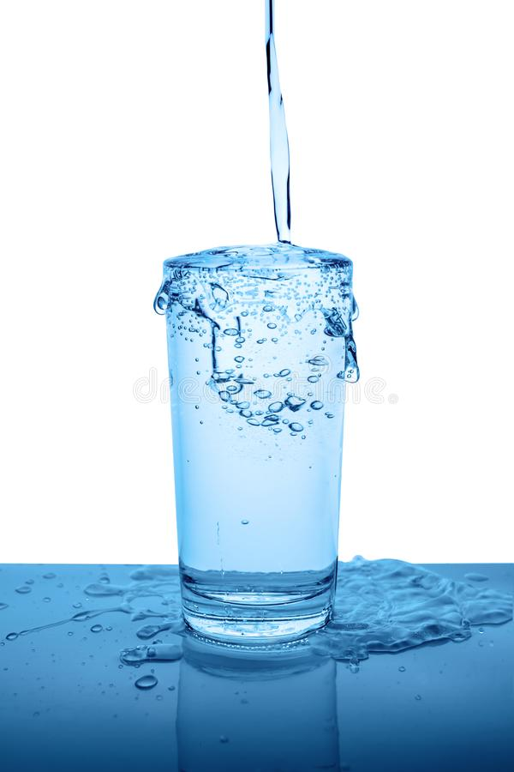
Comparing capacity
I am going to measure 1 litre of water in a jug. I am then going to pour all of the water from the jug into my cup to find out if the capacity of my cup is greater than 1 litre, less than 1 litre or equal to 1 litre.
1 Litre
The water in the cup is overflowing, so I know the cup is not big enough to hold 1 litre of water. This means the capacity of the cup is less than 1 litre.

Slide 56
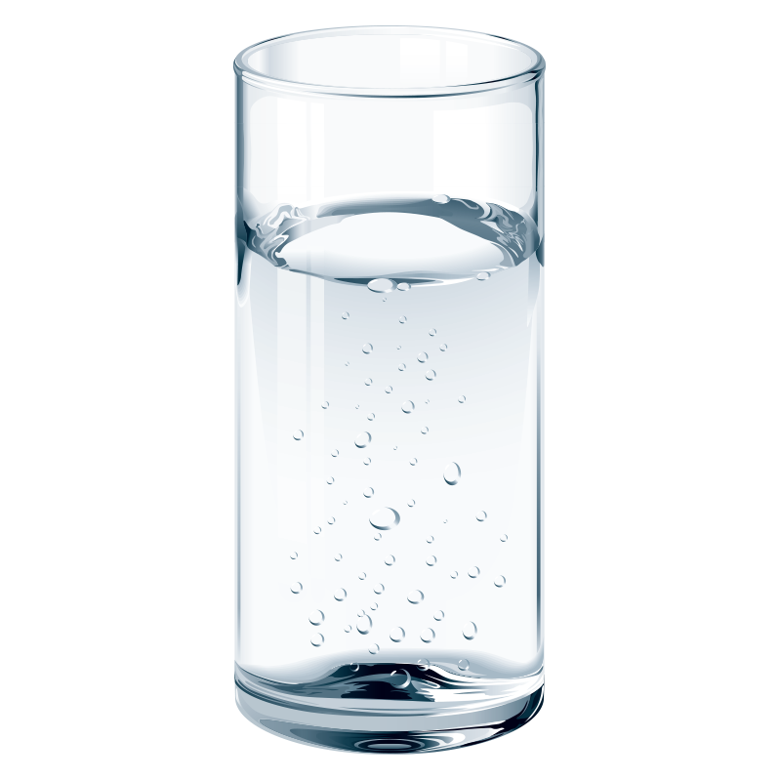
Comparing capacity
I am going to measure 1 litre of water in a jug. I am then going to pour all of the water from the jug into my vase to find out if the capacity of my vase is greater than 1 litre, less than 1 litre or equal to 1 litre.
1 Litre
The water in the vase did not fill to the top, so I know the vase could have held more water. This means the capacity of the vase is greater than 1 litre.

Slide 57
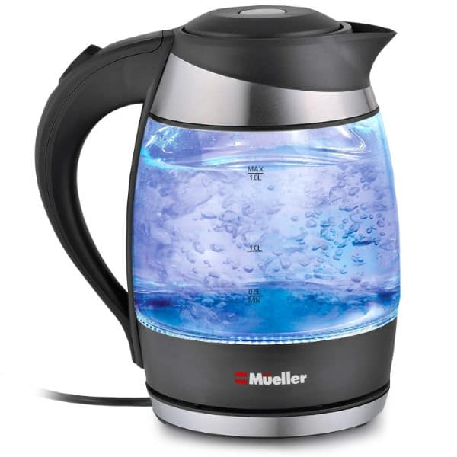
Comparing capacity
I am going to measure 1 litre of water in a jug. I am then going to pour all of the water from the jug into my kettle to find out if the capacity of my kettle is greater than 1 litre, less than 1 litre or equal to 1 litre.
1 Litre
The water in the kettle filled to top and did not overflow. This means the capacity of the kettle is equal to 1 litre – it is the same.

Slide 58
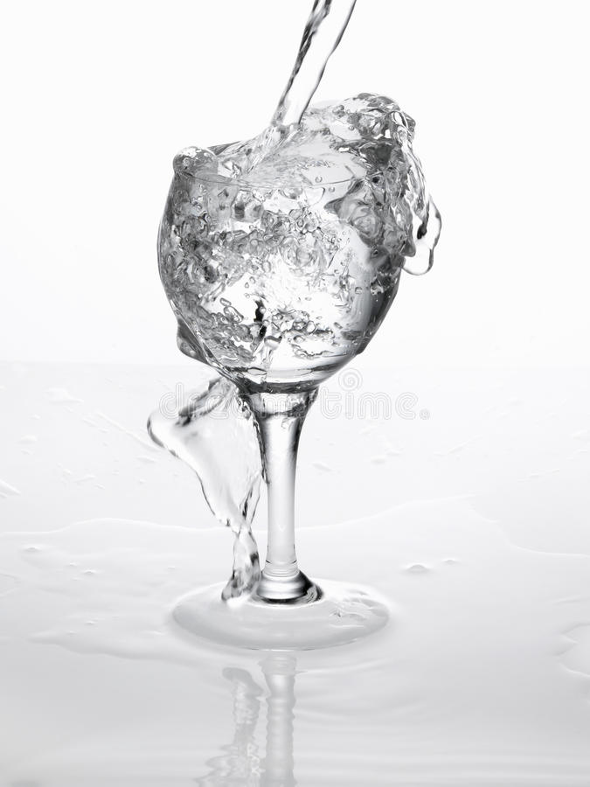
Comparing capacity
I have measured 1 litre of water in a jug. I have poured all of the water in the glass.
Task 5: Complete the sentence to describe the capacity of the glass.
Choose from greater, less or equal to
1 Litre
The capacity of the glass is ________ than 1 litre.

Slide 59
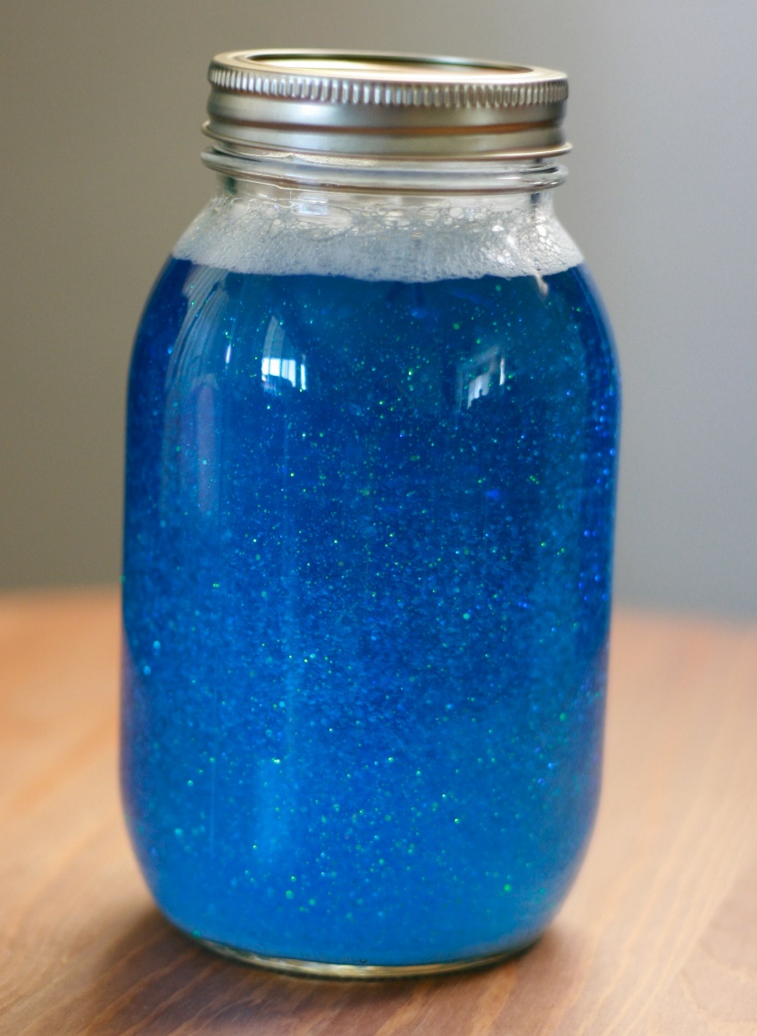
Comparing capacity
I have measured 1 litre of water in a jug. I have poured all of the water in the jar.
Task 6: Complete the sentence to describe the capacity of the jar.
Choose from greater than, less than or equal to
1 Litre
The capacity of the jar is ________ 1 litre.

Slide 60
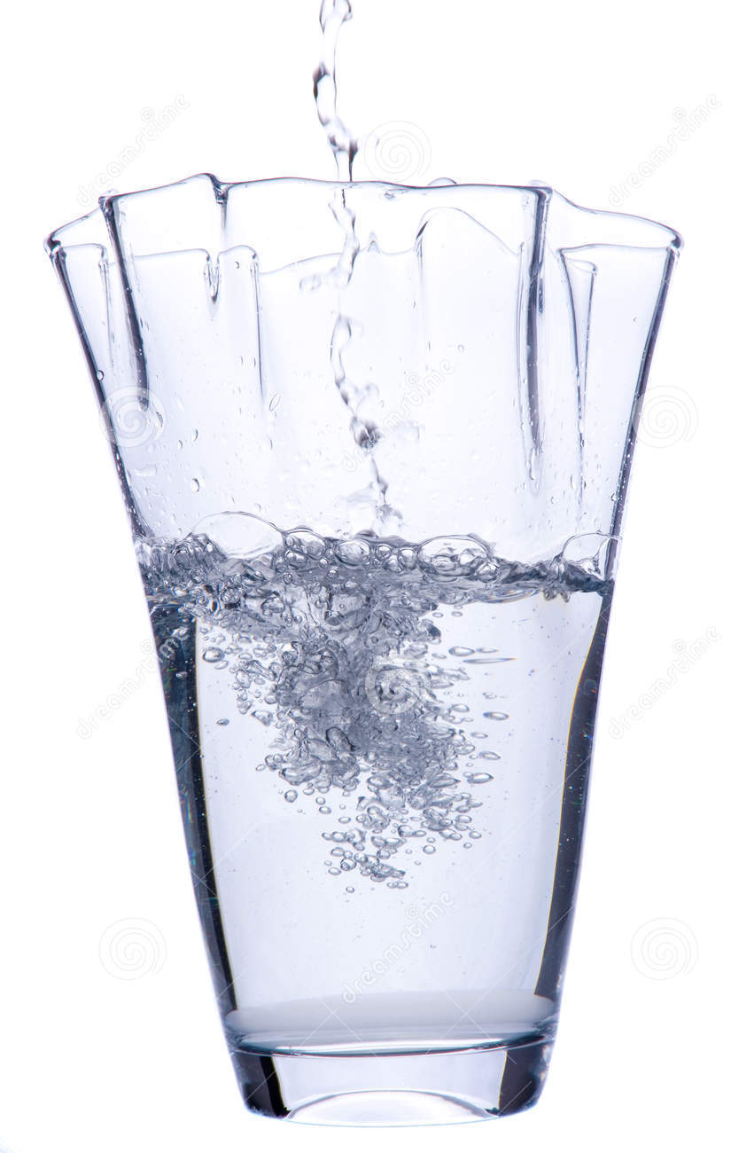
Comparing capacity
I have measured 1 litre of water in a jug. I have poured all of the water in the vase.
Task 7: Complete the sentence to describe the capacity of the vase.
Choose from greater, less or equal to
1 Litre
The capacity of the vase is ________ 1 litre.

Slide 61
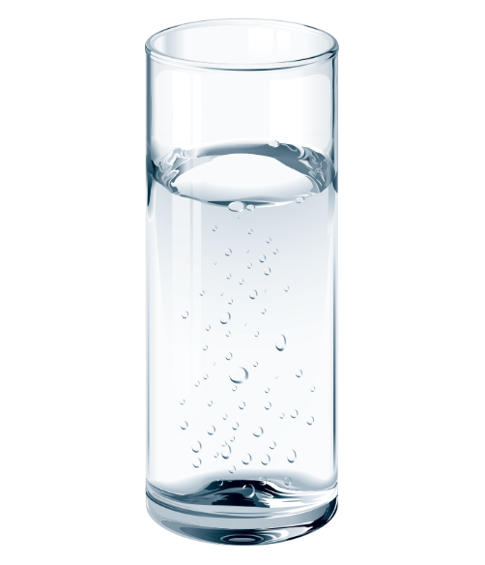
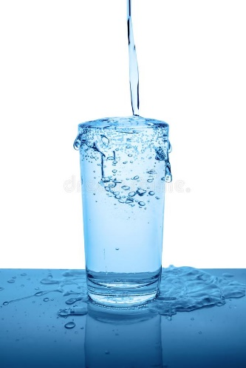
Comparing capacity
Task 8: Use the container you have already used to measure 1 litre of water. Pick 3 more containers. Estimate if you think the capacity of the containers will be greater than, less than or equal to 1 litre.
Then, pour 1 litre of water into each container to find out their capacity.
Do this experiment over a sink in case the water overflows!
1 Litre
Send a picture of you measuring 1 litre of water to our email Pioneerspupils@gmail.com

Slide 62
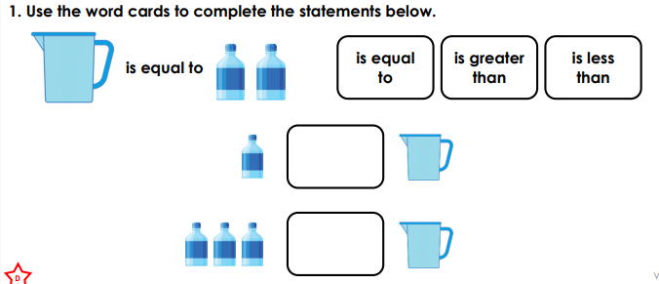
If you are working on a computer, insert a text box to type your answer.
Challenge!
1.
2.
1.
2.

Slide 63
Well done for your hard work today!
Could any completed work / photographic evidence of completed work please be sent to Pioneerspupils@gmail.com or submitted into the drop box at school.
Thank you

Slide 64
Date: 26.02.2021
L.O. To be able to create a rainforest potion.
Subject: Maths

Slide 65
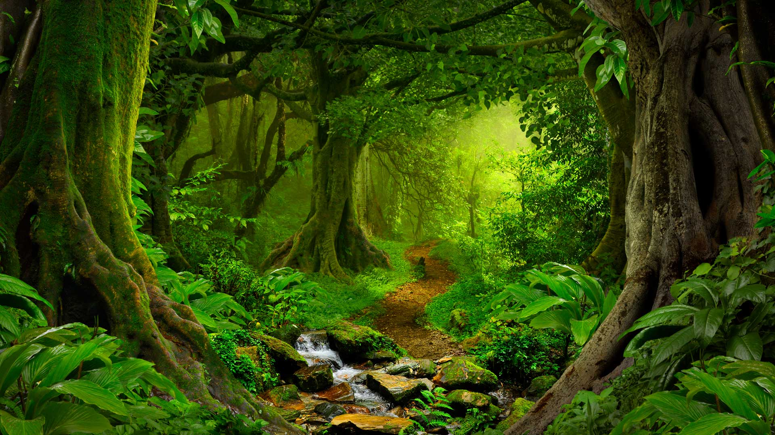
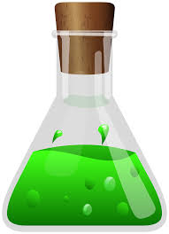
Rainforest potion
Today we are going to do something exciting. We are going to make a rainforest potion!
I am going to mix lots of things together from the rainforest to make a potion.
To help me do this, I am going to use some of the new words we have learnt this week…
full
empty
nearly full
nearly empty
half full

Slide 66
Pre-recorded Teaching
Access the teaching video by Miss McCartney that will support you to complete the work in this lesson. This video will act as a support but all of the work can still be successfully understood & completed using paper-based versions of this pack. If you need further support to understand / complete work then please contact school via e-mail or telephone.
Play the video from the school website.

Slide 67
Rainforest potion
I am going to measure the volume of the liquid in each cup.
In my rainforest potion I have…
1 full cup of squashed tree frogs
1 nearly full cup of crushed bananas
1 half full cup of melted orangutan fur
1 nearly empty cup of liquefied bugs
1 sprinkle of butterfly dust
Comparing Volume
The volume of squashed tree frog is greater than crushed bananas.
The volume of liquefied bugs is less than melted orangutan fur.

Slide 68
Rainforest potion
Your Task: Can you complete the sentences to compare the volume of each cup?
1 full cup of squashed tree frogs
1 nearly full cup of crushed bananas
1 half full cup of melted orangutan fur
1 nearly empty cup of liquefied bugs
1 sprinkle of butterfly dust
Choose from greater than, less than or equal to
Comparing Volume
The volume of crushed bananas is __________ melted orangutan fur.
The volume of liquefied bugs is ____________squashed tree frog.

Slide 69
Rainforest potion
Your Task: Can you create a rainforest potion and measure the volume of each ingredient?
To make a rainforest potion you need water and food colouring (and then name the liquid after something you would find in the rainforest).
If you do not have food colouring, could you use different colour liquids (e.g. coke, orange juice, black current)?
Pour the ingredients into separate containers. Each ingredient needs to be a different volume:
Full
Nearly full
Half full
Nearly empty
Mix together in a container or a bottle. Then, add a sprinkle of something from the rainforest (glitter)!

Slide 70
Rainforest potion ingredients.
1 full cup of squashed tree frogs
1 nearly full cup of crushed bananas
1 half full cup of melted orangutan fur
1 nearly empty cup of liquefied bugs
1 sprinkle of butterfly dust

Slide 71
Rainforest potion ingredients.
Write the ingredients for your rainforest potion. Make sure to use the words ‘full’, ‘nearly full’, ‘half full’ and ‘nearly empty’.
Please send us pictures of you measuring your ingredients, making your potion and the final product!
Pioneerspupils@gmail.com

Slide 72
If you are working on a computer, insert a text box to type your answer.
Challenge!

Slide 73
Well done for your hard work today!
Could any completed work / photographic evidence of completed work please be sent to Pioneerspupils@gmail.com or submitted into the drop box at school.
Thank you

