Slide 1
Date: 05.01.21
LO To be able to recall my 5x table.
Subject: Maths

Slide 2
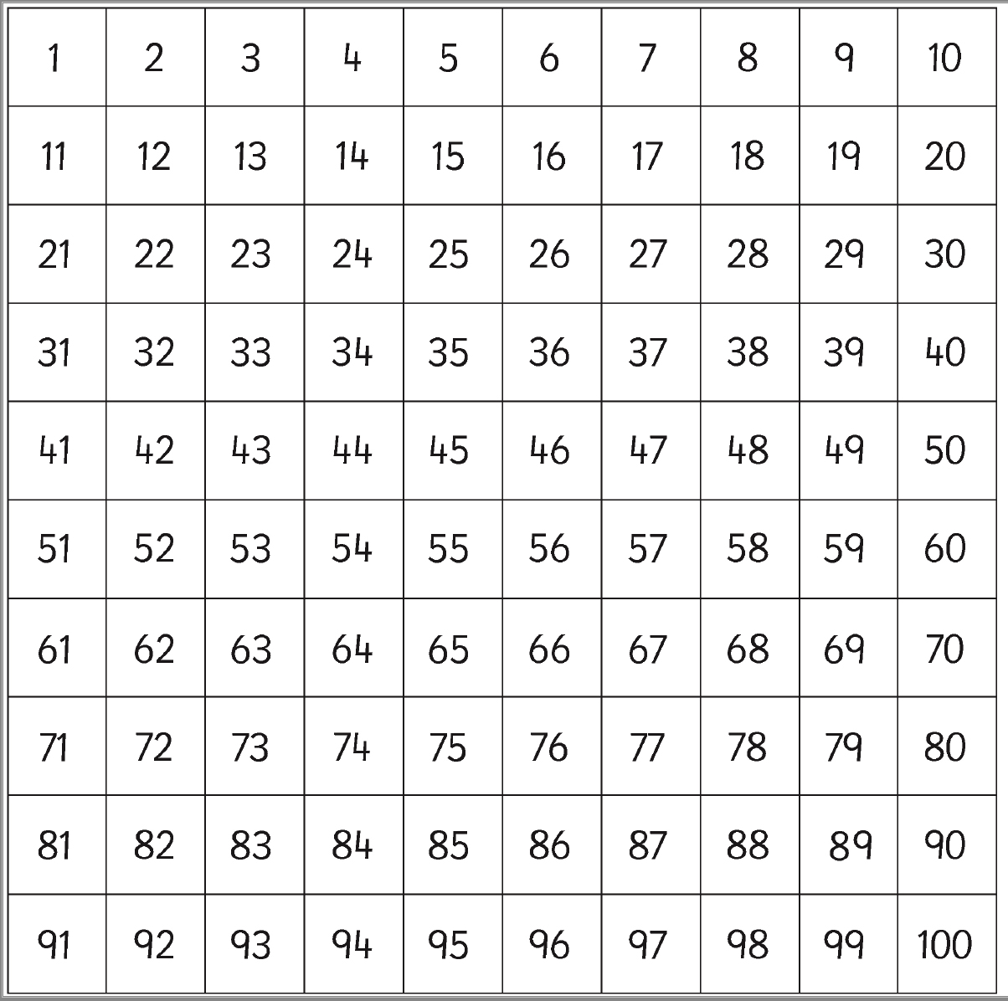
Count in 5s
5 , 10 , 15 , 20 , 25 , 30 , 35 , 40 , 45, 50, 55, 60
Multiples of 5 always end in a 5 or a 0.
Highlight/colour the multiples of 5s

Slide 3
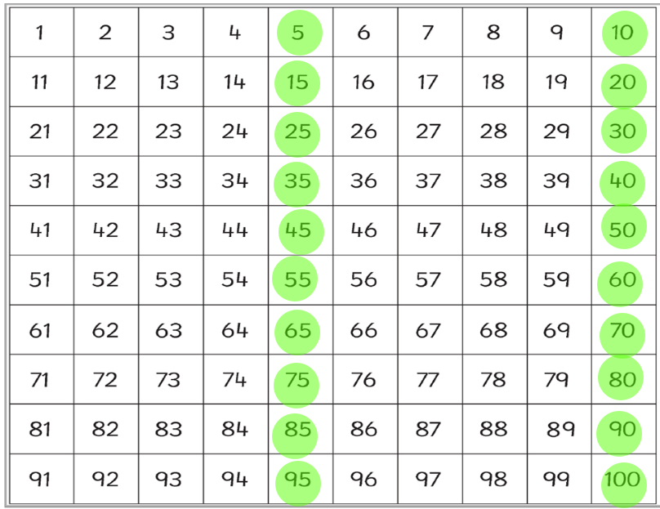
Count in 5s
5 , 10 , 15 , 20 , 25 , 30 , 35 , 40 , 45, 50
Answers – use my hundred square to check your answers.

Slide 4
Fill in the missing numbers …
5 ____ 15 ____ 25 ____ 35 ____ 45 ____
0 ____ ____ 15 20 ____ ____ 35 40 45
10 ____ 20 ____ ____ 35 ____ ____ 50 ____ 60
20 ____ ____ 35 ____ 45 ____ 55 ____ 65 70
40 ____ ____ 55 ____ ____ 70 ____ 80 ____ 90

Slide 5
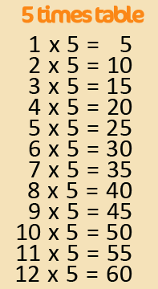
5x Table
Chant your 5 times table to yourself – try different voices like we do in class!

Slide 6
5x Table
Fill in the missing answers to your 5x tables – count in 5’s to help you.
Count in 5’s … 1 time!
Count in 5’s … 3 times!
Count in 5’s…
Count in 5’s…
1 x 5 =
2 x 5 =
3 x 5 =
4 x 5 =
Count in 5’s … 2 times!
Count in 5’s … 4 times!
Count in 5’s…
Count in 5’s…

Slide 7
5x Table
Fill in the missing answers to your 5x tables – count in 5’s to help you.
5 x 5 =
6 x 5 =
7 x 5 =
8 x 5 =
9 x 5 =
10 x 5 =
11 x 5 =
12 x 5 =

Slide 8
5x Table Jumbled Up..
Now have a tried with the sums jumbled up!
4 x 5 =
12 x 5 =
7 x 5 =
3 x 5 =
11 x 5 =
2 x 5 =
2 x 5 =
10 x 5 =
6 x 5 =
9 x 5 =

Slide 9
Challenge!
Have a go at these problems…

Slide 10
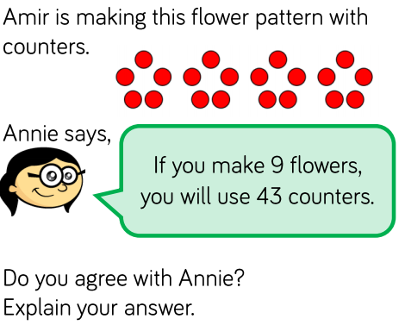
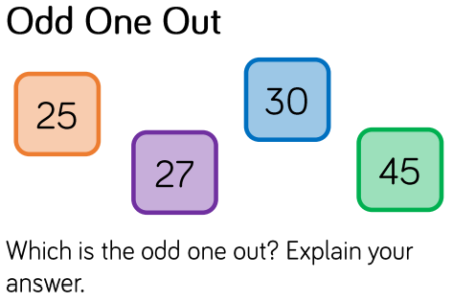
Challenge!
Annie is ___________________ because
The odd one out is ______ because

Slide 11
Tricky Challenge!
Count the flowers, raspberries and blueberries in 5’s when you’ve worked out how many cakes there are!

Slide 12
Date: 06.01.21
LO To be able to recall number bonds to 100.
Subject: Maths

Slide 13
Number Bonds to 100
-
-
10 20 30 40 50 60 70 80 90 100
Count in 10’s to 100 – this will help with your number bonds.

Slide 14
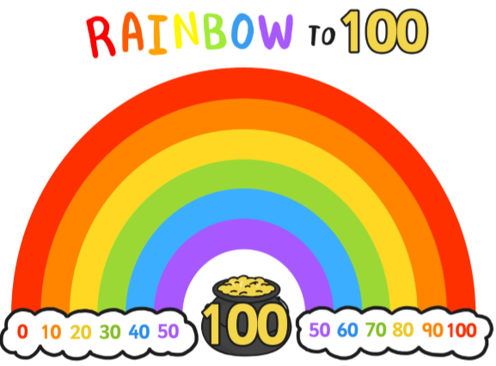
Number Bond Rainbow
Use the rainbow to help you …
Which number goes with 60 to make 100? ______
Which number goes with 10 to make 100? ______

Slide 15
Missing Number Bonds…
Use the 10’s sticks to add to the
60 to make 100…
= 100
60
?

Slide 16
Missing Number Bonds…
Use the 10’s sticks to add to the
60 to make 100…
= 100
80
?

Slide 17
Number Bond Matching
Drag the numbers or draw a line to match the two numbers that make 100.
10
50
50
40
30
90
60
70

Slide 18
Number Bond Matching
Drag the numbers or draw a line to match the two numbers that make 100.
70
80
40
60
90
30
20
10

Slide 19
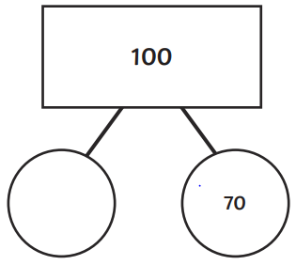
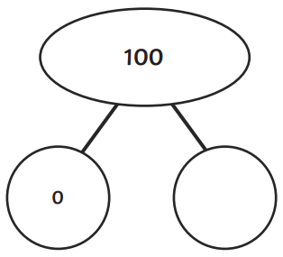
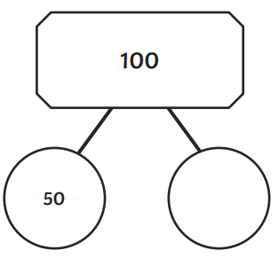
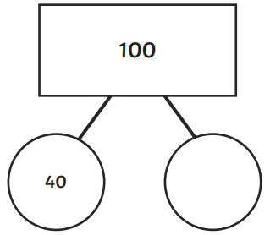
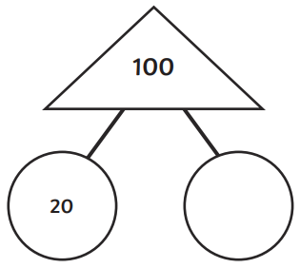
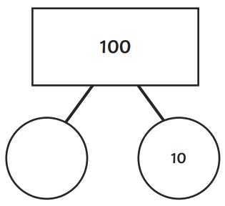
Number Bonds to 100
Fill in the missing number bond to make 100.

Slide 20
Challenge!
Have a go at these problems…

Slide 21
Challenge!

Slide 22
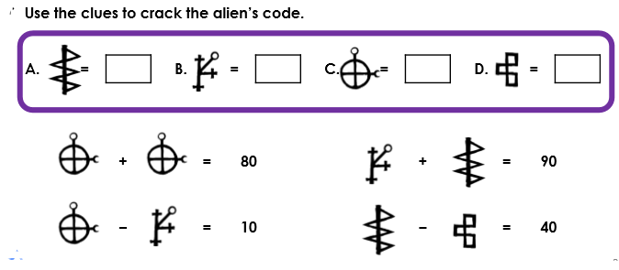
Tricky Challenge!

Slide 23
Date: 07.01.21
LO To be able to add a 2 digit number to a 2 digit number.
Subject: Maths

Slide 24
Count up the counters, start with your tens
and then move to your ones…
Tens and Ones …
T O T O T O
12 + 14 =
2 6
10
1
10
1
1
1
1
1
Count… 10, 20, 21, 22, 23, 24, 25, 26

Slide 25
Tens and Ones …
T O T O T O
45 + 23 =
10
1
10
1
10
1
10
1
10
1
1
Count up your tens and ones and
write your answer here!
10
1
1

Slide 26
Tens and Ones …
T O T O T O
62 + 17 =
This time draw the
tens and ones yourself…
Count up your tens and ones and
write your answer here!

Slide 27
Try yourself…
Don’t forget, you can draw your tens and ones to help you!
1. 24 + 43 =
4. 51 + 46 =
2. 31 + 37 =
5. 30 + 59 =
3. 43 + 34 =
6. 66 + 33 =

Slide 28
Mentally …
T O T O T O
45 + 24 = 69
6 tens
9 ones

Slide 29
Try these mentally …
1. 53 + 41 =
2. 44 + 52 =
3. 32 + 37 =

Slide 30
Challenge!
Have a go at these problems…

Slide 31
Challenge!
Write these as numbers rather than words…

Slide 32
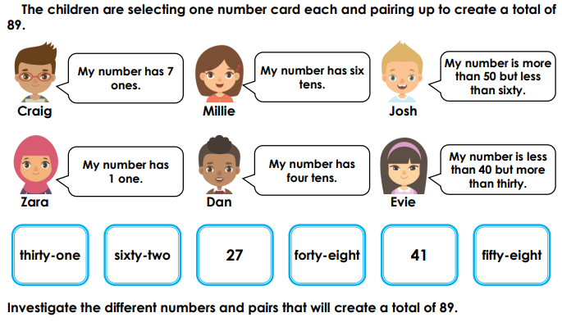
Challenge!
Write the children’s name inside the blue number box.

Slide 33
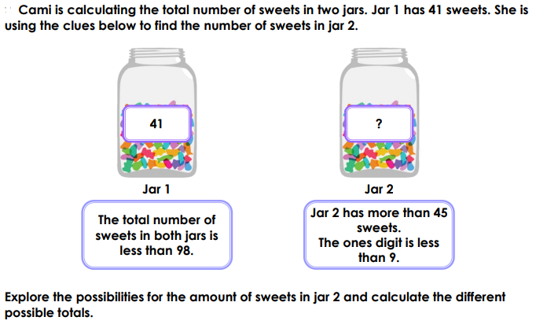
Tricky Challenge!

Slide 34
Date: 08.01.21
LO To be able to count with money.
Subject: Maths

Slide 35
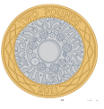
Coins
Match the coins to their amounts…
1p 20p £1 5p 50p £2 10p 2p

Slide 36
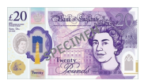
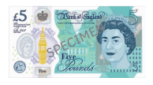
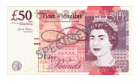
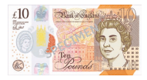
Notes
Match the notes to their amounts…
£5 £10 £50 £20

Slide 37
Counting Money
When it is 1p coins or £1 coins, you only need to count in ones.
= 6p
1p 1p 1p 1p 1p 1p
=
1p 1p 1p 1p
Remember you need to write ‘p’ or ‘£’.

Slide 38
Counting Money
When it is 1p coins or £1 coins, you only need to count in ones.
=
1p 1p 1p 1p 1p 1p 1p 1p
=
£1 £1 £1 £1
Remember you need to write ‘p’ or ‘£’.

Slide 39
Counting Money
Count in 5’s this time!
=
5p 5p 5p 5p
=
5p 5p 5p 5p 5p 5p
Remember you need to write ‘p’ or ‘£’.

Slide 40
Counting Money
=
10p 10p 10p 10p 10p
Remember you need to write ‘p’ or ‘£’.

Slide 41
Counting Money
=
10p 10p 1p 1p 10p
Remember you need to write ‘p’ or ‘£’.

Slide 42
Counting Money
=
10p 50p 1p 1p 20p
Remember you need to write ‘p’ or ‘£’.

Slide 43
Challenge!
Have a go at these problems…

Slide 44
Counting Money
Write the amounts under the coins to help you!
=
£2.23
Drag the box to see the answer!
=
£6.72
Drag the box to see the answer!

Slide 45
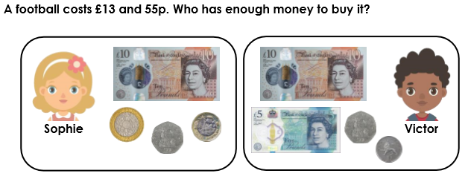
Challenge

Slide 46
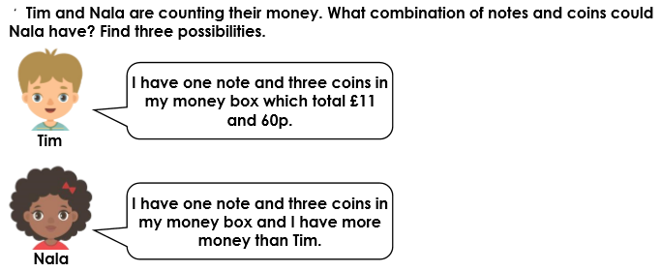
Tricky Challenge

