Slide 1
Monday 12th July
Pioneer’s Home Learning Tasks

Slide 2
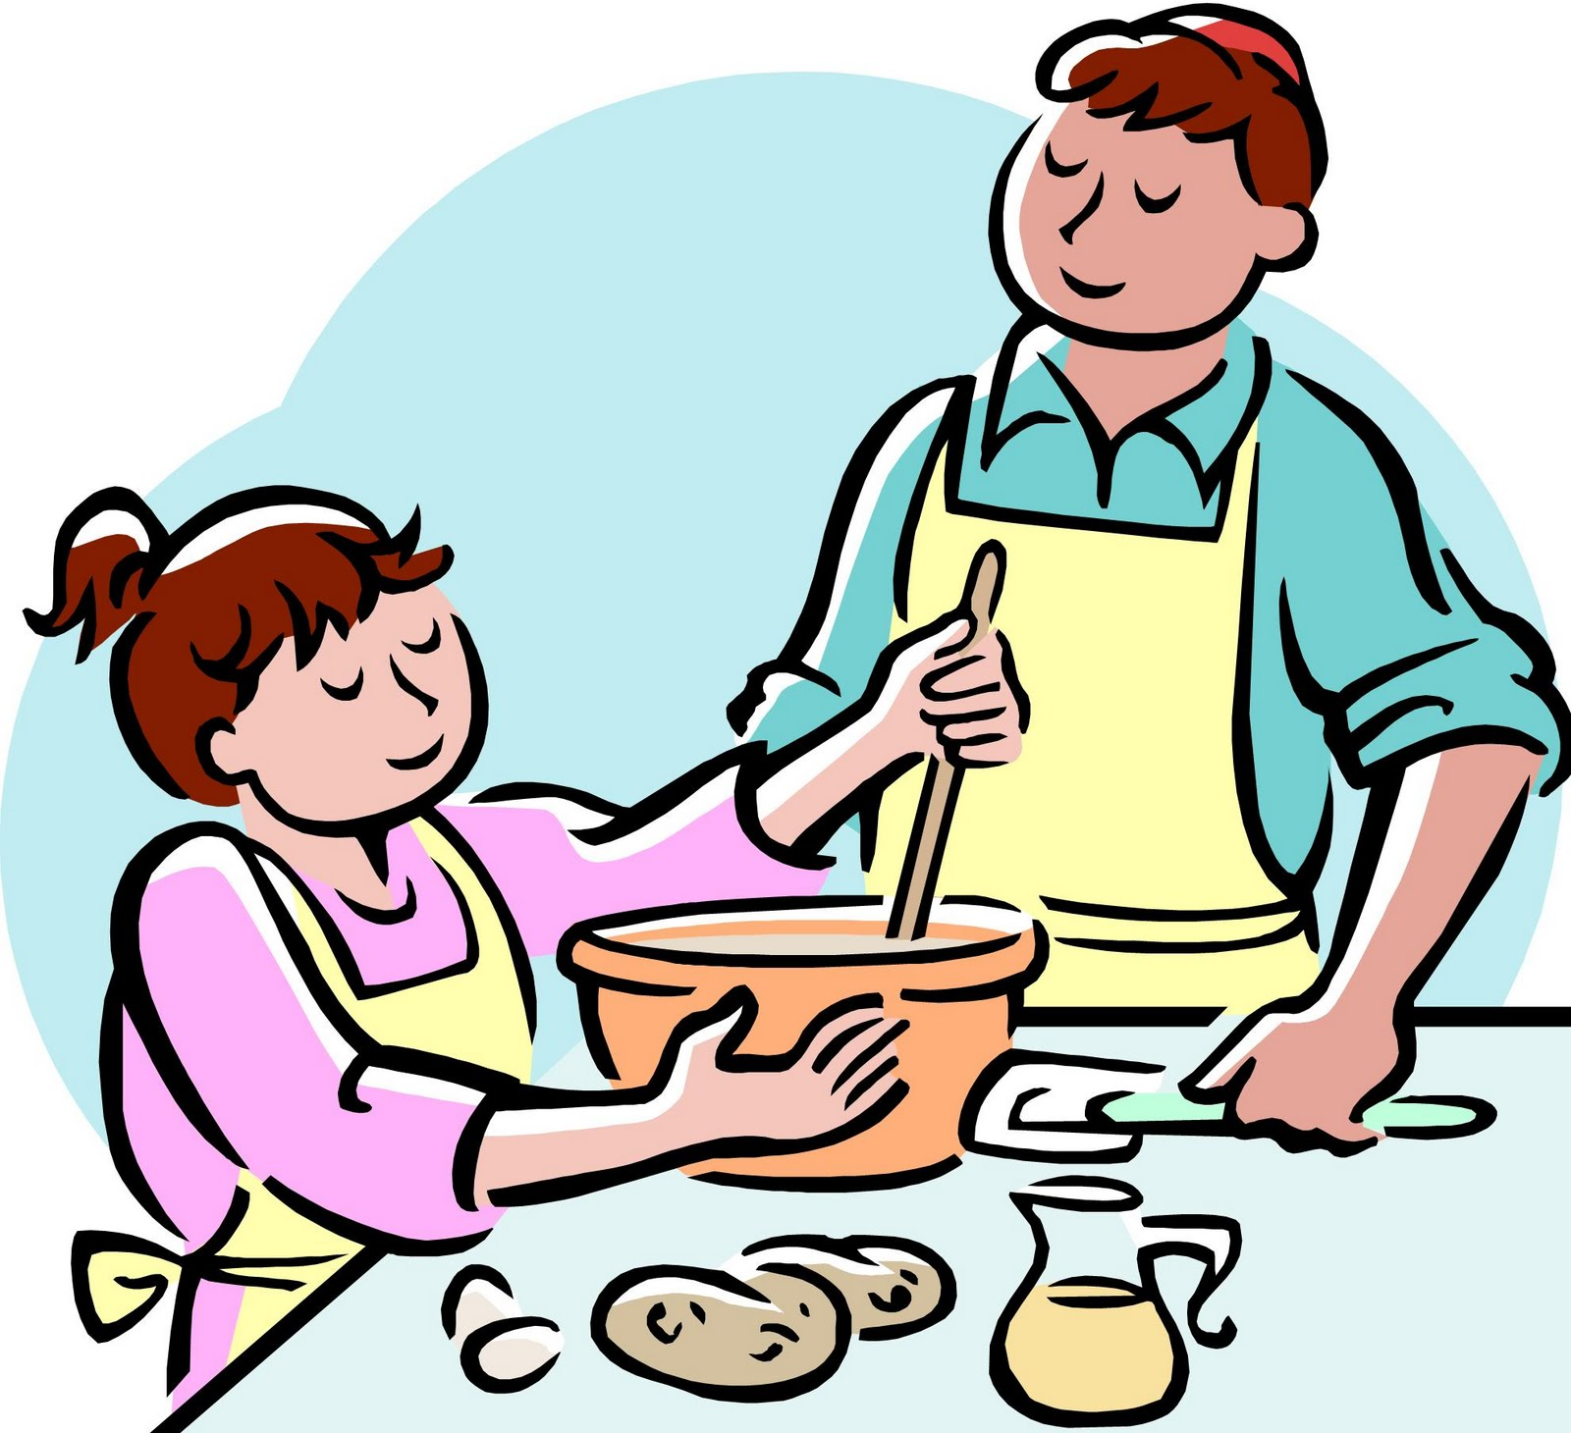
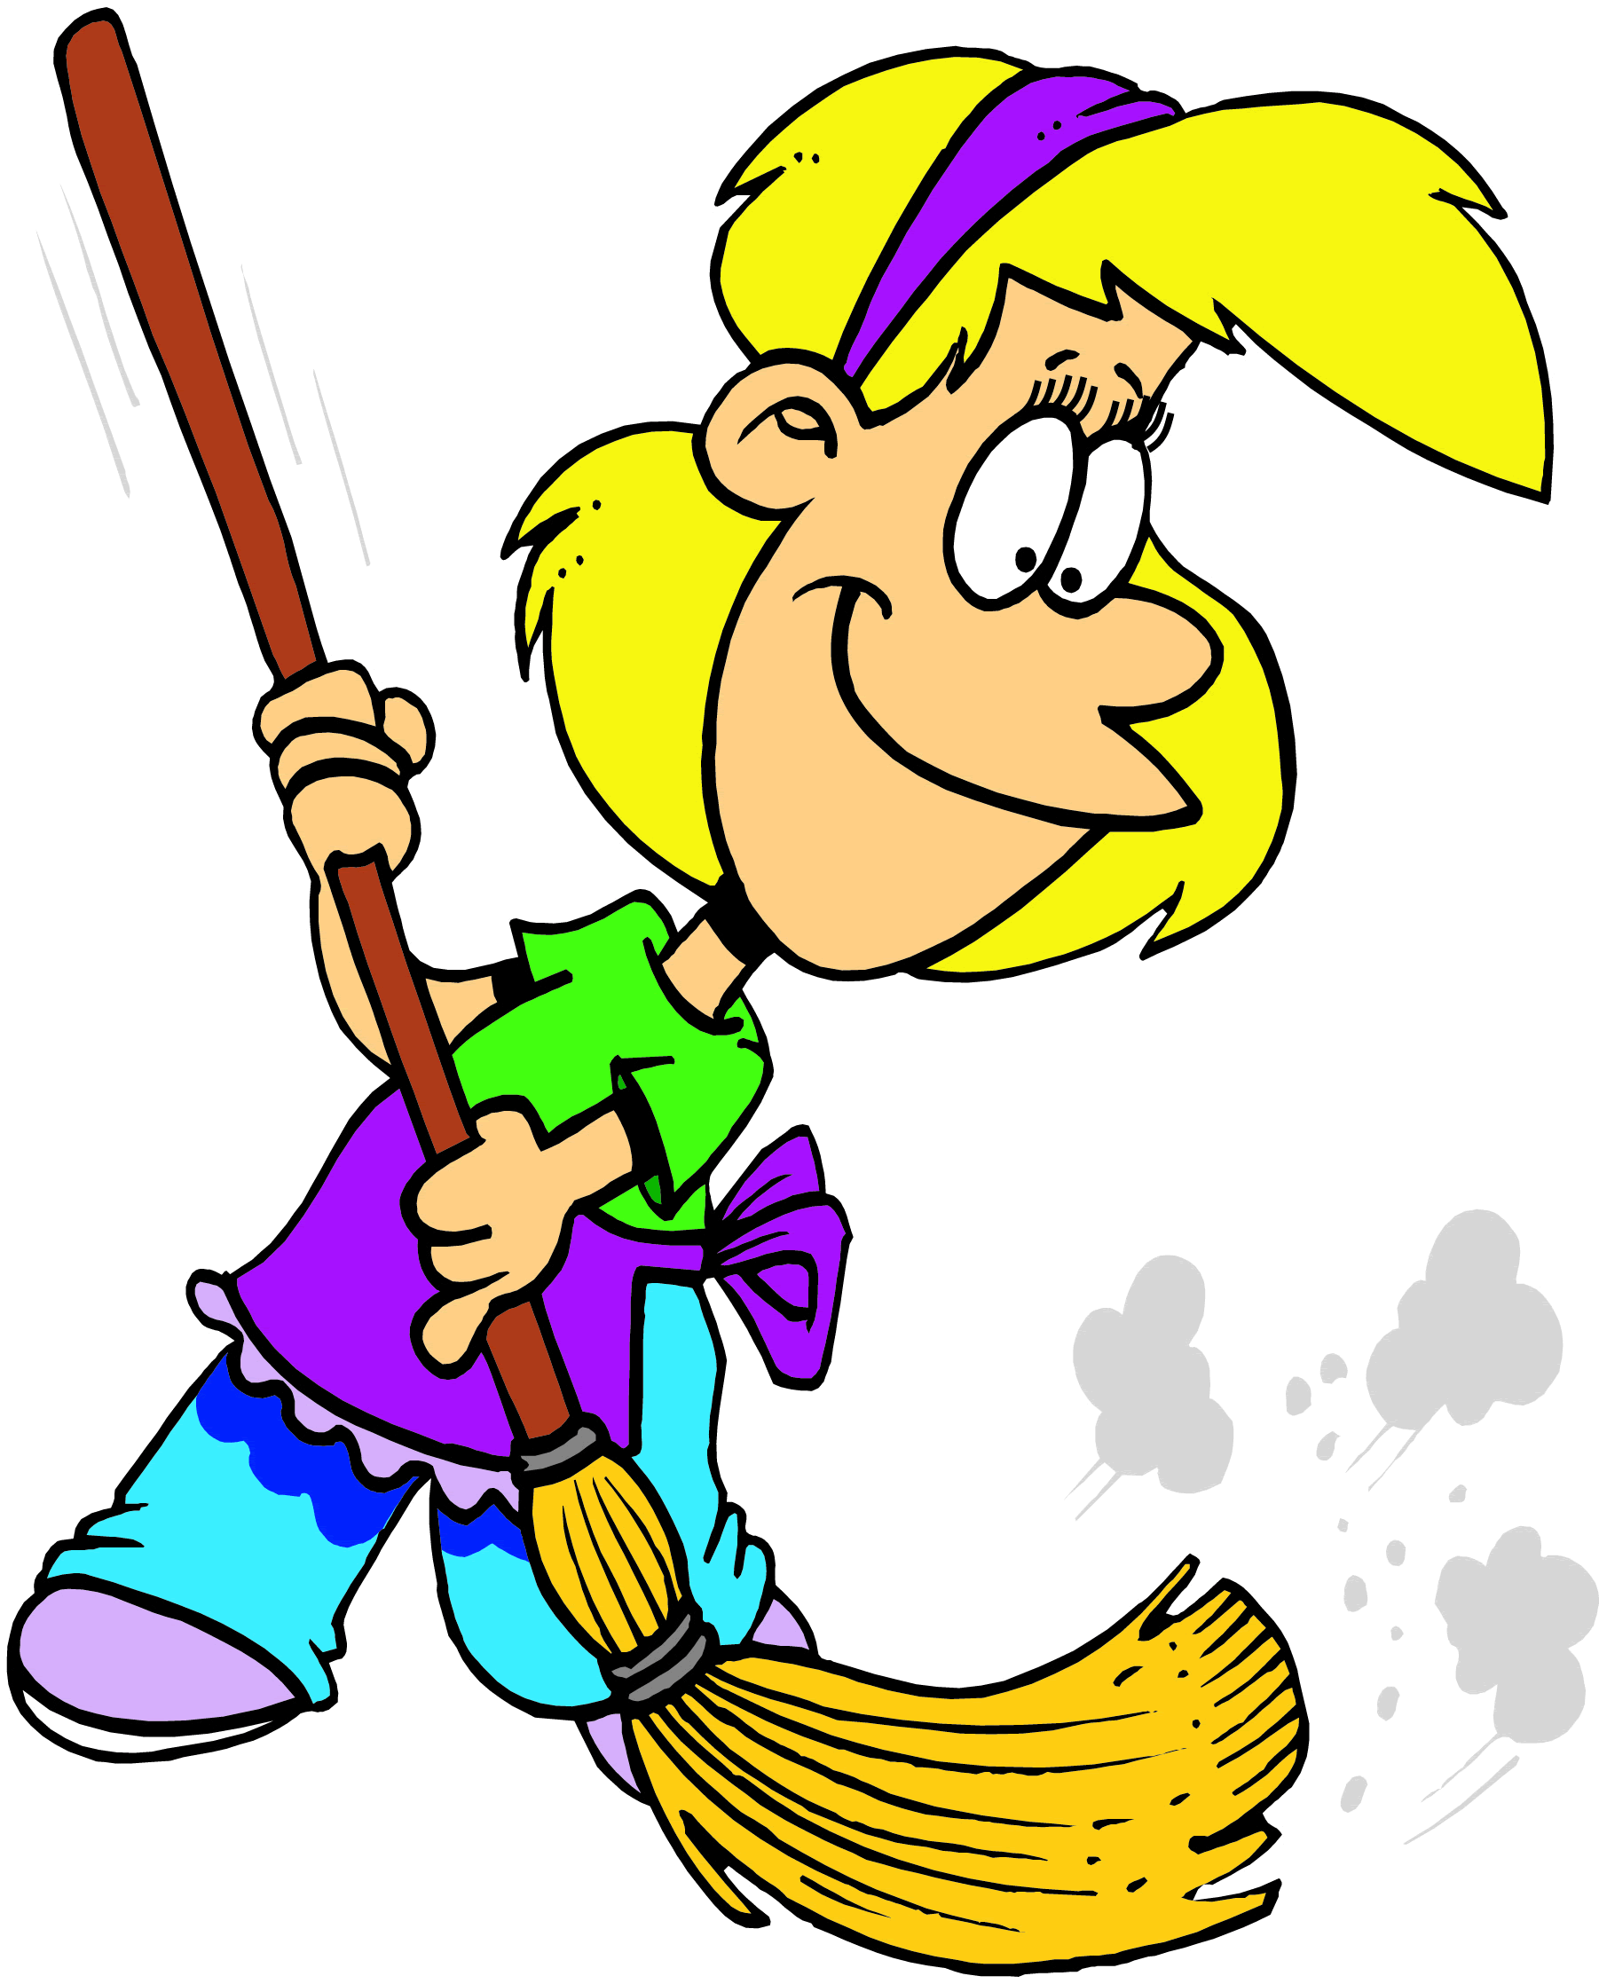
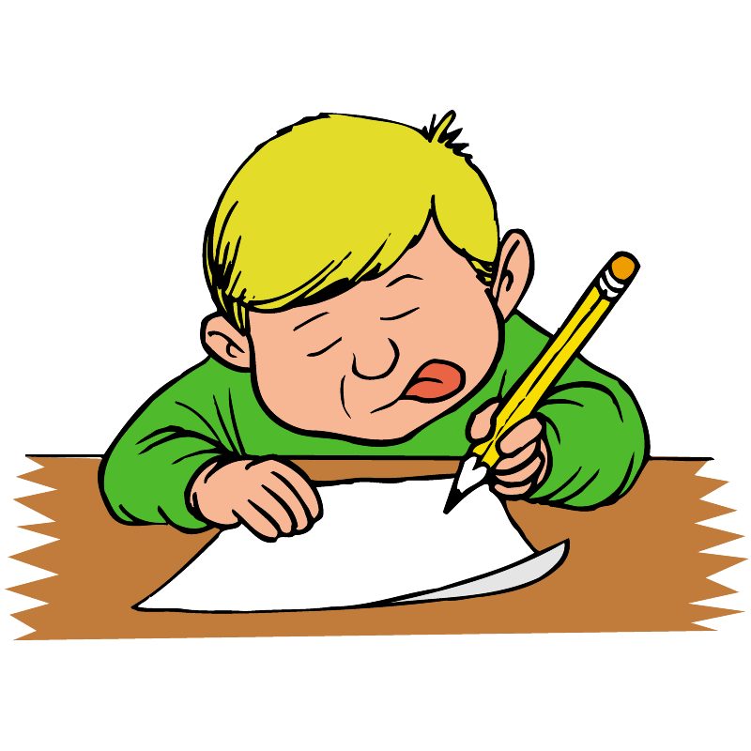
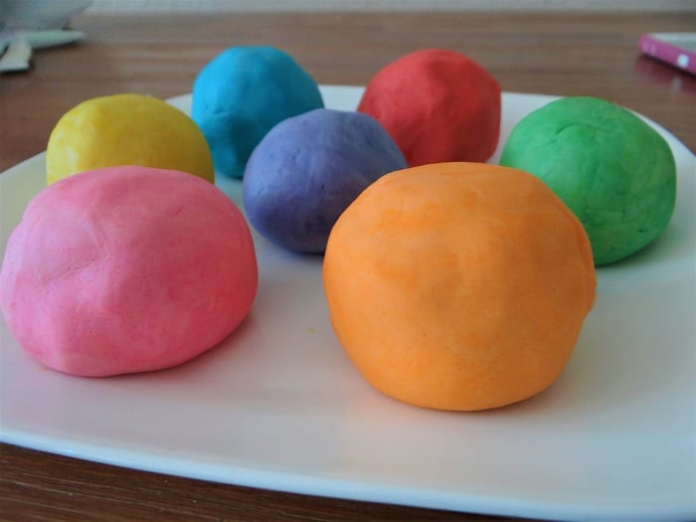
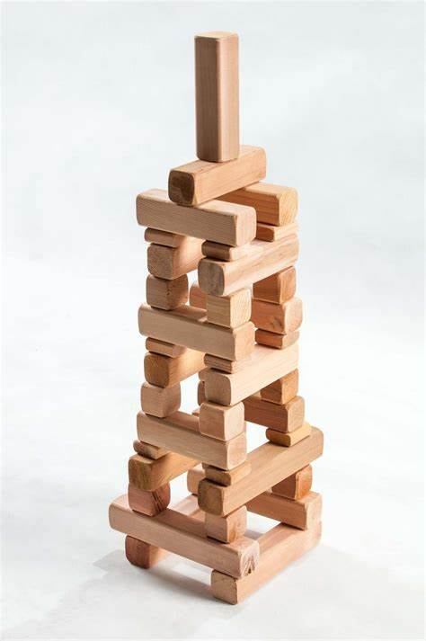
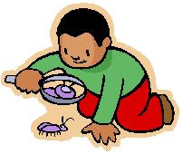
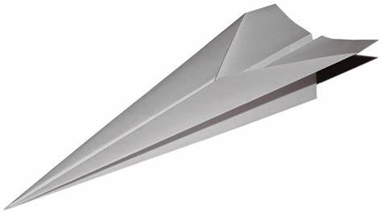
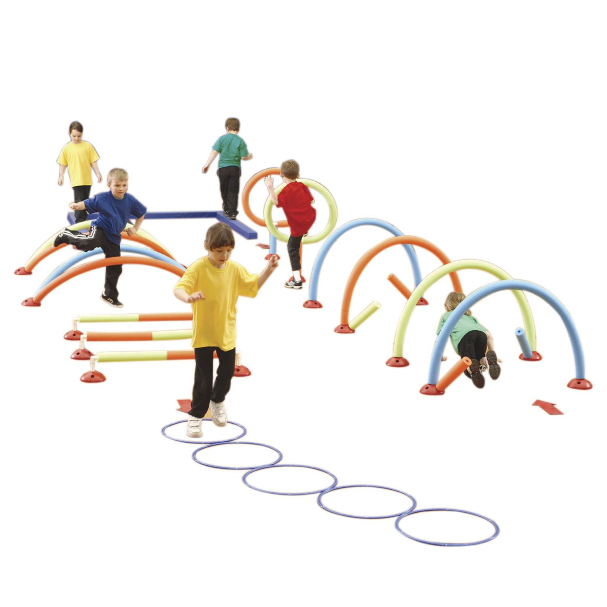
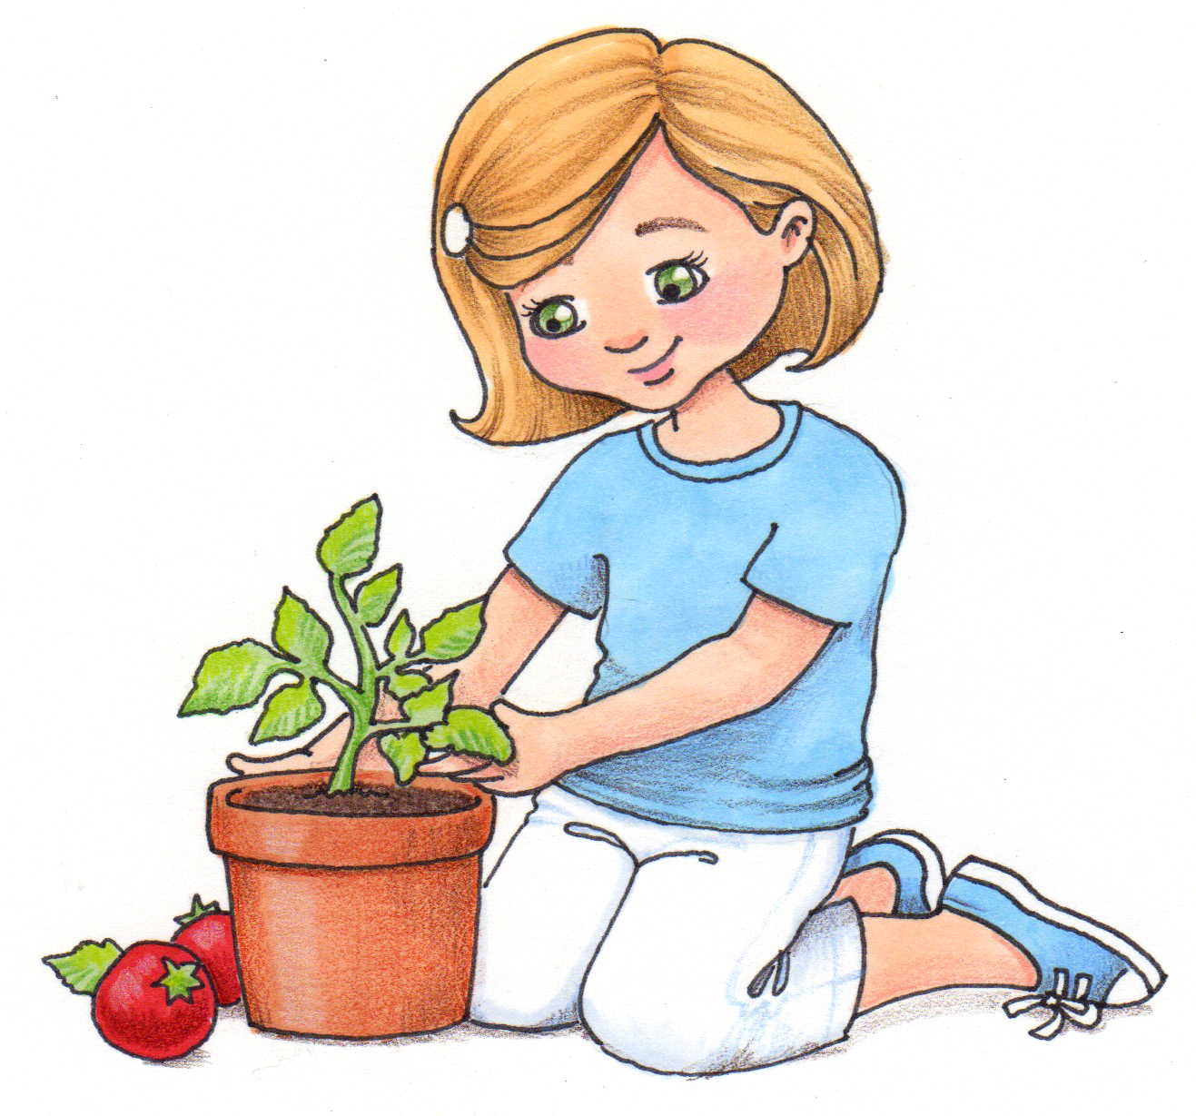
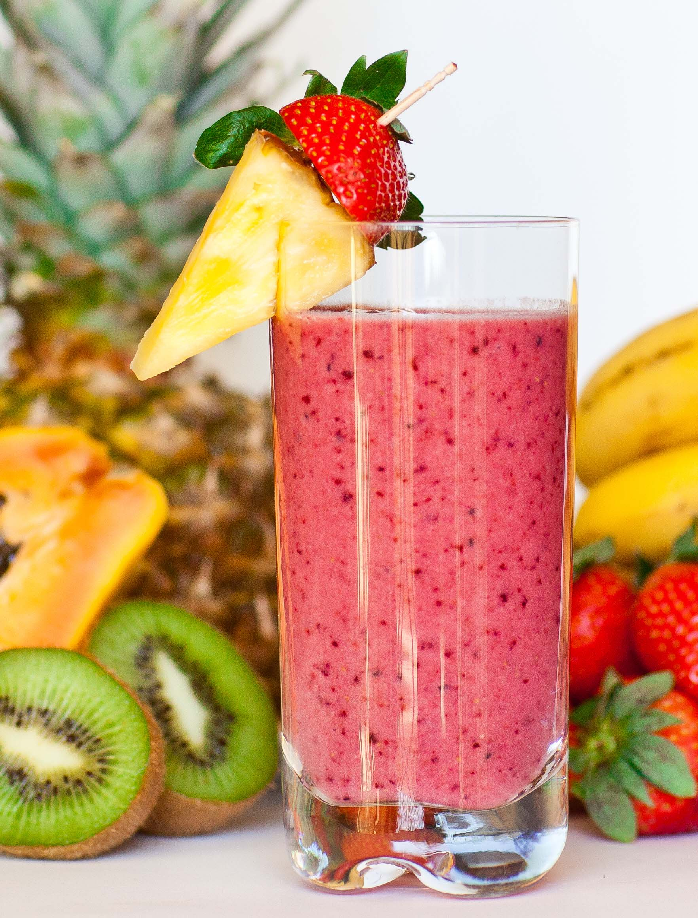
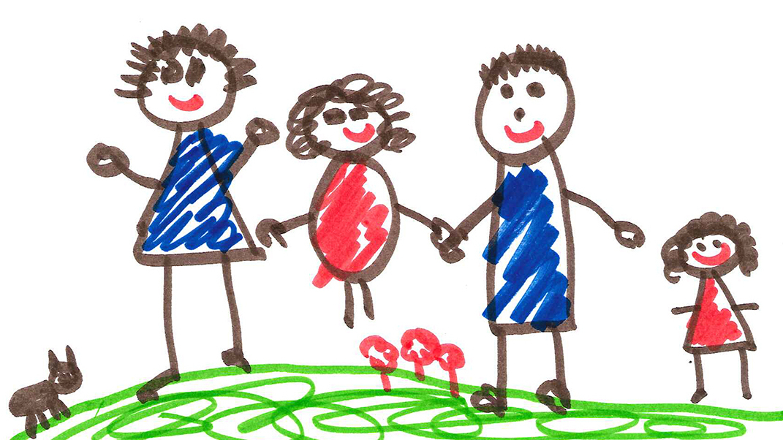
Home Learning Bingo
How many of these activities can you complete this week?
Watch an episode of Newsround | Write your numbers to 50 *Challenge to 100* | Read a book | Follow a recipe to bake/cook something | Help a grown up with a chore around the house
Write your own story | 15 minutes of non stop exercise | Make your own play dough | Practice counting in 2s, 5s and 20s by taking steps up the stairs | Build something taller than you and measure the height
Find an object around the house beginning with every letter of the alphabet | Go on a mini beast hunt in the garden | Write down the alphabet | Complete a jigsaw | Have a paper airplane challenge with your family. Whose plane can fly the best?
Create an obstacle course | Name the months of the year in the correct order | Make a fruit smoothie with a grown up | Plant something | Draw a picture of your family
I would love to see photos of you taking part in some of these activities!

Slide 3
Daily Maths Challenge
Maths Challenge A
5 + 3 =
4 + 5 =
5 + 5 =
7 + 0 =
10 + 3 =
13 + 6 =
15 + 2 =
18 + 1 =
10 + 10 =
13 + 4 =
11. 11 + 3 =
12. 12 + 8 =
13. 19 + 1 =
14. 0 + 16 =
15. 11 + 5 =
16. 14 + 4 =
17. 11 + 2 =
18. 1 + 14 =
19. 4 + 12 =
20. 5 + 13 =
If you think this task was easy try Maths Challenge B on the next slide!

Slide 4
Daily Maths Challenge
Maths Challenge B
20 + 3 =
41 + 5 =
53 + 5 =
70 + 0 =
33 + 10 =
23 + 6 =
45 + 2 =
78 + 1 =
61 + 10 =
43 + 4 =
11. 61 + 3 =
12. 42 + 8 =
13. 29 + 1 =
14. 0 + 19 =
15. 71 + 5 =
16. 84 + 4 =
17. 38 + 2 =
18. 68 + 1 =
19. 43 + 5 =
20. 58 + 2 =
If you found Maths Challenge A easy, have a go at this task!

Slide 5
Euros 2020!
For the first time ever, England competed in the finals of the Euros football competition!
Yesterday, Sunday 11th July England competed against Italy in the final at Wembley!
To celebrate the teams success we are going to complete some football themed activities

Slide 6
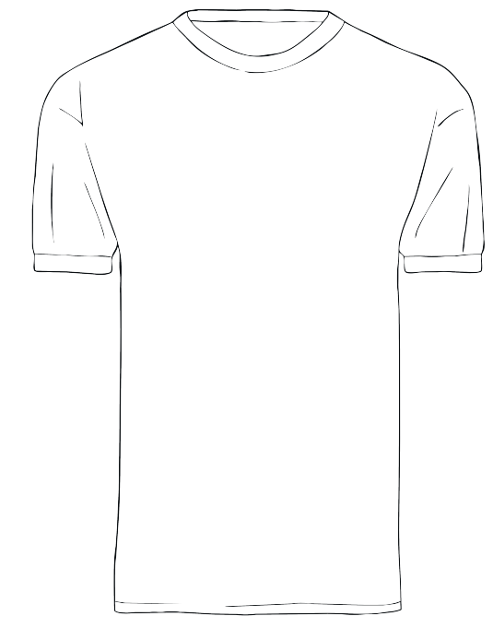
Task 1 – Design a football shirt!

Slide 7
Task 2 – Design a flag!

Slide 8
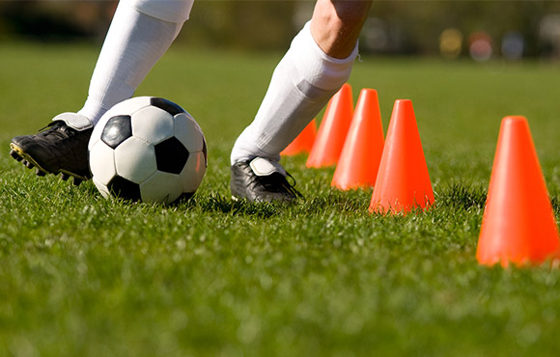
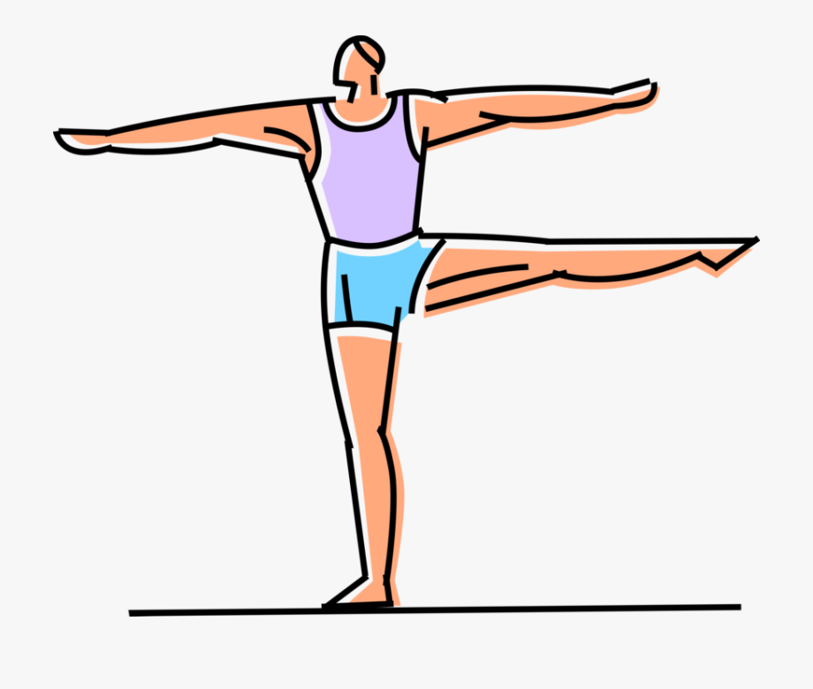
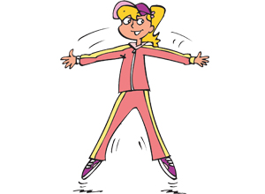
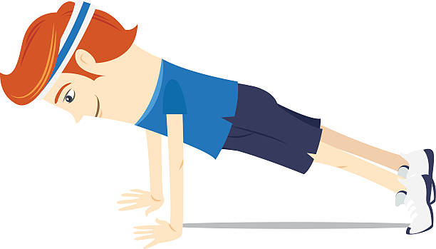
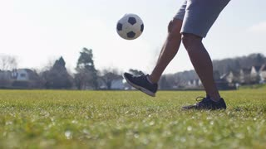
Task 3 – Football skills!
Are you as fit as a footballer? Test your fitness skills!
Go in your garden or find a safe space in your house to complete the activities:
Jog on the spot for 1 minute!
Dribble the ball
(practice running with the ball)
Challenge:
How many kick ups can you do?
Balance on one leg for 10 seconds!
Do 10 press ups!
Jump up and down for 20 seconds
Do 10 star jumps!

Slide 9
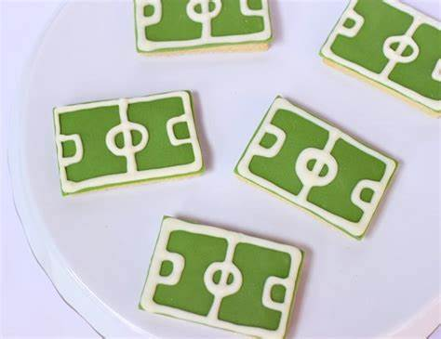
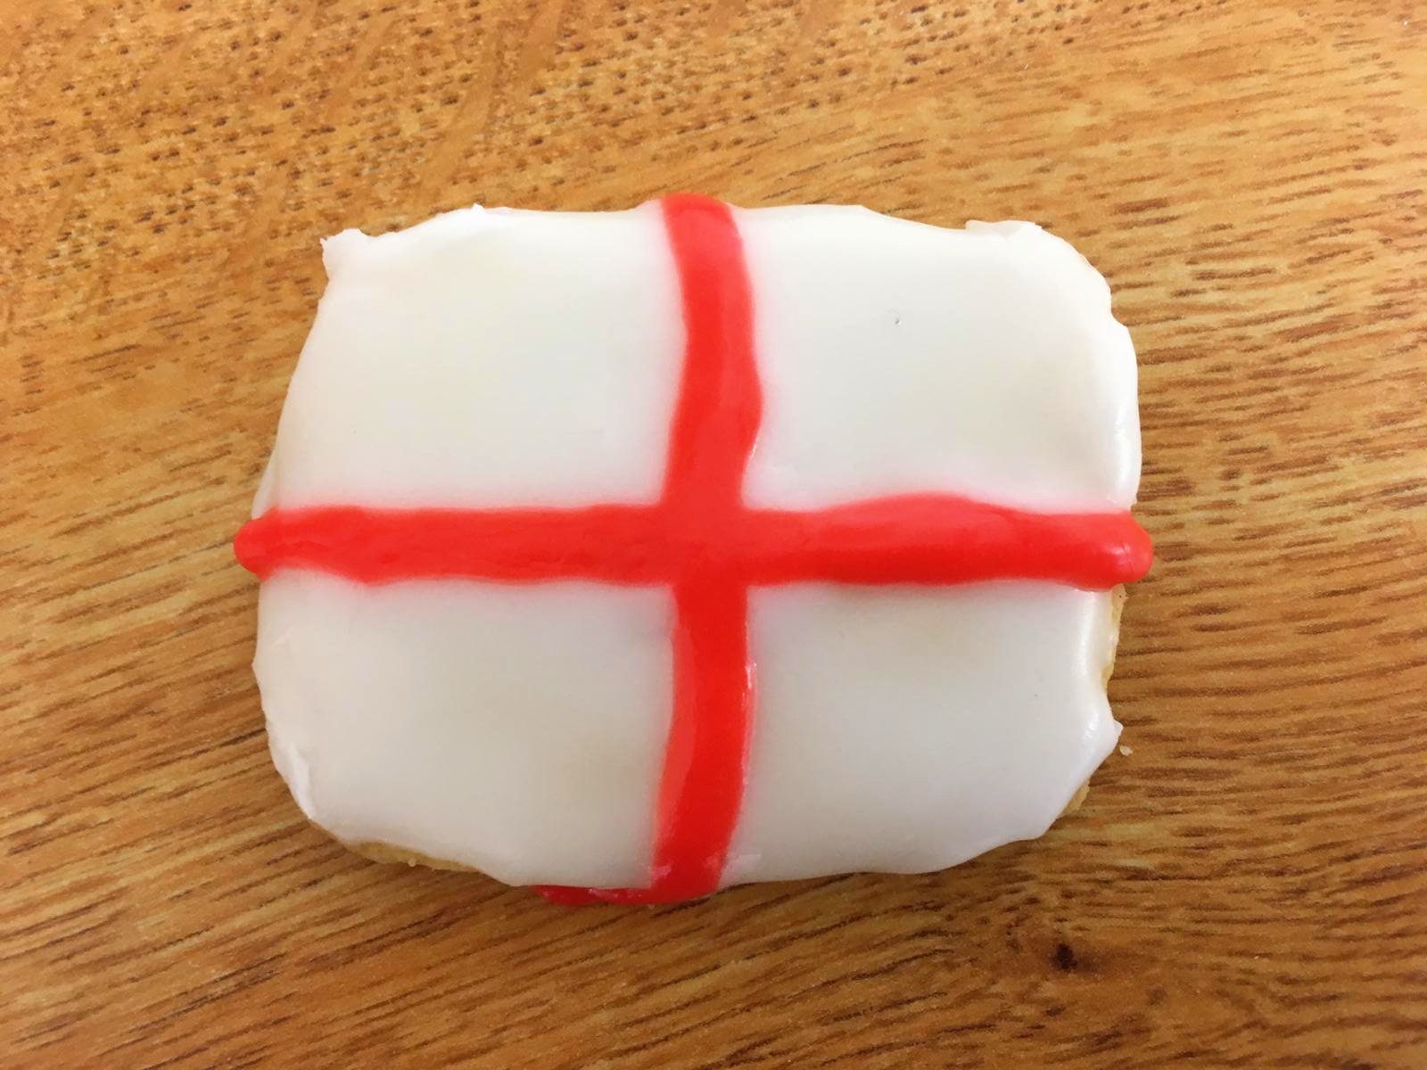
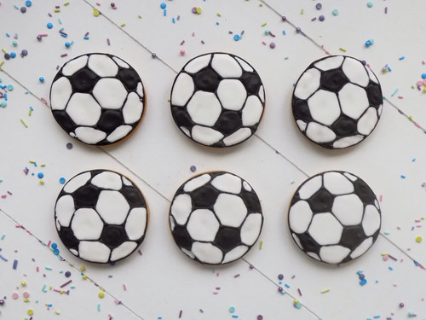
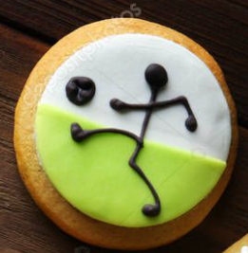
Task 4 – Decorate some biscuits!
If you have some icing at home you could decorate some biscuits and make them football themed!
If you don’t have icing you could use: jam, ice cream sauce or sweets!

Slide 10
Well done for all of your hard work today!
I would love to see a picture of your football shirt!
It would be great to see a picture of you taking part in the fitness challenge!
I would love to see a picture of your decorated biscuits!
I would love to see a picture of your flag design!
Please send your completed work for this session to: pioneerspupils@gmail.com

Slide 11
Tuesday 13th July
Pioneer’s Home Learning Tasks

Slide 12
Daily Maths Challenge
Maths Challenge A
5 - 3 =
6 - 1 =
4 - 2 =
7 - 5 =
10 - 4 =
9 - 6 =
5 - 4 =
8 - 0 =
6 - 6 =
3 - 3 =
11. 14 - 3 =
12. 12 - 1 =
13. 16 - 4 =
14. 17 - 6 =
15. 19 - 5 =
16. 20 - 4 =
17. 17 - 7 =
18. 15 - 15 =
19. 18 - 0 =
20. 17 - 5 =
If you think this task was easy try Maths Challenge B on the next slide!

Slide 13
Daily Maths Challenge
Maths Challenge B
20 - 3 =
18 - 5 =
23 - 2 =
37 - 6 =
39 - 9 =
27 - 0 =
57 - 5 =
78 - 4 =
94 - 1=
43 - 2 =
11. 67 - 3 =
12. 46 - 4 =
13. 69 - 7 =
14. 45 - 10 =
15. 77 - 5 =
16. 88 - 4 =
17. 38 - 7 =
18. 68 - 8 =
19. 43 - 0 =
20. 58 - 6 =
If you found Maths Challenge A easy, have a go at this task!

Slide 14
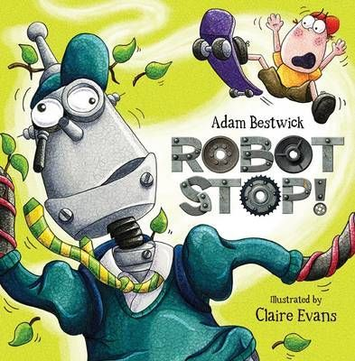
Robot Stop!
Today our activities are going to be based on the story ‘Robot Stop’.
Click on the link below to listen to the story online:
Robot Stop! - Give Us A Story! - YouTube
If you are unable to watch the video online you can read the story on slides
14 - 36

Slide 15
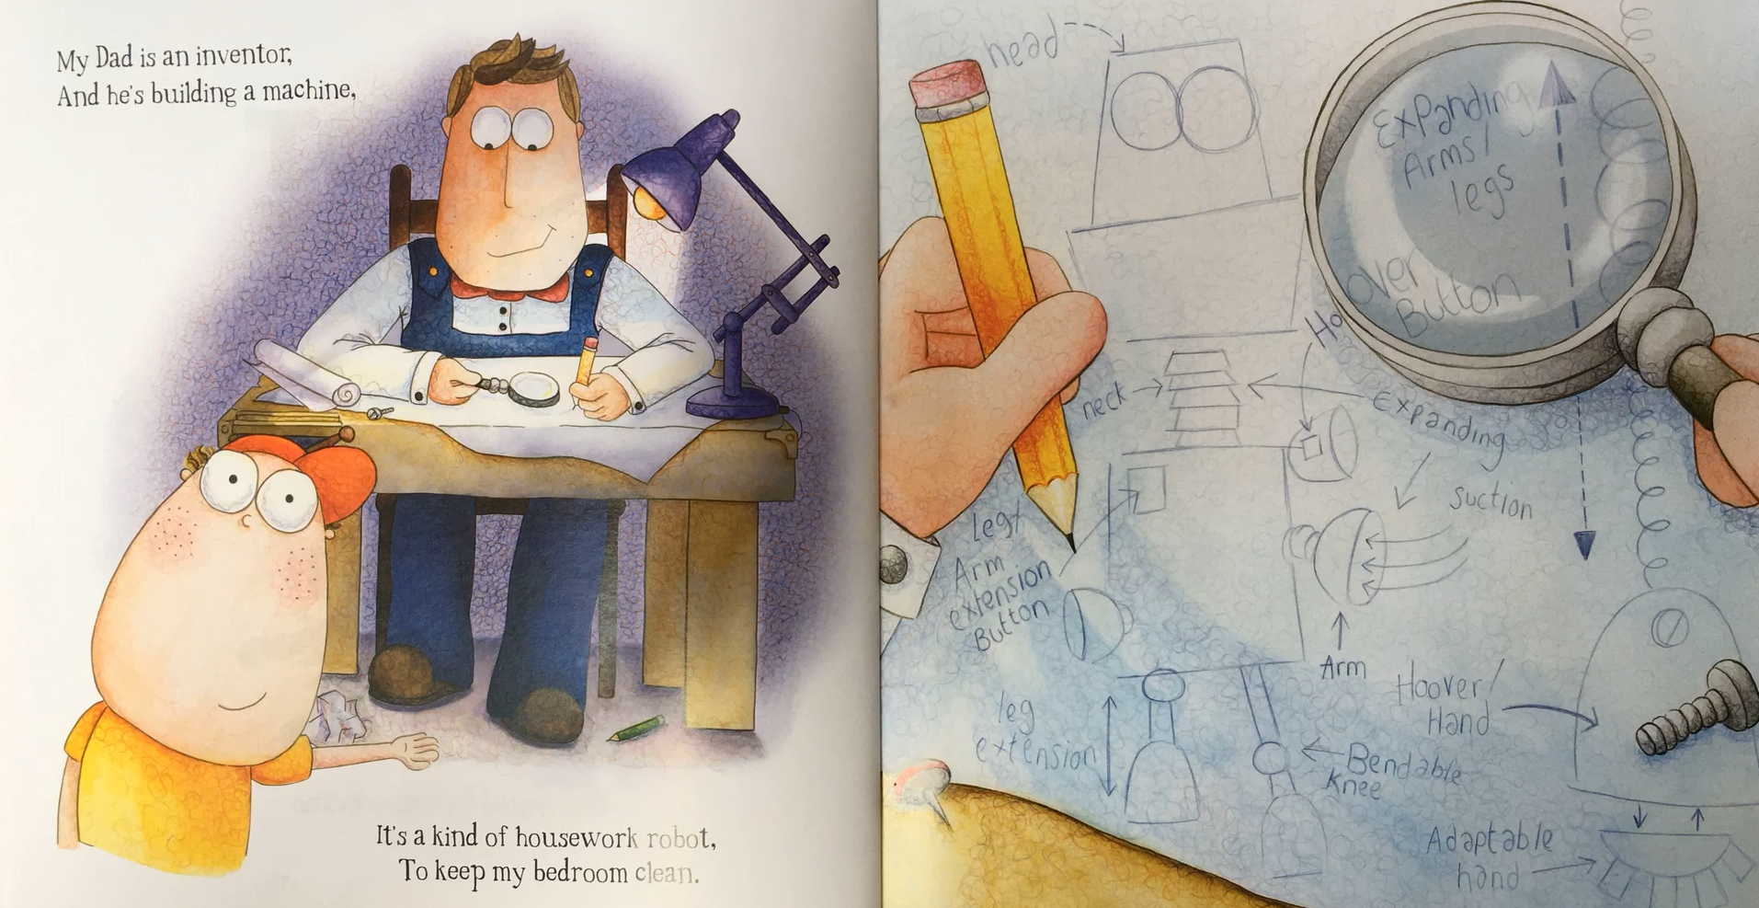

Slide 16
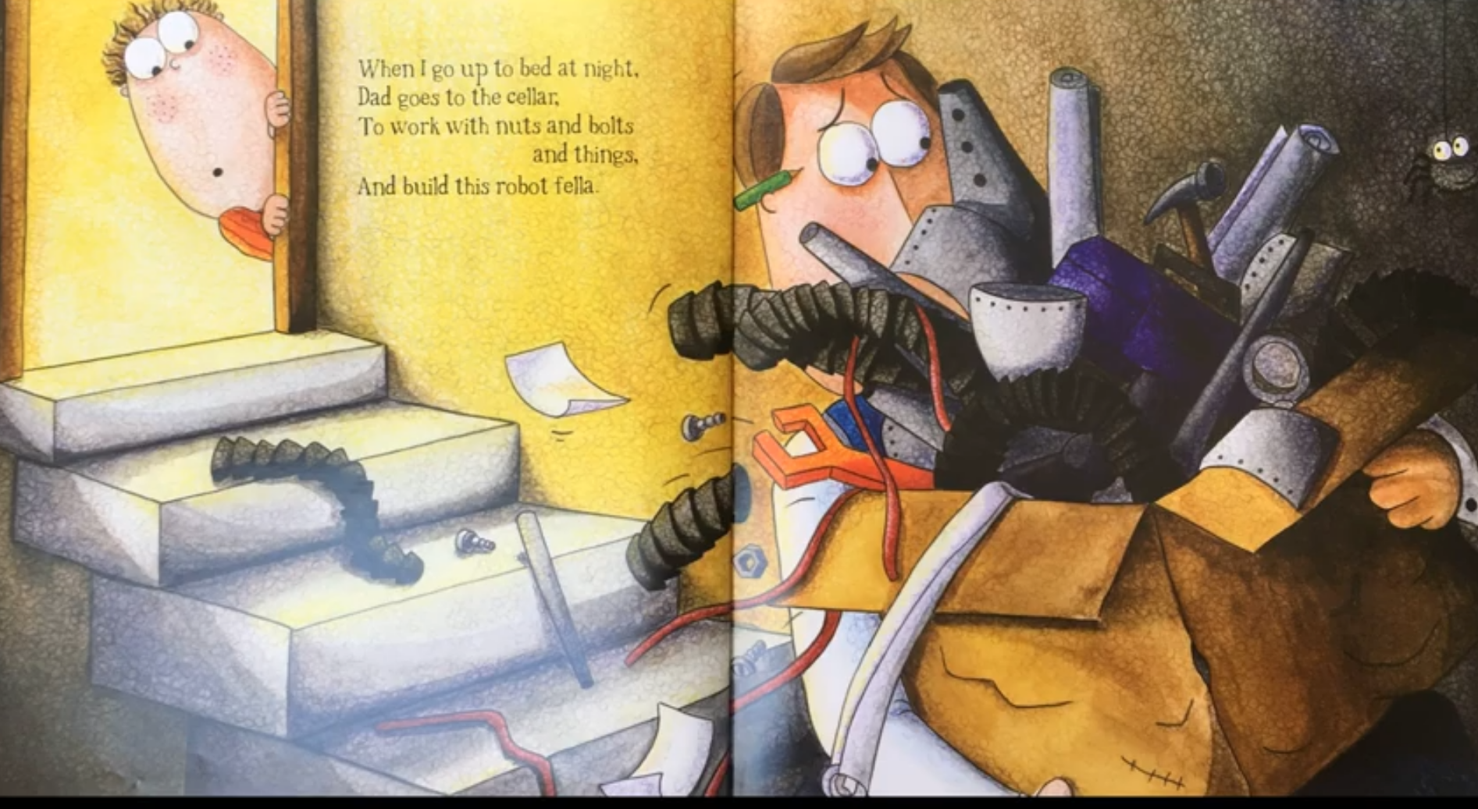

Slide 17
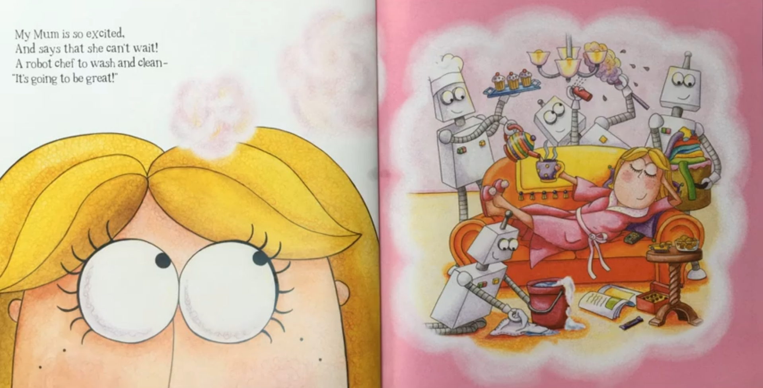

Slide 18
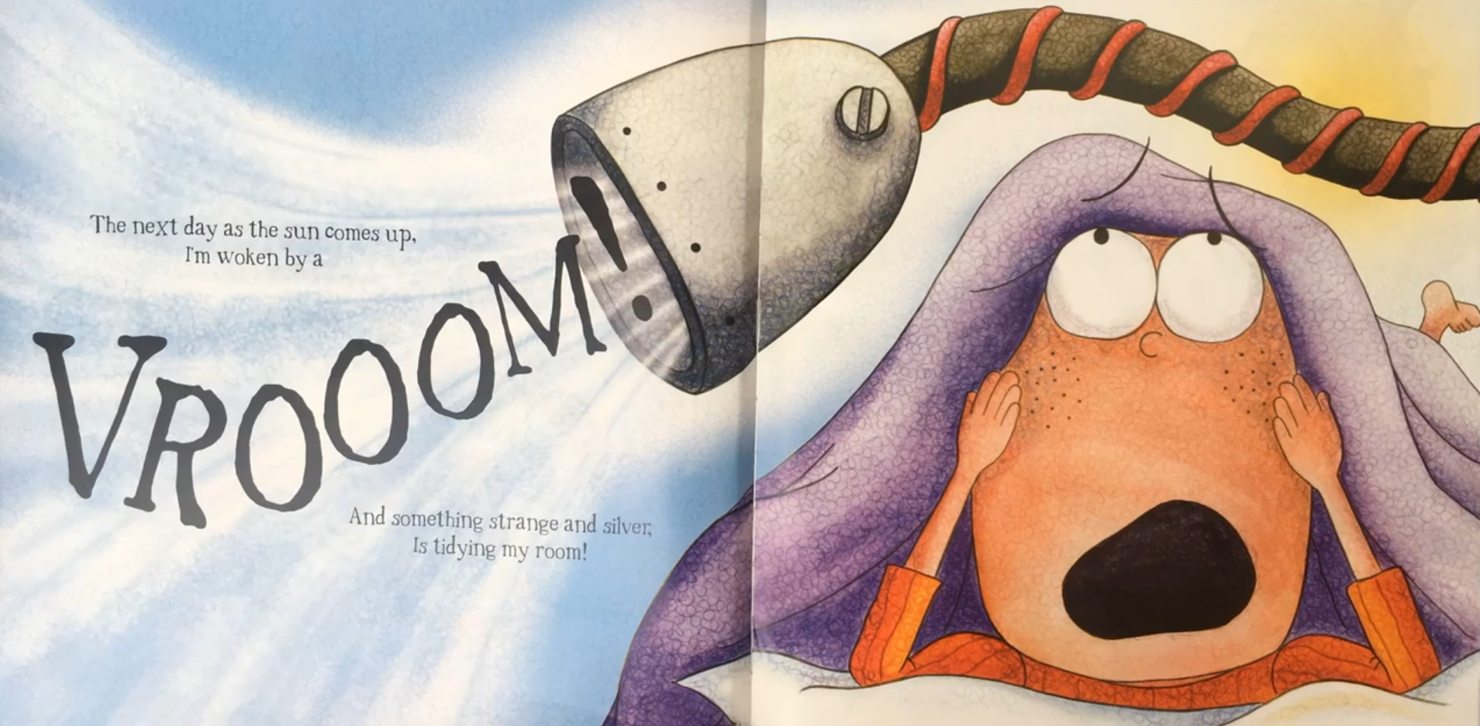

Slide 19
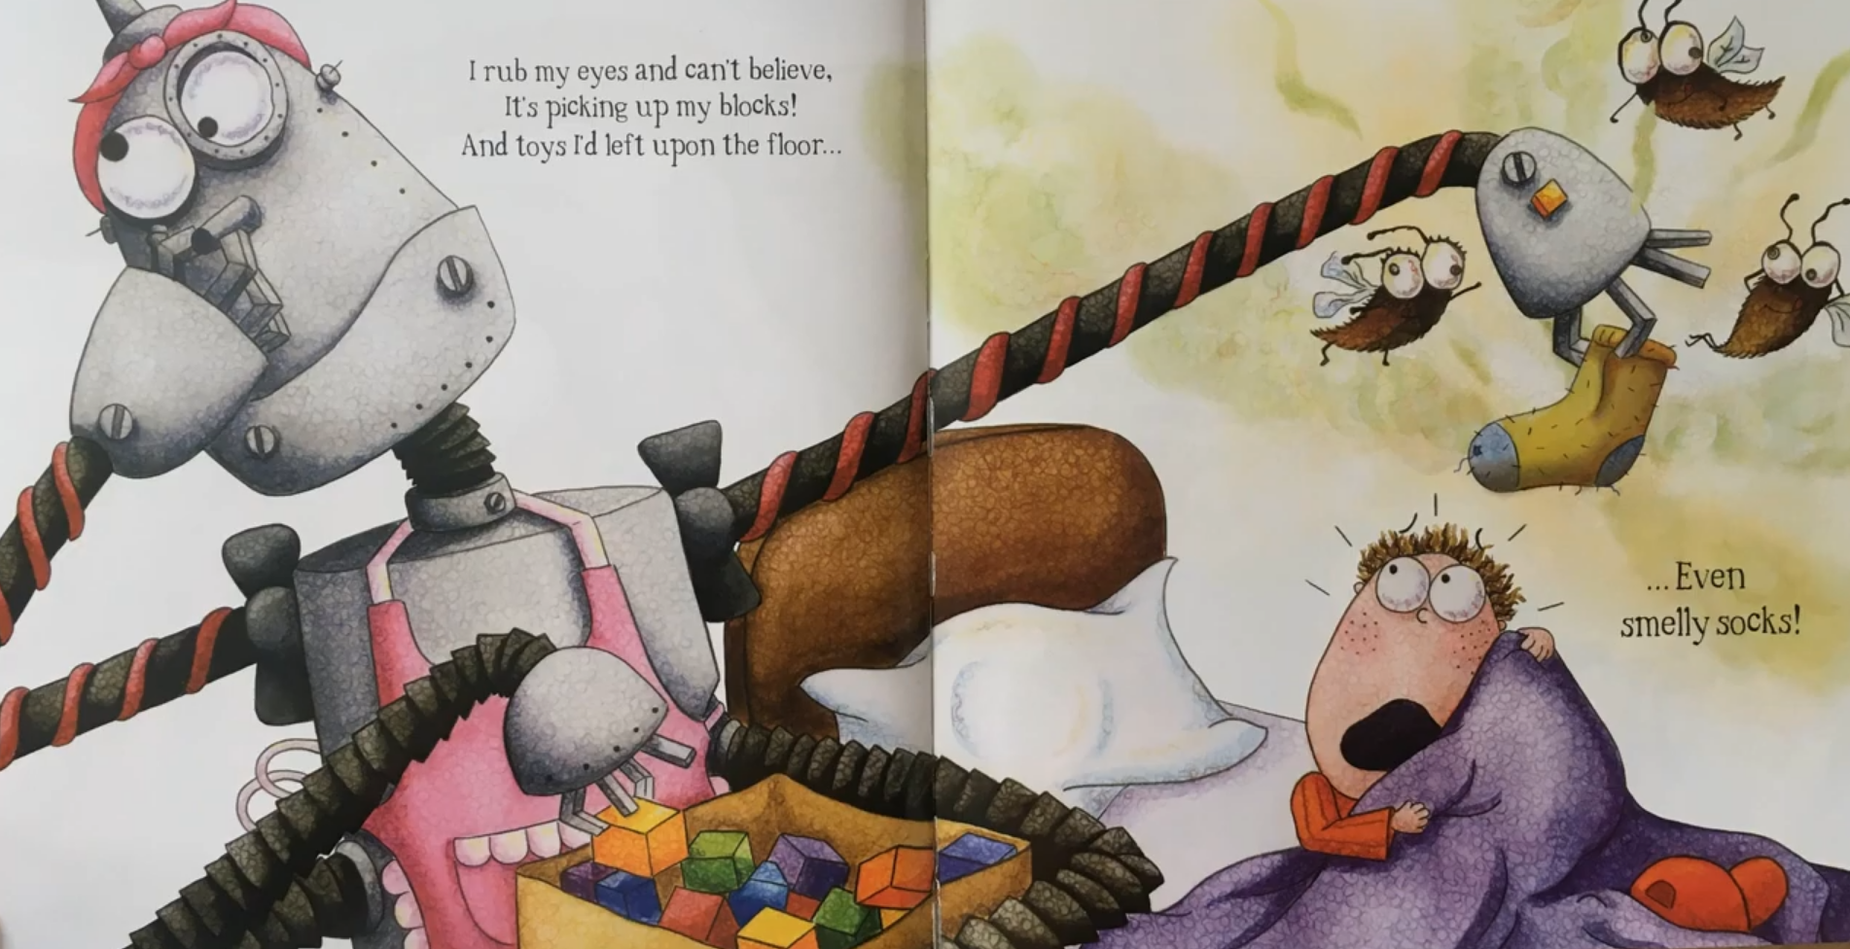

Slide 20
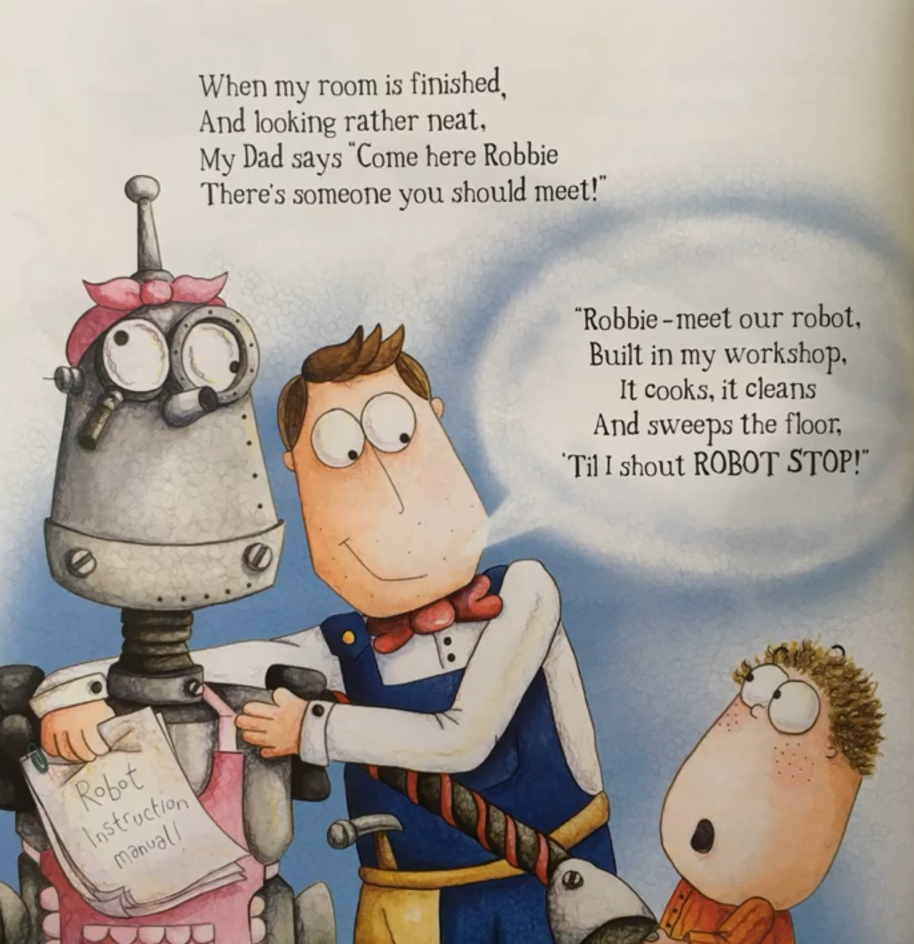

Slide 21
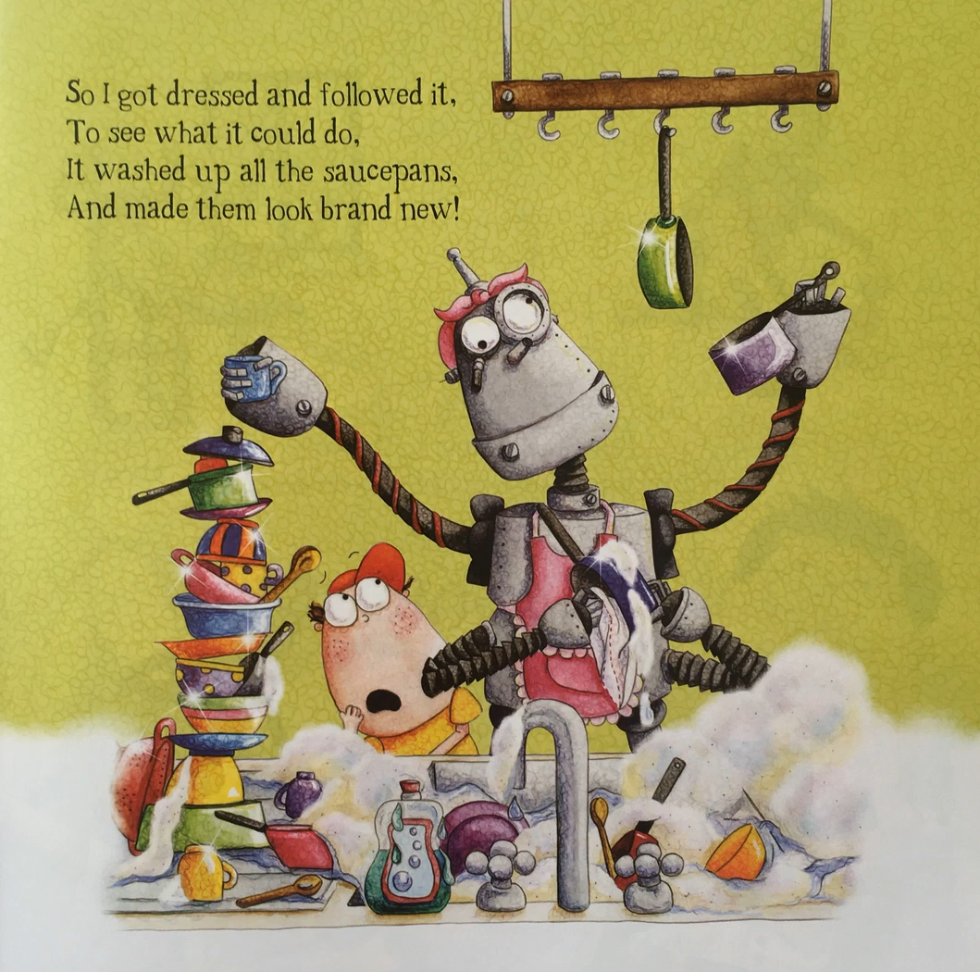

Slide 22
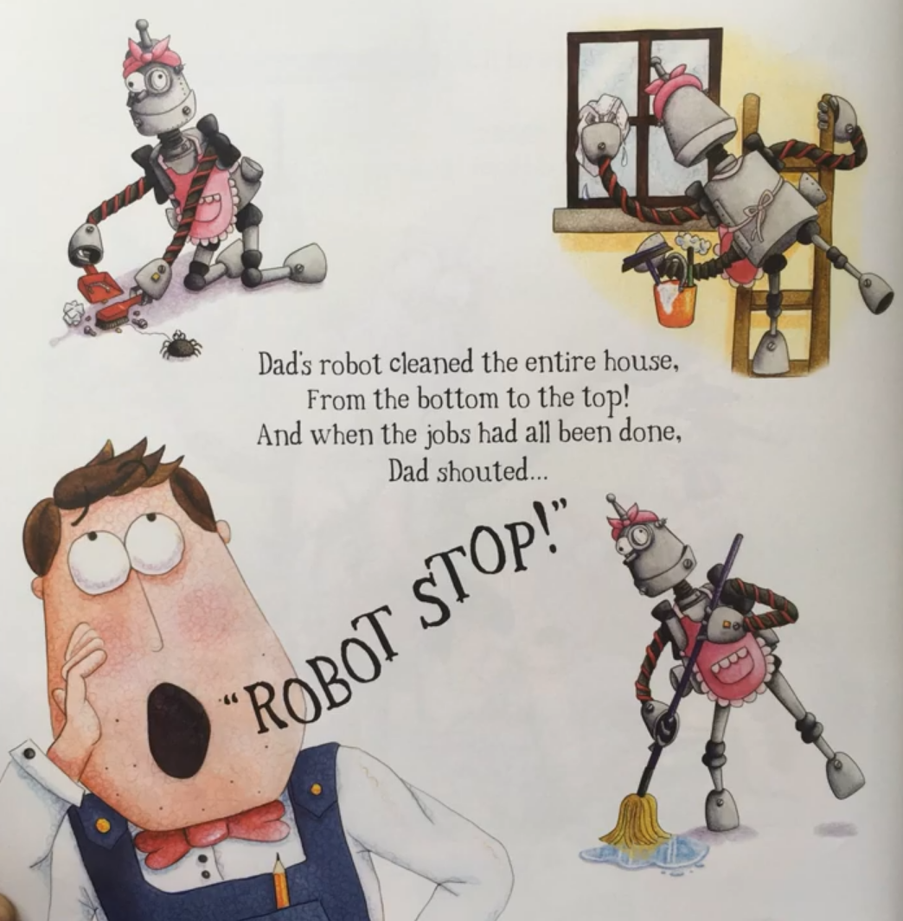

Slide 23
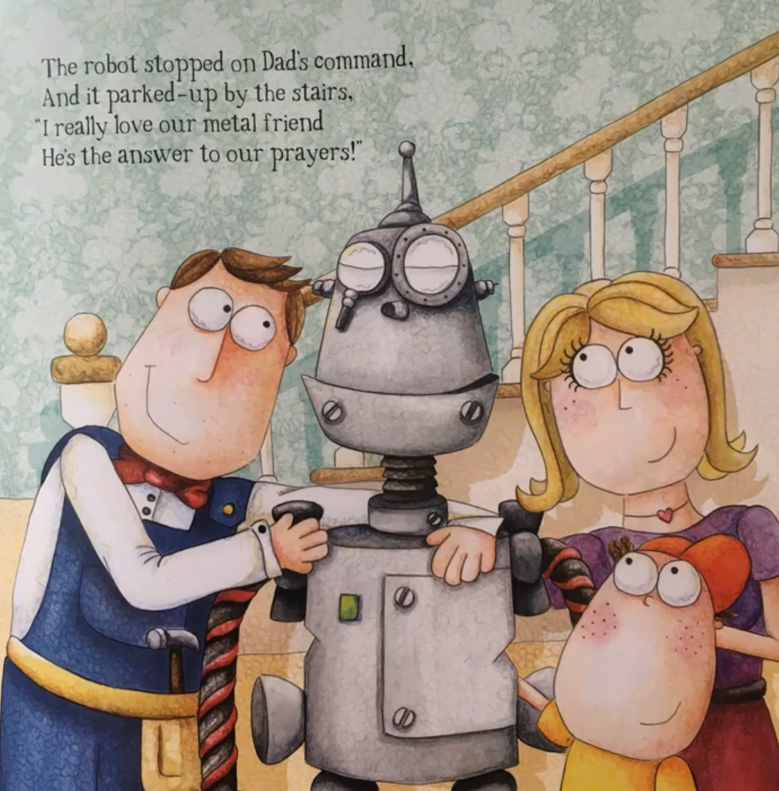

Slide 24
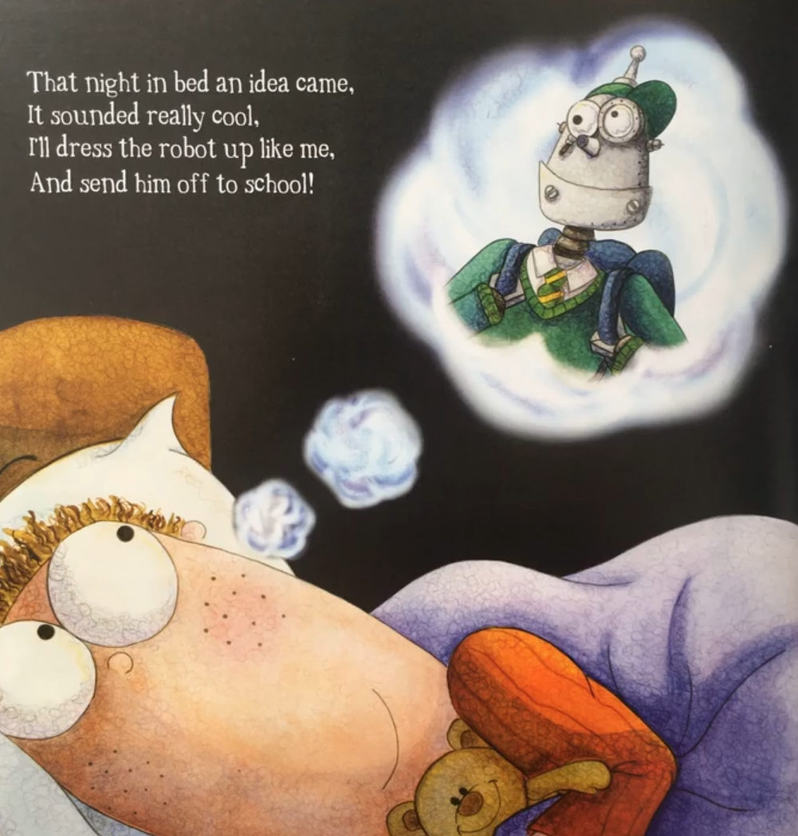

Slide 25
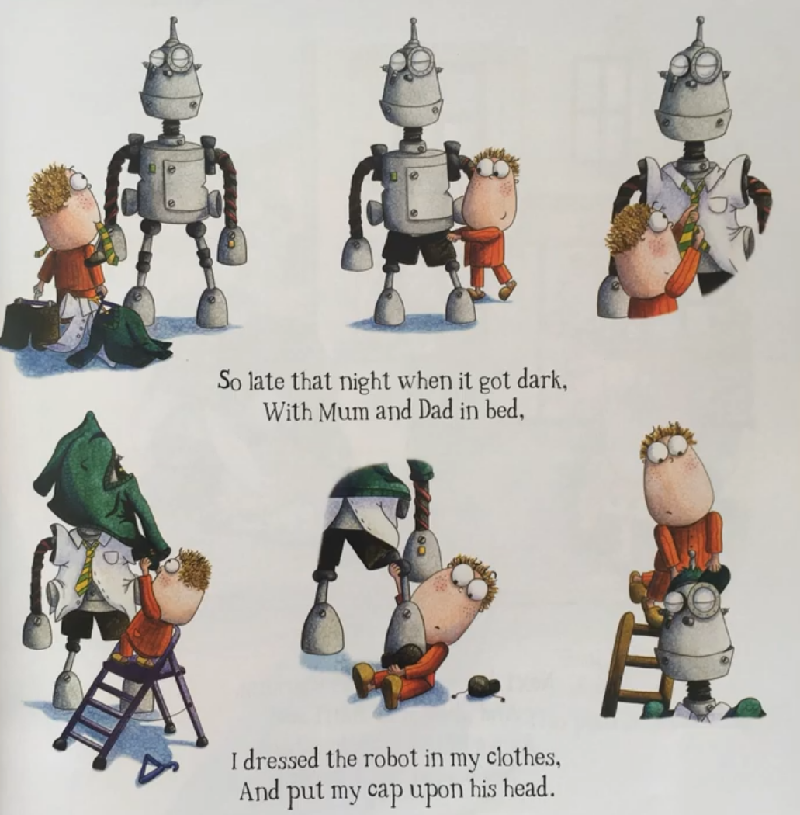

Slide 26
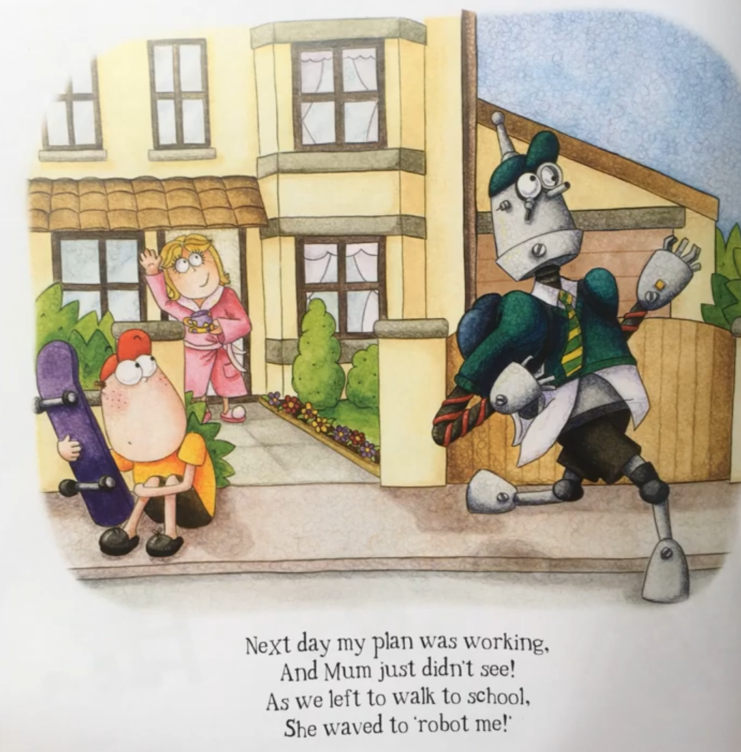

Slide 27
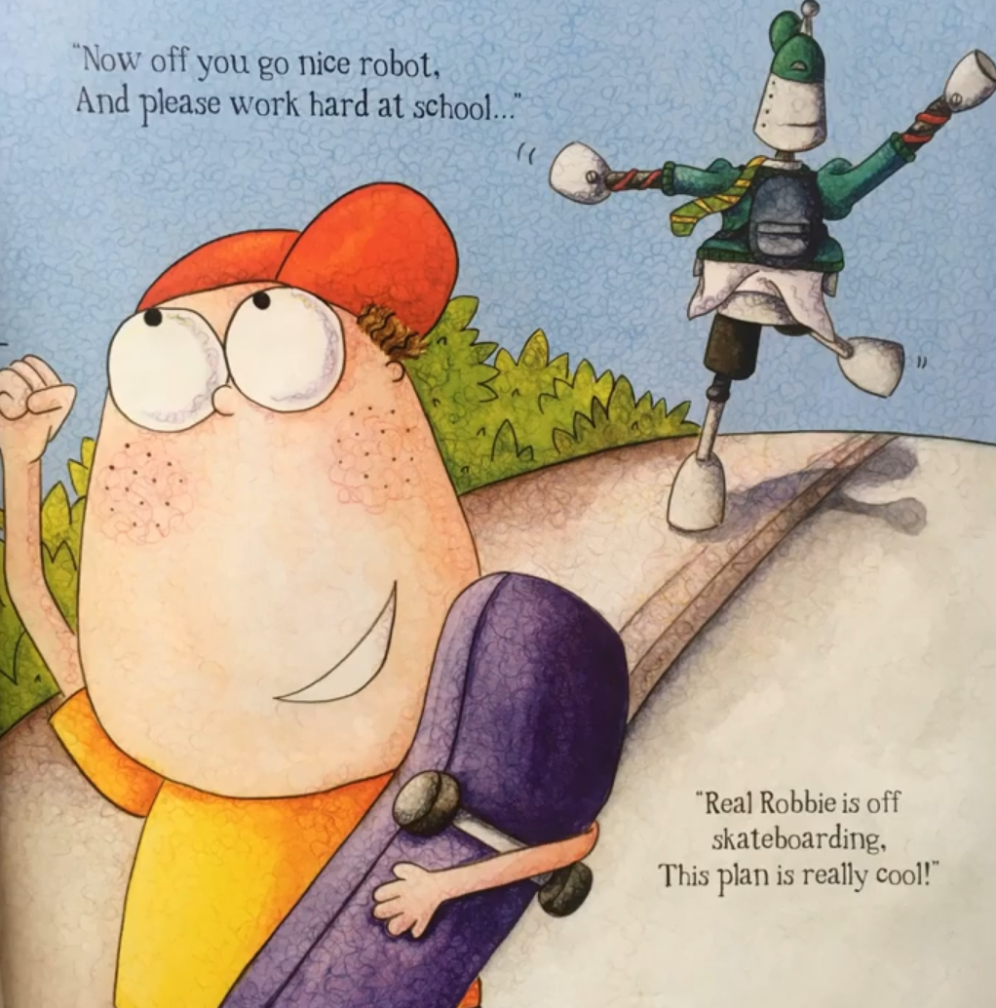

Slide 28
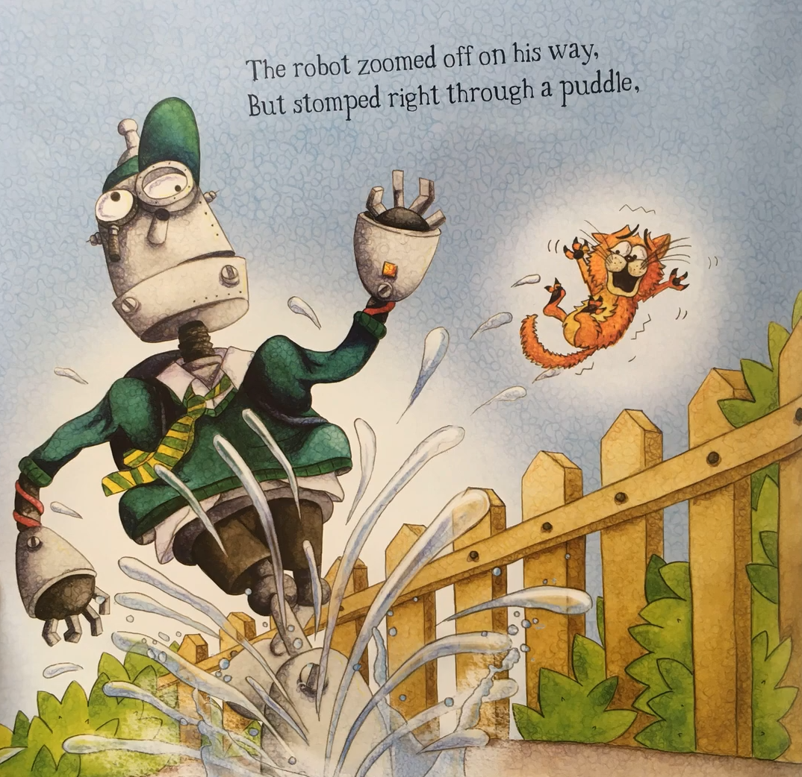

Slide 29
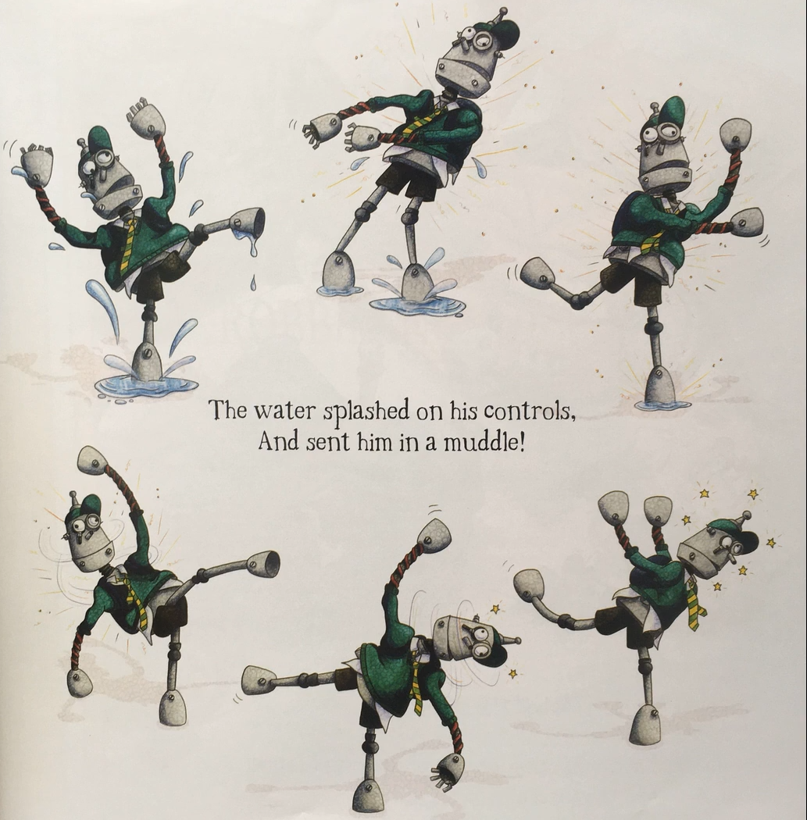

Slide 30
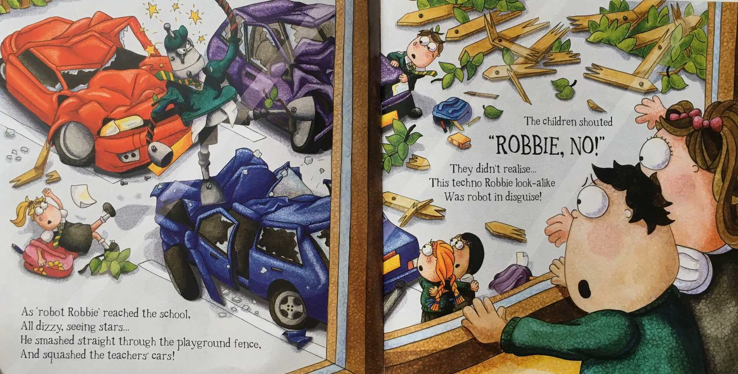

Slide 31
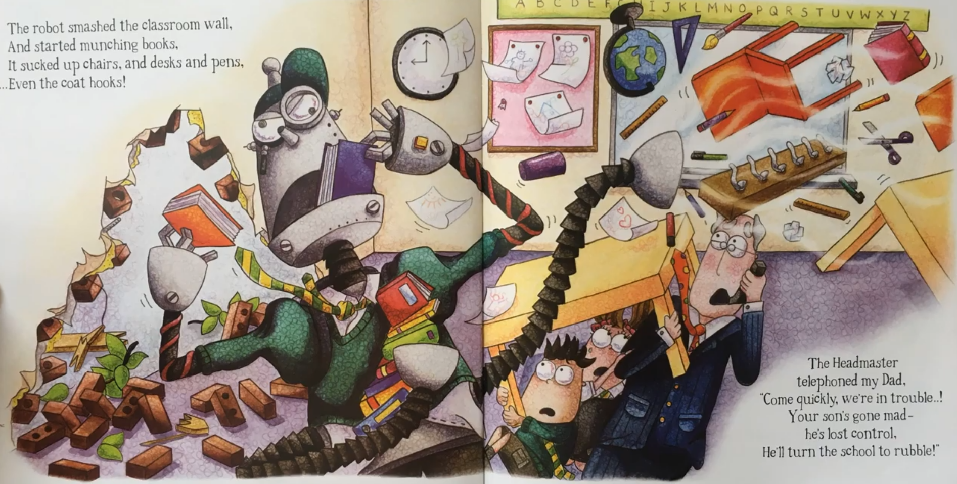

Slide 32
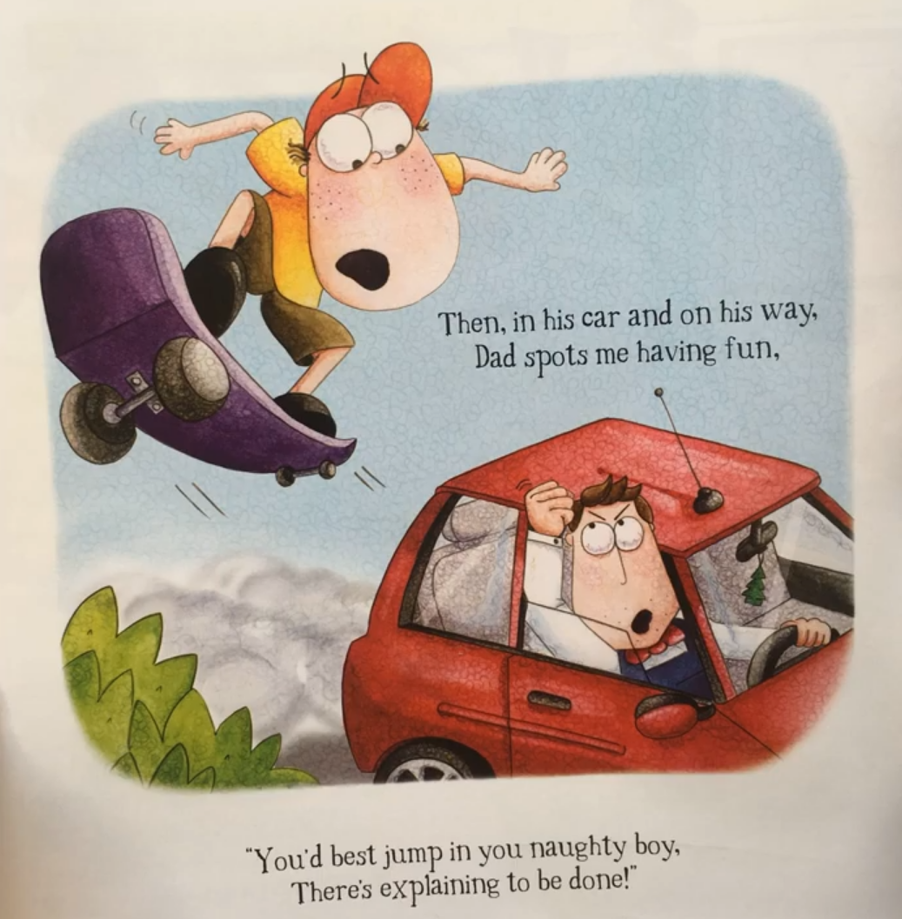

Slide 33
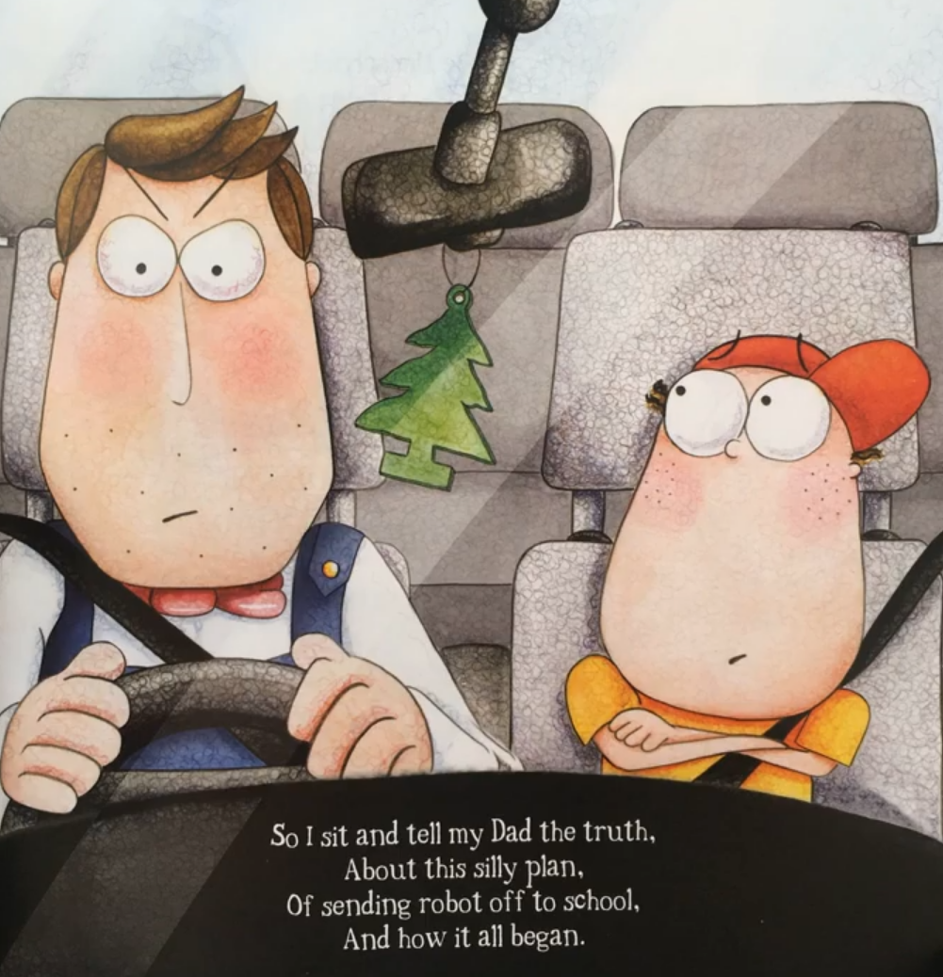

Slide 34
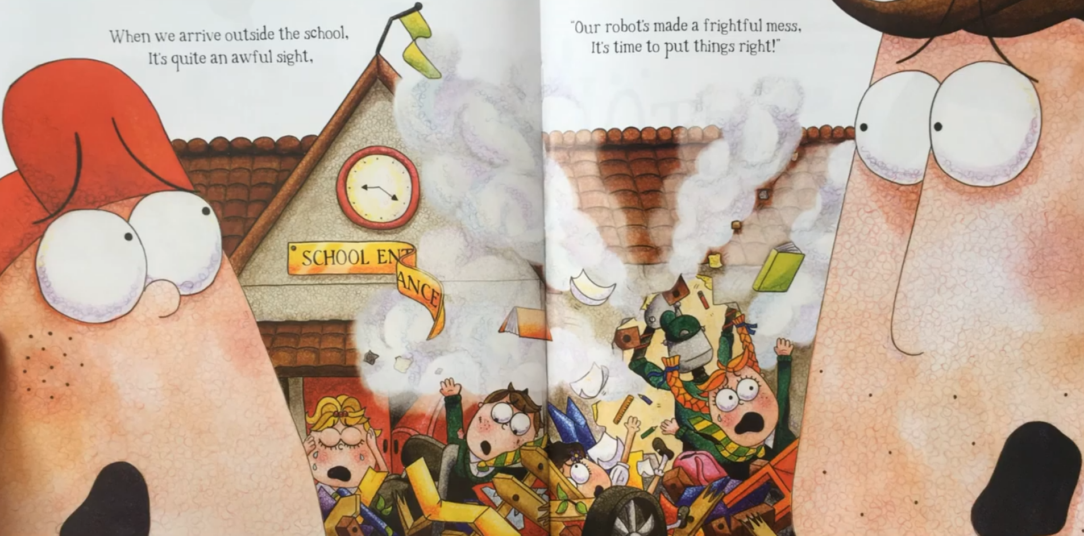

Slide 35
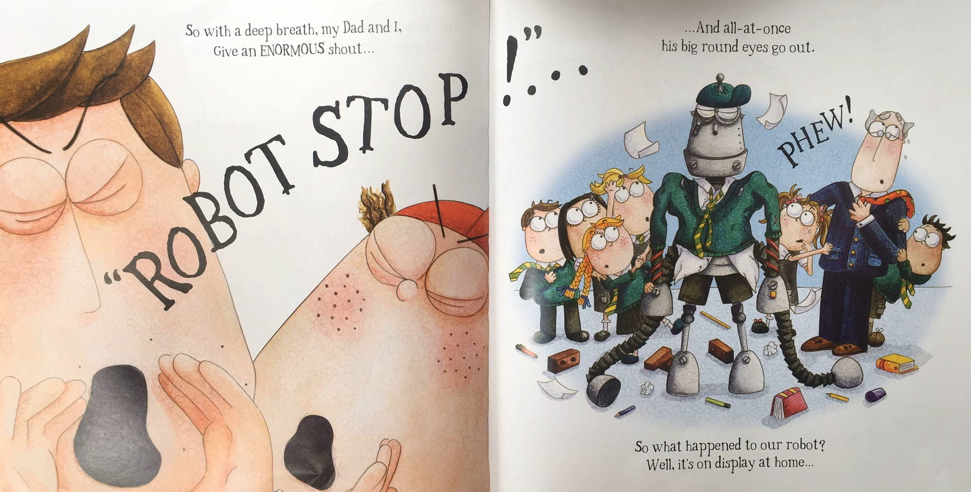

Slide 36
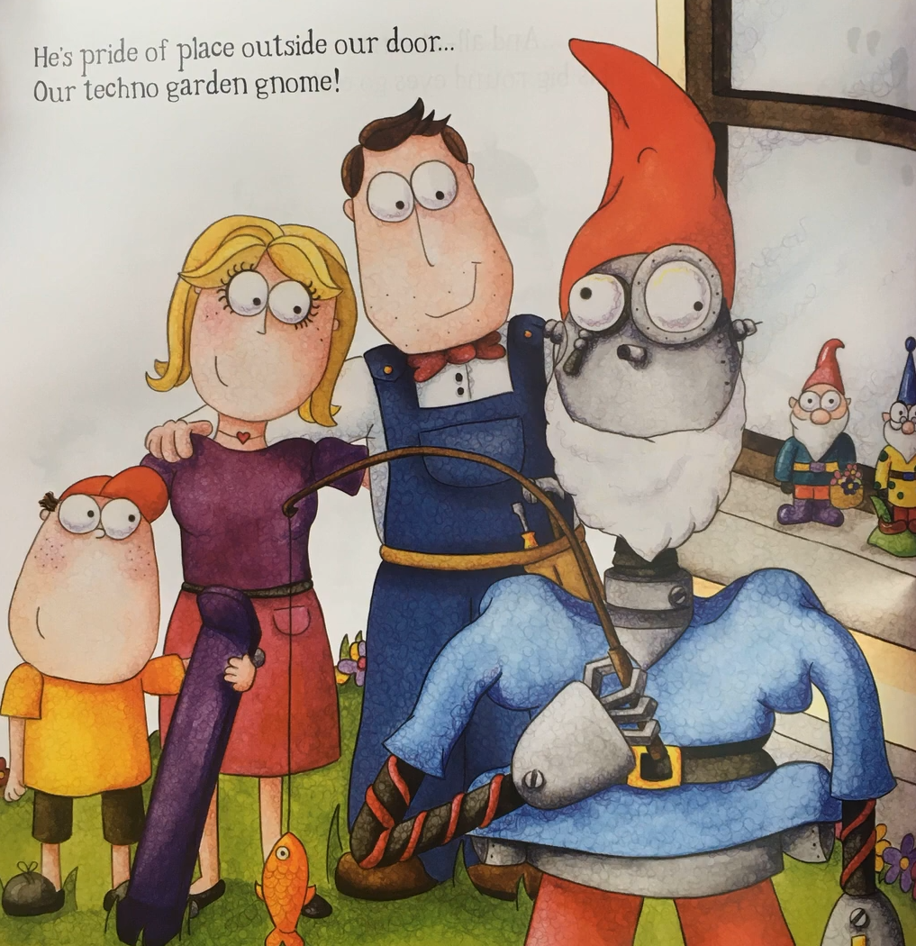

Slide 37
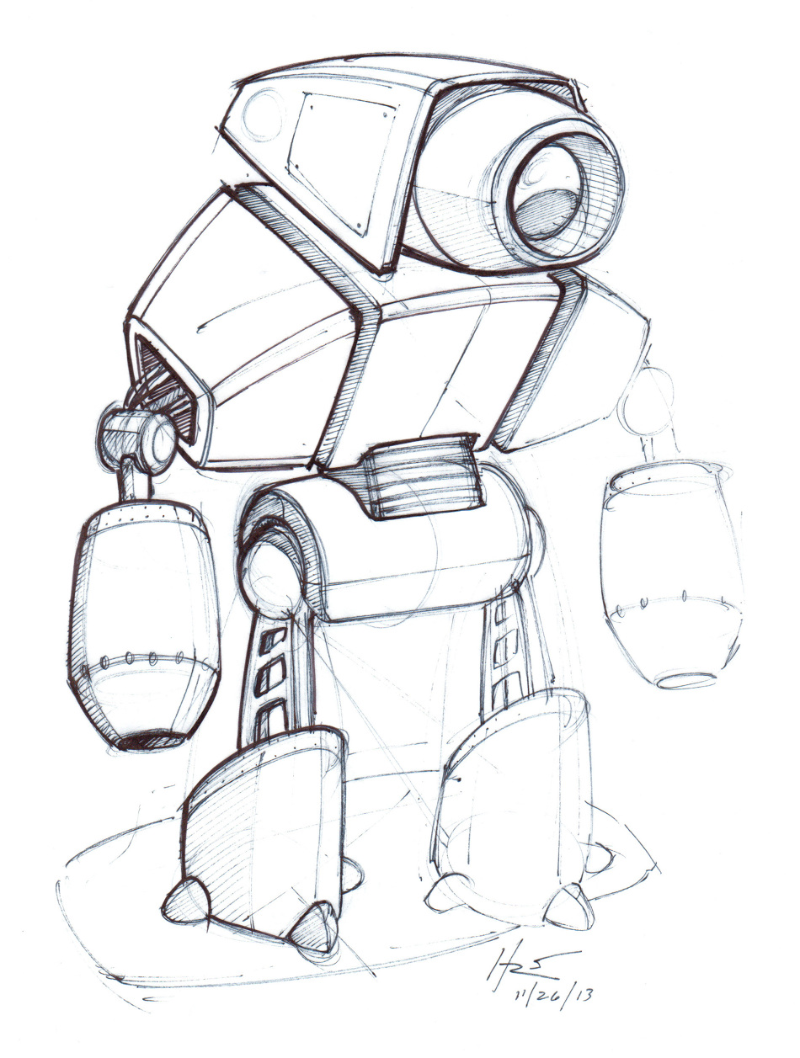
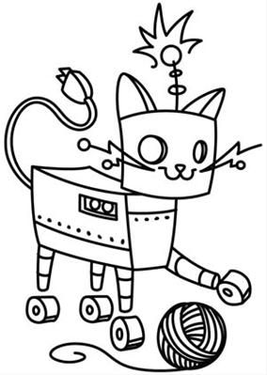
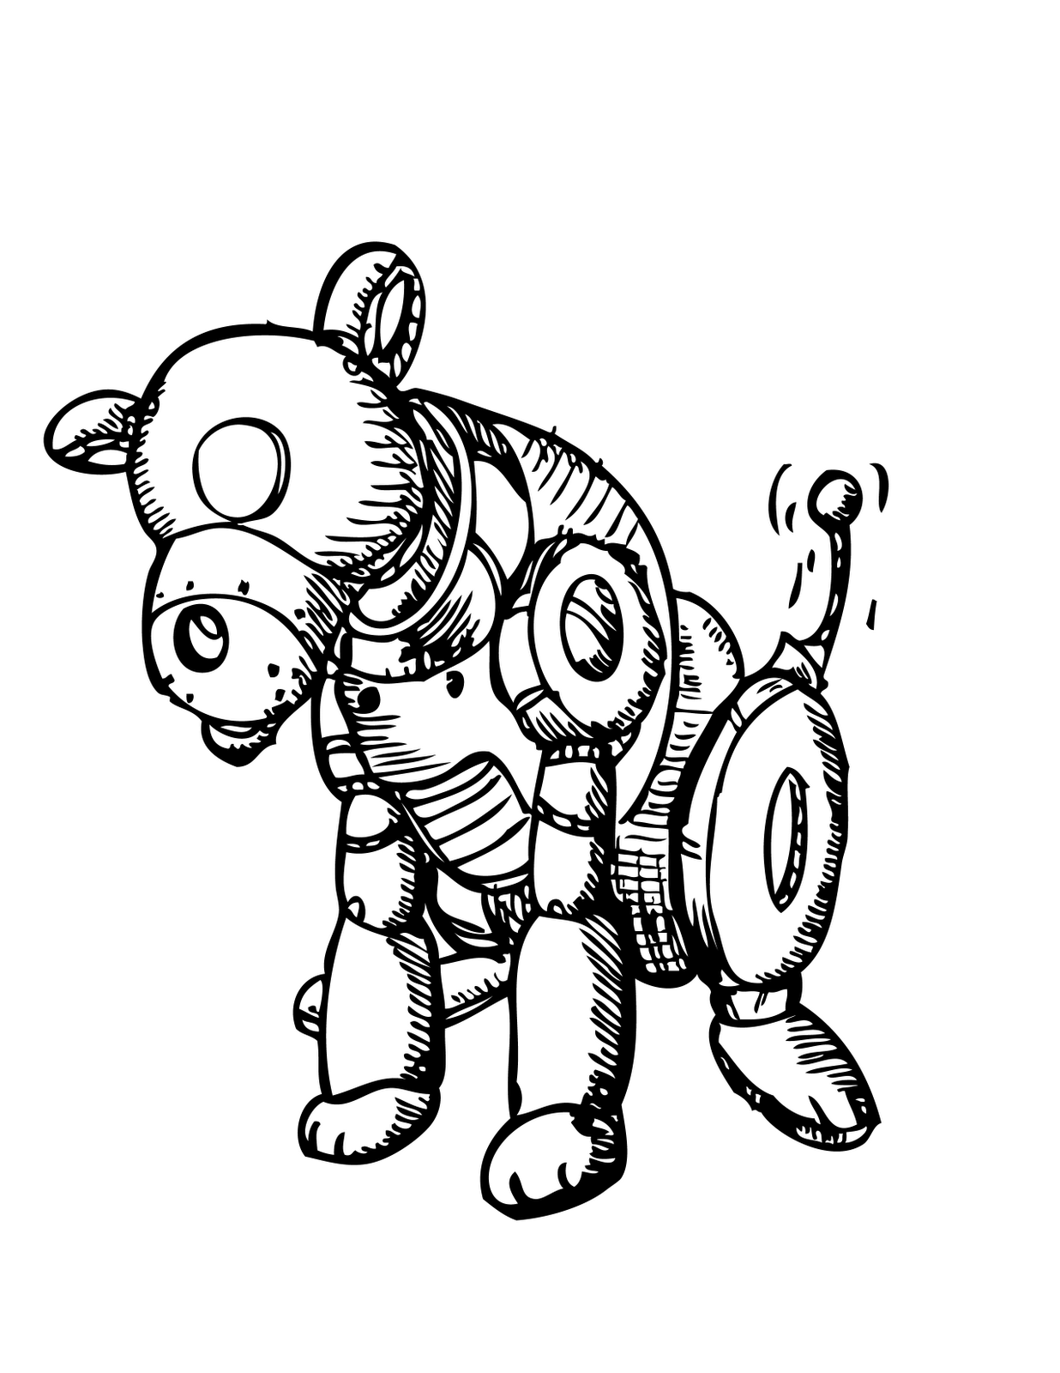
Task 1 – Design your own Robot
Sketch a picture of your very own robot. You can use the examples for some ideas.
Create a name for your Robot.
Think about what you would like your robot to do for example: tidy your bedroom, do your home work or cook your tea.
Write some sentences explaining what your robot can do.

Slide 38
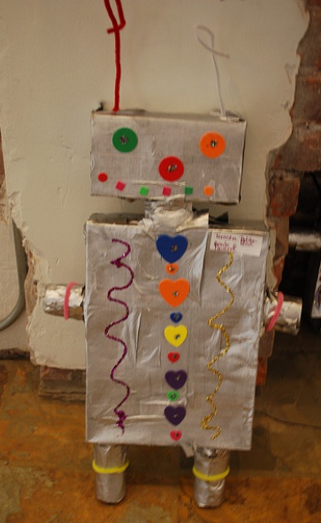
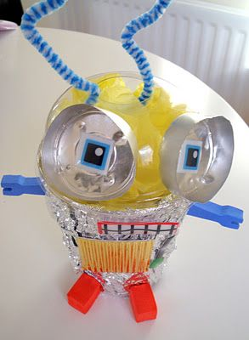
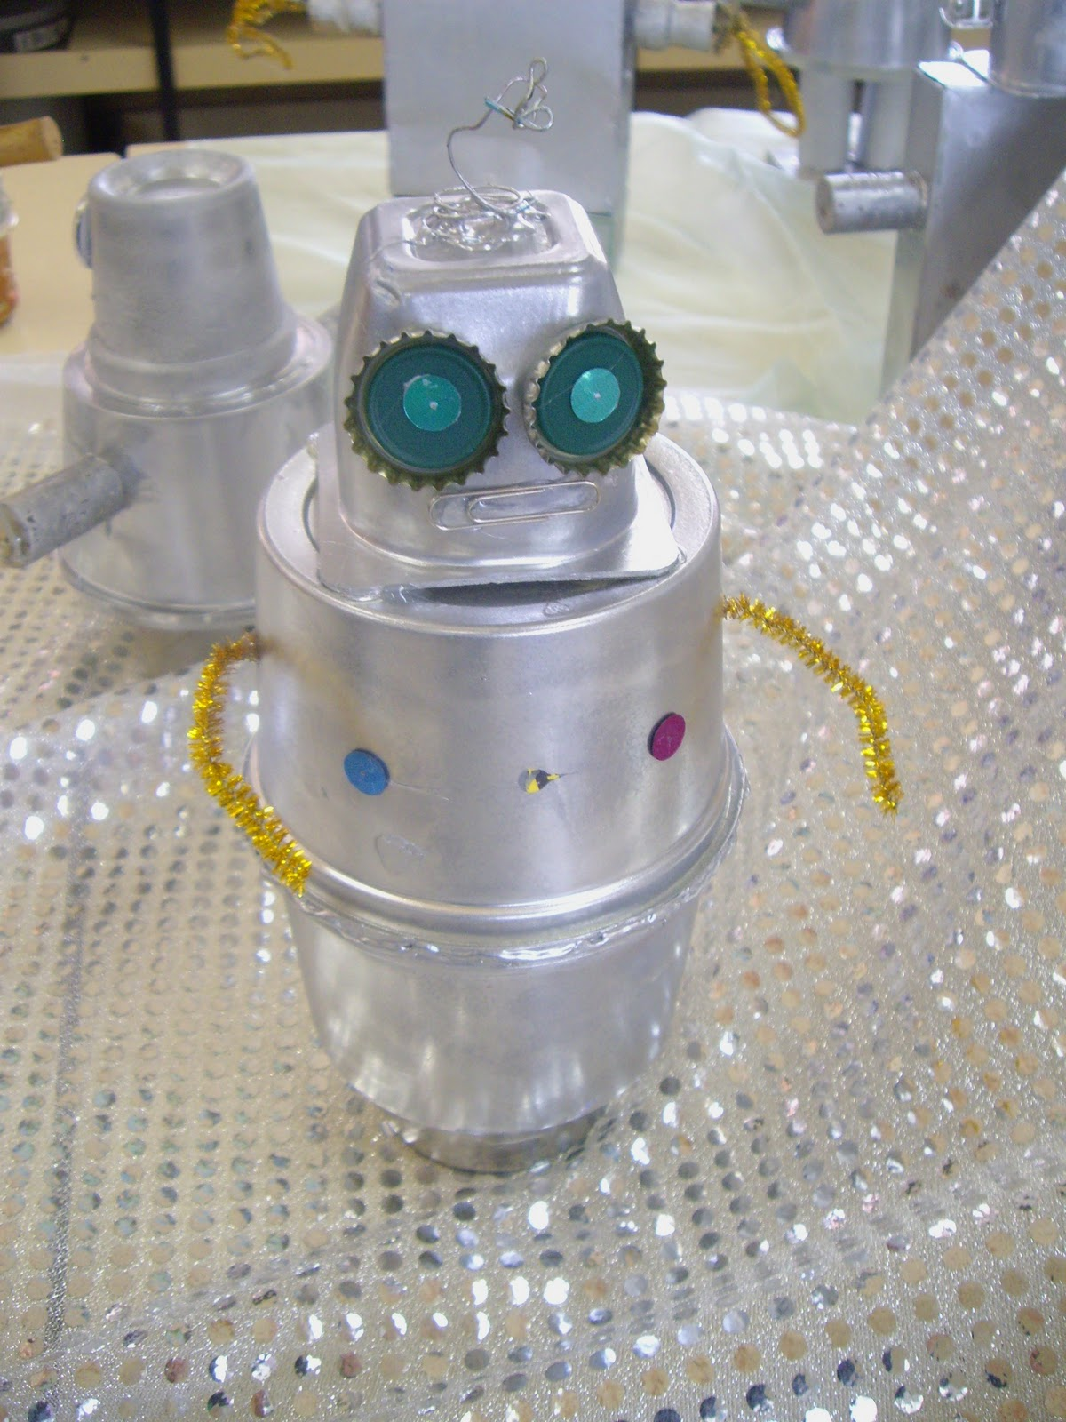
Task 2 – Create your own Robot using recycled materials
Collect a range of recycled materials for example: cardboard boxes, yoghurt pots, toilet roll tubes and bottle tops.
Join your materials together using glue or tape to create the shape of your robot.
Decorate your robot. You could use: pens, paint coloured paper, tin foil, pom poms, pipe cleaners, glitter or stickers.

Slide 39
Home Learning Bingo
How many of these activities can you complete this week?
Watch an episode of Newsround | Write your numbers to 50 *Challenge to 100* | Read a book | Follow a recipe to bake/cook something | Help a grown up with a chore around the house
Write your own story | 15 minutes of non stop exercise | Make your own play dough | Practice counting in 2s, 5s and 20s by taking steps up the stairs | Build something taller than you and measure the height
Find an object around the house beginning with every letter of the alphabet | Go on a mini beast hunt in the garden | Write down the alphabet | Complete a jigsaw | Have a paper airplane challenge with your family. Whose plane can fly the best?
Create an obstacle course | Name the months of the year in the correct order | Make a fruit smoothie with a grown up | Plant something | Draw a picture of your family
I would love to see photos of you taking part in some of these activities!

Slide 40
Well done for all of your hard work today!
It would be great to see a picture of you and your robot you made using recycled materials!
I would love to see a picture of your Robot sketch and your sentences explaining what it can do!
Please send your completed work for this session to: pioneerspupils@gmail.com

Slide 41
Wednesday 14th July
Pioneer’s Home Learning Tasks

Slide 42
Daily Maths Challenge
Maths Challenge A
Compare the numbers using the signs < > =
Remember the crocodile always eats the biggest number!
5 > 3
6 1
8 2
7 7
10 4
12 6
15 14
18 0
6 6
13 3
11. 12 21
12. 18 18
13. 16 29
14. 28 18
15. 15 15
16. 20 4
17. 17 7
18. 25 25
19. 18 9
20. 17 15
I’ve done the first one to help you!
If you think this task was easy try Maths Challenge B on the next slide!

Slide 43
Daily Maths Challenge
Maths Challenge B
Compare the numbers using the signs < > =
Remember the crocodile always eats the biggest number!
15 > 3
61 71
83 82
77 77
13 31
12 21
65 64
78 98
66 66
53 35
11. 42 21
12. 18 18
13. 76 29
14. 98 88
15. 55 55
16. 74 87
17. 17 71
18. 25 52
19. 58 59
20. 67 75
I’ve done the first one to help you!
If you found Maths Challenge A easy, have a go at this task!

Slide 44
Jake’s First Day!
Today our activities are going to be based on the story ‘Jake’s First Day’.
Very soon you will all be moving into a different year group, some of you will be moving into year 2 and some of you will be moving into year 3.
Some of you will be getting a new teacher and moving to a new class room!
No matter which year group you will be in, you are going to have lots of fun and learn lots of new things!
Lets read the story on slides 44 - 56

Slide 58
Task 1 - All about Me!
It’s ok to feel a little bit worried about moving into a new year group but I promise there is nothing to worry about!
To help your teacher get to know you a bit better, we are going to create an ‘All about Me’ poster.
You can create your own poster or use the template on the next slide
You can include:
Your name
Your age
Your pets
Your favourite lessons
Your least favourite lessons
Who your friends are
What you like to play with
What you are feeling a bit worried about

Slide 59
My name is:
Favourite colour/s:
Age:
Picture of me:
Best friends:
Favourite lessons:
I like to play:
My worries:
My least favourite lessons:

Slide 60
Task 2 – Create a Treasure Map!
Create a treasure map like the one from the story.
Remember ‘X’ marks the spot of the treasure!
Label your map to make the locations clear.
Challenge:
Include a compass on your map. Remember a compass shows you the direction of North, East, South and West.
You will find some examples on the next slide

Slide 61
Task 2 – Create a Treasure Map!
Examples:
Top tip:
You can tea stain your paper to make it look old!

Slide 62
Home Learning Bingo
How many of these activities can you complete this week?
Watch an episode of Newsround | Write your numbers to 50 *Challenge to 100* | Read a book | Follow a recipe to bake/cook something | Help a grown up with a chore around the house
Write your own story | 15 minutes of non stop exercise | Make your own play dough | Practice counting in 2s, 5s and 20s by taking steps up the stairs | Build something taller than you and measure the height
Find an object around the house beginning with every letter of the alphabet | Go on a mini beast hunt in the garden | Write down the alphabet | Complete a jigsaw | Have a paper airplane challenge with your family. Whose plane can fly the best?
Create an obstacle course | Name the months of the year in the correct order | Make a fruit smoothie with a grown up | Plant something | Draw a picture of your family
I would love to see photos of you taking part in some of these activities!

Slide 63
Well done for all of your hard work today!
It would be great to see a picture of you and your treasure map!
I would love to see a picture of your all about me poster. I can even send it to your teacher!
Please send your completed work for this session to: pioneerspupils@gmail.com

Slide 64
Thursday 15th July
Pioneer’s Home Learning Tasks

Slide 65
Daily Maths Challenge
Maths Challenge A
Practice counting in 2s, 5s and 10s.
Look closely to see which multiple you need to count in!
5 10 ___ 20 ___ 30 ___ 40 ___ ___ 55 ___
20 25 ___ 35 ___ 45 ___ ___ 60 ___ 70 ___
10 20 30 ___ 50 ___ 70 ___ 90 ___
0 ___ 20 30 ___ ___ 60 ___ ___ 90 100
2 4 6 ___ ___ 12 ___ 16 ___ 20
0 ___ 4 6 ___ 10 ___ 14 ___ 18 ___ 22 ___
If you think this task was easy try Maths Challenge B on the next slide!

Slide 66
Daily Maths Challenge
Maths Challenge B
2 X 5 =
3 X 2 =
6 X 10 =
4 X 2 =
9 X 5 =
7 X 10 =
5 X 5 =
8 X 2 =
10 X 0 =
6 X 2 =
11. 50 ÷ 10 =
12. 14 ÷ 2 =
13. 30 ÷ 5 =
14. 24 ÷ 2 =
15. 80 ÷ 10 =
16. 16 ÷ 2 =
17. 25 ÷ 5 =
18. 70 ÷ 10 =
19. 100 ÷ 10 =
20. 60 ÷ 5 =
If you found Maths Challenge A easy, have a go at this task!

Slide 67
Brilliant Books!
Today we are going to complete some activities based on our favourite book!
Your first task is to find your favourite book!
I can’t wait to see some of your favourite books on our zoom session!

Slide 68
Task 1 – Design the front cover of your favourite book!
You are going to design a front cover for your favourite book. You can use the books front cover to help you!
You could include:
A title
Pictures of the main characters
Picture of the main setting (place) in your book
A sentence to tell someone what your book is about
You can create your own book template or use the template on the next slide.

Slide 70
Task 2 – Make a puppet of your favourite character!
Design a puppet of your favourite character. Here are some examples:
Story spoon puppet
Puppet on a stick
Sock puppet
Finger puppet

Slide 71
Task 3 – Build a den to read your favourite book!
Build a cosy den to read your favourite book. Here are some examples:

Slide 72
Home Learning Bingo
How many of these activities can you complete this week?
Watch an episode of Newsround | Write your numbers to 50 *Challenge to 100* | Read a book | Follow a recipe to bake/cook something | Help a grown up with a chore around the house
Write your own story | 15 minutes of non stop exercise | Make your own play dough | Practice counting in 2s, 5s and 20s by taking steps up the stairs | Build something taller than you and measure the height
Find an object around the house beginning with every letter of the alphabet | Go on a mini beast hunt in the garden | Write down the alphabet | Complete a jigsaw | Have a paper airplane challenge with your family. Whose plane can fly the best?
Create an obstacle course | Name the months of the year in the correct order | Make a fruit smoothie with a grown up | Plant something | Draw a picture of your family
I would love to see photos of you taking part in some of these activities!

Slide 73
Well done for all of your hard work today!
I would love to see a picture of the book front cover you designed!
It would be great to see a picture of you and your puppet!
I would love to see a picture of you reading a book in your den!
Please send your completed work for this session to: pioneerspupils@gmail.com

Slide 74
Friday 16th July
Pioneer’s Home Learning Tasks

Slide 75
Party Time!
Throw your own end of term party!
Dress up in your favourite fancy dress costume or wear your favourite party clothes!
I can’t wait to see your outfits on zoom!

Slide 76
Task 1 – Bake some cakes!
Follow the recipe to bake some delicious cakes for you and your family to enjoy!

Slide 77
Task 1 – Bake some cakes!
Instructions:

Slide 78
Task 1 – Bake some cakes!
Instructions:
If you don’t have icing bags, you can use your spoon to put the icing onto the cakes!

Slide 79
Task 2 – Create your very own party hat!
Examples:
I have included a template on the next slide which you can use!

Slide 81
Task 3 – Make some party decorations
Create some decorations to have your very own end of term party!
Examples:
Paper lanterns
Paper chains
Paper buntings

Slide 82
Task 4 – Have lots of fun!
You could:
Play your favourite games!
Eat the cakes you made
or have a special party meal!
Dance to your favourite songs!

Slide 83
Well done for all of your hard work today!
I would love to see pictures of you baking your cakes!
It would be great to see pictures of your party decorations!
I would love to see a picture of you wearing your party hat!
Please send your completed work for this session to: pioneerspupils@gmail.com

Slide 84
Home Learning Bingo
How many of these activities did you manage to complete this week?
Watch an episode of Newsround | Write your numbers to 50 *Challenge to 100* | Read a book | Follow a recipe to bake/cook something | Help a grown up with a chore around the house
Write your own story | 15 minutes of non stop exercise | Make your own play dough | Practice counting in 2s, 5s and 20s by taking steps up the stairs | Build something taller than you and measure the height
Find an object around the house beginning with every letter of the alphabet | Go on a mini beast hunt in the garden | Write down the alphabet | Complete a jigsaw | Have a paper airplane challenge with your family. Whose plane can fly the best?
Create an obstacle course | Name the months of the year in the correct order | Make a fruit smoothie with a grown up | Plant something | Draw a picture of your family
I would love to see photos of you taking part in some of these activities!

Slide 85
I hope you have a fantastic summer break!
Thank you for all of your hard work!
We can’t wait to see some of you at summer school!

