Slide 1
Base 6

Slide 2
Date: Monday 1st March 2021
L.O. To be able to spell words using the suffix ‘est’ where no change to the root sound is needed.
Subject: English

Slide 3
Spellings
Remember:
1. highest
2. loudest
3. softest
4. longest

Slide 4
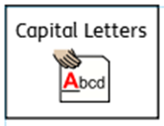
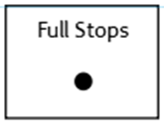
Spellings
Do not forget:
Can you put each one in a sentence?
1. oldest:
2. loudest:
3. softest:
4. longest:

Slide 5
Date: Tuesday ^{2nd} March 2021
L.O. To be able to investigate the suffix ‘est’.
Subject: English

Slide 6
Pre-recorded Teaching
Access the online teaching video below that will support you to complete the work in this lesson. This video will act as a support but all of the work can still be successfully understood & completed using paper-based versions of this pack. If you need further support to understand / complete work then please contact school via e-mail or telephone.
Play Video
You can also copy and paste this link if you would prefer:
https://classroom.thenational.academy/lessons/to-investigate-suffixes-er-and-est-suffixes-ccw32d?activity=video&step=1

Slide 7
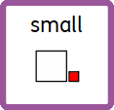
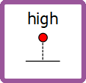
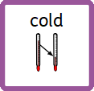
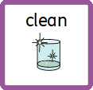
I am going to draw lines to match the root words to the words with ‘est’ suffix which change the root word to mean the most.

Slide 8
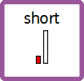
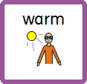
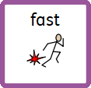
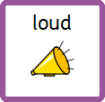
Draw lines to match the root words to the words with ‘est’ suffix which change the root word to mean the most.

Slide 9
My turn, build a sentence :
Singular nouns
I am going to build a sentence using words with the ‘est’ suffix to describe how something is the most.
The giraffe was the tallest of all of the animals.

Slide 10
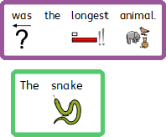
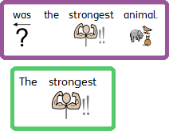
Build a sentence :
Singular nouns
Build 3 sentences using some of the adjectives with ‘est’ suffixes.

Slide 11
Build a sentence :
Singular nouns
Complete 3 sentences by writing an adjective into each sentence with an ‘est’ suffix.

Slide 12
Write A Sentence – Use the adjectives ending with the suffix ‘est’ to write 5 sentences.
Adjectives
fastest loudest shortest warmest quietest
hardest softest coldest sharpest longest shortest

Slide 13
Date: Wednesday 3rd March 2021
L.O. To be able to understand what an adjective is.
Subject: English

Slide 14
Adjectives
Last week we began to explore the characters in our class story Hansel and Gretel. The characters were described using words called adjectives, and you were given some adjectives to help you to write sentences to describe the dad in the story. Today, we are going to further explore adjectives so that you can begin to use some of your own in preparation for making your own story characters!
Can you think of any adjectives (describing words) used to describe how the dad in the story looked?

Slide 15
Amazing Adjectives
Adjectives are words that describe nouns (people, places, things, feelings). They help us to imagine what the person, place, thing or feeling is like:
delicious cake best friend sharp pin
Sometimes adjectives can be used in different ways:
The dark blue plane flew through the sky.
The plane that flew through the sky was dark blue.

Slide 16
For each picture on the following pages, see how many adjectives you can write down in a list to describe it. Or, if you need more help, find the correct symbols to describe it. Try to think of your own too without using the examples if you can!

Slide 17
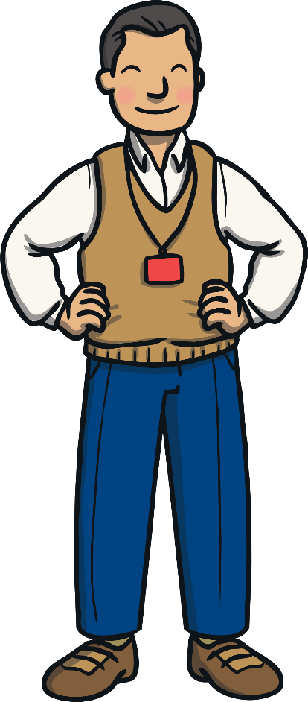
The teacher is: Helpful Kind Caring Professional Fun __________ __________ __________ __________

Slide 18
Rainbows are: ______________ ______________ ______________ ______________ ______________ ______________

Slide 19
Rainbows are: ______________ ______________ ______________ ______________ ______________ ______________
Word Bank
pink | black | purple | orange | bright | dark | Beautiful
brown | colourful | ugly | yellow | red | green | blue

Slide 20
Rainbows are: ______________ ______________ ______________ ______________ ______________ ______________

Slide 21
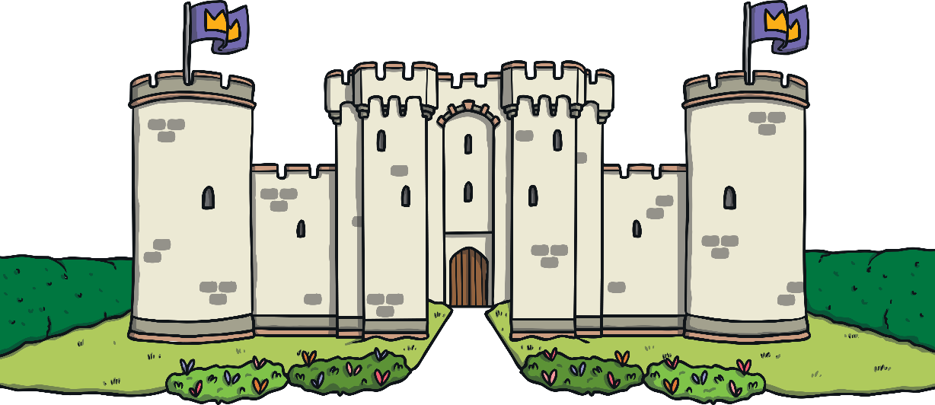
The castle is: ______________ ______________ ______________ ______________ ______________ ______________

Slide 22
The castle is: ______________ ______________ ______________ ______________ ______________ ______________
Word Bank
huge | old | new | haunted | royal | dark | beautiful
colourful | Strong | grey | big | tall | magic | dusty

Slide 23
The castle is: ______________ ______________ ______________ ______________ ______________ ______________

Slide 24
The beetle is: ______________ ______________ ______________ ______________ ______________ ______________

Slide 25
The beetle is: ______________ ______________ ______________ ______________ ______________ ______________
Word Bank
huge | shiny | massive | cute | furry | small | tiny
colourful | black | grey | scary | creepy | loud | quiet

Slide 26
The beetle is: ______________ ______________ ______________ ______________ ______________ ______________

Slide 27
Date: Thursday 4th March 2021
L.O. To be able to use adjectives to describe and design character.
Subject: English

Slide 28
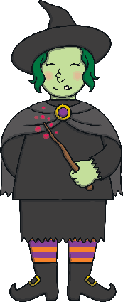
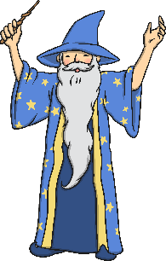
Yesterday, we explored adjectives and used them to describe pictures that we could see. Today, we are going to further explore adjectives and then use then to create our own character for our story Hansel and Gretel. The character is going to be a witch or a wizard, and it is up to you whether you make them a good character or a bad character!

Slide 29
Here is an example of a description of my new Hansel and Gretel character.
kind
The wizard is kind .

Slide 30
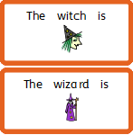

Slide 31
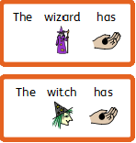

Slide 32
Write 5 sentences to describe what your witch/wizard looks like.
There is a word bank below to help you but try to think of some adjectives of your own too!
The witch/wizard is
The witch/wizard has
Adjective Word Bank
beautiful ugly pretty handsome cool skinny fat
old young long short tall hat cloak dress trousers colourful sparkly glowing tatty beard glasses hair
eyes big small nose warts teeth nails dark bright long ears jewellery shoes wrinkly smooth skin

Slide 33
The witch or wizard is wearing
The witch or wizard is wearing
The witch or wizard is wearing

Slide 34
Write 2 sentences to describe what your witch/wizard’s personality is like.
There is a word bank below to help you but try to think of some adjectives of your own too!
The witch or wizard is
The witch or wizard is also
Adjective Word Bank
grumpy caring rude happy friendly angry sly evil clever kind honest nasty gentle horrible brave helpful
Polite wise scary smart mean horrible shy furious cruel charming cross excitable silly

Slide 35
Write 5 sentences to describe what your witch/wizard looks like.
There is a word bank below to help you but try to think of some adjectives of your own too!
Adjective Word Bank
beautiful ugly pretty handsome cool skinny fat
old young long short tall hat cloak dress trousers colourful sparkly glowing tatty beard glasses hair
eyes big small nose warts teeth nails dark bright long ears jewellery shoes wrinkly smooth skin

Slide 37
Write 2 sentences to describe what your witch/wizard’s personality is like.
There is a word bank below to help you but try to think of some adjectives of your own too!
Adjective Word Bank
grumpy caring rude happy friendly angry sly evil clever kind honest nasty gentle horrible brave helpful
Polite wise scary smart mean horrible shy furious cruel charming cross excitable silly

Slide 38
Date: Friday 5th March 2021
L.O. To be able to use adjectives to design a character.
Subject: English

Slide 39
Yesterday, you worked hard to use adjectives to describe what your new witch/wizard is going to look like. Today, you are going to draw your witch/wizard using the description you wrote yesterday. On the next page is an example of my wizard- we can’t wait to see yours! Make sure you stick to your description when drawing your witch/wizard, we would like to be able to guess whose witch/wizard belongs to witch description so take your time with your drawing.

Slide 40
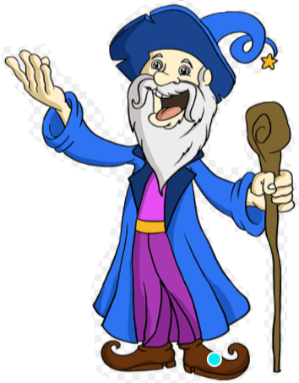
Albert
My wizard is old.
He wizard has a blue hat and cloak.
He also has purple trousers and a purple top.
He is wearing no jewellery, but he does have a gold belt.
He has short, grey hair and a long grey beard.
My wizard is a kind, caring and helpful wizard and so I have drawn him with a happy and smiling face.

Slide 41
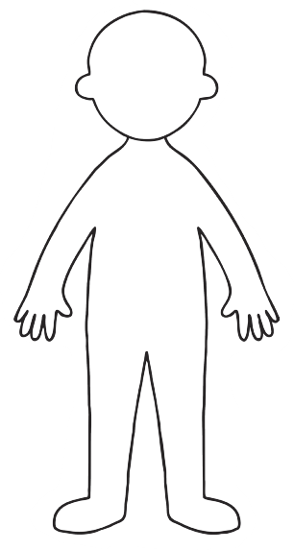

Slide 42
Quiz Time!
Let’s see if we can check our knowledge of adjectives together by completing this quiz. An adult can help you to read any words you are unsure of.

Slide 43
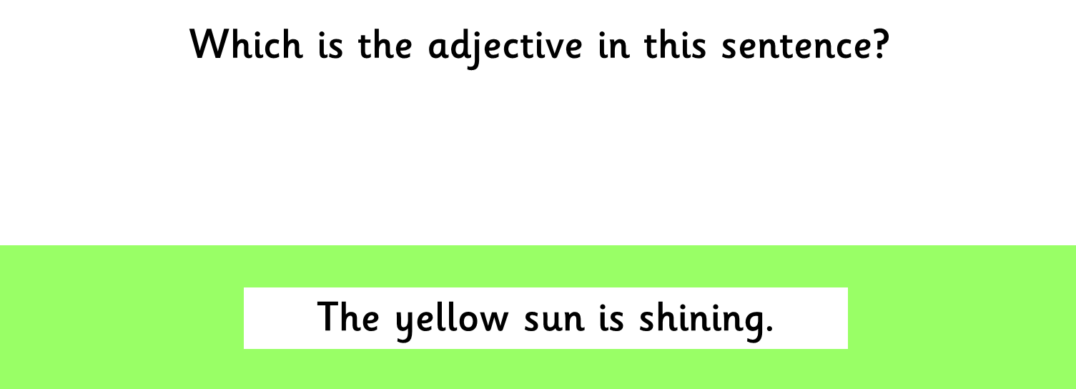
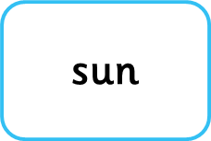
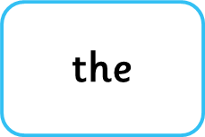
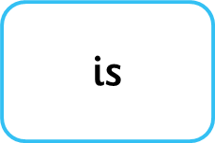
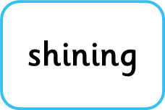

Slide 44
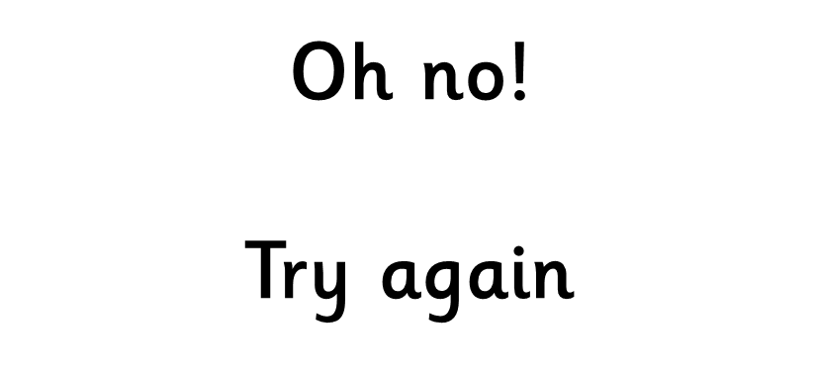

Slide 46
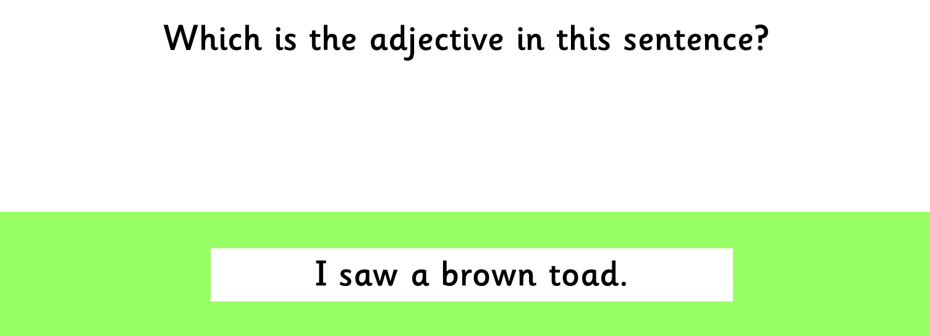
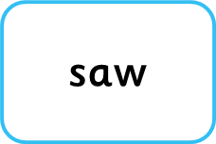
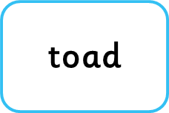
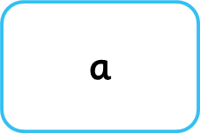
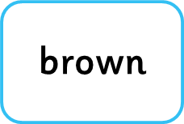

Slide 49
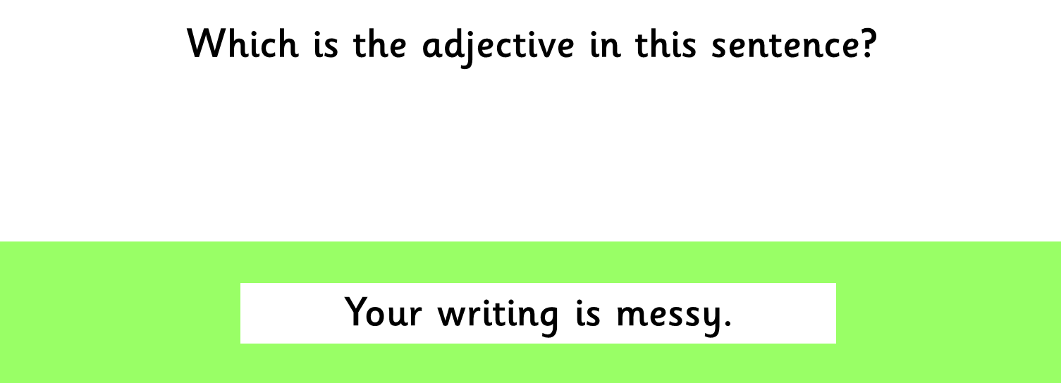
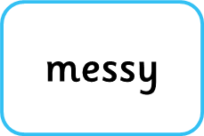
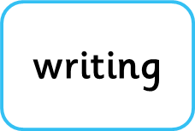
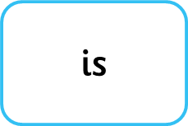

Slide 52
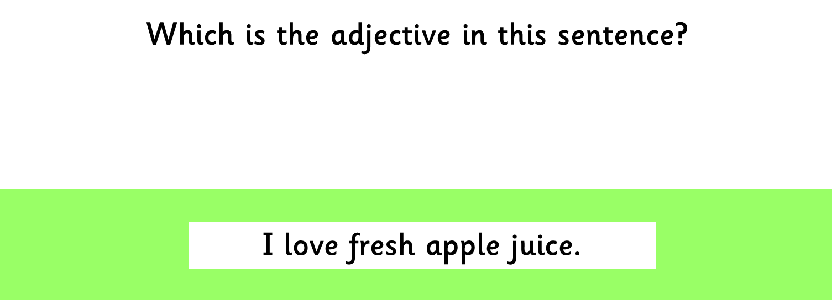
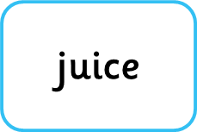
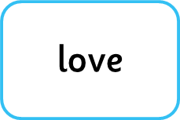

Slide 55
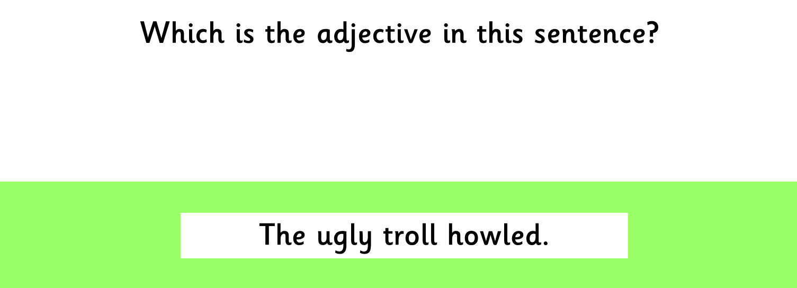
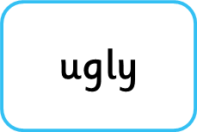

Slide 58
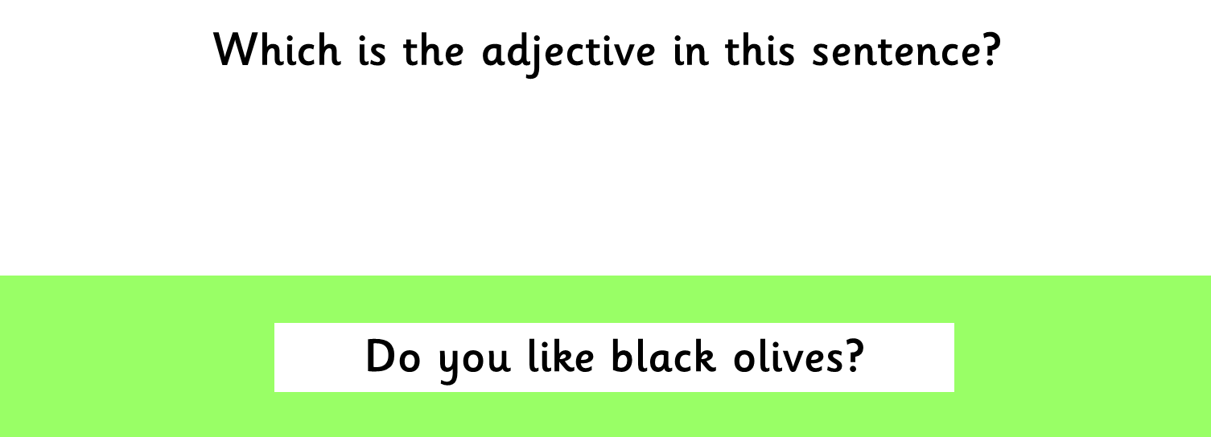
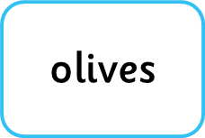
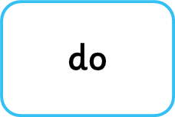

Slide 61
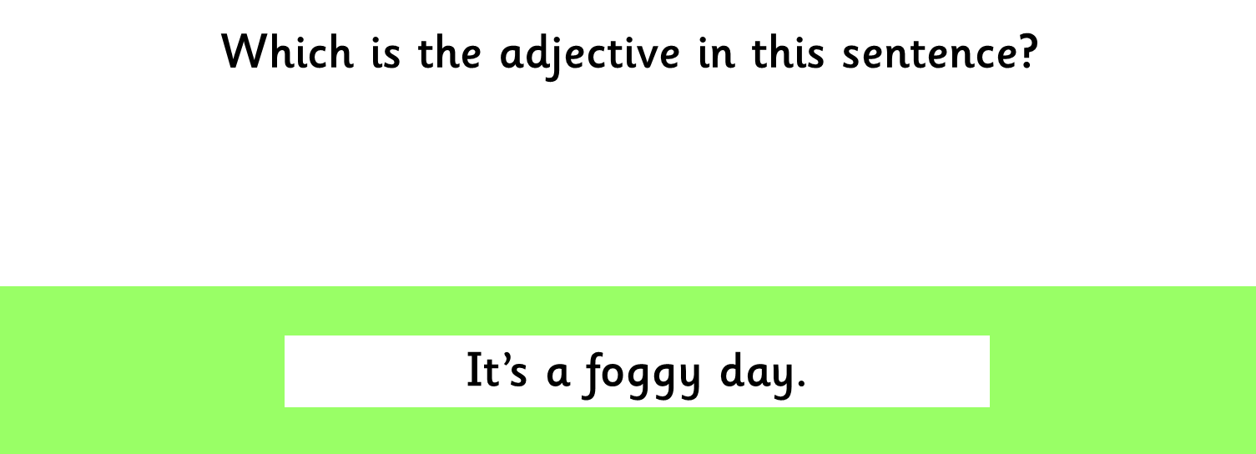
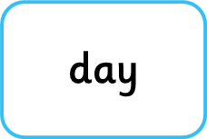
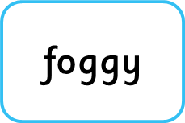
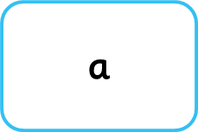

Slide 64
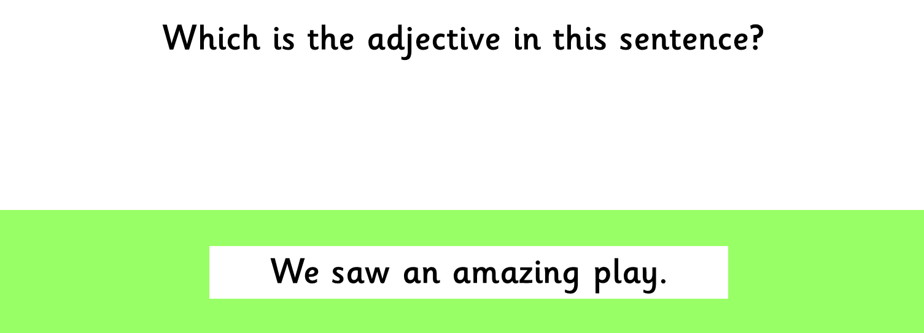
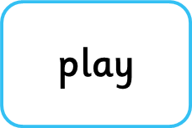
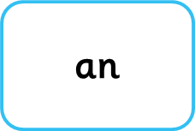

Slide 73
Well done, you completed the quiz!

