Slide 1


Subject: Maths
Pack: A

Slide 2



Date: 8.2.2021
LO. To be able to add two single digit numbers.
Subject: Maths

Slide 3
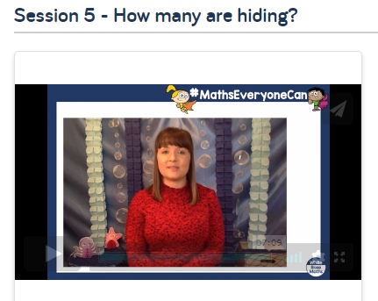
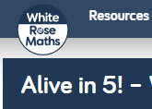
Pre-recorded Teaching
Access the online teaching video below that will support you to complete the work in this lesson. This video will act as a support but all of the work can still be successfully understood & completed using paper-based versions of this pack. If you need further support to understand / complete work then please contact school via e-mail or telephone.
Copy the link below to go to the WhiteRose Maths page.
Choose the video for session 5 – How many are hiding?
https://whiterosemaths.com/homelearning/early-years/alive-in-5-week-2/

Slide 4
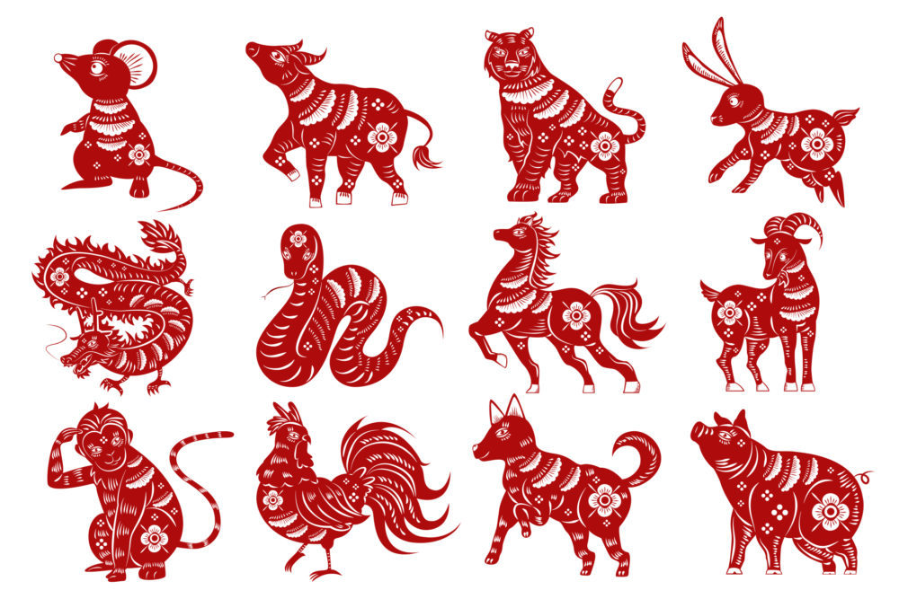
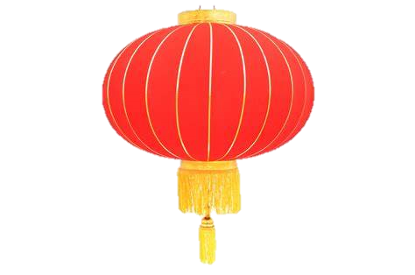

Hidden amounts
If you cannot access the online teaching video then work through the following slides. It is the same learning as the video. If you can access the video, skip to slide 7.
Today we are going to have a look at finding hidden amounts.
I have started with 8 animals altogether.
Count them with me.
Here I can only see 4 of my animals because some of them have been taken away and hidden behind this lantern.
4 + ___ = 8
I know I should have 8 altogether. How many animals are
hiding behind the lantern? 4 + __?__ = 8
1 2 3 4
5 6 7 8
1 2 3 4
?

Slide 5
Hidden amounts
I can find out how many are hidden by using this picture of all 8 animals.
I know I can see 4 animals. I have drawn a circle around the four I have.
Now I can count the animals outside of the circle to see
how many are left.
There are 4 animals outside of the circle.
4 + 4 = 8 “Four animals add four animals, makes 8 animals.”
1 2 3 4
“There must be 4 animals hidden behind the lantern.”

Slide 6
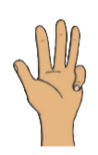
I can also show this using my fingers.
First I hold up 4 fingers on one hand, each finger represents one animal.
As I have 4 fingers I am going to start counting from the number 4. I am going to count on from 4 until I get to 8 adding another finger for each number.
I will stop when I get to 8.
Then I will stop and count how many more fingers I used.
6
7
8
5
I held up 4 more.
This means I have 4 missing animals.
Four and four more make eight. 4 + 4 = 8

Slide 7


Let’s try this one together…
We have 8 animals altogether. 1 2 3 4 5 6 7 8
But here we can only see 5 animals. Some have been taken away and are hidden behind the lantern?
?
1 2 3 4 5
5 + ___ = 5
I know I should have 8 altogether.
How many animals are hiding behind the lantern? 5 + __?__ = 8

Slide 8
Let’s work it out together.
Here are the 8 animals we started with.
I have put a ring around the 5 we can see.
Count the animals ___,___,____
Now can you count how many animals are outside of the circle?
“There must be 3 animals hidden behind the lantern.”
1 2 3 4 5
Now use what you know to fill in the missing numbers parts below.
5 + __= 8 “Five animals add ____ animals, makes 8 animals.”

Slide 9
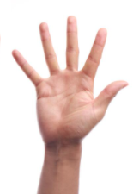
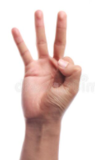
Now lets show this using my fingers.
First I hold up 5 fingers on one hand, each finger represents one animal.
As I have 5 fingers I am going to start counting from the number 5. I am going to count on from 5 until I get to 8 adding another finger for each number.
I will stop when I get to 8.
Then I will stop and count how many more fingers I used.
7
8
6
Complete the missing numbers below
_____ animals and three more make ____.
5 + ______ = 8

Slide 10

Now it’s your turn.
You have 8 animals altogether. 1 2 3 4 5 6 7 8
But here there are only 3 animals. Some have been taken away and are hidden behind the lantern?
1 2 3
3 + ___ = 8
I know I should have 8 altogether.
How many animals are hiding behind the lantern? 3 + __?__ = 8

Slide 11
Can you work it out by yourself.
Here are the 8 animals you started with. Next count the animals that are left.
Put a ring around the number of animals
you can see below.
Tell your adult how many animals must be hidden behind the lantern? Write the answer in the box.
1 2 3
3 + ___ = 8
Ask your adult to say the sentence below and you say the missing parts.
“Three animals, add _______ animals makes eight animals.”

Slide 12
Now can you show me using your fingers.
Hold up 3 fingers on one hand, each finger represents one animal.
You are going to count on from 3 until you get to 8 adding another finger for each number.
Remember to stop when you get to 8.
Then count how many more fingers you used.
Ask your adult to say the sentence below and you say the missing parts.
Three animals and ________ more make eight.
3 + ___ = 8

Slide 13

Have another go.
Try this one.
You have 8 animals altogether. 1 2 3 4 5 6 7 8
But here, there are only 6 animals. Some have been taken away and are hidden behind the lantern?
1 2 3 4 5 6
6 + ___ = 8
“Six animals, add _______ animals makes eight animals.”

Slide 14
Now work it out by yourself.
Here are the 8 animals you started with.
Tell your adult how many animals must be hidden behind the lantern? Write the answer in the box.
1 2 3 4 5 6
6 + ___ = 8
Ask your adult to say the sentence below and you say the missing parts.
“Six animals, add_______ animals makes, six animals.”

Slide 15
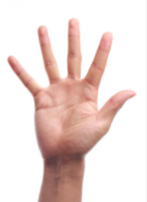

Now can you show me using your fingers.
Hold up 6 fingers on one hand, each finger represents one animal.
You are going to count on from 6 until you get to 8, adding another finger for each number.
Remember to stop when you get to 8.
Then count how many more fingers you used.
Ask your adult to say the sentence below and you say the missing parts.
Six animals and ________ more make eight. 6 + ___ = 8

Slide 16
Date: 9.2.2021
LO. To be able to add two single digit numbers.
Subject: Maths

Slide 17

What’s in the bag?
Today we are going to be developing our understanding of number bonds that make 8.
Look at the Numicon 8.
It has 8 holes.
I know this because I can count them.
1, 2, 3, 4, 5, 6, 7, 8.

Slide 18


What’s in the bag?
Now let’s look at how pairs of other Numicon fit together to make 8.
This is the Numicon that represents the number 2.
This is the Numicon that represents the number 6.
Together they make 8.
2 + 6 = 8
So 2 and 6 are number bonds to 8.

Slide 19


What’s in the bag?
Here are another pair of other Numicon which fit together to make 8.
This is the Numicon that represents the number 3.
This is the Numicon that represents the number 5.
Together they make 8.
3 + 5 = 8
So 3 and 5 are number bonds to 8.

Slide 20

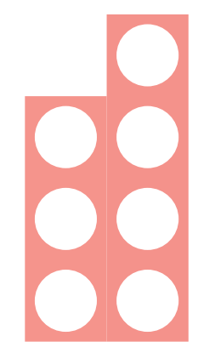
What’s in the bag?
Now let’s do it together.
Let’s put another pair of Numicon together to make 8.
This is the Numicon that represents the number 1.
This is the Numicon that represents the number 7.
Ask your adult to drag them together to make 8.

Slide 21
What’s in the bag?
Now let’s do it together.
That’s correct.
Can you fill out the missing part of the sum below.
I have started it for you.
1 +___ = 8
“One and seven make eight.”
So 1 and 7 are number bonds to 8.

Slide 22

What’s in the bag?
Now let’s do some more together.
Let’s put these pair of Numicon together to make 8.
This is the Numicon that represents the number 4.
Ask your adult to drag them together to make 8.

Slide 23
What’s in the bag?
Now let’s do it together.
That’s correct.
Can you fill out the missing part of the sum below.
I have started it for you.
_____ + 4 = _____
“Four and four make eight.”
So 4 and 4 are number bonds to 8.

Slide 24
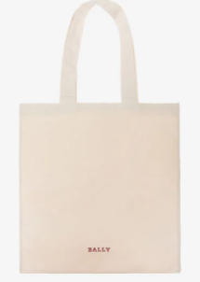
What’s in the bag?
Here are all the Numicon bonds to 8.
Mrs Levington is going to choose a pair of number bonds in this bag so we can not see them.

Slide 25
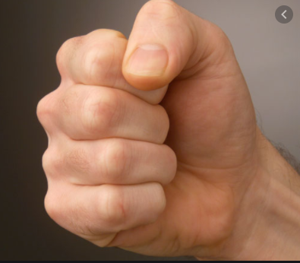
What’s in the bag?
Mr Pennal has taken one of the Numicon out of the bag.
He is hiding it in his hand.
Let’s think about which Numicon could be in Mr Pennal’s hand.

Slide 26

What’s in the bag?
Could Mr Pennal have taken out this Numicon?
No.
That’s right. Mr Pennal could not have taken this Numicon out because this is the Numicon 9. We did not have the Numicon 9 because 9 is not a part of a bond to 8.

Slide 27
What’s in the bag?
Now Mr Pennal has told us that the Numicon in his hand is the Numicon 2.
So what is in the bag?
Let’s work it out by looking at our number bonds again.
Here is the Numicon 2
The Numicon that goes with
2 is 6.
6 must be left in the bag.

Slide 28
What’s in the bag?
Let’s have a look in the bag.
It was 6.
We were right because 6 + 2 = 8
Together they are bonds to 8

Slide 29
What’s in the bag?
Now it’s your turn to work out what’s in the bag.
Mrs Levington has changed the
pair of Numicon in the bag.
Then Mr Pennal took out the
Numicon 4.
So what is in the bag? Remember the total must be 8.
Work it out on the next slide.

Slide 30
What’s in the bag?
Work it out by looking at our number bonds again.
Here is the Numicon 4
Look at which Numicon goes with 4 to make 8.
Complete the sentences below –
It is _______.
I was right because 4 + ____ = 8
Together they are bonds to 8

Slide 31
What’s in the bag?
Mrs Levington changed the pair of Numicon in the bag again.
Then Mr Pennal took out the
Numicon 3.
So what is in the bag? Work it out on the next slide.

Slide 32
What’s in the bag?
Work it out by looking at our number bonds again.
Here is the Numicon 3
Look at which Numicon goes with 3 to make 8.
Complete the sentences below –
It is _______.
I was right because 3 + ____ = 8
Together they are bonds to 8

Slide 33
What’s in the bag?
Mrs Levington changed the pair of Numicon in the bag again.
Then Mr Pennal took out the
Numicon 1.
So what is in the bag? Work it out on the next slide.

Slide 34
What’s in the bag?
Work it out by looking at our number bonds again.
Here is the Numicon 1
Look at which Numicon goes with 1 to make 8.
Complete the sentences below –
It is _______.
I was right because 1 + ____ = 8
Together they are bonds to 8

Slide 35
What’s in the bag?
Great work today!
Mr Pennal almost tricked Mrs Levington when he didn’t have any Numicon in his hand!
But Mrs Levington remembered that 0can
still be used as an amount.
8 + 0 = 8
Together they are bonds to 8

Slide 36
Date: 10.2.2021
LO. To compare the capacity of three containers.
Subject: Maths

Slide 37
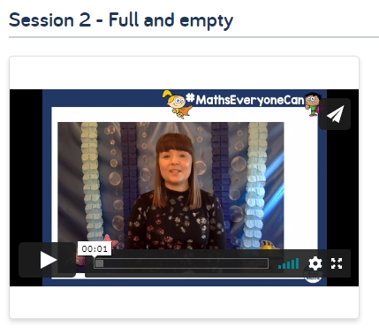
Pre-recorded Teaching
Access the online teaching video below that will support you to complete the work in this lesson. This video will act as a support but all of the work can still be successfully understood & completed using paper-based versions of this pack. If you need further support to understand / complete work then please contact school via e-mail or telephone.
Copy the link below to go to the WhiteRose Maths page.
Choose the video for session 2 – full and empty.
https://whiterosemaths.com/homelearning/early-years/alive-in-5-week-3/

Slide 38
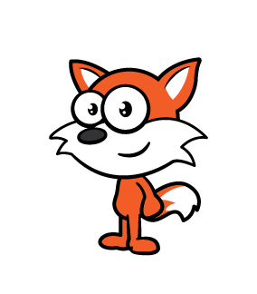
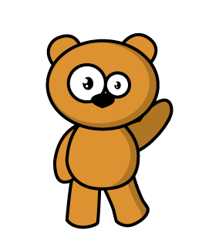

Today we are going to be thinking about full and empty.
Here we have a bear and a fox.
Talk to your adult about who has the empty glass.
Yes. The fox has the empty glass because he doesn’t have any orange juice in his glass.

Slide 39
Now talk to your adult about who has the full glass.
Yes. The bear’s glass is full because we can see that it is filled right up to the top with orange juice. It is full.

Slide 40
Oh no!
What happened?
The bear has knocked over his glass and all of his orange juice has spilt all over the floor.
Talk to your adult about the bear’s glass now.
Yes he has split all of his juice so the bear’s glass is now empty.

Slide 41
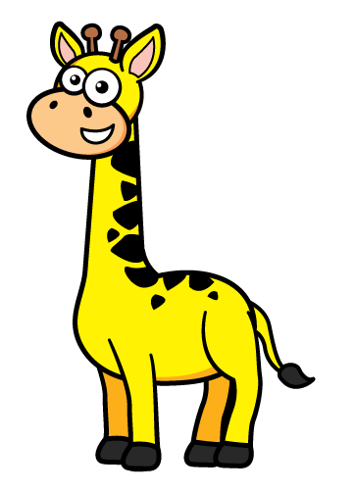
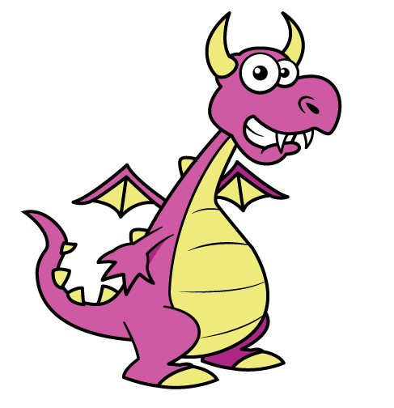
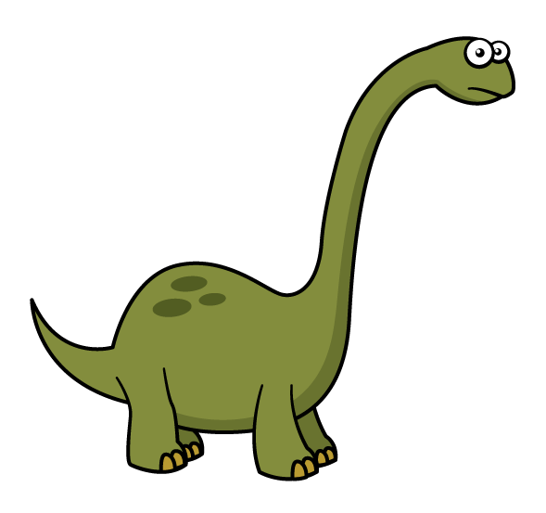
Here are some different animals.
Talk to your adult about what you notice this time.
Yes. Each of these animals has an empty glass. There isn’t any liquid in these glasses. They are all empty.
The animals are very thirsty though. Let’s give them a drink.

Slide 42
Talk to your adult about what you notice now.
Yes. Each of the animal’s glasses are full.
They all have a glass which is full to the top of orange juice.
They are all full.
Now the giraffe is going to have a drink of his juice.

Slide 43
Talk to your adult about what you notice now.
Yes. The giraffe has had a little bit of juice so the giraffe’s glass isn’t full to the top any more but there is still some juice in the glass. So we can say that the giraffe’s glass is nearly full.
It’s not full to the top but it’s nearly full.
Now the dinosaur is going to have a drink.

Slide 44
Talk to your adult about what you notice now.
Yes. The dinosaur’s glass is empty now.
The dinosaur drank all of his juice. There isn’t any left. So his glass is empty.
Now the dragon is going to have a drink.

Slide 45
Talk to your adult about what you notice now.
Yes. The dragon drank most of his drink.
It’s not empty because there is still a little bit of juice in the bottom.
Because the dragon drank most of his juice we can say his glass is nearly empty. There is still some juice there but most of it has gone. So the dragon’s glass is nearly empty.

Slide 46
Here are two glasses. Point to the glass that is nearly full.
Yes. The giraffe’s glass is nearly full. It’s not full to the top but it is nearly full.
Now point to the glass that is nearly empty.
Yes. The dragon’s glass is nearly empty because there is only a little bit of juice in the bottom. It’s not completely empty as there is still some juice there but there is only a little bit of juice so this glass is nearly empty.

Slide 47
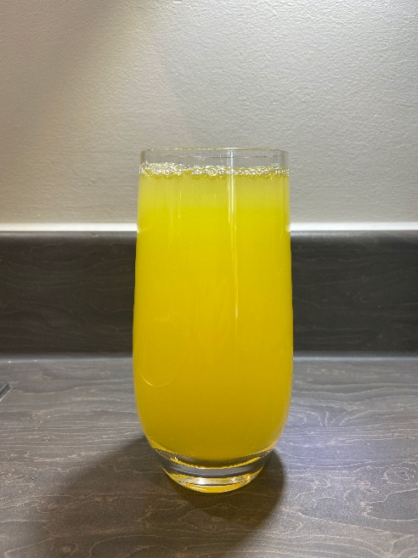
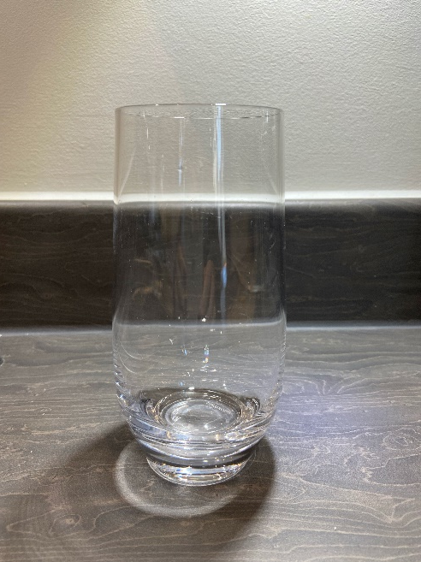
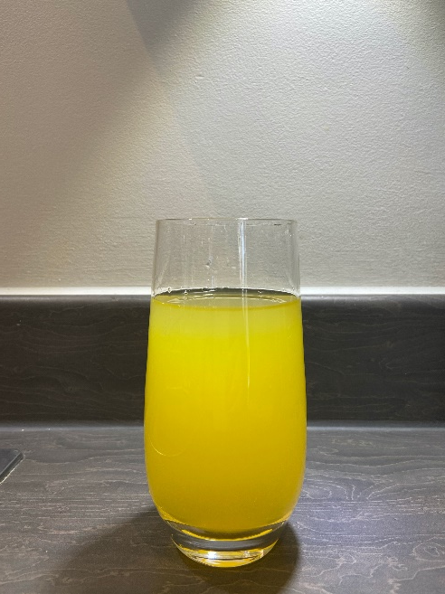
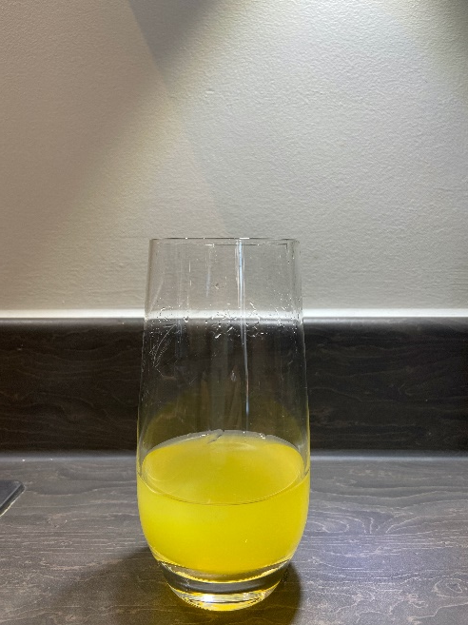
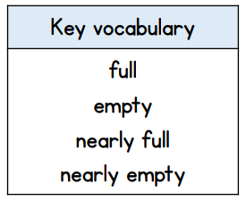
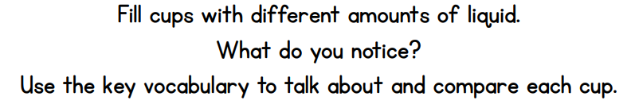
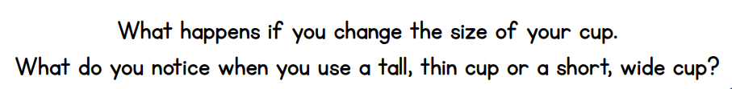
Now it’s your turn. Go and explore this further with the help of your adult..
A full glass
An empty glass
A nearly full glass
A nearly empty glass

Slide 48
Now find another cup that holds more than your first cup.
A full glass
Draw your 3 glasses here or on your own paper.
and another cup that holds less than your first cup.
Tell your adult what you notice about these cups.
Send us some pictures of your capacity investigations.
We would love to see them.

Slide 49
Date: 11.2.2021
LO. To be able to discuss and compare quantities.
Subject: Maths

Slide 50
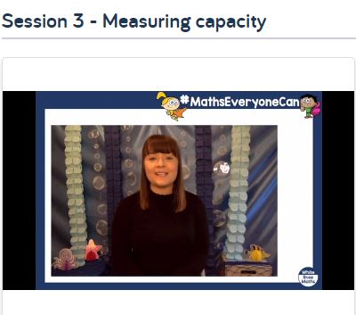
Pre-recorded Teaching
Access the online teaching video below that will support you to complete the work in this lesson. This video will act as a support but all of the work can still be successfully understood & completed using paper-based versions of this pack. If you need further support to understand / complete work then please contact school via e-mail or telephone.
Copy the link below to go to the WhiteRose Maths page.
Choose the video for session 3 – measuring capacity
https://whiterosemaths.com/homelearning/early-years/alive-in-5-week-3/

Slide 51
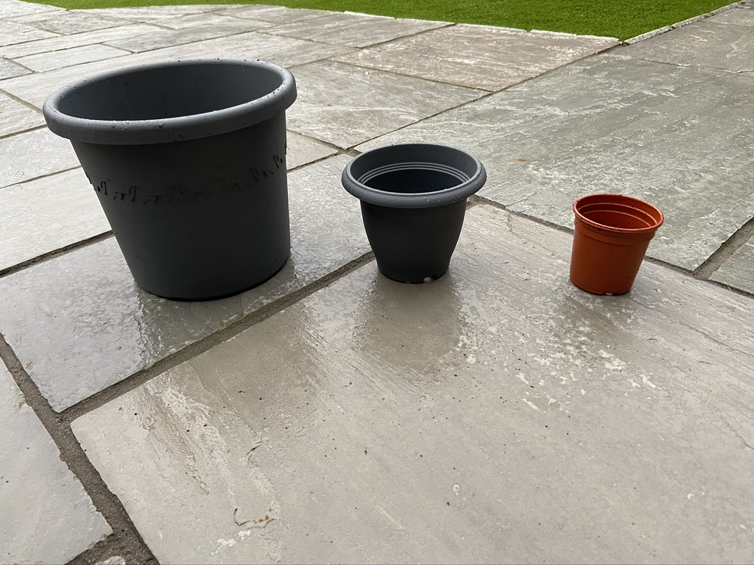
Measuring capacity.
Today we are going to be filling containers and measuring how much each one holds.
Here are Mrs Levington’s 3 containers. I am going to fill each one with soil ready to plant my flowers. Can you see they are all different sizes?
Have a good look. Tell your adult which
pot you think will hold the most soil.
Which do you think will hold the least
amount of soil?
Let’s find out.
I will fill each plant pot with soil.

Slide 52
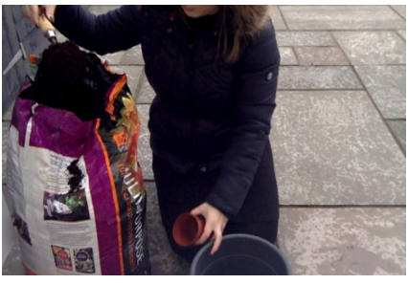
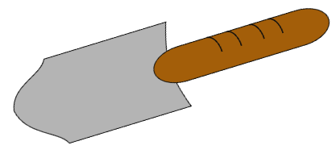
Measuring capacity.
First I will fill the smallest pot with soil. I will use my trowel.
How many trowels full of soil do you think will fit in this smallest pot?
It took 1 trowel full of soil to fill this
smallest pot.
1

Slide 53
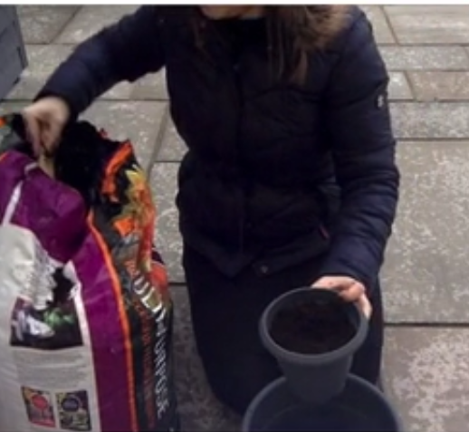
Measuring capacity.
Now I will fill the next size pot with soil. I will use my trowel again.
How many trowels full of soil do you think will fit in this next pot?
It took 3 trowels full of soil to fill this
next pot.
3

Slide 54
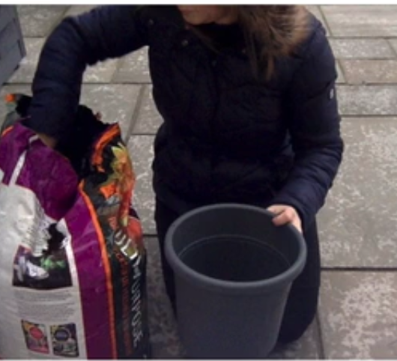
Measuring capacity.
Now I will fill the last and biggest pot with soil. I will use my trowel again.
How many trowels full of soil do you think will fit in this biggest pot?
It took 13 trowels full of soil to fill this
next pot. It was the biggest pot.
13

Slide 55
Measuring capacity.
So here are the different sized plant pots again.
The smallest plant pot held 1 trowel full of
soil.
The next pot was larger so this held 3 trowels
of soil.
And the largest pot held 13 trowels of soil.
Tell your adult which pot holds the most soil.
Yes. The largest pot holds the most soil and
the smallest pot holds the least soil.
1
3
13

Slide 56
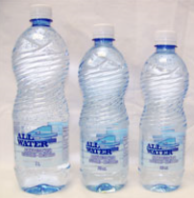
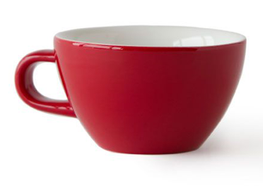
Measuring capacity.
Now let’s do one together.
I have found three different sized bottles.
I have a large, medium and small bottle.
I am going to fill all three bottles with the same cup.
The middle sized bottle was full from three cups.

Slide 57
Measuring capacity.
Now let’s do one together.
The middle sized bottle was full from four cups.
Can you write down how many cups you think will fill the large bottle?
Tell your adult if it is more or less than the medium sized bottle.
Can you write down how many cups will fill the small bottle?
Tell your adult if it is more or less than the medium sized bottle.
Head to the next slide to find out if you were right.
4

Slide 58
Measuring capacity.
The large bottle took 9 cups to fill.
This was more than the medium size bottle.
The small bottle took 2 cups to fill.
This was less than the medium size bottle.
Head to the next slide to find out if you were right.
9
4
2

Slide 59
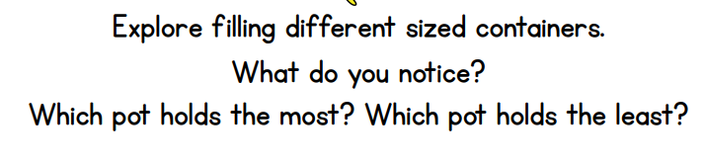
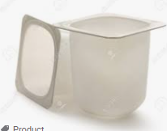
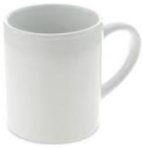
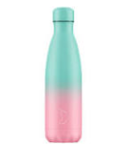
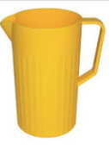
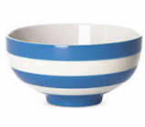
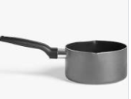
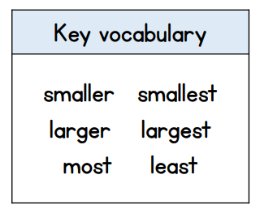
Now it’s your turn. Go and explore this further.
Now use the smallest container to fill up bigger containers.
Count how many small cups it takes to fill the other containers.
Record your results in the table on the next slide.

Slide 60
Now it’s your turn. Go and explore this further.
Draw a picture of 3 of your containers in the first column. Then count how many small cups it takes to fill each one and record this on the table in the next column.
Alternatively, you can draw your own table.
Draw your containers in this column | How many small cups full did it take to fill?

Slide 61
Date: 12.2.2021
LO. To discuss and compare quantities.
Subject: Maths

Slide 62
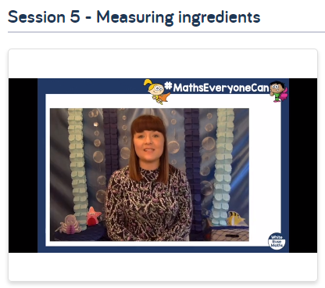
Pre-recorded Teaching
Access the online teaching video below that will support you to complete the work in this lesson. This video will act as a support but all of the work can still be successfully understood & completed using paper-based versions of this pack. If you need further support to understand / complete work then please contact school via e-mail or telephone.
Copy the link below to go to the WhiteRose Maths page.
Choose the video for session 5 – measuring ingredients.
https://whiterosemaths.com/homelearning/early-years/alive-in-5-week-3/

Slide 63

Measuring ingredients.
Today we have an exciting job! We are going to be measuring ingredients
to make our own playdough.
To make the best playdough we need to carefully measure the right amount of our ingredients.
The measuring tools we are going to use today are a cup and a spoon. This will help us make sure we get the right amount of each ingredient.
Throughout this experience you will be able to talk to your adult about the quantities you are using. You could talk about whether your measuring tools are full, nearly full or empty. Whether you need more of an ingredient or whether you have used too much of an ingredient.
Remember the talk is important.

Slide 64

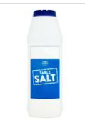
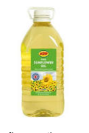
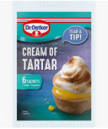
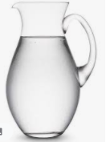
Measuring ingredients.
We also need a big bowl to mix the ingredients together.
With your adult, go and get a cup, a table spoon and a bowl.
You will also need your adult to get the ingredients:
plain flour
salt
water
cream of tartar
oil

Slide 65
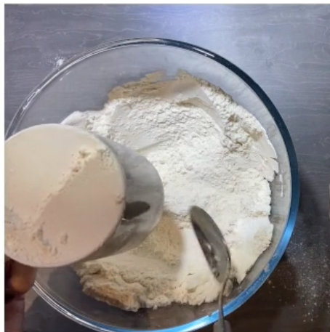
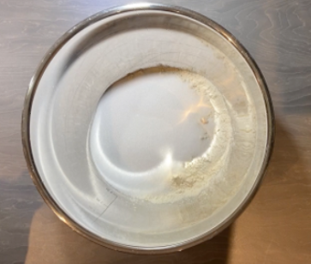
Measuring ingredients.
The first ingredient we need is flour.
Measure 2 cups full of flour.
Put it in your big bowl.
Look how full my cup is. Make sure you fill your cup right to the top.

Slide 66
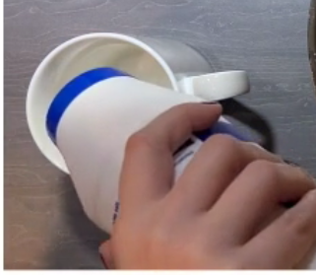
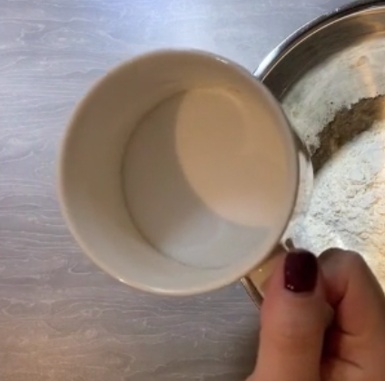
Measuring ingredients.
The next ingredient we need is salt.
Measure half a cup full of salt.
Add it to the big bowl with the flour.
Look how my cup is half full. Make sure you fill your cup only half way.

Slide 67
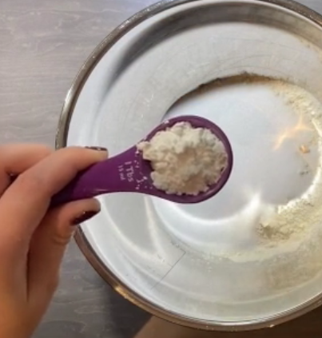
Measuring ingredients.
The next ingredient we need is cream of tartar.
We will need 2 spoons full.
Measure 2 spoons full.
Add it to the big bowl with the flour and salt.
Look how my spoon is full. Make sure you have a full spoon.

Slide 68

Measuring ingredients.
The next ingredient we need is oil.
We will need 2 spoons full.
Measure 2 spoons full.
Add it to the big bowl with the flour, salt and cream of tartar.
Look how my spoon is full. Make sure you have a full spoon.

Slide 69


Measuring ingredients.
The next ingredient is hot water.
We will need 1 cup full.
Get your adult to do this bit for you.
Measure 1 cup full.
Add it to the big bowl with the flour, salt, cream of tartar and oil.
Look how full my cup is. Make sure you have a full cup.

Slide 70

Measuring ingredients.
Measure 1 cup full.
If you want your dough to be colourful. Add some food colouring now.

Slide 71



Measuring ingredients.
The last thing to do is to knead our dough.
Squash and squeeze it all together in a big ball.
Now we can have fun playing with it.
Why don’t you send us some pictures of yourself making the dough and how it turned out. We really would love to see your creations.
Parents – If you do not have all the ingredients for playdough then you could try this super simple recipe for salt dough. All you need is 1 cup of flour, ½ a cup of salt and a ½ a cup of warm water. Mix and knead them altogether and you will have lovely dough for your child to play with and they will still get to try out some measuring whilst you make it together.

Slide 72

Measuring ingredients.
Here is the recipe if you want to make your own play dough again some time.
.
What will you make with your playdough?
You could try making some dough Fortune cookies.

