Slide 1
Hello reception, we hope that you enjoyed your home learning last week and had some great fun with the activities. Here you can find your home learning pack for this week.
We have put together some new exciting activities to learn about while you are at home this week. There’s a new phonics section in your pack this week with some ideas on how you can keep learning your sounds at home. Again, we are always here to help and support you with your learning.
We hope you have lots of fun and enjoy your home learning. From the reception staff.

Slide 2
Parent Guidance
We hope we find you safe and well during these difficult times. We recognise that home learning provides its own challenges and is not always easy. We have put together some daily learning for your children. They have several activities for each day which will hopefully keep their learning moving forward. As the children are still so little the activities will need to be supported by an adult. All children learn differently and at different paces, as well as needing different levels of support. Some children may just need you to be with them while others may need you to write things out for them and support them step by step. All of this is fine. We want the activities to be fun for everybody, including yourselves. ☺
When completing this weeks work please make sure it is completed either on the PowerPoint, or if this isn’t possible written onto paper. This will be used as evidence that the home learning is being completed.
The reception staff at school are always here for you and are ready to help with any queries that you may have. If you have any problems please get in touch via the methods below and we will get back to you as soon as we can.
Email: explorerspupils@gmail.com
Telephone: 01429 820594
Hopefully we will see you all in person really soon, stay safe. The reception team.
Monday | Tuesday | Wednesday | Thursday | Friday
1 phonics activity English Maths Topic | 1 phonics activity English Maths Topic | 1 phonics activity English Maths Topic | 1 phonics activity English Maths Topic | 1 phonics activity English Maths Topic

Slide 3
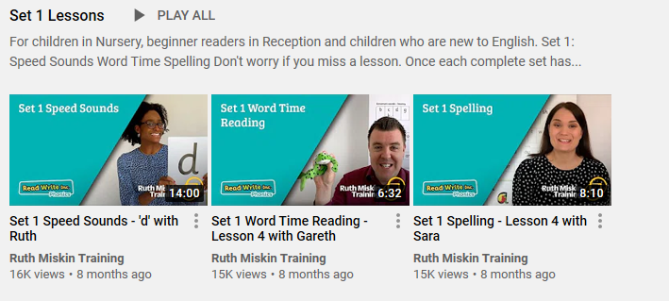
https://www.youtube.com/channel/UCo7fbLgY2oA_cFCIg9GdxtQ?mc_cid=71ef745098&mc_eid=c9705b8c67
Phonics information for remote learning.
At school, the children have daily phonics sessions to teach the letter sounds. In Term 1, reception children were taught all set 1 sounds, how to split simple words into sounds and how to blend sounds together to make words. All children will be at different stages with which sounds they can remember but it will still be beneficial to recap sounds already taught.
The image above is an example of the videos which are available through Read Write Inc on their YouTube channel for you to access daily from home (See link below). The Speed sound lesson video (Circled above) will change daily and the other two videos are there as an example of how to read and spell simple words using the sounds.
S sSubject: Phonics

Slide 4
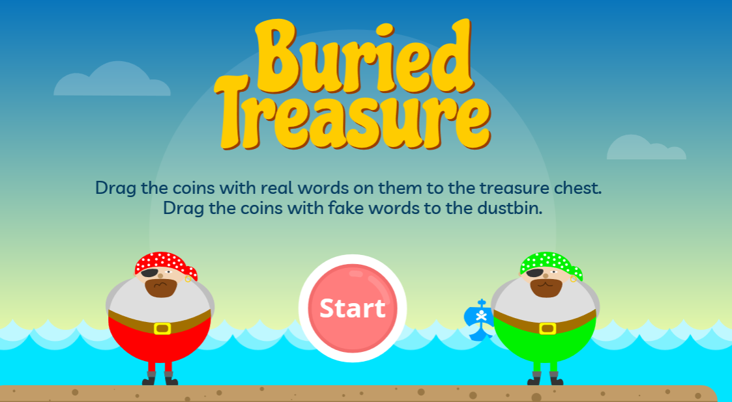
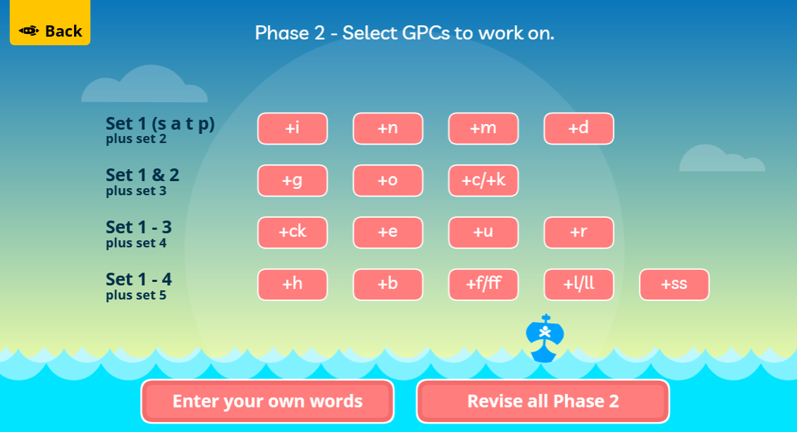
Phonics information for remote learning.
Here are some links to online phonics games you can play with your child at home.
Buried treasure
https://www.phonicsplay.co.uk/resources/phase/2/buried-treasure
After clicking start, choose phase 2 and revise all phase 2 sounds.

Slide 5
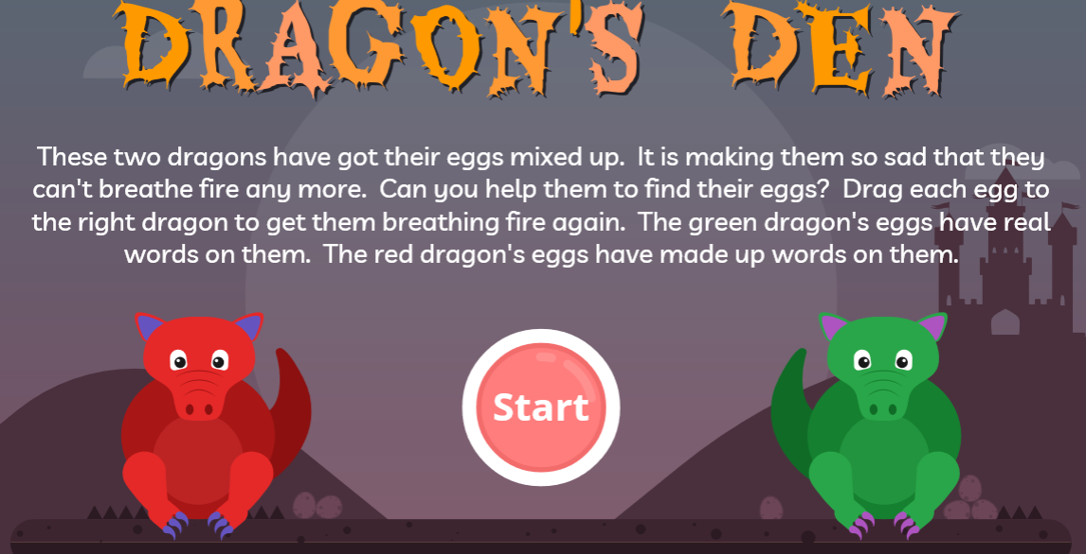
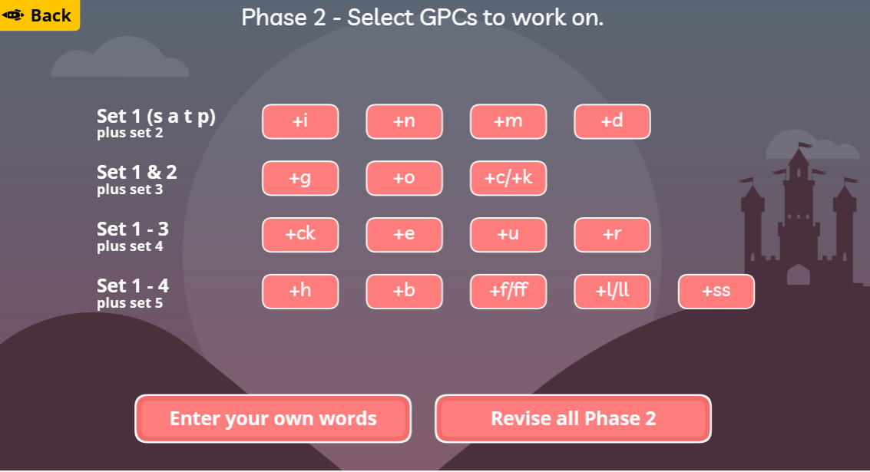
Phonics information for remote learning.
Here are some links to online phonics games you can play with your child at home.
Dragon's Den
https://www.phonicsplay.co.uk/resources/phase/2/dragons-den
After clicking start, choose phase 2 and revise all phase 2 sounds.

Slide 6
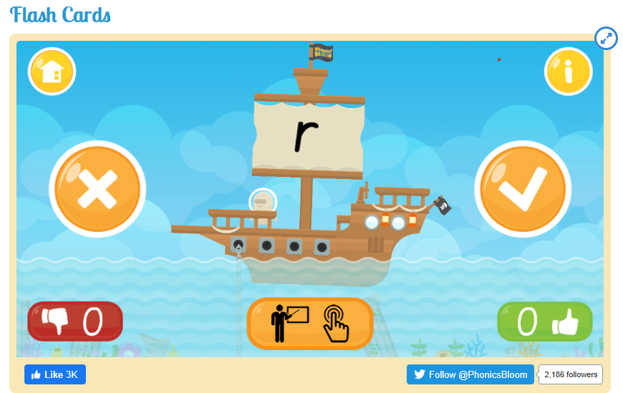
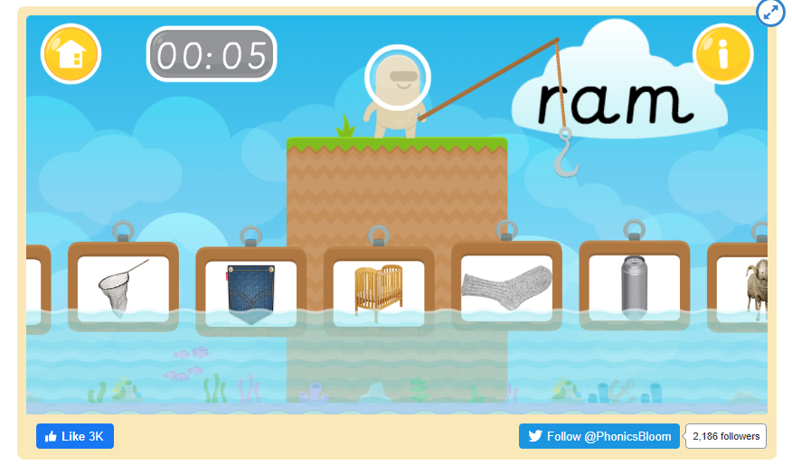
Phonics information for remote learning.
Here are some links to online phonics games you can play with your child at home.
Flash cards
https://www.phonicsbloom.com/uk/game/flash-cards?phase=2
Fishy Phonics
https://www.phonicsbloom.com/uk/game/fishy-phonics?phase=2

Slide 7
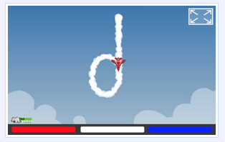
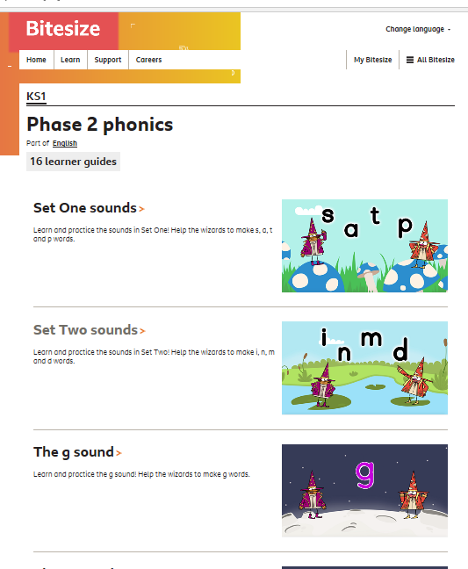
Phonics information for remote learning.
Here are some links to online phonics games you can play with your child at home.
Sky Writer
This is not a game but it demonstrates letter formation in a fun way.
http://www.ictgames.com/mobilePage/skyWriter/index.html
BBC Bitesize Phonics videos
This is a collection of fun videos to learn all about the set 1 and 2 sounds.
https://www.bbc.co.uk/bitesize/topics/zf2yf4j

Slide 8
Date: Monday 11th January 2021
LO. To be able to recognise how stories are structured.
Subject: English

Slide 9
This week we will be looking at the fairy tale The Three Little Pigs. Please start by watching the animated video.
Video
Copy and paste the link to watch the video of The Three Little Pigs.
https://youtu.be/QLR2pLUsl-Y

Slide 10
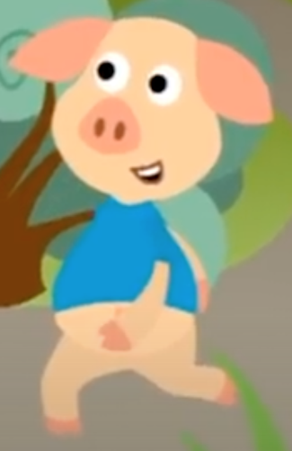
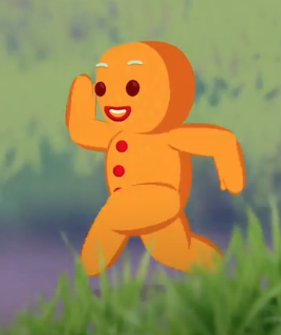
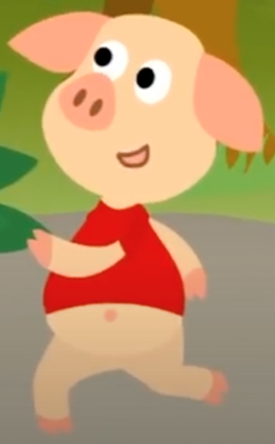
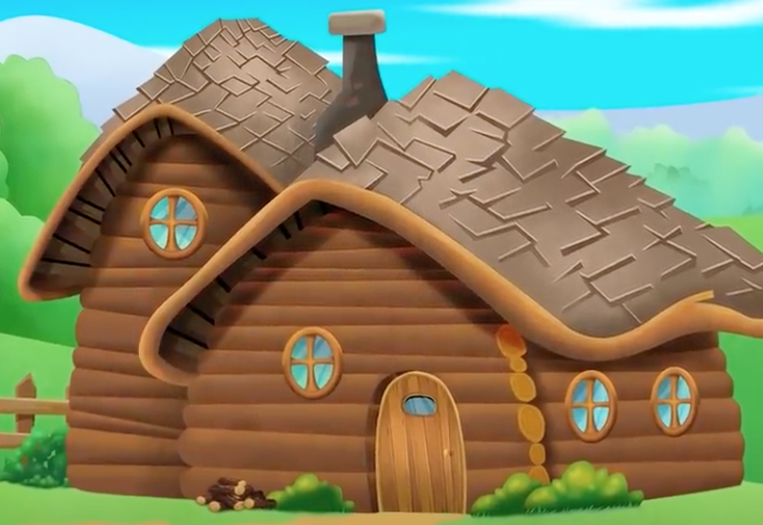
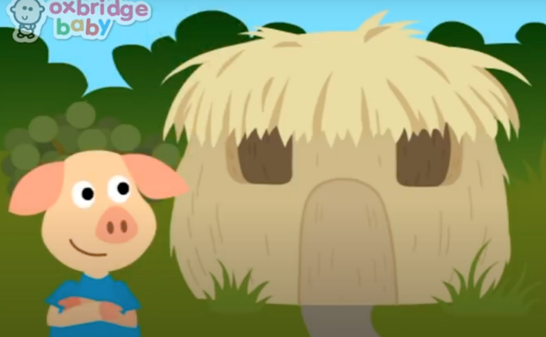
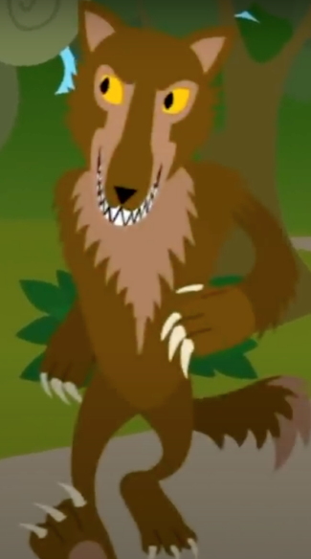
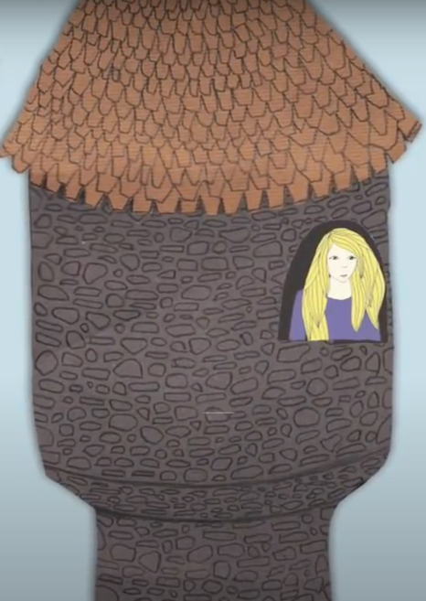
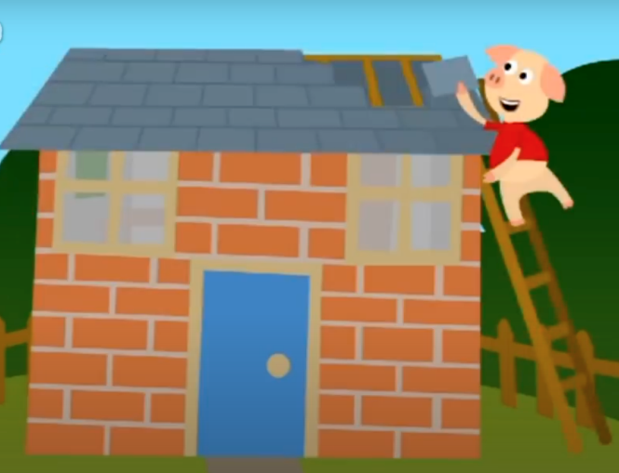
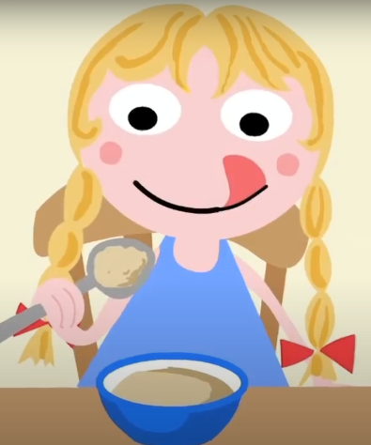
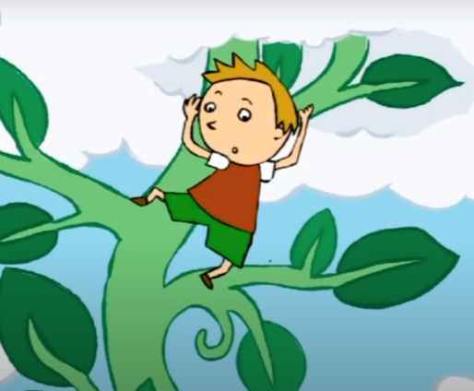
Now you have watched the video we are sure you know all about this fabulous story.
Our first job today is to look at how the story is put together.
We are going to look at who is in the story, where it happened and what they do.
Put a circle around the correct characters and houses from our story.
Who | Where

Slide 11
Think of all the characters in the book, think about what they do in the story. Write your answers in the box below. Your adult can help you with this.
What

Slide 12
Date: 11.1.2021
LO. To be able to add one more.
Subject: Maths

Slide 13
Pre-recorded Teaching
Access the online teaching video below that will support you to complete the work in this lesson. This video will act as a support but all of the work can still be successfully understood & completed using paper-based versions of this pack. If you need further support to understand / complete work then please contact school via e-mail or telephone.
Play Video

Slide 14
This week in maths we are going to be learning about adding 1 more.
There are a few different ways that we can add one more, we can collect objects and add one more or we can look at numbers and think about what comes next.
Lets start by adding one more dot to these five frames.
I had 3 circles in my five frame, I added one more to make 4.
Can you try adding one more circle to the five frames below.
One more can be added to anything. Try the next slide to add one more to different objects.

Slide 15
Write your answers either on some paper or in the box on the PowerPoint. You can draw your one extra object in the space next to the picture but make sure you still count the total.
I have 6 sweets. Show me 1 more. 1 more than 6 is
7
I have 2 flowers. Show me 1 more. 1 more than 2 is
I have 5 coins. Show me 1 more. 1 more than 5 is

Slide 16
I have 7 socks. Show me 1 more. 1 more than 7 is
I have 9 apples. Show me 1 more. 1 more than 9 is
I have 4 stars. Show me 1 more. 1 more than 4 is

Slide 17
Date: Monday 11th January 2021
LO
LO. To be able to make a simple representation of an animal
Subject: Art

Slide 18
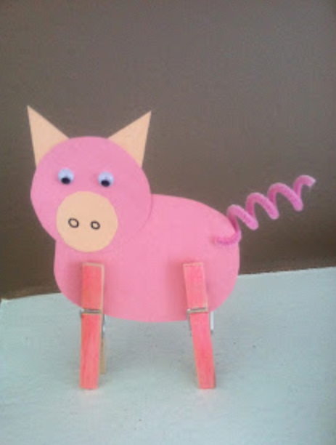
Today we thought you might like to make your own pig.
You will need the following:
Scissors
Two pegs
Black pen
Paint or colouring pencil
Glue
Pipe cleaner
Paper or card
Firstly, you will need to draw each part of the pig before cutting it out
and decorating it.
You can then use either pencil or paint to decorate your pig.
Once you have done that you can glue each part of the pig together.
If you have a pipe cleaner you can add that on for the tail.
Can you identify the different types of shapes you are drawing.

Slide 19
Date: Tuesday 12th January 2021
LO. To be able to write a simple sentence.
Subject: English

Slide 20
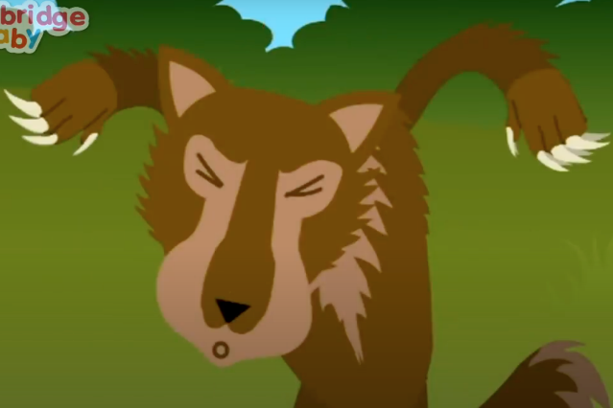
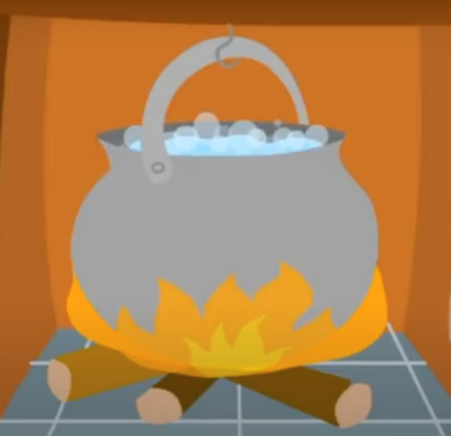
Here are some sentences from the story.
Some of the words in our sentences are missing. Can you pick the correct missing work and put it into the gap.
The little _______ built a house out of straw.
dog
pig
The big _______ wolf huffed and puffed.
bad
sad
The wolf fell in the boiling _______ .
bed
pot

Slide 21
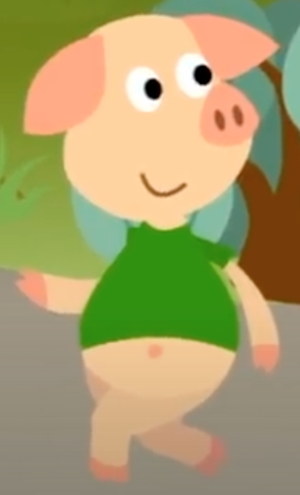
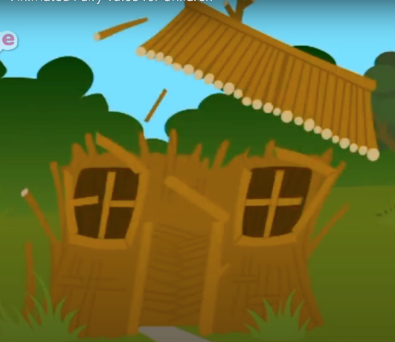
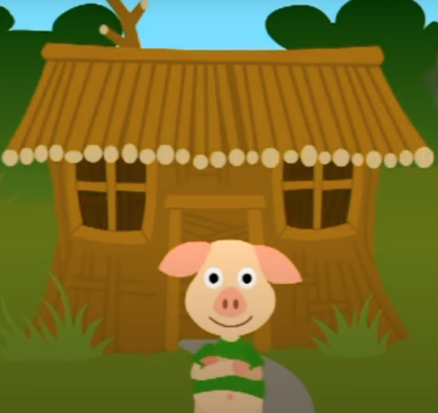
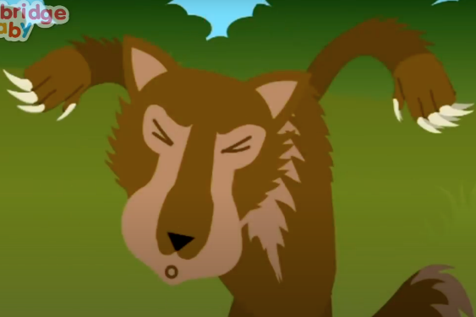
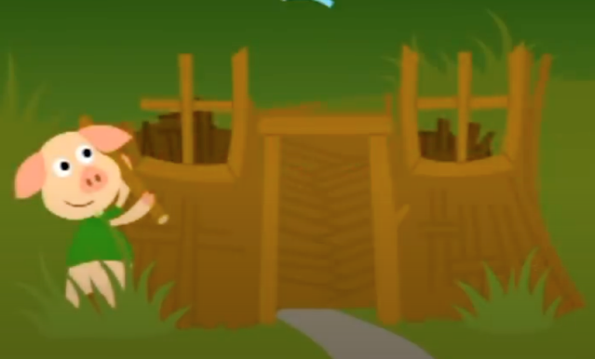
Use the colored boxes below to build two who, doing, what sentences. Make sure your sentence makes sense before writing them into the box below.
Who | Doing | What
is blowing
built a house
down the house.
out of sticks.
The little pig
The big bad wolf
Who | Doing | What

Slide 22
Date: 12.1.2021
LO. To be able to add one more using digits.
Subject: Maths

Slide 23
Pre-recorded Teaching
Access the online teaching video below that will support you to complete the work in this lesson. This video will act as a support but all of the work can still be successfully understood & completed using paper-based versions of this pack. If you need further support to understand / complete work then please contact school via e-mail or telephone.
Play Video

Slide 24
Adding one more digit
Can you put your finger on the number given and jump to the next number. This tells you what one more is.
Can you complete the questions below.
1 more than 5 =
1 more than 9 =
6
1 more than 2 =
1 more than 1 =
1 more than 6 =
1 more than 8 =
1 more than 4 =
1 more than 3 =
1 more than 7 =
1 more than 0 =

Slide 25
Date: Tuesday 12th January 2021
LO
LO. To identify different types of homes.
Subject: Geography

Slide 26
Pre-recorded Teaching
Access the online teaching video below that will support you to complete the work in this lesson. This video will act as a support but all of the work can still be successfully understood & completed using paper-based versions of this pack. If you need further support to understand / complete work then please contact school via e-mail or telephone.
Play Video

Slide 27
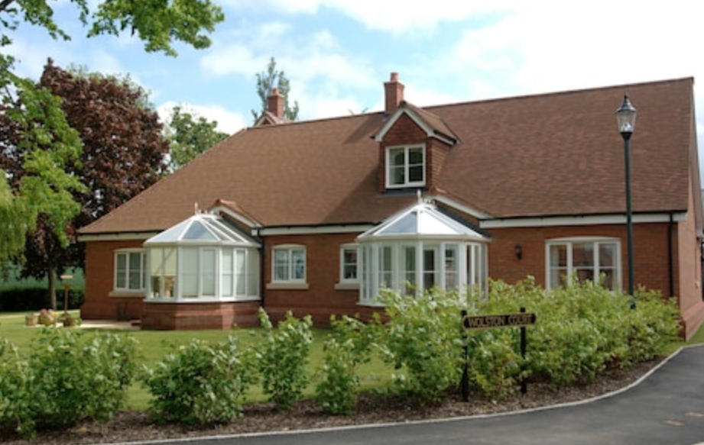
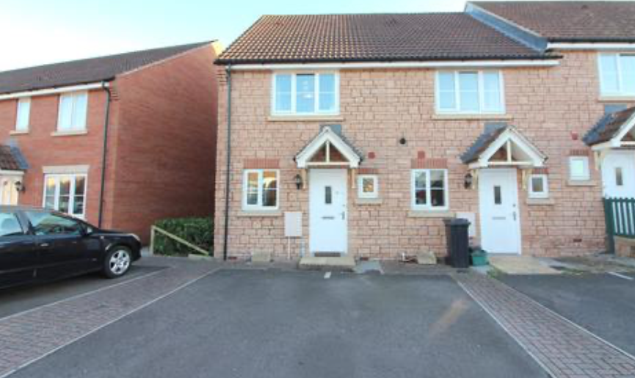
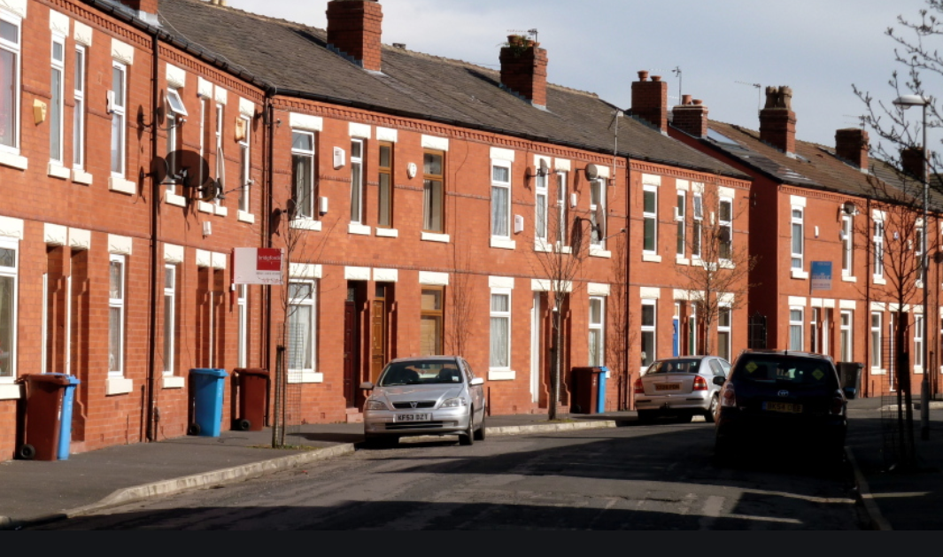
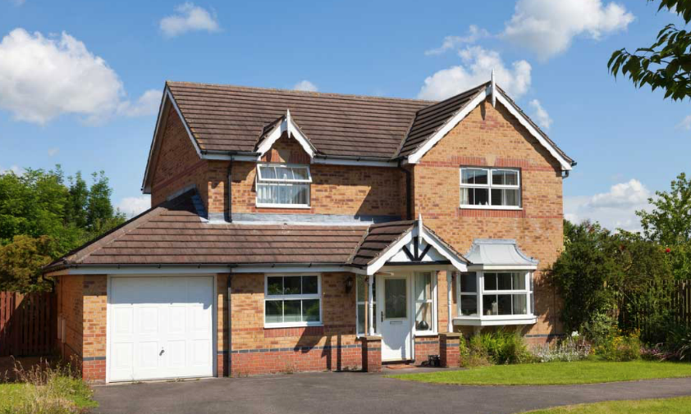
Today we will discuss the different types of homes that we can see in our surroundings.
Can you look out of your window and see what type of homes you can see?
You might be able to see the following homes:
A bungalow
A semi detached house
A terrace house
A detached house

Slide 28
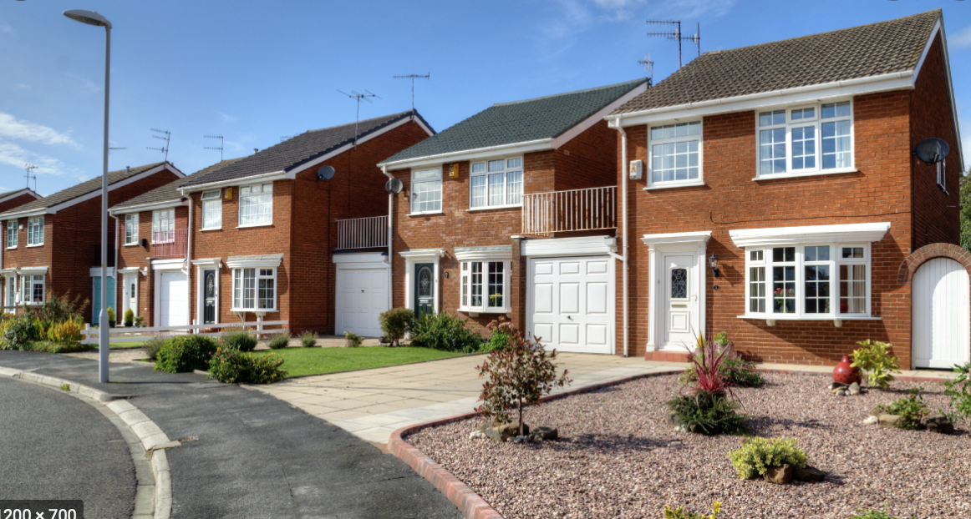
Discuss with your adult the different types of homes you can see.
Does each house look the same? Do they look strong?
Why do they look strong?
What are they made from?
Now go for a walk outside and see if you can notice any homes that are different to the ones you saw from your window?

Slide 29
Observations
Draw a type of house you can see.

Slide 30
Date: Wednesday 13th January 2021
LO. To be able to recognise how stories are structured.
Subject: English

Slide 31
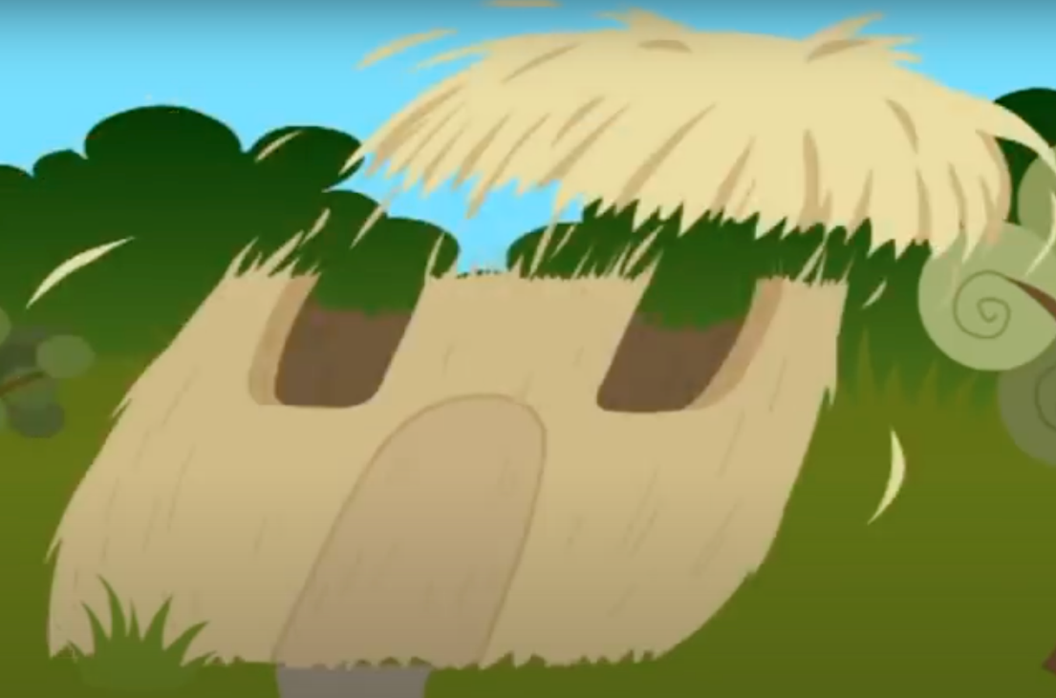
Well done on writing two lovely sentences yesterday. You are getting really good at using our colourful semantics. Today we are going to think about the different parts of the story. Did you know that every story has a beginning, middle and an end.
Beginning
Middle
Can you tell your adult what the three pigs build their houses out of in the beginning of the story.
Can you tell your adult which two houses the wolf blew down in the middle of the story. Also what did the wolf say as he was blowing the houses down?
The three little pig leave home to build their house out of…
The wolf came along and blew the first two pigs’ houses down…

Slide 32
We thought you might like to retell the end of the story. You can either write it down or draw pictures to show what happens. You can draw this on paper if you are working online.
What house did not get blown down?
Where was the wolf at the end?
What happened to the wolf?
Talk about these things with your adults before writing your sentence or drawing your picture.

Slide 33
Date: 13.1.2021
LO. To be able to use part-part-whole to add one more.
Subject: Maths

Slide 34
Pre-recorded Teaching
Access the online teaching video below that will support you to complete the work in this lesson. This video will act as a support but all of the work can still be successfully understood & completed using paper-based versions of this pack. If you need further support to understand / complete work then please contact school via e-mail or telephone.
Play Video

Slide 35
Instructions
Each slide shows a part-whole model with two numbers in the ‘part’.
The ‘whole’ parts of the model is missing.
One of the parts will always be the number 1
Can you work out the missing ‘whole’ number?
Can you say the equation? ‘three add one equals four’
Choose the correct number shape to complete the part-whole model.

Slide 36
Find the correct Numicon piece that shows the answer and drag it into the ‘whole’ circle. (Draw the correct number of circles if you are working on paper.

Slide 37
Find the correct Numicon piece that shows the answer and drag it into the ‘whole’ circle. (Draw the correct number of circles if you are working on paper.

Slide 38
Find the correct Numicon piece that shows the answer and drag it into the ‘whole’ circle. (Draw the correct number of circles if you are working on paper.

Slide 39
Find the correct Numicon piece that shows the answer and drag it into the ‘whole’ circle. (Draw the correct number of circles if you are working on paper.

Slide 40
Find the correct Numicon piece that shows the answer and drag it into the ‘whole’ circle. (Draw the correct number of circles if you are working on paper.

Slide 41
Date: Wednesday 13th January 2021
LO
LO. To know information is available from a computer.
Subject: Computing

Slide 42
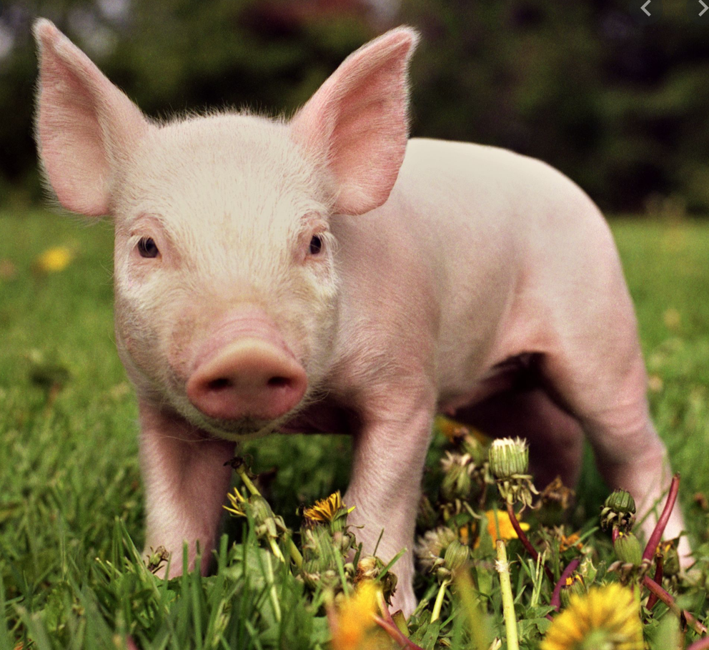
Today we are going to make a fact file about a pig.
Work with your adult to research all about a pig.
Questions to answer and think about:
Where do pigs live?
What do you call a baby pig?
What do you call a boy and girl pig?
What does a pig eat?
What is interesting about the pigs nose?
You can tell us any other interesting facts you have found about a pig.
You can get your adult to help you complete this activity.
On the next slide you can record the facts you have found online and show us what you have found out.

Slide 43
Key facts about a pig

Slide 44
Date: Thursday 14th January 2021
LO. To be able to respond to situations in a story.
Subject: English

Slide 45
Today we are going to think about the three little pigs, they mut have been so scared when they left home. Here are some words to describe how they might have felt.
Can you pick your favourite two words? Draw a circle around them.
Scared
Unsure
Grown up
Worried
Excited
Sad
Brave
Nervous
Confident
Can you finish the sentence below using your two favorite words to describe the pigs.
The little pigs felt __________________ and __________________

Slide 46
Imagine you were a little pig and needed to build a home. What would you build your house out of. Here are some ideas:
Grass / Wood / Cardboard / Ice / Glass / Plastic / Foam / Bricks
If I was a pig I would build my house out of __________________ .
Talk with your adult about why you chose this material to build your house.
Why did you choose this material?
Do you think there would be any problems with your house?
Do you think the wolf could blow your house down? (Circle your answer)
YES NO

Slide 47
Date: 14.1.2021
LO. To be able to add one more.
Subject: Maths

Slide 48
Finding one more is the same as adding one more. Can you solve these addition questions using what you have learnt this week?
4 + 1 =
7 + 1 =
2 + 1 =
3 + 1 =
6 + 1 =
9 + 1 =
8 + 1 =
5 + 1 =
1 + 1 =
10 + 1 =

Slide 49
Date: Thursday 14th January 2021
LO
LO. To observe and comment on different building materials.
Subject: Science

Slide 50
Pre-recorded Teaching
Access the online teaching video below that will support you to complete the work in this lesson. This video will act as a support but all of the work can still be successfully understood & completed using paper-based versions of this pack. If you need further support to understand / complete work then please contact school via e-mail or telephone.
Play Video

Slide 51
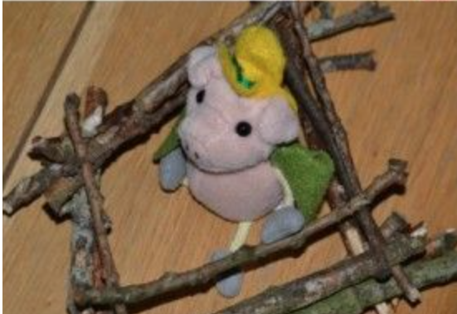
Today we will be making our own home for the three little pigs. We will need to test out our home to make sure it is safe for the pigs to live in it.
You can use any materials you have in the house to complete this activity. Make sure you think about the material you are using.
What materials did the pigs use for their homes and which ones did not work?
What will you use to help hold the house together?
Will the wolf be able to blow your house down?
Discuss the different types of materials you are going to use before starting your experiment.

Slide 52
We thought you might want to sing this song while your building your own home.

Slide 53
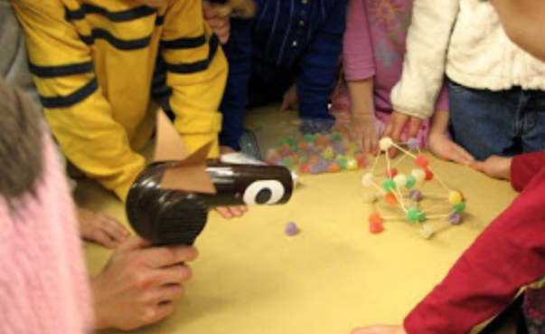
When you have finished making your house you can test whether it will blow down or not. You can do this by using a hair dryer to represent the wolf blowing the house down.
If you house does not fall down after using the hair dryer then well done! You have successfully made a strong home.
Don’t forget to take a photo and show us your lovely home.

Slide 54
Date: Friday 15th January 2021
LO. To be able to write a simple word.
Subject: English

Slide 55
As we do every Friday today we are going to have a word time lesson. Boys and girls you will have to show your parents how to use Fred fingers.
Let’s do an example together.
Let’s write the word ‘dog’. Show your adult three Fred fingers, split up the sounds from the word ‘dog’ onto each finger. Remember to pinch each finger as you say the sound. Then just like we do at school sound out the word three times before trying to write it down. Ask your adult to check that you have written the word correctly.
pig
big
nut
jam
shop
1.
2.
3.
4.
5.
Ask your adult to read the word then hid it from you while you write it down.

Slide 56
Date: 15.1.2021
LO. To be able to solve a word problem.
Subject: Maths

Slide 57
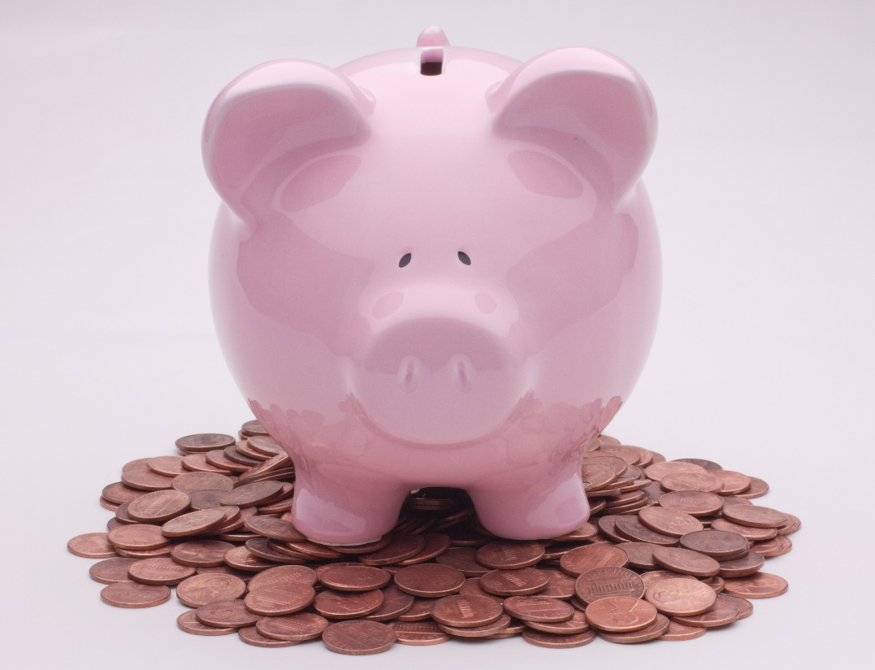
Now you know how to add one more, can you complete these simple word problems?
Mrs Simpson has 4 pennies in her piggy bank, she adds one more. How many does she now have?
Mrs Levington has 7 pennies in her piggy bank, she adds one more. How many does she now have?
Mr Pennal has 5 pennies in his piggy bank, he adds one more.
How many does he now have?
Mrs Bentley has 9 pennies in her piggy bank, she adds one more. How many does she now have?

Slide 58
Date: Friday 15th January 2021
LO
LO. To test different materials with simple equipment .
Subject: Science

Slide 59
Pre-recorded Teaching
Access the online teaching video below that will support you to complete the work in this lesson. This video will act as a support but all of the work can still be successfully understood & completed using paper-based versions of this pack. If you need further support to understand / complete work then please contact school via e-mail or telephone.
Play Video

Slide 60
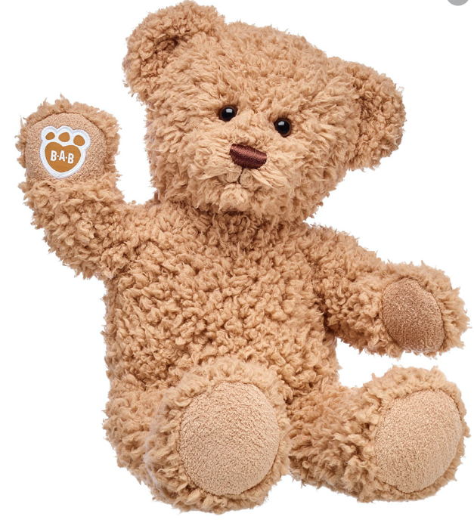
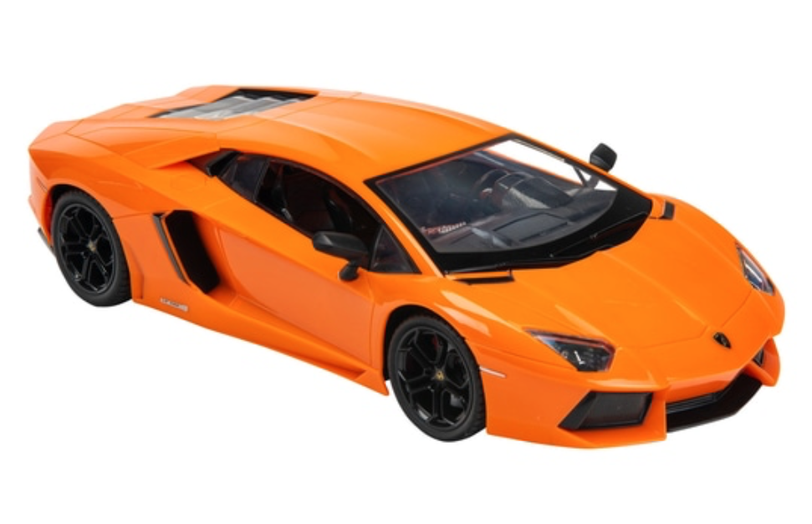
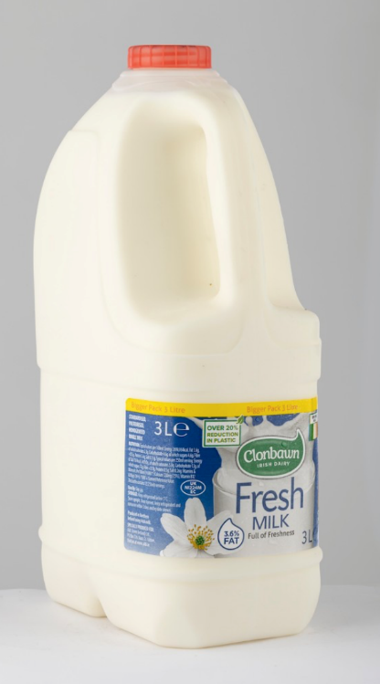
Today we will be completing an experiment.
During the experiment you will be testing each item on whether it will blow away or not.
First, you will need to collect 10 different items in your house.
You don’t need to write your predictions down just discuss with your adult

Slide 61
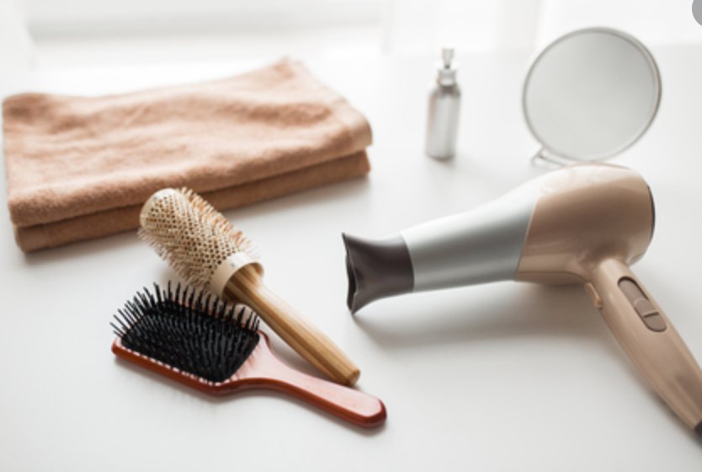
Then, look at each item you have picked and predict whether you think it will blow away or not. You can explain your reasons behind your prediction to your adult.
You can try blow your items yourself or use a hair dryer to complete this experiment.

Slide 62
Record your results of the experiment in the table below.
You can do this by either placing a photo in the box or writing what material was used.
Materials that blow away | Materials that do not blow away

