Slide 1
Subject:Maths

Slide 2
Date: Monday 1st March 2021
L.O. To be able to recognise money
Subject: Maths

Slide 3
Pre-recorded Teaching
Access the online teaching video below that will support you to complete the work in this lesson. This video will act as a support but all of the work can still be successfully understood & completed using paper-based versions of this pack. If you need further support to understand / complete work then please contact school via e-mail or telephone.
https://www.bbc.co.uk/bitesize/articles/zhwy6g8

Slide 4
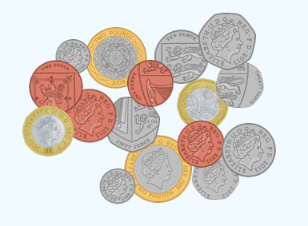
Which coins can you see here?
Which coin is worth the most?
Which coin is worth the least?
Think about…
What different amounts of money could we make using these coins?
Have a go at writing some down.

Slide 5
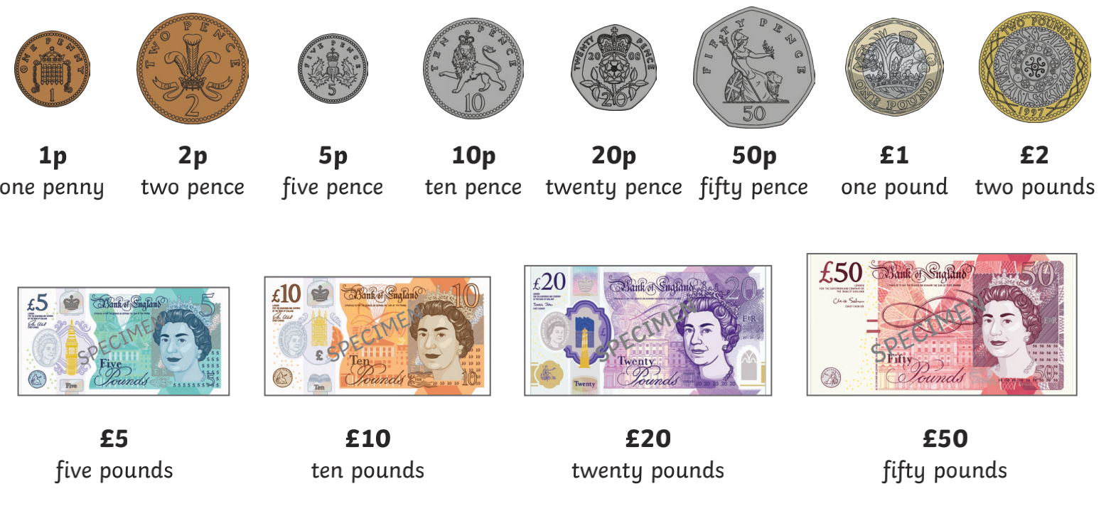
Money we use…
Coins
Notes

Slide 6
Did you know…?
£1 = 100p
Money can be written in both pounds and pence
£2.50 is the same as 250p £5.42 is the same as 542p
x100 to work out how many pence, so move the decimal point 2 places
Tip - add the pounds and the pence separately!

Slide 7
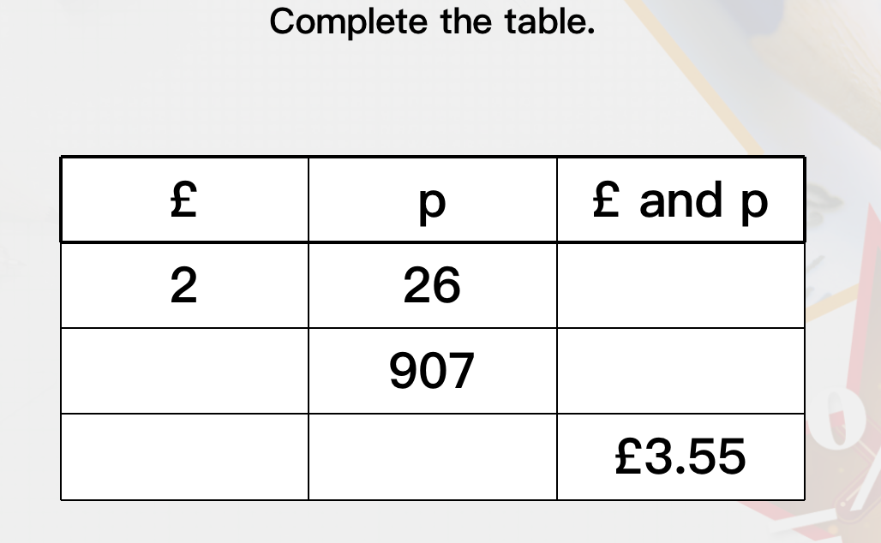
£0.26

Slide 8
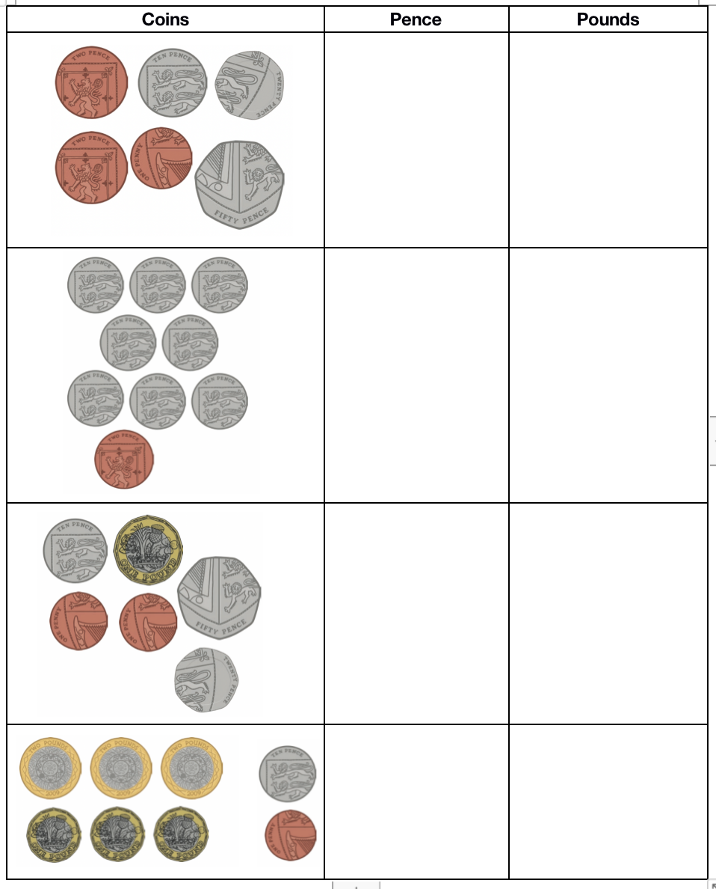
Work out how much money is in each box - show your answers in both pounds and pence.
e.g. – = 54p = £0.54
Tip – work out the POUNDS first.

Slide 9
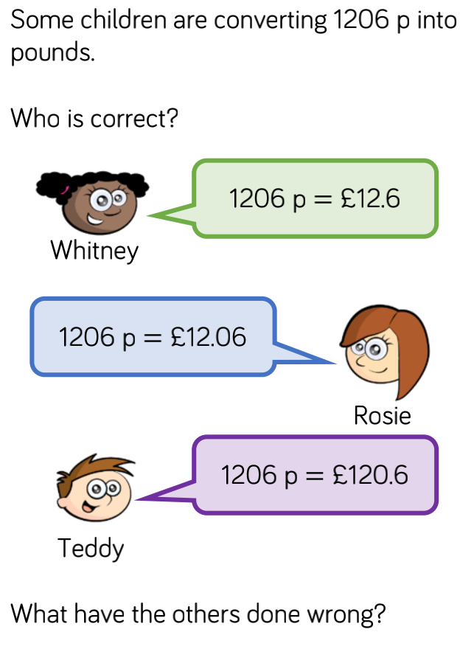
Challenge!

Slide 10
Date: Tuesday 2nd March 2021
L.O. To be able to round amounts of money
Subject: Maths

Slide 11
Pre-recorded Teaching
Access the online teaching video below that will support you to complete the work in this lesson. This video will act as a support but all of the work can still be successfully understood & completed using paper-based versions of this pack. If you need further support to understand / complete work then please contact school via e-mail or telephone.
https://www.bbc.co.uk/bitesize/topics/zh8dmp3/articles/zsvt97h#:~:text=Rounding%20money%20or%20decimals,number%20to%202.8%20is%203

Slide 12
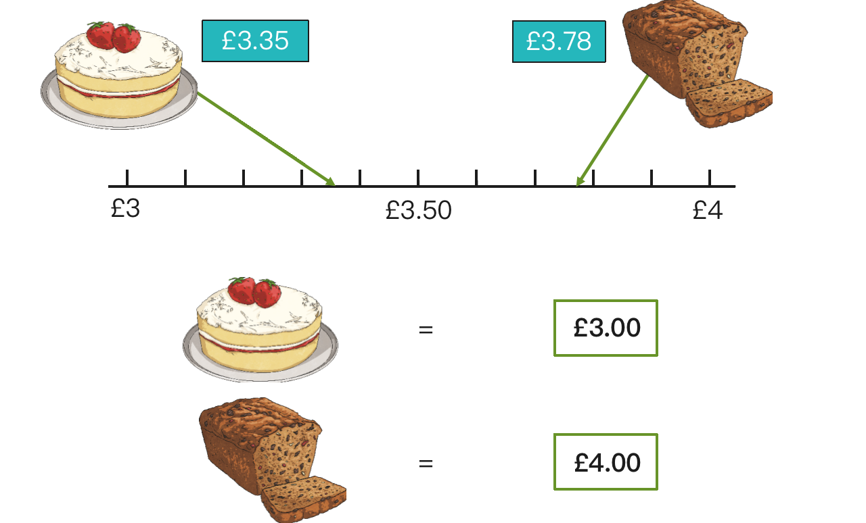
Why do we round amounts of money?
To round money to the nearest pound (£) it makes it easier to add money together quickly.
If you were shopping and had £10 to spend, rounding would help you know approximately how much you had spent and how much change you would receive.
This will give you an idea that you have roughly spent £7 and would have £3 change.
Using a number line like this is a helpful way of rounding.

Slide 13
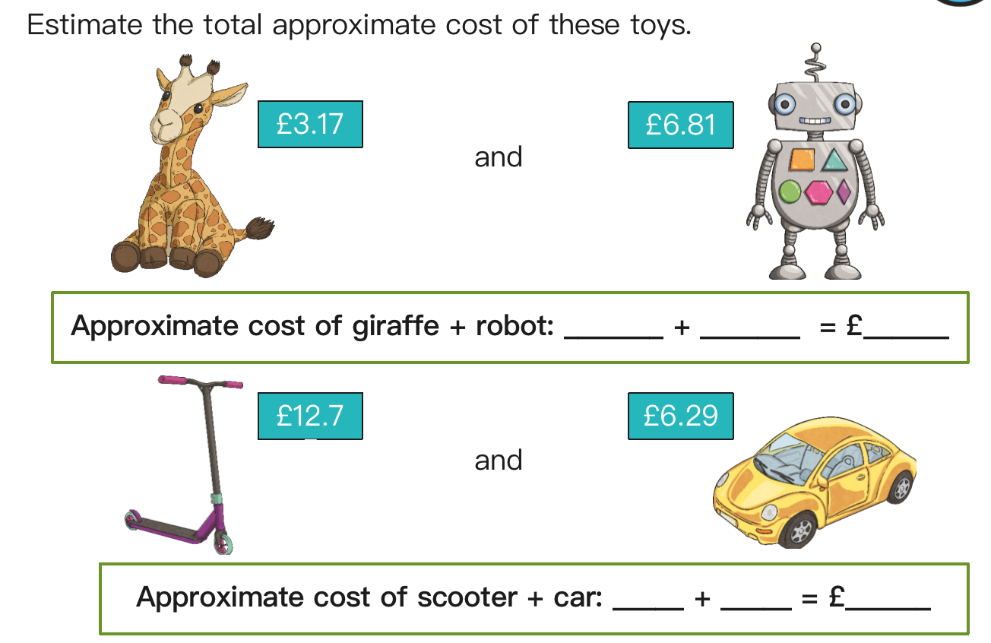
Let’s use a number line to help us work out the answer…

Slide 14
Think back to yesterday when we converted into £ and p
468p = £4.68

Slide 15
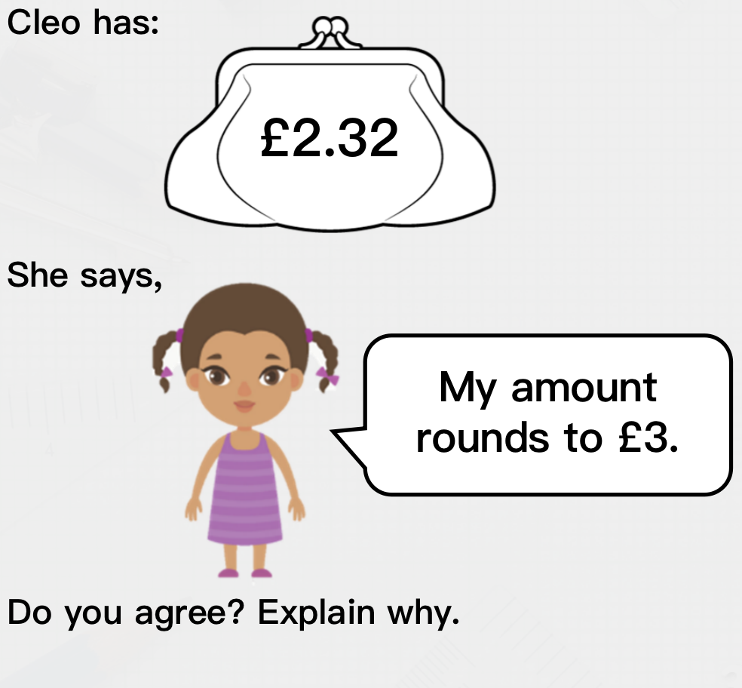
Challenge

Slide 16
Date: Wednesday 3rd March 2021
L.O. To be able to estimate amounts of money
Subject: Maths

Slide 17
Pre-recorded Teaching
Access the online teaching video below that will support you to complete the work in this lesson. This video will act as a support but all of the work can still be successfully understood & completed using paper-based versions of this pack. If you need further support to understand / complete work then please contact school via e-mail or telephone.
https://www.bbc.co.uk/bitesize/articles/z92x8hv

Slide 18
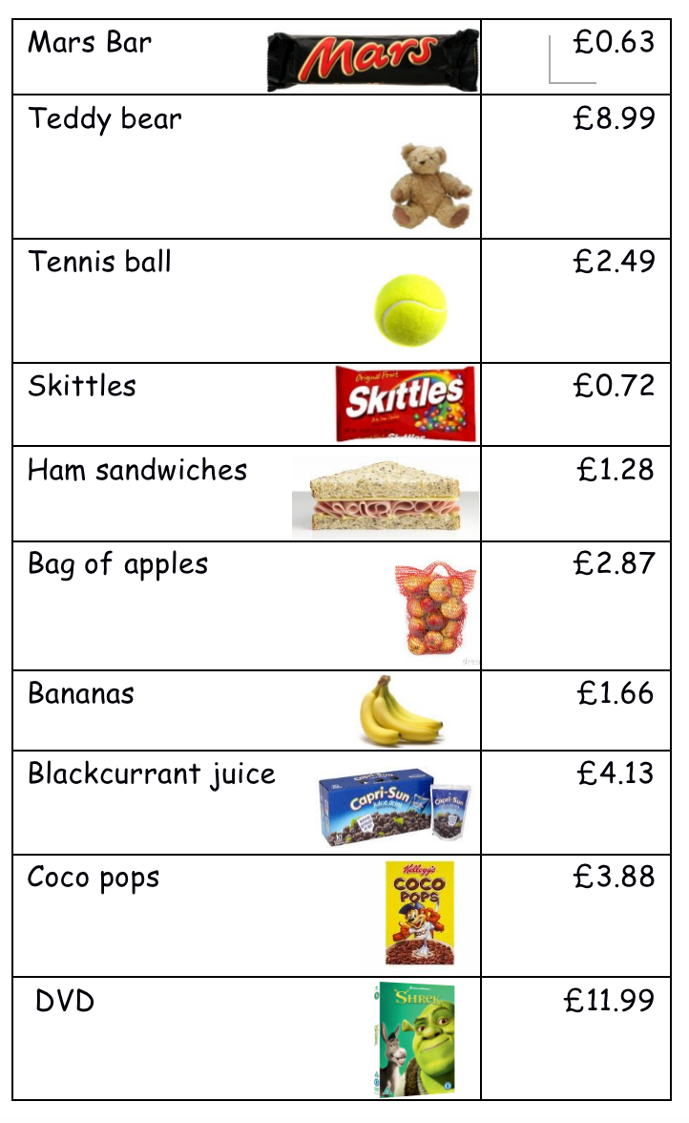
Item | Actual price | Estimate
Mars Bar | £0.63 | £1
Teddy
Tennis Ball
Skittles
Sandwiches
Apples
Bananas
Juice
Coco pops
DVD
The actual price of the Mars bar is £0.63 – so I rounded it up to £1 to reach my estimate. Try the others.

Slide 19
Now use your estimated answers to answers these questions. Make sure you show your working out.
What is the approximate price for ...
1. A ham sandwich and a Mars Bar
________________________________________
2. A DVD and bananas
_______________________________________
3. Blackcurrant juice and skittles
_______________________________________
4. Apples and Coco Pops
_______________________________________
5. Make a list of items you could buy for £6 _______________________________________
_______________________________________
_______________________________________

Slide 20
Challenge
Show your working out:

Slide 21
Date: Thursday 4th March 2021
L.O. To be able to add and subtract amounts of money
Subject: Maths

Slide 22
Pre-recorded Teaching
Access the online teaching video below that will support you to complete the work in this lesson. This video will act as a support but all of the work can still be successfully understood & completed using paper-based versions of this pack. If you need further support to understand / complete work then please contact school via e-mail or telephone.
Click here

Slide 23
Before we start adding and subtracting amounts of money, we need to be confident in understanding the value of a pound.
REMEMBER- £1 = 100p
There are different ways we can make £1…
50p + 50p = £1 20p x 5 = £1
Can you think of any other ways that we can make £1?

Slide 24
90p
Working out…
50p + 20p + 20p
50p + 40p
£0.50
+ £0.40
£0.90

Slide 25
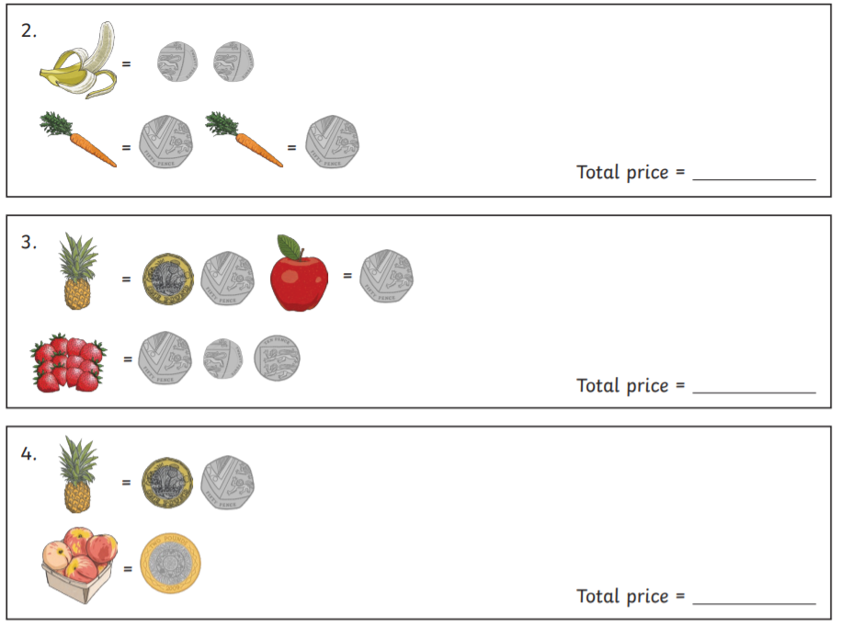
Work out the total cost of the items. Don’t forget to show your working out.

Slide 26
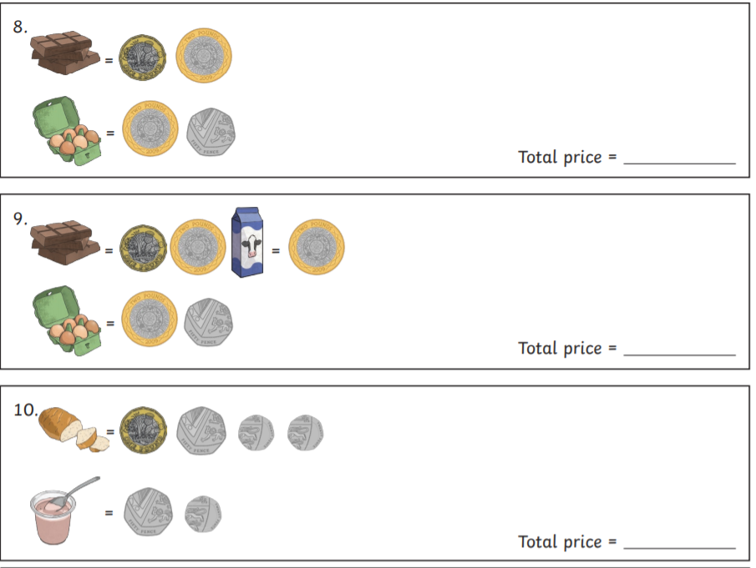
Work out the total cost of the items. Don’t forget to show your working out.

Slide 27
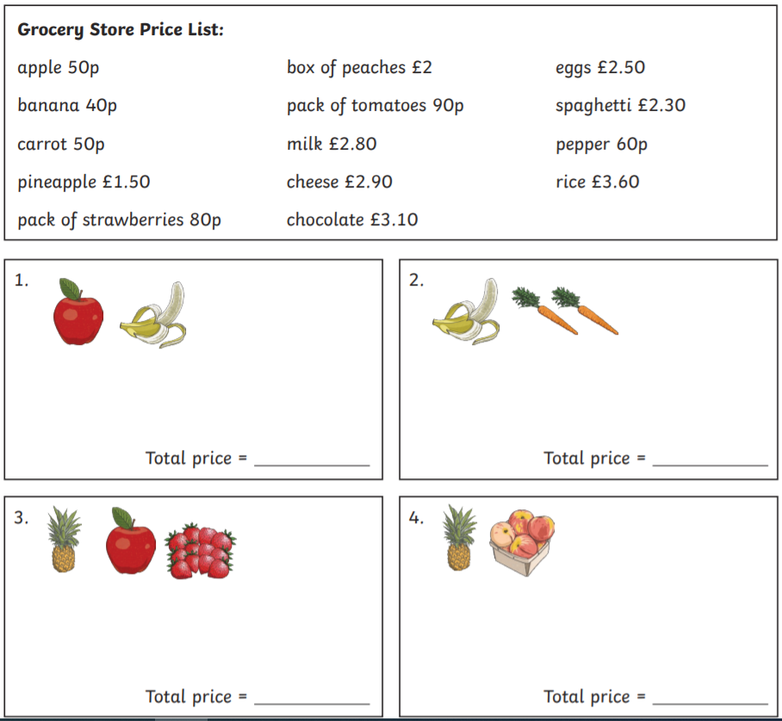
Challenge

Slide 28
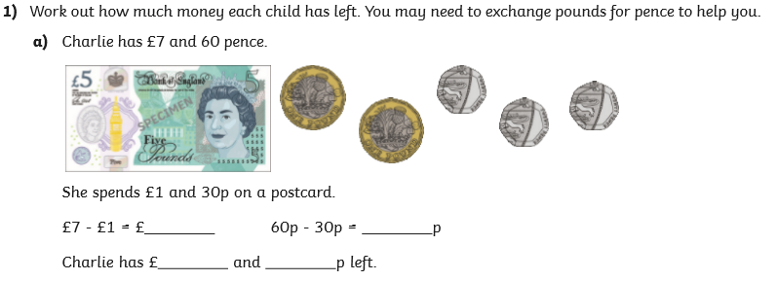
6
30
6
30
760p
-130p
630p
630p = £6.30

Slide 29
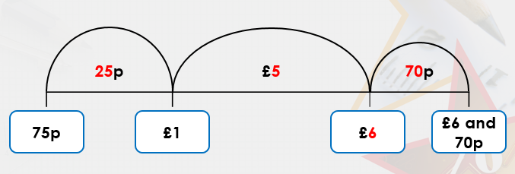
When we are subtracting money, we can use a number line to help us.
£6.70 – 75p =
In this example we have started at 75p and are counting up to work out the difference
Jump 1- how much to add until you get to the next pound
Jump 2- how much to add until you get to the £6
Jump 3- how much to add until you get to £6.70
Then add the amounts together at the top of the number line - £5 + 25p + 70p = £5.95
£6.70 – 75p = £5.95

Slide 30
£4.50 - £1.63 =
Have a go using the number line to work out the answer.
I have included the numbers along the bottom of the number line for you.
£1.63
£2
£4
£4.50

Slide 31
Work out the answers using a number line
£8.60 - £2.30
£10.50 - £1.35 =
£9.70 - £3.50 =
£12.45 - £6.30 =
Number line template:

Slide 32
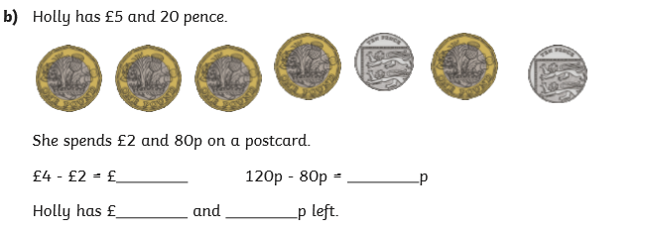
Work out how much money each person will have left.

Slide 33
Date: Thursday 21st January
Date: Friday 5th March 2021
L.O. To practice the 10 times table
Subject: Maths

Slide 34
Pre-recorded Teaching
Access the online teaching video below that will support you to complete the work in this lesson. This video will act as a support but all of the work can still be successfully understood & completed using paper-based versions of this pack. If you need further support to understand / complete work then please contact school via e-mail or telephone.
Click here

Slide 35
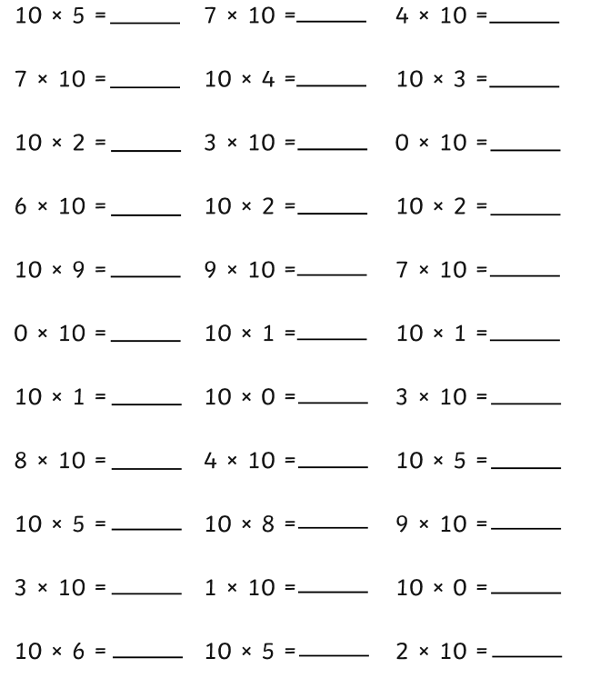

Slide 36
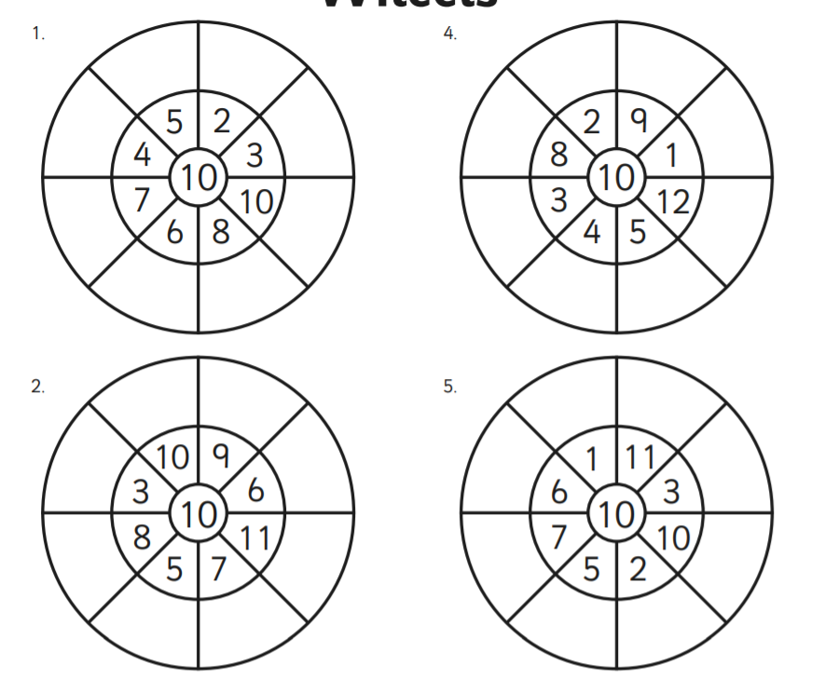
50
20
40
30
Complete the multiplication wheels. I have done the first one for you. ☺
70
100
60
80

Slide 37
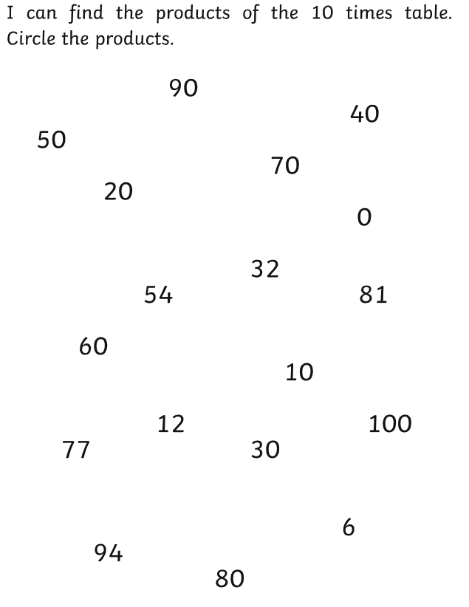
What are products? Products are the answer you get when you multiply (times) two numbers together. 2 x 10 = 20 So, 20 is a product of the 10 times tables

