Slide 1



Date: Monday 25th January
LO: To be able to locate continents on a map by matching.
Subject: Geography

Slide 2




What is a continent?

Slide 3



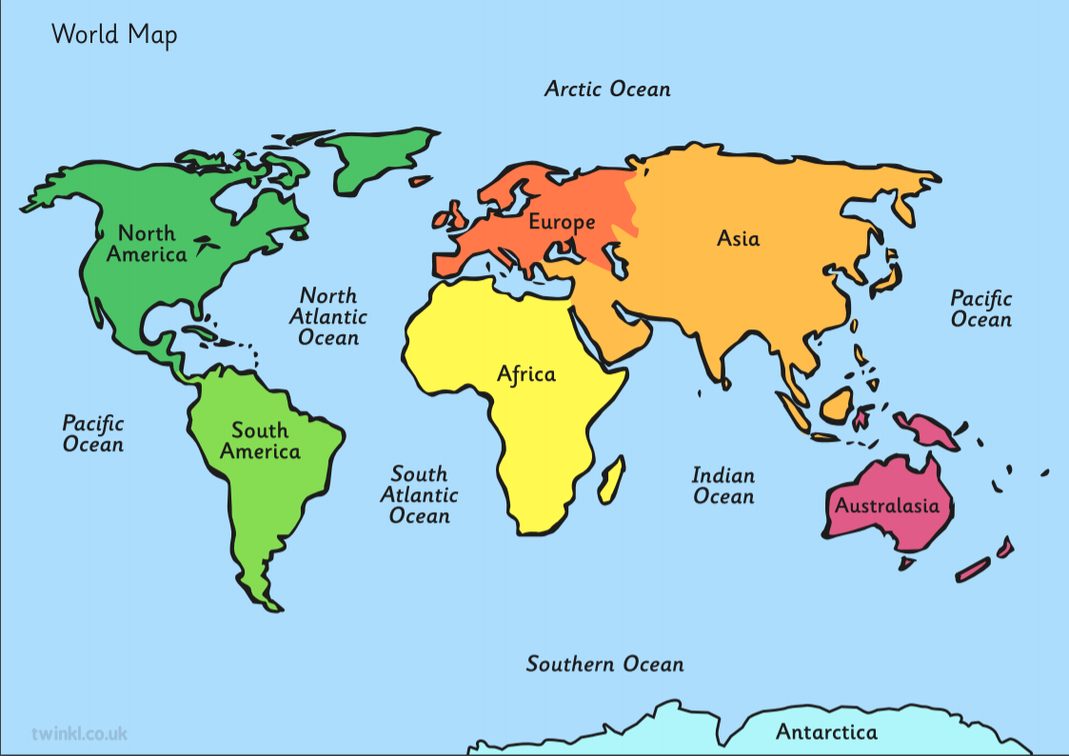






Slide 4
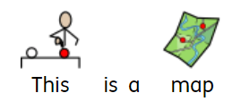

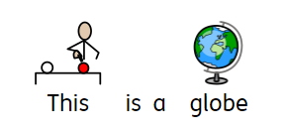
Maps and globes show us where different countries and continents are.

Slide 5
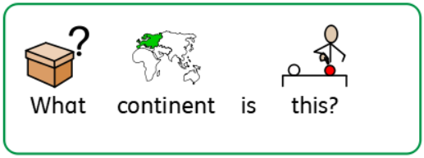


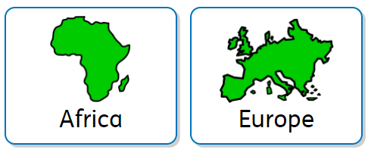
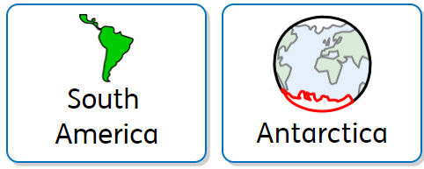

Slide 6
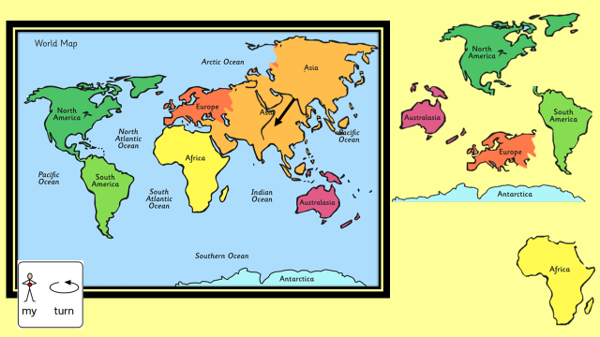

Explanation of activity:
Explanation of activity/Example
For Parents:
Look at the different continents and match them to the correct place on the map. If you have a printed pack, cut them out so your child can place them over the top. As your child picks up/drags each continent, say the name of it aloud.

Slide 7

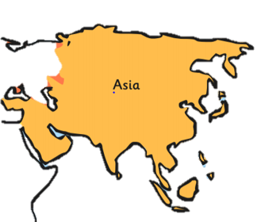



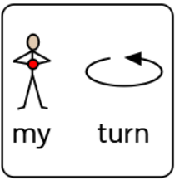

Slide 8


Slide 9

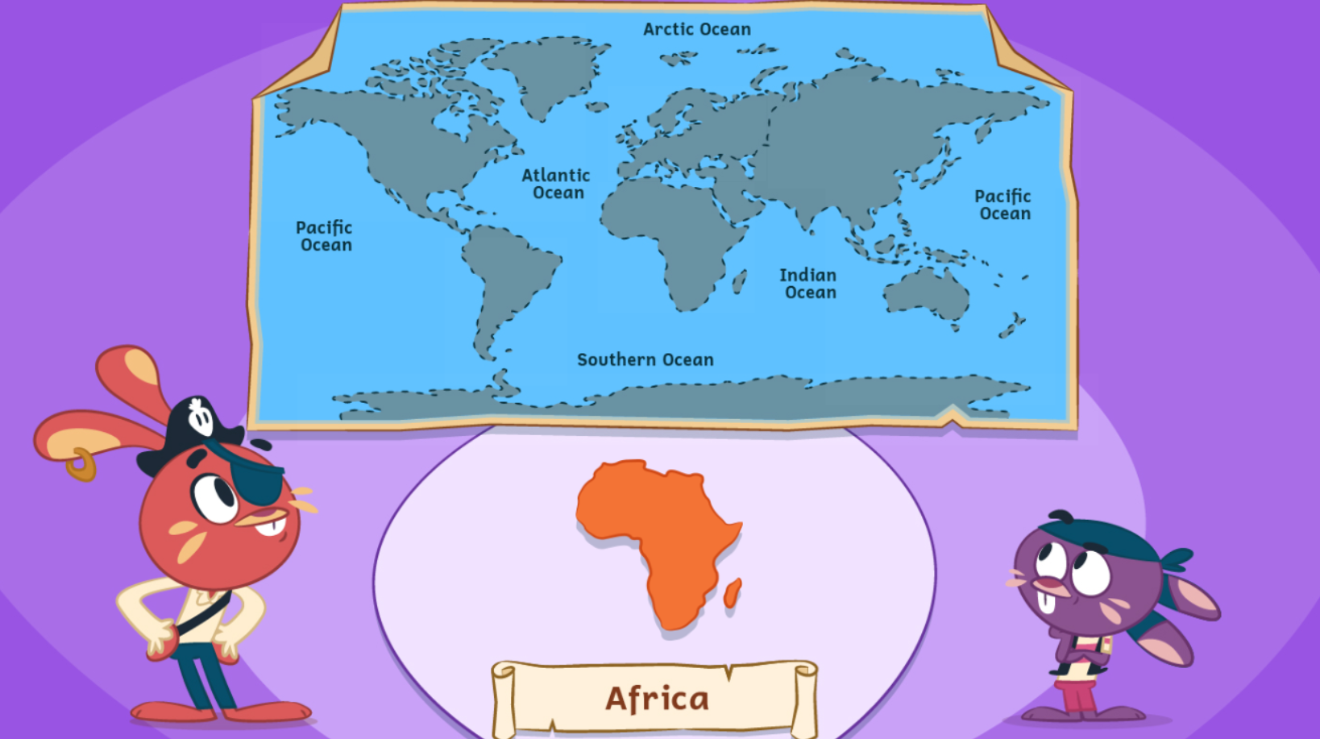
Click on the link and press this symbol to play the
interactive version of the matching game.
https://www.bbc.co.uk/games/embed/education-ivor-pirate-rabbits?exitGameUrl=https%3A%2F%2Fbbc.co.uk%2Fbitesize%2Farticles%2Fz6vyf4j

Slide 10
Date: Tuesday 26th January
LO: To be able to locate oceans on a map.
Subject: Geography

Slide 11



Slide 12





There are five different oceans

Slide 13
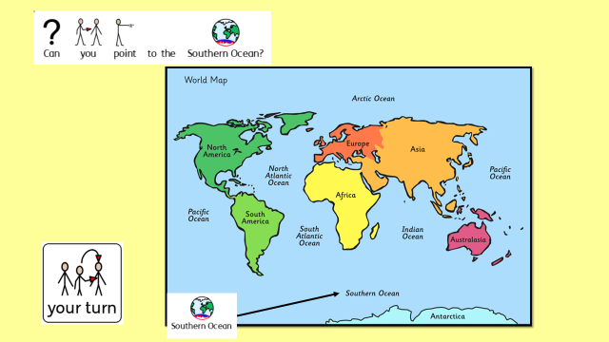
Explanation of activity:
Explanation of activity/Example
For Parents:
Look at the map and read the questions out loud to your child. Can they point to the correct ocean?

Slide 14


Slide 15


Slide 16


Slide 17


Slide 18


Slide 19

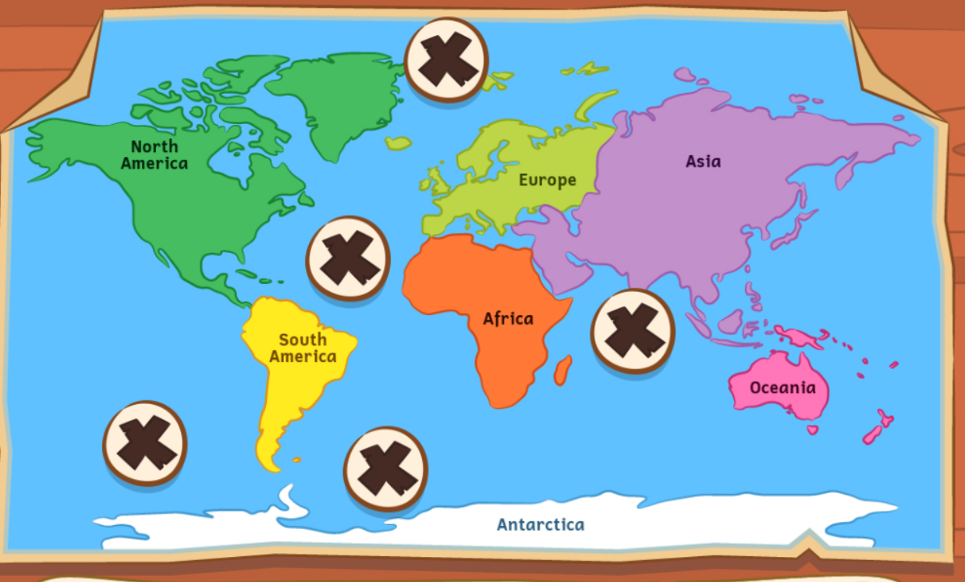
Click on the link to play the ocean discovery game. Click on this symbol to take you to the game.
https://www.bbc.co.uk/games/embed/education-ivor-pirate-rabbits?exitGameUrl=https%3A%2F%2Fbbc.co.uk%2Fbitesize%2Farticles%2Fz6vyf4j

Slide 20
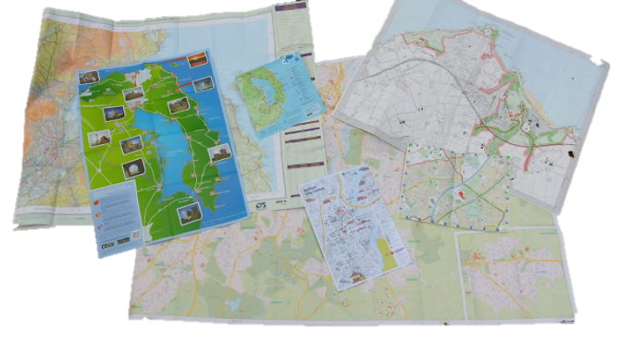
Do you have a map or a globe in your house? Have a look and see if you can point to the continents and oceans.

Slide 21
Date: Thursday 28th January
LO: To be able to identify the UK on a map.
Subject: Geography

Slide 22
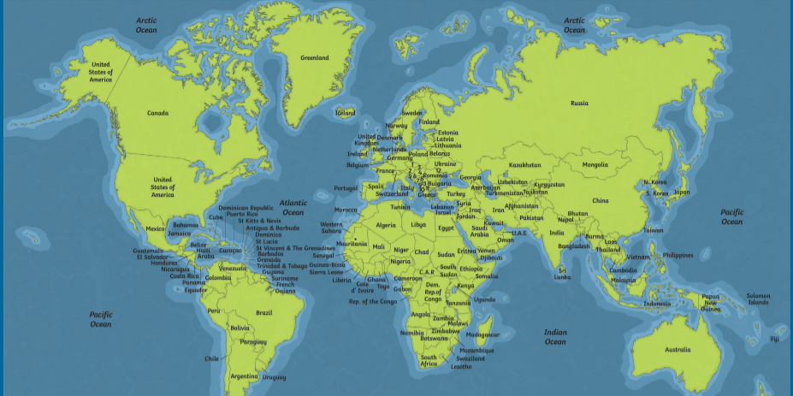
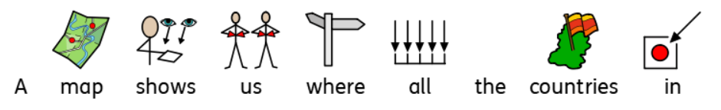


Slide 23

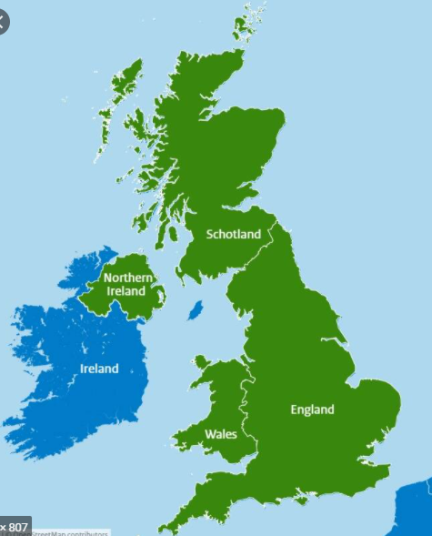

Scotland

Slide 24
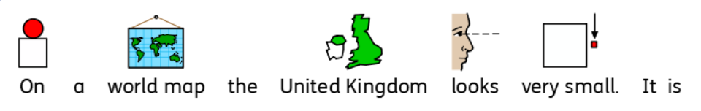

This is the United Kingdom.

Slide 25

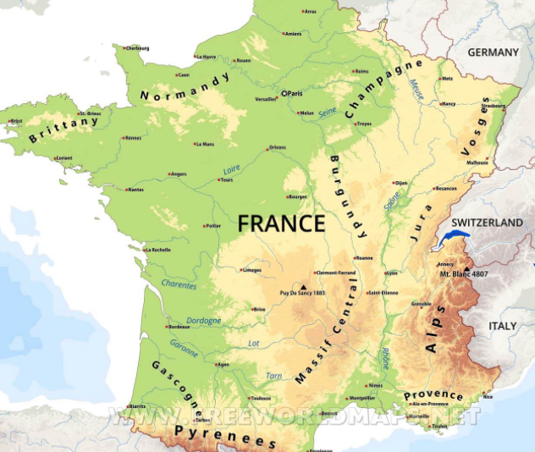


Scotland

Slide 26
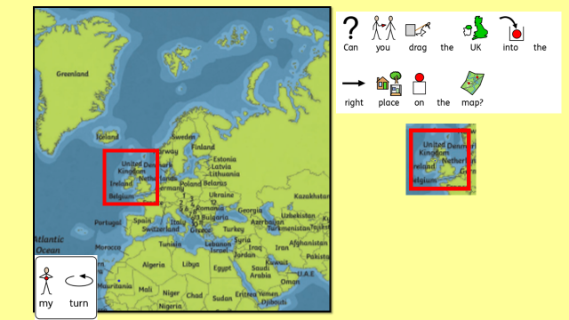
Explanation of activity:
Explanation of activity/Example
For Parents:
Look at the map with your child and locate the red square box, can they drag the UK map part to the correct place on the map?

Slide 27
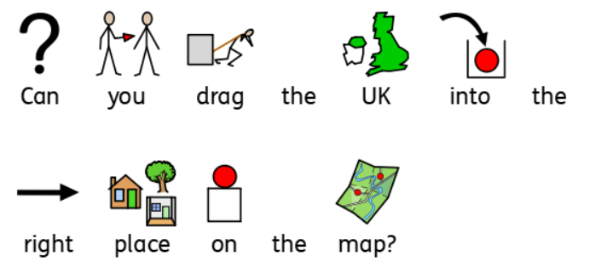
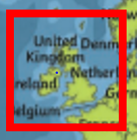

Slide 29
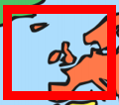

Slide 30
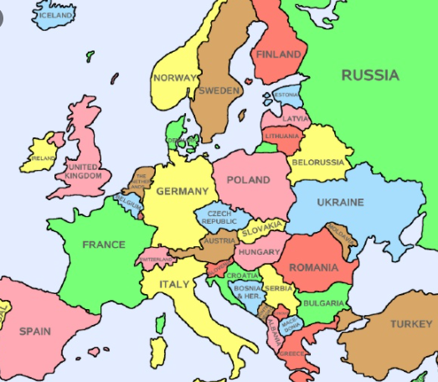
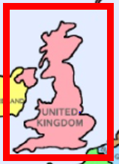

Slide 31
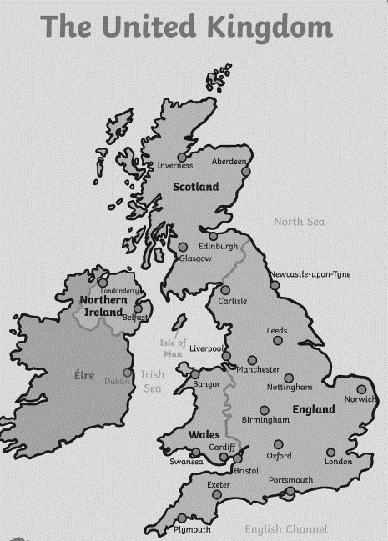
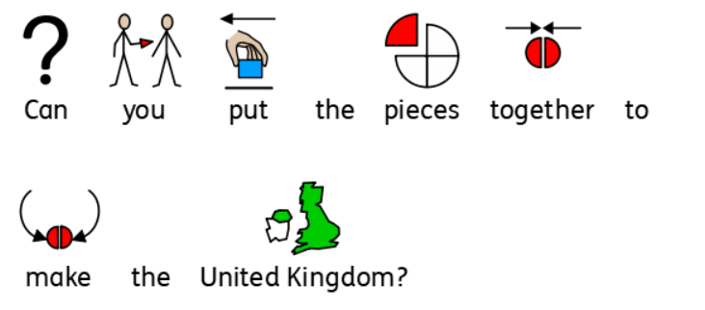
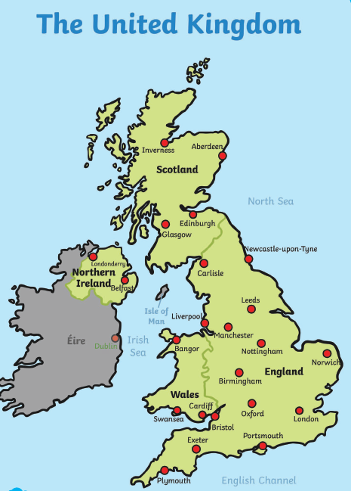

Slide 32
Date: Thursday 28th January
LO: To be able to use compass directions to find locations on a map.
Subject: Geography

Slide 33
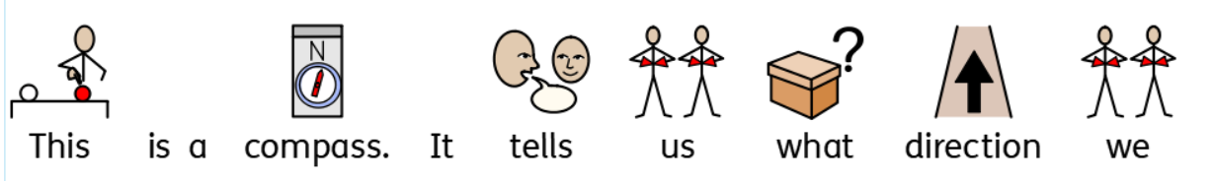
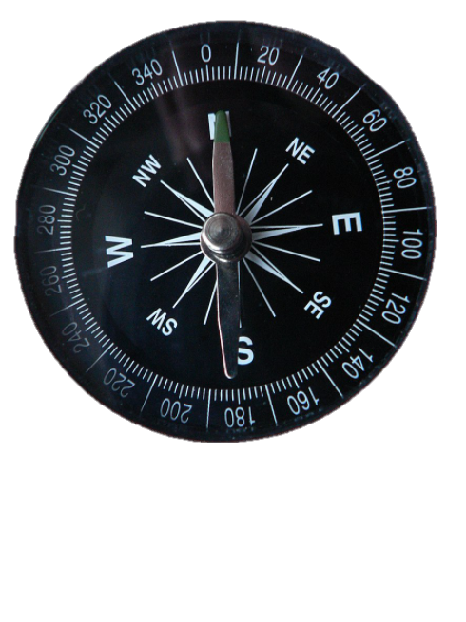


Slide 34
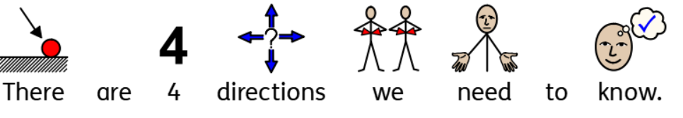
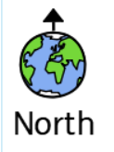



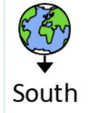

Slide 35
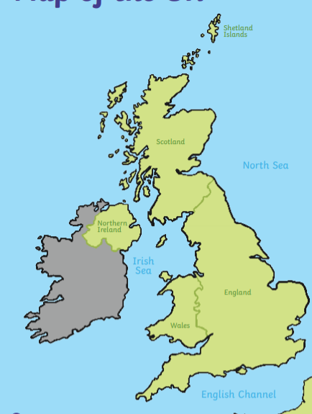
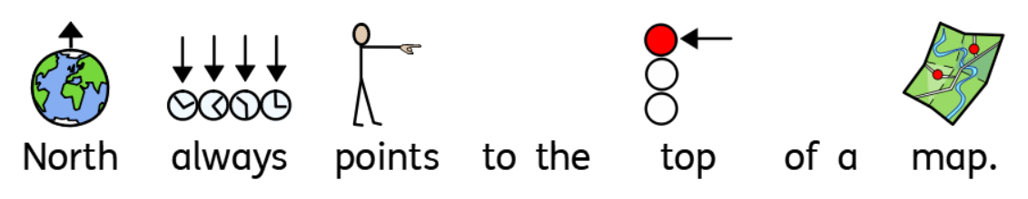

Slide 36
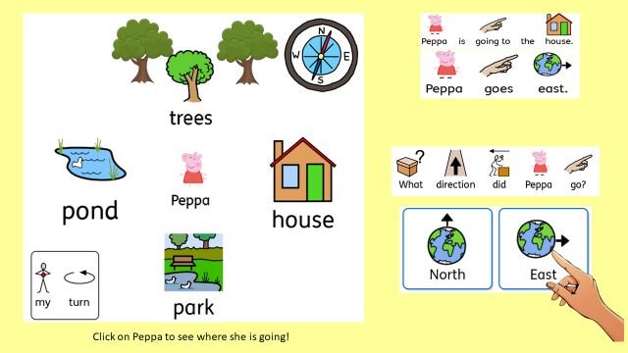
Explanation of activity:
Explanation of activity/Example
For Parents:
Look at the map and read the directions out loud to your child, then click on Peppa to watch her travel in each direction. Can your child point to the correct direction that Peppa travelled in?

Slide 37

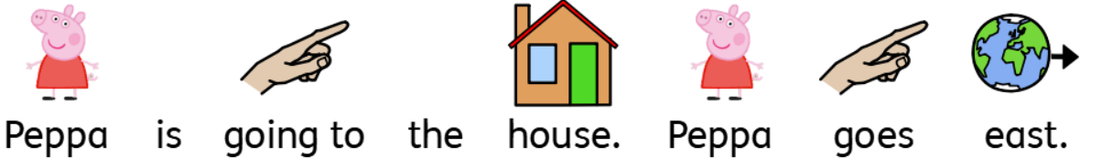



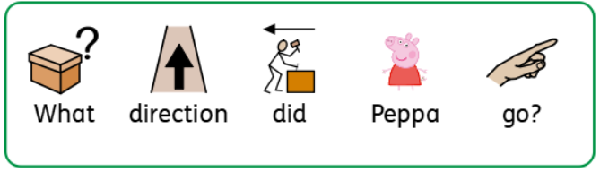

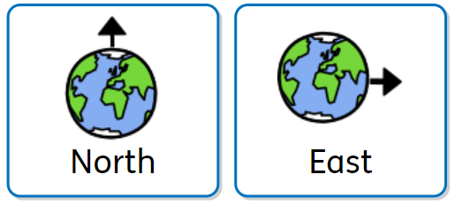

Click on Peppa to see where she is going!

Slide 38

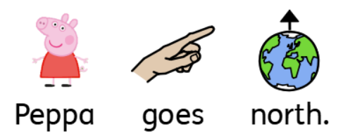
Click on Peppa to see where she is going!

Slide 39
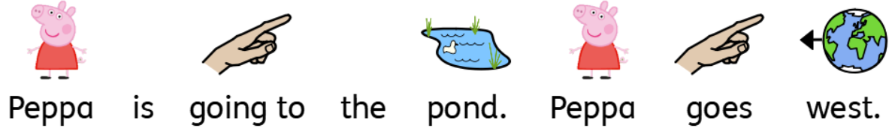
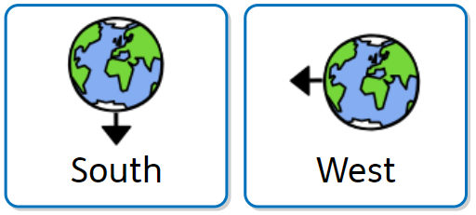
Click on Peppa to see where she is going!

Slide 40
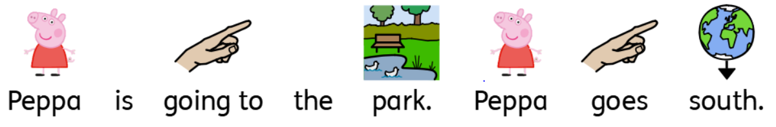
Click on Peppa to see where she is going!

Slide 41
Click on Peppa to see where she is going!

Slide 42
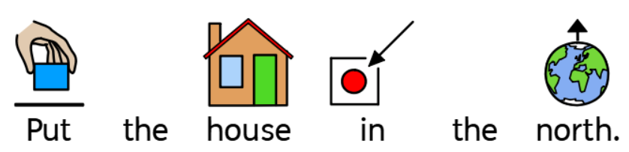
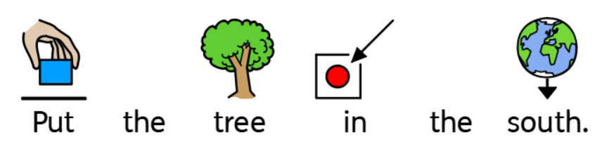
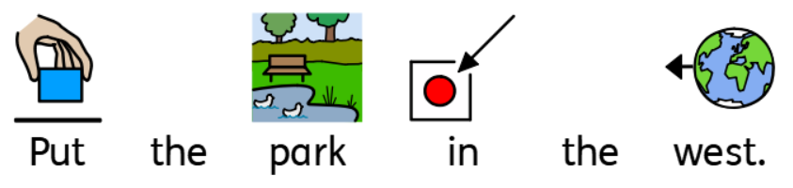



Make your own map!

Slide 43

Date: Friday 29th January
LO: To copy basic movements
Subject: PE

Slide 44

Let’s get our bodies moving so we can warm up!
Click the link to play the freeze game:
https://www.youtube.com/watch?v=2UcZWXvgMZE

Slide 45
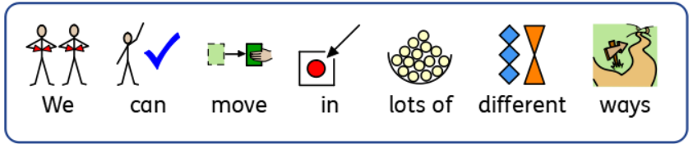



We can jump.
We can skip.
We can turn.

Slide 46
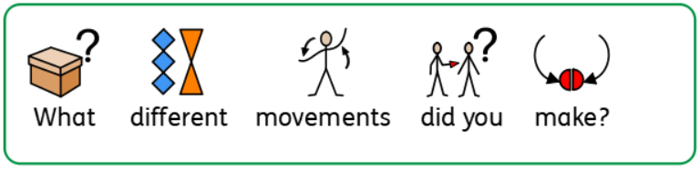
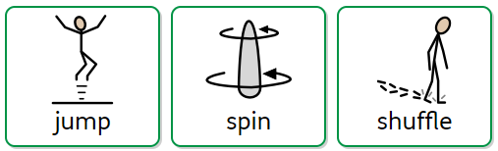
Choose some of the songs in the video below. Can you copy the movements?
https://www.youtube.com/watch?v=HUF5gmH_2YM

