Slide 1
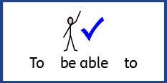
Date: Monday 8th February 2021
LO: To be able to spell words containing hyphens.
Subject: Reading

Slide 2
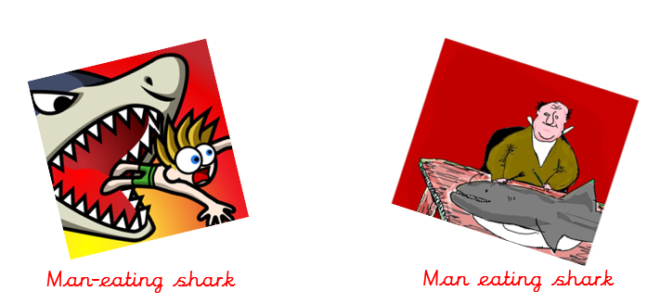
Hyphens are often used to avoid ambiguity in sentences.
Ambiguity means to have one clear meaning to avoid confusion.
For this sentence, the hyphenated words man-eating refer to the shark eating the man.
For this sentence, the words man eating refer to the man eating the shark.

Slide 3
Compound Adjectives
A compound adjective is a single adjective made up of more than one word. The words in a compound adjective are usually grouped together using hyphens to show it is a single adjective
She attacked with her razor-sharp cutlass.
Beware of the green-eyed monster.
I love this brightly-lit room.
Danny’s dog is well-behaved.
Choose the sugar-free drink.

Slide 4
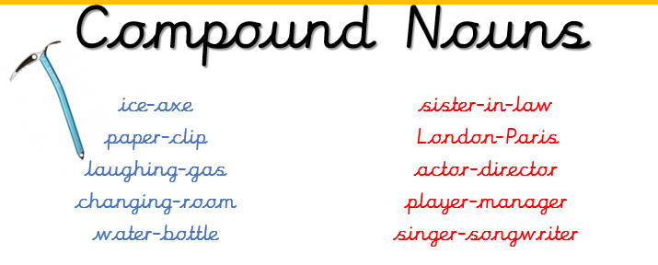
It also helps us to avoid ambiguity.
ice-axe = an axe used on ice.
ice axe = an axe made of ice.

Slide 5
We use a hyphen when the prefix ends with the same vowel that the root word begins with.
We use a hyphen when the prefix is joined to a proper noun.
We use a hyphen to show a change in meaning.
re-sign = sign again
resign = leave or quit

Slide 6
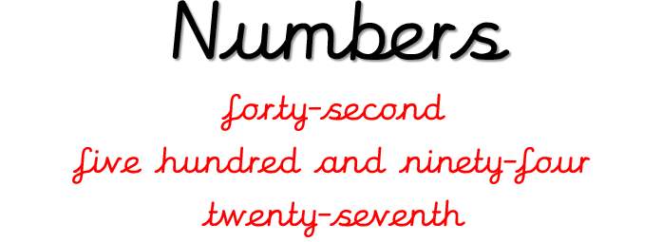
We use a hyphen to show the relationship between two digit numbers.

Slide 7
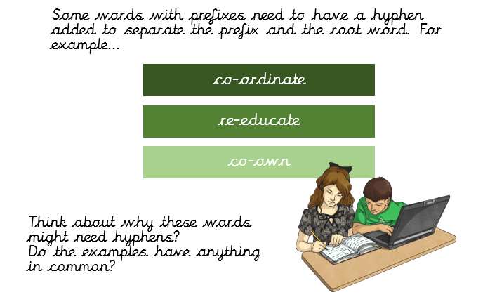

Slide 9
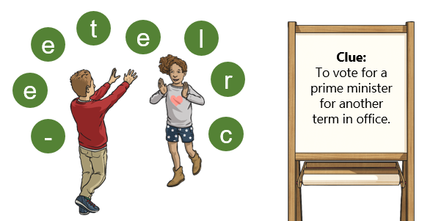

Slide 10
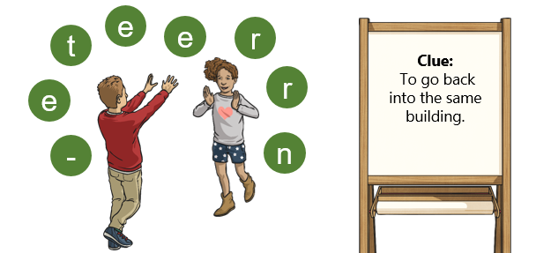
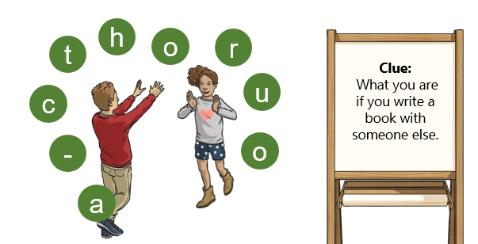

Slide 11
Here are the answers to the word jumbles!
How many did you get correct?

Slide 12
Read, copy, cover, spell this week’s spellings.
Date: Monday 8th February 2021
co-operate
re-enter
co-owner
sugar-free
forty-second
twenty-seventh
re-sign
re-treat

Slide 13
Date: Tuesday 9th February 2021
LO: To be able to retrieve information and explain inferences.
Subject: Reading

Slide 14
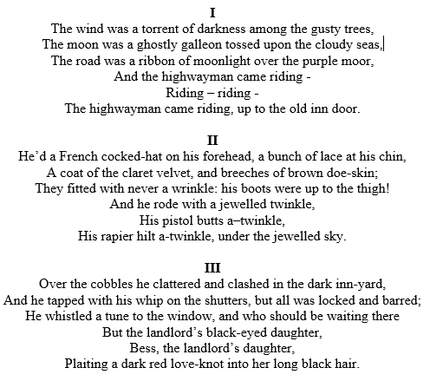
The Highway Man By Alfred Noyes
We are only going to look through one part of the poem.

Slide 15
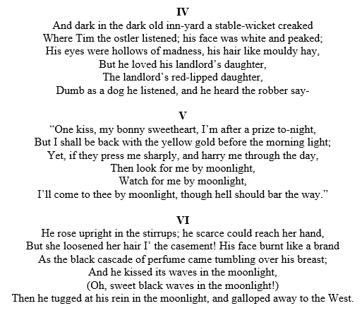

Slide 16
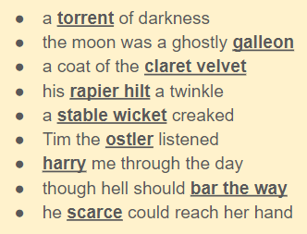
Vocabulary Check
What do you think these phrases mean? Discuss them with an adult.

Slide 17
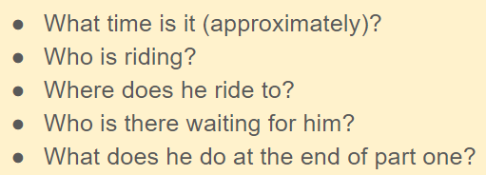
Quick Recall Questions
Now you have read the text, recall the answers to the questions below. You do not need to write these answers down.

Slide 18
For the next set of questions, write your answers down onto a piece of paper.

Slide 19
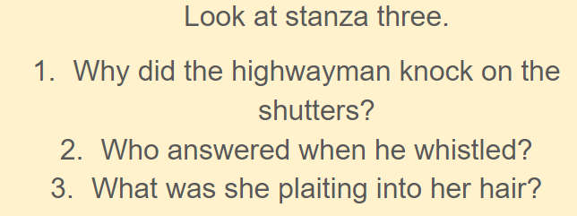

Slide 21
Date: Wednesday 10th February 2021
LO: To be able to retrieve information and explain inferences.
Subject: Reading

Slide 22
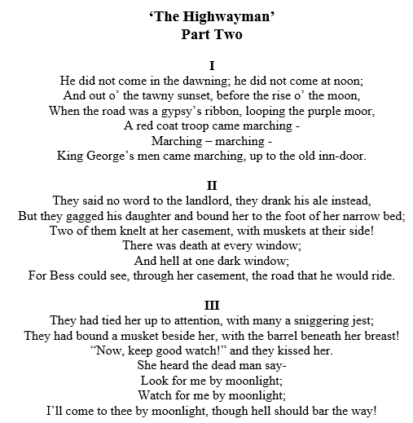
The Highwayman Alfred Noyes Part Two
We are going to read part two of the poem now.

Slide 23
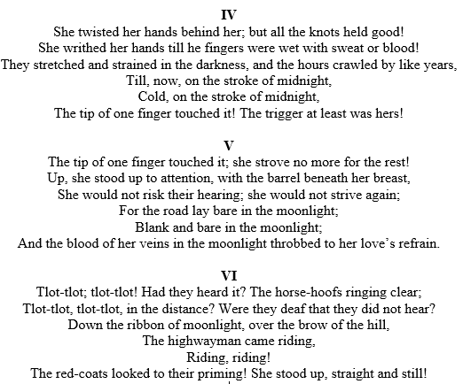

Slide 24
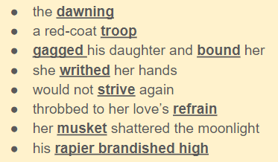
Vocabulary Check
What do you think these phrases mean? Discuss them with an adult.

Slide 25
Quick Recall Questions
Now you have read the text, recall the answers to the questions below. You do not need to write these answers down.

Slide 26
For the next set of questions, write your answers down onto a piece of paper.
1.
2.
3.
4.

Slide 30
Date: Thursday 11th February 2021
LO: To be able to retrieve information and explain inferences.
Subject: Reading

Slide 31
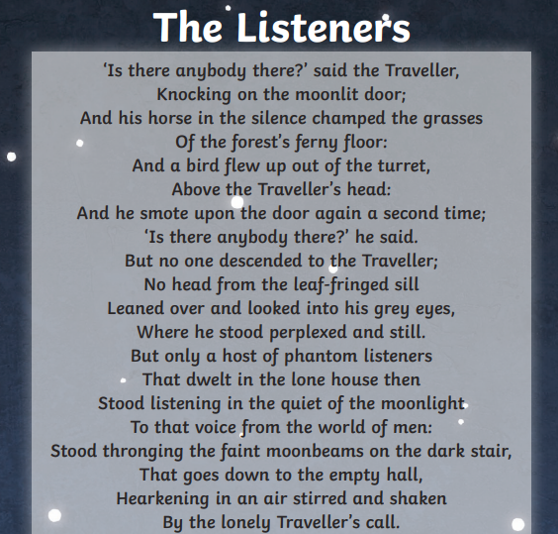
Read the poem out loud. Try and use expression in your voice.

Slide 33
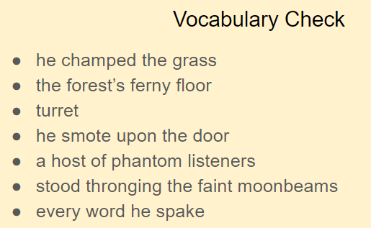
What do you think these phrases mean? Discuss them with an adult.

Slide 34
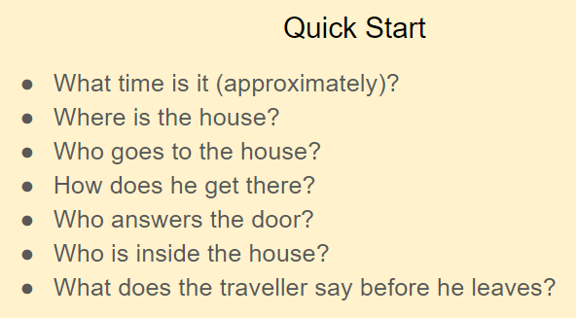
Now you have read the text, recall the answers to the questions below. You do not need to write these answers down.

Slide 35
For the next set of questions, write your answers down onto a piece of paper.
1.
2.
3.

Slide 36
4.
5.
6.
7.

Slide 37
Date: Friday 12th February 2021
LO: To be able to retrieve information and explain inferences.
Subject: Reading

Slide 38
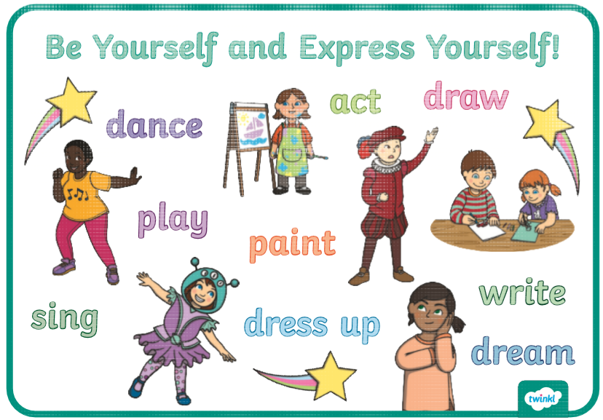
Children's Mental Health Week is taking place this week (1-7 February 2021). This year's theme is Express Yourself.
Read the information over the next few pages to find out more. Then answer the questions either on the page or a separate piece of paper. There are a couple of activities at the end to celebrate Children’s Mental Health Week which you can choose to do if you would like!

Slide 39
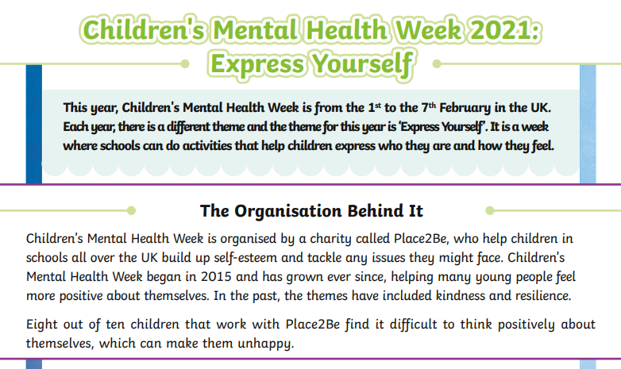

Slide 41
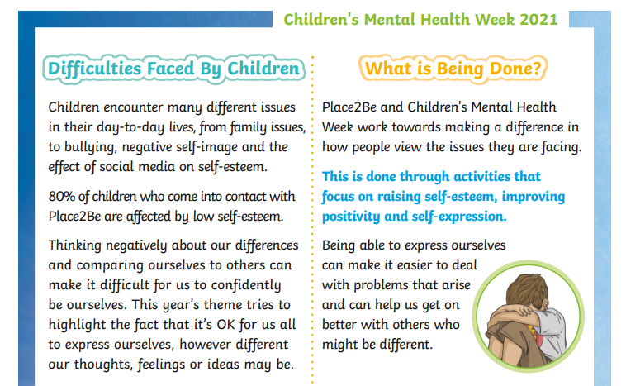

Slide 43
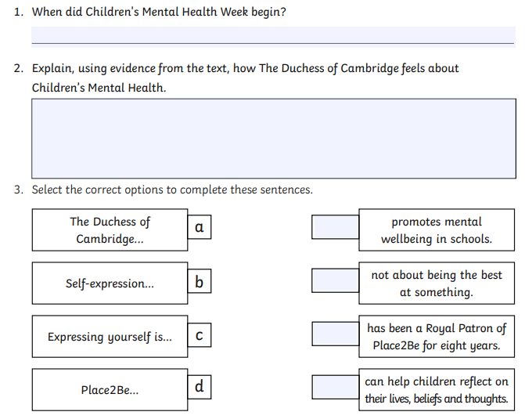

Slide 44
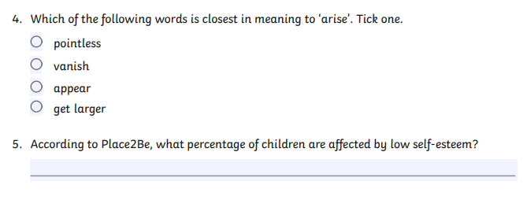
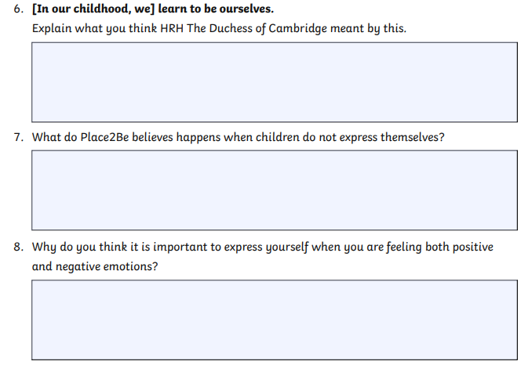

Slide 45
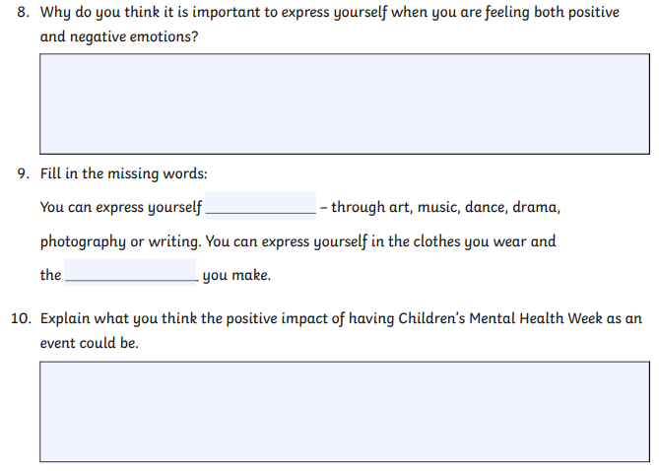

Slide 46
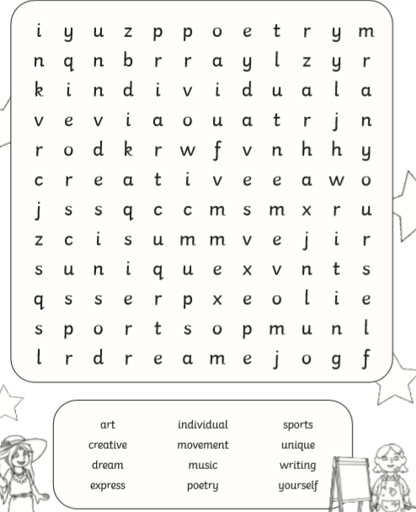
In celebration of Children’s Mental Health Week, here are a some activities you can complete if you would like to.

Slide 47
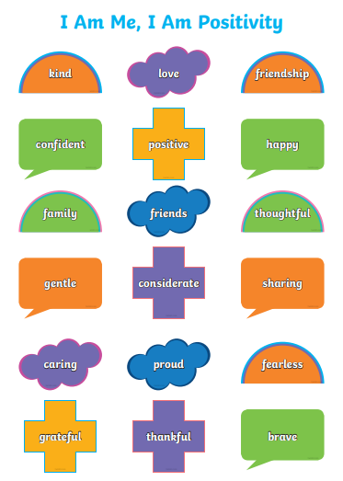
Draw a picture of yourself in the mirror and add words to describe yourself. There are some examples provided but you can include other words.

Slide 49
