Slide 1
Subject: Maths

Slide 2
Date: Monday 1st February 2021
L.O. To be able to count in multiples of 100
Subject: Maths

Slide 3
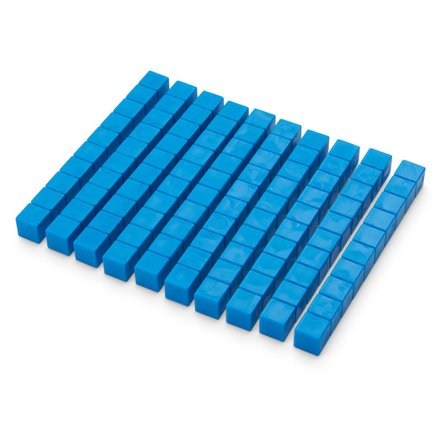
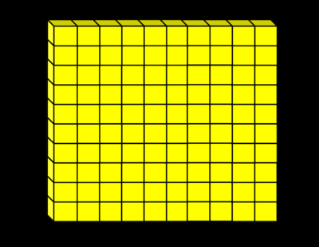
Th | H | T | O
100
There are lots of ways to represent 100…
100
Th | H | T | O
one hundred

Slide 4
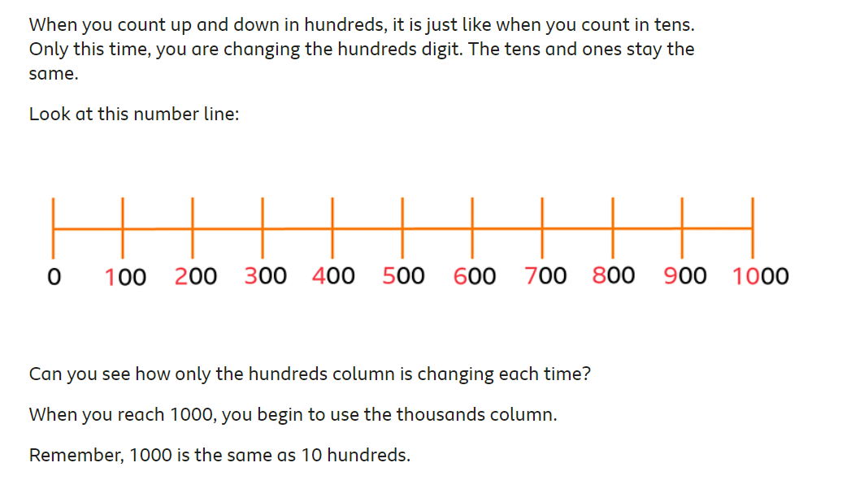
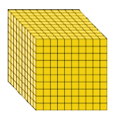
+100
=

Slide 5
Counting forwards in multiples of 100…
When we count forwards, the numbers increase in value.
Which digit is getting larger?
H | T | O
1 2 3 | 0 0 0 | 0 0 0
My turn
+100
400
500
600
700
800
900
1000

Slide 6
Counting backwards in multiples of 100…
When we count backwards, the numbers decrease in value.
Which digit is getting smaller?
H | T | O
4 3 2 | 0 0 0 | 0 0 0
My turn
-100
900
800
700
600
500
400
300

Slide 7
Your turn
Click here for a helpful video
+100
500
Your turn
-100
1100

Slide 8
Can you correctly place 200 on the number lines?
100
400
600
500
0
500

Slide 9
Date: Tuesday 2nd February 2021
L.O. To be able to count in multiples of 1000
Subject: Maths

Slide 10
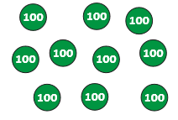
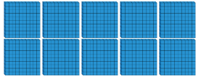
Th | H | T | O
There are lots of ways to represent 1000…
1000
Th | H | T | O
one thousand

Slide 11
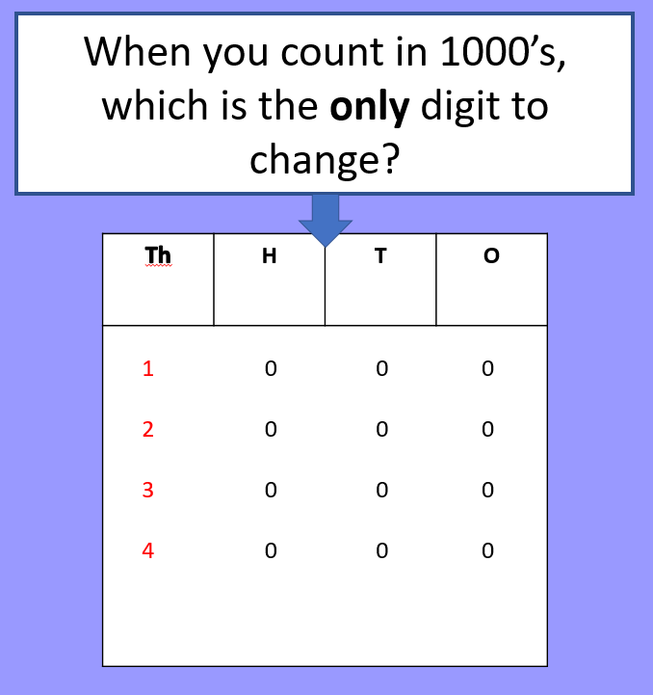
Counting forwards in multiples of 1000…
When we count forwards, the numbers increase in value.
My turn
+1000
4000
5000
6000
7000
8000

Slide 12
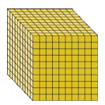
Counting forwards in multiples of 1000…
When we count forwards, the numbers increase in value.
Your turn: complete the number sequence, counting forwards in multiples of 1000
+1000
What number is being represented? 4 lots of 1000

Slide 13
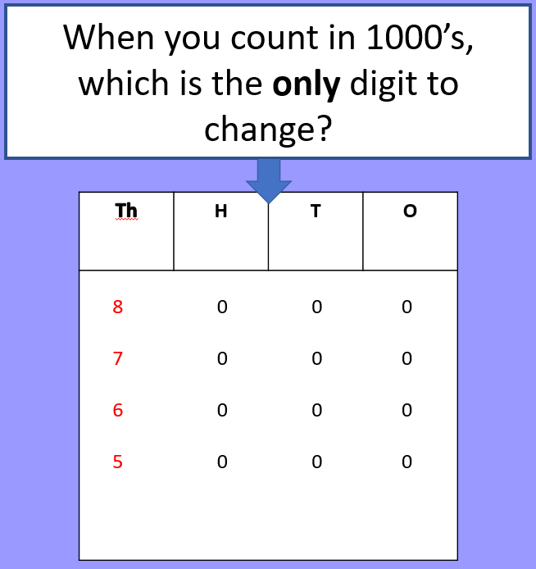
Counting backwards in multiples of 1000…
When we count backwards, the numbers decrease in value.
My turn
- 1000
 | 5000 | 4000 | 3000 | 2000 | 1000

Slide 14
Counting backwards in multiples of 1000…
When we count backwards, the numbers decrease in value.
Your turn: complete the number sequence, counting backwards in multiples of 1000
- 1000
What number is being represented? 9 lots of 1000

Slide 15
What numbers are being represented below? Can you find 1000 less and 1000 more.
-1000
+1000

Slide 16
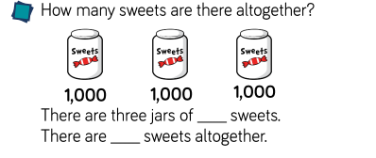
When you count in 1000’s, which is the only digit to change?
Th | H | T | O
8 0 0 0 7 0 0 0 6 0 0 0 5 0 0 0
Challenge: How many sweets would there be in 8 jars?
How is counting in multiples of 1000 similar to counting in multiples of 1?

Slide 17
Date: Wednesday 3rd January 2021
L.O. To be able to count in multiples of 50
Subject: Maths

Slide 18
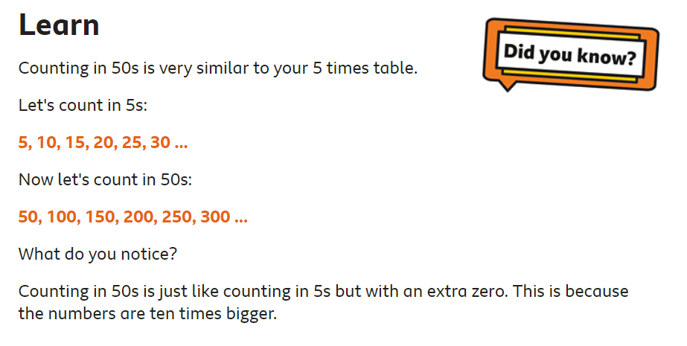
+ 5
5 | 10 | 15 | 20 | 25 | 30
+ 50
50 | 100 | 150 | 200 | 250 | 300
Do you notice any patterns between the two number sequences?

Slide 19
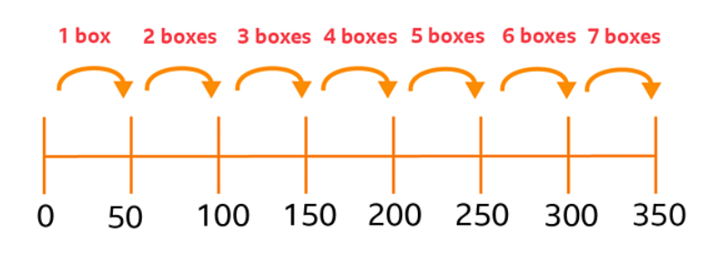
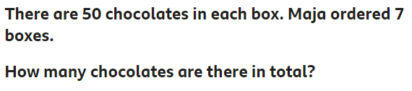
Introduction to counting in 50's - click here for extra help and complete the fun quiz! See how many questions you can get right...
My turn
Answer: There are 350 chocolates in 7 boxes.
Another way you could have worked this out is by using your 5 times table knowledge.
If 5 x 7 = 35, then 50 x 7 = 350, because when you count in multiples of 50, it is 10 times greater than counting in multiples of 5.

Slide 20
Your turn: work out the answer to this question using a number line…
Could you use your knowledge of the 5 times tables to help you work out the answer?
50
150
200
250
300
350
400
450
500
550

Slide 21
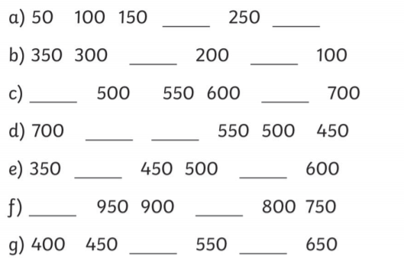
Fill in the missing gaps for each number sequence. Make sure you check whether the sequence is counting forwards in 50’s or backwards in 50’s.
Challenge

Slide 22
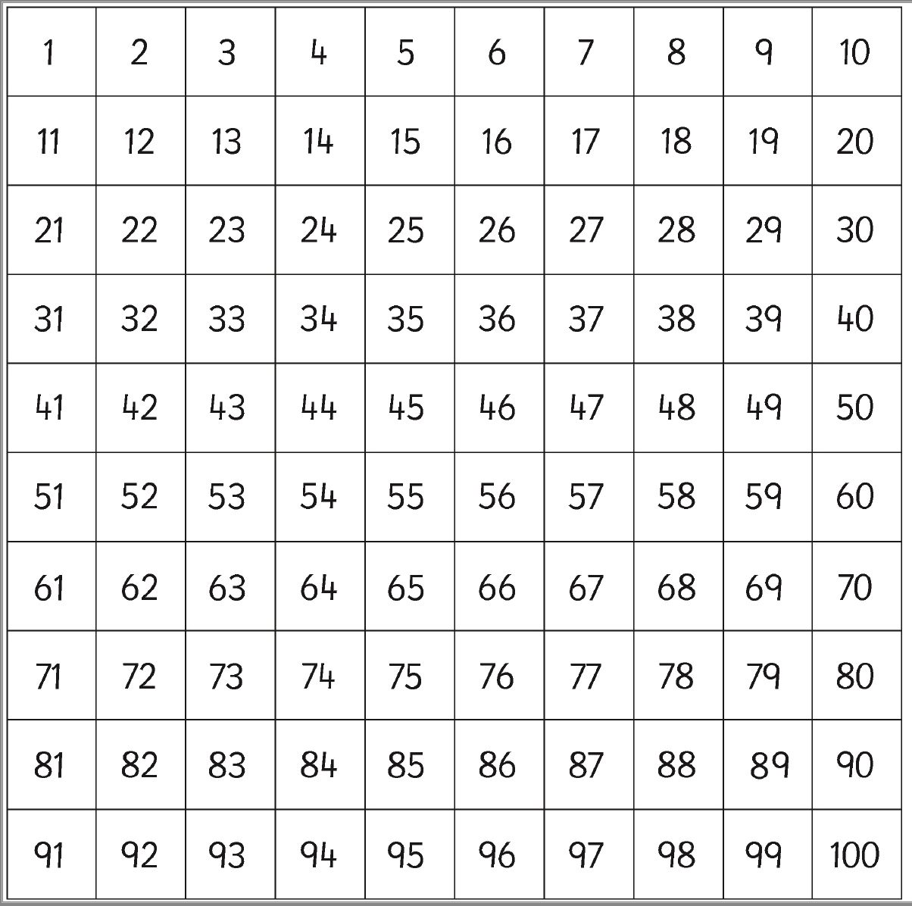
Colour all the numbers that are multiples of 50.

Slide 23
Date: Thursday 4th February 2021
LO. To be able to count in multiples of 25
Subject: Maths

Slide 24
Counting forwards in multiples of 25.
When we count forwards, the numbers increase in value.
+25
+25
What would the next 3 numbers in the sequence be?

Slide 25
Counting backwards in multiples of 25.
When we count backwards, the numbers decrease in value.
-25
H | T | O
H | T | O
What would the next 3 numbers in the sequence be?
What number is being represented here?
What number is being represented here?

Slide 26
Let’s look at this together.
Compare the two number sequences.
What is the same? What is different??
0 25 50 75 100
100 75 50 25 0
Similarities | Differences
They are both counting in multiples of 25. | One is counting forwards in multiples of 25 and one is counting backwards in multiples of 25.
Can you see any other similarities?

Slide 27
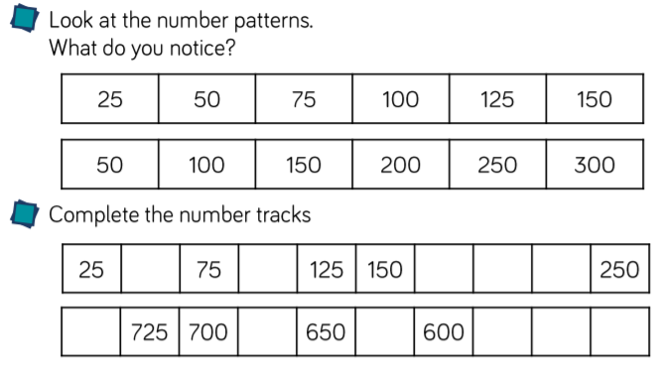
Task 1:
Task 2:

Slide 28
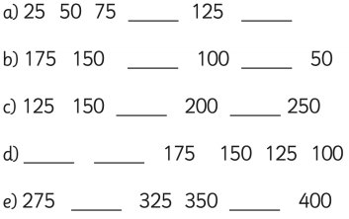
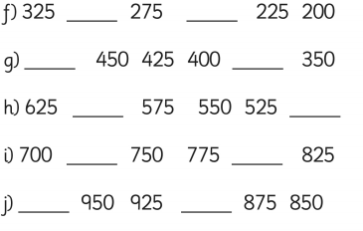
Task 3:
Challenge
Fill in the missing numbers to complete the sequences.
100
150
300
250

Slide 29
Colour all the numbers that are multiples of 25

Slide 30
c
Date: Thursday 21st January
Date: Friday 5th February 2021
L.O. To practice the 9 times tables
Subject: Maths

Slide 31
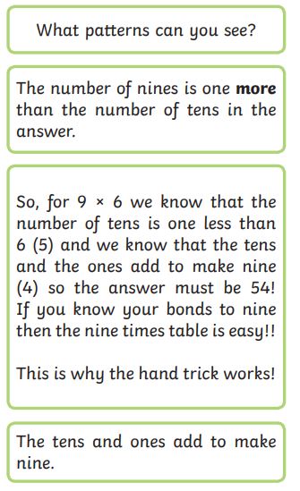
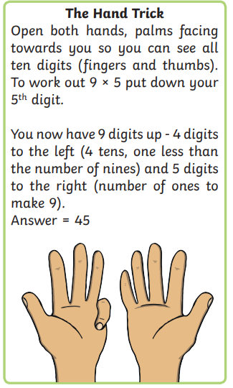
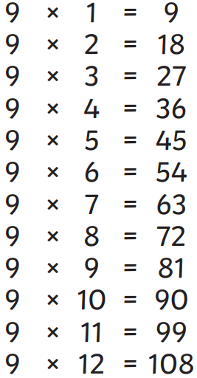

Slide 32
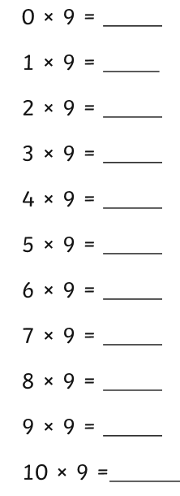
Task 1:
Can you write out your 9 times tables?
Click here and listen to the 9 times table songs!

Slide 33
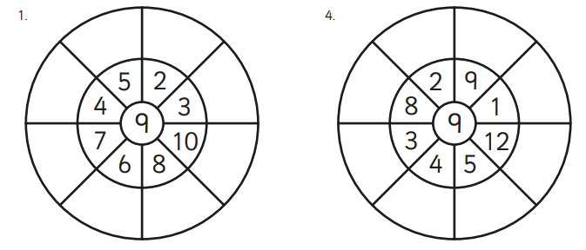
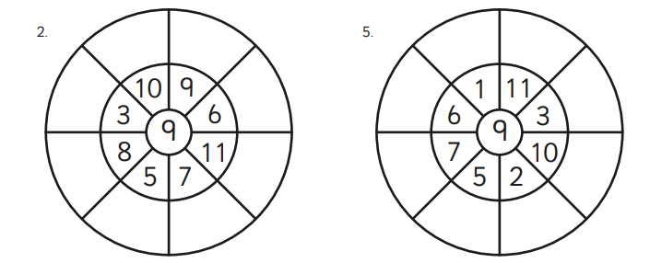
c
Task 2:
45
18
Complete the multiplication wheels. I have done the first one for you! ☺
36
27
63
90
54
72

Slide 34
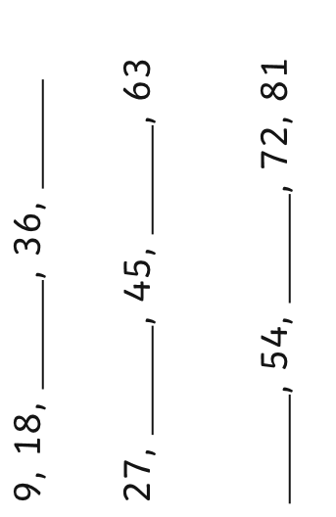
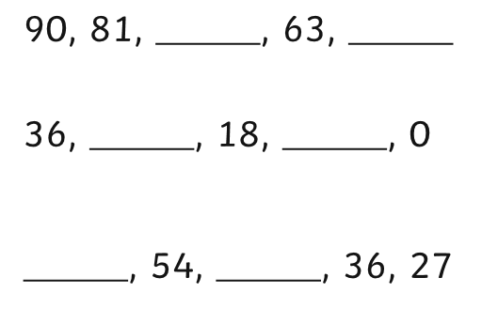
Task 3:
Can you complete the number sequences?
Counting forwards in multiples of 9
Counting backwards in multiples of 9

