Slide 1



Date: Monday 11th January 2021
L.O. To identify and create rhyming couplets.
Subject: English

Slide 2
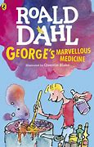
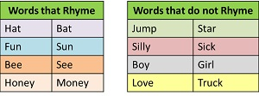
Last week we began to look at George’s Marvellous Medicine.
We are going to use our knowledge from last week to develop our own free verse poem this week.
Firstly, we are going to look at rhyming couplets.
Words that Rhyme have the same sound at the end:
Rhyming couplets have two lines that rhyme together:
Lightening, thunder all around
So much rain falls to the ground.
When I am at home I just can’t wait,
To get to school I think its great.
Can you see the rhyming sound.
Its important to discuss how it might look different but the verbal sound is the same.

Slide 3
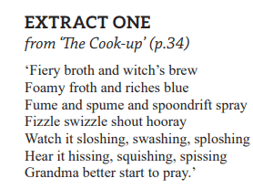
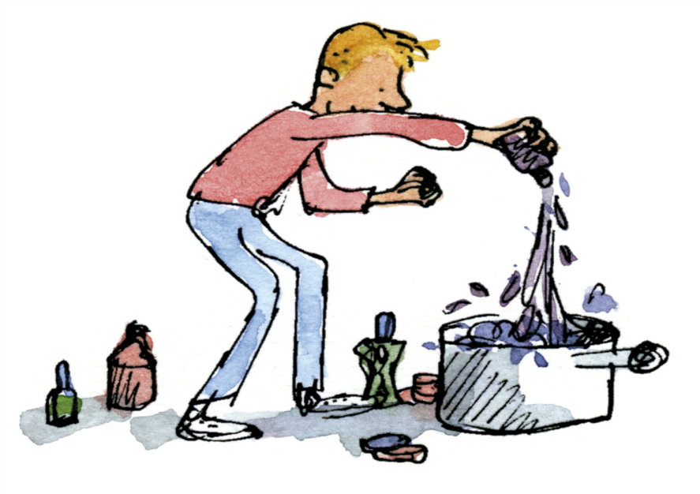
Can you find the rhyming couplets in the poem from Georges Marvellous Medicine?
The first one has been done, can you finish the table?
Brew | Blue

Slide 4
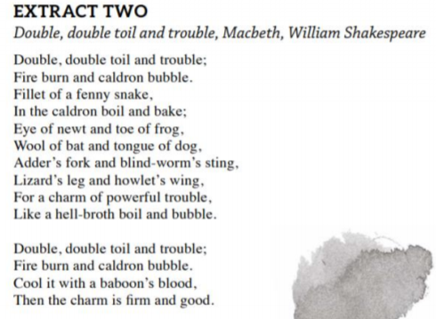

Can you colour in the rhyming couplets in this poem?

Slide 5
Can you make your own rhyming couplets?
1. My cat she likes to chase a mouse,
Especially one that’s in the ______________.
2. Humpty Dumpty sat on a ______________,
Humpty Dumpty had a great ______________.
3. Do you like bread and ___________?
Do you eat it with some _____________?
4. I like to sleep in my ___________,
Not outside in the ____________.

Slide 6
Date: Tuesday 12th January
L.O. To identify and use onomatopoeia.
Subject: English

Slide 7
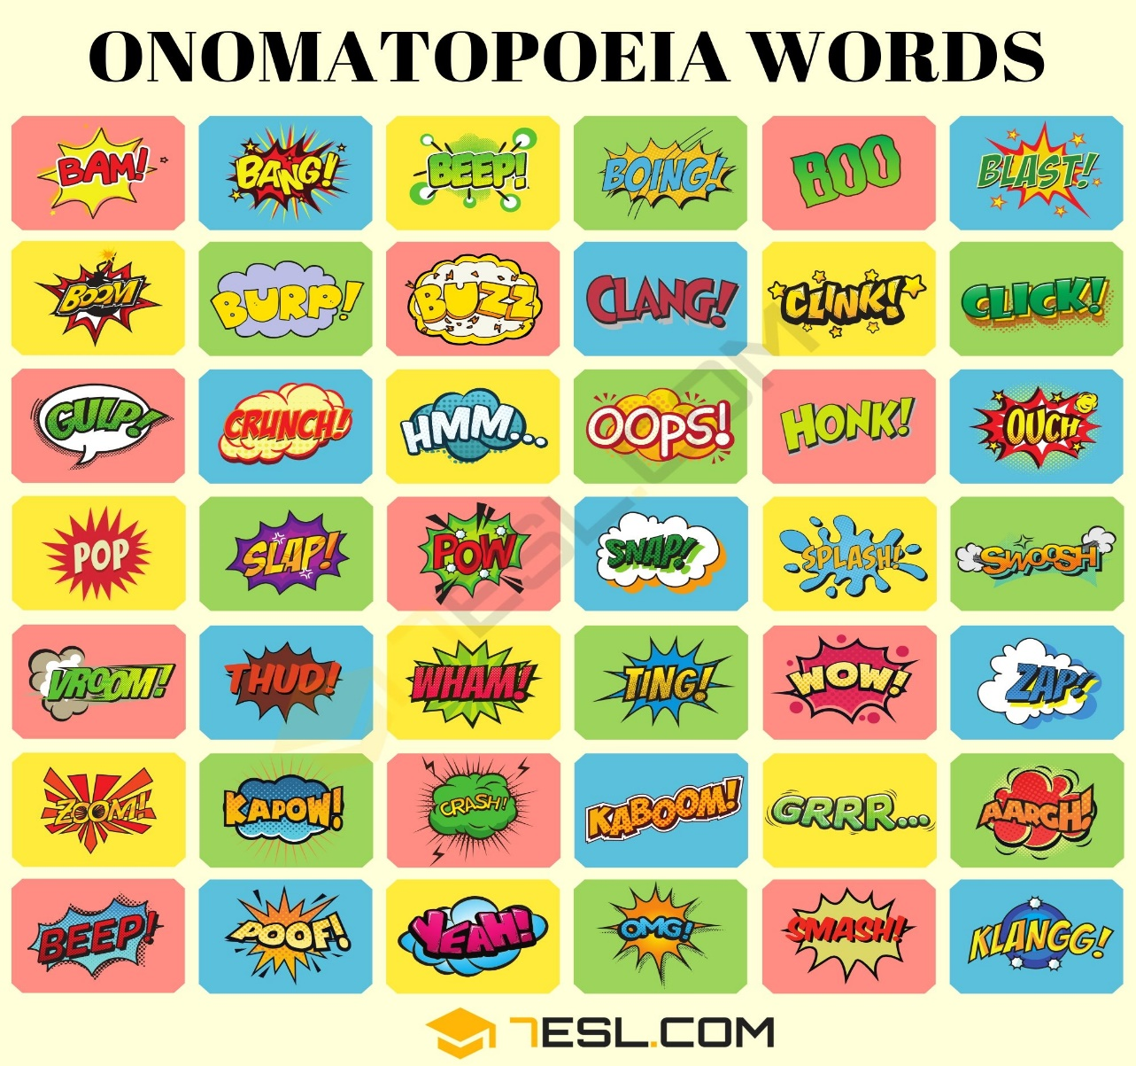
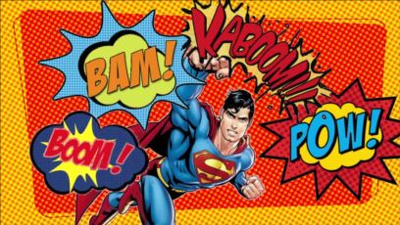

Today, we are going to look at onomatopoeia.
Onomatopoeia is when a word that sounds like what it means:
We often find them in comic books
Where else might you find Onomatopoeia words?

Slide 8
Georges Marvellous Medicine using some Onomatopoeia.
Can you find the Onomatopoeia words?
One has been done, can you finish the table?
Sloshing

Slide 9
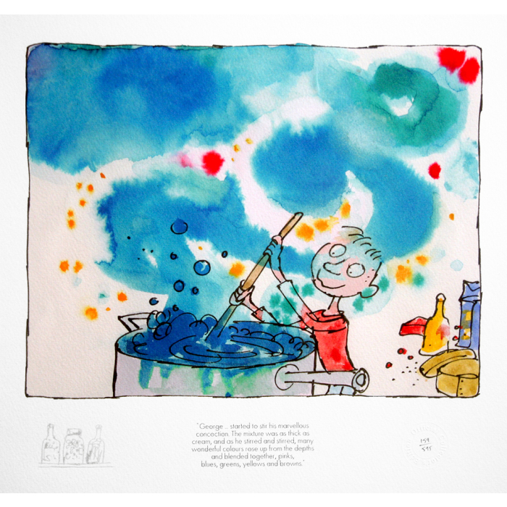
What Onomatopoeic words describe this picture?
Pop
________
Hiss
Whizz
________
Bang
Can you think of two of your own?

Slide 10
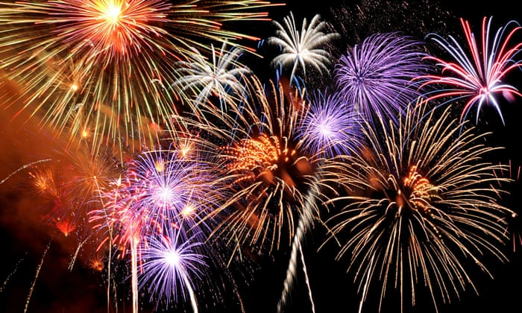

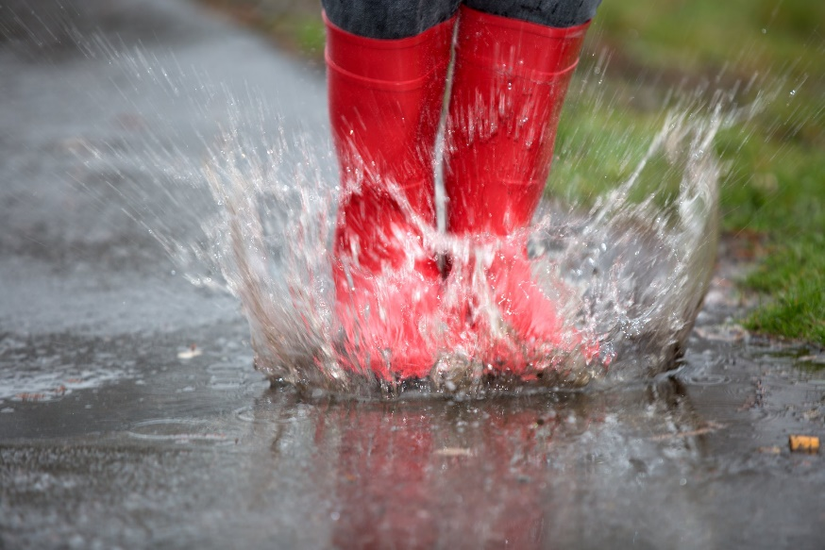
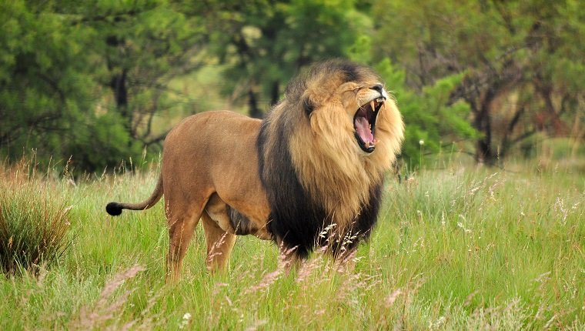
What Onomatopoeic words can you use to describe these pictures?
Use these words to help you:
Roar
Splash
Boom
Vroom
Then think of two more for each.

Slide 11
Date: Wednesday 12th January
L.O. To identify and use Alliteration.
Subject: English

Slide 12
Today, we are going to look at Alliteration.
Alliteration is when words next to each other in a sentence use the same sound :
Can you see all the letters in red are the same sound.
This is Alliteration.
Bees buzz brilliantly next to the beautiful butterfly.
She sells sea shells on the sea shore.
This time all the letters in red are not the same sound.
This is not Alliteration.
Bees fly around next to the colourful butterfly.
Georgina finds shells on the beach .

Slide 13
Can you find Alliteration in the poem from Georges Marvellous Medicine?
The first one has been done, can you finish the table?
Foamy | Froth

Slide 14
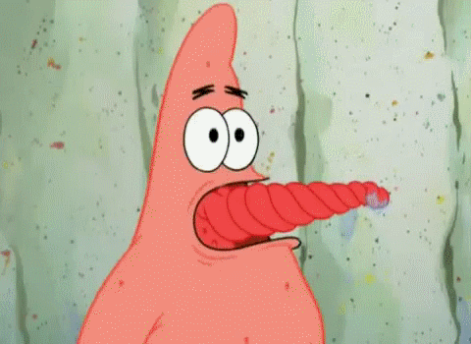

Can you colour in the Alliteration in this these tongue twisters?
A big bug bit the little beetle but the little beetle bit the big bug back.
Peter piper picked a peck of pickled peppers.
If two witches were watching two watches, which witch would watch which watch?
Now can you try saying them out loud as quick as you can.

Slide 15

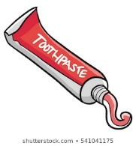
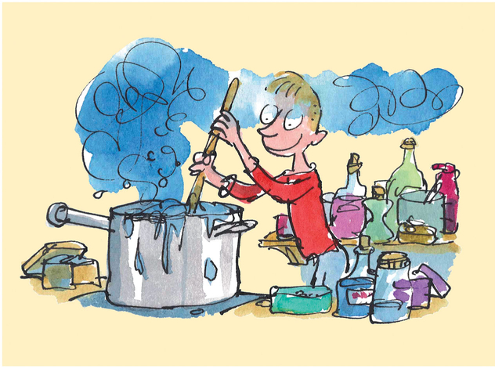
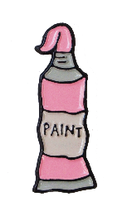
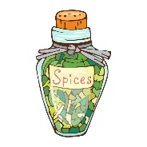
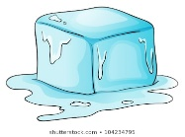
Now we are going to create our own Alliteration
Start with your name: Kind Kimberley Silly Steph Super Sarah Glorious Gail
Then use Alliteration to describe the ingredients for Georges potion.
 | Smelly | Shampoo

Slide 16
ursday
Date: Thursday 14th January
L.O. To identify and use similes.
Subject: English

Slide 17
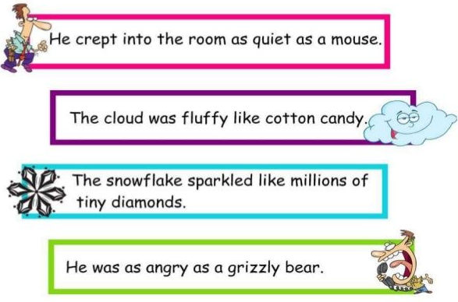
Today, we are going to look at similes.
Similes are used to compare something to another:
We are comparing the creeping man to a quiet mouse.
We are comparing the fluffy cloud to cotton candy.
We are comparing the snowflakes to tiny diamonds
We are comparing the angry man to a grizzly bear.
We often use ‘as’ or ‘like’ when writing a simile.

Slide 18
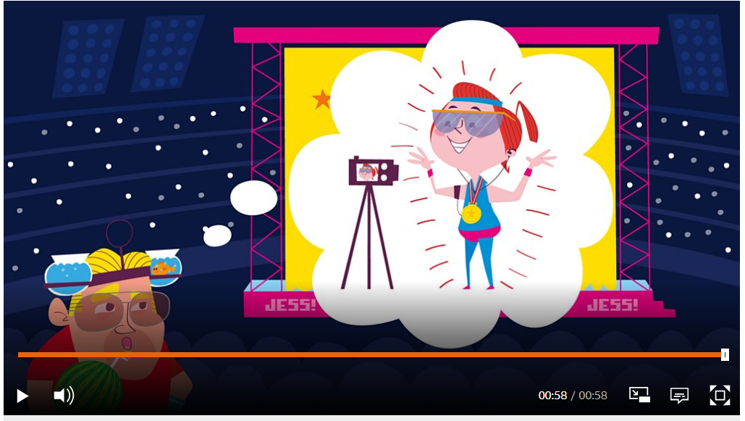
Watch this video about Similes :
https://www.bbc.co.uk/bitesize/topics/zfkk7ty/articles/z9tkxfr

Slide 19
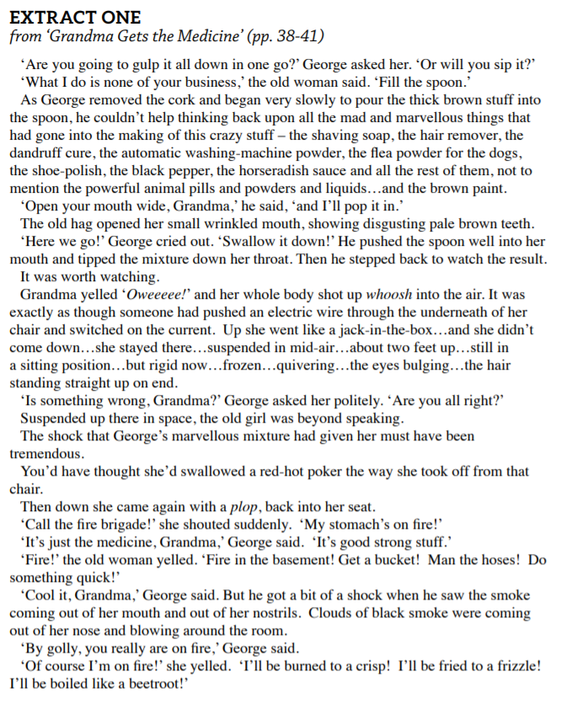
Read this together then see if you can find the similes:
Can you find any others?
Roald Dahl compares Grandma shooting up into the air like she had an electric shock.
Roald Dahl compares Grandma flying up to a __________________________________
Roald Dahl compares _____________ __________________________________

Slide 20
Now lets have a go at creating our own similes:
Use mine to help you then create your own.
As happy as a pig in mud.
As happy as ___________________________________
As fresh as a daisy.
As fresh as __________________________________
As busy as a bee.
As busy as ___________________________________

Slide 21
ursday
Date: Friday 15th January
L.O. To create my own free verse poem using what I have learnt this week.
Subject: English

Slide 22
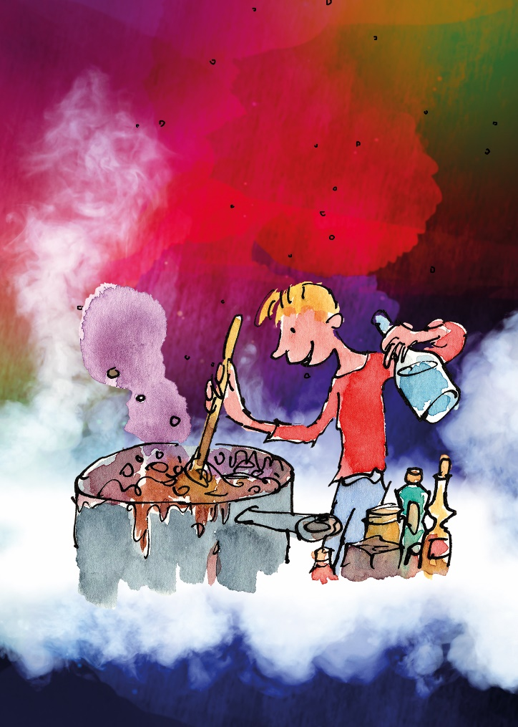
Together we are now going to create a poem all about your own Marvellous Medicine.
First we need a title so decide what special power your magic medicine will have.
Mine is:
Kimberley’s whizz bopping potion for growing huge sprouts.
Make your own title:
_______________’s potion for __________________________.

Slide 23
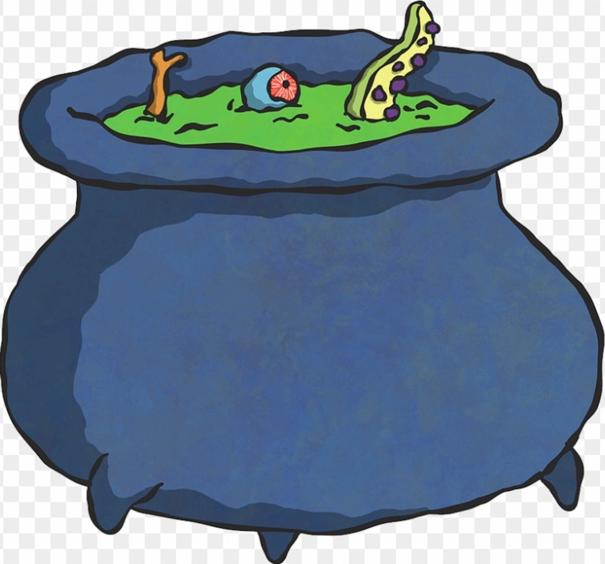
Now we need to create a revolting recipe.
Start with a rhyming couplet:
To create Kimberley’s perilous potion,
Throw in a wiggly, squiggly worm,
That should make your stomach squirm.
Start with a rhyming couplet:
To create ___________perilous potion,
________________________________
________________________________

Slide 24
Now we need to create a revolting recipe.
Next some onomatopoeia:
To create Kimberley’s perilous potion,
Throw in a wiggly, squiggly worm,
That should make your stomach squirm.
Hear it ‘pop,’ ‘bang,’ ‘sizzle’ and ‘whizz’
Add onomatopoeia :
To create ___________perilous potion,
________________________________
________________________________
________________________________

Slide 25
Now we need to create a revolting recipe.
Add some alliteration:
To create Kimberley’s perilous potion,
Throw in a wiggly, squiggly worm,
That should make your stomach squirm.
Hear it ‘pop,’ ‘bang’ and ‘whizz’
Watch the saucepan slosh, sizzle and swirl.
Add Alliteration:
To create ___________perilous potion,
________________________________
________________________________
________________________________
________________________________

Slide 26
Now we need to create a revolting recipe.
Add a simile to finish:
To create Kimberley’s perilous potion,
Throw in a wiggly, squiggly worm,
That should make your stomach squirm.
Hear it ‘pop,’ ‘bang’ and ‘whizz’
Watch the saucepan slosh, sizzle and swirl.
It smells disgusting like an old cabbage.
Add a simile:
To create ___________perilous potion,
________________________________
________________________________
________________________________
________________________________
________________________________

Slide 27
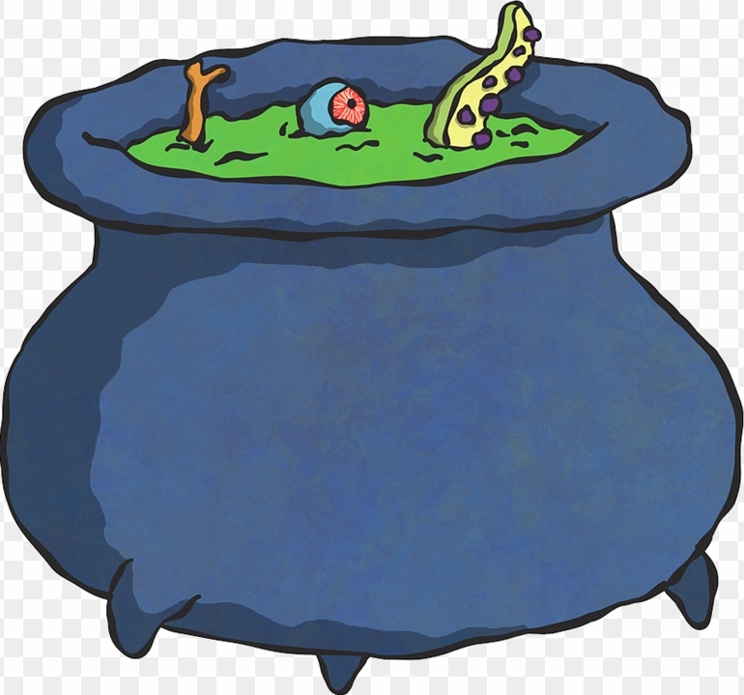

And you have your own revolting recipe poem.
To create Kimberley’s perilous potion,
Throw in a wiggly, squiggly worm,
That should make your stomach squirm.
Hear it ‘pop,’ ‘bang’ and ‘whizz’
Watch the saucepan slosh, sizzle and swirl.
It smells disgusting like an old cabbage.

Slide 28
Date: Week commencing 5th January
L.O I can spell common exception words.
Subject: English

Slide 29
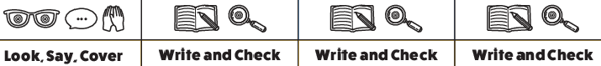
Spellings
Remember:
Child
Plant
Whole
Who
Poor
Hour
Fast
class

Slide 30

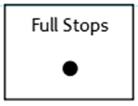

Spellings
Do not forget:
Can you put each one in a sentence?
Child:
Plant:
Whole:
Who:

Slide 31
Spellings
Do not forget:
Can you put each one in a sentence?
Poor:
Hour:
Fast:
Class:

