Slide 1


Subject: Maths
Base 1

Slide 2


Date: 1.3.21
L.O: To be able to compare fractions with the same denominator.
Subject: Maths

Slide 3

Pre-recorded Teaching
Access the online teaching video below that will support you to complete the work in this lesson. This video will act as a support but all of the work can still be successfully understood & completed using paper-based versions of this pack. If you need further support to understand / complete work then please contact school via e-mail or telephone.
Play Video
You can also copy and paste this link if you would prefer:
https://classroom.thenational.academy/lessons/comparing-fractions-6rr68e

Slide 4


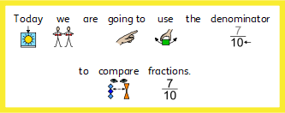


2
8

Slide 5








5
8
7
8

Slide 6

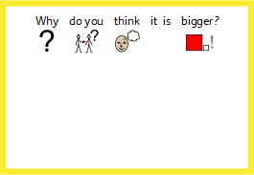
5
8
7
8

Slide 7


5
8
7
8

Slide 8
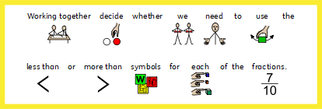

3
10
9
10
4
8
3
8
6
12
2
12
1
4
2
4

Slide 9


3
7
5
7
2
8
8
8
5
10
7
10
10
12
11
12
10
10
9
10
3
4
1
4

Slide 10
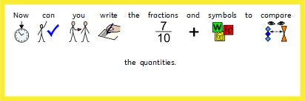
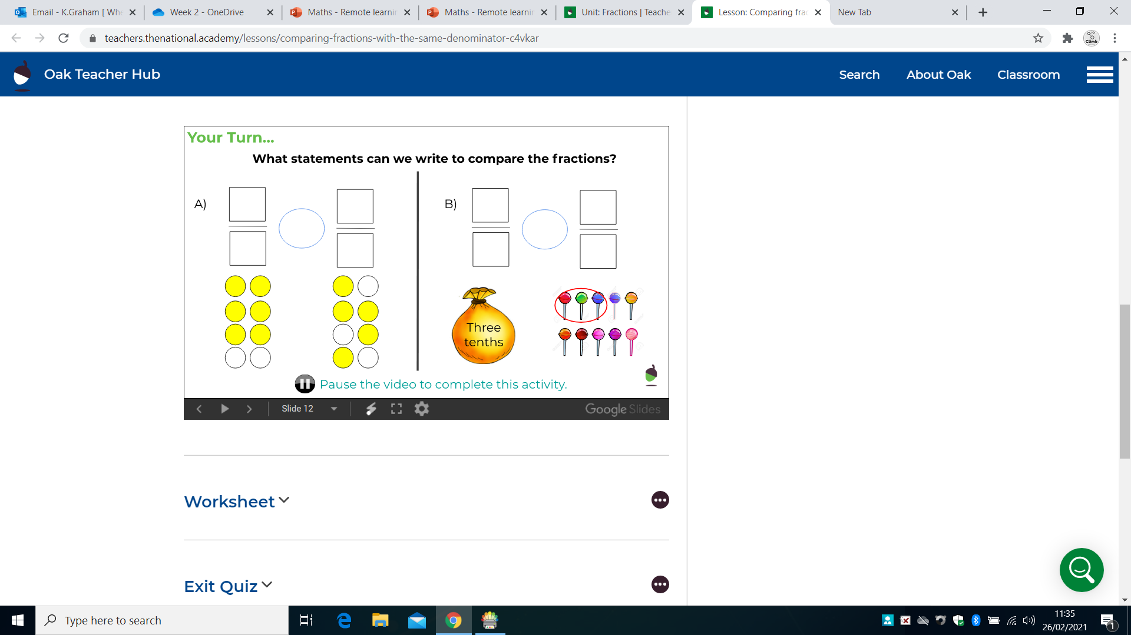
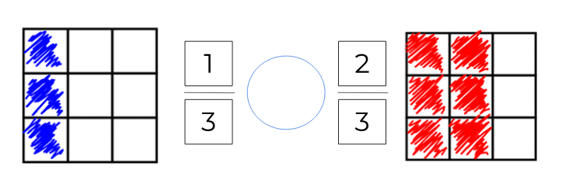

Slide 11
Date: 2.3.21
L.O: To be able to compare and order unit fractions.
Subject: Maths

Slide 12
Pre-recorded Teaching
Access the online teaching video below that will support you to complete the work in this lesson. This video will act as a support but all of the work can still be successfully understood & completed using paper-based versions of this pack. If you need further support to understand / complete work then please contact school via e-mail or telephone.
Play Video
You can also copy and paste this link if you would prefer:
https://classroom.thenational.academy/lessons/ordering-fractions-cct38r

Slide 13
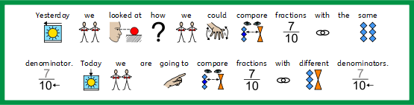

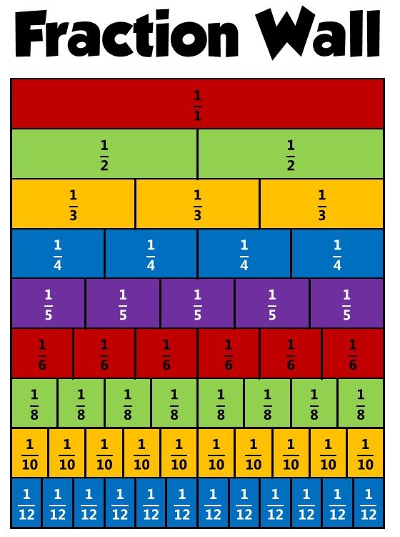
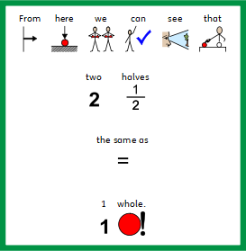

Slide 14






Slide 15


Slide 16





Slide 17


1
8
1
3
1
2
1
10
1
10
1
8
1
12
1
2
1
4
1
3
1
1
1
6

Slide 18
Date: 3.2.21
L.O: To be able to recognise equivalent fractions, using visual representations.
Subject: Maths

Slide 19
Pre-recorded Teaching
Access the online teaching video below that will support you to complete the work in this lesson. This video will act as a support but all of the work can still be successfully understood & completed using paper-based versions of this pack. If you need further support to understand / complete work then please contact school via e-mail or telephone.
Play Video
You can also copy and paste this link if you would prefer:
https://classroom.thenational.academy/lessons/equivalent-fractions-68rk2d

Slide 20
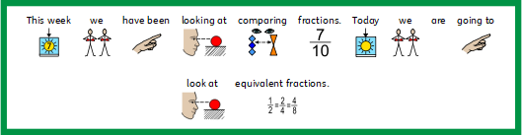





Slide 21
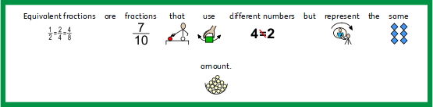
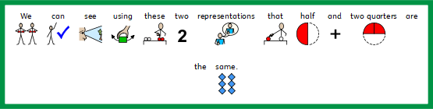


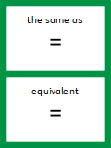


Slide 22



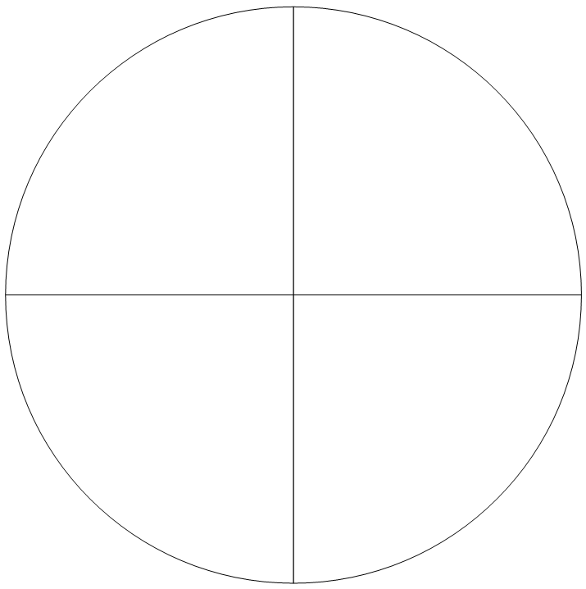
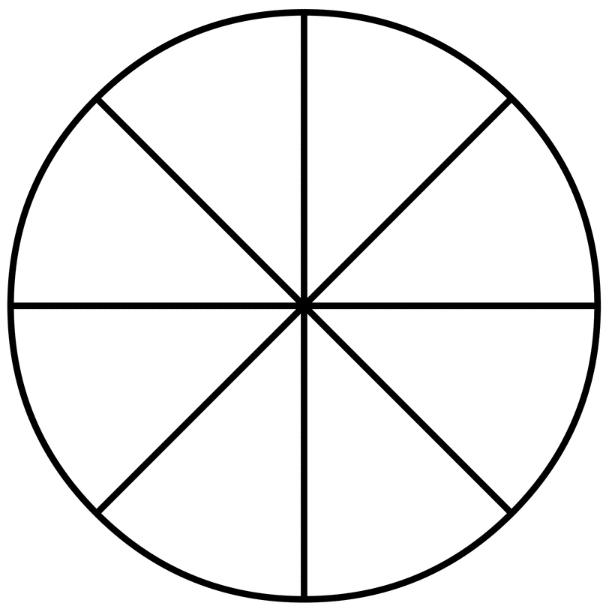

Slide 23


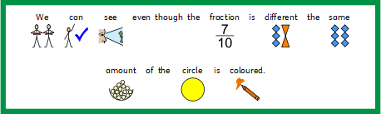




Slide 24

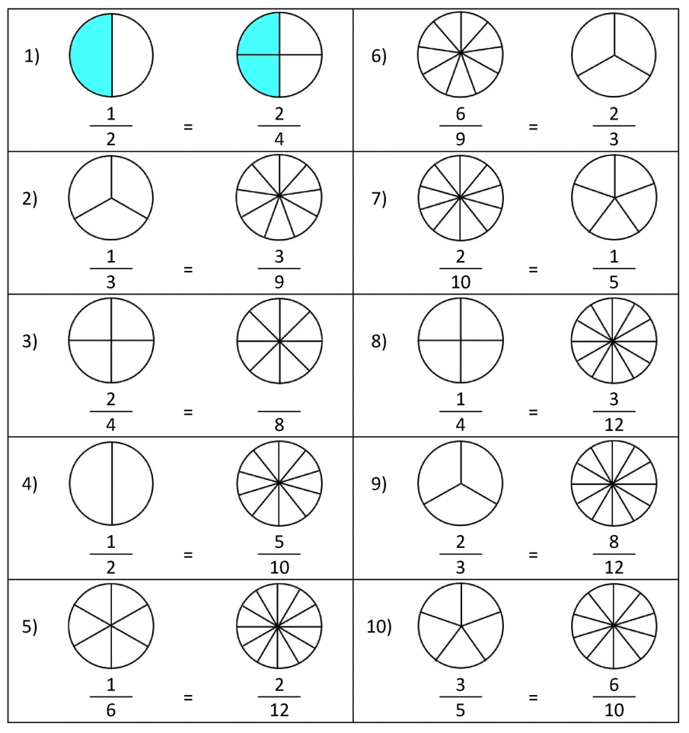

Slide 25
Date: 4.3.21
L.O: To be able to recognise equivalent fractions using unit fractions.
Subject: Maths

Slide 26
Pre-recorded Teaching
Access the online teaching video below that will support you to complete the work in this lesson. This video will act as a support but all of the work can still be successfully understood & completed using paper-based versions of this pack. If you need further support to understand / complete work then please contact school via e-mail or telephone.
Play Video
You can also copy and paste this link if you would prefer:
https://classroom.thenational.academy/lessons/equivalent-fractions-68rk2d

Slide 27
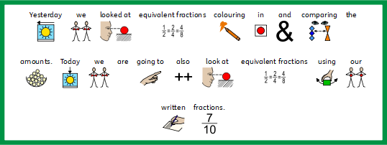


Slide 28

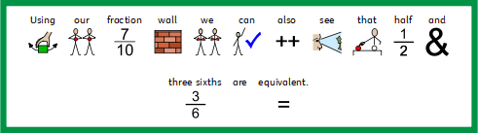



Slide 29
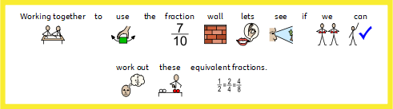


1/1
¼ | 2/4 | ¾ | 4/4
1/3 |  | 2/3 |  | 3/3
1/6

Slide 30


Slide 31

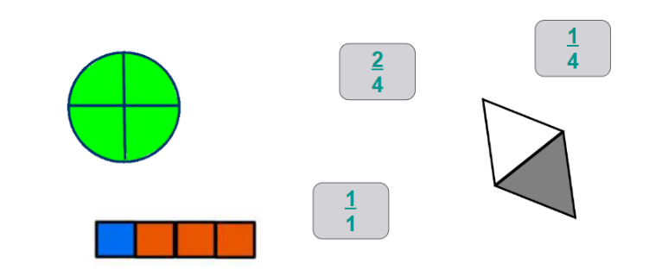
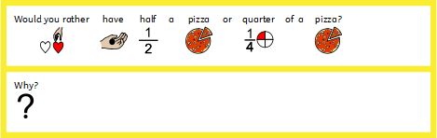

Slide 32
Date: 5.3.21
L.O: To be able to share between a given amount.
Subject: Maths intervention.

Slide 33
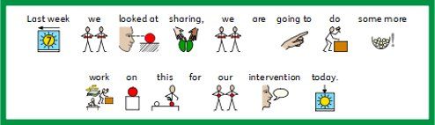


Slide 34






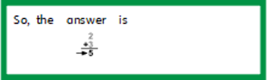

Slide 36

