Slide 1
Date: Monday 1st March
LO To be able to identify the features of an advert.
Subject: English

Slide 2
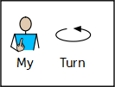
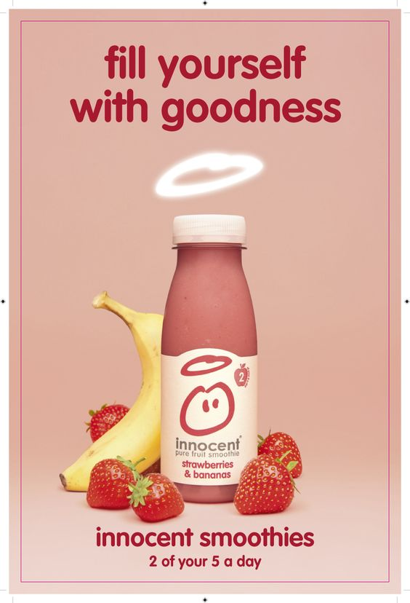
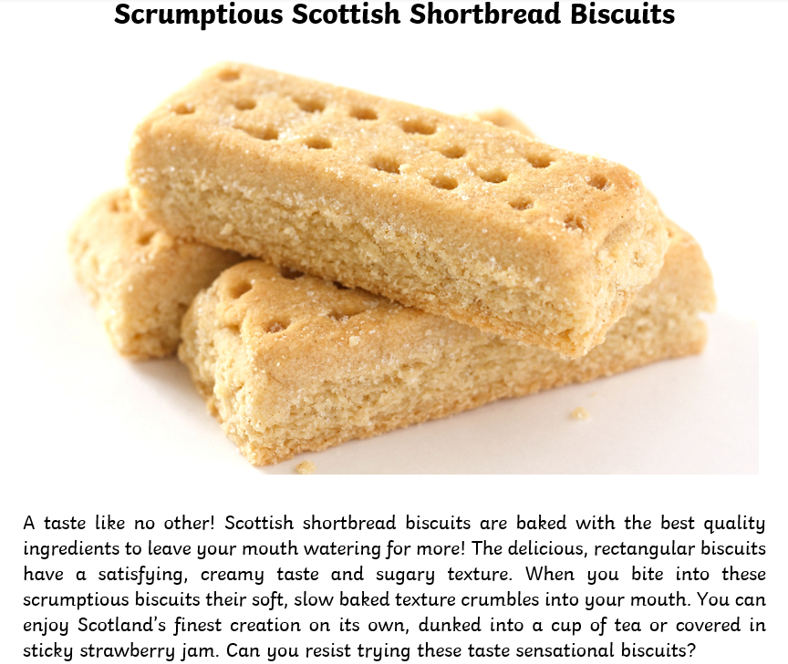
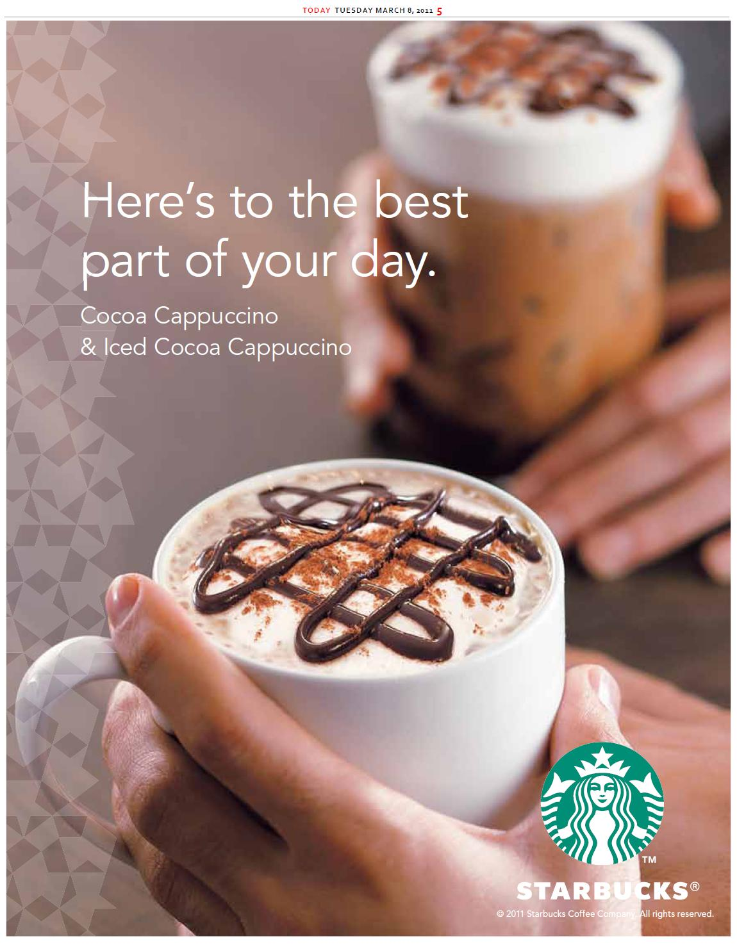
Adverts
This week we are going to look at adverts. Adverts are designed to make people want to buy a product.
Here are some examples:
Health benefits
Descriptions to make the product sound good
Catchy slogans
Eye catching pictures
Rhetorical questions

Slide 3
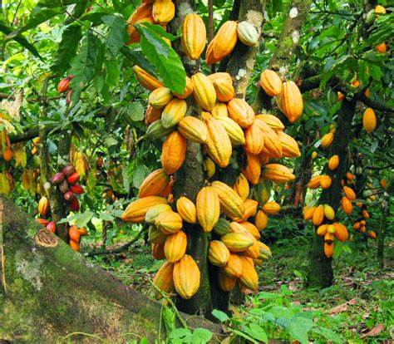
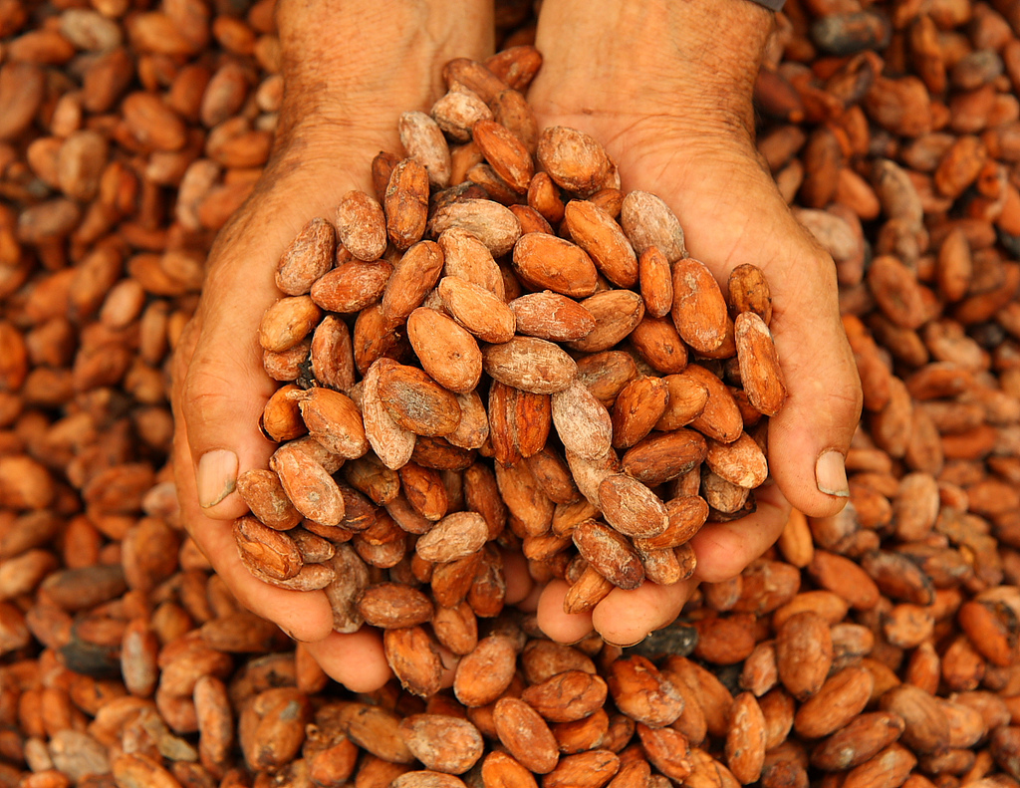
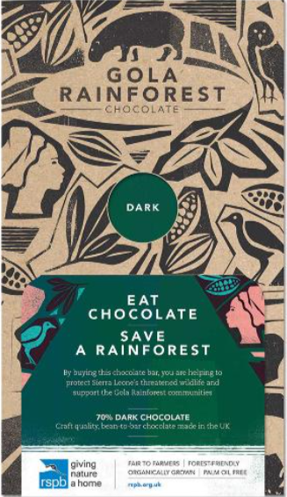
Read my advert!
Delicious delightful dark chocolate
A taste like no other! Gola rainforest chocolate will leave your mouth watering for more! Grown in the depth of the luxurious, green Amazon Rainforest this chocolate is harvested and crafted with passion and perfection. Gola chocolate is made using the best quality cocoa beans to provide you with a taste sensation in every bite! The delicious, rectangular chocolate bar has a smooth, creamy texture which melts in your mouth. You can enjoy this chocolate on its own, melted and drizzled over strawberries or baked as part of a scrumptious, chocolate cake.
Can you resit trying this taste sensational chocolate? Why wait buy your Gola Rainforest chocolate bar today!
Not only does Gola Rainforest chocolate taste sensational, every bar you buy helps to save the rainforests. Chocolate that tastes good and does good!

Slide 4
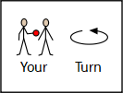
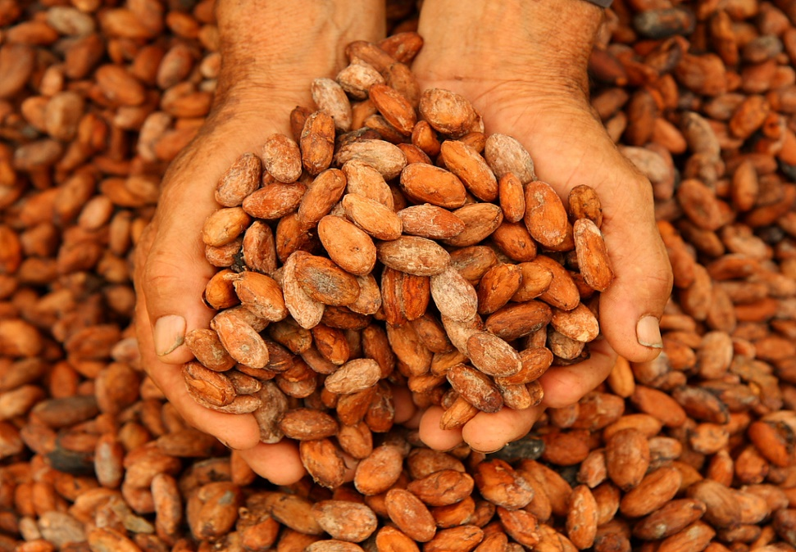
Now find the features
Delicious delightful dark chocolate
A taste like no other! Gola rainforest chocolate will leave your mouth watering for more! Grown in the depth of the luxurious, green Amazon Rainforest this chocolate is harvested and crafted with passion and perfection. Gola chocolate is made using the best quality cocoa beans to provide you with a taste sensation in every bite! The delicious, rectangular chocolate bar has a smooth, creamy texture which melts in your mouth. You can enjoy this chocolate on its own, melted and drizzled over strawberries or baked as part of a scrumptious, chocolate cake.
Can you resit trying this taste sensational chocolate? Why wait buy your Gola Rainforest chocolate bar today!
Not only does Gola Rainforest chocolate taste sensational, every bar you buy helps to save the rainforests. Chocolate that tastes good and does good!
Use the key to highlight/ underline the key features in the correct colour
Remember adjectives are describing words!
title
picture
adjectives
question
exclamation mark

Slide 5
Well done for all of your hard work today! We cant wait to see your completed work.
Could any completed work / photographic evidence of completed work please be sent to pioneerspupils@gmail.com
Thank you!

Slide 6
Date: Tuesday 2nd March
LO To be able to write sentences using expanded noun phrases.
Subject: English

Slide 7
Nouns are things…
Recap on expanded noun phrases
An expanded noun phrase is adjective , adjective noun
Adjectives are describing words…

Slide 8
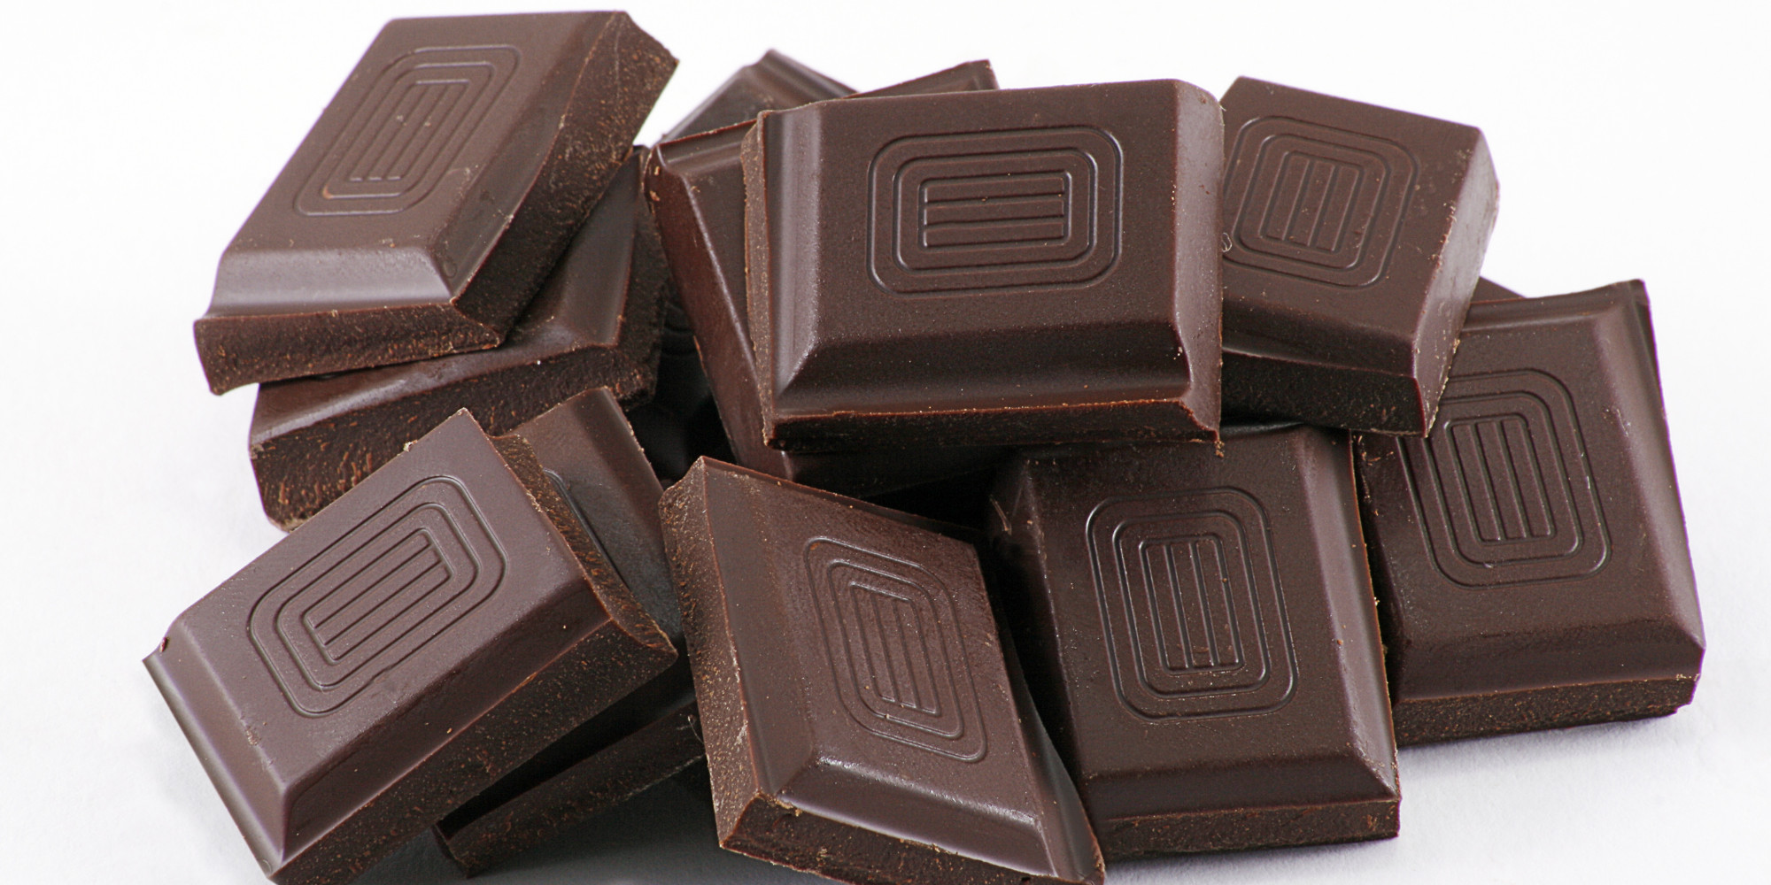
Nouns are things…
wrapper
pods
leaves
tree
packaging
chocolate
beans
Can you think of any others?

Slide 9
Adjectives are describing words…
Complete the expanded noun phrases by
adding 2 adjectives before the noun.
ripe, yellow pods
long , green leaves
_____________ _____________ tree
_____________ _____________ beans
______________ _____________ chocolate
_____________ _______________ texture
______________ _____________ shape
______________ _____________ taste
Don’t forget! Have you put a comma between your two describing words?

Slide 10
Example advert
Read my advert …
A taste like no other! Gola rainforest chocolate will leave your mouth watering for more! Grown in the depth of the luxurious, green Amazon Rainforest this chocolate is harvested and crafted with passion and perfection. Gola chocolate is made using the best quality cocoa beans to provide you with a taste sensation in every bite! The delicious, rectangular chocolate bar has a smooth, creamy texture which melts in your mouth. You can enjoy this chocolate on its own, melted and drizzled over strawberries or baked as part of a scrumptious, chocolate cake.
Can you resit trying this taste sensational chocolate? Why wait buy your Gola Rainforest chocolate bar today!
Not only does Gola Rainforest chocolate taste sensational, every bar you buy helps to save the rainforests. Chocolate that tastes good and does good!

Slide 11
Read through the description again and highlight/underline the expanded noun phrases.
What is an expanded noun phrase?
adjective , adjective noun
A taste like no other! Gola rainforest chocolate will leave your mouth watering for more! Grown in the depth of the luxurious, green Amazon Rainforest this chocolate is harvested and crafted with passion and perfection. Gola chocolate is made using the best quality cocoa beans to provide you with a taste sensation in every bite! The delicious, rectangular chocolate bar has a smooth, creamy texture which melts in your mouth. You can enjoy this chocolate on its own, melted and drizzled over strawberries or baked as part of a scrumptious, chocolate cake.
Can you resit trying this taste sensational chocolate? Why wait buy your Gola Rainforest chocolate bar today!
Not only does Gola Rainforest chocolate taste sensational, every bar you buy helps to save the rainforests. Chocolate that tastes good and does good!

Slide 12
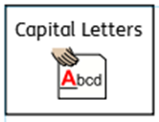
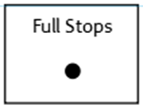
Sentences using expanded noun phrases…
Choose 4 of your expanded noun phrases and turn them into full sentences.
Don’t forget:
The Amazon rainforest is filled with ripe, yellow pods of cocoa.
Keep your sentences safe, you will be able to use them in your advert on Thursday!

Slide 13
Well done for all of your hard work! We can’t wait to see your completed work.
Could any completed work / photographic evidence of completed work please be sent to pioneerspupils@gmail.com
Thank you!

Slide 14
Date: Wednesday 3rd March
LO To be able to punctuate sentences with an exclamation mark.
Subject: English

Slide 15
Pre-Recorded Teaching
Access the online teaching video below by Miss Noble that will support you to complete the work in this lesson. This video will act as a support but all of the work can still be successfully understood & completed using paper-based versions of this pack. If you need further support to understand / complete work then please contact school via e-mail or telephone.
You can play this video on our school website.

Slide 16
Exclamation Mark
An exclamation mark looks like this !
Can you draw an exclamation mark with your finger?
Now can you write an exclamation mark on your paper?

Slide 17
Exclamation Mark
Exclamation marks can be used for a command or an exclamation.
Command
You must go to the shop now!
Exclamation
The rainforest is in danger!

Slide 18
Command or exclamation
Can you decide if these sentences are a command or an exclamation ?
1. You must save the animals from danger!
2. This chocolate is divine!
3. Stop cutting down the trees!
4. We need to take care of the forest and live together!
5. You must save the rainforest!

Slide 19
Command or exclamation- Answers
Can you decide if these sentences are a command or an exclamation ?
1. You must save the animals from danger! Command
2. This chocolate is divine! Exclamation
3. Stop cutting down the trees! Command
4. We need to take care of the forest and live together! Exclamation
5. You must save the rainforest! Command

Slide 20
Exclamation Mark
Exclamation marks are used at the end of sentences when a strong emotion is being expressed.
shocked
cross
angry
happy
Expressions
scared
excited
sad
surprised

Slide 21
Add the exclamation mark
Can you punctuate the sentences correctly using an exclamation mark – remember an exclamation mark looks like this !
I can’t wait to eat this chocolate, it smells amazing
This chocolate tastes scrumptious
Eat chocolate and save the rainforest
It’s not too late to save the animals
Remember the ! goes at the end of the sentence

Slide 22
Add the exclamation mark - answers
Can you punctuate the sentences correctly using an exclamation mark – remember an exclamation mark looks like this !
I can’t wait to eat this chocolate, it smells amazing !
This chocolate tastes scrumptious !
Eat chocolate and save the rainforest !
It’s not too late to save the animals !

Slide 23
Exclamation mark or question mark?
Read the sentences and decide if they need a exclamation mark or a question mark at the end.
1. Help save our homes
2. What is your favourite chocolate
3. This chocolate is so tasty, you won’t want to stop eating it
4. Did you know chocolate is made from cocoa beans
5. The animals need your help

Slide 24
Exclamation mark or question mark? Answers
1. Help save our homes !
2. What is your favourite chocolate ?
3. This chocolate is so tasty, you won’t want to stop eating it !
4. Did you know chocolate is made from cocoa beans ?
5. The animals need your help !

Slide 25
My turn …
Don’t forget:

Slide 26
Now write 6 of your own sentences that end with an exclamation mark. Your sentences could be about chocolate or saving the rainforest.
Write your sentences neatly onto a piece of paper or type them on the lines below.
You can use some of the sentences we have already looked at to help.
Don’t forget:

Slide 27
Well done for all of your hard work today! We cant wait to see your completed work.
Could any completed work / photographic evidence of completed work please be sent to pioneerspupils@gmail.com
Thank you!

Slide 28
Date: Thursday 4th March
LO To be able to write an advert.
Subject: English

Slide 29
Re read my advert to get it back in your head.
Delicious delightful dark chocolate
A taste like no other! Gola rainforest chocolate will leave your mouth watering for more! Grown in the depth of the luxurious Amazon Rainforest this chocolate is harvested and crafted with passion and perfection. Gola chocolate is made using the best quality cocoa beans to provide you with a taste sensation in every bite! The delicious, rectangular chocolate bar has a smooth and creamy texture which melts in your mouth. You can enjoy this chocolate on its own, melted and drizzled over strawberries or baked as part of a scrumptious chocolate cake.
Can you resit trying this taste sensational chocolate? Why wait buy your Gola Rainforest chocolate bar today!
Not only does Gola Rainforest chocolate taste sensational, every bar you buy helps to save the rainforests. Chocolate that tastes good and does good!

Slide 30
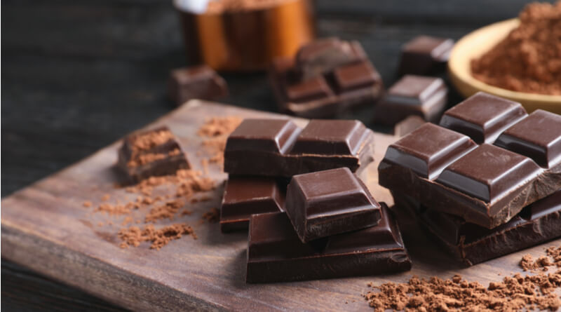
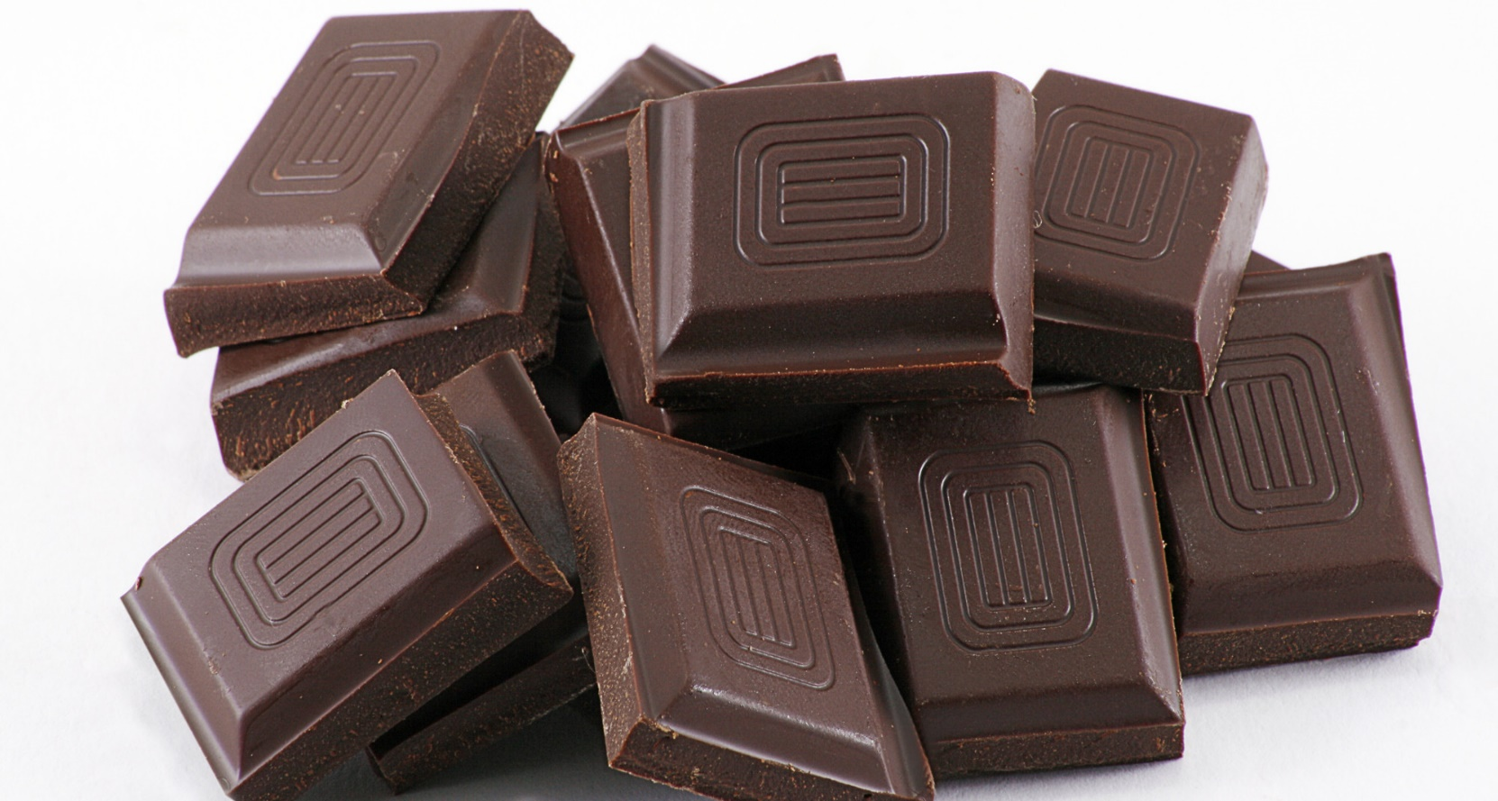
Delicious delightful dark chocolate
Before you write your advert click on the links to watch different chocolate companies try and sell their products using adverts. This will help you get some ideas of what to include in your advert!
How chocolate is saving the rainforest - YouTube
Lindt Lindor - "Do you dream in chocolate?" - YouTube
If you are unable to access the videos online you will find clips of the adverts on the next two slides.

Slide 31
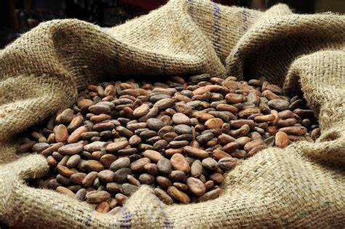
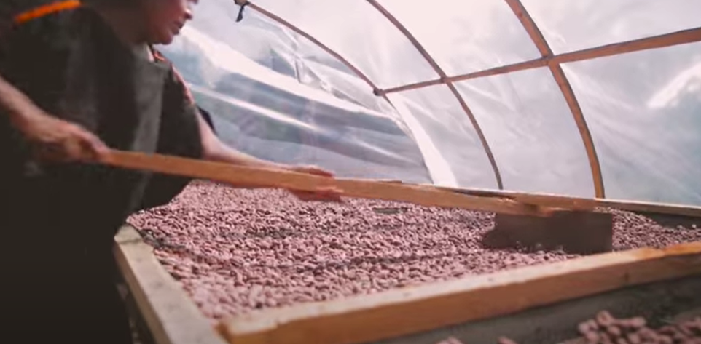
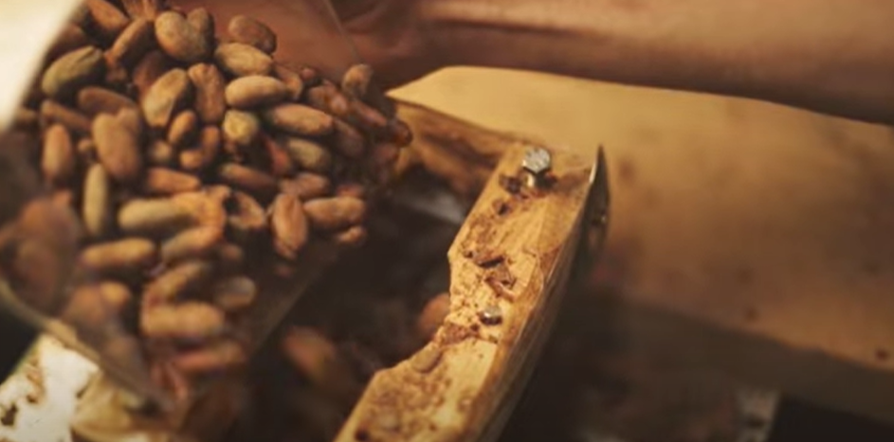
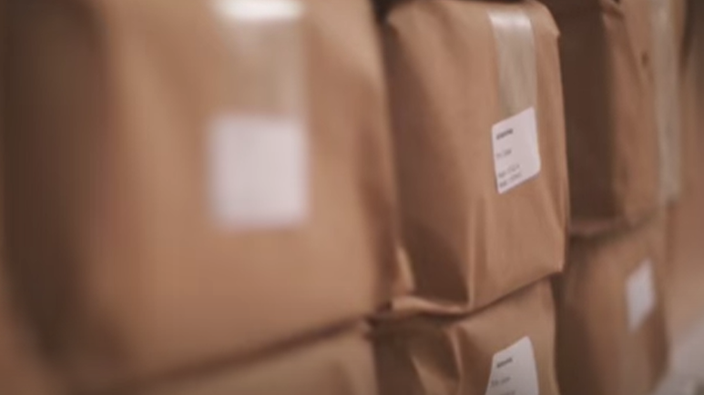
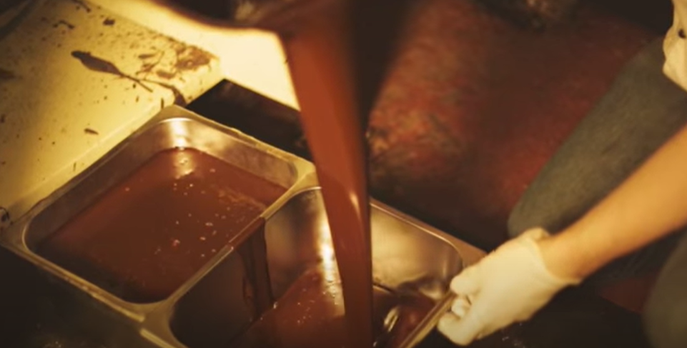
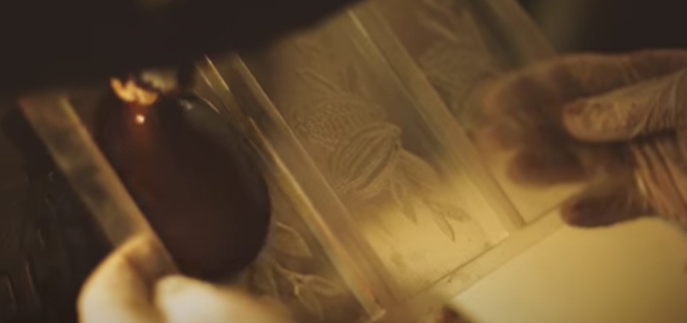
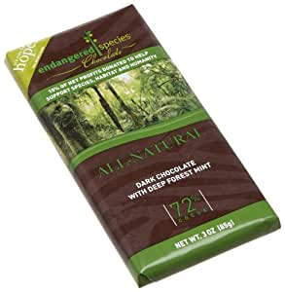
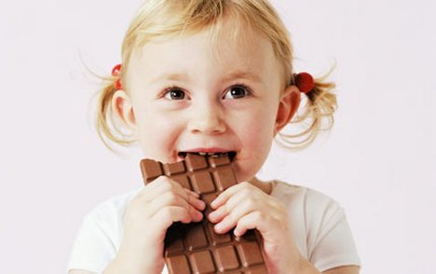
Process of chocolate making (how chocolate is saving the rainforest video)
The beans are grown on trees and are hand picked when they have grown to perfection.
The cocoa beans are then roasted to bring out their sensational natural flavours.
The cocoa beans are then grinded into small pieces.
The beans are then wrapped up and left to ‘age’ for 40 days until they reach the desired delicious taste.
The rich, creamy chocolate is then melted for 16 hours.
The chocolate is then added to a mould to turn it into the desired shape and size.
The packaging is then added to the chocolate and the chocolate is sent to the shops to be sold.
Finally the mouth watering chocolate is ready for us to eat and enjoy.

Slide 32
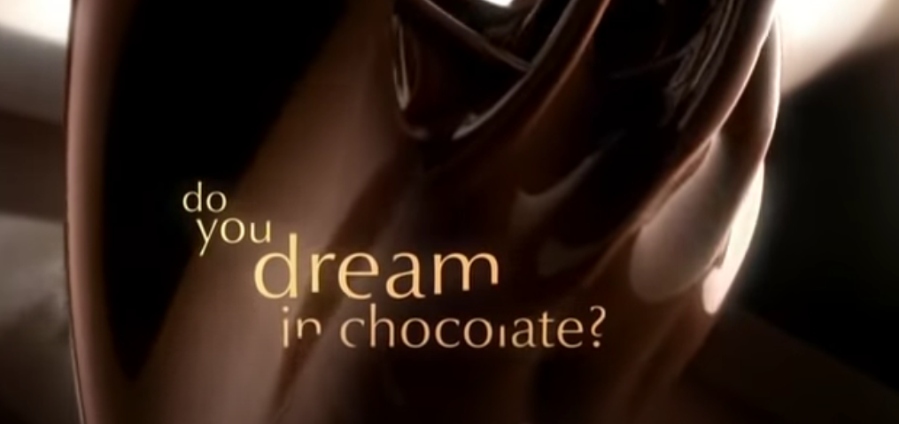
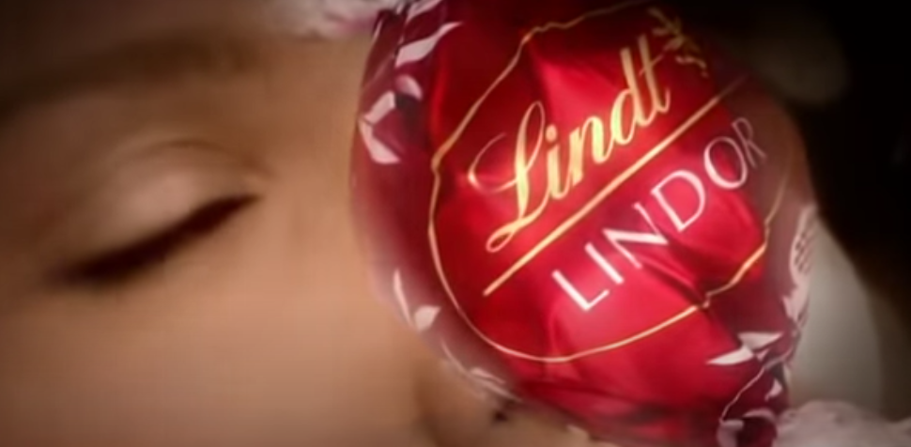
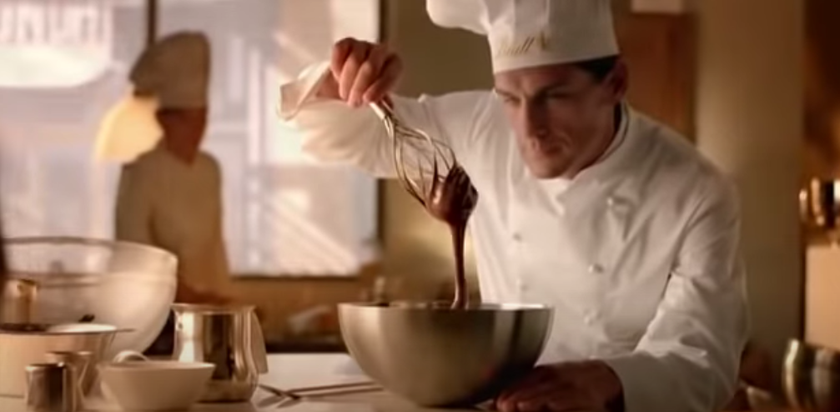
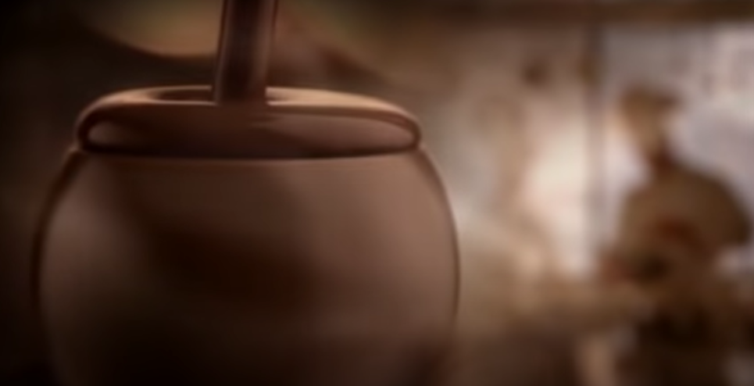
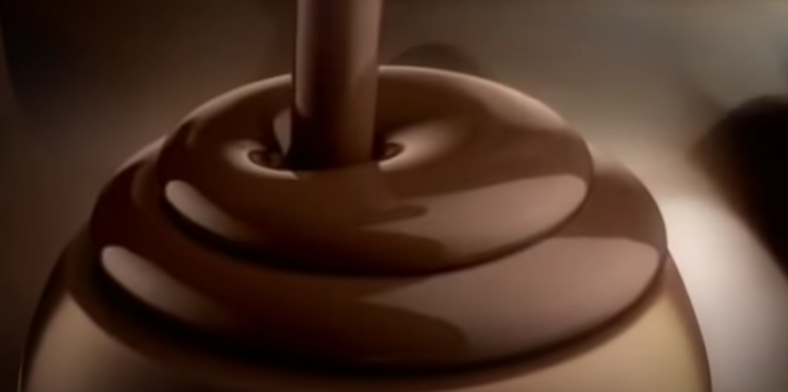
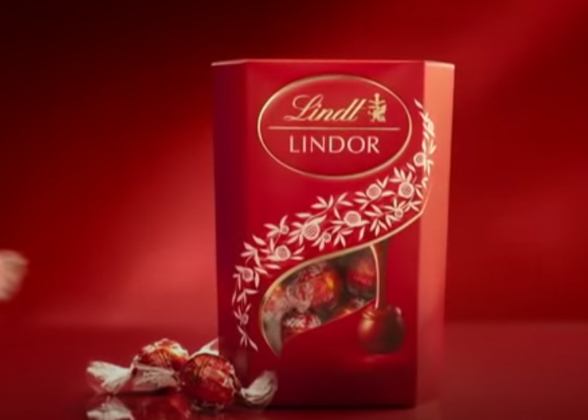
Lindt Lindor – do you dream in chocolate? (Video)
Taste the Lindor truffle.
created with passion only by Lindt’s master chocolatiers
like nothing you’ve ever experienced
when Lindor's irresistible centre starts to melt
so will you
Smooth, flowing luscious chocolate like no other
The Lindor truffle from the Lindt master chocolatier

Slide 33
Pre-Recorded Teaching
Access the online teaching video below by Miss Malloy that will support you to complete the work in this lesson. This video will act as a support but all of the work can still be successfully understood & completed using paper-based versions of this pack. If you need further support to understand / complete work then please contact school via e-mail or telephone.
You can play this video on our school website.

Slide 34
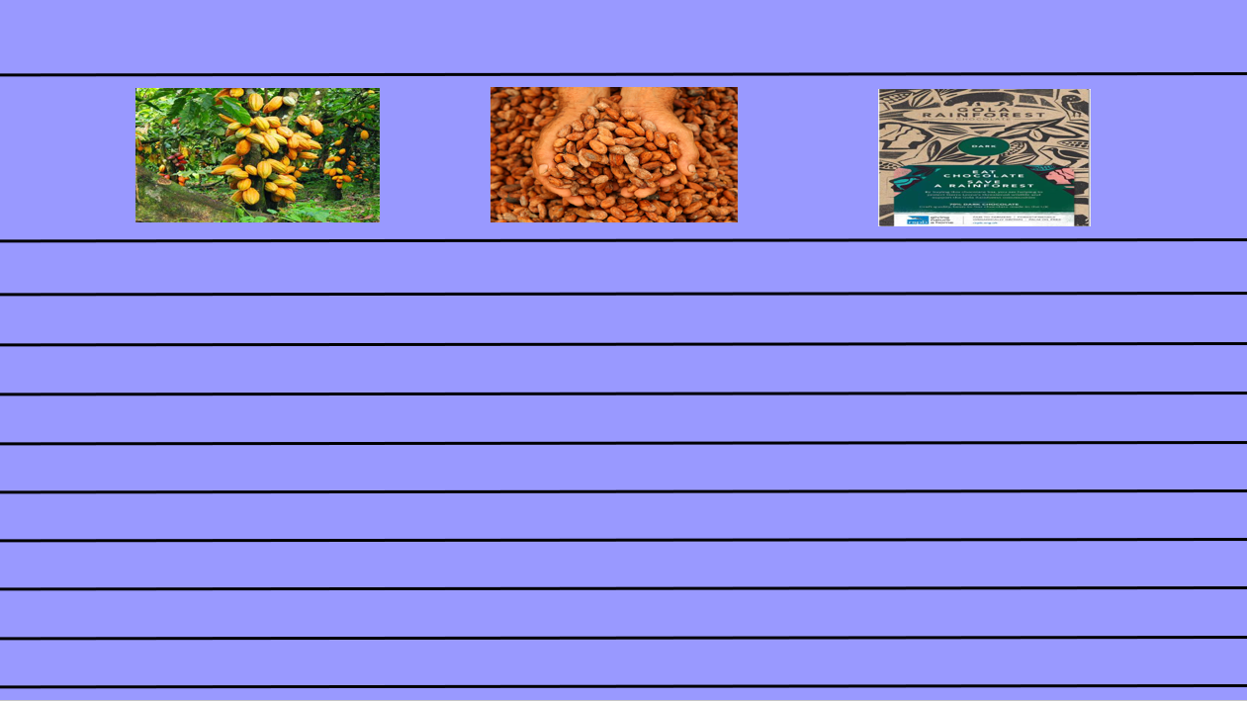
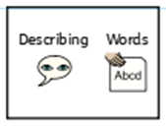
Writing an advert
Today you are going to write an advert for ‘Gola Rainforest Chocolate’.
Your aim is to make people want to buy the chocolate! Describe how delicious the chocolate is and how it helps to save the rainforest!
Your advert must include:
At least 8 sentences
Expanded noun phrases (at least 4)
Exclamations (at least 3)
Questions (at least 2)
Pictures
You can use the blank template on the next slide to type your advert or you can write your advert on paper.
Title
Pictures
This piece of writing should take approximately 45 minutes
Advert - writing

Slide 36
Well done for all of your hard work today! We cant wait to see your completed work.
Could any completed work / photographic evidence of completed work please be sent to pioneerspupils@gmail.com
Thank you!

Slide 37
Date: Friday 5th March
LO To be able to read and spell words with the ‘el’ sound.
Subject: English

Slide 38
‘el’ after m,n,r,s,v and w
The spelling rule we are focusing on today is ‘el’ at the end of words.
The ‘el’ sound is used at the end of words after the letters m,n,r,s,v and w.
Click on the links or copy and paste the links into your internet browser to watch the spelling videos.
Spelling el words – YouTube
Spelling Rule: /l/ sound spelt using 'el' - YouTube

Slide 39
Read the words
level
novel
tunnel
panel
camel
travel
easel
tinsel
jewel
towel
vowel
squirrel
gravel
Now write the words on a piece of paper and underline the ‘el’ sound.

Slide 40
Real or Alien words?
Read the words and decide if they are real words or alien words.
Real words
camel
Alien words
wabel
tunnel
jewel
booel
towel
grobel
yapel
gravel
squirrel
notel
Remember alien words are made up words!

Slide 41
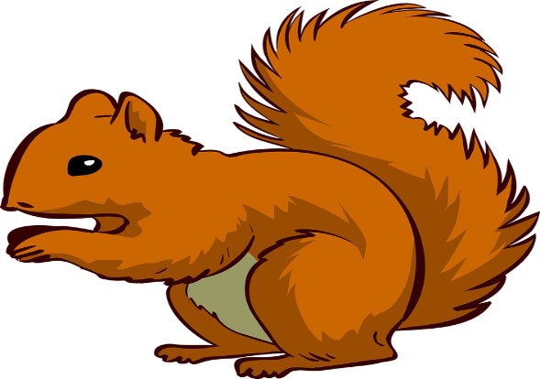
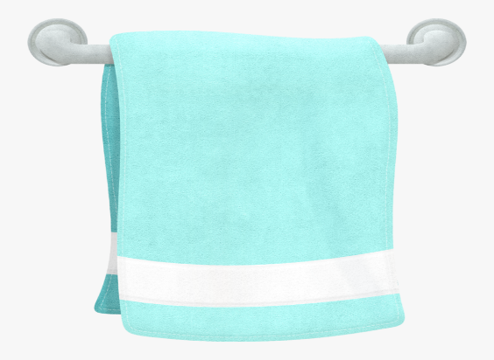
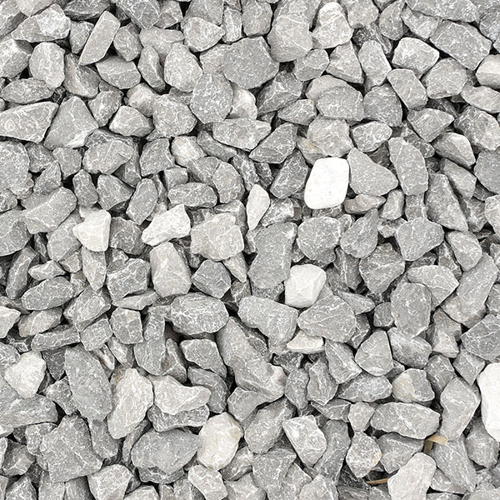
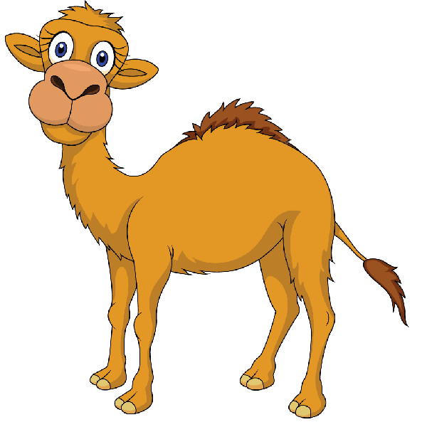
Match the picture to the correct word
towel
jewel
camel
gravel
squirrel

Slide 42
Match the picture to the correct word - answers
towel
jewel
camel
gravel
squirrel

Slide 43
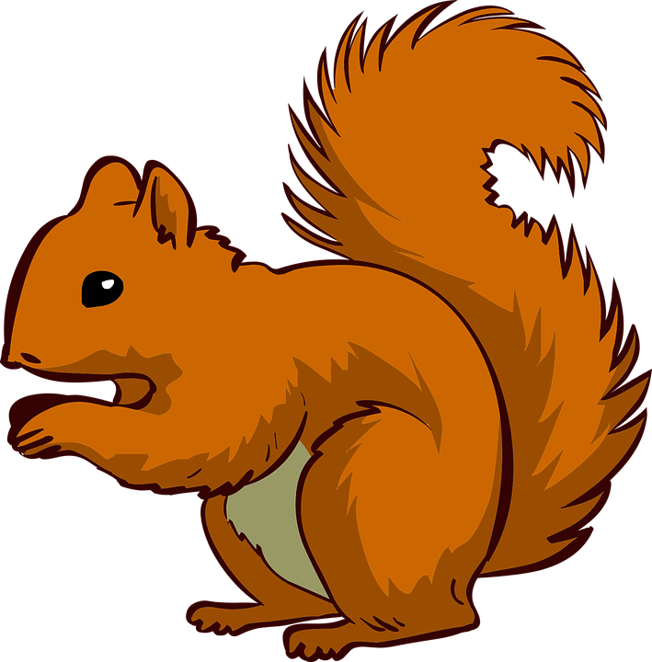
Write the word under the picture

Slide 44
Read the sentences and fill in the missing word
Choose from the 5 words below. Read the sentence and decide which word makes sense.
squirrel
towel
gravel
jewel
camel
I hurt my knee when I fell on the __________.
A __________ likes to eat nuts.
When I go swimming I need to take a __________.
A__________ lives in the desert.
The pirate had to keep his __________ safe.

Slide 45
word | 1st try | 2nd try | 3rd try
camel
towel
jewel
gravel
squirrel
tunnel
tinsel
level
Practice writing the words on a piece of paper or type into the table on your computer.

Slide 46
Words ending in ‘el’
Now pick 3 words ending in ‘el’ and write a sentence including each word.
towel
gravel
jewel
tunnel
easel
camel
squirrel
level
tinsel

Slide 47
Word search

Slide 48
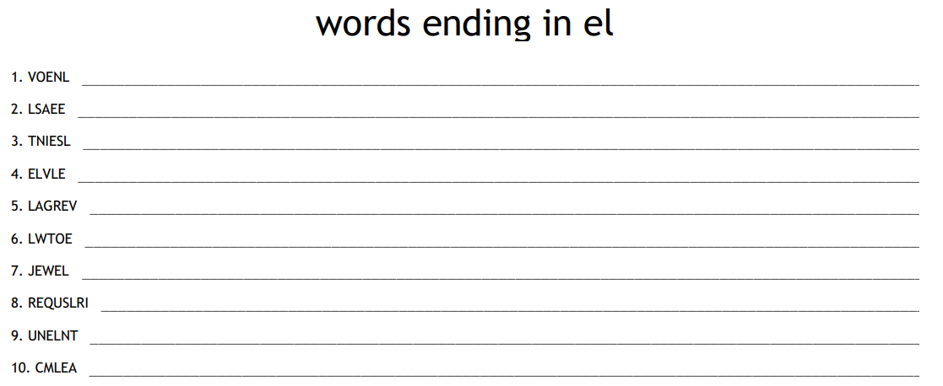
Unscramble the words

Slide 49
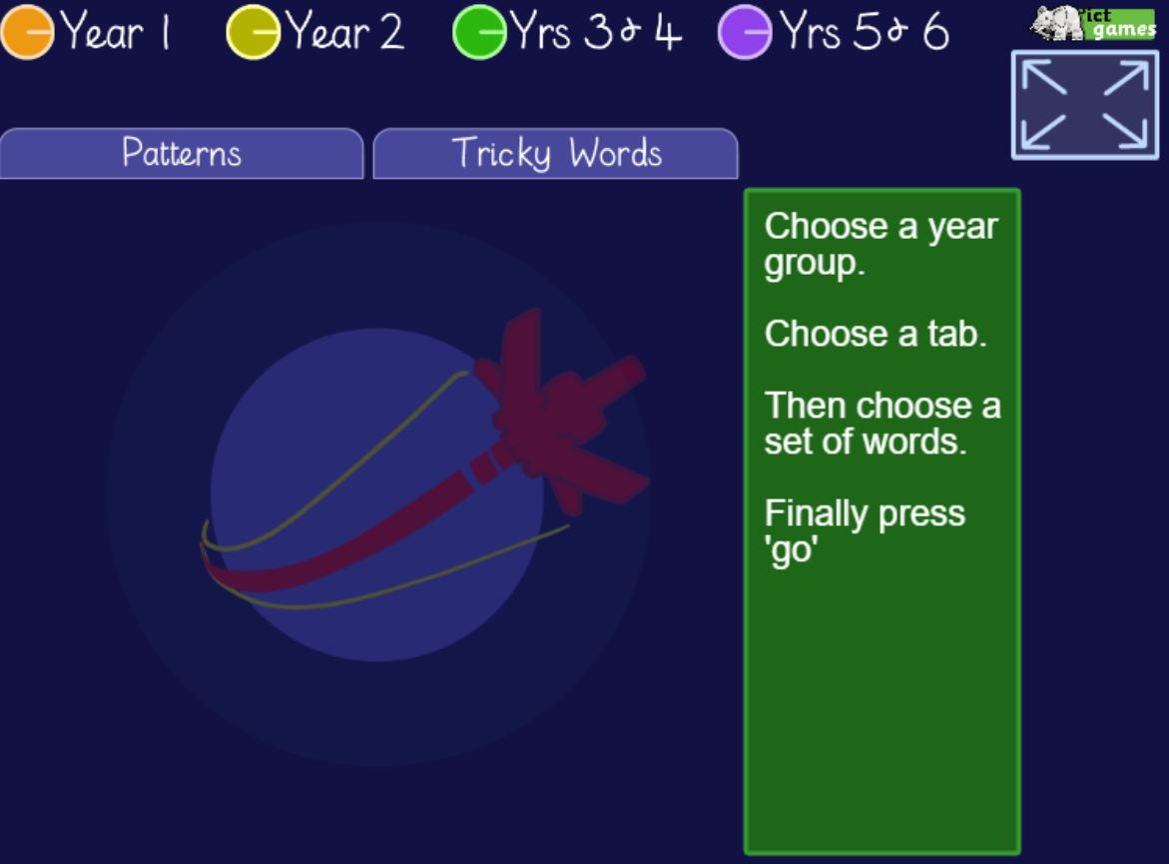
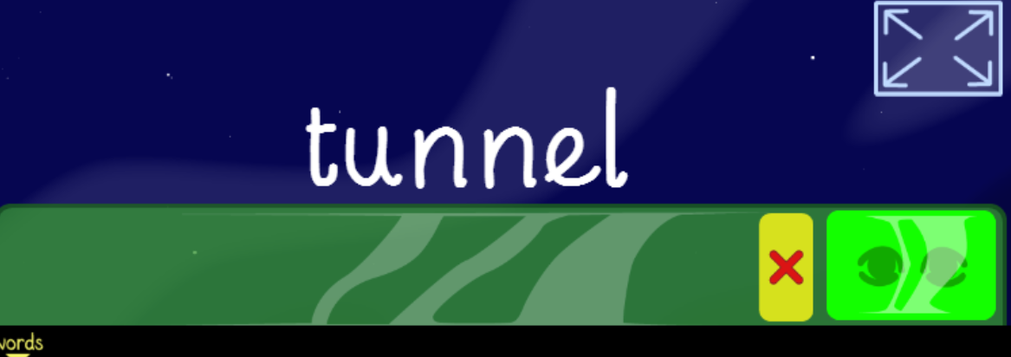
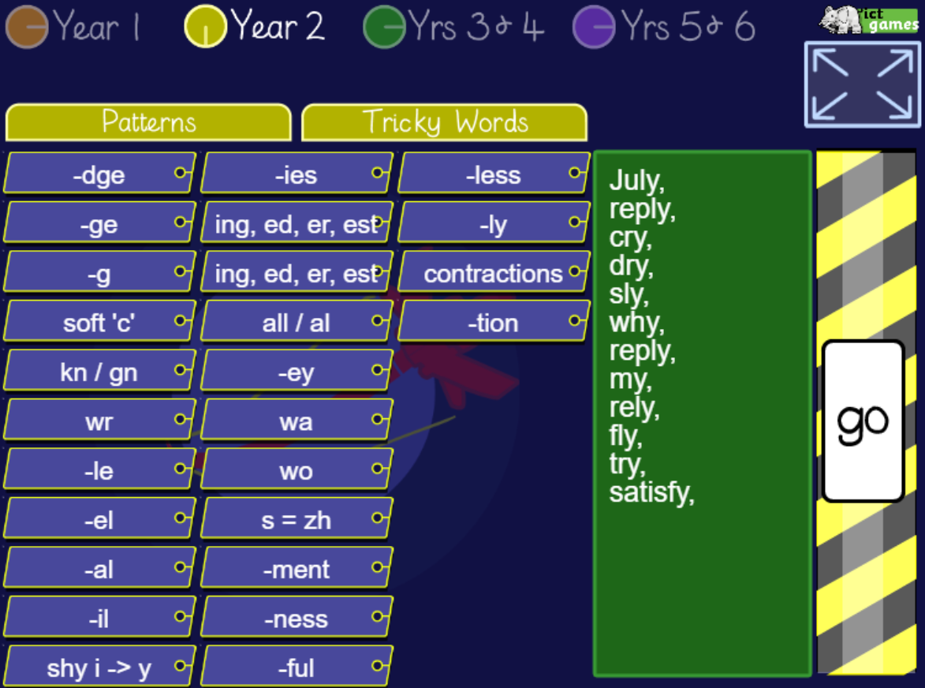
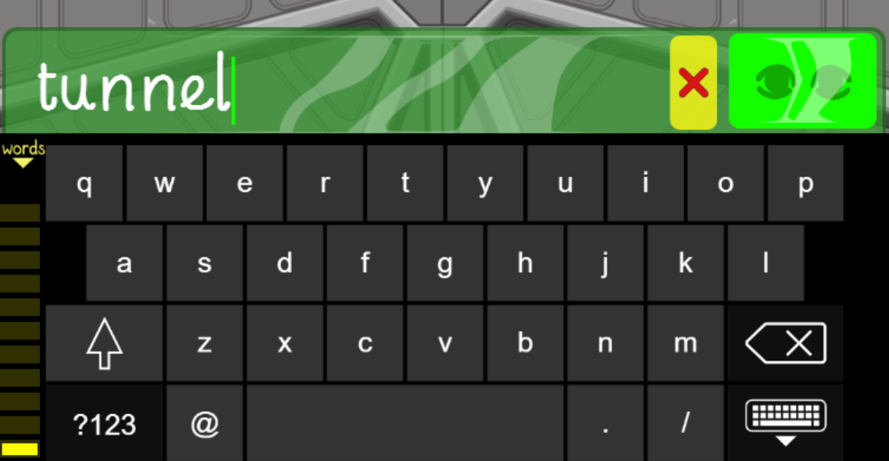
Spelling game!
Use the link to play the game and practice spelling the words which end with ‘el’
Look, Cover, Write, Check- mobile friendly (ictgames.com)

Slide 50
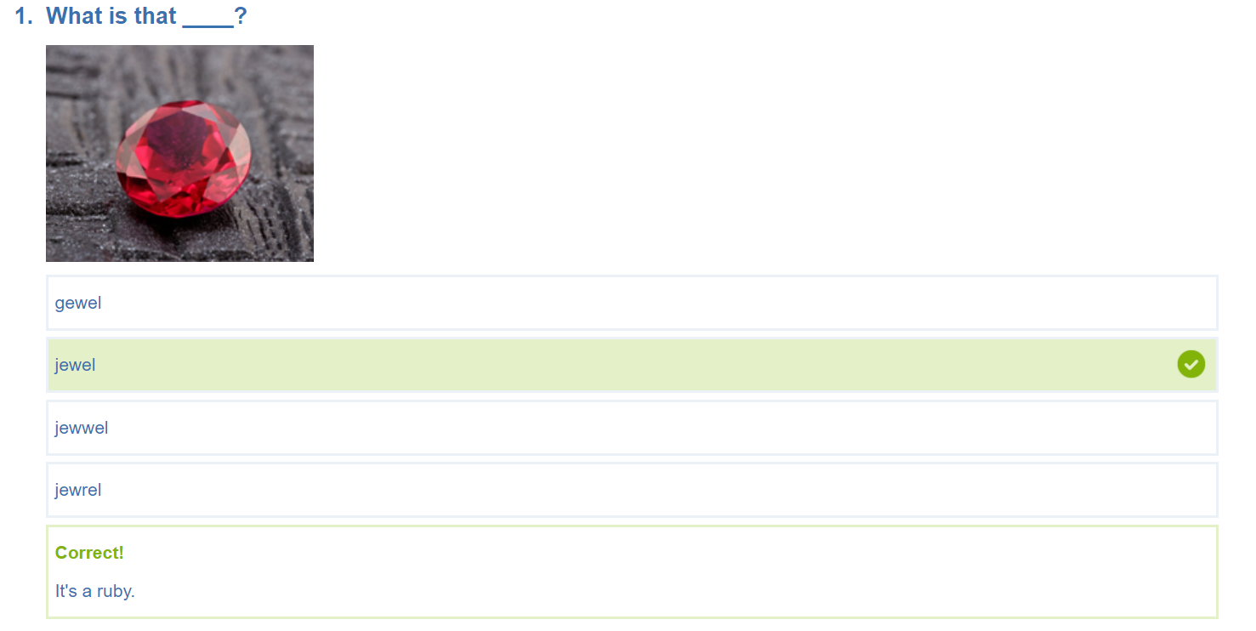
Spelling game!
Use the link to play the game and practice reading and spelling the words which end with ‘el’
KS1 Spelling | Words Ending with EL Year 2 Quiz (educationquizzes.com)

Slide 51
Well done for all of your hard work today! We cant wait to see your completed work.
Could any completed work / photographic evidence of completed work please be sent to pioneerspupils@gmail.com
Thank you!

Slide 52
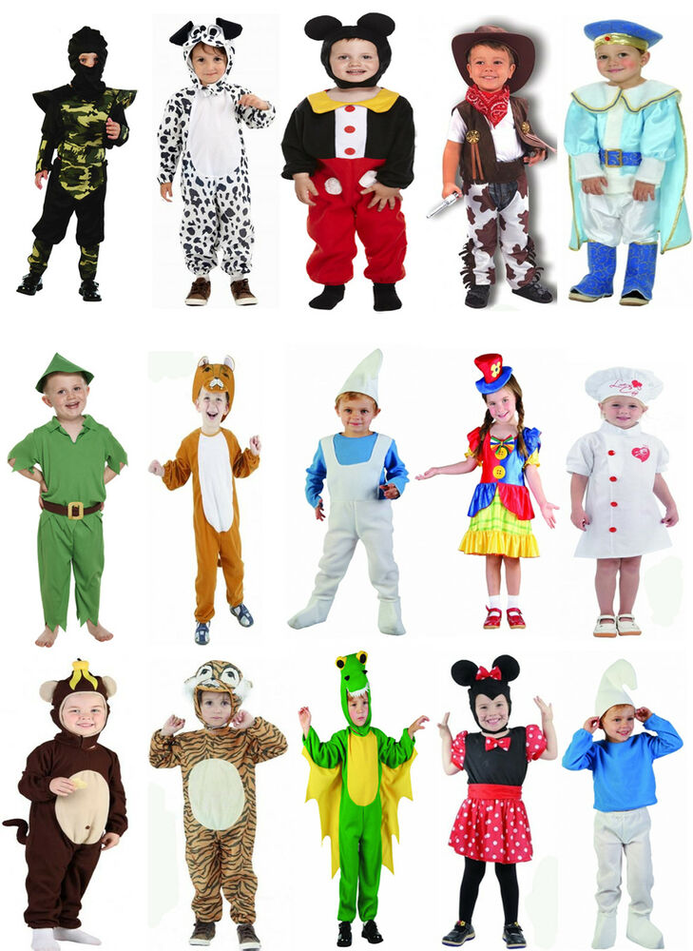
World Book Day!
World book day is this week, so lets spend some time looking at our favourite books, characters and authors.
You could dress up as one of your favourite characters …
You could build a den and read your favourite story …
We would love to see some photos!

Slide 53
World Book Day!
World book day is this week, so lets spend some time looking at our favourite books, characters and authors.
Choose your favourite book and write a book review
Think about:
Why do you like this book?
What is your favourite part?
Who is your favourite character? Why?
We would love to see some photos!

Slide 54
World Book Day!
World book day is this week, so lets spend some time looking at our favourite books, characters and authors.
Design a character mask
We would love to see some photos!

Slide 55
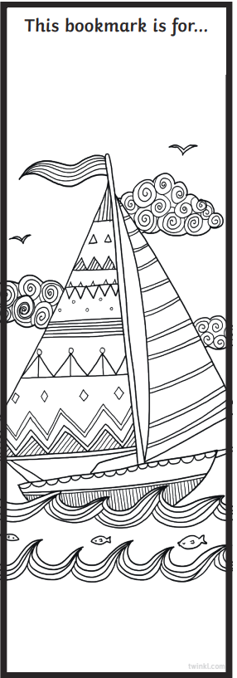
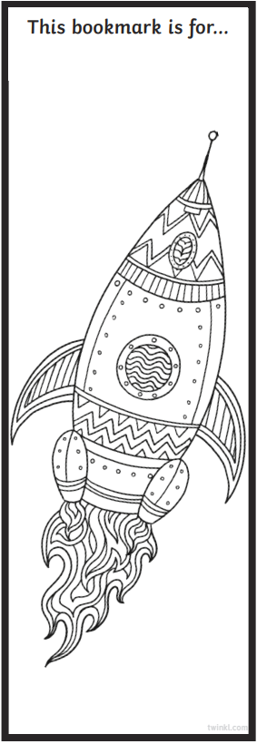
World Book Day!
World book day is this week, so lets spend some time looking at our favourite books, characters and authors.
Create a book mark
You could design your own book mark or colour in these templates.
We would love to see some photos!

Slide 56
World Book Day!
World book day is this week, so let's spend some time looking at our favourite books, characters and authors.
Object | Title of book | Page number
Apple | Snow white | 12
Witch
Bear
Frog
Dog
Tree
Car
Horse
Train
House
Dinosaur
Book scavenger hunt
Look through your books at home and see how many of the objects you can find. Remember to write down the title of the book you found the object in!
We would love to see some photos!

Slide 57
Well done for all of your hard work today! We cant wait to see your completed work.
Could any completed work / photographic evidence of completed work please be sent to pioneerspupils@gmail.com
Thank you!

