Slide 1


Subject: Topic
Pack: A

Slide 2


Date: Monday 1st February 2021
LO
LO. To be able to identify that some living things lay eggs.
Subject: Science

Slide 3
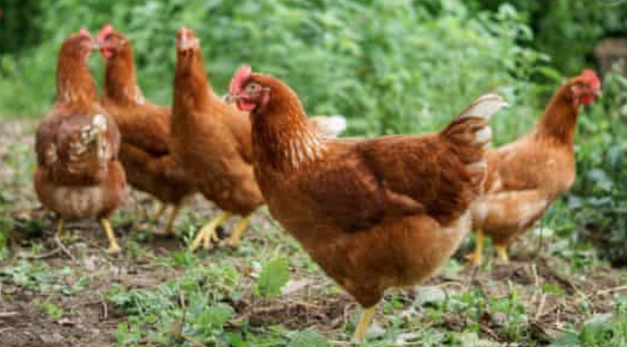

All about a bird
Today we are going to learn about the different features of a bird.
What do you already know about birds?
Discuss with your adult and write your ideas down in the blank box below.

Slide 4
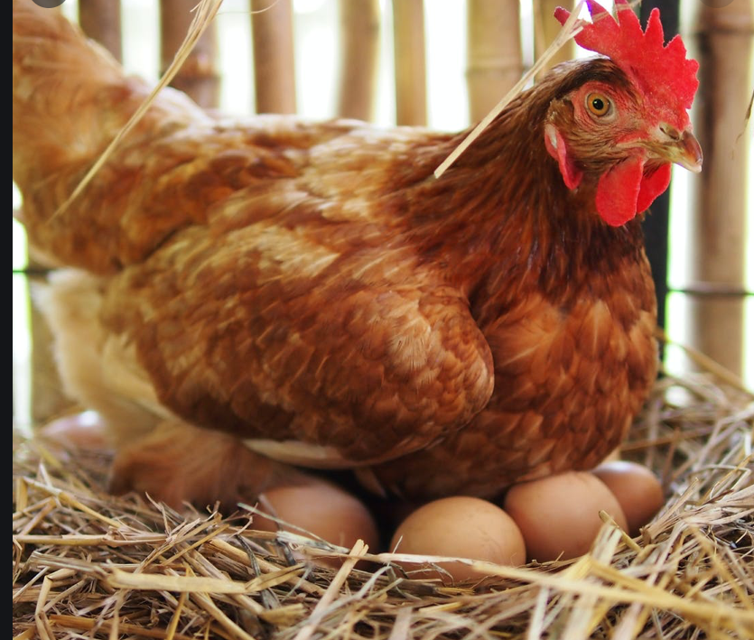

Key features of a bird
All birds have the following key features:
Lay eggs
Beak
Wings
2 legs
Today we are going to look at animals that are birds and animals that are not bird.

Slide 5
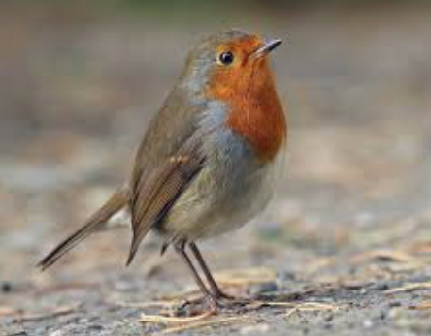
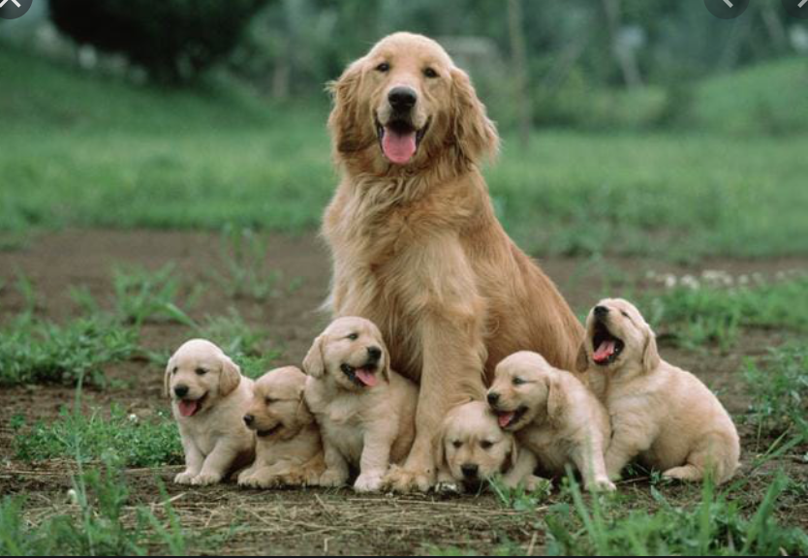
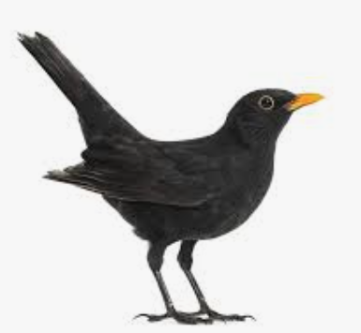
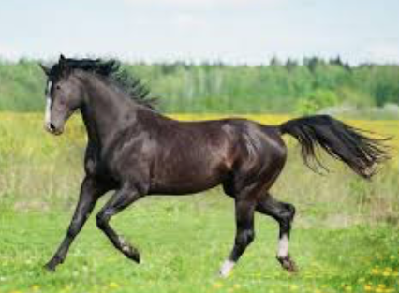
Birds and non birds
Mrs Levington has completed a table of animals to show which animals are birds and which ones are not.
She knows this by looking for the key features of a bird.
The birds have two legs, wings and a beak.
Birds | Not a bird

Slide 6
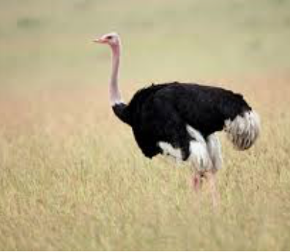
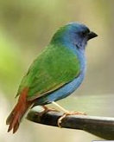
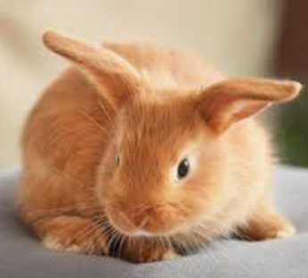
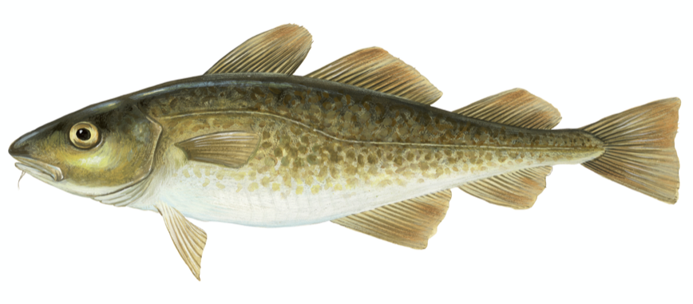
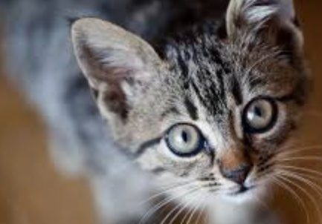

What animals do and do not lay eggs?
Now let’s have a try together and put the animals in the correct place.
Lets see if they have the key features of a bird.
Do they have two legs?
Do they have wings?
Do they have a beak? We have done some for you.
Birds | Not a bird
Talk with your adult to complete the rest of the table by either dragging the photo or write in the box.

Slide 7
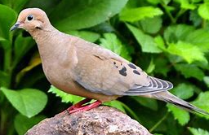
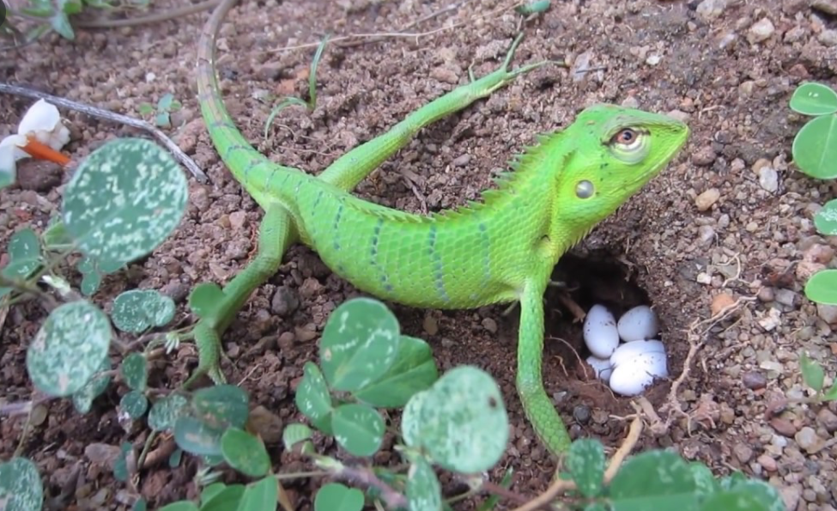
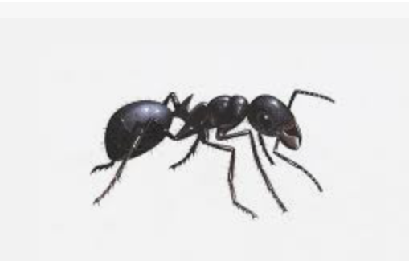
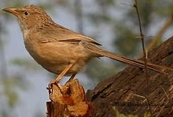
What animals do and do not lay eggs?
Your turn to place the correct animals in the box.
Remember that mammals do not lay eggs as they give birth.
You can refer back to previous slides to help you.
You can drag the animals or draw the animals in the correct box.
Do lay eggs | Do not lay eggs

Slide 8
Date: Tuesday 2nd February 2021
LO
LO. To be able to identify animals and their babies.
Subject: Science

Slide 9

Pre-recorded Teaching
Access the online teaching video below that will support you to complete the work in this lesson. This video will act as a support but all of the work can still be successfully understood & completed using paper-based versions of this pack. If you need further support to understand / complete work then please contact school via e-mail or telephone.
Play Video
You can also copy and paste this link if you would prefer:
https://classroom.thenational.academy/lessons/to-know-the-names-for-the-offspring-animals-not-human-6mr36r?activity=video&step=1

Slide 10
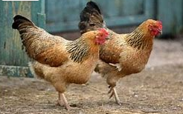
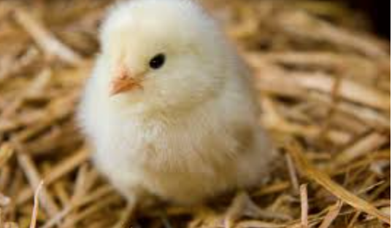
Looking at farm animals and their offspring.
Today we are going to look at different farm animals and their babies.
In the Chicken Licken story we saw a chicken, a duck, a hen, a cockerel.
All these animals can be found on a farm.
Lets have a look at farm animals and their babies.
A chicken’s baby is called a chick.
chicken
chick

Slide 11
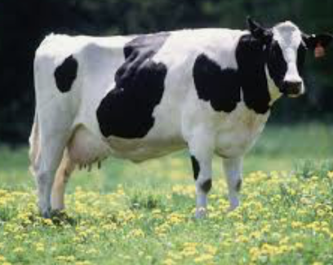
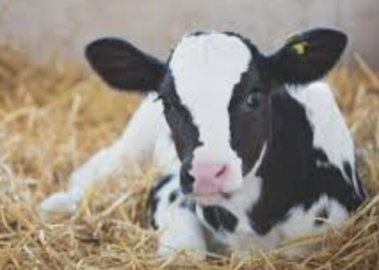
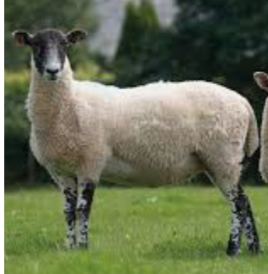
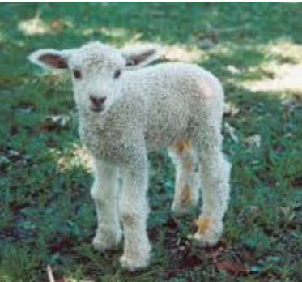
Looking at farm animals and their offspring.
A cow’s baby is called a calf.
Cow
Calf
A sheep’s baby is called a lamb.
Sheep
Lamb

Slide 12
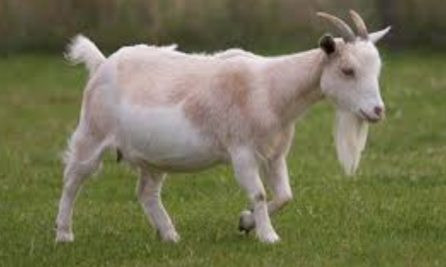
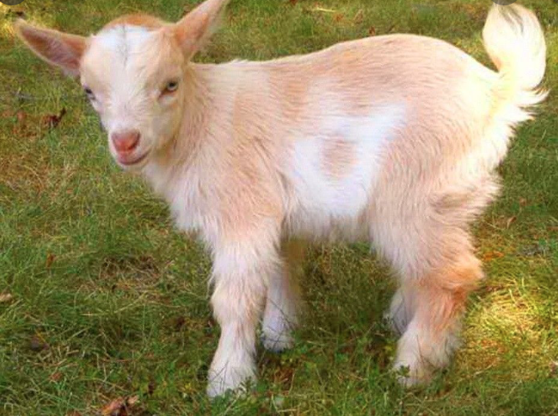
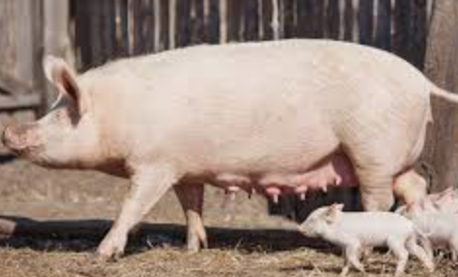
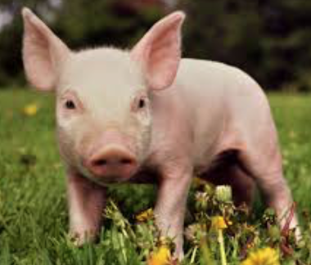
Looking at farm animals and their offspring.
A goat’s baby is called a kid.
goat
kid
A pig’s baby is called a piglet.
pig
piglet

Slide 13
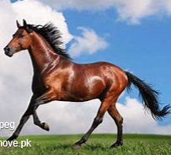
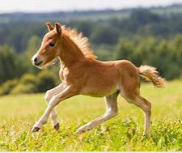
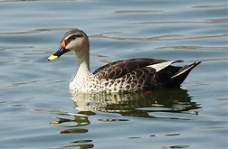
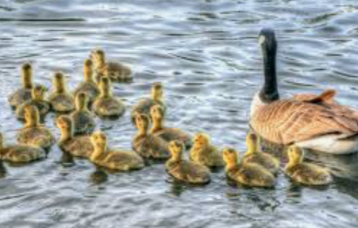
Looking at farm animals and their offspring.
A horse’s baby is called a foal.
horse
foal
A duck’s baby is called a duckling
duck
duckling

Slide 14
We will work together to see if we can match the farm animal with their baby.
The animal below is a cow.
Can you remember what we call a cow’s baby?
Draw a line to match the cow to the correct baby.
Interesting fact!
A animal’s baby is also called it’s offspring. Look out for this word on future slides.
Super work! A cow’s baby is a calf.

Slide 15
Draw a line to match the goat with their offspring.
Can you tell your adult the name of the offspring?

Slide 16
Draw a line to match the horse with their offspring.
Can you tell your adult the name of the offspring?

Slide 17
Draw a line to match the chicken with their offspring.
Can you tell your adult the name of the offspring?

Slide 18

Date: Wednesday 3rd February 2021
LO
LO. To be able draw a variety of lines to make a picture.
Subject: Art

Slide 19
We are going to teach you how to draw a sheep. Use this page for your drawing. Try to make it a good size so that you can include all of the details.
Get ready to follow the instructions.

Slide 20
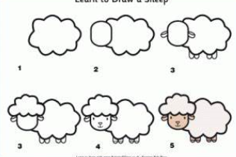
Today we will be drawing our own sheep.
Mrs Simpson has started to draw her own sheep by drawing the body first.
Step 1. Draw your own body of a sheep in the box provided using a curved line.

Slide 21
What shape in the sheep’s head?
Can you discuss this with your adult?
Step 2. Look at the example of the sheep’s head and try to draw your own on your sheep. Remember you will need a curved line.

Slide 22
This step has two parts.
Mrs Simpson has drawn the sheep’s ears first then added the 4 legs.
Step 3. Look at the example and try add the ears and legs to your sheep.

Slide 23
Step 4. At some hair to your sheep.
Mrs Simpson has shown you her example below and used a cloud shape to draw the hair on the sleep. To make the cloud she she joined lots of curved lines together.

Slide 24
Step 5. Draw the facial features of a sheep.
You need to draw the eyes, nose and mouth onto your sheep.

Slide 25
Step 6. Complete your sheep
Apply some colour to the sheep’s face and feet.
Well done, you have managed to draw your very own sheep using a variety of lines. Great work.

Slide 26
Date: Thursday 4th February 2021
LO
LO. To be able fold paper.
Subject: Art

Slide 27
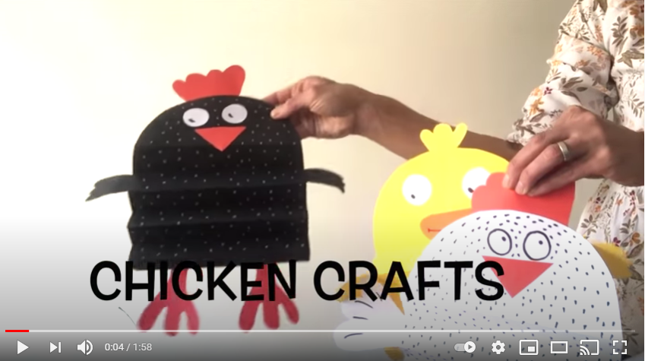
Make a chicken
Today we are going to make our own chicken.
Watch the video to follow the step by step method on how to complete this activity.
https://www.youtube.com/watch?v=7IOANPZffRU&feature=emb_logo

Slide 28
Here is your template. Print it out and then follow the instructions to make your chick.

Slide 29
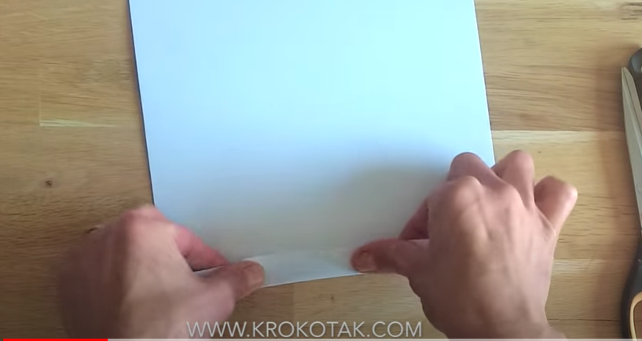
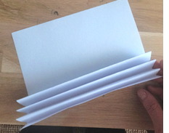
Step 1
For this activity you with need the following:
Paper,
Scissors
Glue
Coloured pencils
Fold your paper from the bottom up. Fold it to the next line. Remember when folding to line to edge of the paper with the next line before pressing down firmly to make the crease. After each fold, turn over and fold again.

Slide 30
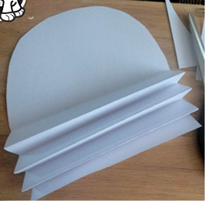
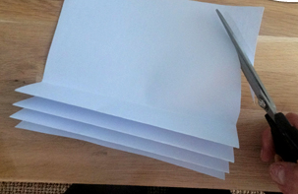
Step 2
Use your scissors to cut around the curved line on your template. Make sure your scissors follow the line as a guide.

Slide 31
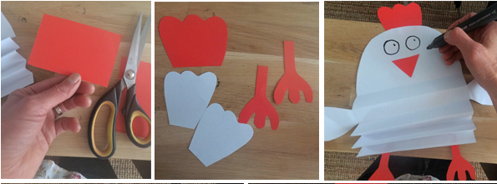
Step 3
Now you will need to get a piece of paper and draw some feet and arms for your chick.
Once you have done that, cut the feet and arms out and stick them on your chick.
You can also cut a piece out for your nose and stick it on.

Slide 32
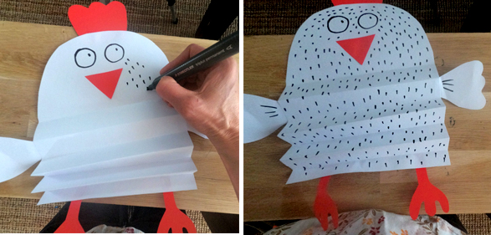
Step 4
Your last step is to decorate your chick.
Don’t forget to send across, a photograph of your chick.
We can see your amazing work!

Slide 33
Date: Friday 5th February 2021
LO
LO. To be able to place simple items on a map.
Subject: Geography

Slide 34
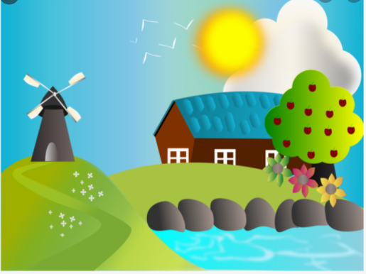
Farmers field
Today we will be talking about where different farm animal live.
The sheep live in a field near the wind mill.
Where on the map would the sheep go?
Miss Bentley has placed the sheep on the map, next to the windmill.

Slide 35
Farmers field
Now lets have a go together.
The horse lives next to the barn.
Lets have a go at drawing the horse in the correct place on the picture.

Slide 36

A duck lives beside the water.
Has Mrs Levington put the duck next to the water?
Tick one of the boxes below.
Yes
No
Don’t forget to explain your
answer to your adult.

Slide 37
A bird lives in the tree.
Mr Pennal has put the bird in the sky.
Is he correct?
Tick one of the boxes below.
Yes
No
Don’t forget to explain your
answer to your adult.

Slide 38
A cow lives at the bottom of the hill.
Miss Bentley has put the cow next to the water.
Is she correct?
Tick one of the boxes below.
Yes
No
Don’t forget to explain your
answer to your adult.

