Slide 1



Date: 11.01.21
LO To practice counting to 10.
Subject: Maths

Slide 2
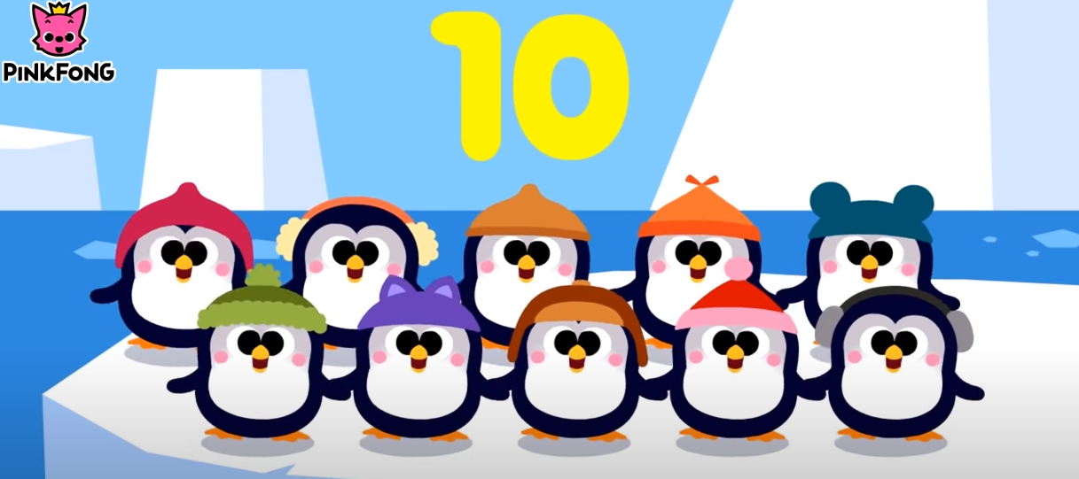
1 2 3 4 5 6 7 8 9 10
https://www.youtube.com/watch?v=Yt8GFgxlITs
For Parents: Encourage your child to count along the numbers with their finger while you count aloud, then watch the counting video.

Slide 3
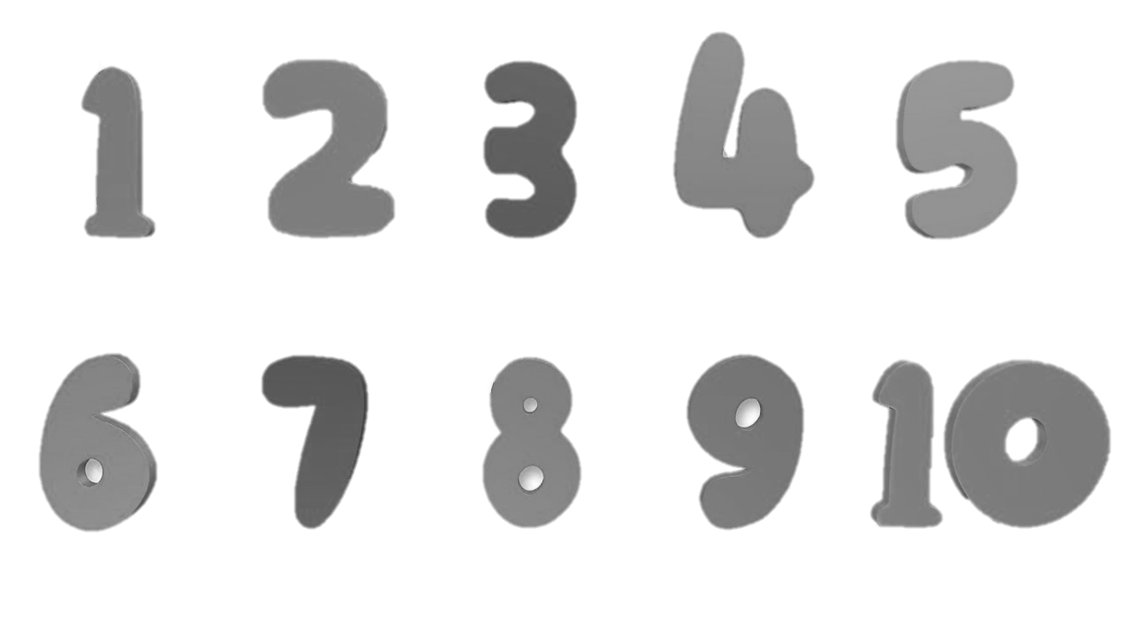
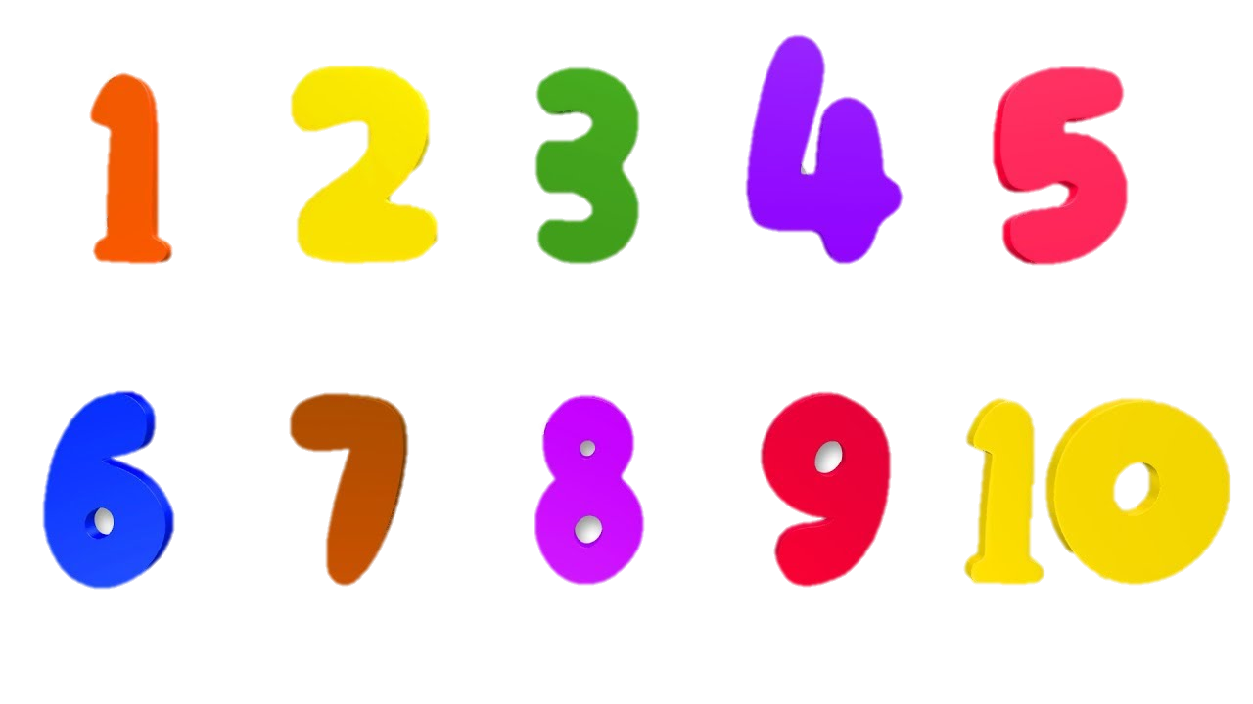
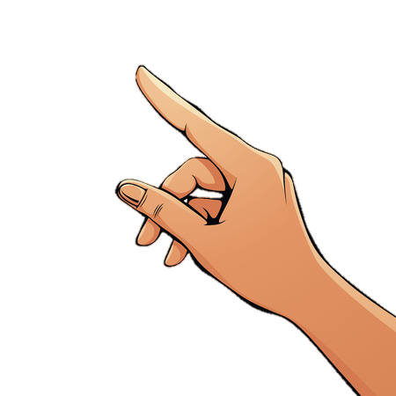
Explanation of activity/Example
For Parents: Support your child to drag the numbers from 1-10 (starting with number 1) into the correct order, like the example below.

Slide 5
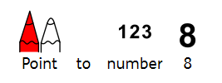



Slide 6
Date: 12.01.21
LO To practice counting to 10.
Subject: Maths

Slide 7
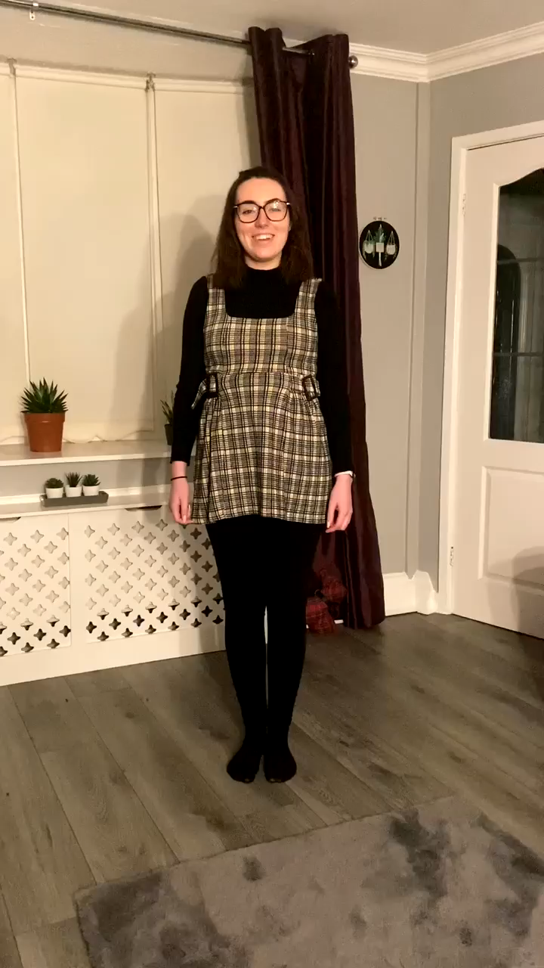
Let's count together!
Click to play the video, can you follow along
with the actions for our number rocket?

Slide 8
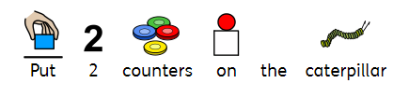













Explanation of activity/Example
For Parents:
Using the caterpillar number line in your printed pack, support your child to count out pom poms, counters or smarties and place them over the required amount of numbers for the question.

Slide 10


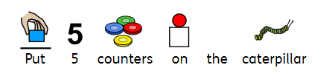
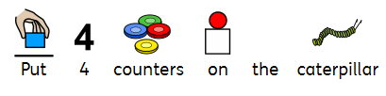

Slide 11
Date: 13.01.21
LO To practice forming numbers to 5.
Subject: Maths

Slide 12
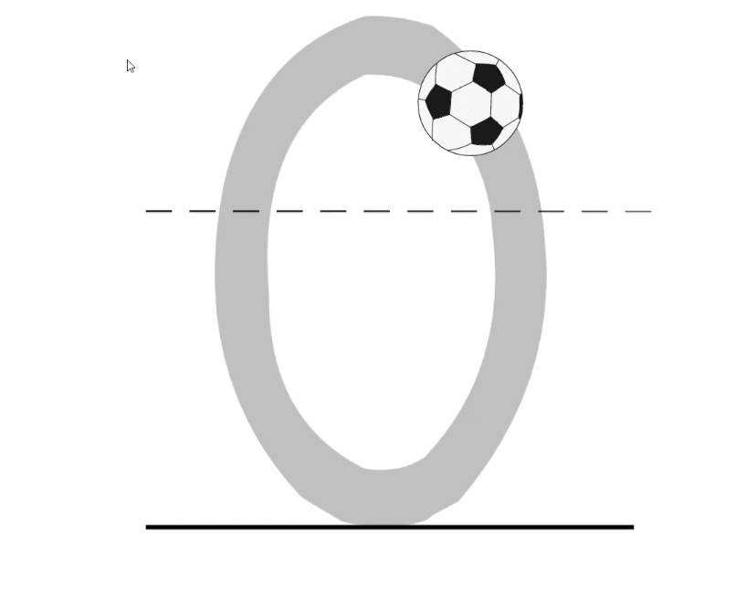
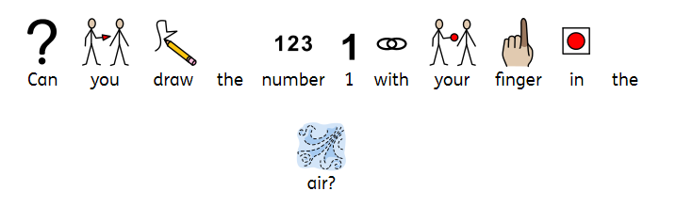
Press play to watch how we form our numbers. Once you have watched the video play it again and follow along with your finger.

Slide 13
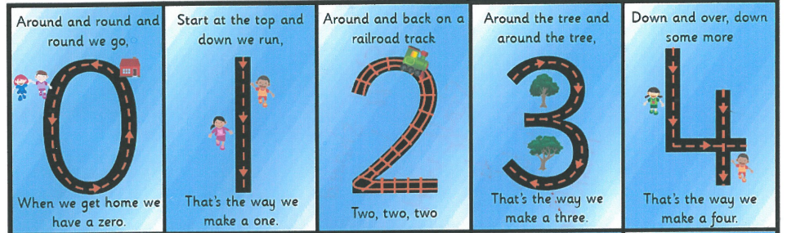
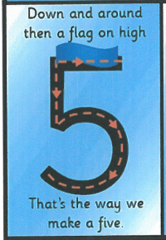
Have a go at forming the numbers by following the lines with your finger.
Parents: read the rhyme as you support your child to form the number. The printed numbers will also be provided in your printed pack.

Slide 14
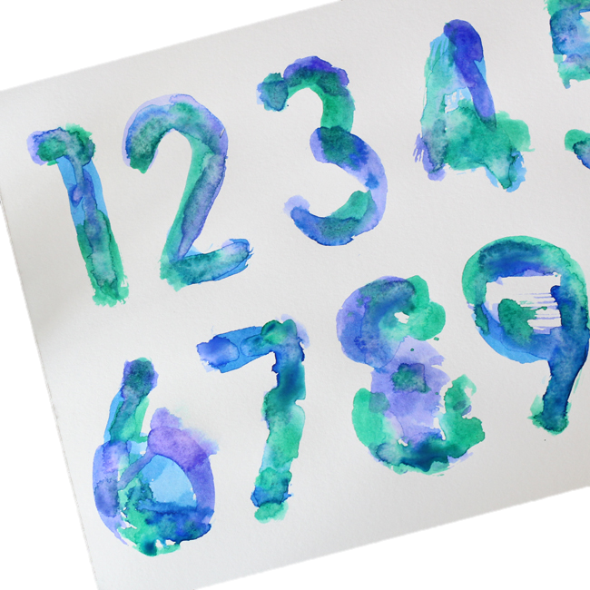
Explanation of activity/Example
For Parents:
Mix some food colouring with water and put it in a plastic
glass/ tub.
Draw number 1-5 on a piece of paper and work together
with your child to paint over the numbers.

Slide 15
Date: 14.01.21
LO To practice counting to 10.
Subject: Maths

Slide 16
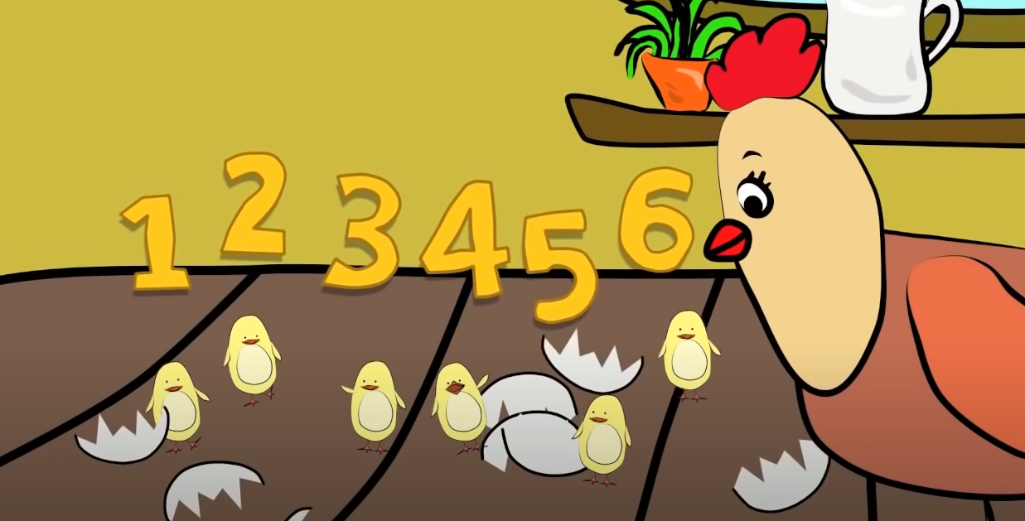
Lets count to 10! Watch the video below:
https://www.youtube.com/watch?v=DR-cfDsHCGA

Slide 17
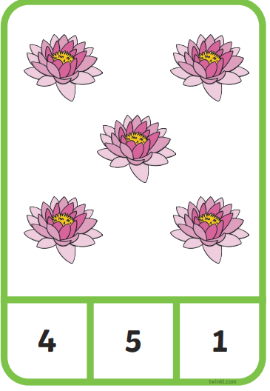
Explanation of activity/Example
For Parents:
Count the amounts of objects on each card aloud to your child.
Support their finger to touch each object while counting it.
Once you have counted aloud, announce the amount to your child and ask them to point to the answer with their finger.
“1…2…3…4…5… Can you find 5?”

Slide 18
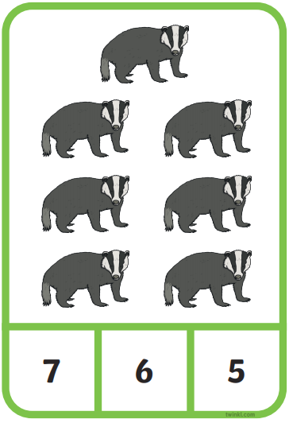
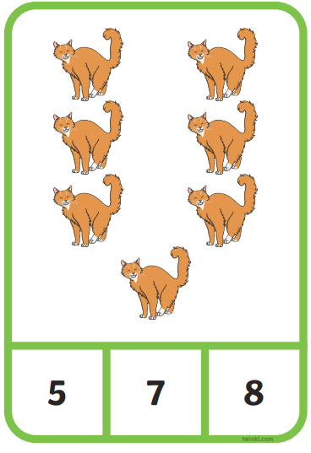
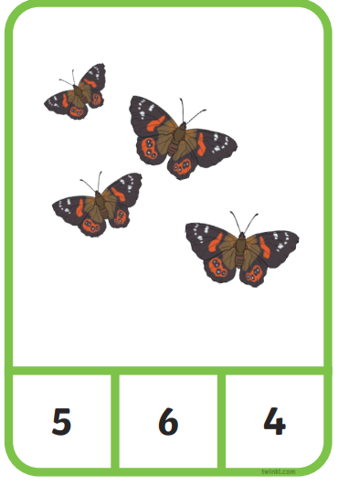

Slide 19
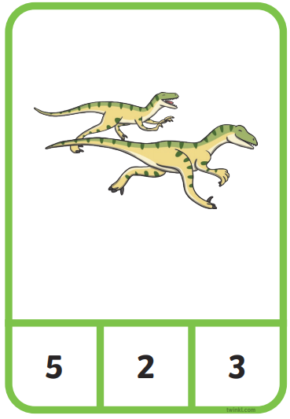
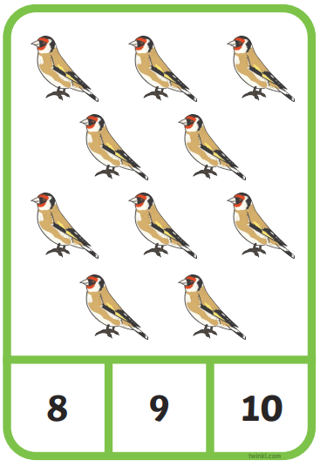
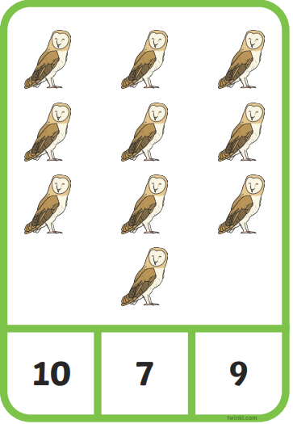

Slide 20
Date: 15.01.21
LO To practice counting to 10.
Subject: Maths

Slide 21

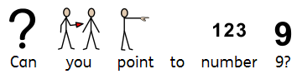
Point to the numbers
For parents: Count from 1 to 10 aloud with your child, follow along with your finger. Once you have counted, see if your child can point to the numbers independently.

Slide 22
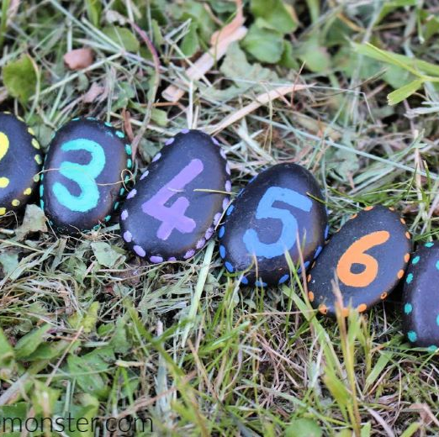
Explanation of activity/Example
For Parents:
Find some stones with your child and paint on the numbers 1-10 (If you don’t have any stones feel free to use written numbers or the cards provided in the printed pack). Present the numbers to your child jumbled up and model putting them in the correct order. Mix the stones up and see if your child can put them in order independently.

