Slide 1
Date: 11.01.21
LO To be able to count with money.
Subject: Maths

Slide 2
Recap
Remind yourself of the coins and notes we looked at last week. Can you remember their amounts?

Slide 3
Pre-recorded Teaching
Access the online teaching video below that will support you to complete the work in this lesson. This video will act as a support but all of the work can still be successfully understood & completed using paper-based versions of this pack. If you need further support to understand / complete work then please contact school via e-mail or telephone.
Play Video

Slide 4
Counting Money
1. Look very carefully at the coins to find out how much they are worth…
=
10p 10p 1p 1p 1p 1p 1p
4. Finally, count up your tens and ones to get your answer.
2. Then write how much each coin
worth…
3. Next, draw your tens and ones – a 10p coin is worth 10 like a stick of base 10 & a 1p coin is worth one.

Slide 5
Counting Money
=
__p __p __p __p __p __p __p __p
You write the amounts this time!
Count up your tens and ones to get your answer.

Slide 6
Counting Money
=
__p __p __p __p __p __p __p __p __p
Count up your tens and ones to get your answer.
Write the amounts.
Draw the tens and ones that are missing…

Slide 7
Counting Money
Use the same strategy of drawing your tens and ones to count this money…
=
1.
2.
3.
4.
=
=
=

Slide 8
Trickier Coins
How to represent these coins using your tens and ones:
50p 20p 2p
TO TO O
50 20 2

Slide 9
Trickier Coins
Use the same strategy of drawing your tens and ones to count this money…
1.
2.
3.
4.
=
=
=
=

Slide 10
Challenge!
Have a go at these problems…

Slide 11
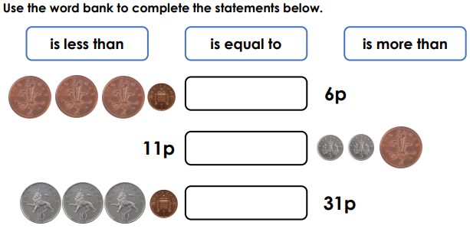
Challenge

Slide 12
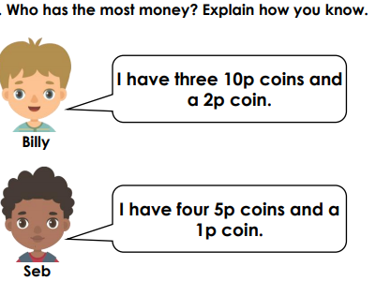
Tricky Challenge

Slide 13
Well done for all of your hard work this lesson!
Please send any completed work/photographed evidence of completed work (practical activities) to pioneerspupils@gmail.com or deliver it to the dropbox outside of school on a Friday.

Slide 14
Date: 12.01.21
LO To be able to count with money.
Subject: Maths

Slide 15
Recap
Remind yourself of the coins and notes we looked at last week. Can you remember their amounts?

Slide 16
Making £1
£1 is the same as 100 1p’s
£1
=
2 50p’s make £1
50p 50p £1

Slide 17
Making £1
Remember - £1 is 100p!
How many 20p’s are the same as £1?
How many 10p’s are the same as £1?
How many 5p’s are the same as £1?

Slide 18
Answers
Remember - £1 is 100p!
How many 20p’s are the same as £1?
5
How many 10p’s are the same as £1?
10
How many 5p’s are the same as £1?
20

Slide 19
Counting Money
Find the coins that make £1 first.
1. £1 goes at the start of your answer.
3. Then how many pence you have left over goes after the decimal point.
= £1.21
£1
2. Then you need a decimal point (a dot).
21p

Slide 20
Counting Money
Find the coins that make £1 first.
£1 goes at the start of your answer.
How many pence are left?
= £1.
£1
Then you need a decimal point (a dot).

Slide 21
Counting Money
Find the coins that make £1 first.
Have you made £1?
= £ .
How many pence are left?
Write your amounts here…
Remember - £1 is 100p!

Slide 22
Counting Money
Find the coins that make £1 first.
= £ .
Count up your amounts and write your total.
Write your amounts here…
Remember - £1 is 100p!

Slide 23
Counting Money
Find the coins that make £1 first.
= £ .
Count up your amounts and write your total.
Write your amounts here…
Remember - £1 is 100p!

Slide 24
Counting Money
Find the coins that make £1 first.
How many £’s do you have this time?
= £ .
Count up your amounts and write your total.
Write your amounts here…
Remember - £1 is 100p!

Slide 25
Counting Money
Find the coins that make £1 first.
How many £’s do you have this time?
= £ .
Count up your amounts and write your total.
Write your amounts here…
Remember - £1 is 100p!

Slide 26
Counting Money
Find the coins that make £1 first.
How many £’s do you have this time?
= £ .
Count up your amounts and write your total.
Write your amounts here…
Remember - £1 is 100p!

Slide 27
Challenge!
Have a go at these problems…

Slide 28
Challenge

Slide 29
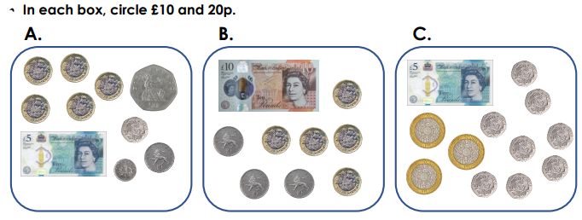
Tricky Challenge!

Slide 30
Further Learning: Pre-recorded
Access the online teaching video below that will support you to complete the work in this lesson. This video will act as a support but all of the work can still be successfully understood & completed using paper-based versions of this pack. If you need further support to understand / complete work then please contact school via e-mail or telephone.
Play Video

Slide 31
Well done for all of your hard work this lesson!
Please send any completed work/photographed evidence of completed work (practical activities) to pioneerspupils@gmail.com or deliver it to the dropbox outside of school on a Friday.

Slide 32
Date: 13.01.21
LO To be able to make an amount in a variety of ways.
Subject: Maths

Slide 33
Making amounts
8p can be made in different ways using different coins.
Here are 6 different ways 8p can be made using coins…
2p + 1p + 1p + 1p + 1p + 1p + 1p = 8p
5p + 1p + 1p + 1p = 8p
8p
5p + 2p + 1p = 8p
2p + 2p + 2p + 2p = 8p
1p + 1p + 1p + 1p + 1p + 1p + 1p + 1p = 8p
2p + 2p + 2p + 1p + 1p = 8p

Slide 34
How many ways…
Can you find at least 5 ways?
Can you make 10p?
10p
Draw your coins and write their amounts…

Slide 35
Here are some of the ways you may have had…
2p + 2p + 2p + 2p + 2p = 10p
1p + 1p + 2p + 2p + 2p + 2p = 10p
10p
5p + 5p = 10p
1p + 1p + 1p + 5p + 2p = 10p
5p + 1p + 1p + 1p + 1p + 1p = 10p
2p + 2p + 5p + 1p = 10p

Slide 36
How many ways…
Can you find at least 5 ways?
Can you make 34p?
34p
Draw your coins and write their amounts…

Slide 37
Here are some of the ways you may have had…
10p + 10p + 10p + 2p + 2p = 34p
20p + 10p + 2p + 2p = 34p
34p
5p + 5p + 20p + 2p + 1p + 1p = 34p
10p + 10p + 10p + 1p + 1p + 1p + 1p =
34p
10p + 10p + 5p + 5p + 2p + 2p = 34p
20p + 10p + 1p + 1p + 1p + 1p = 34p

Slide 38
How many ways…
Can you find at least 5 ways?
Can you make £1
£1
Draw your coins and write their amounts…

Slide 39
Here are some of the ways you may have had…
5p + 5p + 10p + 20p + 20p + 20p + 20p = £1
£1
10p + 20p + 20p + 20p + 20p +
5p + 1p + 1p + 1p + 1p + 1p = £1
10p + 10p + 10p + 10p + 10p +
10p + 20p + 20p = £1
20p + 20p + 20p + 20p + 20p = £1
10p + 10p + 20p + 20p + 20p + 20p = £1

Slide 40
Challenge!
Have a go at these problems…

Slide 41
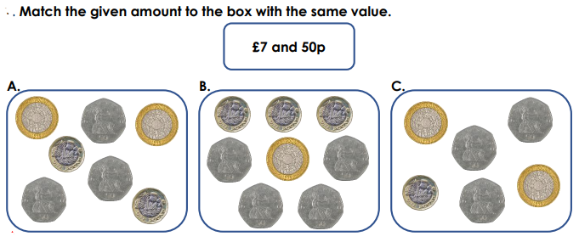
Challenge

Slide 42
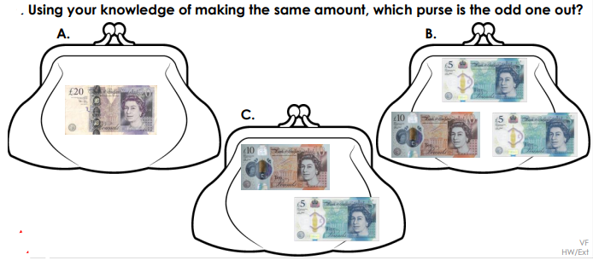
Tricky Challenge

Slide 43
Further Learning: Pre-recorded
Access the online teaching video below that will support you to complete the work in this lesson. This video will act as a support but all of the work can still be successfully understood & completed using paper-based versions of this pack. If you need further support to understand / complete work then please contact school via e-mail or telephone.
Play Video

Slide 44
Well done for all of your hard work this lesson!
Please send any completed work/photographed evidence of completed work (practical activities) to pioneerspupils@gmail.com or deliver it to the dropbox outside of school on a Friday.

Slide 45
Date: 14.01.21
LO To be able to subtract 2 digit numbers.
Subject: Maths

Slide 46
Warm Up
Complete these take aways as quickly as you can:
5 – 2 =
9 – 1 =
7 – 4 =
10 – 3 =
9 – 7 =
8 – 2 =
10 – 5 =
7 – 6 =
9. 4 – 1 =
10. 6 – 6 =
11. 9 – 5 =
12. 10 – 6 =

Slide 47
Pre-recorded Teaching
Access the online teaching video below that will support you to complete the work in this lesson. This video will act as a support but all of the work can still be successfully understood & completed using paper-based versions of this pack. If you need further support to understand / complete work then please contact school via e-mail or telephone.
Play Video

Slide 48
Subtracting 2 digits
T O T O T O
1. Make your biggest number (67 – 6 tens and 7 ones).
67 - 25 =
4 2
10
10
1
1
10
1
1
2. Then cross out the number of tens you are taking away (25 - 2 tens and 5 ones).
10
1
3. Count up how many you have got left…
10, 20, 30, 40, 41, 42
10
1
10
1

Slide 49
Subtracting 2 digits
T O T O T O
1. Make your biggest number (59 – 5 tens and 9 ones).
59 - 31 =
10
1
1
Write your answer here!
10
1
1
2. Then cross out the number of tens you are taking away (31 - 3 tens and 1 ones).
10
1
1
10
1
1
Count up how many you have got left…
__________________________________
10
1

Slide 50
Subtracting 2 digits
T O T O T O
1. Make your biggest number (88 – 8 tens and 8 ones).
88 - 65 =
10
10
1
1
Write your answer here!
10
10
1
1
10
10
1
1
Cross out your tens and ones.
Count up how many you have got left…
__________________________________
10
1
10
1

Slide 51
Subtracting 2 digits
T O T O T O
Make your biggest number – draw your tens and ones here:
76 - 45 =
Write your answer here!
Cross out your tens and ones.
Count up how many you have got left…
__________________________________

Slide 52
Subtracting 2-digit numbers
Use the same method to work out these take aways:
49 – 35 =
62 – 21 =
98 – 44 =
75 – 35 =
5. 67 – 46 =
6. 79 – 55 =
7. 88 – 26 =
8. 56 – 51 =

Slide 53
Challenge!
Have a go at these problems…

Slide 54
Challenge

Slide 55
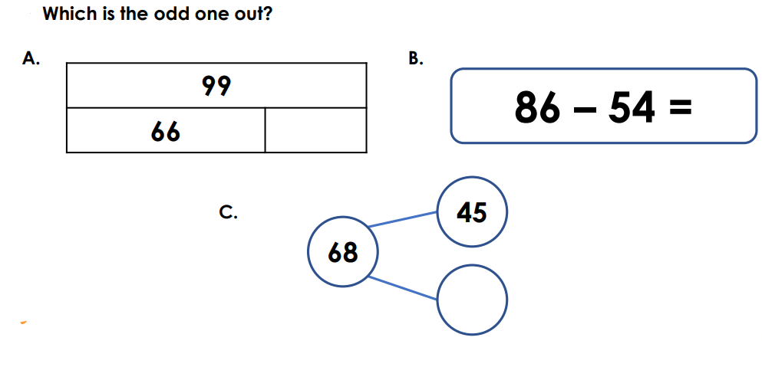
Tricky Challenge
Explain why they are the odd one out here…

Slide 56
Well done for all of your hard work this lesson!
Please send any completed work/photographed evidence of completed work (practical activities) to pioneerspupils@gmail.com or deliver it to the dropbox outside of school on a Friday.

Slide 57
Date: 15.01.21
LO To be able to subtract to find change.
Subject: Maths

Slide 58
Pre-recorded Teaching
Access the online teaching video below that will support you to complete the work in this lesson. This video will act as a support but all of the work can still be successfully understood & completed using paper-based versions of this pack. If you need further support to understand / complete work then please contact school via e-mail or telephone.
Play Video

Slide 59
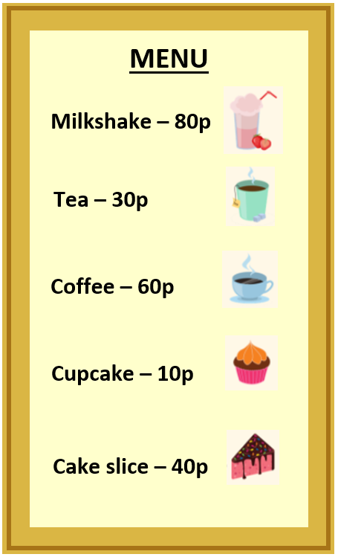
The Cafe
Sometimes we don’t have the correct coins to pay for something…
If I wanted to buy a cupcake but I only had these coins…
I would have to pay with the 20p because I don’t have a 10p
and the other coins aren’t enough money.

Slide 60
Finding Change
When we pay with a coin worth more money, we will need some change (money back).
Betty works out how much change she needs to give to her customers by subtracting (taking away).
20p - 10p = 10p
Betty

Slide 61
The Cafe
Sometimes we don’t have the correct coins to pay for something…
If I wanted to buy a cup of tea but I only had these coins…
I would have to pay with the because I don’t have 30p
and the other coins aren’t enough money.

Slide 62
Finding Change
When we pay with a coin worth more money, we will need some change (money back).
Draw the coin here.
Betty works out how much change she needs to give to her customers by subtracting (taking away).
50p - 30p =
Write Betty’s change here.
Betty

Slide 63
The Cafe
Sometimes we don’t have the correct coins to pay for something…
If I wanted to buy a milkshake but I only had these coins…
I would have to pay with the because I don’t have 80p
and the other coins aren’t enough money.

Slide 64
Finding Change
When we pay with a coin worth more money, we will need some change (money back).
Draw the coin here.
Betty works out how much change she needs to give to her customers by subtracting (taking away).
£1
100p - 80p =
Write Betty’s change here.
Betty
Cross out your tens…

Slide 65
The Cafe
Sometimes we don’t have the correct coins to pay for something…
If I wanted to buy a cake slice but I only had these coins…
I would have to pay with the because I don’t have 40p
and the other coins aren’t enough money.

Slide 66
Finding Change
When we pay with a coin worth more money, we will need some change (money back).
Draw the coin here.
Betty works out how much change she needs to give to her customers by subtracting (taking away).
50p - 40p =
Draw your sticks of 10…
Write Betty’s change here.
Betty
Cross out your tens…

Slide 67
The Cafe
Sometimes we don’t have the correct coins to pay for something…
If I wanted to buy a coffee but I only had these coins…
I would have to pay with the because I don’t have 60p
and the other coins aren’t enough money.

Slide 68
Finding Change
When we pay with a coin worth more money, we will need some change (money back).
Create your own take away to work out the change for Betty…
Draw the coin here.
Betty works out how much change she needs to give to her customers by subtracting (taking away).
Draw your sticks of 10…
Write Betty’s change here.
Betty
Cross out your tens…

Slide 69
Challenge!
Have a go at these problems…

Slide 70
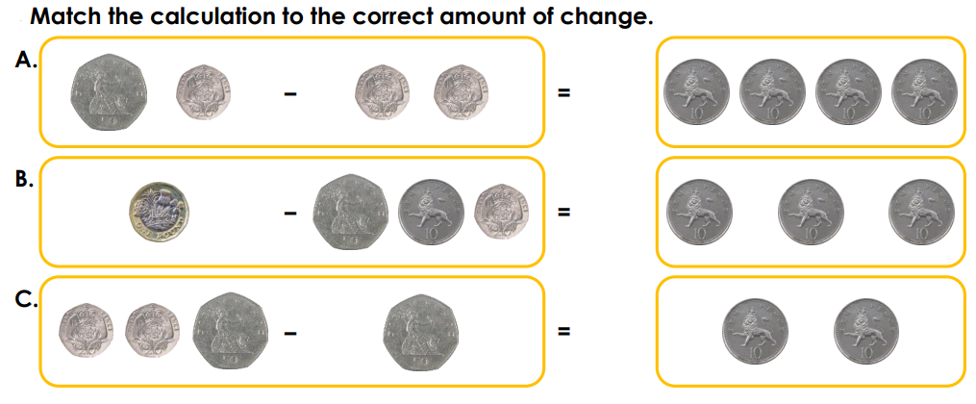
Challenge

Slide 71
Tricky Challenge
He could buy the doll and have 50p change.
Find the other 3 single or combination of items and how much change he would get:

Slide 72
Well done for all of your hard work this lesson!
Please send any completed work/photographed evidence of completed work (practical activities) to pioneerspupils@gmail.com or deliver it to the dropbox outside of school on a Friday.

