Slide 1
Date: 28.06.21
L.O. To be able to name 3D Shapes
Subject: Maths

Slide 2
3D Shapes
Lets take a look at some 3D shapes. Can you get an adult to read the names of the shapes to you and repeat them.

Slide 3
cone
cuboid
sphere
What are these shapes?
square base pyramid
cylinder
triangular prism
tetrahedron
cube
Can you drop and drag the correct shape to its name.

Slide 4
Can you look around the house and draw two items that look like the shapes.

Slide 5
Have a go at the games
https://www.education.com/game/dino-crunch-3dshapes/
https://www.education.com/game/2d-3d-shape-match/
)

Slide 6
Date: 29.06.2021
L.O. To be able to describe properties of 3D shapes
Subject: Maths

Slide 7
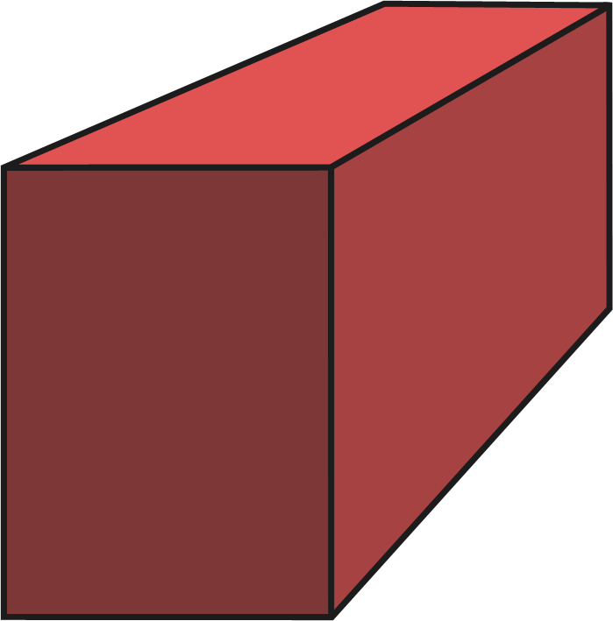
Cuboids have:
6 faces
12 edges
8 vertices/corners
edges that are not all the same length.
Sunda

Slide 8
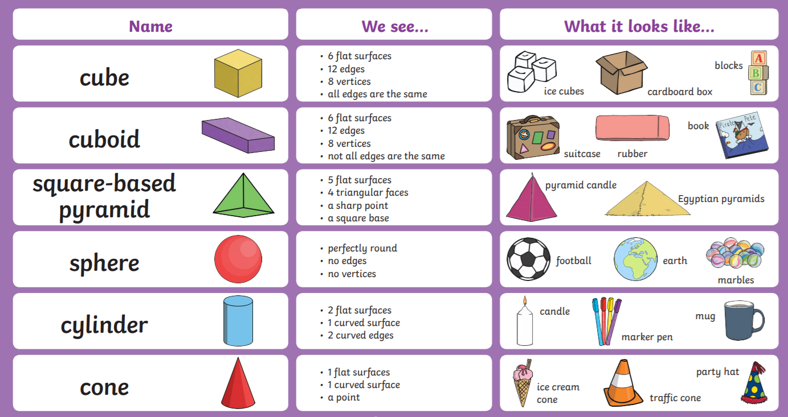
OR

Slide 9
Can you drop and drag the correct properties to it shape.
Triangular based sphere cone cylinder
pyramid
Perfectly round
I have 2 flat surfaces.
I have 4 sides.
No vertices
I flat surface
I have 5 flat surface
No edges.
4 triangular faces
I have 4 corners
I curved side
One point
2 curved edges

Slide 10
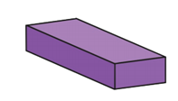
Square- based pyramid rectangle based cuboid
pyramid
I have 12 edges
I have 6 faces
I have 5 flat faces.
I have 4 triangular face
I have 6 corners .
I have 5 faces.

Slide 11
Can you complete the table
Can you support your child to help them complete the table.

Slide 12
Date: 30.06.2021
L.O. To be able to describe line of symmetry in a 2d shape
Subject: Maths

Slide 13
A line of symmetry is a line that cuts a shape exactly in half. This means that if you were to fold the shape along the line, both halves would match exactly.

Slide 14
Watch the clips to help support your learning.
https://www.youtube.com/watch?v=SJlhywRfvh8
https://www.youtube.com/watch?v=pu2dcm8BlAo

Slide 15
Can you use your finger and draw a line of symmetry.

Slide 16
Date: 1.07.2021
L.O. To be able to describe line of symmetry in a 2d shape
Subject: Maths

Slide 17
A line of symmetry is a line that cuts a shape exactly in half. This means that if you were to fold the shape along the line, both halves would match exactly.
Name square
Sides 4
Lines of symmetry 4

Slide 18
Name Triangle
Sides 3
Lines of symmetry 3

Slide 19
Can you write or tell an adult the name of the shapes, how many sides and the amount of lines of symmetry each shape has.

Slide 20
Date: 2.07.2021
L.O. To be able to draw line of symmerty
Subject: Maths

Slide 21
Symmetry is where each side needs to look the same.

Slide 22
Symmetry is where each side needs to look the same.

Slide 23
Can you use you finger and draw the other side of the shape.

